Slide 1
Optical Coherence Tomography-Guided or
Intravascular Ultrasound-Guided PCI
: The OCTIVUS Randomized Clinical Trial
Duk-Woo Park, MD, PhD for the OCTIVUS Investigators
Division of Cardiology, Asan Medical Center, University of Ulsan College of Medicine, Seoul, Korea
European Society of Cardiology Congress 2023 – Annual Scientific Session
Hot Line 4
August 27, 2023
Notes:
I going to present primary results of OCT-guided vs. IVUS-guided PCI: OCTIVUS trial.
I am DW Park from AMC, Seoul, Korea, on behalf of OCTIVUS trial investigators.

Slide 2
Disclosure
The OCTIVUS was an investigator-initiated trial supported by the CardioVascular Research Foundation (Seoul, Korea) and Abbott Vascular (US), and Medtronic (US).
The funders did not participate in the trial design, data collection, data analysis, or manuscript preparation.
Notes:
OCTIVUS is IIT, funded by CVRF, Abbott, and Medtroics.

Slide 3
Background
Intracoronary imaging-guided PCI with intravascular ultrasound (IVUS) and optical coherence tomography (OCT) showed superior clinical outcomes compared to angiography-guided PCI.¹⁻⁴
Each intracoronary imaging modality has different imaging technologies, lesion applications, advantages, or limitations.⁵
However, data on the comparative effectiveness of OCT or IVUS for PCI guidance for broad-range of patients with respect to relevant clinical outcomes are still limited.⁶⁻⁷
PCI, percutaneous coronary intervention
¹Hong SJ, et al. JAMA 2015;314:2155-63. ²Kim BK, et al. Circ Cardiovasc Interv 2015;8. ³Zhang J, et al. J Am Coll Cardiol 2018;72:3126-37. ⁴Lee JM, et al. New Engl J Med 2023;388:1668-79. ⁵Schlofmitz E, et al. Circ Cardiovasc Interv 2020;13. ⁶Ali ZA, et al. Lancet 2016;388. ⁷Kubo T, et al. Eur Heart J 2017;38.
Notes:
- Intracoronary imaging-guided PCI with IVUS or OCT showed
-

Slide 4
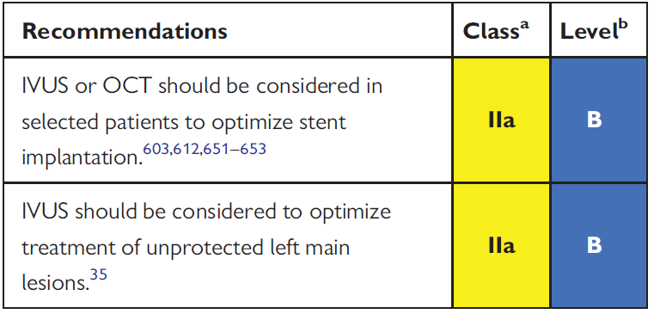
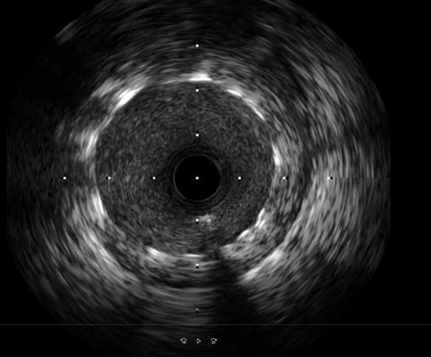
Background: Current Guidelines
Recommendations for intravascular imaging for PCI optimization
OCT
IVUS
IVUS, intravascular ultrasound; OCT, optical coherence tomography
Neumann FJ et al. Eur Heart J 2019;40:87-165
Notes:
- Current guideline recommendations for intravascular imaging for PCI optimization.
- IVUS or OCT can be considered in selective patients…

Slide 5
Objective
To compare the clinical efficacy and safety of OCT-guided and IVUS-guided strategies in patients who underwent PCI for significant CAD.
We hypothesize that OCT-guided PCI is noninferior to IVUS-guided PCI with respect to target-vessel failure at 1 year.
Kang DY, Park DW et al. Am Heart J 2020;228:72-80
Notes:
Primary Objective of trial;
- To compare the clinical efficacy and safety of
- We hypothesize OCT guided PCI is noninferior to IVUS-guided PCI regarding clinical endpoint of TVF at 1 year.

Slide 6
Pragmatic Trial Design
Optical Coherence Tomography–guided versus IntraVascular UltraSound–guided percutaneous coronary intervention
OCTIVUS Trial
2,000 patients with obstructive CAD undergoing PCI in routine PCI clinical practice
A permuted block size of 4 or 6, stratified randomization by (1) trial center
OCT-guided PCI strategy
(N=1,000)
IVUS-guided PCI strategy
(N=1,000)
The composite primary end point (target-vessel failure) was cardiac death, target-vessel myocardial infarction, or ischemia-driven target vessel revascularization at 1-year
Kang DY, Park DW et al. Am Heart J 2020;228:72-80
Notes:
Key features of a pragmatic design are incorporated,
(1) The clinically relevant tools of usual intracoronary imaging in the routine PCI practice,
(2) A diverse study population with various clinical and anatomical characteristics,
(3) Heterogeneous PCI management practice settings,
(4) Use of a broad range of clinical end points,
(5) Clinically unmet issues in the daily clinical practice.

Slide 7
Inclusion and Exclusion Criteria
INCLUSION
EXCLUSION
Men or women at least age ≥ 19 years.
Patients with obstructive coronary artery disease (native or restenotic) undergoing PCI with contemporary drug-eluting stents or drug-coated balloons (only for in-stent restenotic lesion) under intracoronary imaging guidance.
The patient or guardian agreed to the study protocol and the schedule for clinical follow-up, and provided informed written consent, as approved by the appropriate Institutional Review Board/Ethical Committee of the respective clinical site.
ST-elevation myocardial infarction.
Severe renal dysfunction (eGFR <30 mL/min/1.73 m²), unless patient is on renal replacement therapy.
Cardiogenic shock or decompensated heart failure with severe left ventricular dysfunction (left ventricular ejection fraction < 30%).
Life expectancy < 1 years for any non-cardiac or cardiac causes.
Any lesion characteristics resulting in the expected inability to deliver the intracoronary imaging catheter during PCI (e.g., severe vessel calcification or tortuosity).
PCI, percutaneous coronary intervention
Notes:
중요도가 낮은 아래의 두 개 exclusion 은 적지 않았습니다.
6.
Any clinically significant abnormality identified at the screening visit, physical examination, laboratory tests, or electrocardiogram, which in the judgment of the investigator would preclude safe completion of the study.
7.
Unwillingness or inability to comply with the procedures described in this protocol.

Slide 8
Imaging-guided PCI
PCI procedure was performed using standard techniques.
In each group, either IVUS (Opticross™ or Opticross™ HD, Boston Scientific, CA) or OCT (C7-XR™ and OPTIS™, Abbott, CA) was used before, during, and immediately after PCI; a final imaging assessment for PCI optimization was mandated.
Stent size, length, and optimization of the stented segment was determined with the use of a predefined common algorithm for IVUS or OCT on the basis of EAPCI expert consensus.¹
A distal lumen or external elastic membrane reference-based stent sizing strategy was used and a sufficient stent expansion of more than 80% of the mean reference lumen area with avoiding major stent malapposition or edge dissection was achieved.
All intravascular imaging data were measured by the independent imaging core laboratories (the Asan Medical Center, Core-lab).
¹Raber L, et al. Eur Heart J 2018;39:3281-3300.
Notes:
- PCI was performed using standard techniques.
- Conventional IVUS and OCT device was used at before, during and immediately after PCI: final imaging was mandatory for assessment of PCI optimization.
- Predefined optimization algorithm was recommended; distal lumen or EEM reference-based sizing strategy was used and a sufficient stent expansion with avoiding major stent malapposition or edge dissection was recommended.

Slide 9
Endpoints
Primary endpoint
Target-vessel failure (a composite of death from cardiac cause, target vessel-MI, or ischemia-driven target-vessel revascularization) at 1 year after randomization
Secondary endpoints
Individual components of the primary composite outcome
Target-lesion failure*
Stent thrombosis
Stroke
Repeat revascularization
Rehospitalization
Bleeding events
contrast-induced acute kidney injury
procedural complications requiring active intervention
MI, myocardial infarction
*Target-lesion failure was a composite of death from cardiac causes, target-vessel MI, or ischemia-driven target-lesion revascularization.
Notes:
Primary trial endpoint was target-vessel failure.
Secondary endpoint included individual component, target-lesion failure, stent thrombosis, repeat revascularization, contrast-induced nephropathy, procedural complications.

Slide 10
Statistical Considerations
Power Calculation (N = 2,000)
Assuming a 1-year event rate of 8.0% in the IVUS-guided PCI group
Statistical power of 80% to detect noninferiority of OCT-guided PCI group with 3.1% of noninferiority margin in primary endpoint (which represented 39% of the expected percentage of patients with an event)
Calculated with the likelihood-score method by Farrington and Manning at a one-sided type I error of 0.05
Pre-Specified Statistical Analysis
Primary intention-to-treat analysis
Kaplan-Meier estimates for calculating cumulative event rates
Cox proportional hazard models
Estimate the relative risks if proportional hazards assumption is not violated
Sensitivity analysis
Sensitivity analyses in the per-protocol and as-treated populations
The interaction term between randomized groups and key subgroups was evaluated for primary outcome.
Notes:
- Initially, we assumed 1-year event rate of 8.0 in the IVUS group on the basis of prior real-world studies using IVUS-guided PCI.
- Statistical power of 80%, non-inferiority margin of 3.1%, represented 39% of expected percentage of patients with event.
- Primary ITT analysis was performed.

Slide 11
Participating Investigators and Trial Organization
Participating Investigators (9 Sites in South Korea)
Do-Yoon Kang, Jung-Min Ahn, Sung-Cheol Yun, Hoyun Kim, Yeonwoo Choi, Jinho Lee, Duk-Woo Park, Seung-Jung Park (Asan Medical Centers); Seung-Ho Hur, Yun-Kyeong Cho, Cheol Hyun Lee (Keimyung University Dongsan Hospital); Soon Jun Hong, Subin Lim (Korea University Anam Hospital); Sang-Wook Kim, Hoyoun Won (Chung-Ang University Hospital); Jun-Hyok Oh, Jeong Cheon Choe (Pusan National University Hospital); Young Joon Hong (Chonnam National University Hospital); Young Won Yoon (Gangnam Severance Hospital); Soo-Joong Kim (Kyunghee University College of Medicine); Jang-Ho Bae (Konyang University Hospital).
Executive Committee
Duk-Woo Park (Trial PI) Seung-Jung Park (Trial Co-PI) Do-Yoon Kang Jung-Min Ahn
Additional Steering Committee
Seung-Ho Hur Cheol Hyun Lee Soon Jun Hong Sang-Wook Kim
Event Adjudication Committee
Hanbit Park Junghoon Lee Ju Hyeon Kim
Ha Hye Jo Joong Min Lee Do-Hyeon Kim
Data & Safety Monitoring Board
Jong-Min Song So-Yeon Choi Byeong-Keuk Kim
Mineok Jang Elly Jeong-youn Bae
Trial Funding CardioVascular Research Foundation (CVRF) Abbott Vascular Medtronic
Notes:
- 9 sites in South Korea have participated in the OCTIVUS trial.
- I would like to thank you very much again co-investigator, their hard work for completion of OCTIVUS trial.

Slide 12
Patient Flow and Follow-Up
Screened (3879)
(from April 12, 2018, through January 14, 2022)
Randomized (2008)
OCT-guided PCI (1005)
IVUS-guided PCI (1003)
1 Failure to pass imaging device
25 Cross-over to IVUS-guided PCI by
the operator’s discretion
1 Did not use intravascular imaging
devices by the operator’s discretion
1 Failed PCI
1 Failure to pass imaging device
6 Cross-over to OCT-guided PCI by
the operator’s discretion
4 Withdrew consent at <12 mo
8 Were lost to follow-up at <12 mo
2 Withdrew consent
6 Were lost to follow-up
At 12-month follow-up:
993 (98.8%) Completed follow-up
At 12-month follow-up:
995 (99.2%) Completed follow-up
1005 (100%) Were included
in the intention-to-treat analysis
1003 (100%) Were included
in the intention-to-treat analysis
Notes:
- From 2018 to 2022, 3897 patients were screened and 2008 patients were randomized.
- In the OCT group, 25 patients were cross-over to IVUS arm; In the IVUS group, 6 patients were cross-over to IVUS group.
- Clinical FU at 1 year was completed in 99% in both groups.

Slide 13
Key Baseline Characteristics
 | OCT-Guided PCI (N = 1005) | IVUS-Guided PCI (N = 1003)
Age [yrs], mean (SD) | 64.3 (10.3) | 65.1 (10.5)
Female sex | 215 (21.4) | 218 (21.7)
Body-mass index | 24.9±3.2 | 25.0±3.1
Diabetes mellitus — no. (%) | 325 (32.3) | 345 (34.4)
Hypertension — no. (%) | 647 (64.4) | 639 (63.7)
Dyslipidemia — no. (%) | 840 (83.6) | 841 (83.9)
Current smoking — no. (%) | 217 (21.6) | 189 (18.8)
Previous PCI — no. (%) | 226 (22.5) | 202 (20.1)
Previous CABG — no. (%) | 33 (3.3) | 18 (1.8)
Previous stroke — no. (%) | 66 (6.6) | 73 (7.3)
Atrial fibrillation — no. (%) | 28 (2.8) | 38 (3.8)
End-stage renal disease on dialysis — no. (%) | 20 (2.0) | 26 (2.6)
Left ventricular ejection fraction [%], mean (SD) | 58.8 (9.1) | 58.3 (10.1)
Clinical indication for index PCI — no. (%)
Silent ischemia | 106 (10.6) | 115 (11.5)
Chronic coronary syndrome | 663 (66.0) | 654 (65.2)
Acute coronary syndrome | 236 (23.5) | 234 (23.3)
Unstable angina | 137 (13.6) | 135 (13.5)
NSTEMI | 99 (9.9) | 99 (9.9)
Notes:
- Baseline characteristics of both groups are well balanced.
- Mean age was 64, female gender were 20%,
- Diabetes was present in 33% of patients
- Stable angina 75%, ACS were approximate 23%.

Slide 14
Anatomical Characteristics
 | OCT-Guided PCI (N = 1005) | IVUS-Guided PCI (N = 1003)
Multivessel disease — no. (%) | 608 (60.5) | 629 (62.7)
Treated complex coronary lesions — no. (%)
Left main disease | 116 (11.5) | 148 (14.8)
Any bifurcation disease — no. (%) | 516 (51.3) | 540 (53.8)
Ostial lesion — no. (%) | 96 (9.6) | 99 (9.9)
Chronic total occlusion — no. (%) | 56 (5.6) | 52 (5.2)
Severely calcified lesion — no. (%)† | 76 (7.6) | 76 (7.6)
In-stent restenotic lesion — no. (%) | 87 (8.7) | 77 (7.7)
Diffuse long lesion — no. (%)‡ | 575 (57.2) | 594 (59.2)
Bypass graft disease — no. (%) | 3 (0.3) | 0 (0.0)
SYNTAX score
Mean | 15.1±8.9 | 15.8±9.5
Category — no./total no. (%)
Low, 0 to 22 | 813 (80.9) | 773 (77.1)
Intermediate, 23 to 32 | 141 (14.0) | 173 (17.3)
High, >32 | 51 (5.1) | 57 (5.7)
† Those with encircling calcium seen on angiography ‡ Lesion length ≥28 mm or stent length ≥32 mm of treated segment
SYNTAX, Synergy between Percutaneous Coronary Intervention with Taxus and Cardiac Surgery.
Notes:
Overall, a substantial proportion of patients had diverse types of coronary-artery lesions
61% had multivessel disease,
13% had left main disease,
52% had bifurcation disease, 58.2% had diffuse long disease.
The mean SYNTAX score was similar in both groups; a relatively low-risk of patients were enrolled in terms of mean SYNTAX score 15.5

Slide 15
Procedural Characteristics
 | OCT-Guided PCI (N = 1005) | IVUS-Guided PCI (N = 1003) | P Value
PCI approach |  |  | 0.99
Radial access | 639 (63.6) | 638 (63.6)
Femoral access | 366 (36.4) | 365 (36.4)
PCI modality
Use of drug-eluting stents | 970 (96.5) | 973 (97.1) | 0.45
Used of drug-coated balloons (only for ISR lesion) | 35 (3.5) | 29 (2.9)
Total no. of lesions treated per patient | 1.3±0.6 | 1.4±0.6 | 0.36
Mean number of stents per patient | 1.6±1.0 | 1.6±1.0 | 0.38
Total stent length per patient — mm | 47.2±32.4 | 47.8±32.2 | 0.69
Post-dilatation with larger or high-pressure balloon — no. (%) | 931 (92.6) | 917 (91.5) | 0.35
Total amount of contrast media used — mL | 238.3±112.4 | 199.8±109.7 | <0.001
Total PCI time — min | 46.1±23.6 | 48.9±25.1 | <0.001
ISR, In-stent restenosis.
Notes:
- Contemporary DES was predominantly used.
- Total stent length per patients 47,
- Post additional balloon dilation was performed more than 90% both group.
- The total amount of contrast dye used was higher in the OCT group, however, the total PCI time was shorter in the OCT group.

Slide 16
Procedural Outcomes
 | OCT-Guided PCI (N = 1005) | IVUS-Guided PCI (N = 1003) | P Value
Procedural success — no. (%)
Angiography-based‖ | 993 (98.8) | 990 (98.7) | 0.84
Imaging-based† | 476 / 986 (48.3) | 546 / 995 (54.9) | 0.003
Procedural complications requiring active intervention — no. (%)‡
Any | 22 (2.2) | 37 (3.7) | 0.047
IVUS or OCT procedure related complications | 0 (0) | 0 (0)
‖ Angiographic device success is defined as successful PCI at the intended target lesion with final in-stent residual stenosis of less than 30% by quantitative coronary angiography.
† By patient-level analyses: imaging-based device success is defined as successful PCI at the intended target lesion, which fulfills all optimal criteria for stent implantation by IVUS or OCT. Among patients with multivessel interventions, all treated lesions should be met for optimization criteria.
‡ Procedural complications requiring active intervention, which were related to PCI or use of intravascular imaging (i.e., procedural safety outcomes).
Notes:
- Angiographic procedural success was 99%
- Imaging-based procedural success fulfil all optimization criteria was achieved in 48% in OCT, 55% in IVUS group.
- Procedural complications requiring active intervention was lower in the OCT-guided group.

Slide 17
Core Lab-Imaging Analysis : Lesion-Level Analysis
 | OCT-Guided PCI (N = 1005 Patients) (N = 1279 Lesions) | IVUS-Guided PCI (N = 1003 Patients) (N = 1271 Lesions) | P Value
Core Lab Imaging analysis – final post-PCI
Minimum stent area — mm² | 5.60 ± 2.01 | 6.70 ± 2.37 | <0.001
Minimum stent expansion — % | 85.36 ± 17.49 | 91.37 ± 22.31 | <0.001
Minimum stent area by distal reference lumen area — % | 134.81 ± 47.75 | 126.04 ± 39.12 | <0.001
Optimization Imaging-Guided PCI Criteria
All stent-optimization criteria met — no./total no. (%) | 613 / 1148 (53.4%) | 743 / 1236 (60.1%) | 0.001
Optimal stent expansion† | 712 / 1148 (62.0%) | 860 / 1236 (69.6%) | <0.001
Plaque burden at stent landing zone < 50% | 708 / 800 (88.5%) | 1016 / 1186 (85.7%) | 0.07
No major malapposition§ | 1059 / 1147 (92.3%) | 1209 / 1235 (97.9%) | <0.001
No large dissection¶ | 1114 / 1141 (97.6%) | 1222 / 1231 (99.3%) | 0.001
A relative stent expansion of >90% — no./total no.(%) | 394 / 1025 (38.4%) | 575 / 1179 (48.8%) | <0.001
*Plus–minus values are means ± SD. ‡ Optimal stent expansion was defined as a relative stent expansion of >80% (an in-stent minimum stent area divided by average reference lumen area). In lesions with non-evaluable reference lumen area, optimal stent expansion was defined as an absolute in-stent minimum stent area of >5.5 mm² by IVUS and >4.5 mm² by OCT.
§ Extensive stent malapposition was defined as an acute stent malapposition of ≥0.4 mm with longitudinal extension >1 mm of the stent over its entire length against the vessel wall.
¶ Large dissection was defined as a dissection that occurred 5mm from the edge of the stent, extended to extensive lateral >60º, longitudinal extension >2mm, and flap extending to media or adventitia.
Notes:
This is lesion-level core lab analysis;
MSA & minimal stent expansion was smaller.

Slide 18
Primary Endpoint of TVF: Cardiac Death, TV-MI, or TVR
5%
4%
3%
2%
1%
0%
Hazard ratio, 0.80 (95% CI, 0.47–1.36)
P for noninferiority <0.001
3.1%
IVUS-guided
Patients (%)
2.5%
OCT-guided
0 | 3 | 6 | 9 | 12
Months since Randomization
No. at Risk
OCT-guided PCI
IVUS-guided PCI
1005 | 990 | 984 | 979 | 912
1003 | 985 | 981 | 969 | 893
CI, confidence interval; TV-MI, target-vessel myocardial infarction; TVR, target-vessel revascularization
Notes:
As a result,
Primary endpoint of TVF:

Slide 19
Types of CV Outcomes
Outcome* | OCT-Guided PCI (N = 1005) | IVUS-Guided PCI (N = 1003) | Risk Difference (95% CI) | HR (95% CI)†
Primary composite outcome‡ | 25 (2.5%) | 31 (3.1%) | −0.6 (−2.0 to 0.8) | 0.80 (0.47 to 1.36)
Secondary outcomes
Target-lesion failure§ | 22 (2.2%) | 29 (2.9%) | −0.7 (−2.1 to 0.7) | 0.76 (0.43 to 1.31)
Death | 10 (1.0%) | 14 (1.4%) | −0.4 (−1.4 to 0.6) | 0.71 (0.32 to 1.60)
From cardiac cause | 3 (0.3%) | 6 (0.6%) | −0.3 (−0.9 to 0.3) | 0.71 (0.32 to 1.60)
From noncardiac cause | 7 (0.7%) | 8 (0.8%) | −0.1 (−0.9 to 0.6) | 0.87 (0.32 to 2.40)
Target-vessel myocardial infarction | 9 (0.9%) | 14 (1.4%) | −0.5 (−1.4 to 0.4) | 0.64 (0.28 to 1.48)
Periprocedural | 7 (0.7%) | 11 (1.1%) | −0.4 (−1.2 to 0.4) | 0.64 (0.25 to 1.64)
Spontaneous | 2 (0.2%) | 3 (0.3%) | −0.1 (−0.5 to 0.3) | 0.67 (0.11 to 3.98)
Repeat revascularization | 16 (1.6%) | 19 (1.9%) | −0.3 (−1.5 to 0.8) | 0.84 (0.43 to 1.63)
Target-lesion revascularization | 11 (1.1%) | 14 (1.4%) | −0.3 (−1.3 to 0.7) | 0.78 (0.36 to 1.72)
Target-vessel revascularization | 14 (1.4%) | 16 (1.6%) | −0.2 (−1.3 to 0.9) | 0.87 (0.43 to 1.79)
Contrast-induced nephropathy — no. (%)** | 14 (1.4%) | 15 (1.5%) | −0.1 (−1.1 to 0.9) | 0.93 (0.45 to 1.91)
*The percentages were estimated by the Kaplan–Meier estimates. †Hazard ratios are for the OCT-guided PCI group, as compared with the IVUS-guided PCI group by use of Cox proportional hazard models. ‡The primary composite outcome was death from cardiac cause, target-vessel myocardial infarction, or target vessel revascularization.
§Target-lesion failure was a composite of death from cardiac causes, target-vessel MI, or ischemia-driven target-lesion revascularization. ** Contrast-induced nephropathy was defined as either a greater than 25% increase of serum creatinine or an absolute increase in serum creatinine of 0.5 mg/dL from baseline within 72 h after the index PCI procedure. Event rates (%) of contrast-induced nephropathy are presented as calculated percentages. CI, confidence interval; HR, hazard ratio; PCI, percutaneous coronary intervention
Notes:
- TLF
- Contrast-induced nepropahty

Slide 20
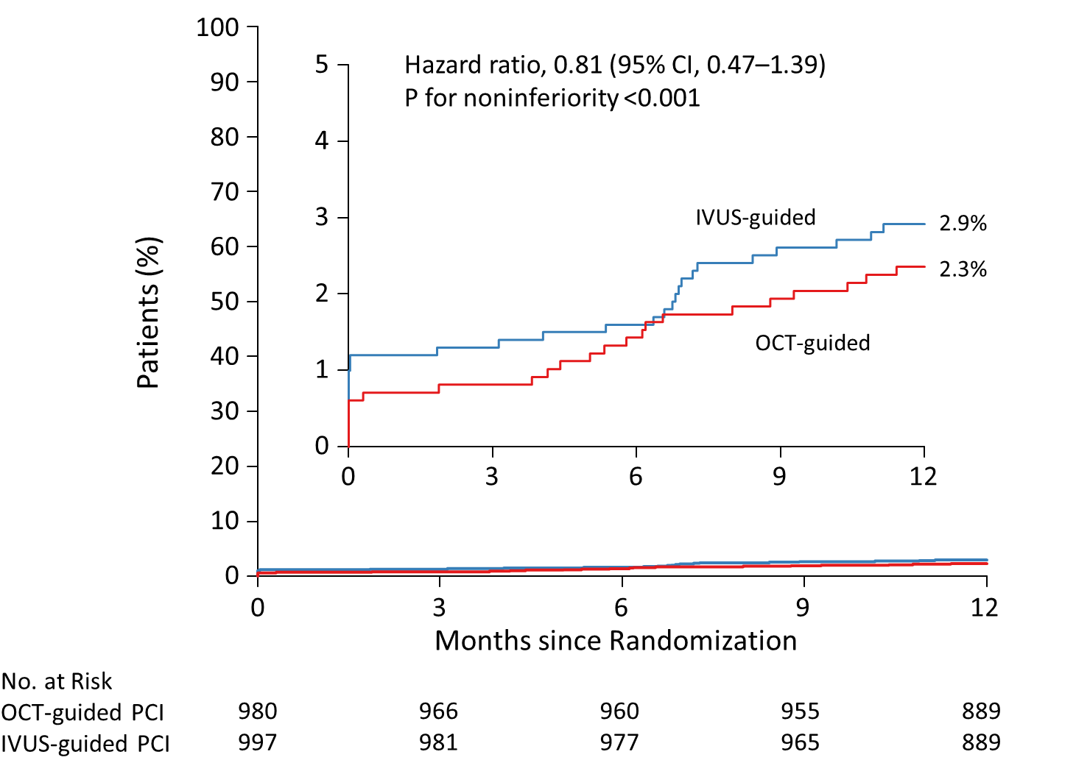
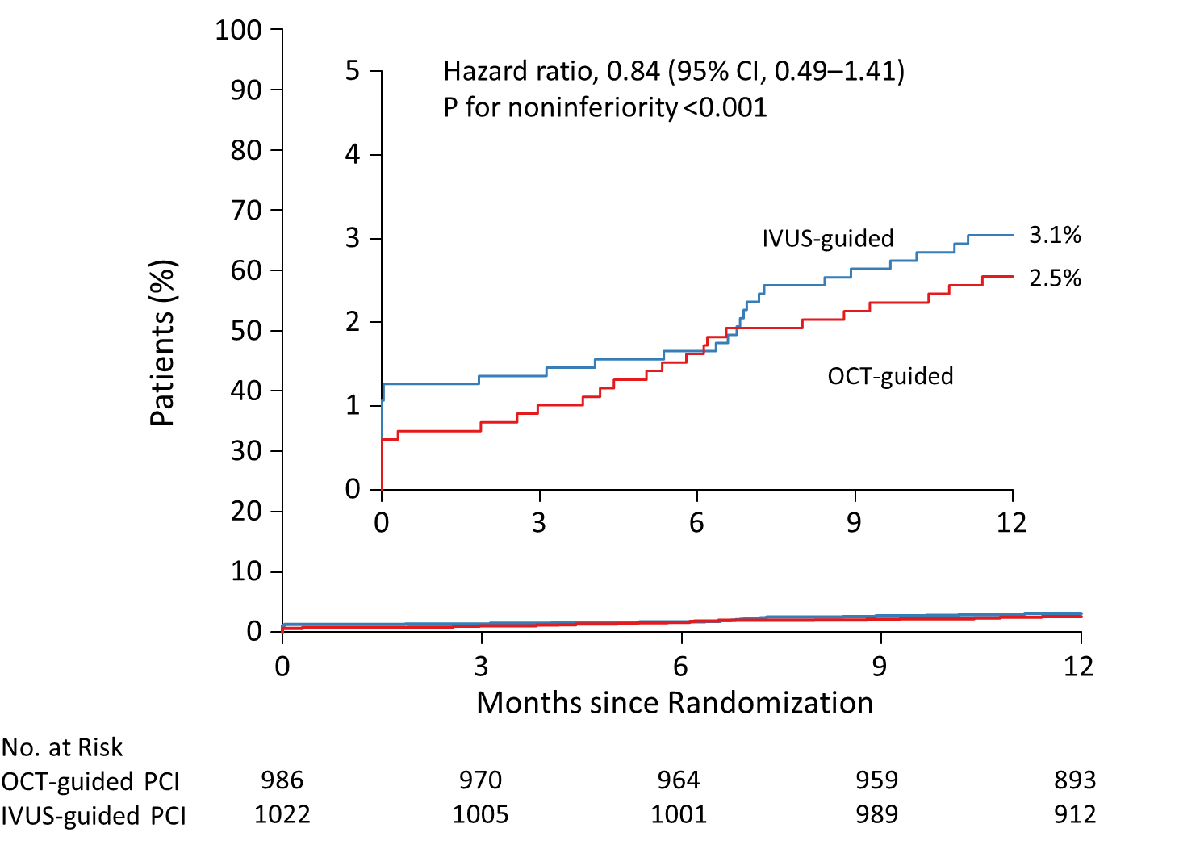
Sensitivity Analysis
Primary Endpoint in the Per-Protocol Population
Primary Endpoint in the As-Treated Population
Notes:
In per-protocol and as-tread analysis, primary findings were consistent.

Slide 21
Prespecified
Key Subgroups
Analysis:
by Clinical Factors
Estimated 1-Yr
Event Rate (%)
Subgroup
Percent of
Patients
Hazard Ratios (95% CI)
P-for-
Interaction
OCT-guided
IVUS-guided
48.2 | 2.3 | 2.1
51.8 | 2.8 | 4.0
21.6 | 2.3 | 5.1
78.4 | 2.6 | 2.6
33.4 | 4.4 | 3.8
66.6 | 1.6 | 2.8
23.4 | 3.0 | 4.3
76.6 | 2.4 | 2.7
11.2 | 6.3 | 8.1
88.8 | 2.0 | 2.9
Age |  |  |  |  |  |  | 0.419
< 65 |  |  |  |  |  | 1.07 (0.45 to 2.51)
≥ 65 |  |  |  |  |  | 0.68 (0.35 to 1.34)
Sex |  |  |  |  |  |  | 0.212
Female |  |  |  |  |  | 0.46 (0.16 to 1.31)
Male |  |  |  |  |  | 0.99 (0.53 to 1.85)
Diabetes mellitus |  |  |  |  |  |  | 0.222
Yes |  |  |  |  |  | 1.14 (0.54 to 2.43)
No |  |  |  |  |  | 0.59 (0.28 to 1.25)
Acute coronary syndrome |  |  |  |  |  |  | 0.710
Yes |  |  |  |  |  | 0.69 (0.26 to 1.81)
No |  |  |  |  |  | 0.86 (0.46 to 1.61)
Left ventricular ejection fraction |  |  |  |  |  |  | 0.847
≤ 50% |  |  |  |  |  | 0.78 (0.26 to 2.38)
> 50% |  |  |  |  |  | 0.69 (0.35 to 1.34)
OCT-guided PCI better
IVUS-guided PCI better
Notes:
In Prespecified key subgroup analysis by several important clinical factors,
We did not find any differential treatment effect.

Slide 22
Prespecified
Key Subgroups
Analysis:
by Anatomical Factors
Estimated 1-Yr
Event Rate (%)
Subgroup
Percent of
Patients
Hazard Ratios (95% CI)
P-for-
Interaction
OCT-guided
IVUS-guided
Left main disease |  |  |  |  |  | 0.868
Yes |  |  |  |  | 0.78 (0.28 to 2.16)
No |  |  |  |  | 0.87 (0.47 to 1.61)
Bifurcation disease |  |  |  |  |  | 0.901
Yes |  |  |  |  | 0.83 (0.43 to 1.61)
No |  |  |  |  | 0.78 (0.32 to 1.87)
Diffuse long coronary artery lesion |  |  |  |  |  | 0.077
Yes |  |  |  |  | 1.15 (0.60 to 2.22)
No |  |  |  |  | 0.41 (0.16 to 1.05)
Severely calcified lesion |  |  |  |  |  | 0.149
Yes |  |  |  |  | 1.36 (0.60 to 3.07)
No |  |  |  |  | 0.61 (0.31 to 1.23)
Multivessel disease |  |  |  |  |  | 0.547
Yes |  |  |  |  | 0.75 (0.42 to 1.36)
No |  |  |  |  | 1.13 (0.35 to 3.71)
SYNTAX score |  |  |  |  |  | 0.096
Low |  |  |  |  | 0.52 (0.26 to 1.04)
Intermediate |  |  |  |  | 1.63 (0.57 to 4.70)
High |  |  |  |  | 1.93 (0.46 to 8.06)
13.2 | 5.3 | 6.8
86.9 | 2.2 | 2.5
52.6 | 3.1 | 3.7
47.4 | 1.9 | 2.4
58.2 | 3.3 | 2.9
41.8 | 1.4 | 3.4
7.6 | 7.9 | 8.1
92.4 | 2.1 | 2.7
61.6 | 3.2 | 4.2
38.4 | 1.5 | 1.4
79.0 | 1.5 | 2.9
15.6 | 5.7 | 3.5
5.4 | 9.9 | 5.3
OCT-guided PCI better
IVUS-guided PCI better
Notes:
Also, In several anatomical subgroup, we did not find any differential treatment effect.

Slide 23
CV Outcomes during the Entire Follow-up Period
(Median 2.0 years; range 1.0-4.8 years)
Outcome* | OCT-Guided PCI (N = 1005) | IVUS-Guided PCI (N = 1003) | HR (95% CI)†
Primary composite outcome‡ | 58 (5.8%) | 61 (6.1%) | 0.91 (0.63 to 1.30)
Secondary outcomes
Target-lesion failure§ | 50 (5.0%) | 56 (5.6%) | 0.85 (0.58 to 1.25)
Death | 28 (2.8%) | 27 (2.7%) | 0.99 (0.58 to 1.69)
From cardiac cause | 11 (1.1%) | 11 (1.1%) | 0.93 (0.39 to 2.18)
From noncardiac cause | 17 (1.7%) | 16 (1.6%) | 1.03 (0.52 to 2.05)
Target-vessel myocardial infarction | 9 (0.9%) | 20 (2.0%) | 0.45 (0.21 to 0.99)
Periprocedural | 7 (0.7%) | 11 (1.1%) | 0.64 (0.25 to 1.64)
Spontaneous | 2 (0.2%) | 9 (0.9%) | 0.22 (0.05 to 1.04)
Repeat revascularization | 52 (5.2%) | 50 (5.0%) | 1.01 (0.68 to 1.49)
Target-lesion revascularization | 31 (3.1%) | 33 (3.3%) | 0.90 (0.55 to 1.48)
Target-vessel revascularization | 39 (3.9%) | 38 (3.8%) | 0.98 (0.63 to 1.54)
*The listed percentages were estimated as the ratio of the numerator and denominator.
†Hazard ratios are for the OCT-guided PCI group, as compared with the IVUS-guided PCI group by use of Cox proportional hazard models.
‡The primary composite outcome was death from cardiac cause, target-vessel myocardial infarction, or target vessel revascularization.
§Target-lesion failure was a composite of death from cardiac causes, target-vessel MI, or ischemia-driven target-lesion revascularization.

Slide 24
Study Limitations
It was not possible to mask the imaging modalities from the patients and investigators (the possibility of ascertainment or selection bias).
The observed number of primary-outcome events was lower than expected (several explanations would be possible).
There would be the possibility of discrepancy on a site-determined and core-laboratory measured imaging interpretation.
The generalizability and reproducibility of our trial findings may be potentially limited due to the geographic variability in the use of intravascular imaging in the daily PCI practice.
Our trial did not include an angiography-guided arm.
Notes:
At the time of trial design, there were no referent RCTS evaluating IVUS-guided PCI in a broad range of patients with various anatomical or clinical characteristics reflecting “all-comer” PCI population.
Therefore, our sample size assumption was determined on prior observational studies using IVUS-guided PCI in real-world setting.
However, the observed number of primary-outcome events was lower than expected.
his discrepancy might be explained in part by differences between clinical or lesion characteristics (i.e., low-risk nature of the study population reflected on mean SYNTAX score 15.5), and a rapid evolving interventional practice or medical care, which include improved stent technology, more effective adjunctive pharmacologic therapy, high levels of GDMT, and combined use of physiology (i.e., fractional flow reserve)-guided PCI.
However, there could be of concern for the assessment of noninferiority using an absolute-risk noninferiority margin.
Nevertheless, overall trend of primary findings was consistent in the entire follow-up period.
Given the observed rates of primary outcome events was lower-than-expected, an extremely large study sample (approximately more than 7,500 patients) would be required to detect a clinically relevant difference.

Slide 25
Summary for the OCTIVUS Key Findings
In this large-scale, pragmatic RCT comparing OCT and IVUS for PCI guidance in patients with diverse anatomical or clinical characteristics, we found that OCT-guided PCI was noninferior to IVUS-guided PCI procedures with respect to a primary composite of death from cardiac causes, target-vessel MI, or ischemia-driven TVR at 1 year.
The incidence of primary outcomes was lower than expected, possibly due to improvements in the methods/techniques to perform PCI and general improvements in cardiovascular care during the past few years.
The amount of contrast dye used during the procedures was higher in the OCT group than in the IVUS group, but it was not related to an increase of contrast-induced nephropathy.

Slide 26
Conclusions
In this OCTIVUS trial involving patients who are undergoing PCI for diverse coronary-artery lesions,
OCT-guided PCI was noninferior to IVUS-guided PCI with respect to a composite of death from cardiac causes, target-vessel myocardial infarction, or ischemia-driven target-vessel revascularization at 1 year.
However, the selected study population and lower than expected event rates should be considered in interpreting the trial.

Slide 27
Circulation. 2023; [published online ahead of print]. DOI: 10.1161/CIRCULATIONAHA.123.066429
Optical Coherence Tomography-Guided or Intravascular Ultrasound-Guided Percutaneous Coronary Intervention: The OCTIVUS Randomized Clinical Trial
Do-Yoon Kang, MD; Jung-Min Ahn, MD; Sung-Cheol Yun, PhD; Seung-Ho Hur, MD; Yun-Kyeong Cho, MD; Cheol Hyun Lee, MD; Soon Jun Hong, MD; Subin Lim, MD; Sang-Wook Kim, MD; Hoyoun Won, MD; Jun-Hyok Oh, MD; Jeong Cheon Choe, MD; Young Joon Hong, MD; Yong‑Hoon Yoon, MD; Hoyun Kim, MD; Yeonwoo Choi, MD; Jinho Lee, MD; Young Won Yoon, MD; Soo-Joong Kim, MD; Jang-Ho Bae, MD; Duk-Woo Park, MD; and Seung-Jung Park, MD for the OCTIVUS Investigators
Circulation
https://www.ahajournals.org/doi/10.1161/CIRCULATIONAHA.123.066429

