Slide 1
The HEART-FID Trial
Efficacy and Safety of Ferric Carboxymaltose as Treatment for Heart Failure with Iron Deficiency
On behalf the HEART-FID Investigators and Participants
August 26, 2023

Slide 2
Background
Iron deficiency (ID) is common in patients with heart failure with reduced ejection fraction (HFrEF) and it is associated with worse symptoms and adverse prognosis.
IV ferric carboxymaltose (FCM) improves quality of life and exercise capacity in HFrEF with ID.
AFFIRM-AHF, IRONMAN and meta-analyses suggested potential benefits with IV iron on HF hospitalizations without a significant effect on mortality.
Thus, further evidence is needed regarding the effect of FCM on clinical events.
Ponikowski P, et al. Lancet 2020;396(10266):1895-1904.
Kalra PR, et al. Lancet 2022;400(10369):2199-2209.
Graham FJ, et al. Eur J Heart Fail 2023;25(4):528-537.
Anker SD, et al. Eur J Heart Fail 2023 (in press).
Mentz RJ, et al. Circ Heart Fail 2021;14(5):e008100.

Slide 3
Design
Double-blind, placebo-controlled, event-driven RCT
Chronic HFrEF (EF ≤40%)
with Iron Deficiency*
Primary Endpoint:
Hierarchical Composite:
All-cause mortality (12 m)
HF hospitalizations (12 m)
Change in 6-MWD (6 m)
Placebo (PBO)
N ~ 3014
Visits every 3 mos and dosing every 6 m,
as needed
6 m
12 m
Top Secondary Endpoint:
CV death or HF hospitalization
1:1
Randomization
FCM
Key Inclusion Criteria:
*Iron deficiency
Ferritin <100 ng/mL or
100-300 ng/mL + TSAT <20%
HF hosp (12 m) or ↑ NT-proBNP (90 d)
[>600 pg/mL (NSR) or >1000 pg/mL (AF)]
FCM Dosing (every 6 m based on labs†)
<50 kg | ≥50kg
Two doses of 15 mg/kg separated by 7 days | Two doses of 750 mg separated by 7 days
†Once iron replete, transition to placebo; blinding maintained
Mentz RJ, et al. Circ Heart Fail 2021
ClinicalTrials.gov Identifier: NCT03037931

Slide 4
Statistical Methods
HIERARCHICAL PRIMARY ENDPOINT
PRIMARY METHODOLOGY:
Patients ranked from lowest to highest based on hierarchical composite
Wilcoxon-Mann-Whitney test: Compared sum of ranks
2-sided significance of 0.01 (US regulatory purposes)
Estimated 90% power with 1507 per group (N=3014)
FCM Group
Placebo Group
vs.
Death
at 12 mos?
Yes
Patient who survives (or survives longest) “wins”
No—neither patient died
P-value (Wilcoxon-Mann-Whitney test) < 0.01
Hospitalization(s) for HF at 12 mos?
Yes
Patient who was not hospitalized (or has fewest hospitalizations) “wins”
TO SUPPORT CLINICAL INTERPRETATION — WIN RATIO:
Each participant from FCM group ranked for comparison with each participant from control group
No—neither patient hospitalized
(or same number of hospitalizations)
TOP SECONDARY ENDPOINT
Time to CV death or HF hospitalization
2-sided significance level of 0.04
Anticipated HR set at 0.80
Target 771 participants with an event
Estimated 90% power
Change in
6-MWD at 6 mos
Patient with greatest improvement (or smallest worsening) in 6MWD “wins”
Mentz RJ, et al. Circ Heart Fail 2021

Slide 5
Study Execution
Enrolled
N = 8195
ENROLLMENT BEGAN March 2017
Excluded (N = 5127)
17 Consent not given
4652 Inclusion criteria not met
457 Exclusion criteria met
1 Screened in error
RECRUITMENT ENDED November 2021
Randomized*
N = 3065
FOLLOW-UP ENDED February 2023
FCM
N = 1532
Placebo
N = 1533
55 Discontinued the study early (other than death)
7 Lost-to-follow-up
48 Withdrew consent (end-of-study vital status known for all except 14)
45 Discontinued the study early (other than death)
4 Lost-to-follow-up
41 Withdrew consent
(end-of-study vital status known for all except 14)
Long-term Efficacy and Safety
Median Follow-up of 1.9 years (IQR, 1.3 to 3.0)
*3 patients randomized twice

Slide 6
Baseline Characteristics
Characteristics | FCM (N=1532) | Placebo (N=1533)
Age (yr) | 69±11 | 69±11
Women | 33% | 35%
White race | 86% | 86%
Black race | 11% | 10%
North America | 47% | 47%
Asia Pacific | 7% | 7%
Europe | 46% | 46%
EF (%) | 31 ± 7 | 31 ± 7
NYHA II / III-IV | 52% / 48% | 54% / 46%
Ischemic etiology | 61% | 59%
NT-proBNP (pg/mL) | 1486 (727, 3045) | 1424 (710, 2884)
Hemoglobin (g/dL) | 12.6 ± 1.4 | 12.5 ± 1.4
eGFR (mL/min/1.73m²) | 59 ± 22 | 61 ± 22
ACEi or ARB / ARNI | 59% / 30% | 60% / 29%
Beta-blocker | 92% | 93%
MRA | 56% | 55%
SGLT2i | 8% | 7%
Presented as %, Mean ± SD or median (IQR)
Notes:
US: Black = 321 / 1216 (26.4%)

Slide 7
Study Drug Dosing and Iron Indices
Measure | FCM | Placebo
Number of injections — median (IQR) | 6 (4, 10) | 6 (4, 10)
Cumulative dose of FCM during year 1 — mean±SD | 1809 ± 680 mg | N/A
Day 180 — received placebo due to adequate iron repletion | 82% | N/A
IV iron outside protocol (during follow-up) | 31 (2%) | 104 (7%)
Ferritin (µg/mL)
TSAT (%)
FCM:
FCM:
24
33
31
56
289
254
800
PBO:
57
66
65
60
PBO:
23
24
25
600
Mean TSAT
(%)
Mean Ferritin (µg/mL)
40
400
20
200
0
0
Baseline
Day 160
Baseline
Day 160
Day 340
Day 340
Presented as %, Mean ± SD or median (IQR)

Slide 8
Primary Hierarchical Endpoint
0.019
P-value (Wilcoxon-Mann-Whitney test) =
All-cause Mortality (12 mos)
Total HF Hospitalizations (12 mos)
Change in 6-MWD (6 mos)
10.3%
8.6%
Among 227 patients (14.8%)
Among 204 patients (13.3%)
Placebo
FCM
Placebo
FCM
Placebo
FCM
1.7% ARR
270 fewer HF hospitalization days
+4 meter
benefit
Notes:
Fewer deaths – fewer HF hosp – largest 6MWD improvement

Slide 9
Primary Endpoint: Win Ratio
Overall Win Ratio (99%CI) = 1.10 (0.99, 1.23)
1st Imputed Dataset:
Death
at 12 mos
Wins
9.8%
20% more Wins
OVERALL:
27 fewer deaths
(1.7% ARR)
Wins
Ties
82.0%
Win Ratio
=
18% of
Decisions
Losses
8.2%
Losses
Hospitalizations for HF at 12 mos
Wins
9.0%
Similar % wins
Ties
64.1%
OVERALL:
35 fewer HF hospitalizations
270 fewer HF hospitalization days
18% of
Decisions
Losses
9.0%
Change in 6-MWD
at 6 mos
Wins
33.5%
Ties
0.3%
11%
more
Wins
64% of Decisions
Losses
30.2%
Notes:
1.20, 1/1.09, 1.10
7.7 days per HF hosp ON AVERAGE

Slide 10
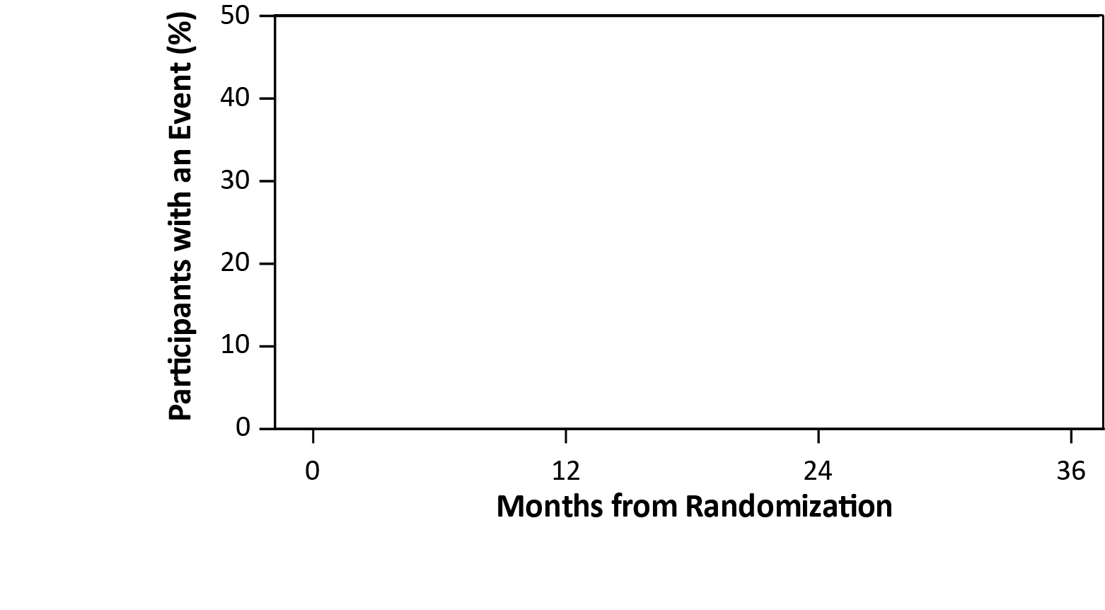
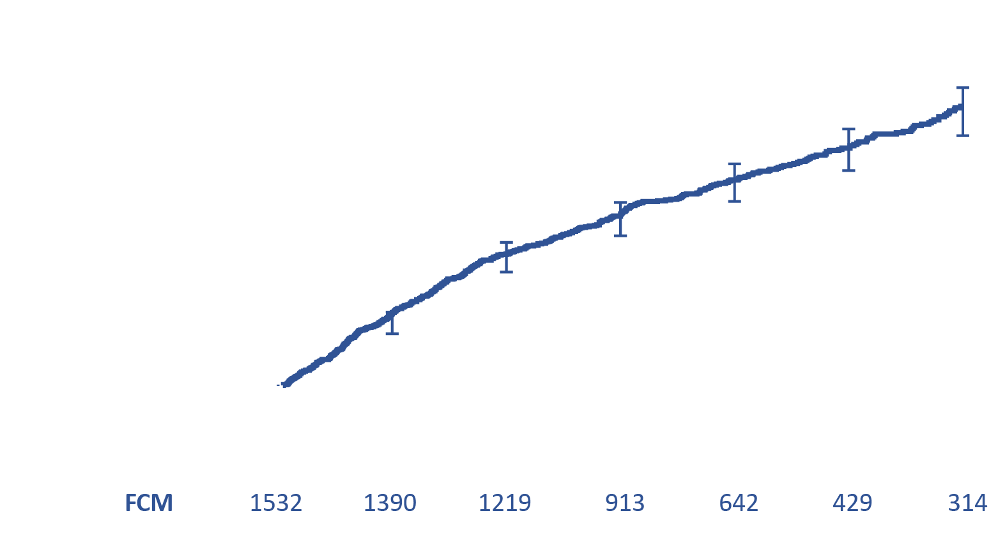
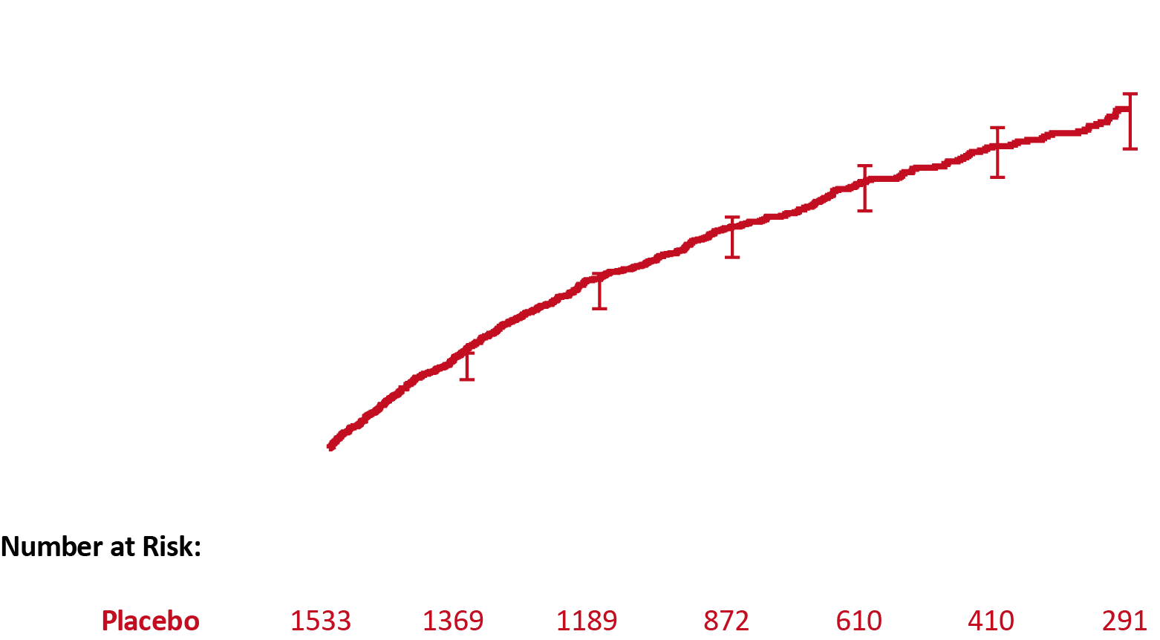
Top Secondary Endpoint
Time to Cardiovascular Death or First HF Hospitalization
Placebo 494 / 1533 (32.2%)
Target 771 patients with a first event
Observed 969 patients with an event
HR (96% CI) = 0.93
(0.81 to 1.06)
17.3 (PBO) vs. 16.0 (FCM) events per 100 patient years
FCM 475 / 1532 (31.0%)
Median Follow-up of 1.9 years (IQR, 1.3 to 3.0)

Slide 11
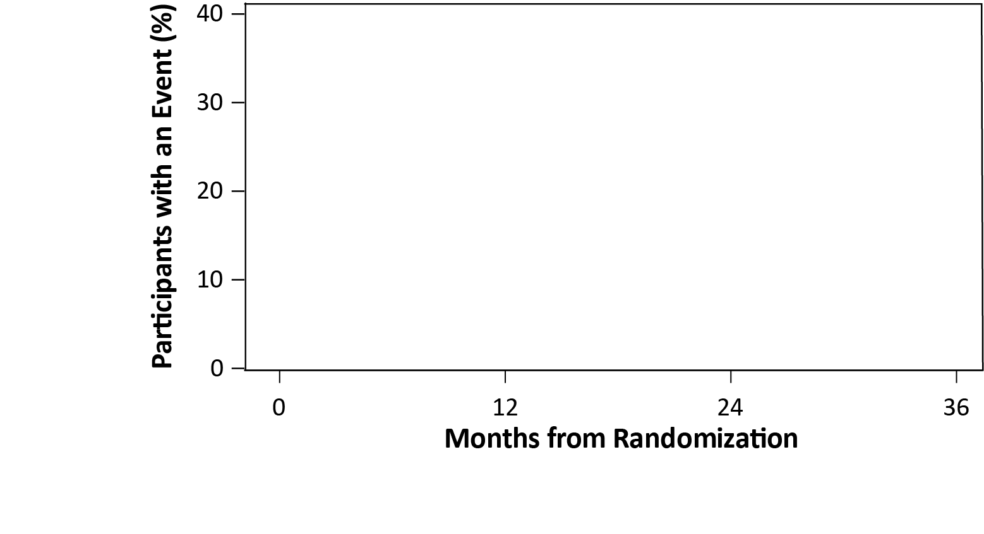
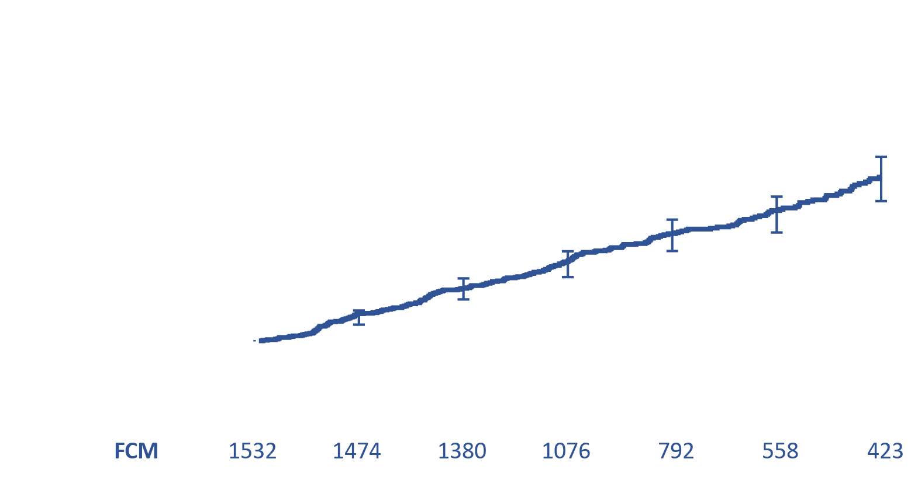
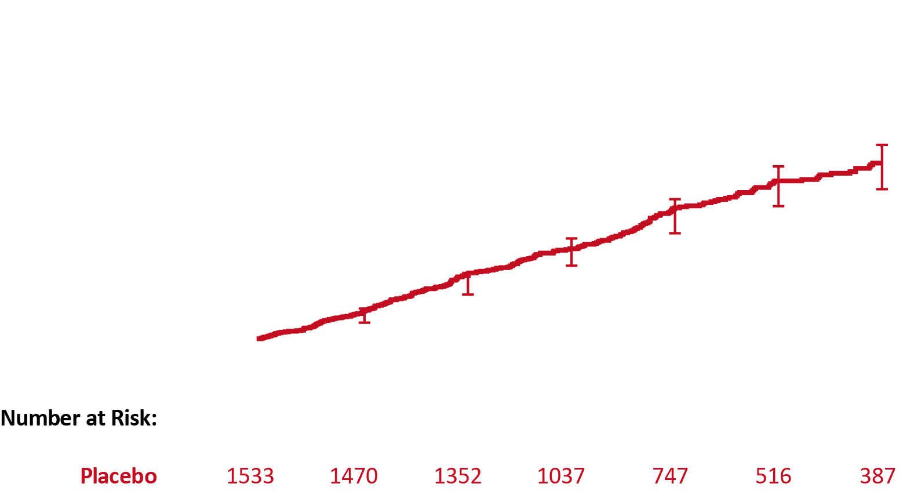
Time to CV Death
HR (96% CI) = 0.86 (0.72 to 1.03)
Placebo 275 / 1533 (17.9%)
8.2 (PBO) vs. 7.2 (FCM) events per 100 patient years
FCM 251 / 1532 (16.4%)
Median Follow-up of 1.9 years (IQR, 1.3 to 3.0)
Notes:
Fewer CV deaths

Slide 12
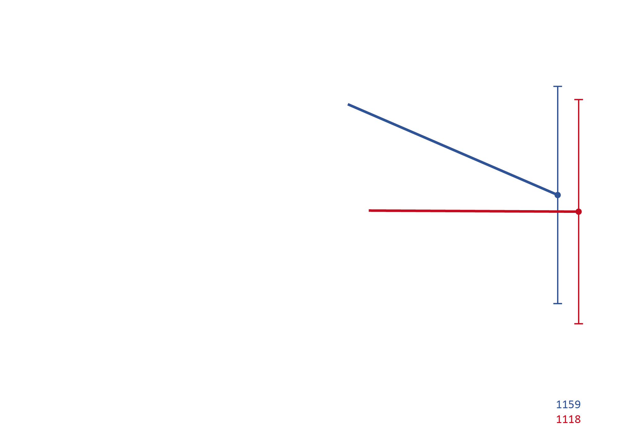
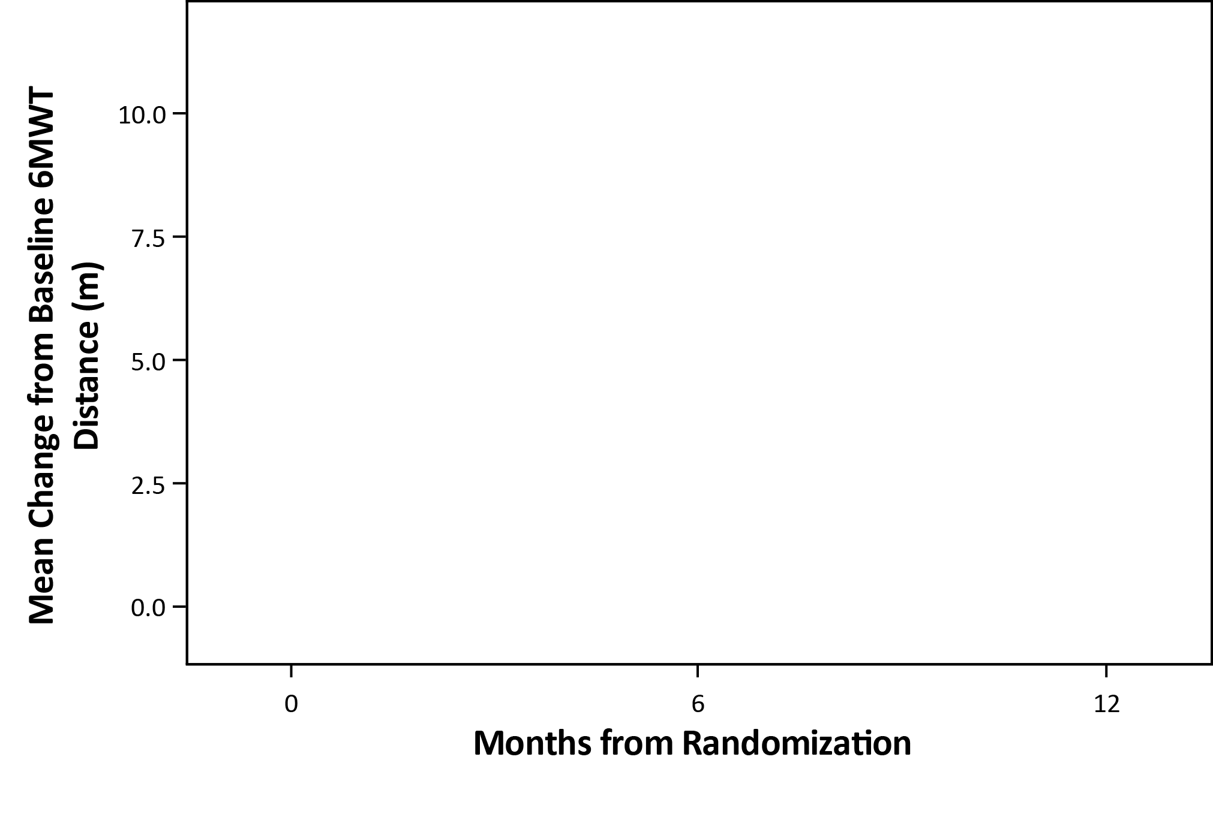
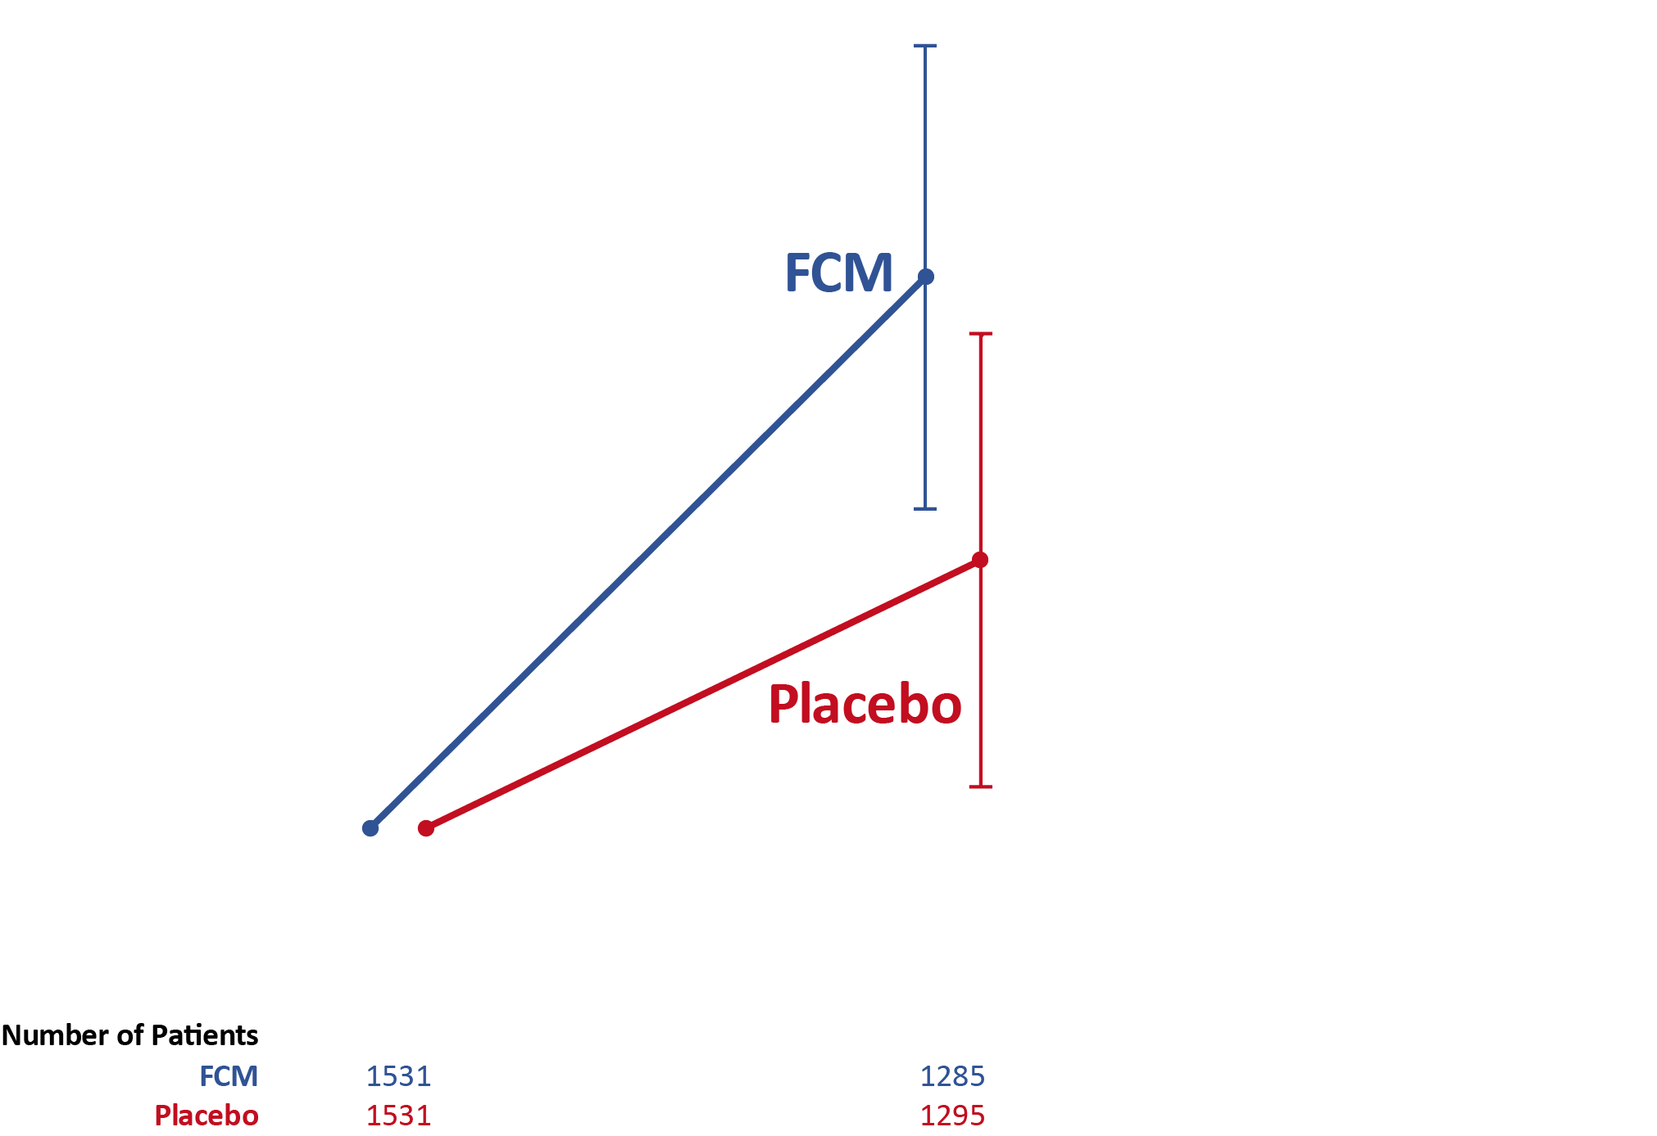
Change in 6-MWD (from Baseline to 12 m)
 | 6 mos
LS mean difference (96% CI) | 4 meters (-1, 9)
12 mos
0 meters (-6, 6)

Slide 13
Pre-specified Responder Analysis Change in 6-minute walk distance
 | FCM | Placebo | Odds Ratio (95% CI) vs. Placebo
Change from Baseline at 6 Months
Improved ≥ 10 m | 41% | 36% | 1.24 (1.08, 1.44)
Improved ≥ 20 m | 31% | 26% | 1.27 (1.09, 1.49)
Change from Baseline at 12 Months
Improved ≥ 10 m | 38% | 31% | 1.32 (1.13, 1.53)
Improved ≥ 20 m | 30% | 26% | 1.24 (1.06, 1.45)
≥24% increase in the Odds of Response with FCM

Slide 14
Safety: Treatment Emergent AEs
TEAEs
 | FCM | Placebo
Hypophosphatemia | 1 | 0
Hypersensitivity / Anaphylactoid reactions | 7 | 1
Percentage of Patients
Placebo
FCM
Placebo
FCM
Placebo
FCM
Hypophosphatemia (N=1)
Unrelated to study drug (PI assessment); resolved and study drug was continued
Angioedema (N=2)
1 probably related to study drug (PI assessment) - facial edema of moderate severity; resolved in hours with oral therapy
Hypersensitivity (N=5)
3 probably related to study drug (PI assessment) - 1 of these being severe; all patients recovering
Notes:
complement activated-related pseudo-allergy (CARPA), or other non-IgE mediated mechanisms of complement activation
https://jamanetwork.com/journals/jamanetworkopen/fullarticle/2790508

Slide 15
Summary
HEART-FID is the largest study to assess the long-term safety and efficacy of IV FCM in HFrEF + ID.
Well-powered for the primary and top secondary endpoint.
FCM appeared safe and resulted in modest improvement for the hierarchical endpoint of all-cause mortality, HF hospitalizations and 6-MWD.
This did not achieve the pre-specified statistical significance level based on a higher US regulatory threshold (P=0.019 with specified level of 0.01).
While the observed differences in the primary endpoint were driven by the wins in death, the other components contributed to a larger proportion of decisions in the analysis.
The totality of evidence with IV FCM from prior studies assessing symptomatic and functional status endpoints combined with clinical outcomes studies including HEART-FID, show overall safety and clinical benefits of IV FCM in HFrEF with ID.

Slide 16
Thank you! HEART-FID Investigator Teams, Sponsor, DSMB & Participants
STEERING COMMITTEE, SPONSOR, KCR AND DCRI COORDINATING CENTER
AF Hernandez, MD (PI); RJ Mentz, MD (Clinical Lead); J Butler, MD; CG De Pasquale, MBBS; JA Ezekowitz, MBBCh; GD Lewis, MD; E O’Meara, MD; P Ponikowski, MD; RW Troughton, MBChB; YW Wong, MBBS;
R Adamczyk, PharmD; D Aguilar; J Bambrick; N Blackman, PhD; K Moriarty; A Secci, MD; T Storie, MD;
S Califf; AP Ambrosy, MD; D Blythe; S Carlino; B Franklin-Goode; J Garg; J Harrington, MD; P Lavender; S Mangum, RN; L Perkins; MD Samsky, MD; She L, PhD; D Stournaras; C Wilson; D LeLoudis; F Rockhold, PhD.
KCR: K Lange; S Iesipov; S Wojcik.
DCRI CEC: WS Jones, MD (CEC Co-PI); A DeVore, MD (CEC Co-PI).
DATA AND SAFETY MONITORING BOARD
K Mahaffey, MD (DSMB Chair); D DeMets, PhD; S Goodman, MD, MSc; Barry Greenberg, MD; Marvin Konstam, MD.
COLLABORATORS
CVC: T Temple; C Gubbels. SAHMRI: L Griffith; J Butters; D Sacca. GLCC: C Alsweiler; H White.

Slide 17
Simultaneous Publication

