Slide 1


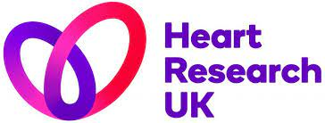


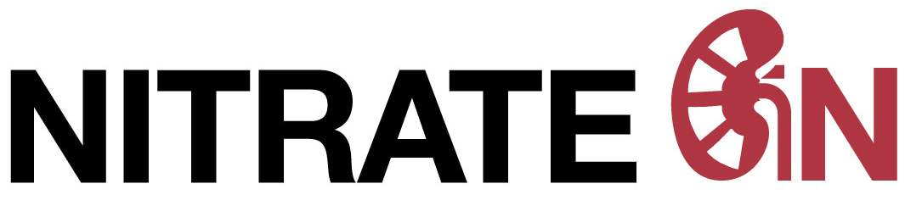
The Effect of Inorganic Nitrate on Contrast-Induced Nephropathy in Patients undergoing Coronary Angiography/Percutaneous Coronary Intervention for Acute Coronary Syndrome (ACS)
DA Jones, AM Beirne, M Kelham, L Wynne, M Andiapen, KS Rathod, T Parakaw, J Adams, A Learoyd, K Khan, T Godec, P Wright, S Antoniou, A Wragg, M Yaqoob, A Mathur, A Ahluwalia - NITRATE-CIN Investigators
Notes:
Good afternoon

Slide 2
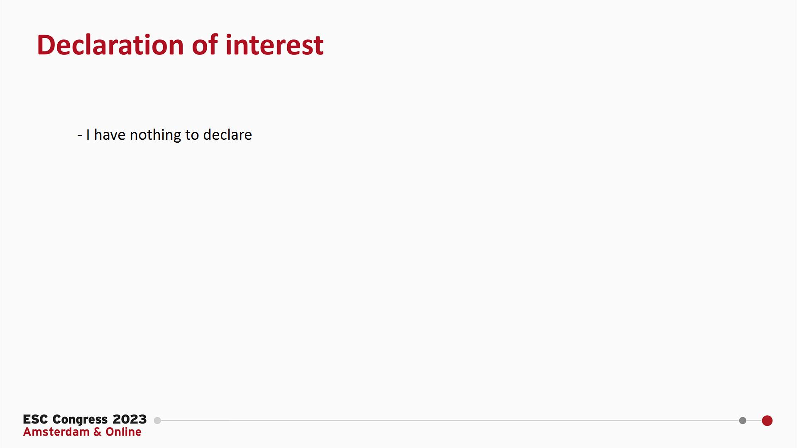

Slide 3

Contrast Induced Nephropathy
CIN, or contrast associated acute kidney injury (CA-AKI), defined by a deterioration in kidney function after contrast exposure
Higher risk post angiography for ACS in older patients and/or those with heart failure, chronic kidney disease or diabetes
Significant clinical consequences: longer hospital stays, increased risk for renal replacement therapy, recurrent revascularisation procedures and higher mortality.
Notes:
Comsidred a serious complication of CA
Incidnece varises based on patient charateristics, and definition used
Signifciant clinical cons

Slide 4
Pathophysiology
Mechanisms
Inflammation
Platelet Activation
Embolisation
ROS Generation
Vasoconstriction
Microvascular Injury
↓ Nitric Oxide
(NO)
Replace “LOST” Nitric Oxide
Notes:
Although the pathophysiological mechanism of CIN have not been fully clarified, the possible mechanisms include the direct toxic effects of CM, renal hemodynamic changes, oxygen-free radicals, inflammation and likely embolization of debris from catheters. What we do know from pre-cinical studies and early phase trials is that a key factor in the development is a deficiency occurs in Nitric oxide (NO) )NO scavenging and NO synthase ysfunction). Nitric oxide is an important homeostatic mediator of renal hemodynamics and thus, strategies that seek to replace this ‘lost’ NO represents an approach that may confer therapeutic benefit

Slide 5

The Solution
Dietary Inorganic
Nitrate (NO₃⁻)
Notes:
We propose that the solution to rplacing this lost NO lies in the form of dietary inorganic nitrate. Found in the diet, endogenously produced and Distinct from medicinally synthesized organic nitrates such as ISMN (familial with)

Slide 6
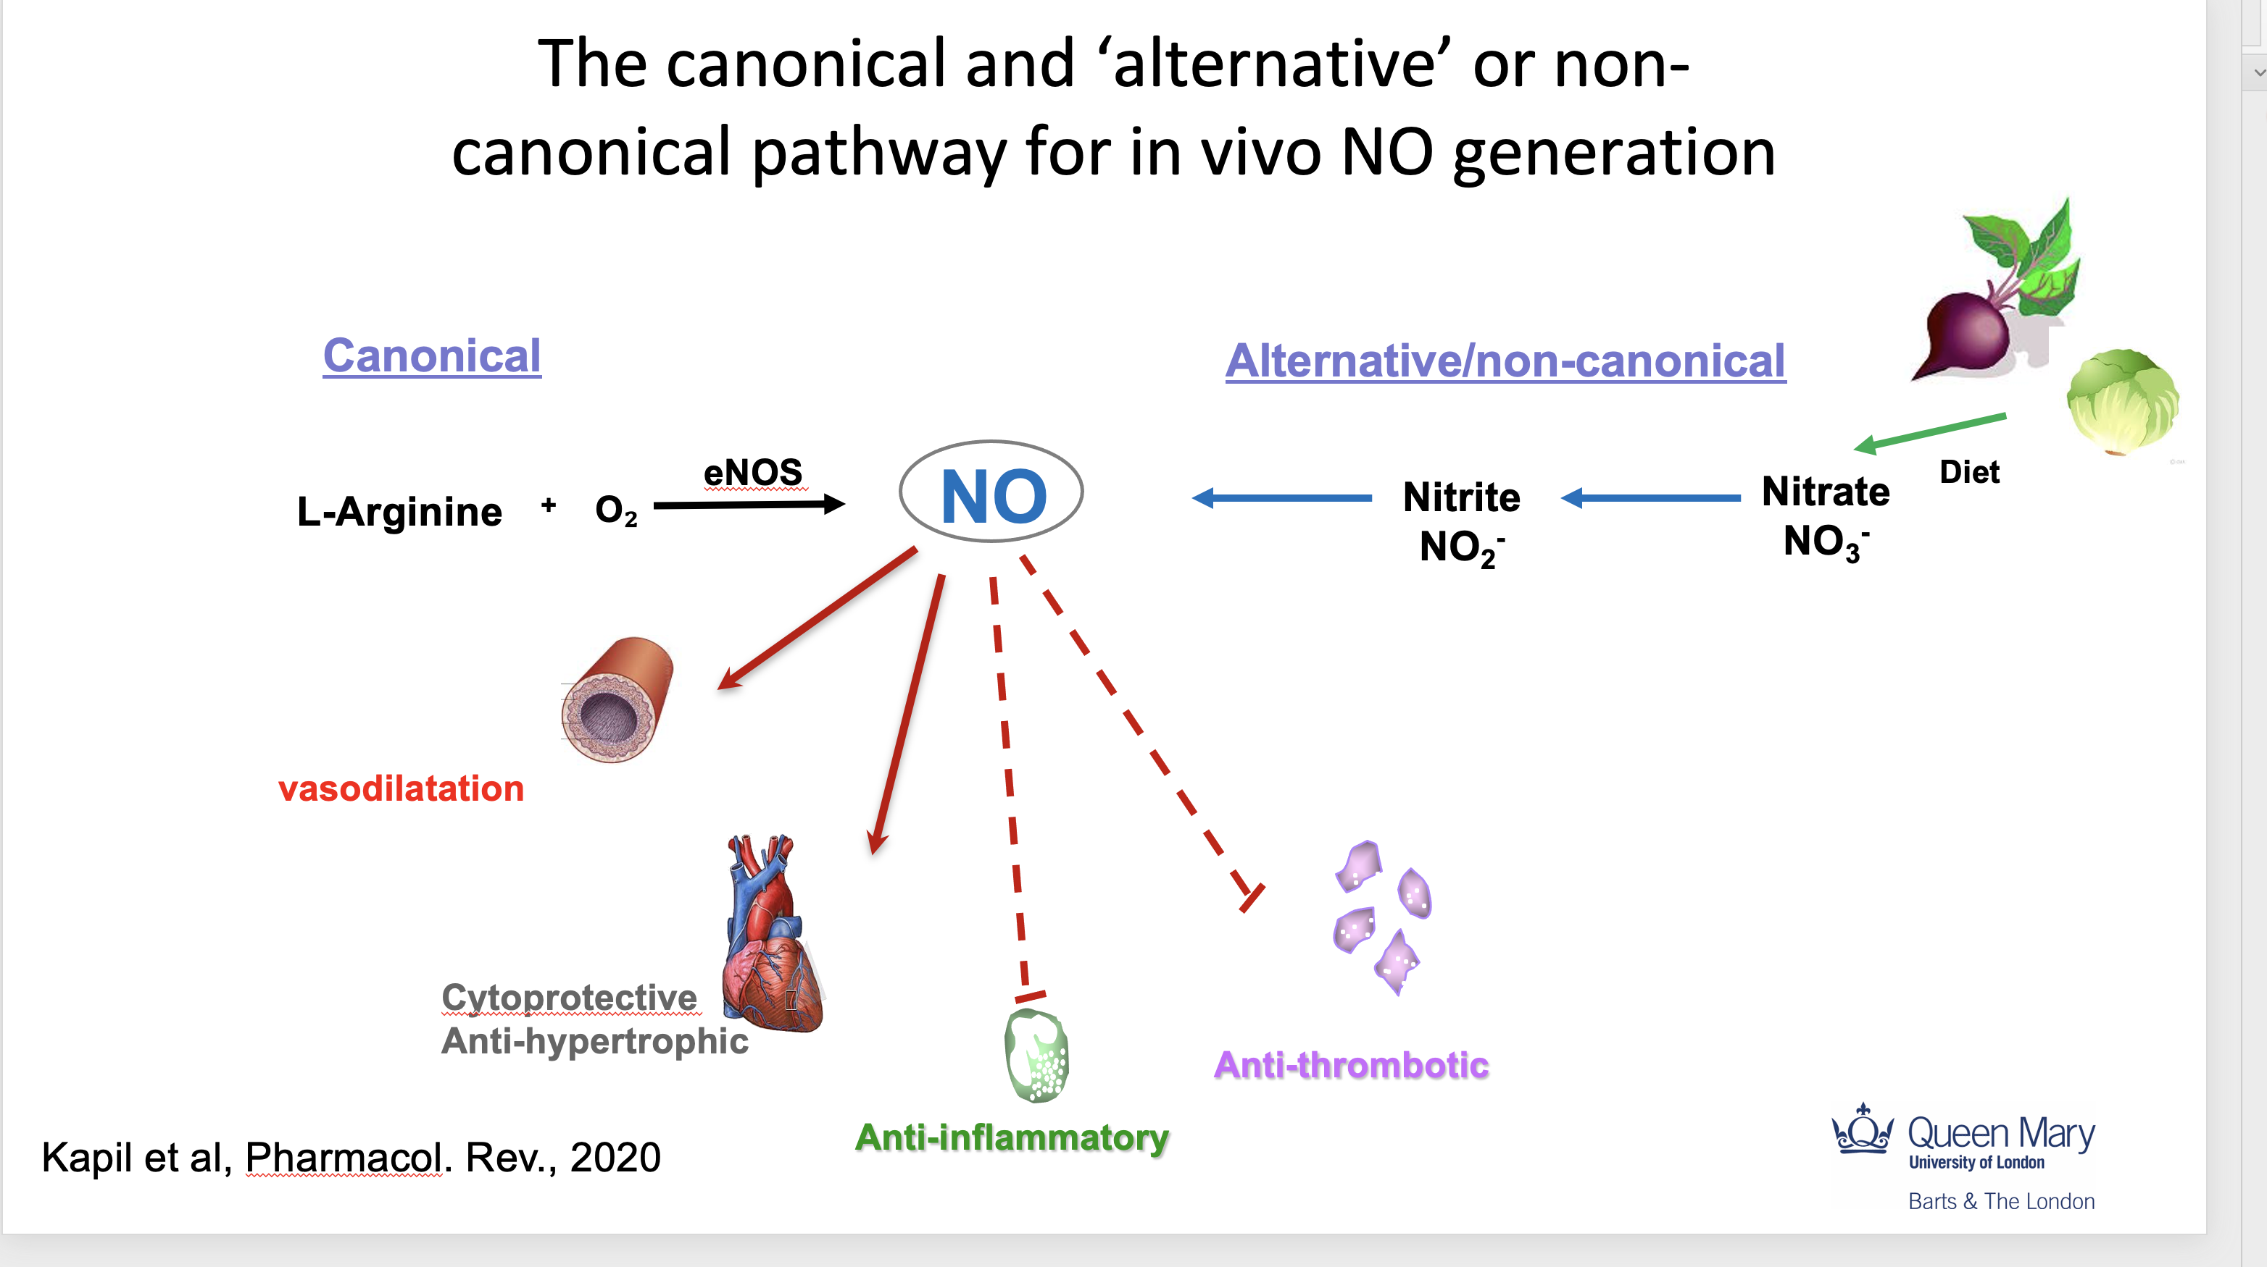
Pathways and Benefits of NO
Notes:
Nitrite is found endogenously in blood and tissues and represent a stable intravascular storage form of NO that exerts several beneficial effects such as ….., Since the ingestion of inorganic nitrate (NO₃⁻) can be used to safely and effectively elevate circulating nitrite levels via the enterosalivary or non-canonical pathway. Therefore we assessed the potential therapeutic benefit that could be derived from the use of inorganic nitrate in the prevention of CIN in patients with ACS.

Slide 7
Pilot Data
Elevated Nitrite Levels and Renoprotection
Rates of AKI
Change in Creatinine
16 μmol/L diff
*P=0.015
12.5% vs 2.5%
P=0.108
*Significance shown for unpaired t test between groups

Slide 8

NITRATE-CIN
A prospective, randomised, double-blind placebo-controlled trial to test the efficacy of inorganic nitrate in the prevention of CIN in patients undergoing invasive coronary angiography for NSTE-ACS
640 pt.
Potassium Nitrate
(12 mmol/744 mg nitrate)
5 days
1:1
Potassium Chloride
5 days
VS
Notes:
Please don’t say high dose here-no need to comment. If there is a question we cvan answer.
Levels of circulating NO₂⁻ achieved with 12mmol KNO₃ are approximately 0.8-1.0 μmol/L 1-3 hours after ingestion²³, which correspond well with the levels achieved following a bolus dose of sodium nitrite in NITRITE AMI (0.67±0.18μM) that was associated with a reduction in the occurrence of CIN of 80% with nitrite treatment,

Slide 9
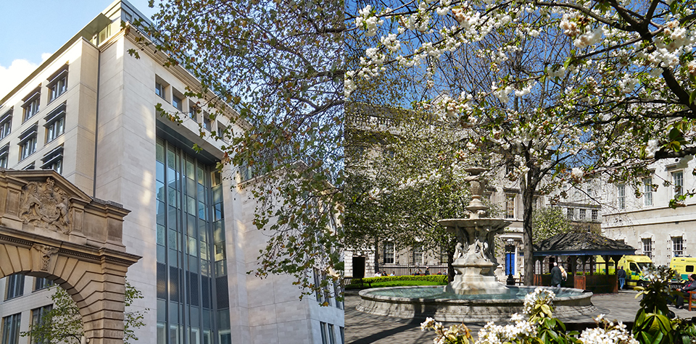
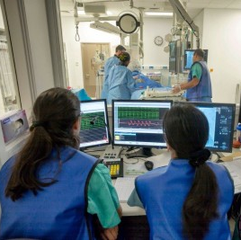

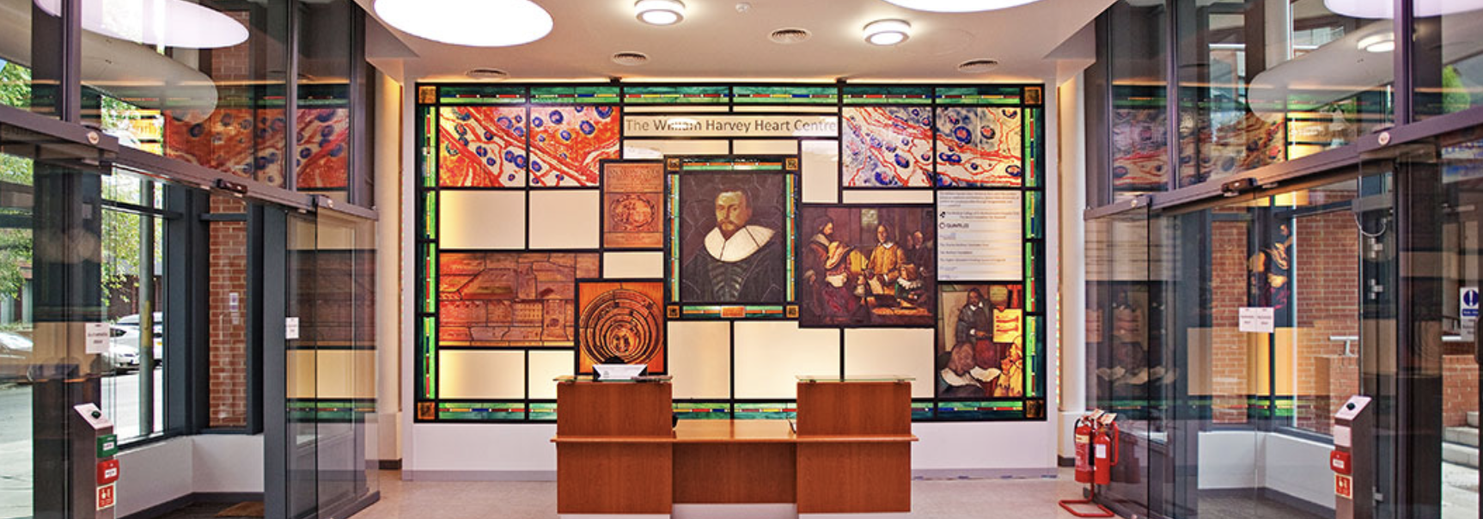

St Bartholomew’s Hospital
640 Patients
Single Centre Study
St Bartholomew's Hospital, London, UK
Sponsor: Queen Mary University of London
Adopted by Barts Cardiovascular CTU
Funded by Heart Research UK

Slide 10
Eligibility Criteria
Inclusion Criteria
Patients undergoing invasive coronary angiography
NSTE-ACS and Convalescent STEMI
Aged ≥18
At risk of Contrast Induced Nephropathy
  eGFR<60ml/min OR
  2 of the following:
    Diabetes
    Liver failure (cirrhosis)
    Age > 70yr
    Exposure to contrast in last 7 days
    Heart Failure (or LVEF<40%)
    Concomitant renally active drugs
Exclusion Criteria
ST segment myocardial infarction
Haemodynamic or Clinical Instability
Subjects with eGFR<20ml/min or on renal replacement therapy
Current life-threatening condition other than vascular disease
Pregnancy or unknown pregnancy status.

Slide 11
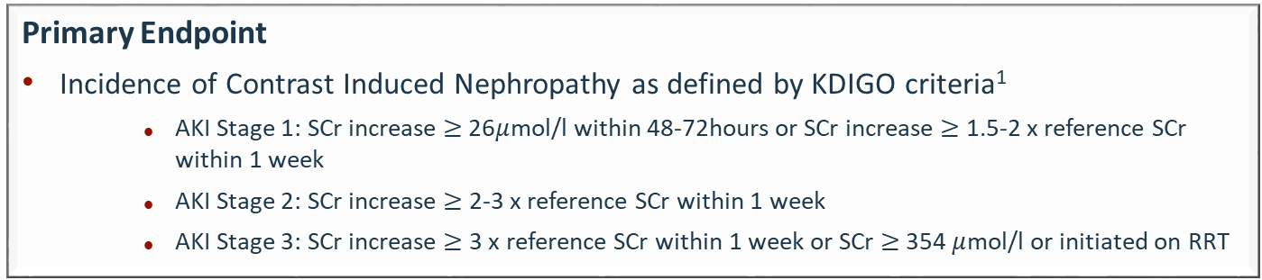
Primary Endpoint
Primary Endpoint
Incidence of Contrast Induced Nephropathy as defined by KDIGO criteria¹
      AKI Stage 1: SCr increase $≥$26$μ$mol/l within 48-72hours or SCr increase $≥$ 1.5-2 x reference SCr within 1 week
      AKI Stage 2: SCr increase $≥$ 2-3 x reference SCr within 1 week
      AKI Stage 3: SCr increase $≥$ 3 x reference SCr within 1 week or SCr $≥$354 $μ$mol/l or initiated on RRT
Sample Size
640 patients provided:
  90% power for CIN reduction of 60% assuming 12% CIN rate
  80% power allowing for 25% drop-out
1. Fliser D, Laville M, et al. A. Nephrol Dial Transplant Off Publ Eur Dial Transpl Assoc - Eur Ren Assoc 2012 :4263–72.

Slide 13
Baseline Demographics
 |  | Placebo (N=321) | Inorganic Nitrate (N=319)
Age (years), mean ± SD |  | 71.2 ± 11.5 | 70.8 ± 11.8
Sex, n (%) | Female | 80 (24.9) | 91 (28.5)
 | Male | 241 (75.1) | 228 (71.5)
Ethnicity, n (%) | Asian | 44 (13.7) | 58 (18.2)
 | Black | 31 (9.7) | 22 (6.9)
 | White | 242 (75.4) | 239 (74.9)
BMI (kg/m²), mean ± SD |  | 28.6 ± 5.8 | 28.1 ± 5.6
Hypertension, n (%) |  | 248 (77.3) | 237 (74.3)
Hypercholesterolaemia, n (%) |  | 190 (59.0) | 196 (61.0)
Previous PCI, n (%) |  | 105 (32.7) | 107 (33.5)
Previous MI, n (%) |  | 104 (32.4) | 106 (33.2)
Diabetes, n (%) |  | 148 (46.1) | 146 (45.8)
 | Type I | 3 (0.9) | 3 (0.9)
 | Type II: Diet controlled, | 20 (6.2) | 21 (6.6)
 | Type II: Drug therapy, | 89 (27.7) | 94 (29.5)
 | Type II: Insulin | 36 (11.2) | 28 (8.8)
Presentation, n (%) | Unstable angina | 47 (14.6) | 50 (15.7)
 | NSTEMI | 274 (85.4) | 269 (84.3)
Peripheral Vascular Disease, n (%) |  | 9 (2.8) | 17 (5.3)
Stroke, n (%) |  | 21 (6.5) | 17 (5.3)
CKD (eGFR<60ml/min), n (%) |  | 167 (52.1) | 191 (59.8)
LV impairment, n (%) |  | 118 (37.0) | 128 (40.0)
Notes:
Mean LVEF 48_/11 vs 48_/12

Slide 14
Procedural Characteristics
 |  |  | Placebo (N=321) | Inorganic Nitrate (N=319)
Access route, n (%) |  | Femoral | 45 (14) | 22 (6.9)
 |  | Radial | 276 (86) | 297 (93)
Contrast (mL), mean ± SD |  |  | 181 ± 95 | 169 ± 85
Radiation (mGy), mean ± SD |  |  | 390 ± 400 | 315 ± 323
Radiation (mGy^2), mean ± SD |  |  | 2,176 ± 3,741 | 1,732 ± 2,077
Syntax Score, mean ± SD |  |  | 15 ± 9 | 14 ± 10
Outcome, n (%) | Medical | Medical | 128 (39.9) | 137 (42.9)
 | PCI | PCI | 160 (49.8) | 147 (46.1)
 | Surgery | Surgery | 33 (10.3) | 35 (10.9)
Vessel Treated, n (%) | LMS | LMS | 5 (1.6) | 7 (2.2)
 | LAD | LAD | 84 (26) | 66 (21)
 | LCx | LCx | 48 (15) | 39 (12)
 | RCA | RCA | 52 (16) | 51 (16)
Intravascular Imaging, n (%) | IVUS | IVUS | 58 (18) | 49 (15)
 | OCT | OCT | 22 (6.9) | 9 (2.8)
Adjunctive Techniques, n (%) | Rotational Atherectomy | Rotational Atherectomy | 11 (6.8) | 9 (6.1)
 | IVL | IVL | 3 (2.0) | 0 (0)
Notes:
Mean LVEF 48_/11 vs 48_/12

Slide 15
Mehran Score
 |  | Placebo (N=321) | Inorganic Nitrate (N=319)
Mehran score, mean (SD) |  | 9.74 (3.59) | 10.28 (3.44)
Mehran risk group, n (%) | Low (≤5) | 26 (8.10) | 25 (7.84)
 | Medium (6-10) | 183 (57.01) | 153 (47.96)
 | High (11-15) | 88 (27.41) | 112 (35.11)
 | Very high (≥16) | 24 (7.48) | 29 (9.09)

Slide 16
Contrast Induced Nephropathy
9.1% vs 30.5%, p<0.0001
Mehran Model
7.3% vs 21.8%, p<0.0001
Notes:
Overall there was a 20% CIN rate in the trial, 90% was stage 1, 8% stage 2, 2 % stage 3.
Split by treatment group this left a 30.5% event rate in placebo group
9.1% in nitrate group
Mehran Model 7.3% vs 21.8%, P<0.0001

Slide 17
Pre-Specified Subgroup Analysis
 |  | Subgroup | Placebo N=282 | Inorganic Nitrate N=274 | OR (95% CI) | P value | Interaction P value
CIN, number (%) | Pre-existing organic nitrate use, N=72 |  | 10 (24.39) | 6 (19.35) | 0.65 (0.20 to 2.08) | 0.465 | 0.040
 | No prior organic nitrate use, N=484 |  | 76 (31.54) | 19 (7.82) | 0.17 (0.10 to 0.29) | <0.001
 | Diabetic, N=261 |  | 49 (36.30) | 16 (12.70) | 0.23 (0.12 to 0.45) | <0.001 | 0.583
 | Non-diabetic, N=295 |  | 37 (25.17) | 9 (6.08) | 0.18 (0.08 to 0.39) | <0.001
 | Troponin positive, N=480 |  | 74 (30.45) | 21 (8.86) | 0.20 (0.12 to 0.35) | <0.001 | 0.837
 | Troponin negative, N=76 |  | 12 (30.77) | 4 (10.81) | 0.24 (0.07 to 0.83) | 0.025
 | Mehran risk score – (≤10), N=320 |  | 43 (24.43) | 7 (4.86) | 0.16 (0.07 to 0.36) | <0.001 | 0.520
 | Mehran risk score – (≥11), N=236 |  | 43 (40.57) | 18 (13.85) | 0.22 (0.12 to 0.42) | <0.001

Slide 18
Elevation in Circulating Nitrite and Nitrate Levels

Slide 19
Blood Pressure

Slide 20
Procedural MI
SCAI definition
4.1% vs 12.5%, p=0.003

Slide 21
Change in Renal Function at 3 Months Compared to Baseline
Notes:
Now looking at the longer-term effects on renal function. Assessment of the change in creatinine or eGFR from baseline to 3 months demonstrated that there was a significant improvement in both measures with inorganic nitrate therapy compared to placebo. At three months a significant increase in creatinine (10.42 μmol/L [95% CI 5.86-14.98], P<0.001) and decline in eGFR (5.17 ml/min [95% CI 2.94-7.39], P<0.001) were evident in the placebo group when compared to those receiving inorganic nitrate (Figure 2). These effects were accompanied by significantly higher rates of persistent renal dysfunction i.e. 20.3% in the placebo group vs 6.0% at 3 months in the inorganic nitrate group (P<0.001).

Slide 22
1 Year MACE
MACE
All-cause mortality
MI
Unscheduled Revascularisation
Notes:
At 1-year overall MACE rates were 13.6% (87/638). There was a significant reduction in MACE rates in the inorganic nitrate group (9·1%) compared to the placebo group (18.1%, P=0.001) over the 1-year period. This was driven by reduced rates of all-cause mortality (5.4% vs 10.9%, P=0.011), non-fatal MI (3.8% vs 7.8%, P=0.033) and unscheduled revascularization (1.6% vs 4.7%, P=0.031)

Slide 23
1 Year MAKE
MAKE
All-cause mortality
Renal Replacement Therapy (RRT)
Persistent Renal Dysfunction
>50% increase in baseline serum creatinine
Notes:
At 1-year overall MAKE rates were 20.2% (129/638). There was a significant reduction in MAKE rates in the inorganic nitrate group (11.0%) compared to the placebo group (29.4%, P<0.001) over the 1-year period. This was driven by reduced rates of all-cause mortality (5.4% vs 10.9%, P=0.011) and persistent renal dysfunction (6.0% vs 20.3%, P<0.001)

Slide 24
Summary
In patients at risk of renal injury undergoing coronary angiography for ACS, dietary inorganic nitrate reduces CIN compared to placebo
This corresponded to improved renal outcomes at 3 months and both MACE and MAKE out to 12 months
These findings could have important implications in reducing the burden of CIN on healthcare systems worldwide
Further studies powered off MACE are needed to confirm these findings.

Slide 25
Acknowledgements
Study Team
Amrita Ahluwalia
Anthony Mathur
Anne-Marie Beirne
Mervyn Andiapen
Lucinda Wynne
Barts CVCTU
Anna Learoyd
Kamran Khan
Tom Godec
Jessica Adams
Victoria Hammond
Marian Benford
Shahana Chowdhury
Simon Menezes
Barts Heart Centre
Matthew Kelham
Krishnaraj Rathod
Nasim Forooghi
Susana Palma
Andreas Baumbach
TSC DSMC
Andrew Wragg Rob Bell
Suzanne Forbes Sotiris Antoniou
Paul Wright Alex Sirker
Ray Amersey Rhian Gabe
Oliver Guttmann

