Slide 1
Outcomes for Primary Prevention Patients in the CLEAR Outcomes Trial
Steven E. Nissen MD MACC
On behalf of the CLEAR investigators and our extraordinary patients
Study Sponsor:
Esperion Therapeutics, Inc.

Slide 2
Background
Bempedoic acid, an ATP citrate lyase inhibitor, inhibits hepatic cholesterol synthesis upstream of HMG-Co-A reductase, the enzyme inhibited by statins.
Bempedoic acid is a pro-drug activated in the liver, but not peripheral tissues, resulting in a low incidence of muscle-related adverse events.
The CLEAR outcomes trial demonstrated cardiovascular event reduction with bempedoic acid administration in patients unable or unwilling to tolerate guideline recommended statin doses.
Effects of bempedoic acid on cardiovascular outcomes in the 30% (4200) primary prevention patients have not been fully described.

Slide 3
CLEAR Outcomes Trial Design
Statin intolerance: An adverse effect that started or increased during statin therapy and resolved or improved after therapy discontinued.
Intolerance to 2 or more statins or 1 statin if unwilling to attempt a second statin or advised by physician to not attempt second statin. Very low dose statin therapy permitted (< lowest approved dose).
Bempedoic Acid 180 mg/day
Cardiovascular outcomes assessed after 40.6 months median follow up
Primary or secondary prevention patients with LDL-C ≥ 100 mg/dL
3
Matching Placebo

Slide 4
Definition of High Risk for Cardiovascular Event (Primary Prevention)
Reynolds Risk score >30%, or
SCORE risk >7.5% over 10-years, or
Patients with Type 1 or 2 diabetes, aged >65 years (women) or >60 years (men), or
CAC score of >400 AU at any time in the past

Slide 5
Primary Prevention Patients: Baseline Characteristics
Characteristic | Bempedoic Acid N=2100 | Placebo N=2106
Mean Age (years) | 67.9 | 68.0
Female sex | 58.8% | 59.2%
Diabetes | 65.2% | 67.0%
White | 92.2% | 90.8%
LDL cholesterol (mg/dL) | 142.2 | 142.7
HDL cholesterol (mg/dL) | 51.1 | 50.9
Triglycerides (mg/dL) | 162.0 | 161.5
Hemoglobin A1c | 6.2 | 6.2
hsCRP (mg/L) | 2.4 | 2.4

Slide 6
Effect of Trial Regimens on LDL-C and hsCRP
-1.4%
Time averaged difference 23.2 mg/dL
-22.7%

Slide 7
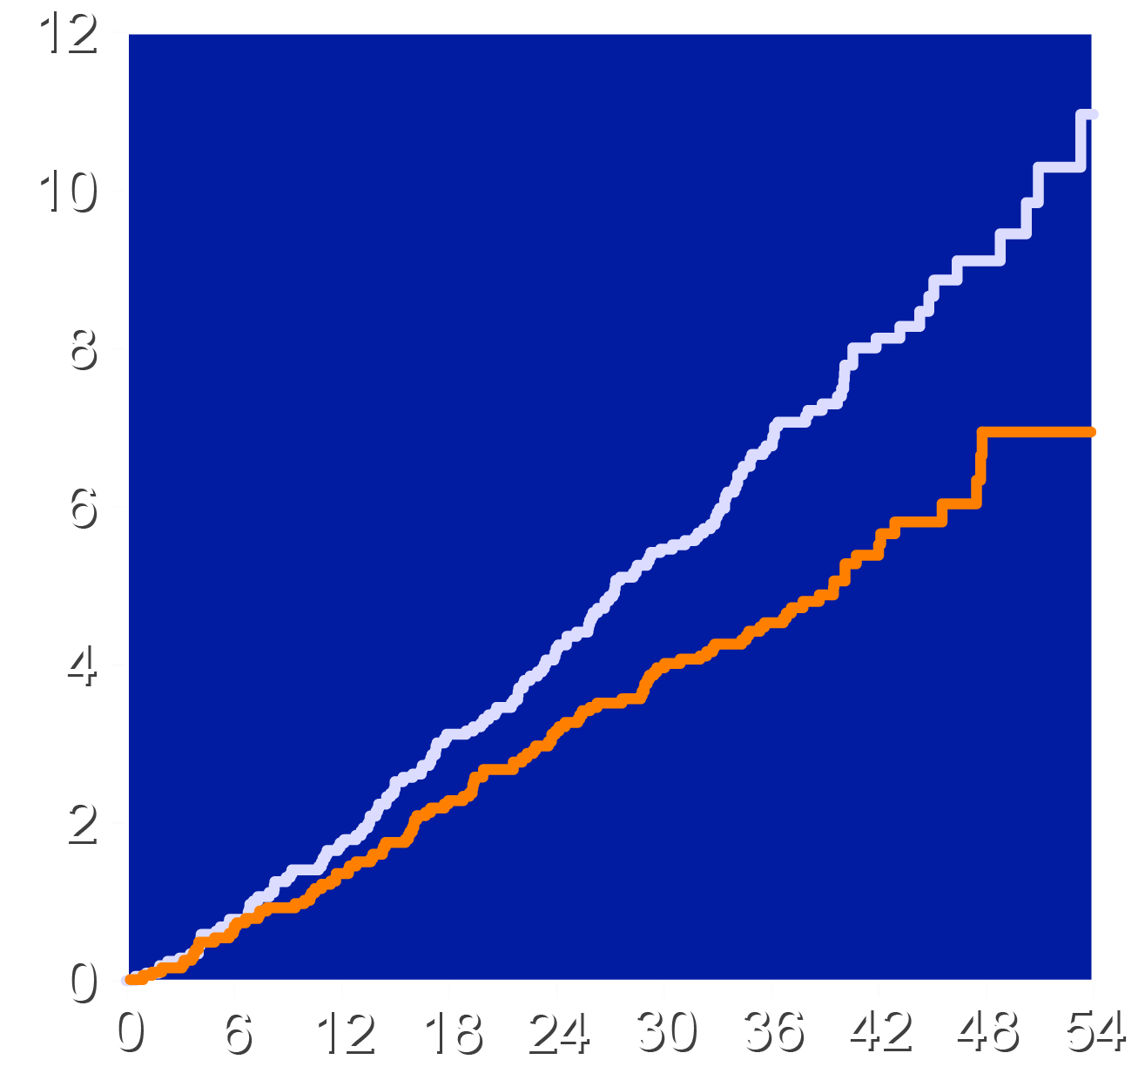
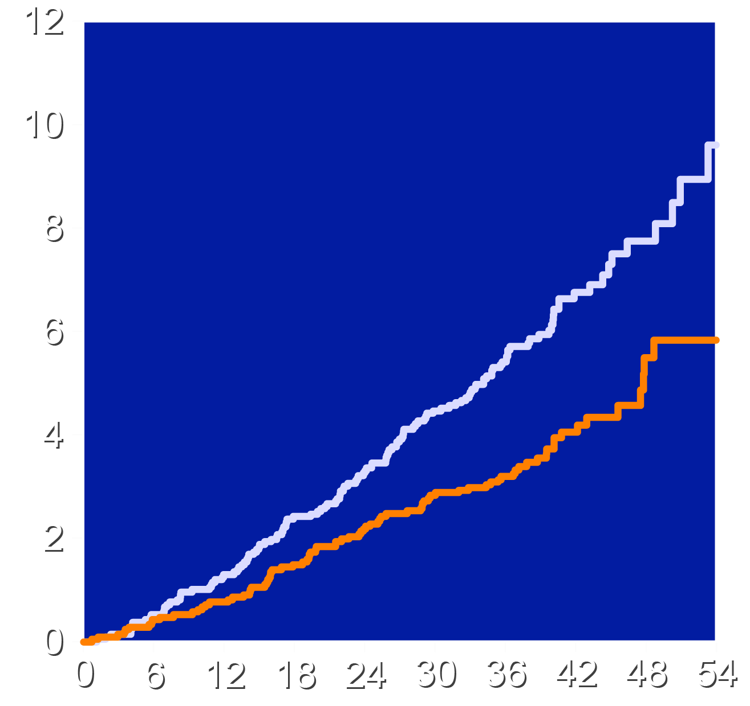
Effects on Major Adverse Cardiovascular Events
4-component MACE
3-component MACE
Placebo
Bempedoic Acid
Placebo
Bempedoic Acid
HR 0.70 (95% CI 0.55-0.89)
P=0.002
HR 0.64 (95% CI 0.48-0.84)
P<0.001
Patients with an Event (%)
Patients with an Event (%)
Months Since Randomization
Months Since Randomization

Slide 8
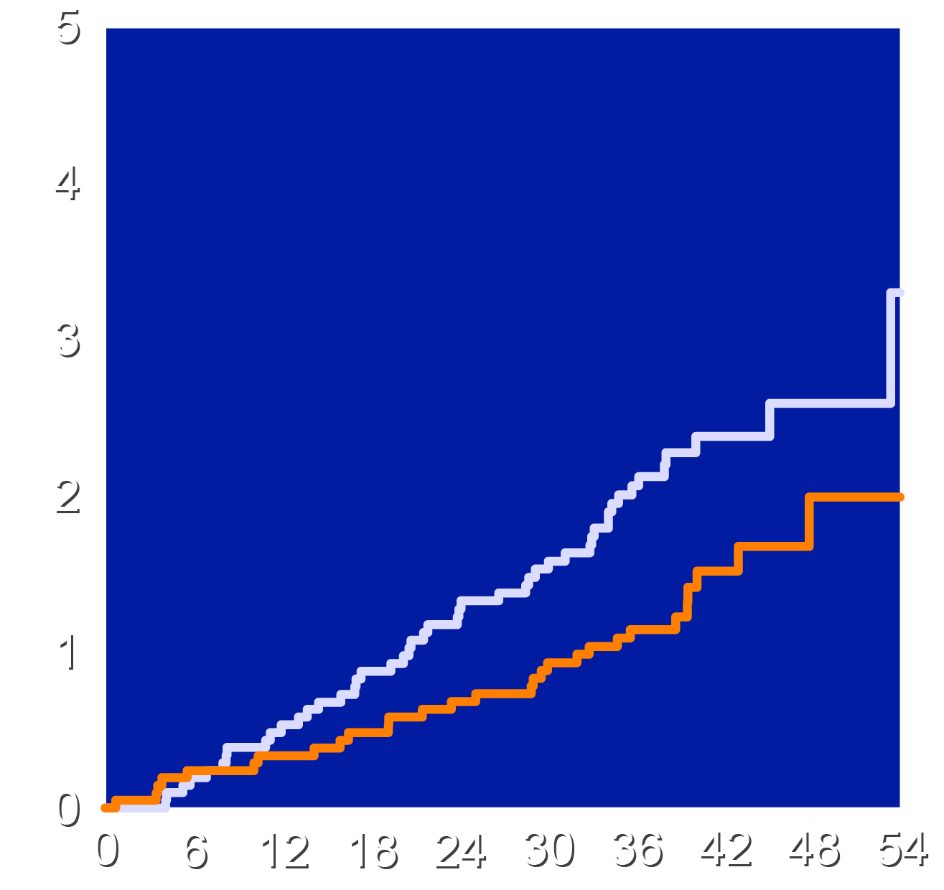
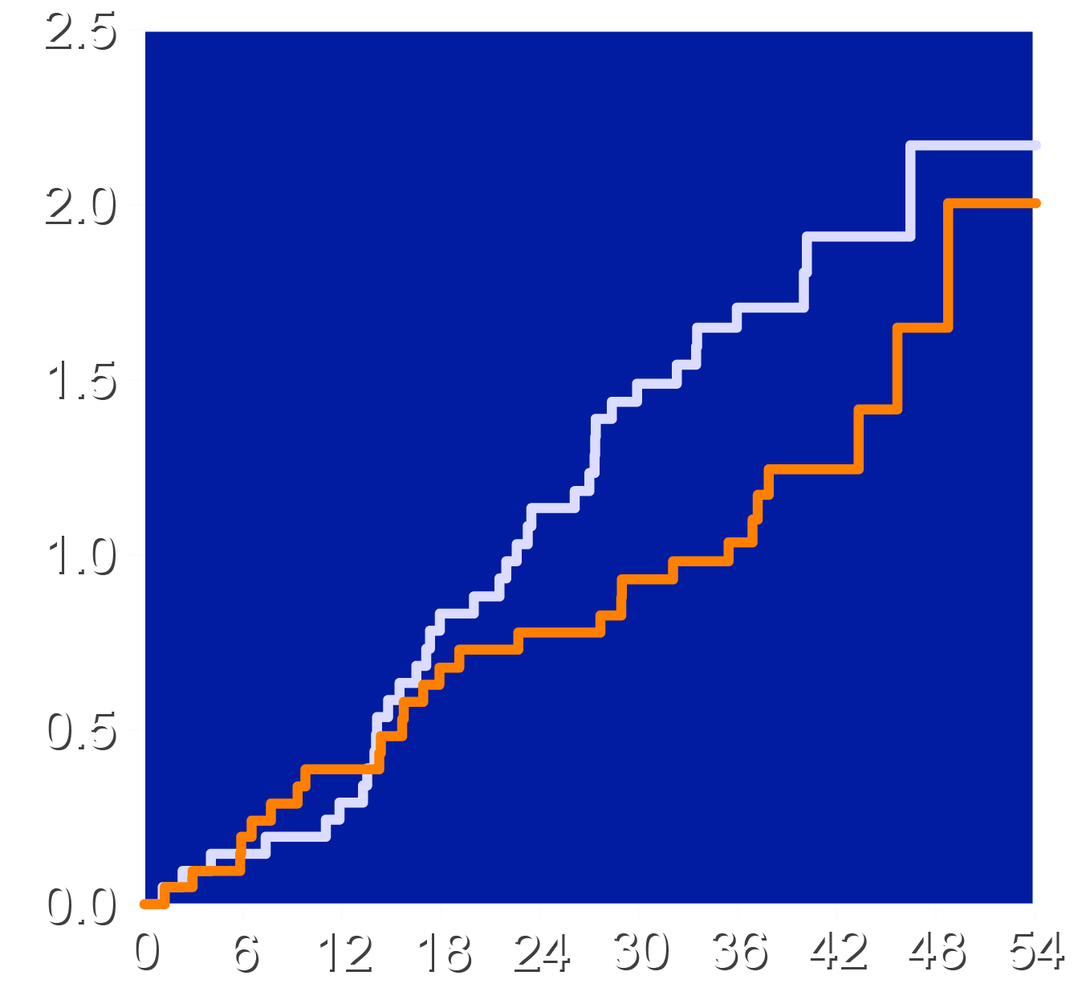
Effects on Myocardial Infarction and Stroke
Myocardial Infarction
Stroke
Placebo
Bempedoic Acid
Placebo
Bempedoic Acid
HR 0.61 (95% CI 0.39-0.98)
HR 0.76 (95% CI 0.46-1.26)
Patients with an Event (%)
Patients with an Event (%)
Months Since Randomization
Months Since Randomization

Slide 9
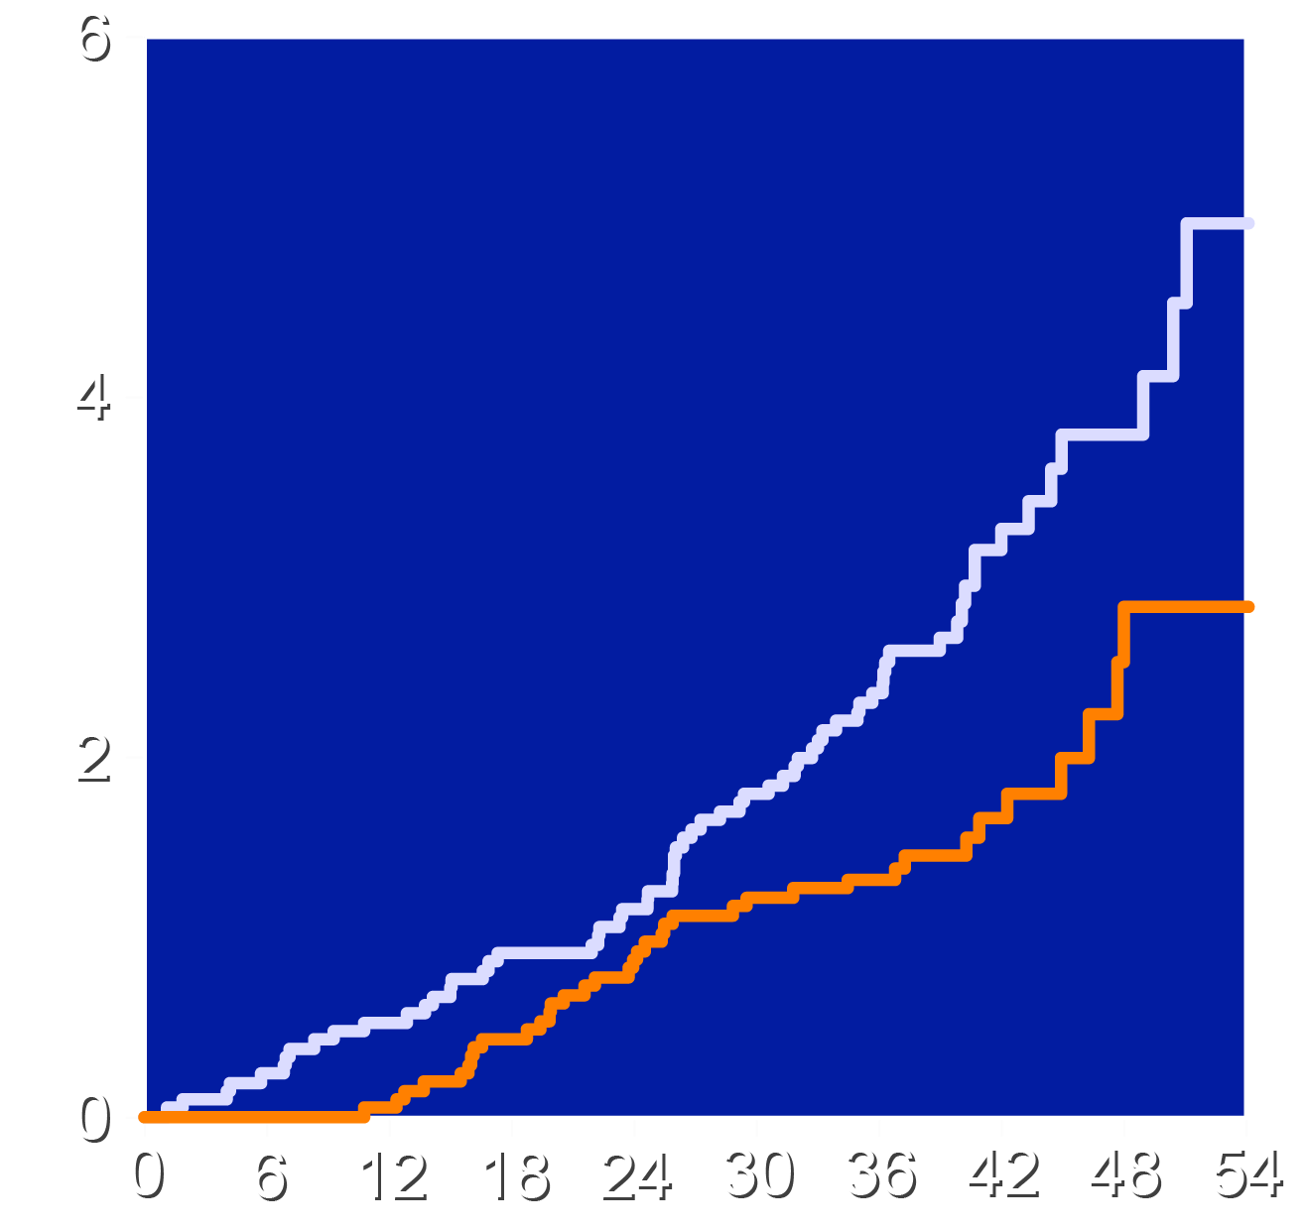
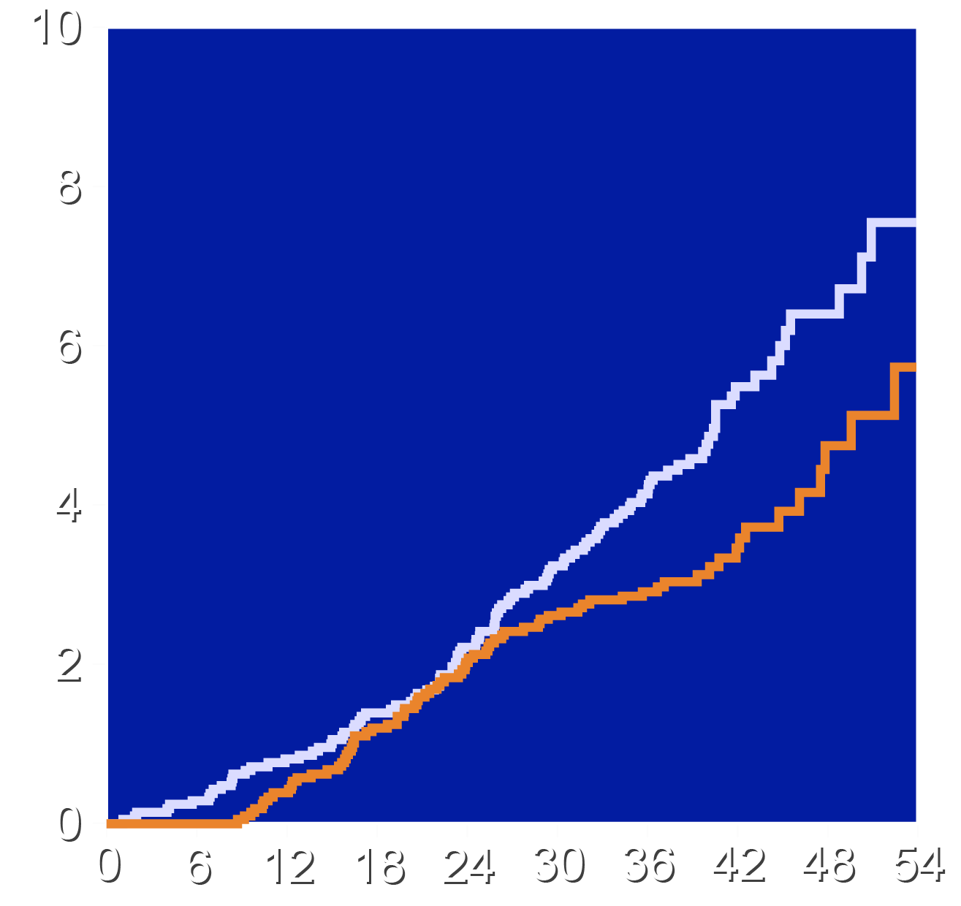
Effects on Cardiovascular Death and All-Cause Mortality
Cardiovascular Death
All-cause Mortality
Placebo
Bempedoic Acid
Placebo
Bempedoic Acid
HR 0.61 (95% CI 0.41-0.92)
HR 0.73 (95% CI 0.54-0.98)
Patients with an Event (%)
Patients with an Event (%)
Months Since Randomization
Months Since Randomization

Slide 10
Investigator-Reported Adverse Effects
Characteristic | Bempedoic Acid N=7001 | Placebo N=6964
Serious Treatment Emergent Adverse event | 19.9% | 20.8%
Adverse event leading to drug discontinuation | 9.9% | 9.9%
Any muscle disorder | 12.8% | 13.9%
New onset diabetes | 6.4% | 6.9%
Elevated hepatic enzymes | 4.5% | 2.6%
Prespecified renal events | 10.3% | 8.1%
Gout | 2.6% | 2.0%
Cholelithiasis | 2.5% | 1.1%

Slide 11
Limitations
This was a secondary analysis of a subpopulation in a larger randomized trial.
Such analyses can result in false positive findings due to testing of multiple subgroups.
The inclusion of statin intolerant patients resulted in a relatively high LDL cholesterol.
These were patients at high risk of a first cardiovascular event. Results may not apply to lower risk populations.

Slide 12
Conclusions
Bempedoic acid was well-tolerated in primary prevention patients (66% with diabetes) unable or unwilling to take statins
Bempedoic acid lowered LDL-C by 21.3% and hsCRP by 21.5% with small increases in the incidence of gout and cholelithiasis.
4-component MACE was reduced 30%, 3-component MACE 36%, myocardial infarction 39%, CV death 39%, and all cause mortality 27%.
These findings suggest large benefits from lowering LDL-C and hsCRP with bempedoic acid in high-risk primary prevention patients.

Slide 13
