Slide 1
Effect of Myocardial Viability, Functional Recovery and PCI on Clinical Outcomes in the REVIVED-BCIS2 Trial
Prof Divaka Perera MD FRCP
King’s College London, UK
On behalf of the REVIVED Investigators
@divaka_perera | @REVIVED_BCIS2

Slide 2
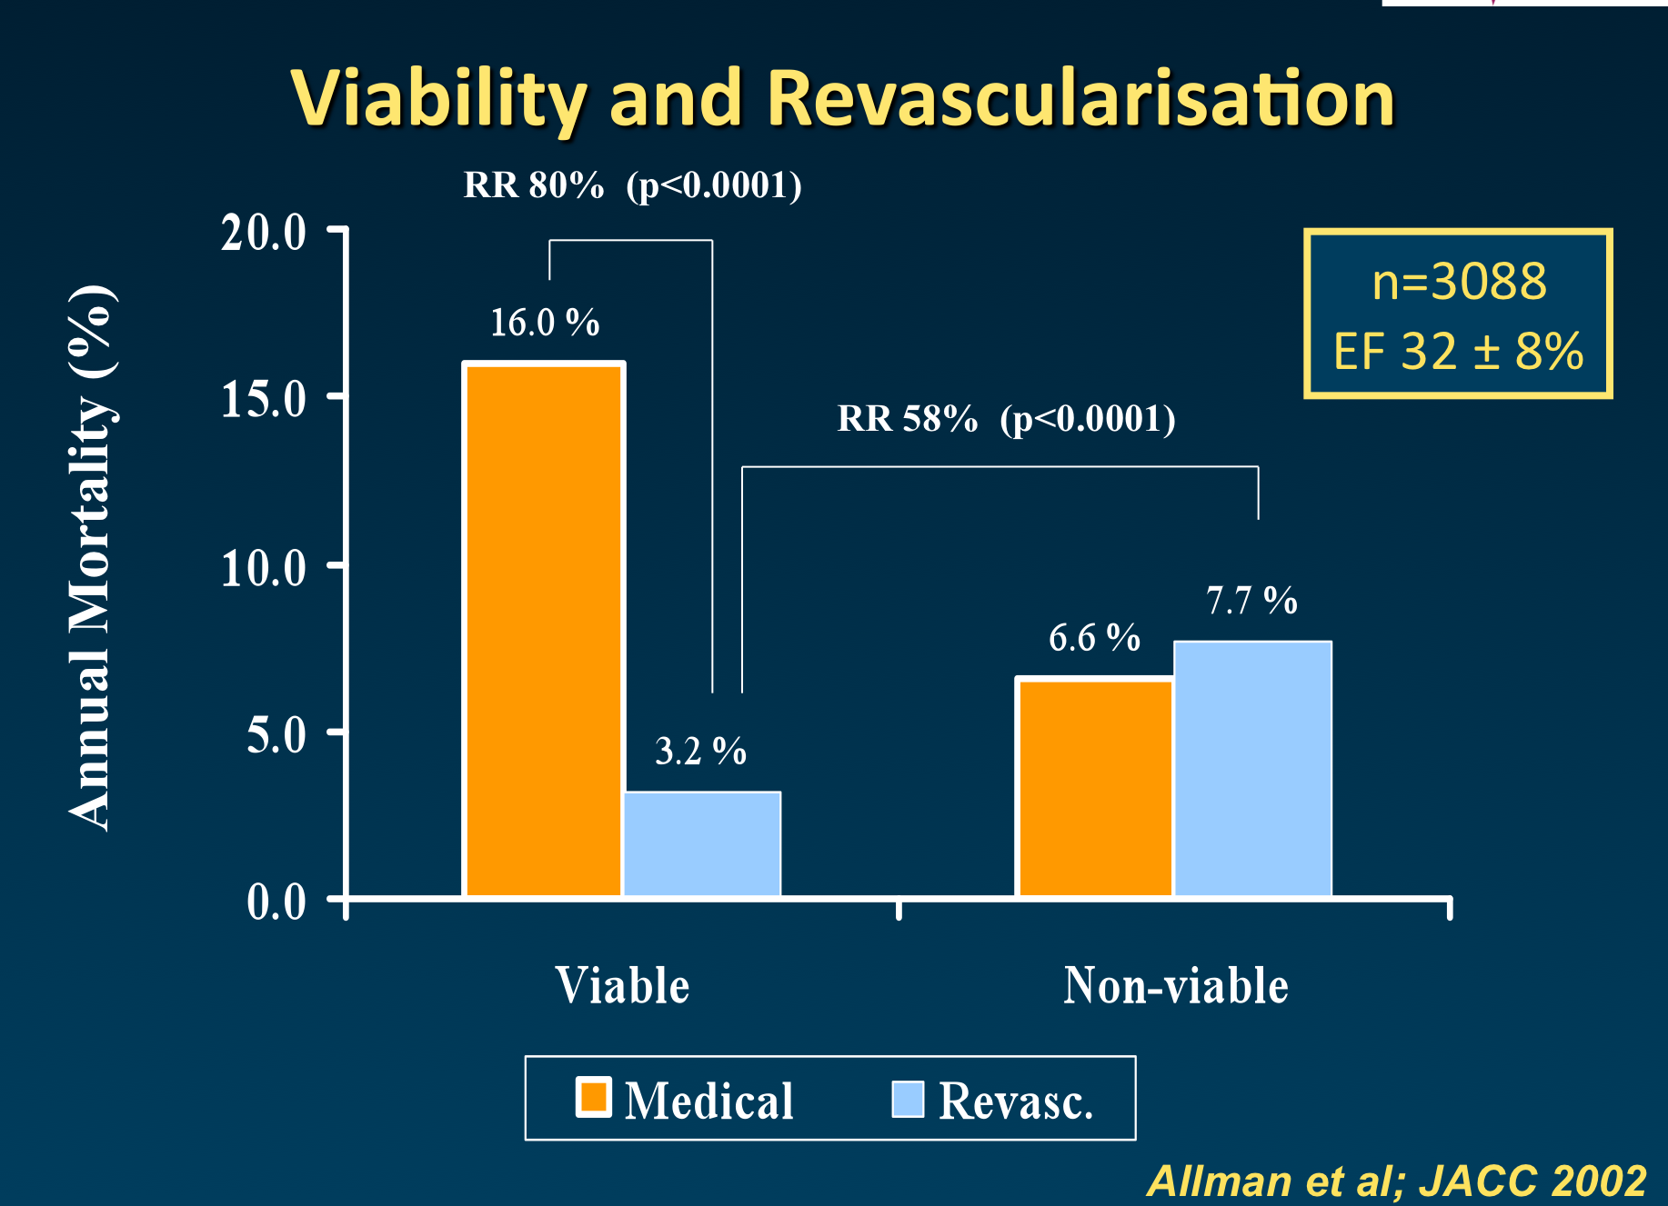
Binary Viability Classification
SPECT/PET/DSE
Observational
Meta-analysis
Allman, Shaw, Hachamovitch, Udelson. JACC 2002

Slide 3
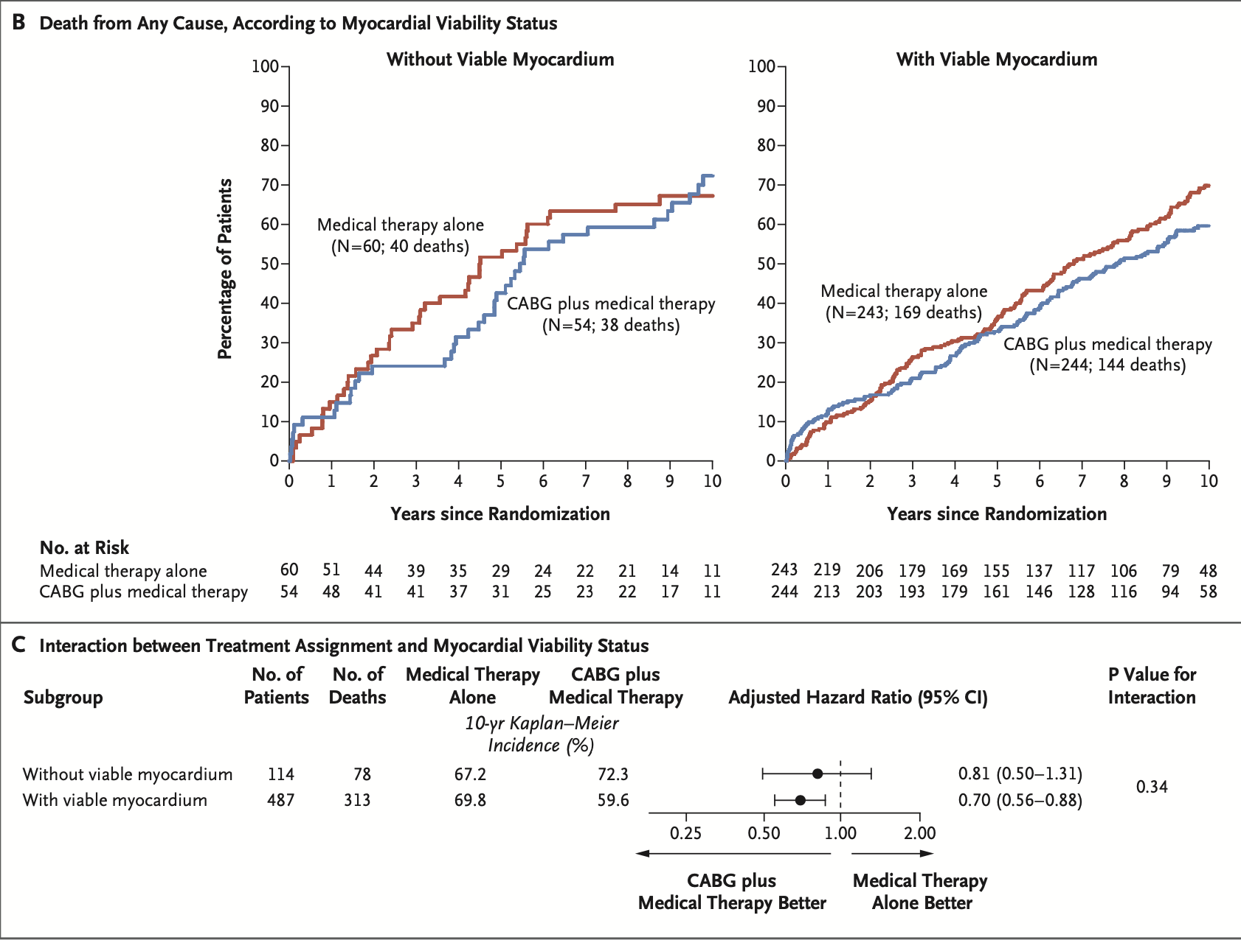
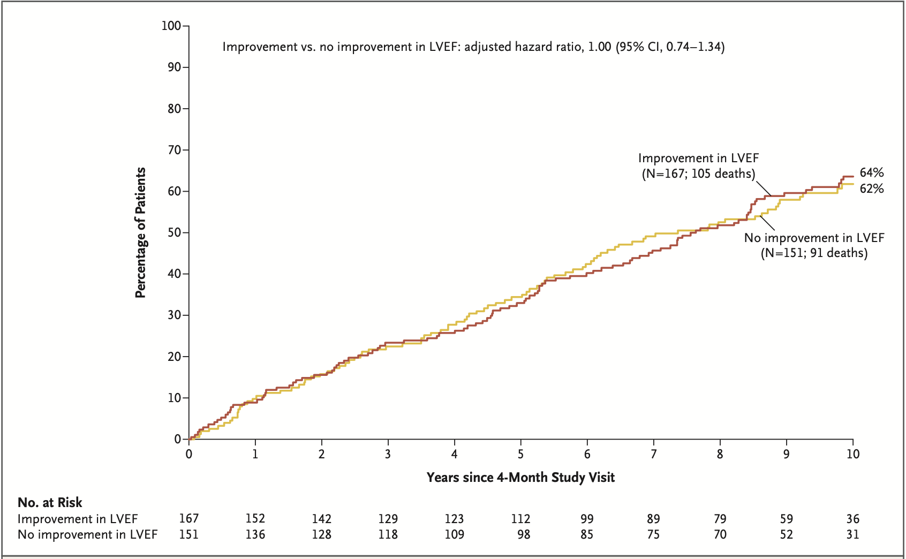
STICH(ES) Viability Study
Binary Viability Classification
SPECT/DSE
Discretionary Testing
Bonow et al NEJM 2011; Panza et al NEJM 2019

Slide 4
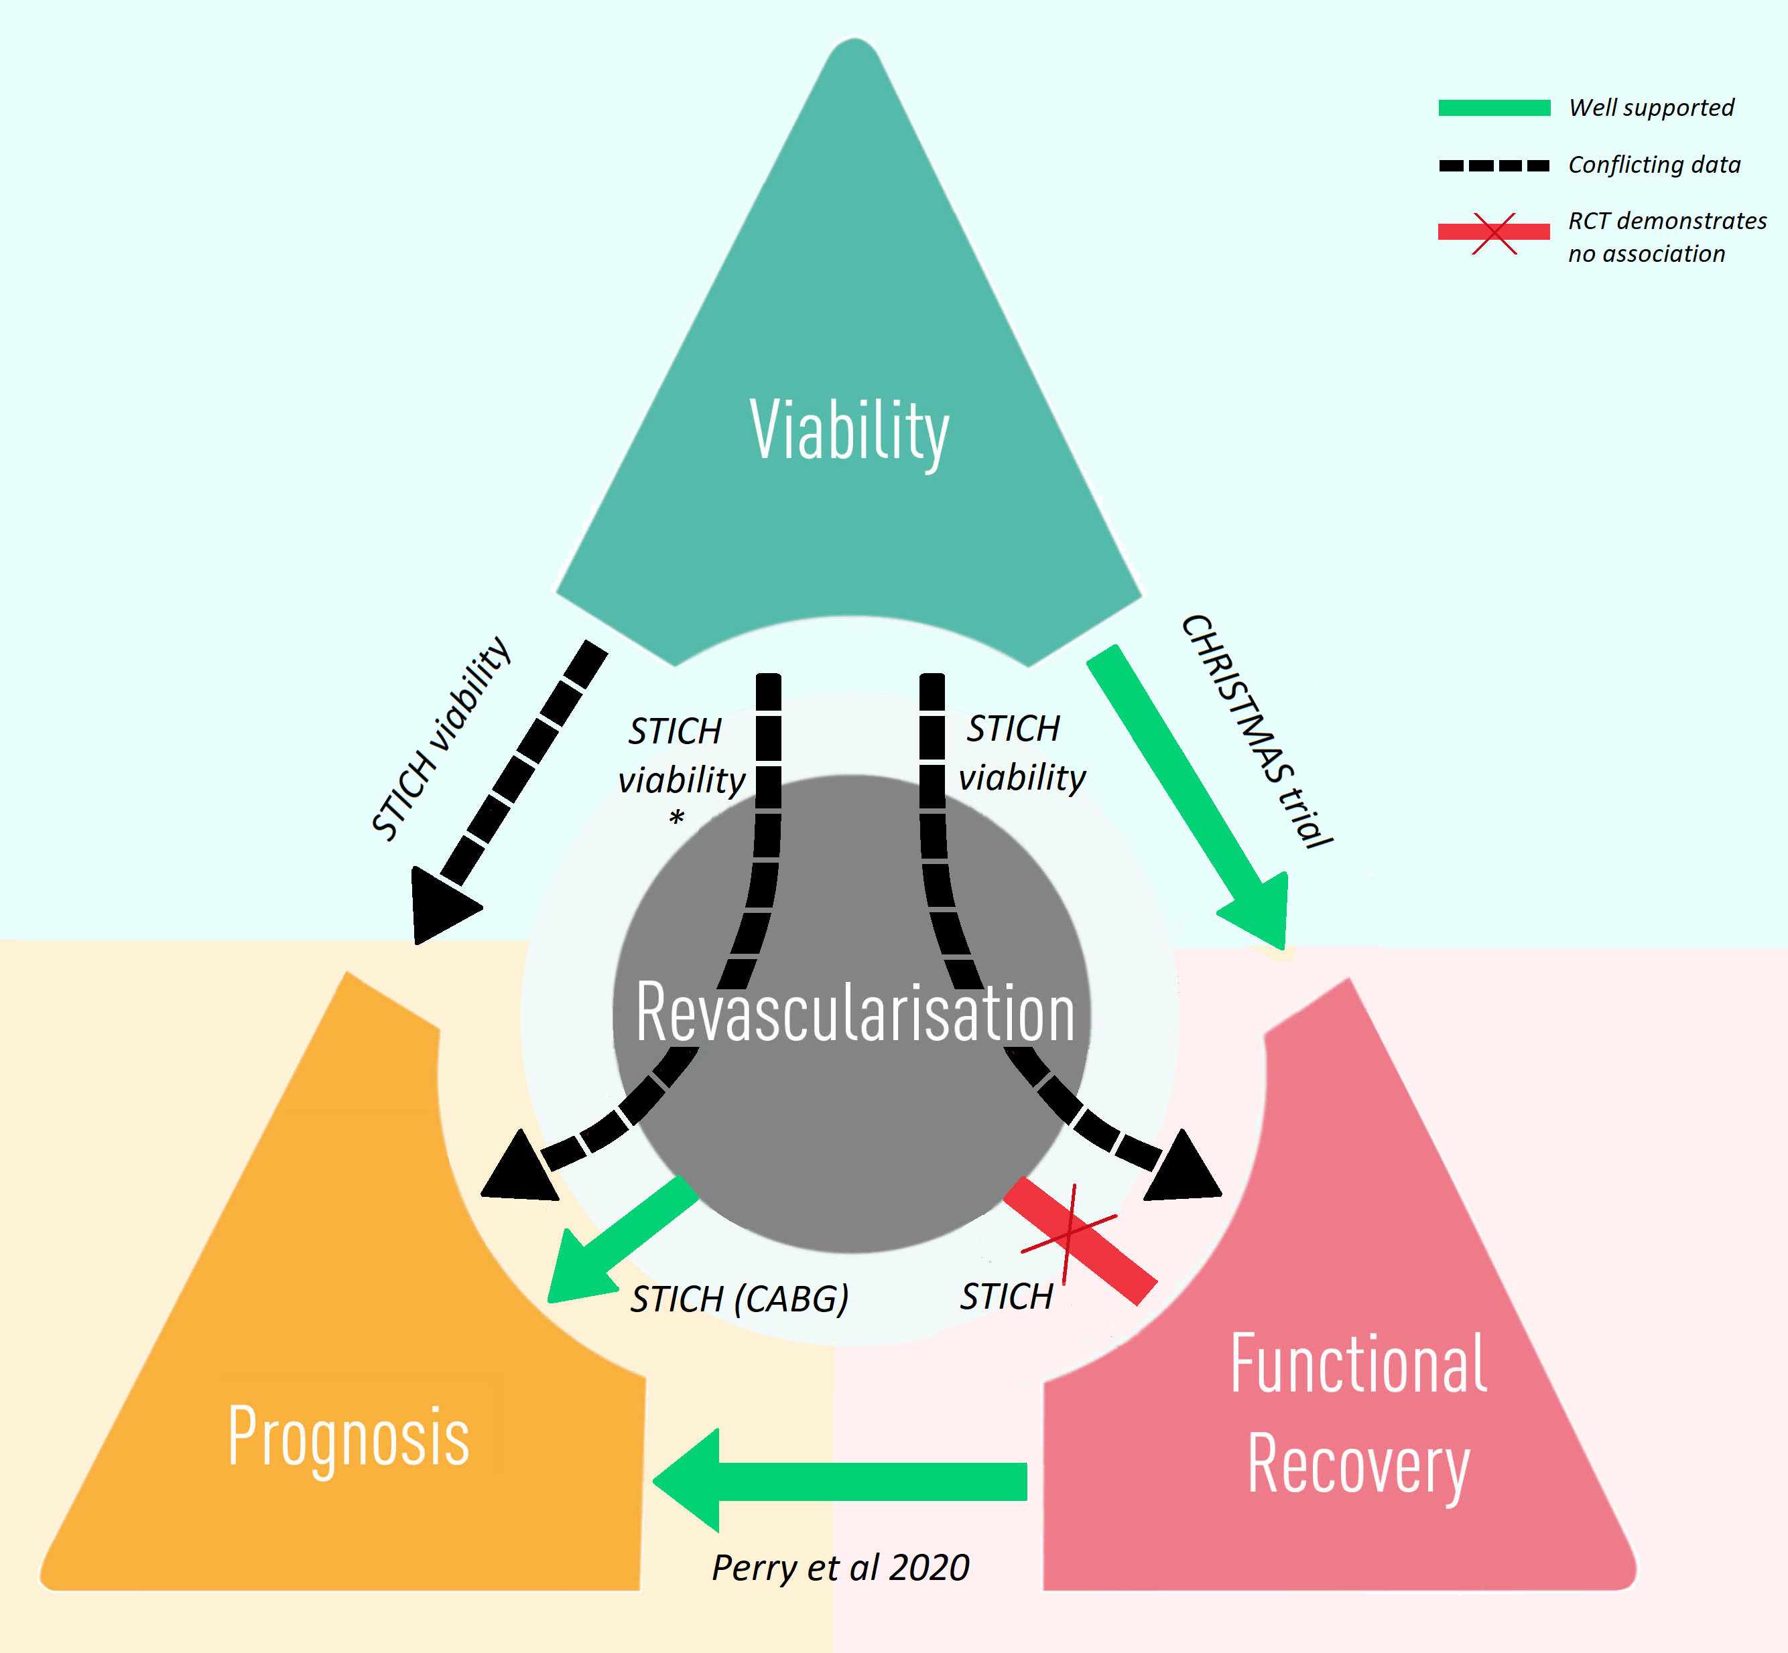
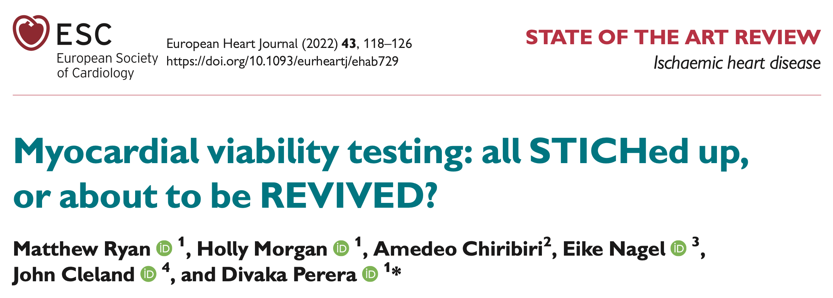

Slide 5
H1
Hypothesis 1
Viability characterization predicts
event-free survival

Slide 6
H1
H2
Hypothesis 2
Viability characterization predicts
left ventricular recovery

Slide 7
H1
H2
Hypothesis 3
Viability characterization predicts response to
PCI vs OMT
H3

Slide 8
H1
H2
Hypothesis 4
Left ventricular recovery predicts
event-free survival
H3
H4

Slide 9
Scar
Potential for recovery
Viability characterized by continuous variables

Slide 10

Primary Outcome
All-cause death or hospitalisation for heart failure
Major Secondary Outcome
Left ventricular ejection fraction at 6- and 12-months
Perera et al, NEJM 2022: 1351-1360

Slide 11


Viability Characterization
Blinded CMR
Core Laboratory
Director:
Prof Amedeo Chiribiri
Blinded Stress Echo Core Laboratory
Director:
Prof Roxy Senior

Slide 12
610 patients
Viability Characterization: Potential for Recovery
Wall motion
Potential for recovery
Normokinetic
All segments
Dysfunctional-Viable
DSE (CR)
CMR LGE ≤25%
Dysfunctional yet viable myocardium
(% of LV)
Dysfunctional
Non-Viable
DSE (no CR)
CMR LGE >25%

Slide 13
Viability Characterization: Potential for Recovery
Wall motion
Potential for recovery
All Viable Myocardium
Normokinetic
Normal
All segments
+
Dysfunctional-Viable
DSE (CR)
CMR LGE ≤25%
Dysfunctional-Viable
Dysfunctional
(% of LV)
Non-Viable
DSE (no CR)
CMR LGE >25%

Slide 14

Viability Characterization: Scar Burden
478
patients
Wall motion
Segmental scar
0
1 - 25
All segments
Scar Burden
(% of LV)
26 - 50
51 - 75
76 - 100

Slide 15
Statistical considerations
Outcome measures
All-cause death or hospitalization for heart failure
Change in LV EF at 6 months
Binary (≥ median change)
Cox Proportional Hazards
adjusted for
age
sex
diabetes
previous HFH
chronic renal failure
extent of CAD (BCIS-JS)
modality of viability testing
baseline LV ejection fraction

Slide 16

700 underwent randomisation
Randomisation
347 assigned to
PCI + OMT
353 assigned to
OMT only
Viability testing
CMR
n = 246
DSE
n = 91
Other
n = 14
CMR
n = 247
DSE
n = 93
Other
n = 17
Core labs
6 unavailable
4 insufficient quality
24 unavailable
4 had CMR
4 insufficient quality
4 insufficient quality
16 unavailable
3 had CMR
2 insufficient quality
CMR
n = 236
DSE
n = 59
CMR
n = 243
DSE
n = 72
Follow up
Primary outcome in 98.7%
Primary outcome in 100%
Primary outcome in 99.2%
Primary outcome in 100%

Slide 17
Baseline characteristics
 | PCI n=295 | OMT n=315 | All n=610
Age (yrs) | 69.8 (9.1) | 68.8 (8.9) | 69.3 (9.0)
Female sex | 37 (12.5) | 38 (12.1) | 75 (12.3)
Diabetes | 116 (39.3) | 134 (42.5) | 250 (41.0)
BCIS jeopardy score | 10 [8, 12] | 10 [8, 12] | 10 [8, 12]
Left ventricular ejection fraction (%) | 32.0 (9.9) | 32.0 (9.7) | 32.0 (9.8)
Viability test CMR DSE | 236 (80.0) 59 (20.0) | 243 (77.1) 72 (22.9) | 479 (78.5) 131 (21.5)
Normal segments | 6 [4, 9] | 6 [4, 9] | 6 [4, 9]
Dysfunctional-Viable segments | 5 [3, 9] | 5 [2, 8] | 5 [2, 8]
Non-viable segments | 5 [2, 7] | 5 [2, 7] | 5 [2, 7]

Slide 18
Death or HHF by viability characterization
All-Viable Myocardium
HR 0.93 (CI 0.87 to 1.00)*
p=0.048 (adjusted)
Dysfunctional-Viable Myocardium
HR 0.98 (CI 0.93 to 1.04)*
p=0.56 (adjusted)
*per 10% increase in volume

Slide 19
Death or HHF by scar burden
Scar burden
HR 1.18 (CI 1.04 to 1.33)
p=0.009 (adjusted)
per 10% increase in scar volume

Slide 20
Treatment effect by viability characterization

Slide 21
Treatment effect by viability characterization
Adjusted hazard ratio 0.98 (0.61 to 1.59)
Adjusted hazard ratio 0.83 (0.54 to 1.28)
Adjusted hazard ratio 1.28 (0.79 to 2.10)
p for interaction = 0.43

Slide 22
Left ventricular recovery by viability characterization
Binary LV recovery: ≥ median change (4.7% EF)

Slide 23
Treatment effect by viability characterization

Slide 24
Death or HHF by LV recovery
HR 0.62 (0.41 to 0.95)
p=0.029 (adjusted)
Graph only includes patients with paired baseline and 6-month
corelab-analyzed echocardiograms
(without imputation)

Slide 25
Conclusions
PCI does not improve prognosis or LV recovery in ischemic cardiomyopathy, compared to OMT alone, regardless of viability characteristics at baseline
✅
✅
Scar burden predicts prognosis and likelihood of
LV recovery in ischemic cardiomyopathy
independent of baseline LVEF or extent of CAD
❌
❌
The abundance of dysfunctional-yet-viable segments was not associated with
prognosis or likelihood of LV recovery
✅
@divaka_perera | @REVIVED_BCIS2

Slide 26



THANK YOU
CORE LABS
CMR
DSE
Echo
@divaka_perera | @REVIVED_BCIS2

