Slide 1
The CLEAR Outcomes Trial
Cholesterol Lowering via Bempedoic Acid, an ACL-Inhibiting Regimen
Steven E. Nissen MD MACC
On behalf of the CLEAR investigators and our extraordinary patients
Study Sponsor:
Esperion Therapeutics, Inc.

Slide 2
Executive Committee
Steven E. Nissen (Study Chair)
A Michael Lincoff
Co-Principal Investigator
John J.P. Kastelein
Paul D. Thompson
Leslie Cho
Harold E. Bays
Jorge Plutzky
Stephen Nicholls
Co-Principal Investigator
Kausik K. Ray
Peter Libby
Patrick M. Moriarty
Michael J. Louie (non-voting)
Diederick E. Grobbee Denise Mason Maggie Horner & LeAnne Bloedon
European ARO Partner C5Research Lead Project Manager Esperion Lead Managers

Slide 3
Background
Statin intolerance is a vexing problem that prevents many patients from achieving LDL-C levels associated with cardiovascular benefits.
Bempedoic acid, an ATP citrate lyase inhibitor, inhibits hepatic cholesterol synthesis upstream of HMG-Co-A reductase, the enzyme inhibited by statins.
Bempedoic acid is a pro-drug activated in the liver, but not peripheral tissues, resulting in a low incidence of muscle-related adverse events.
Although approved for lowering LDL-C, the effects of bempedoic acid on cardiovascular outcomes has not been assessed .

Slide 4
CLEAR Outcomes Trial Design
Statin intolerance: An adverse effect that started or increased during statin therapy and resolved or improved after therapy discontinued.
Intolerance to 2 or more statins or 1 statin if unwilling to attempt a second statin or advised by physician to not attempt second statin. Very low dose statin therapy permitted (< lowest approved dose).
≥1,620 primary 4-component MACE
≥810 key secondary 3-component MACE
≥24 months follow up
Bempedoic Acid 180 mg/day
Primary or secondary prevention patients with LDL-C ≥ 100 mg/dL
4
Matching Placebo

Slide 5
Statin Intolerance Confirmation Form
Patient must confirm and sign:
“…I can’t tolerate these medications (called statins) even though I know they would reduce my risk of a heart attack or stroke or death. My doctor has explained and I am aware that many patients who are unable to tolerate a single statin medication may also be able to tolerate a different statin or dose.”
Signed provider statement:
“…in my opinion, this patient is unable to tolerate statin therapy (except possibly at very low average daily doses)….based on my review of the medical and medication histories and discussion with the patient."

Slide 6
Primary and Key Secondary Endpoints
Primary endpoint 4-component MACE: nonfatal MI, nonfatal stroke, coronary revascularization or cardiovascular death
Hierarchical testing of key secondary endpoints:
3-component MACE (MI, stroke or CV death)
Fatal and nonfatal MI
Coronary revascularization
Fatal and nonfatal stroke
Cardiovascular death
All-cause mortality
Sequential Testing

Slide 7
Study Milestones
13,970 patients randomized at 1250 sites in 32 countries.
Patients enrolled December 2016 to August 2019 with a median duration of follow-up 40.6 months.
Despite the pandemic, complete assessment for the primary endpoint in 95.3% and vital status in 99.4% of patients.
4-component MACE occurred in 1746 patients and 3-component MACE in 1238 patients.

Slide 8
Selected Baseline Characteristics
Characteristic | Bempedoic Acid N=6992 | Placebo N=6978
Mean Age (years) | 65.5 | 65.5
Female sex | 48.1% | 48.4%
White | 91.5% | 90.8%
LDL cholesterol (mg/dL) | 139.0 | 139.0
HDL cholesterol (mg/dL) | 49.6 | 49.4
hsCRP (mg/L) | 2.3 | 2.3
High Risk Primary Prevention | 30.0% | 30.2%
Secondary Prevention | 70.0% | 69.8%
Diabetes | 45.0% | 46.3%
Baseline statin use | 22.9% | 22.5%

Slide 9
Effect of Trial Regimens on LDL-C and hsCRP
3

Slide 10
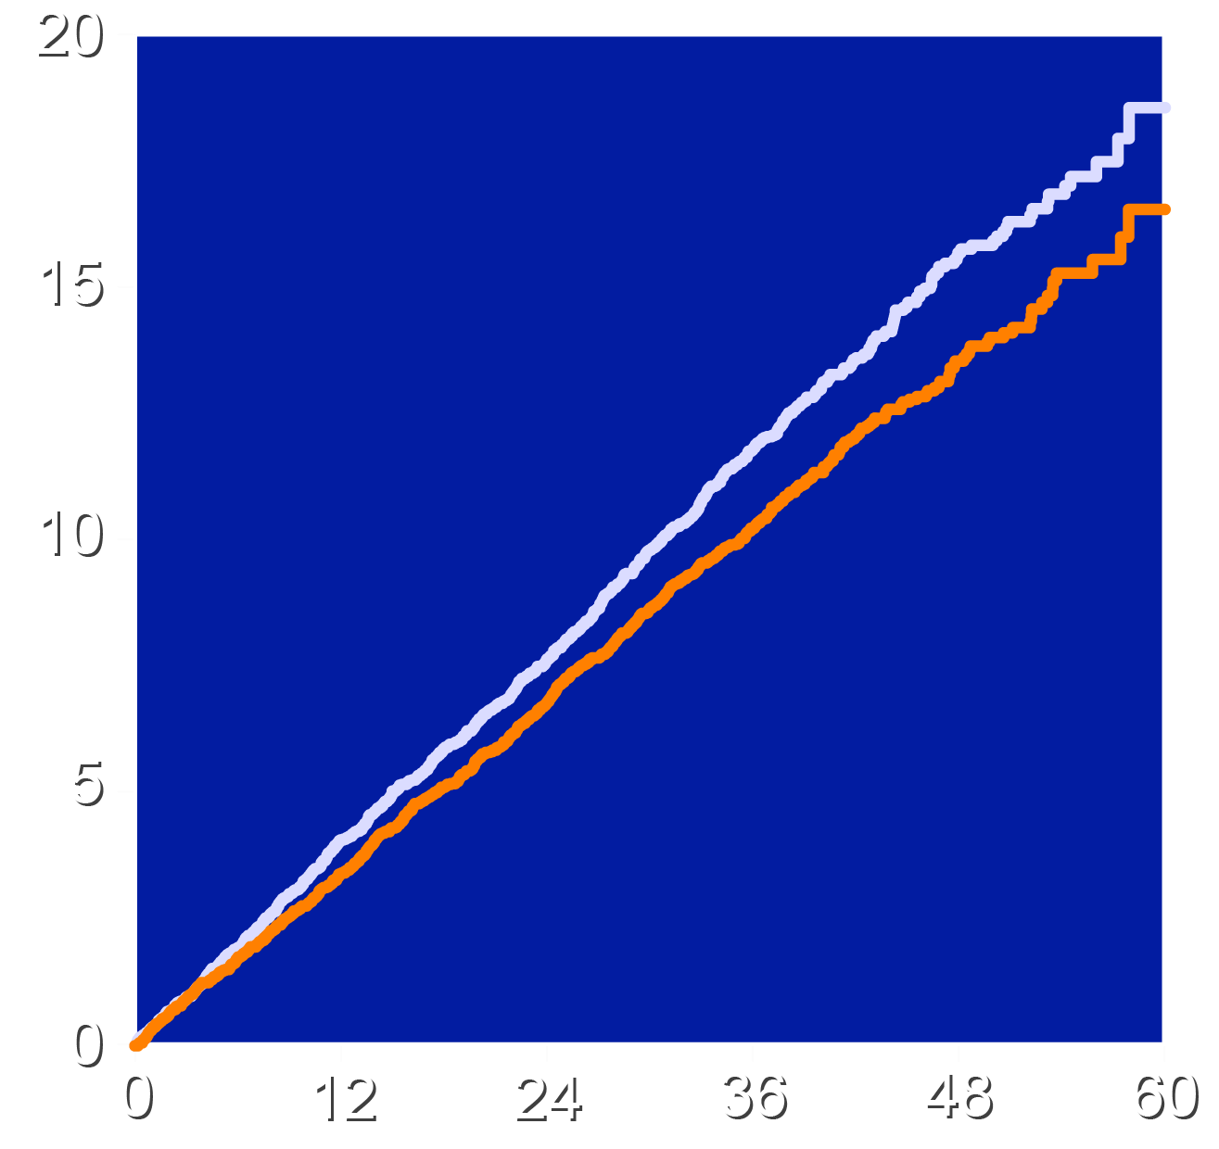
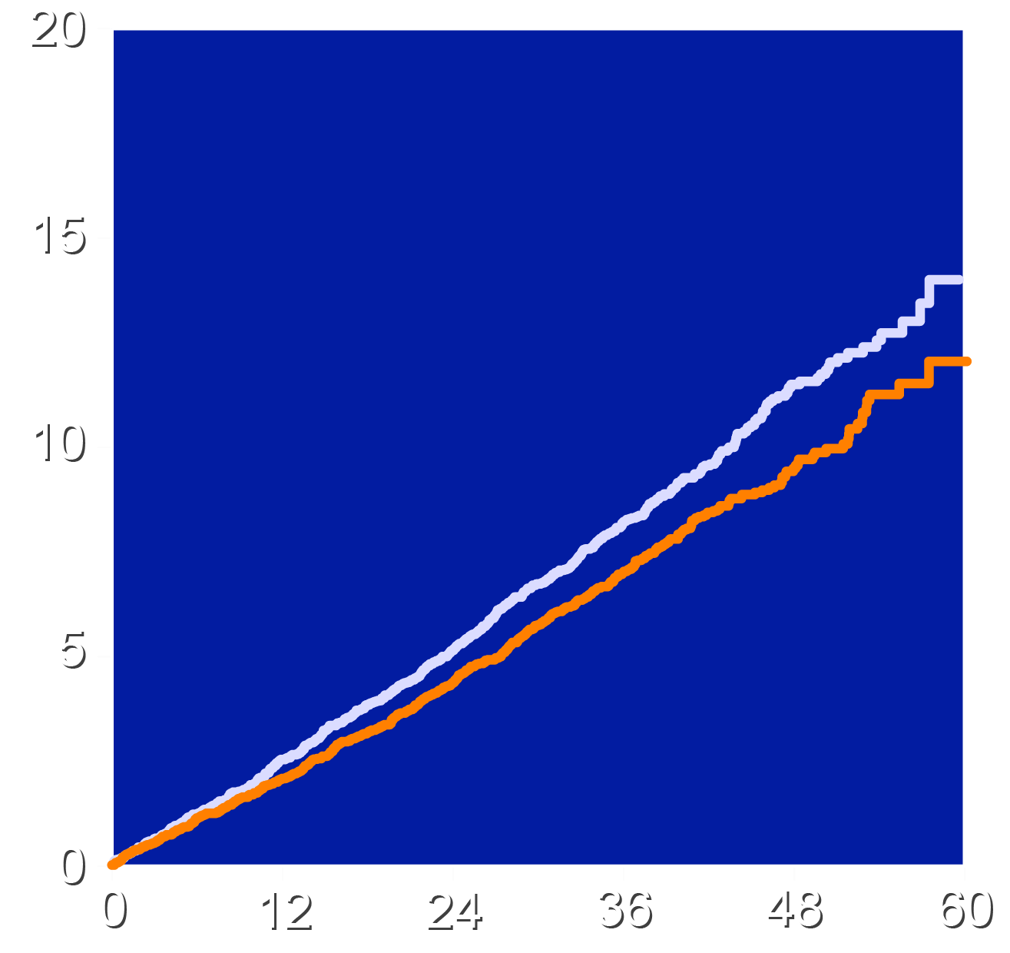
Primary and First Key Secondary Cardiovascular End Points
4-component MACE
3-component MACE
HR 0.87 (95% CI 0.79-0.96)
P=0.004
Absolute risk reduction 1.6%
NNT=63
HR 0.85 (95% CI 0.76-0.96)
P=0.006
Absolute risk reduction 1.3%
Patients with an Event (%)
Patients with an Event (%)
Placebo
Bempedoic Acid
Placebo
Bempedoic Acid
Months Since Randomization
Months Since Randomization

Slide 11
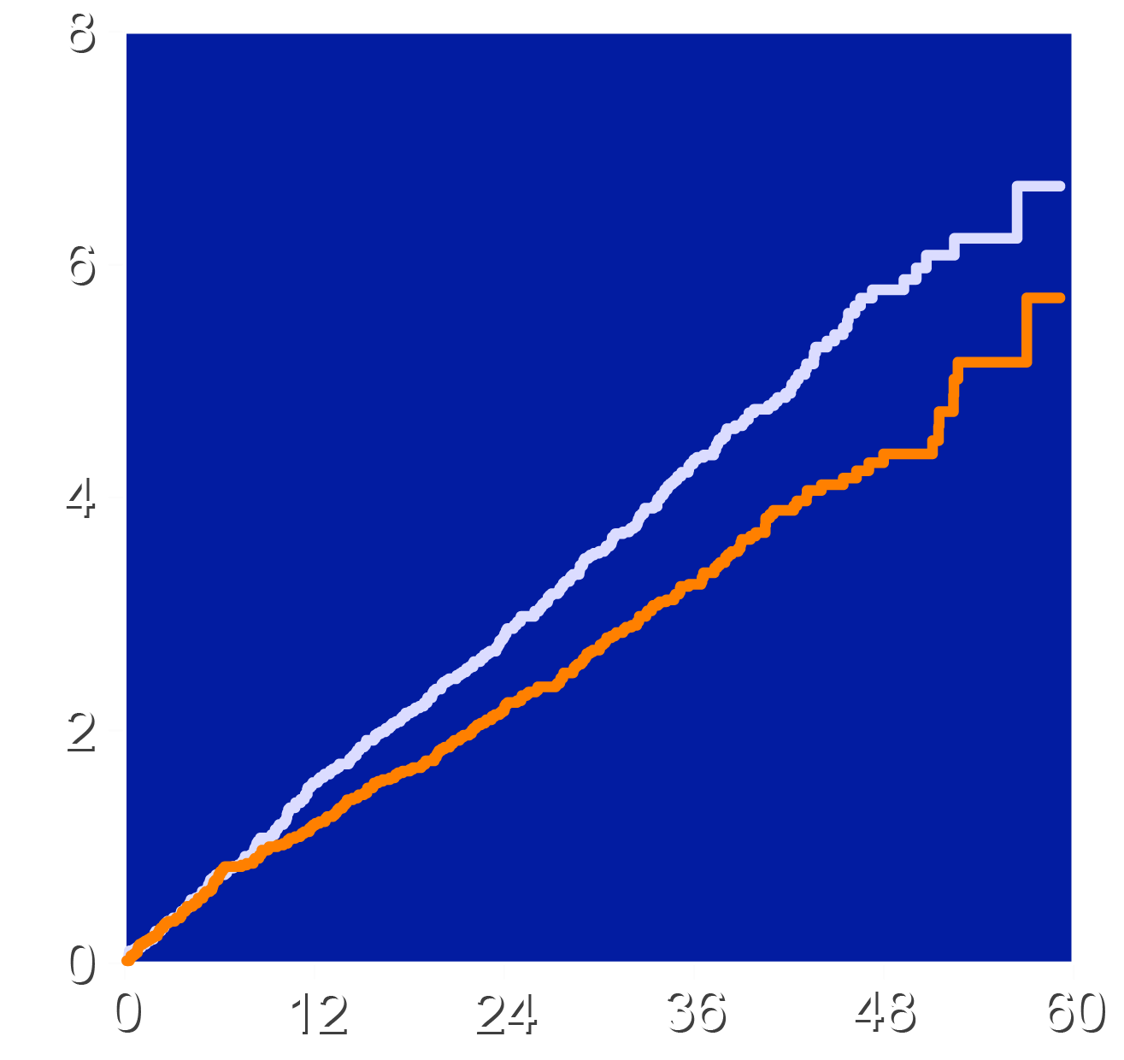
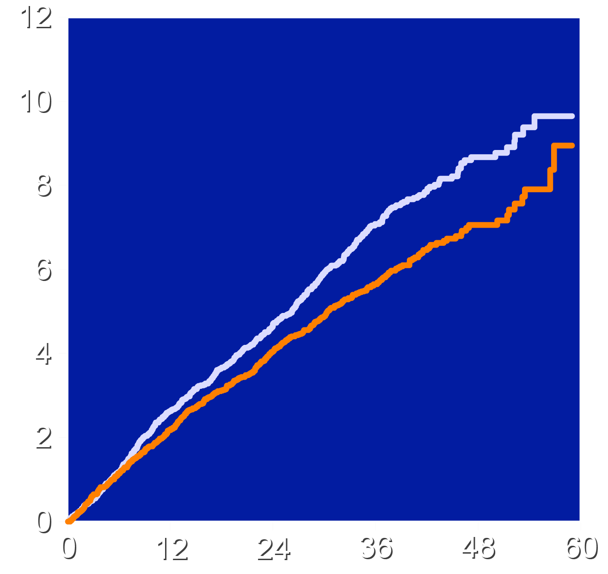
Key Secondary End Point: MI and Coronary Revascularization
Fatal and Nonfatal MI
Coronary Revascularization
HR 0.77 (95% CI 0.66-0.91)
P=0.002
Absolute risk reduction 1.1%
HR 0.81 (95% CI 0.72-0.92)
P=0.001
Absolute risk reduction 1.4%
Patients with an Event (%)
Patients with an Event (%)
Placebo
Bempedoic Acid
Placebo
Bempedoic Acid
Months Since Randomization
Months Since Randomization

Slide 12
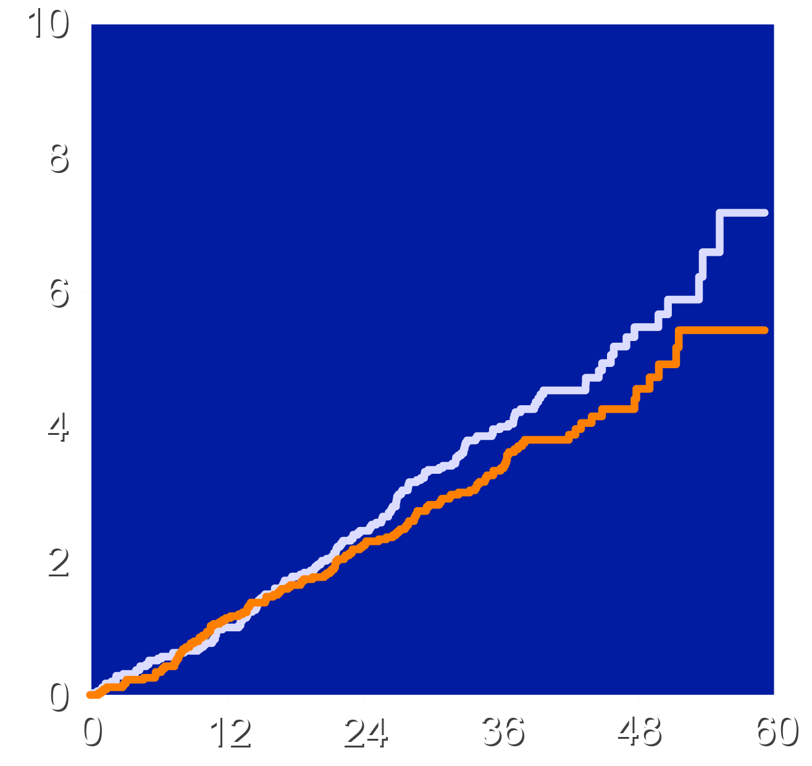
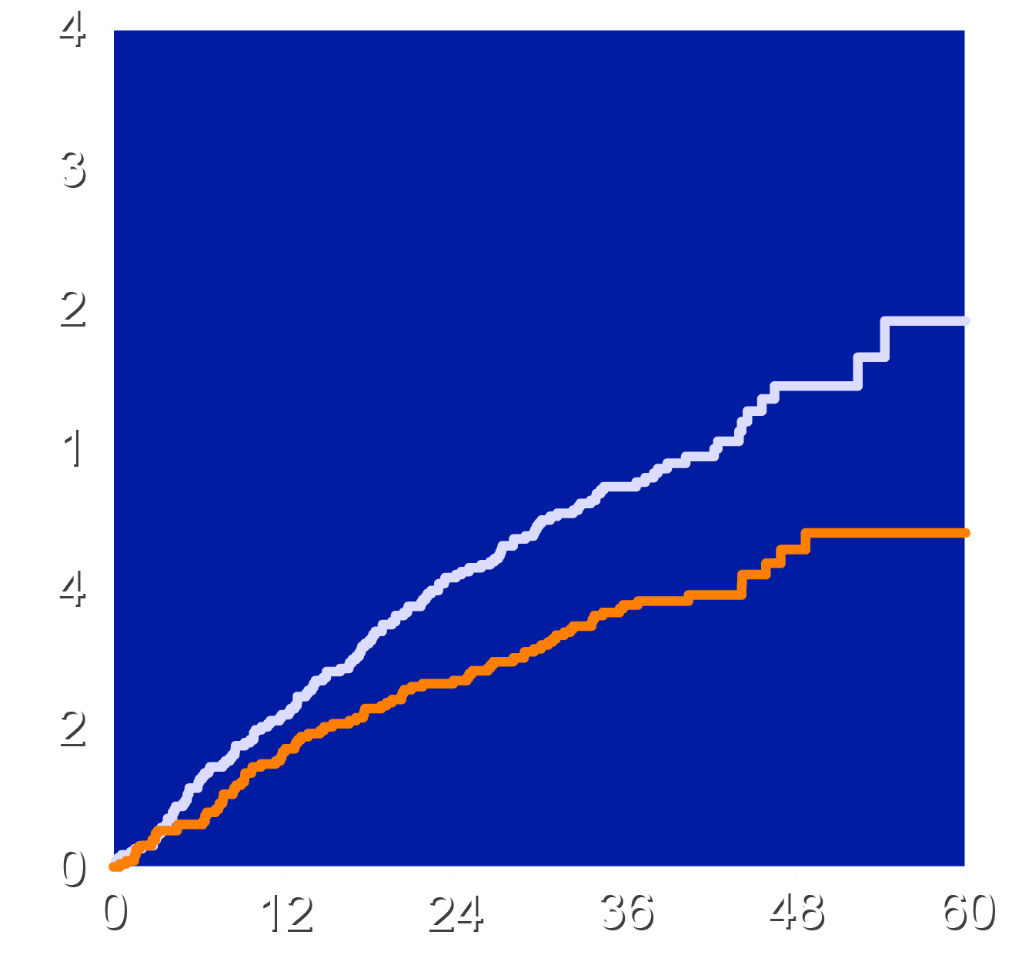
Effect on Stroke and Hospitalization for Unstable Angina
Fatal and Nonfatal Stroke
Hospitalization for Unstable Angina
HR 0.85 (95% CI 0.67-1.07)
HR = 0.66 (95% CI 0.50 – 0.86)
Patients with an Event (%)
Patients with an Event (%)
Placebo
Bempedoic Acid
Placebo
Bempedoic Acid
Months Since Randomization
Months Since Randomization

Slide 13
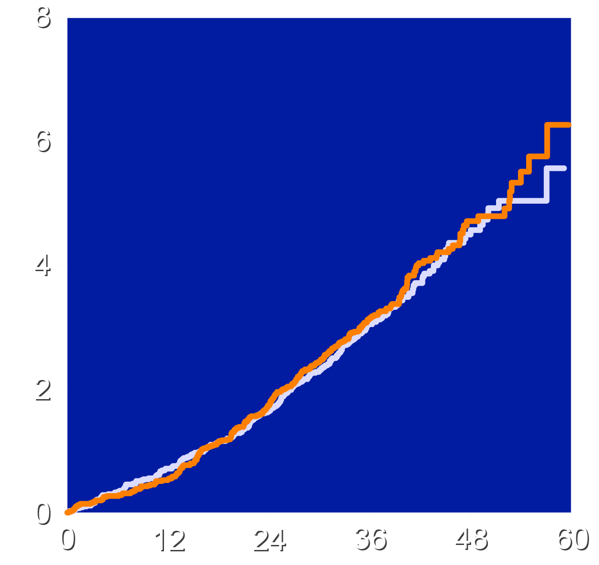
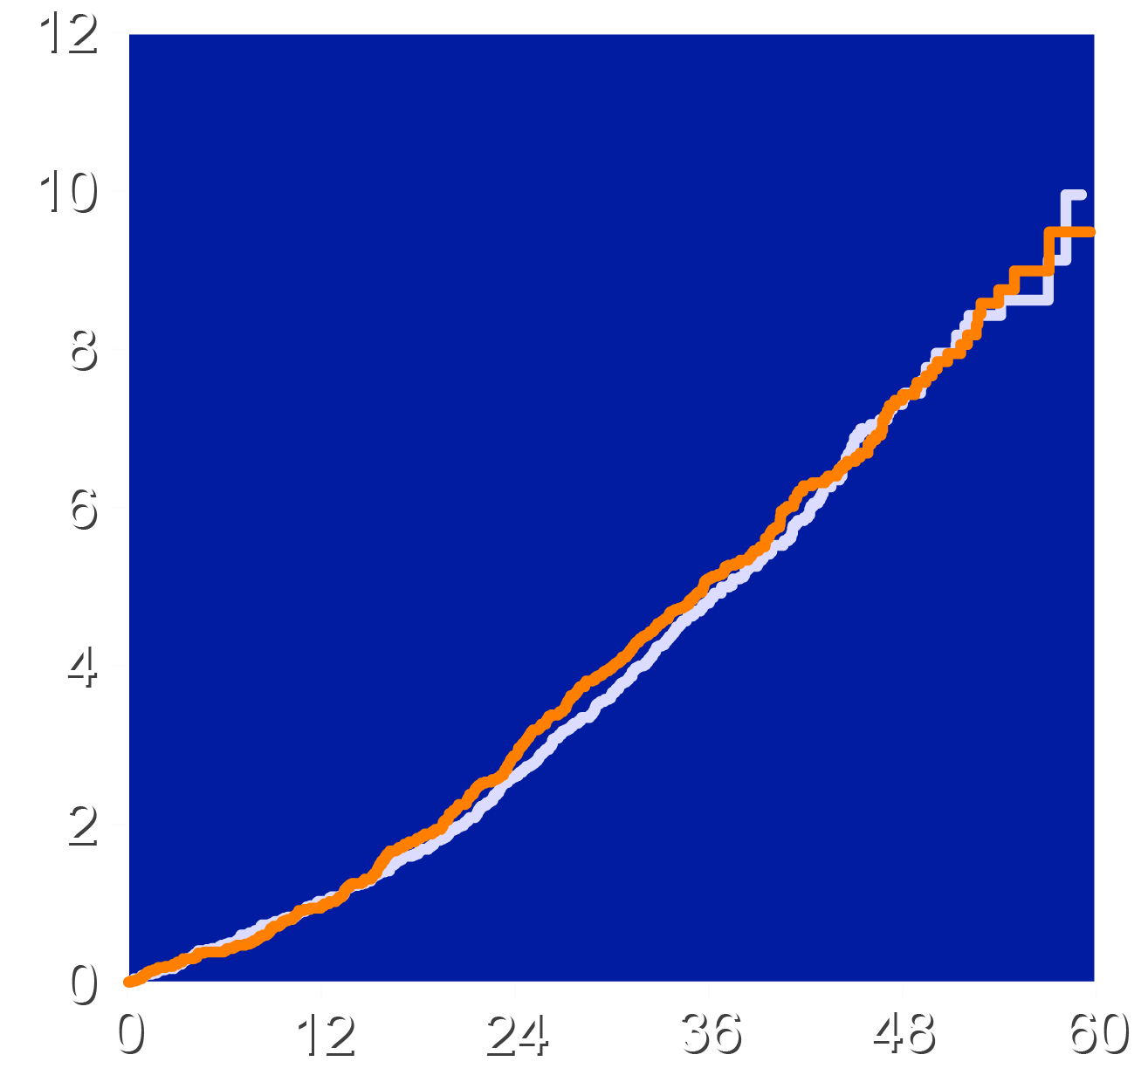
Effects of Trial Regimens on Mortality End Points
Cardiovascular Death
All-cause Mortality
HR 1.04 (95% CI 0.88-1.24)
HR 1.03 (95% CI 0.90-1.18)
HR 1.03 (95% CI 0.90-1.18)
Patients with an Event (%)
Patients with an Event (%)
Placebo
Bempedoic Acid
Placebo
Bempedoic Acid
Months Since Randomization
Months Since Randomization

Slide 14
Investigator-Reported Adverse Effects
Characteristic | Bempedoic Acid N=7001 | Placebo N=6964
Serious Treatment Emergent Adverse event | 25.2% | 24.9%
Adverse event leading to drug discontinuation | 10.8% | 10.4%
Any muscle disorder | 15.0% | 15.4%
New onset diabetes | 16.1% | 17.1%
Elevated hepatic enzymes | 4.5% | 3.0%
Prespecified renal events | 11.5% | 8.6%
Gout | 3.1% | 2.1%
Cholelithiasis | 2.2% | 1.2%
Adjudicated tendon rupture | 1.2% | 0.9%

Slide 15
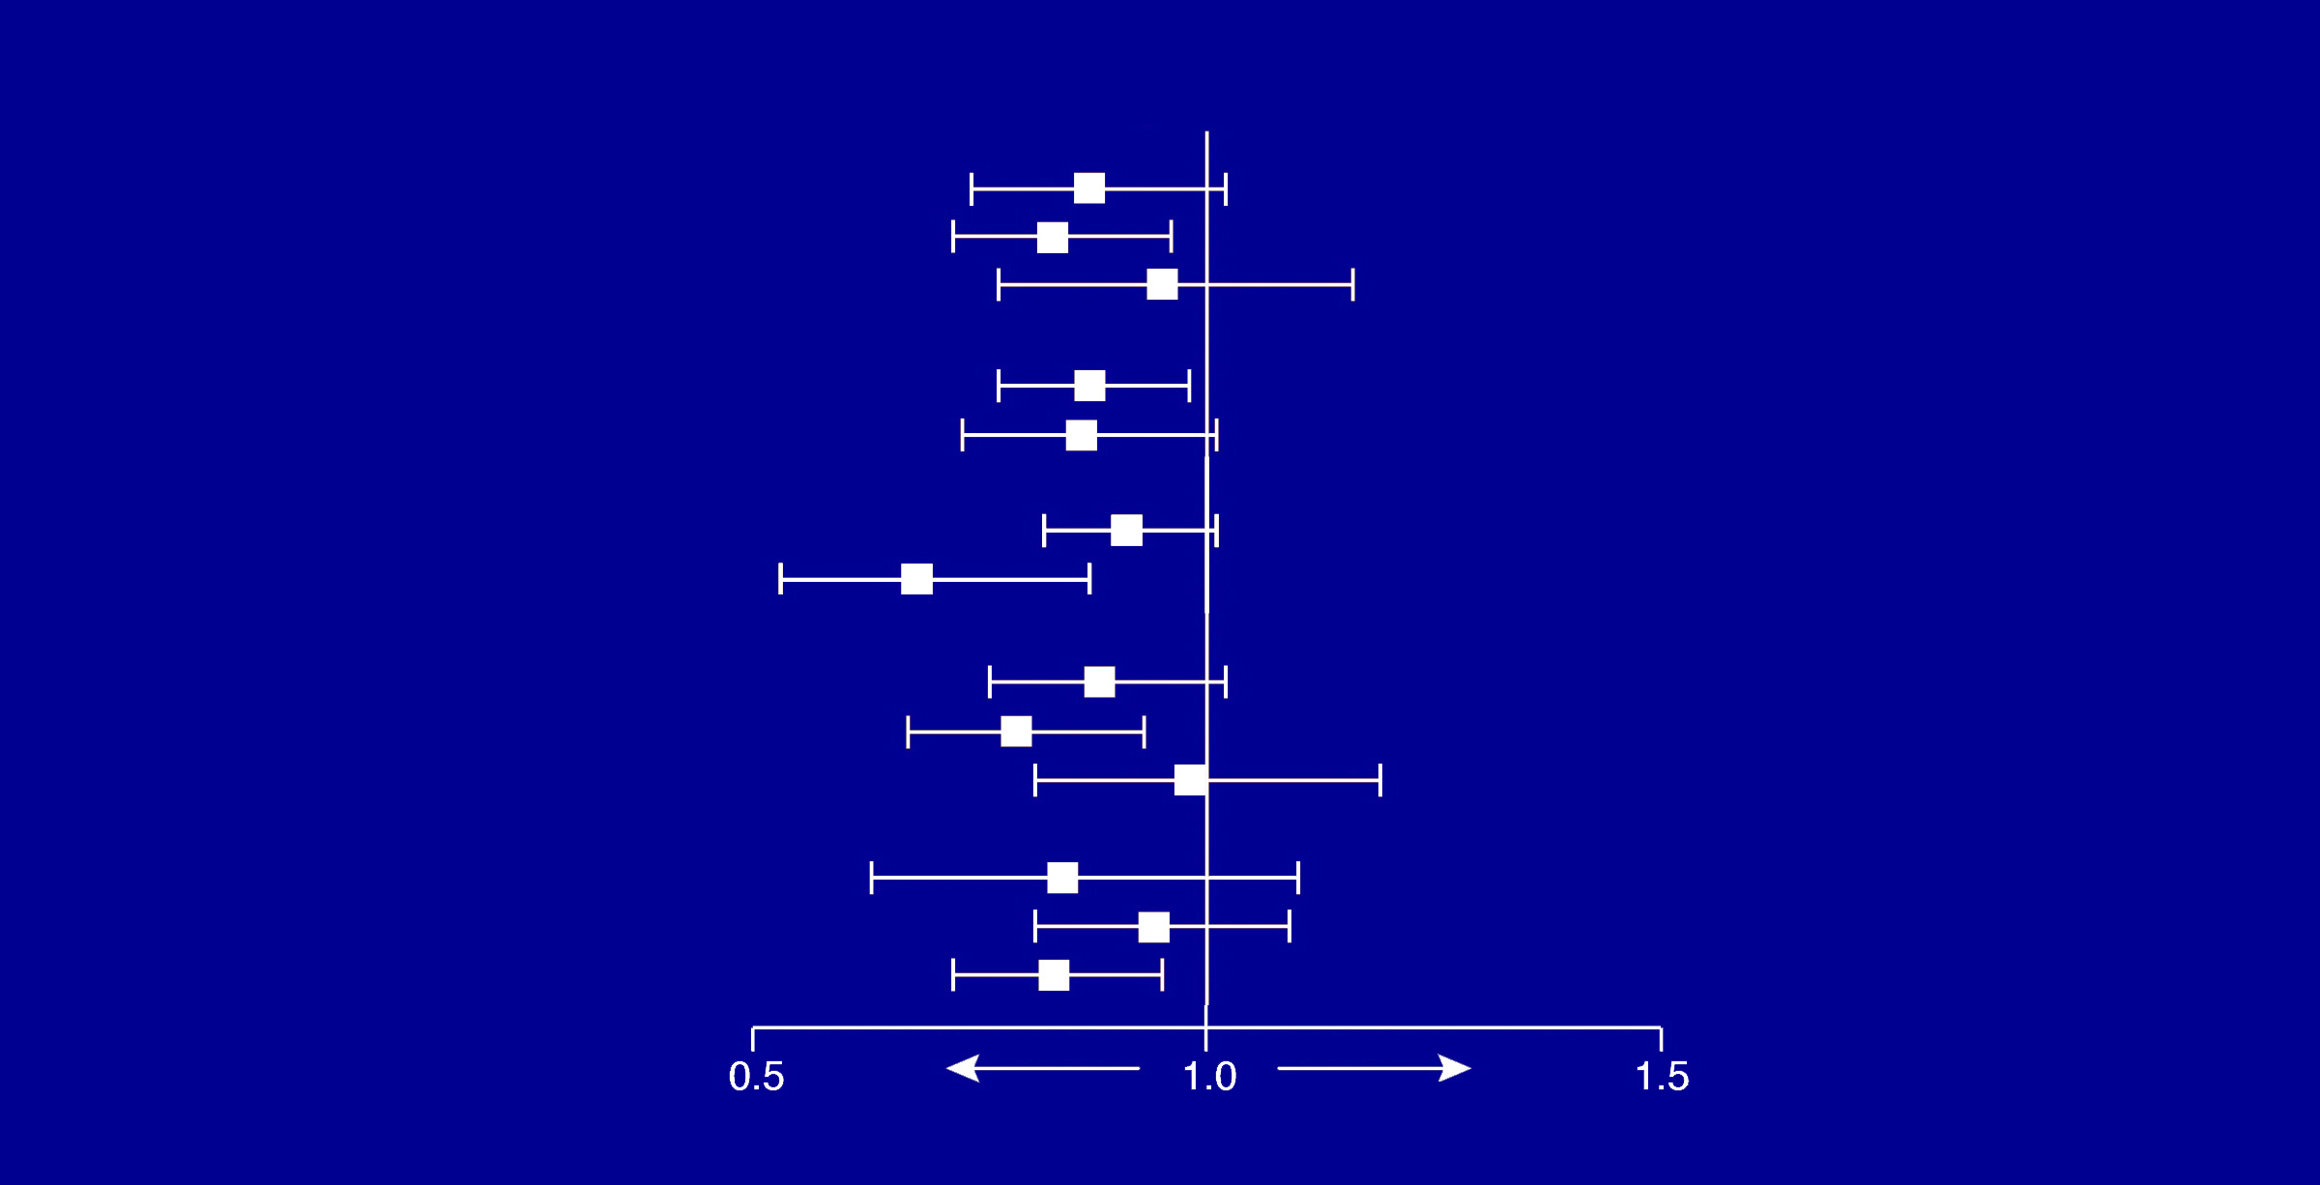
Primary MACE-4 End Point in Selected Subgroups
Endpoints
Age <65 ≥65 to <75 >75
Sex
Male
Female
CVD Risk Category
Secondary Prevention
Primary Prevention
Baseline LDL-C
<130
≥130 to <160
≥160
Baseline glycemic status
Normoglycemic
Prediabetes
Diabetes
Hazard Ratio
0.87 0.83 0.95
0.87
0.86
0.91
0.68
0.88
0.79
0.98
0.84
0.94
0.83
Favors Treatment
Favors Placebo

Slide 16
Limitations
The trial enrolled only patients with documented statin intolerance. Effects in other populations were not studied.
Addition of other therapies (including PCSK9 inhibitors) narrowed the LDL-C differences between bempedoic acid and placebo over time.
The pandemic created challenges in achieving complete follow up, although full outcome data were available in 95.3% of patients and vital status determined in 99.4%.

Slide 17
Conclusions
Bempedoic acid was well-tolerated in a mixed population of primary and secondary prevention patients unable or unwilling to take statins
Bempedoic acid lowered LDL-C by 21.7% and hsCRP by 22.2% with small increases in the incidence of gout and cholelithiasis.
The primary end point, 4-component MACE was reduced 13%, 3-component MACE 15%, myocardial infarction 23% and coronary revascularization 19%.
These findings establish bempedoic acid as an effective approach to reduce major cardiovascular events in statin intolerant patients.

Slide 18
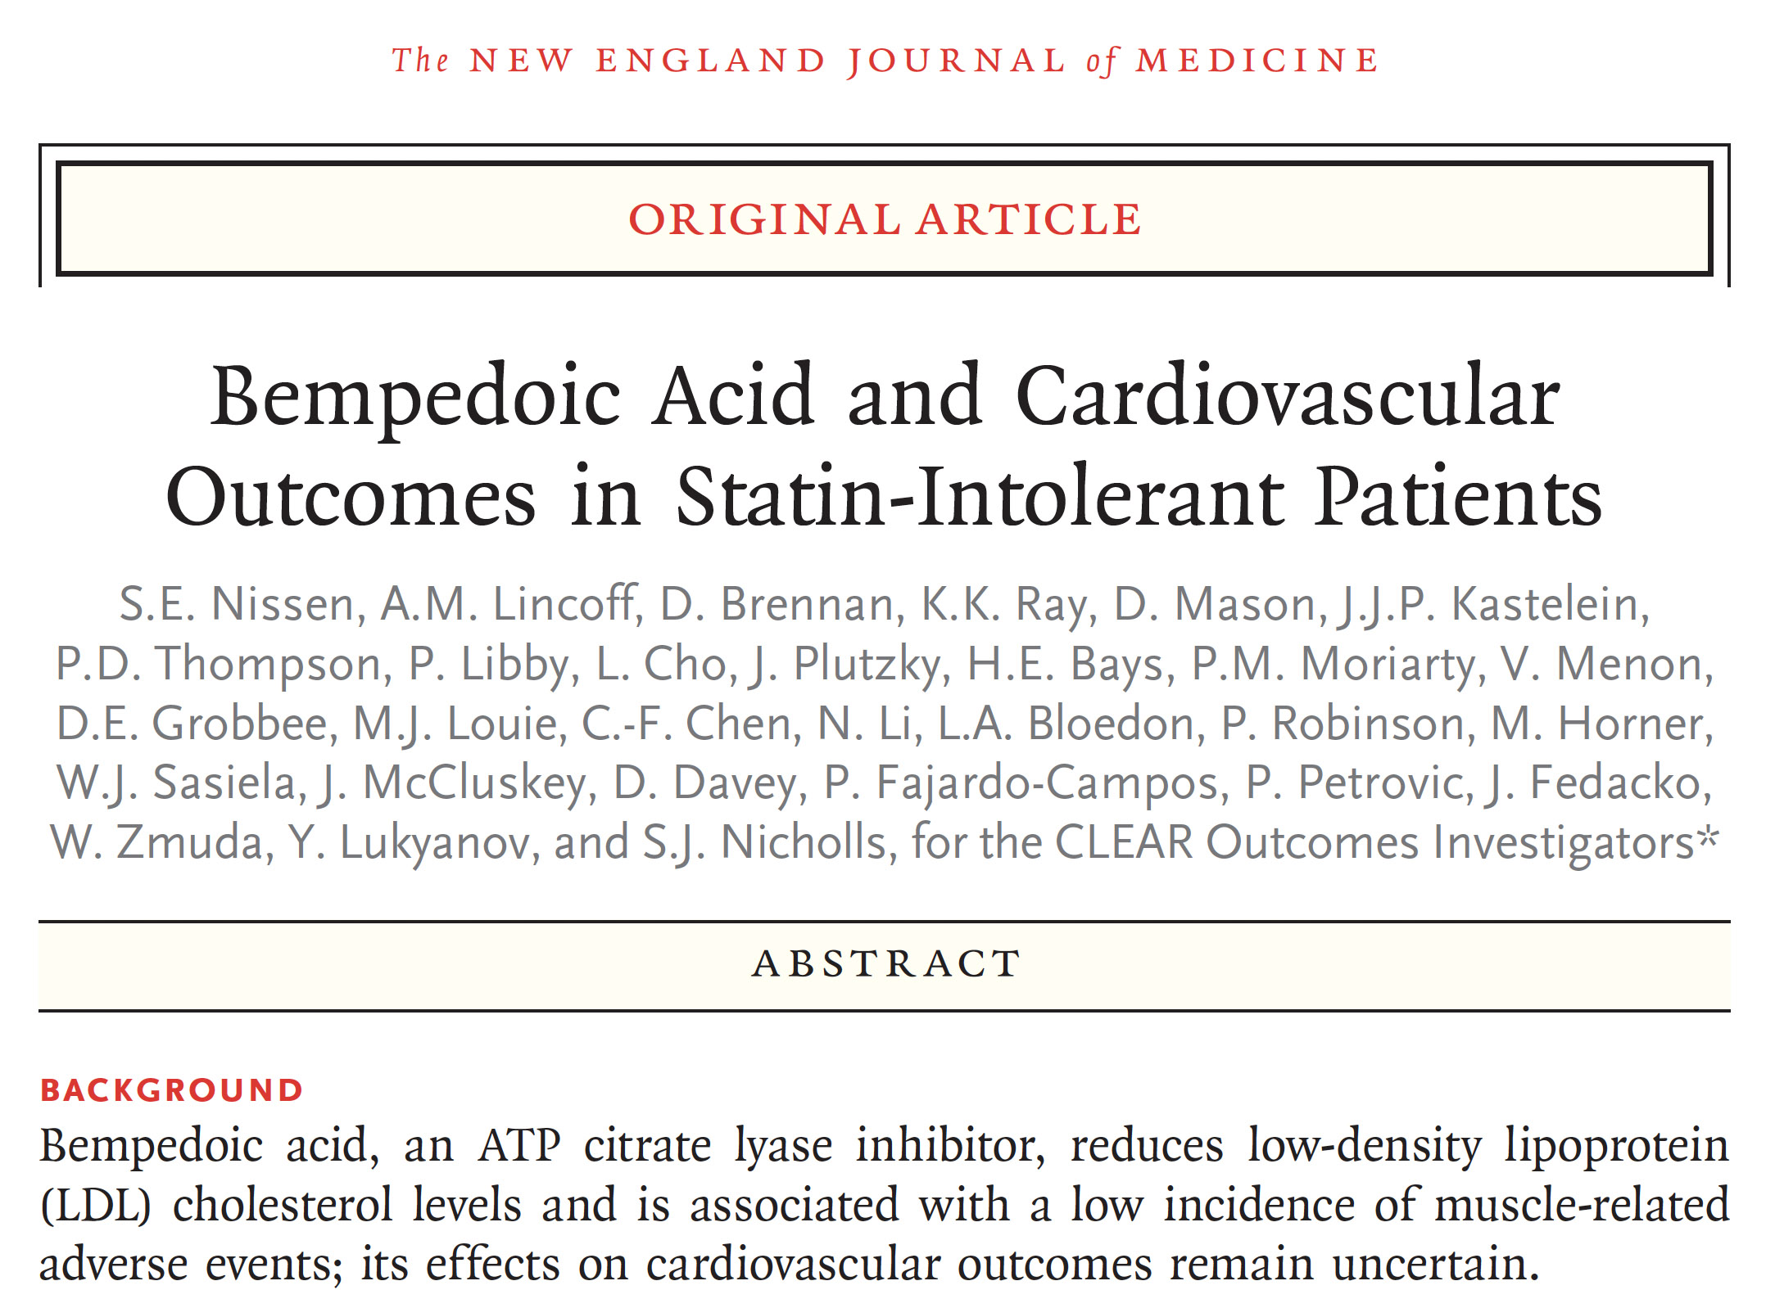

Slide 19
A Final Thought
Management of patients unable or unwilling to take statins represents a challenging and frustrating clinical issue.
Regardless whether this problem represents the nocebo effect or actual intolerance, these high-risk patients need effective alternative therapies.
The CLEAR Outcomes trial provides a sound rationale for use of bempedoic acid to reduce major adverse cardiovascular outcomes in patients intolerant to statins.

Slide 21
Backup

Slide 22
Summary of All LMT Cross-ins During the Trial
LMT Category | Bempedoic Acid (N = 6992) | Placebo (N = 6978)
Any LMT | 660 ( 9.4%) | 1089 (15.6%)
Statins* | 283 (4.0%) | 456 (6.5%)
PCSK9 inhibitors -mAb | 194 (2.8%) | 306 (4.4%)
Selective Cholesterol Absorption Inhibitors (Ezetimibe) | 189 (2.7%) | 382 (5.5%)
Fibrates | 72 (1.0%) | 91 (1.3%)
Bile Acid Sequestrants | 11 (0.2%) | 17 ( 0.2%)
Bempedoic Acid | 11 (0.2%) | 10 (0.1%)
Fixed Dose Combination: Bempedoic Acid + Ezetimibe | 6 (0.1%) | 3 (<0.1%)
PCSK9-siRNA | 4 (0.1%) | 5 (0.1%)
Niacin derivatives | 4 (0.1%) | 6 (0.1%)
* At the end of the study <4% patients receiving a moderate or high intensity statin

Slide 23
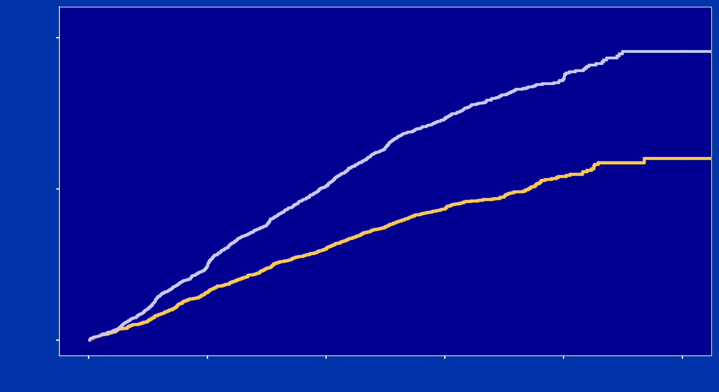
Time to Cross-in to Additional Lipid Modifying Therapy
20%
Placebo
Probability of Starting Additional Therapy
10%
Bempedoic Acid
0%
0
12
24
36
48
60
Months Since Randomization

Slide 24
CTTC End Point Calculation
Bempedoic Acid (N=6992), n (%) | Placebo (N=6978), n (%) | HR | P-value
703 (10.1) | 816 (11.7) | 0.85 (0.77,0.94) | 0.001
 | Bempedoic Acid (N=6992) | Placebo (N=6978)
Baseline, n | 6992 | 6978
Mean (SD) | 139.0 (34.9) | 139.0 (35.2)
Month 12, n | 5977 | 5824
Mean (SD) | 107.2 (37.8) | 133.2 (41.4)
Change from baseline, LS Mean (SE) | -28.5 (0.42) | -2.47 (0.43)
Difference of LS Means (SE) | -26.1 (0.59) mg/dl (0.67 mmol/L)
CTTC calculation = Expected HR for 0.67 mmol/L LDL-C reduction = 0.846

Slide 25
Outcomes: Non-Statin LDL-C Lowering Therapies
 | 3-Component MACE | Nonfatal MI
Ezetimibe | 0.90 | 0.87
Evolocumab | 0.80 | 0.73†
Alirocumab | 0.86* | 0.86
Bempedoic Acid | 0.85 | 0.73
*Trial used all-cause mortality rather than CV death
†Fatal and nonfatal MI

