Slide 1
The UK Mini Mitral Trial
Minimally invasive thoracoscopically-guided right minithoracotomy versus conventional sternotomy for mitral valve repair: a multicentre randomised controlled trial
Professor Enoch Akowuah
@EnochAkowuah1

Slide 2

Disclosure Statement of Financial Interests
No relevant financial relationships with any commercial entity

Slide 3


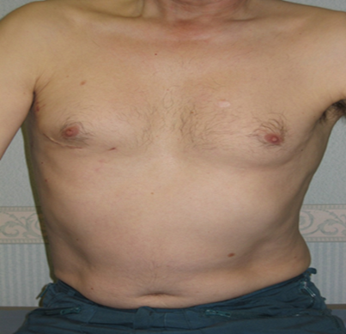
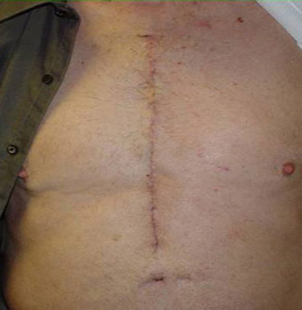
Minimally invasive versus conventional sternotomy at 12 weeks post surgery

Slide 4
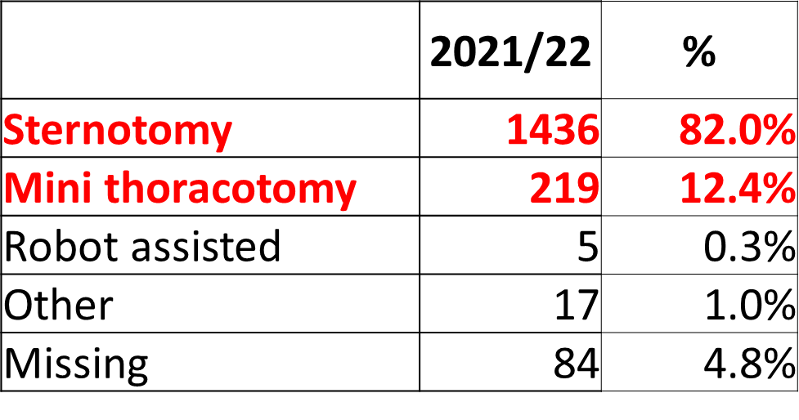
Background
The best surgical approach for mitral valve repair is widely debated
Minimally Invasive MVrep via mini thoracotomy is preferred by patients
However there are significant question marks which centre on
  ‘can you repair as many’ ?
  ‘can you repair them as well’ ?
  ‘is it as safe’ ?
The emergence of percutaneous strategies to treat DMR and the need for trials to determine which procedures benefits specific patients groups make defining the optimum surgical approach an urgent priority

Slide 5
Objectives
Primary
The primary objective was to determine if physical function and associated return to usual activities measured by change in SF-36 physical functioning scale from baseline to 12 weeks following index surgery was superior in Mini versus Sternotomy
  ‘once I’m assured of surgical expertise, the key question influencing my choice of procedure is speed of recovery of physical function after surgery’
Secondary
Physical function at 6 weeks
Physical activity and sleep efficiency measure by accelerometery at 6 and 12 weeks
Mitral valve repair rates
Quality of Mitral valve repair (rate of moderate or severe MR at 12 weeks and 1 year)
Adverse events (Death, stroke, heart failure, hospitalisation, and repeat intervention on the mitral valve )

Slide 6
Trial Methodology
Expertise based superiority RCT
Potentially eligible patients reviewed by Multi-Disciplinary Heart Team (MDT)
  DMR
  Suitable for both approaches
Eligibility patients were randomised 1:1 to a Mini or Conventional expert
Patients had to move surgeons
All had intra op TOE
MVrep techniques were at the discretion of the surgeon
Follow-up for 1 year post surgery including
  SF-36v2 physical function scores measured by a blinded researcher
  Echocardiogram early (within 12 weeks) and at 1 year after surgery assessed by Core Laboratory
  Physical activity and sleep efficiency measured by accelerometers for 1 week at a time
  Follow-up every at 6, 12, 18, 24, 38, 52 weeks (post-intervention) with phone calls from the research team.

Slide 7
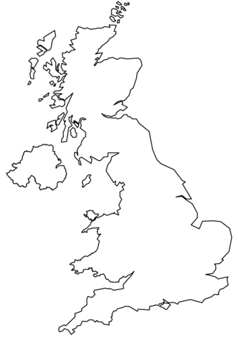
Participating sites
Royal Infirmary of Edinburgh, Edinburgh
Blackpool Teaching Hospital, Blackpool
James Cook Hospital, Middlesbrough
Liverpool Chest and Heart Hospital, Liverpool
Derriford Hospital, Plymouth
Bristol University Hospital, Bristol
Harefield Hospital, Uxbridge
Hammersmith Hospital, London
Kings College Hospital, London
Basildon University Hospital, Basildon
1
3
2
4
7
10
6
8
9
5

Slide 8
Inclusion criteria
Adult (≥18 years old at consent) patients with degenerative mitral valve disease, requiring isolated MVr (patients requiring concomitant surgery for Atrial Fibrillation and/or Patent Foramen Ovale (PFO) closure will be included).
Written informed consent.
Fit for cardiac surgery and cardiopulmonary bypass.

Slide 9
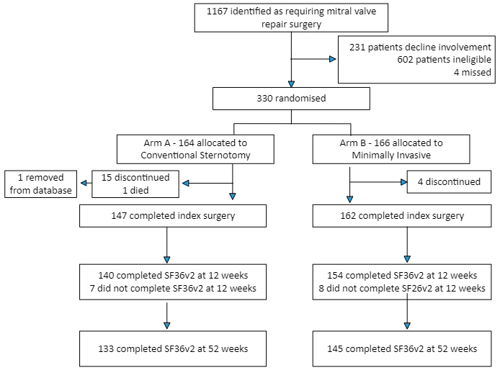
Participant flow
Screening
 | Total
Total Patients Screened | 1167
Total Patients Ineligible | 602
Total Patients Declined | 231
Total Patients Missed | 4
Total Patients Randomised | 330

Slide 10
Surgical expertise
28 surgeons were approved by the Trial Steering Committee as experts able to perform surgery in the trial
Experts had to have completed 50 procedures
Surgeon Expertise | Sternotomy (n=16) | Mini (n=12) | Total (n=28)
Number of years performing the operation prior to performing surgery in the trial (IQR;min-max) | 14.5 (IQR 11.25;4-26) | 7.5 (IQR 6.5; 2.5-13) | 9 (IQR 8.5; 1.5-26)
Number of operations performed prior to performing surgery in the trial (IQR;min-max) | 162 (IQR 300;59-1000) | 86 (IQR 145; 50-500) | 110 (IQR 166.5; 50-1000)

Slide 11
Characteristic | Conventional Sternotomy (N=163) | Minithoracotomy (N=166)
Demographic
Age at randomisation— yr | 66.99±11.51 | 67.29±10.13
Male Sex — no. (%) | 111 (68.1) | 118 (71.1)
Race — no. (%)†
White | 158 (96.9) | 166 (100)
Non white | 5 (3.1) | 0 (0)
BMI—mean±SD; no. ‡ | 26.2±4.21; 160 | 26.5±4.20; 165
Clinical — no./total no. (%)
History of Atrial Fibrillation | 69/160 (43.1) | 69/165 (41.8)
History of Heart Failure | 45/160 (28.1) | 42/165 (25.5)
History of Stroke | 13/160 (8.1) | 7/165 (4.2)
History of previous MI | 5/160 (3.1) | 6/165 (3.6)
History of Chronic Obstructive Pulmonary Disease | 11/160 (6.9) | 14/165 (8.5)
Asthma | 13/160 (8.1) | 17/165 (10.3)
History of Peripheral Vascular Disease | 1/160 (0.6) | 4/165 (2.4)
History of Pulmonary Hypertension | 24/150 (16) | 30/162 (18.5)
Moderate (vs No) | 16/150 (10.7) | 17/162 (10.5)
Severe (vs No) | 8/150 (5.3) | 13/162 (8)
NYHA functional class III/IV | 77/150 (51.3) | 87/162 (53.7)
In-house urgent patient | 18/150 (12) | 14/162 (8.6)
Euroscore II — mean±SD; no. | 1.7±1.43; 150 | 1.72±1.67; 162
Baseline physical function (SF-36 PF score) §
Low | 36 (22.1) | 36 (21.7)
Medium (vs Low) | 58 (35.6) | 60 (36.1)
High (vs Low) | 69 (42.3) | 70 (42.2)
Baseline Characteristics
KEY MESSAGES
Patients in both groups were similar
Average age 67
AF 40%
Women 30%
NYHA III/IV 50%
EuroScore II 1.7
Characteristic*, ** | Conventional Sternotomy (N=163) | Minithoracotomy (N=166)
Demographic
Age at randomisation— yr | 66.99±11.51 | 67.29±10.13
Male Sex — no. (%) | 111 (68.1) | 118 (71.1)
Race — no. (%)†
White | 158 (96.9) | 166 (100)
Non white | 5 (3.1) | 0 (0)
BMI—mean±SD; no. ‡ | 26.2±4.21; 160 | 26.5±4.20; 165

Slide 12
Baseline TTE
Variable | Sternotomy n/N(%) | Mini n/N(%) | Total n/N(%)
MR Severity
Mild | 0/103(0%) | 0/106(0%) | 0/209(0%)
Moderate | 8/105(7.62%) | 7/107(6.54%) | 15/212(7.08%)
Severe | 97/105(92.38%) | 100/107(93.46%) | 197/212(92.92%)
Missing | 2/107(1.87%) | 2/109(1.83%) | 4/216(1.85%)
Location of Mitral Valve Pathology
Type I | 5/106(4.72%) | 2/109(1.83%) | 7/215(3.26%)
Type II | 101/106(95.28%) | 106/109(97.25%) | 207/215(96.28%)
Type IIIa (leaflet restriction rheumatic) | 0/106(0%) | 1/109(0.92%) | 1/215(0.47%)
Type IIIb (leaflet restriction ischemic) | 1/106(0.94%) | 0/109(0%) | 1/215(0.47%)
Other | 2/106(1.89%) | 1/109(0.92%) | 3/215(1.4%)
Missing | 1/107(0.93%) | 0/109(0%) | 1/216(0.46%)
Location of Mitral Pathology
Bileaflet involvement | 24/105(22.86%) | 28/108(25.93%) | 52/213(24.41%)
Isolated anterior leaflet | 8/105(7.62%) | 8/108(7.41%) | 16/213(7.51%)
Isolated posterior leaflet | 68/105(64.76%) | 71/108(65.74%) | 139/213(65.26%)
Leaflets normal | 5/105(4.76%) | 1/108(0.93%) | 6/213(2.82%)
Missing | 2/107(1.87%) | 1/109(0.92%) | 3/216(1.39%)
KEY MESSAGES
92% had severe MR
96% had Type II MV pathology
65% had isolated P2 prolapse
23% had bileaflet prolapse

Slide 13
Operative data
Operative Data – no/total no% | Conventional Sternotomy (n=163) | Mini (n=166)
Mitral valve repair | 142/146 (97.3) | 153/160 (95.6)
AF surgery | 20/69 (30%) | 21/69 (30%)
TV surgery | 10/111 (9) | 2/120 (1.7)
Repair technique
Resection | 28/146 (19.2) | 10/157 (6.4)
Chords | 39/146 (26.7) | 22/157 (14)
Premeasured loops | 48/146 (32.9) | 89/157 (56.6)
Edge to Edge | 4/146 (2.7) | 8/157 (5.1)
Mitral valve ring size— mm., mean±SD; no. | 32.73±2.56; 142 | 31.5±2.9; 153
CPB time — m., mean±SD; no. | 102.01±74.59; 146 | 134.77±41.04; 159
Aortic cross clamp time — m., mean±SD; no. | 74.53±24.52; 146 | 85.6±30.82; 158
Duration of procedure — m., mean±SD; no. | 184.34±42.65; 145 | 228.73±56.38; 159
Repeat bypass run for valve re repair or replacement | 7/146 (4.8) | 5/160 (3.1)
KEY MESSAGES
Mini procedure took more time
X clamp time 11 minutes
CPB time 30 minutes
Procedure time 44 minutes

Slide 14
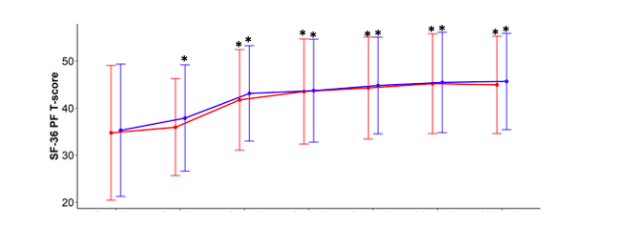
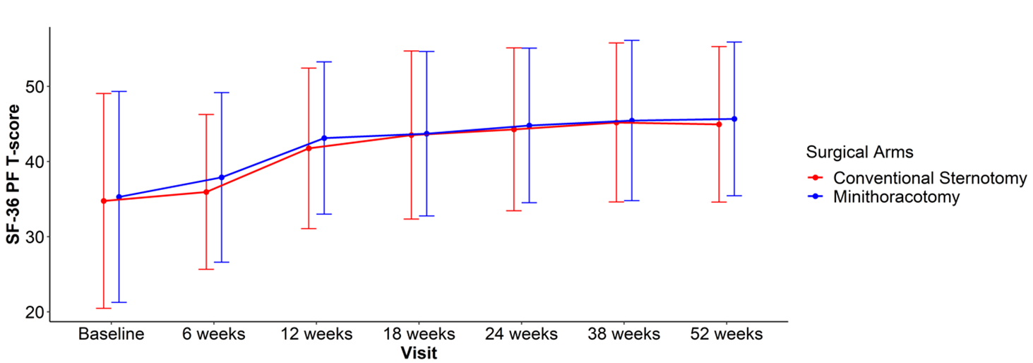
Change in PF from baseline at up to 52 weeks
*
*
*
*
*
*
*
*
*
*
*
For Mini PF T-scores increase significantly from baseline to 6 weeks and increased throughout the year.
For Sternotomy PF T-scores at 6 weeks are not significantly different from baseline, however they become significantly different from 12 weeks and increase further throughout the year.

Slide 15
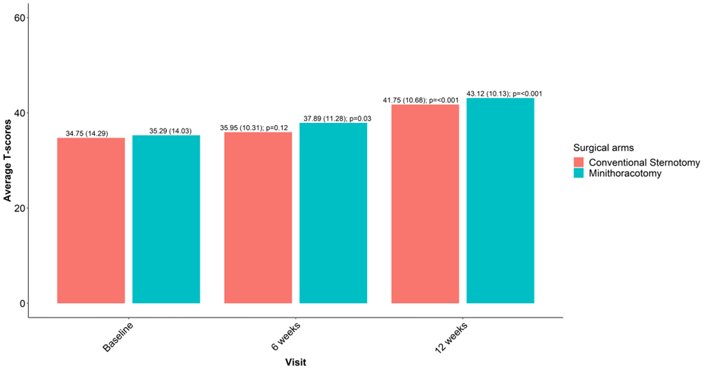
Primary Outcome: the difference in the change in PF from baseline to 12 weeks between groups was not significant
The mean difference in physical function (T-score) from baseline between groups: 0.675 (-1.89,3.26); 0.61

Slide 16
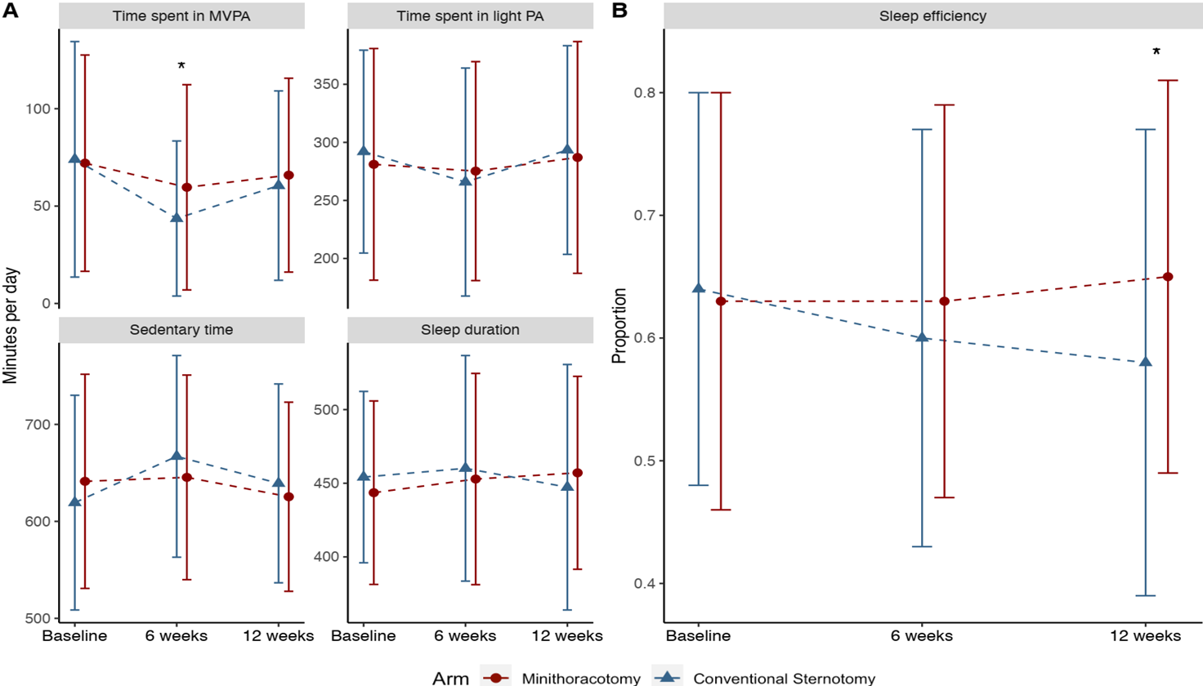
Physical Activity and Sleep (Accelerometer)

Slide 17
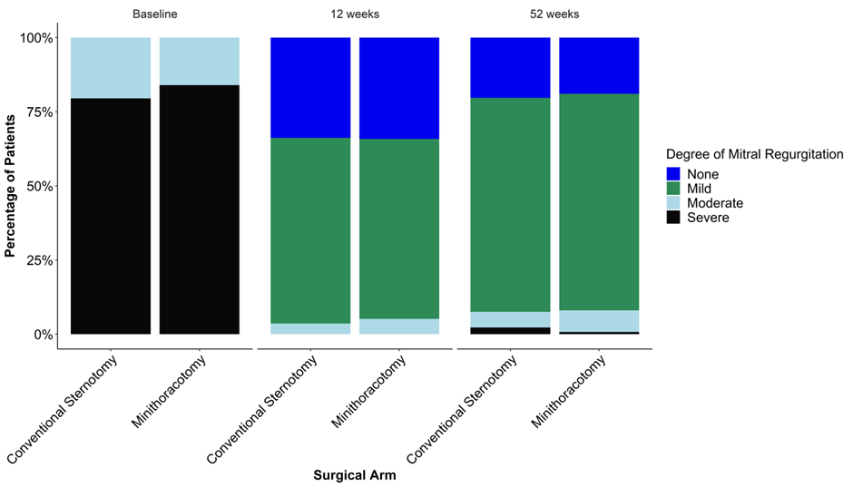
Echocardiographic outcomes
MR reduced to grade none or mild for 95% of participants in both groups at 12 weeks and 92% at 52 weeks.
At 52 weeks 3 Sternotomy participants and 1 Mini participant had severe MR
At 52 weeks, in both groups, left ventricular dimensions and volumes reduced significantly compared to baseline with no significant differences between groups

Slide 18
Early outcomes safety (up to 12 weeks)
 | Conventional Sternotomy | Minithoracotomy | Odds Ratio (95%CI); p-value
Death | 4*(2.5) | 1 (0.6) | 0.24 (0.03,2.2); 0.2
Stroke with permanent deficit | 5 (3.1) | 1 (0.6) | 0.19 (0.02,1.67); 0.13
MI** | 1 (0.6) | 0 (0) | -
Tracheostomy | 0 (0) | 3 (1.8) | -
Renal Impairment – AKIN criteria (150% increase over baseline /-replacement therapy) | 4 (2.5) | 3 (1.8) | 0.63 (0.14,2.92); 0.55
Prolonged ventilation (>48 Hrs) | 3 (1.8) | 4 (2.41) | 1.19 (0.26,5.47); 0.82
ICU LOS (hours) – median (IQR) | 21.7 (9.2) | 23.03 (21.6) | P=0.07
Proportion of prolonged CICU stay (>48 hours) | 19 (11.7) | 21 (12.7) | 1.25 (0.62,2.52); 0.54

Slide 19
Mini patients had a reduced length of stay
 | Conventional Sternotomy | Minithoracotomy | Odds Ratio (95%CI); p-value
Hospital LOS - median (IQR) | 6 (3) | 5 (3) | p=0.003
Early discharge (<=4 days post-surgery) | 25 (15.3) | 55 (33.1) | 2.81 (1.6,4.94); <0.001

Slide 20
Days alive and at home (DAOH) was higher for MINI
DAOH is an important measure of quality. It accounts for:
  The initial hospital stay if prolonged by peri-op complications
  Readmissions due to inappropriate discharges or complications (e.g. wound infections)
  Discharge to nursing home or rehabilitation facilities or any institutionalised care
  Deaths
Now recognised as an important outcome for trials and used as a primary outcome in key trials

Slide 21
V
Late safety outcomes (up to 1 year)
KEY MESSAGES
There was no difference in important safety outcomes at 1 year
Death
A repeat operation
Heart failure

Slide 22
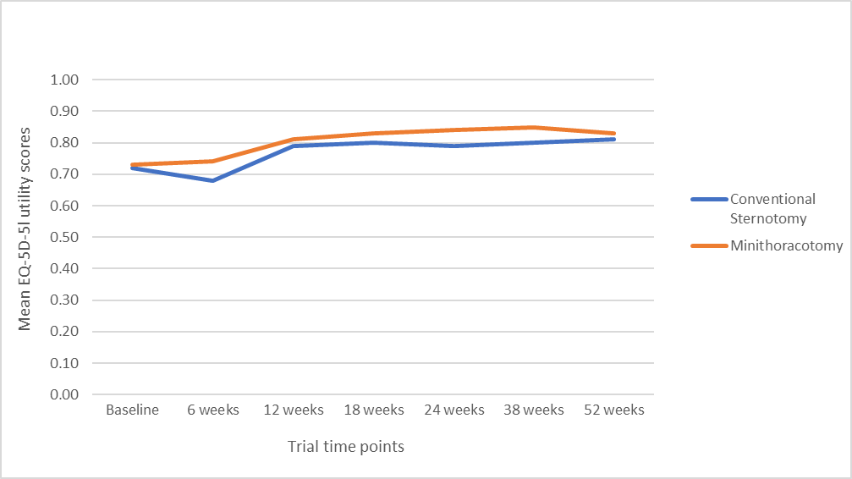
Quality of life outcomes at 6 and 12 weeks
KEY MESSAGES
Quality of life score fell after surgery in both groups but less in the Mini than Conventional
The differences were small and of uncertain clinical significance

Slide 23
Summary of findings
First and largest multicentre RCT.
Expertise based randomisation to account for the learning curve was successfully performed.
The difference in the change in PF from baseline to 12 weeks between groups was not significant
Physical function improves from baseline to 6 weeks in Mini but in Sternotomy patients.
Moderate-Vigorous PA and sleep efficiency were significantly greater with Mini at 6 weeks.
Reduced post-operative LOS for Mini.
Early discharge more than twice as likely with Mini.
DAOH was greater for Mini at 30 and 90 days
Small differences in QOL in favour of Mini at all time points (Full cost effectiveness analysis awaited)
High repair rate in both arms 96% and echo outcomes at 1 year were excellent (93% mild MR or less).
Rates of Death, HFH, reintervention on the mitral valve at 1 year were similar and low.

Slide 24
Conclusions
Mini MVr is as safe and effective as sternotomy MVr for DMR.
Recovery from baseline to 6 weeks is may be better with Mini.
At 12 weeks the mean change in physical function from baseline is the same
The findings should give confidence to patients and clinicians and aid adoption of Mini MVRep .

