Slide 1



Bivalirudin Plus a High-dose Infusion Versus Heparin Monotherapy in Patients with STEMI Undergoing Primary PCI
The BRIGHT-4 Trial
Gregg W. Stone MD
On behalf of Yaling Han and the BRIGHT-4 investigators

Slide 2
Disclosure Statement of Financial Interest
Dr. Gregg W. Stone
Specific to this topic: None
General (within 36 months): Speaker honoraria from Medtronic, Pulnovo, Infraredx, Abiomed, Abbott; consultant to Valfix, TherOx, Robocath, HeartFlow, Ablative Solutions, Vectorious, Miracor, Neovasc, Abiomed, Ancora, Elucid Bio, Occlutech, CorFlow, Apollo Therapeutics, Impulse Dynamics, Cardiomech, Gore, Amgen, Adona Medical, Millennia Biopharma; equity/options from Ancora, Cagent, Applied Therapeutics, Biostar family of funds, SpectraWave, Orchestra Biomed, Aria, Cardiac Success, Valfix, Xenter.

Slide 3
Bivalirudin vs. Heparin Anticoagulation During Primary PCI in STEMI
Six completed randomized trials have reported conflicting results¹⁻⁶
Substantial heterogeneity was present in the prior trial designs, in particular:
- Routine vs. selective use of GPIIb/IIIa inhibitors (GPI) with heparin
- Use, dose and duration of a post-PCI bivalirudin infusion
- Radial vs. femoral vascular access
Post hoc analyses suggest that bivalirudin with a 2-4-hour post-PCI high-dose infusion and heparin monotherapy are the two regimens likely to minimize both ischemic and hemorrhagic complications in STEMI patients undergoing primary PCI with radial access
These two regimens have not been compared in an adequately powered randomized trial
1. N Engl J Med 2008; 358(21): 2218-30. (HORIZONS-AMI)
2. N Engl J Med 2013; 369(23): 2207-17. (EUROMAX)
3. Lancet 2014; 384(9957): 1849-58. (HEAT PPCI)
4. JAMA 2015; 313(13): 1336-46. (BRIGHT)
5. N Engl J Med 2015; 373(11): 997-1009. (MATRIX)
6. N Engl J Med 2017; 377(12): 1132-42. (VALIDATE-SWEDEHEART)

Slide 4
Trial Design
BivaliRudin with prolonged full-dose Infusion durinG primary PCI versus Heparin Trial (BRIGHT)-4
Multicenter, randomized, investigator-sponsored, open-label trial
Patients
Inclusion criteria:
Any age
STEMI within 48h* undergoing primary PCI
Written informed consent provided
Major exclusion criteria:
Thrombolytic therapy
Anticoagulant or GPI use before randomization
Mechanical complications of MI
STEMI undergoing primary PCI
(n=6000)
R
Bivalirudin
(n=3000)
Heparin
(n=3000)
Study treatment
Bivalirudin:
0.75 mg/kg bolus; 1.75 mg/kg/hr during the PCI procedure and for 2-4 hours afterwards; additional bolus given if ACT <225 s
Heparin:
70 U/kg bolus; additional bolus given if ACT <225 s
Both arms:
GPI permitted only for procedural thrombotic complications
Emergency angiography/revascularization
Clinical follow-up @ 30 days, 6 and 12 months
Clinicaltrials.gov identifier: NCT03822975
*Eur Heart J. 2018;39(2):119-177.

Slide 5
Endpoints and Sample Size Considerations
Primary Endpoint
All-cause death or BARC types 3-5 bleeding¹ at 30 days
MACCE (all-cause death, reinfarction,² ischemia-driven TVR, stroke)
Individual components of MACCE
NACE (MACCE or BARC 3-5 bleeding)
Stent thrombosis³
BARC types 2-5 bleeding¹
Acquired thrombocytopenia*
Secondary Endpoints
(at 30 days, 6 and 12 months)
Assuming a 3.3% incidence of the primary endpoint in the heparin group, allowing for 1% lost to follow-up, 3000 patients per group (6000 total) would provide 80% power to detect a 1.2% absolute risk reduction with bivalirudin with a 2-sided alpha 0.05.⁴
Sample Size
1. Mehran R, et al. Circulation 2011;123:2736-47. 2. Thygesen K, et al. JACC 2018;72:2231-64. 3. Cutlip DE, et al. Circulation 2007;115:2344-51. 4. Han Y, et al. JAMA 2015; 313:1336-46.
*Nadir platelet count <150×10⁹/L after the index procedure in patients in whom the baseline platelet count was >150×10⁹/L .

Slide 6
Trial Organization
Principal investigator: | Yaling Han (General Hospital of Northern Theater Command, Shenyang, China).
Co-principal investigator: | Gregg W. Stone (Icahn School of Medicine at Mount Sinai, New York, NY, USA).
Steering committee: | Yaling Han (Chair); Gregg W. Stone; Quanmin Jing (General Hospital of Northern Theater Command, Shenyang, China), Xiaozeng Wang (General Hospital of Northern Theater Command, Shenyang, China), Yi Li (General hospital of Northern Theater Command, Shenyang, China).
Project manager: | Zhenyang Liang (General Hospital of Northern Theater Command, Shenyang, China).
Clinical events adjudication committee: | Peng Qu (Chair, The Second Affiliated Hospital of Dalian Medical University, Dalian, China); Dalin Jia (The First Affiliated Hospital of Chinese Medical University, Shenyang, China); Zhijun Sun (The Second Affiliated Hospital of Chinese Medical University, Shenyang, China); Wenyue Pang (The Second Affiliated Hospital of Chinese Medical University, Shenyang, China).
Contract research organization: | ExcellentCRO Co, Ltd, Shenyang, China.
Data analysis center: | Beijing Bioknow Information Technology Co. Ltd, Beijing, China.

Slide 7
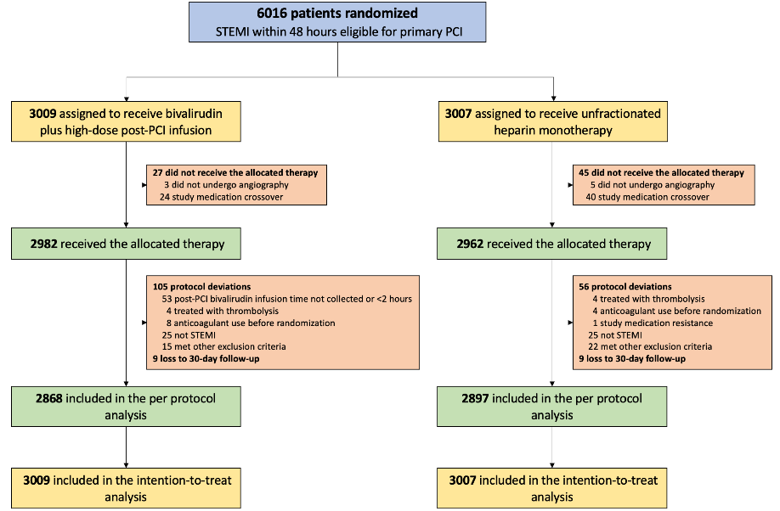
Patient Flow
87 Sites in China
Feb 14, 2019 - Apr 7, 2022
99.7% 30-day follow-up

Slide 8
Top Ten Enrolling Sites
Site | Site Investigator(s)
General Hospital of Northern Theater Command | Yaling Han
Kaifeng Central Hospital | Lei Qin
West China Hospital of Sichuan University | Mian Wang
Yuzhou City Peoples Hospital | Xianzhao Wang
Taian City Central Hospital | Huanyi Zhang, Jinlong Li
Tianjin Chest Hospital | Yin Liu
Tangdu Hospital, Air Force Medical University | Yang Li
The Fifth People's Hospital of Jinan | Zhisheng Jia
The Second Hospital of Shenyang Medical College | Limin Liu, Jie Lu, Jingru Ma
Affillated Hospital of Qilu Medical University | Hongyan Zhang

Slide 9
Baseline and Procedural Characteristics
Characteristic | Heparin (N=3007) | Bivalirudin (N=3009)
Age, years | 60.6 ± 12.2 | 60.5 ± 12.1
Male | 78.9% | 78.1%
Diabetes mellitus | 23.2% | 22.2%
Hypertension | 50.5% | 52.0%
BMI (kg/m²) | 65.0 ± 3.8 | 24.8 ± 3.6
Prior MI | 6.6% | 6.2%
Prior PCI | 6.2% | 6.2%
Prior stroke | 11.4% | 11.7%
Killip class III-IV | 10.7% | 10.2%
Sx-door time, hr | 3.3 (1.7-6.7) | 3.3 (1.7-6.4)
>12 hours | 12.2% | 11.0%
Characteristic | Heparin (N=3007) | Bivalirudin (N=3009)
P2Y12 inhibitor
Clopidogrel | 34.4% | 33.7%
Ticagrelor | 65.6% | 66.3%
Transradial access | 92.6% | 93.6%
Revascularization | 98.4% | 98.1%
PCI | 98.1% | 97.8%
CABG | 0.4% | 0.4%
Door-wire time, hr | 1.1 (0.9-1.7) | 1.1 (0.9-1.6)
Thrombus aspiration | 17.9% | 18.1%
TIMI 0/1 pre (site read) | 83.4% | 82.0%
TIMI 3 post (site read) | 97.5% | 98.5%

Slide 10
Study Drug Treatments
 | Heparin (N=3007) | Bivalirudin (N=3009) | P value
Heparin | 98.7% | 0.8% | -
Total dose, IU | 5570 (4800-6775) | - | -
Bivalirudin | 1.3% | 99.2% | -
Post-PCI infusion administered | - | 2953/2953 (100.0%) | -
Post-PCI infusion duration, hr | - | 3.0 (2.2-4.0) | -
Additional bolus of study medications | 35.1% | 3.5% | <0.0001
Peak activated clotting time, sec | 267 (238-317) | 321 (278-365) | <0.0001
GPI for procedural complications | 13.7% | 11.5% | 0.01

Slide 11
Primary Endpoint: All-cause death or BARC types 3-5 bleeding
Heparin monotherapy
Bivalirudin with high-dose infusion
Heparin
4.4%
ARR: 1.3%
NNT: 76
3.1%
All-cause death or BARC
types 3-5 bleeding (%)
Bivalirudin
Hazard ratio: 0.69, 95%CI: 0.53-0.91
P=0.0070
No. at risk:
Days since randomization
Heparin 3007 2913 2896 2889 2882 2877 2875
Bivalirudin 3009 2942 2927 2924 2919 2918 2917

Slide 12
All-cause Death
Heparin monotherapy
Bivalirudin with high-dose infusion
3.9%
3.0%
All-cause death (%)
Hazard ratio: 0.75, 95%CI: 0.57-0.99
P=0.0420
No. at risk:
Days since randomization
Heparin 3007 2924 2908 2903 2896 2891 2889
Bivalirudin 3009 2944 2929 2926 2922 2921 2920

Slide 13
BARC 3-5 Bleeding
Heparin monotherapy
Bivalirudin with high-dose infusion
Hazard ratio: 0.21, 95%CI: 0.08-0.54
P=0.0014
BARC types 3-5 bleeding (%)
0.8%
0.2%
Days since randomization
No. at risk:
Heparin 3007 2989 2987 2985 2983 2983 2983
Bivalirudin 3009 3005 3005 3005 3004 3004 3004

Slide 14
Patients with BARC 3-5 Bleeding
BARC types 3-5 bleeding | Heparin (n=24) | Bivalirudin (n=5)
Access site-related | 1 (4.2%) | 0 (0.0%)
Non-access site-related | 23 (95.8%) | 5 (100.0%)
Gastrointestinal | 17 (70.8%) | 4 (80.0%)
Intracranial | 3 (12.5%) | 1 (20.0%)
Other | 3 (12.5%) | 0 (0.0%)
Blood transfusion | 14 (58.3%) | 2 (40.0%)
Mean volume, units | 2.3 ± 0.7 | 1.8 ± 0.4
Surgery to treat bleeding | 0 (0.0%) | 0 (0.0%)
Endoscopic procedure for bleeding | 4/17 (23.5%) | 1/4 (25.0%)
DAPT discontinuation* after bleeding† | 21 (87.5%) | 4 (80.0%)
Stent thrombosis after bleeding† | 0 (0.0%) | 0 (0.0%)
Death after bleeding† | 10 (41.7%) | 2 (40.0%)
*Discontinuation of either aspirin or a P2Y12 inhibitor or both. †Within the 30-day follow-up period.

Slide 15
Reinfarction and Stent Thrombosis
Heparin monotherapy
Bivalirudin with high-dose infusion
Heparin monotherapy
Bivalirudin with high-dose infusion
Reinfarction (%)
Hazard ratio: 0.68, 95%CI: 0.37-1.26
P=0.22
Stent thrombosis (%)
Hazard ratio: 0.33, 95%CI: 0.17-0.66
P=0.0015
0.8%
1.1%
0.6%
0.4%
Days since randomization
Days since randomization
No. at risk:
No. at risk:
Heparin 3007 2993 2992 2986 2985 2983 2982
Bivalirudin 3009 3002 2998 2995 2994 2994 2992
Heparin 3007 2983 2980 2976 2975 2974 2974
Bivalirudin 3009 3002 2999 2999 2998 2998 2998

Slide 16
MACCE and NACE
Heparin monotherapy
Bivalirudin with HD infusion
Heparin monotherapy
Bivalirudin with HD infusion
5.2%
5.6%
MACCE (%)
NACE (%)
4.1%
4.2%
Hazard ratio: 0.79, 95%CI: 0.62-1.00
P=0.0509
Hazard ratio: 0.74, 95%CI: 0.59-0.94
P=0.0124
No. at risk
Days since randomization
No. at risk
Days since randomization
Heparin 3007 2906 2880 2869 2862 2855 2853
Bivalirudin 3009 2926 2903 2896 2891 2891 2887
Heparin 3007 2895 2869 2858 2850 2843 2841
Bivalirudin 3009 2924 2901 2894 2889 2889 2885

Slide 17
30-Day Outcomes (ITT Population)
Events | Heparin (N=3007) | Bivalirudin (N=3009) | Hazard ratio (95%CI) | P value
Primary endpoint | 4.4% | 3.1% | 0.69 (0.53-0.91) | 0.0070
All-cause death | 3.9% | 3.0% | 0.75 (0.57-0.99) | 0.0420
BARC 3-5 bleeding | 0.8% | 0.2% | 0.21 (0.08-0.54) | 0.0014
Access site-related | 0.03% | 0 | - | -
Non-access site-related | 0.8% | 0.2% | 0.22 (0.08-0.57) | 0.0019
Reinfarction | 0.8% | 0.6% | 0.68 (0.37-1.26) | 0.22
Ischemia-driven TVR | 0.6% | 0.3% | 0.50 (0.22-1.11) | 0.09
Stroke | 0.5% | 0.5% | 1.07 (0.52-2.22) | 0.85
Stent thrombosis | 1.1% | 0.4% | 0.33 (0.17-0.66) | 0.0015
Acute (<24 hours) | 0.5% | 0.1% | 0.29 (0.09-0.87) | 0.0268
Subacute (1-30 days) | 0.6% | 0.2% | 0.37 (0.15-0.87) | 0.0231
MACCE | 5.2% | 4.1% | 0.79 (0.62-1.00) | 0.051
BARC bleeding, types 2-5 | 2.6% | 2.1% | 0.82 (0.59-1.14) | 0.24
Acquired thrombocytopenia | 4.2% | 3.3% | 0.79 (0.60-1.03) | 0.08
NACE | 5.6% | 4.2% | 0.74 (0.59-0.94) | 0.0124

Slide 18
Limitations
The open-label design may have introduced potential bias; however, clinical events were adjudicated by an independent committee blinded to treatment assignment after review of source documents
Analyses of secondary endpoints and subgroups have not been adjusted for multiple comparisons – hypothesis generating
Patients were enrolled only in centers in China; however, genetic polymorphisms affecting anticoagulant outcomes have not been reported, and the results are consistent with those from the European MATRIX trial

Slide 19
Conclusions
Among patients with STEMI undergoing primary PCI with radial artery access, bivalirudin with a median 3-hour post-PCI high-dose infusion reduced the 30-day composite of all-cause mortality or BARC types 3-5 major bleeding compared with heparin monotherapy

Slide 20
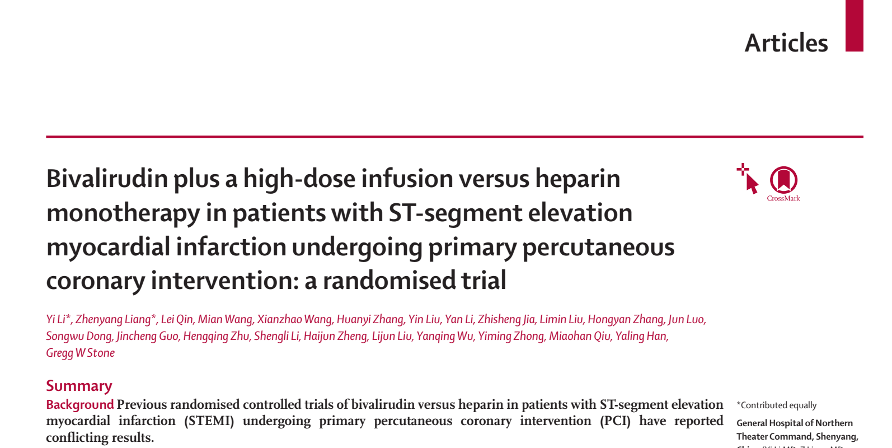
Lancet 2022:on-line

