Slide 1
Reduction of Lipoprotein(a) With Small Interfering RNA Results of the OCEAN(a)-DOSE (TIMI 67) Trial
Michelle L. O’Donoghue MD MPH, Baris Gencer MD, J. Antonio G. López MD, Beat Knusel PhD, Julia F. Kuder MA, Xinhui Ran MS, Sabina A. Murphy MPH, Huei Wang PhD, You Wu PhD, Helina Kassahun MD
and Marc S. Sabatine MD MPH,
on Behalf of the OCEAN(a)-DOSE Trial Investigators
Clinicaltrials.gov: NCT04270760
The study was funded by Amgen

Slide 2
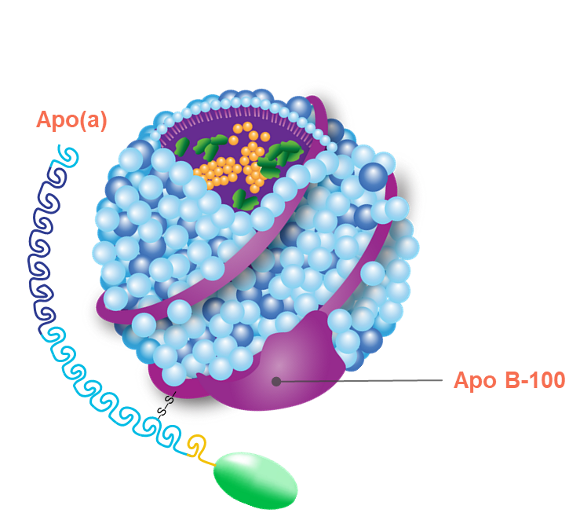
Lipoprotein(a)

Slide 3
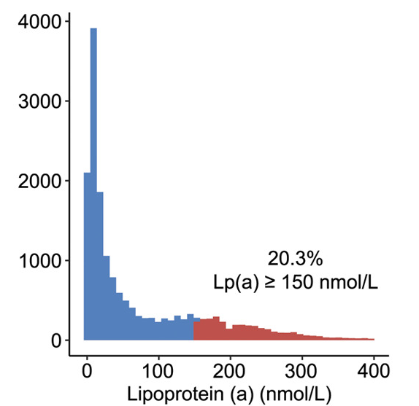
Lp(a) and Coronary Heart Disease Risk
Lp(a) distribution in individuals with established atherosclerotic cardiovascular disease
Lp(a) is associated with atherosclerotic cardiovascular disease risk independent of traditional risk factors
# of individuals
Adjusted hazard ratio
Patel et al., Arterioscler Thromb Vasc Biol 2021;41:465-474.

Slide 4
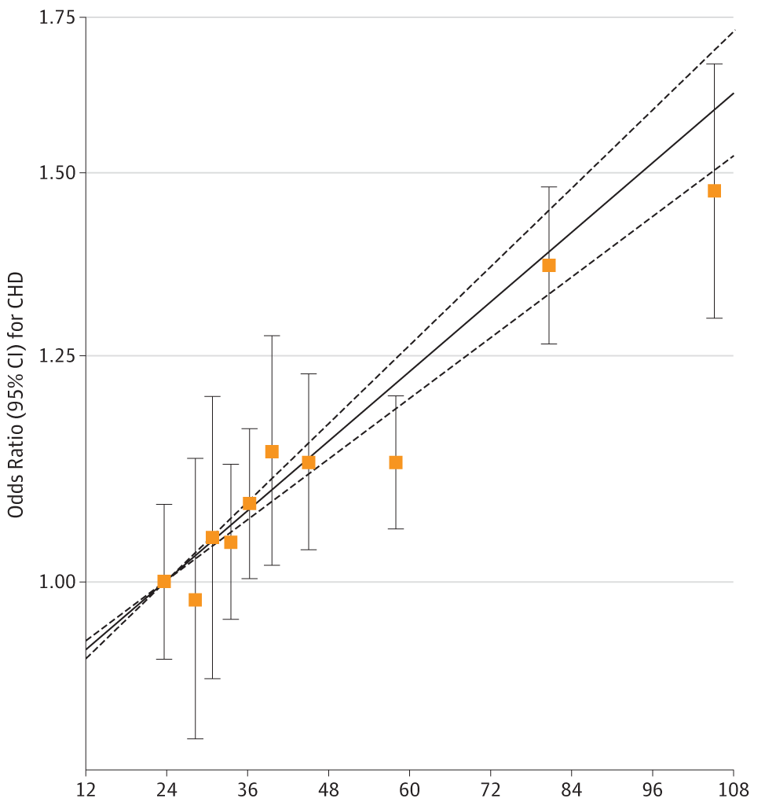
Lp(a) and Coronary Heart Disease Risk
Mendelian randomization data support a causal role for Lp(a) in coronary heart disease (CHD) risk
Odds ratio (95% CI) for CHD
Genetically predicted Lp(a) concentration (mg/dl, arithmetic mean)
Burgess et al., JAMA Cardiol 2018;3(7):619-627.

Slide 5
Olpasiran: Mechanism of Action
Olpasiran
siRNA
Mechanism of action
Small interfering RNA directed to the liver.
The antisense strand is loaded into an RNA-induced silencing complex (RISC) in the hepatocyte.
The complex then binds to apo(a) mRNA, leading to its degradation and preventing protein translation.
ASGPR
Passenger
Hepatocyte
Guide
mRNA degraded
RISC
Apo(a)
Apo(a)
mRNA
Transcription
LPA
O’Donoghue ML et al., Am Heart J 2022;251:61-69

Slide 6
OCEAN(a)-DOSE: STUDY SCHEMA
Clinicaltrials.gov: NCT04270760
Patients aged
18
-
80
years
with atherosclerotic disease
&
Lp(
a) >
150
nmol/
L
N=281
RANDOMIZE 1:1:1:1:1 DOUBLE BLIND
Olpasiran
10mg Q12W
Olpasiran
75mg Q12W
Olpasiran
225mg Q12W
Olpasiran
225mg Q24W
Placebo
Primary Endpoint: % Change in Lp(a) from Baseline to Week 36
Key Secondary Endpoint: % Change in Lp(a) from Baseline to Week 48
O’Donoghue ML et al., Am Heart J 2022;251:61-69

Slide 7
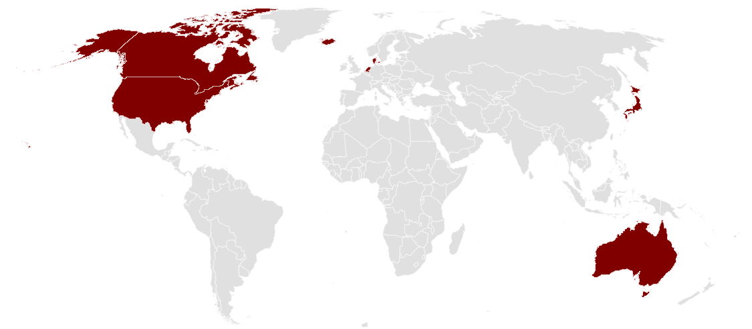
Investigative Sites
Iceland
Denmark
D. Gaudet
J. Bergeron,
H. Bajaj
R. Goldenberg
G. Thanassoulis
B. Bordestgaard
I.C. Klausen
Canada
G. Thorgeirsson
United States
Y. Ishii
J. Kanda
K. Kajinami
I. Inoue
Netherlands
Japan
R. Rosenson
N. Lepor
S. Baum
E. Stout
T. Leucker
C. Ballantyne,
H. Ginsberg,
P. Moriarty
L. Laffin
R. Strzinek
H. Weintraub
A. Carlisle
R. Troquay
E. Stroes
J. Westerink
A. Mairuhiu
H. Monajemi
34 sites
7 countries
K. Kostner,
D. Sullivan
G. Watts
D. Colquhoun
S. Nicholls
Australia

Slide 8
Baseline Characteristics
 | Olpasiran Pooled Dose Arms (N=227) | Placebo Q12W SC (N=54)
Age in years, mean (SD) | 61.6 (9.6) | 63.4 (8.9)
Female sex | 32% | 33%
White | 88% | 89%
Region / Country
North America | 58% | 69%
Europe | 19% | 17%
Australia | 16% | 11%
Japan | 7% | 4%
Coronary Artery Disease | 91% | 93%
Myocardial Infarction | 27% | 37%
Peripheral Artery Disease | 12% | 6%
Cerebrovascular Disease | 20% | 22%

Slide 9
Baseline Lipids & Background Therapies
 | Olpasiran Pooled Dose Arms (N=227) | Placebo Q12W SC (N=54)
Selected lipid lowering therapy use at baseline
Statin | 89% | 83%
Ezetimibe | 55% | 41%
PCSK9 inhibitor | 24% | 22%
Fibrates | 3.1% | 3.7%
Baseline laboratory values, median (IQR)
Lipoprotein(a), (nmol/L) | 261 (197, 360) | 246 (200, 343)
LDL-C, (mg/dl) | 68 (52, 87) | 65 (48, 81)
Apolipoprotein B, (mg/dl) | 68 (56, 82) | 63 (49, 76)

Slide 10
Changes in Lp(a) Through Follow-Up
Last injection
Placebo
Least square means % change in Lp(a)
Olpasiran 10mg Q12W
Olpasiran 75mg Q12W
Olpasiran 225mg Q12W

Slide 11
Changes in Lp(a) Through Follow-Up
Placebo
Least square means % change in Lp(a)
Last active drug injection
Olpasiran 225mg Q24W

Slide 12
Primary Endpoint:
% Change in Lp(a) at 36 weeks
Olpasiran Doses
Placebo-adjusted least square means % change in Lp(a)

Slide 13
% Achieving Lp(a) Concentration <125 nmol/L
Week 36

Slide 14
Interindividual Variability in
Lp(a) Response at Week 36
% change from baseline Lp(a)

Slide 15
Lp(a) Reduction by Subgroups
Age
Sex
Race
Region
Baseline
Lp(a)
Baseline
LDL-C
High-potency lipid-lowering therapy
Euro-
Aus
≥65
<65
F
M
White
Non-white
N Am
Japan
≥median
<median
≥median
<median
Yes
No
Placebo-adjusted least square means % change in Lp(a) for olpasiran 225 mg every 12 weeks at week 36
Placebo-adjusted least square means change in Lp(a) for olpasiran 225 mg every 12 weeks
LLT: lipid-lowering therapy

Slide 16
Changes in LDL-C and Apolipoprotein B
Week 36
Placebo-adjusted least squares means % change

Slide 17
Safety & Tolerability
 | Olpasiran 10 mg Q12W SC (N=58) | Olpasiran 75 mg Q12W SC (N=58) | Olpasiran 225 mg Q12W SC (N=56) | Olpasiran 225 mg Q24W SC (N=55) | Placebo Q12W SC (N=54)
Treatment Emergent Adverse Events | 78% | 79% | 84% | 85% | 83%
Serious adverse events | 5.2% | 5.2% | 11% | 7.3% | 15%
Reported as related to study drug | 12% | 22% | 29% | 25% | 20%
Leading to discontinuation of study drug | 1.7% | 1.7% | 1.8% | 1.8% | 1.9%
Myalgia | 5.2% | 1.7% | 7.1% | 7.3% | 7.4%
Liver-related adverse events | 1.7% | 3.4% | 1.8% | 1.8% | 3.7%
Hyperglycemia, new-onset or worsening diabetes mellitus | 8.6% | 5.2% | 8.9% | 5.5% | 5.6%
Injection site reactions* | 5.2% | 19% | 21% | 24% | 11%
Hypersensitivity reactions** | 1.7% | 6.9% | 5.4% | 9.1% | 1.9%
*Injection site reactions were generally mild
**Hypersensitivity reactions were generally described as mild injection site pain

Slide 18
Conclusions
Olpasiran, an siRNA, dosed 75 mg or higher every 12 weeks, reduces Lp(a) concentration by more than 95% in patients with established atherosclerotic cardiovascular disease
To date, the drug appears both safe and well-tolerated.
Injection site and related hypersensitivity reactions were more common with olpasiran. These were described as mild in severity and resolved without treatment.
These findings set the foundation for phase 3 testing scheduled to commence later this year (NCT05581303).

Slide 19
