Slide 1
Treatment Time and In-Hospital Mortality Among Patients With ST-Segment Elevation Myocardial Infarction, 2018-2021
James G. Jollis, MD; Christopher B. Granger, MD; Jessica K. Zègre-Hemsey, RN, PhD; Timothy D. Henry, MD; Jacqueline E. Tamis-Holland, MD; Mayme Lou Roettig, RN, MSN; Murtuza J. Ali, MD, MBA; William J. French, MD; Ram Poudel, MS, MPH; Juan Zhao, PhD; R. Harper Stone, MD; Alice K. Jacobs, MD

Slide 2
Disclosure
Nothing relevant to disclose pertaining to this presentation

Slide 3

Regional focused initiative to coordinate diagnosis and rapid reperfusion of STEMI patients
    Broad leadership: Interventional Cardiology, Emergency Medicine, EMS, Hospital Administration, Nurses, Paramedics, Quality Experts
    Common regional treatment plan
    Ongoing measurement and feedback with regional reports
Solis P, Amsterdam EA, Bufalino V, Drew BJ, Jacobs AK. Circulation. 2007;116:e73-6.

Slide 4

Improving Care of ST Segment Elevation Myocardial Infarction in the United States 2008 to 2012: A Report from
Granger CB, et al. J Am Heart Assoc. 2019;8:e008096.

Slide 5
Adjusted In-Hospital Mortality
Mortality |  | P value (trend)
2008 | 1.00 (ref) | 0.23
2009 | 0.95 (0.87, 1.05)
2010 | 0.95 (0.87, 1.03)
2011 | 0.96 (0.89, 1.05)
2012 | 1.03 (0.94, 1.12)
Mortality, excluding cardiac arrest*
2008 | 1.00 (ref) | <0.001
2009 | 0.90 (0.81, 1.00)
2010 | 0.86 (0.79, 0.94)
2011 | 0.78 (0.71, 0.86)
2012 | 0.75 (0.68, 0.83)
0.5
1
2
* prehospital cardiac arrest data collected since 2011
Odds Ratio (95% CI), vs 2008
Odds Ratio (95% CI), vs 2008

Slide 6
Objective
To describe time process measures and outcomes
for 114,871 patients with STEMI
treated at 648 hospitals
between Quarter 2, 2018 and Quarter 3, 2021
in the Get With The Guidelines® - Coronary Artery Disease registry.

Slide 7
Methods
Voluntary registry – hospitals focused on quality of care for STEMI patients
Consecutive patients
Complete case analysis including those flagged as having a “non-system reason for delay”
Mortality comparisons adjusted in multivariable logistic regression models that included demographics and illness severity descriptors present on admission: cardiac arrest, shock, and heart failure on presentation

Slide 8
Results – select hospital characteristics
 | Number of hospitals | Percentage
Total | 601 | 100%
Mission Lifeline STEMI Receiving (PCI on site) | 505 | 84%
Mission Lifeline STEMI Referring (Transfer for PCI) | 60 | 10%
24-hour PCI capable | 496 | 83%
500 or more beds | 102 | 17%
Less than 200 beds | 191 | 32%
Critical access hospital | 129 | 22%

Slide 9
Results – select patient characteristics
 | EMS arrival n=57303 | Walk in n=32483 | Transfer n=25085
Age (median) | 69 | 74 | 72
Female % | 31 | 26 | 28
Race and ethnicity %
Asian | 4 | 5 | 2
Black | 12 | 10 | 8
Hispanic | 7 | 10 | 8
Admission diagnoses %
Cardiac arrest | 10 | NA | NA
Heart failure | 8 | 6 | 8
Cardiogenic shock | 10 | 3 | 6

Slide 10
Results
PCI | Fibrinolysis | No reperfusion
84.6% | 4.5% | 9.3%

Slide 11
Results
 | EMS arrival n=57303 | Walk in n=32483 | Transfer n=25085
Symptom onset to PCI device [minutes] | 148 (111-226) | 195 (127-349) | 240 (166-402)

Slide 12
System goal bar and whisker chart
If top of box below horizontal line, 75% of patients treated within time goal.
Met time goal for 75% of patients
Time goal = 120 minutes
75th percentile
median
25th percentile
Q2
2018

Slide 13
System goal bar and whisker chart
If top of box below horizontal line, 75% of patients treated within time goal.
Met time goal for 75% of patients
Did not meet time goal for 75% of patients
75th percentile
median
25th percentile
Time goal = 120 minutes
75th percentile
median
25th percentile
Q2
2018
Q2
2018

Slide 14
Direct to PCI hospital, Emergency Medical Service transported
Horizontal lines - corresponding process time goals for 75% of patients
200
150
100
First medical contact to device
(90 min)
Minutes
50
EMS cath. lab activation
(20 min)
Emergency department time
(15 min)
0
Q2
2018
Q1
2020
Q3
2021
Quarter, Year

Slide 15
Direct to PCI hospital, walk in
Horizontal lines - corresponding process time goals for 75% of patients
200
150
100
Door to device
(90 min)
Minutes
50
ECG time
(10 min)
0
Q2
2018
Q1
2020
Q3
2021
Quarter, Year

Slide 16
Inter-hospital transfer for PCI
Horizontal lines - corresponding process time goals for 75% of patients
400
300
Minutes
200
First hospital arrival to device
(120 min)
100
Door in door out
(30 min)
0
Q2
2018
Q1
2020
Q3
2021
Quarter, Year

Slide 17
In-hospital mortality by process time goal
Direct to PCI hospital, emergency medical service transported
P<0.001
P<0.001
P<0.001
Emergency medical service cath. lab activation ≤ 20 minutes adjusted OR 0.54 (95% CI 0.48 -0.60)
Emergency department wait time ≤ 15 minutes adjusted OR 0.50 (95% CI 0.44-0.57)
First medical contact to device ≤ 90 minutes adjusted OR 0.40 (95% CI 0.36-0.44)

Slide 18
In-hospital mortality by process time goal
Direct to PCI hospital, walk in
P<0.001
P<0.001
Hospital arrival to ECG ≤ 10 minutes adjusted OR 0.52 (95% CI 0.45-0.60)
First medical contact to device ≤ 90 minutes adjusted OR 0.47 (95% CI 0.40-0.55)

Slide 19
In-hospital mortality by process time goal
Inter-hospital transfer for PCI
P<0.05
P<0.01
Door in door out ≤ 30 minutes adjusted OR 0.51 (95% CI 0.32-0.78)
First hospital arrival to device ≤ 120 minutes adjusted OR 0.44 (95% CI 0.26-0.71)

Slide 20
In-hospital mortality by quarter
Adjusted 95% odds ratio, reference = second quarter 2018
Quarter 2 2018 | Reference quarter
Quarter 3 2018 | 0.88 (0.71-1.08)
Quarter 4 2018 | 1.18 (0.97-1.43)
Quarter 1 2019 | 1.11 (0.92-1.33)
Quarter 2 2019 | 1.09 (0.91-1.32)
Quarter 3 2019 | 1.06 (0.88-1.28)
Quarter 4 2019 | 1.16 (0.97-1.40)
Quarter 1 2020 | 1.08 (0.90-1.30)
Quarter 2 2020 | 1.22 (1.01-1.47)
Quarter 3 2020 | 1.15 (0.95-1.38)
Quarter 4 2020 | 1.29 (1.08-1.55)
Quarter 1 2021 | 1.38 (1.15-1.65)
Quarter 2 2021 | 1.26 (1.05-1.51)
Quarter 3 2021 | 1.17 (0.97-1.41)
Quarters with significantly
higher adjusted mortality

Slide 21
Limitations
Self reported data
Missing data, <=10%
Confounding between time process delays and complications leading to higher mortality for patients not meeting time goal

Slide 22
Conclusions
Treatment time process goals are highly associated with significantly lower mortality.
Possibly related to
Less myocardial necrosis.
Better teams and processes associated with faster care.
Confounding with time delays related to managing severe complications.

Slide 23
Conclusions
“The converse to quality improvement through measurement and feedback leading to improved quality of care is that the loss of such efforts leads to a decline in quality.”

Slide 24
Conclusions
The strong association between time process goals and lower mortality,
persistently delayed treatment for more than 25% of patients, and
increasing adjusted in-hospital mortality
provide strong impetus for renewed focus on STEMI systems.

Slide 25
Implications – STEMI systems
  Regional collaborative efforts led by coordinators and informed by a common data system.
  Focus on paramedic cath. lab activation within 20 minutes for patients presenting by EMS.
  Focus on diagnosis, activation, and pre-planned timely transfer for patients requiring transfer between hospitals for primary PCI.

Slide 26
Implications
This analysis underscores the importance of rededicating our attention to regional systems of care

Slide 27
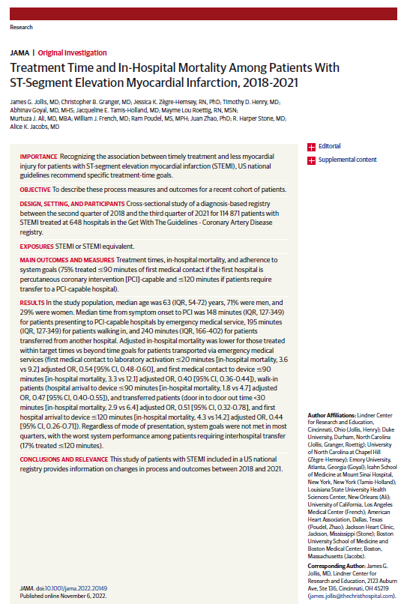

James G. Jollis, MD; Christopher B. Granger, MD; Jessica K. Zègre-Hemsey, RN, PhD; Timothy D. Henry, MD; Jacqueline E. Tamis-Holland, MD; Mayme Lou Roettig, RN, MSN; Murtuza J. Ali, MD, MBA; William J. French, MD; Ram Poudel, MS, MPH; Juan Zhao, PhD; R. Harper Stone, MD; Alice K. Jacobs, MD
Treatment Time and In-Hospital Mortality Among Patients With ST-Segment Elevation Myocardial Infarction, 2018-2021
Published simultaneously online, November 6, 2022

