Slide 1

TCT Template
Title 30 pt Bold Arial
Impact of Underlying Causes of Acute Coronary Syndrome on 1-Year Outcomes After Percutaneous Coronary Intervention:
Results from OCT Guided Primary PCI Registry -TACTICS Registry-
John Doe, MD
Subtitle 25 pt Arial Bold Italics
Toshiro Shinke, MD, PhD
On behalf of TACTICS investigators

Slide 2

Disclosure Statement of Financial Interest
Within the past 12 months, I or my spouse/partner have had a financial interest/arrangement or affiliation with the organization(s) listed below.
Affiliation/Financial Relationship | Company
Grant/Research Support | Abbott Medical Japan.
Consulting Fees/Honoraria | Abbott Medical Japan, Boston Scientific, Bayer, Daiichi-Sankyo, Bristol Meyers
Major Stock Shareholder/Equity | None
Royalty Income | None
Ownership/Founder | None
Intellectual Property Rights | None
Other Financial Benefit | None

Slide 3
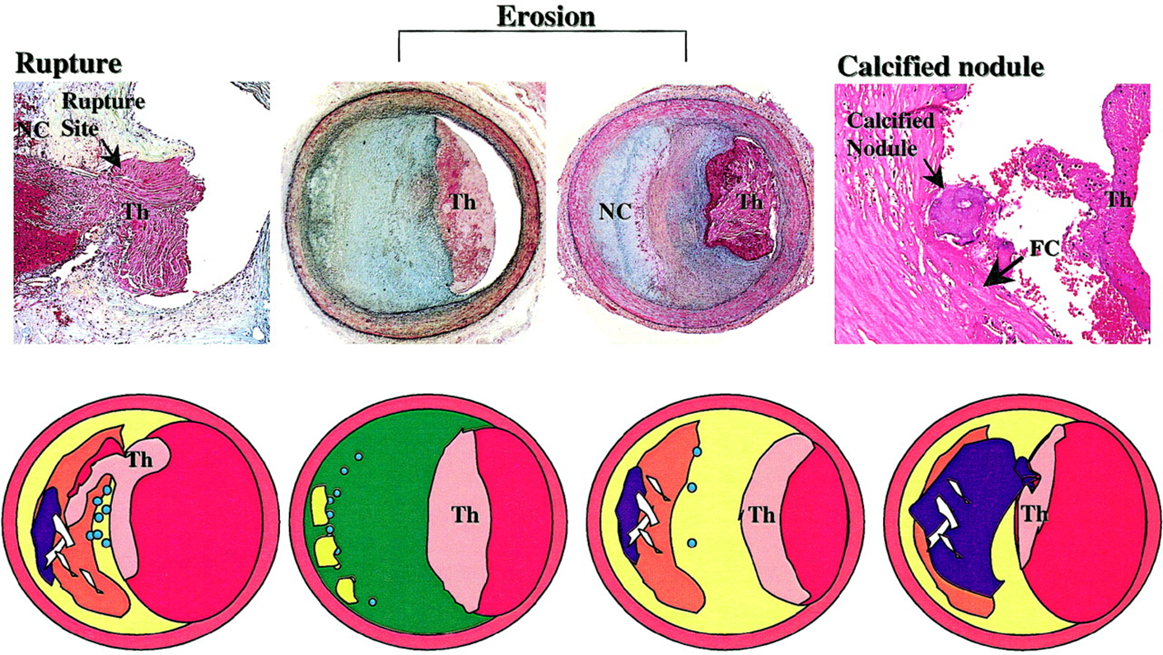
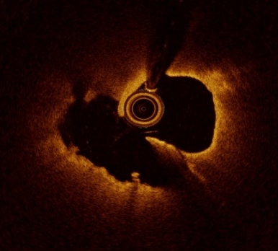
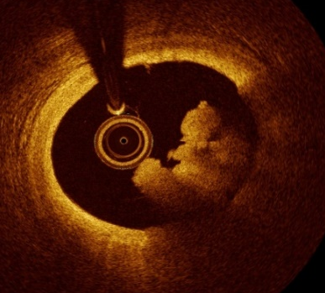
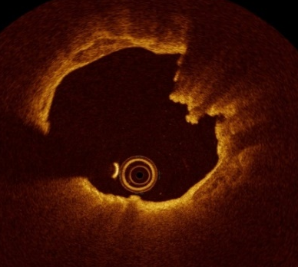
Underlying causes of ACS
Plaque Rupture
Plaque Erosion
Calcified Nodule
The retrospective studies have suggested optical coherence tomography (OCT) enables to diagnose underlying causes of acute coronary syndrome (ACS) such as plaque rupture, plaque erosion and calcified nodule.
Virmani R et al. ATVB. 2000;20:1262-1275.
Notes:
2

Slide 4
Prevalence of ACS underlying causes
Author | Lesions | Plaque Rupture | Plaque Erosion | Calcified Nodule | Others
Jia et al. | 126 | 55 | 39 | 10 | 19
Guagliumi et al. | 128 | 63 | 32 | – | 31
Wang et al. | 80 | 37 | 25 | 2 | 16
Higuma et al. | 112 | 72 | 30 | 9 | –
Kajander et al | 70 | 34 | 31 | 5 | –
The prevalence of the ACS underlying causes had been reported
in several OCT studies with relatively slight populations.
Ali ZA et al. JACC Cardiovasc Interv. 2017;10(24):2473-2487.
Jia H et al. J Am Coll Cardiol. 2013;62:1748–58.
Guagliumi G et al. J Am Coll Cardiol Intv. 2014;7:958–68.
Wang L et al. Eur Heart J Cardiovasc Imaging. 2015;16:1381–9.
Higuma T et al. J Am Coll Cardiol Intv. 2015;8:1166–76.
Kajander OA et al. EuroIntervention. 2016;12:716–23.
Ali ZA, et al. J Am Coll Cardiol Intv 2017;10:2473–87

Slide 5

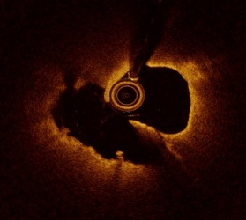
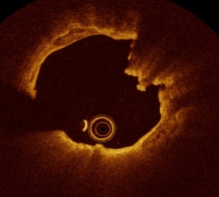
Clinical outcomes related to underlying cause of ACS
The clinical outcomes associated with the ACS underlying cause
have not been evaluated in large-scale multicenter study.
The clinical utility of OCT-guided primary PCI for ACS patients in the “real world” was still debatable.
ACS-PCI
?
Clinical
outcome
Notes:
4

Slide 6
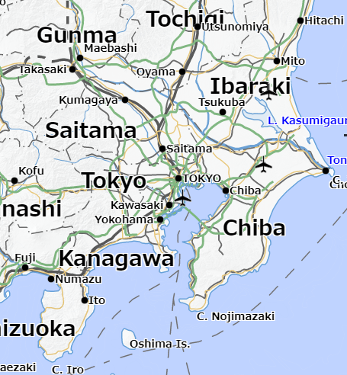

TACTICS Registry
Tokyo / Kanagawa / Chiba / Shizuoka / Ibaraki active OCT applications for ACS
Investigator-initiated, prospective, multicenter, observational study
Showa University Hospital (Tokyo)
Nippon Medical School Chiba Hokusoh Hospital(Chiba)
Showa University Koto-Toyosu Hospital (Tokyo)
Showa University Fujigaoka Hospital (Kanagawa)
Tsuchiura Kyodo General Hospital (Ibaraki)
Hitachi Medical Center Hospital (Ibaraki)
New Tokyo Hospital (Chiba)
Tokyo Medical and Dental University (Tokyo)
Japanese Red Cross Musashino Hospital (Tokyo)
Juntendo University Graduate School of Medicine (Tokyo)
Teikyo University Hospital (Tokyo)
Tokyo Medical University Hospital (Tokyo)
Tokyo Women's Medical University (Tokyo)
Edogawa Hospital (Tokyo)
Ayase Heart Hospital (Tokyo)
Kanto Rosai Hospital (Kanagawa)
Yokohama Minami Kyosai Hospital (Kanagawa)
Kikuna Memorial Hospital (Kanagawa)
St. Marianna University School of Medicine(Kanagawa)
Tokai University School of Medicine (Kanagawa)
Showa University Northern Yokohama Hospital (Kanagawa)
Juntendo University Shizuoka Hospital (Shizuoka)
22 hospitals

Slide 7
Study Design of TACTICS registry
Design | Investigator-initiated, prospective, multicenter, observational study
Objectives | To identify the prevalence of underlying causes of ACS using OCT-defined morphology for the culprit lesion To assess the impact of underlying causes of ACS on clinical outcomes
Subjects | ACS patients underwent OCT-guided primary PCI within 24 hours from symptom onset.
Follow-up duration | up to 2 years
RESEARCH FUND | Abbott Medical Japan LLC.
Study identifier: UMIN 000039050, UMIN 000042459
Study design: Yamamoto MH et.al. J Cardiol. 2022;S0914-5087(22)00164-2.
Notes:
6

Slide 8
Inclusion and key exclusion criteria
Inclusion criteria
1. ACS patients underwent OCT-guided primary PCI within 24 hours from symptom onset.
2. Age ≥20 years
3. Willing and able to provide written informed consent
Key exclusion criteria
1. In-stent thrombosis of previously implanted stent
2. Anticipated technical contraindication to OCT
3. Estimated life expectancy <2 years

Slide 9
OCT-Guided Primary PCI
・Prompt Recanalization: Thrombus aspiration, pre-dilatation with ≦2.0 mm
balloon or excimer laser before initial OCT if necessary
・Underlying causes of ACS defined by OCT: Primary Endpoint
・Lesion preparation
Morphology
・ Reference site: Minimally diseased site with the least lipid plaque
・ Stent Sizing: Based on lumen / EEL diameter at reference sites
Sizing
・TIMI III flow achievement
・Minimum stent / lumen area ≥4.5 mm² or % stent expansion ≥70%
・No major dissection, large malapposition, extensive protrusion or thrombus
Optimization
Changes in PCI strategy based on OCT findings were documented
Study design: Yamamoto MH et.al. J Cardiol. 2022;S0914-5087(22)00164-2.

Slide 10
Algorithm to classify underlying causes of ACS
by independent OCT core-laboratory*
ACS
Culprit Lesion
performed PCI
Others
Luminal Narrowing
Significant stenosis
Spontaneous coronary
artery dissection
Spasm
Fibrous cap
Disruption
No
Thrombus
No
Yes
Yes
Plaque
Burden
Minimal
Others
Thrombotic
Obstruction
Underlying
Plaque
Ectasia
Embolism
Lipid
plaque
Calcified
plaque
≥ Mild
Plaque
Rupture
Calcified
Nodule
Plaque
Erosion
* Kobe Cardiovascular Core Analysis Laboratory,
Kobe, Japan

Slide 11
Endpoints
・Primary Endpoint
Prevalence of underlying causes of ACS using OCT-defined morphology
(plaque rupture, plaque erosion, calcified nodule, and others)
・Secondary Endpoints
Hazard ratios of major cardiovascular events (MACE: cardiovascular
death, myocardial infarction, heart failure or ischemia-driven
revascularization) at one-year in patients with each underlying cause
Notes:
10

Slide 12
Statistical Design
Sample size estimation
This is an single-arm study designed to present descriptive information.
Sample size estimation was based on the previous data reporting the incidence of plaque rupture, plaque erosion and calcified nodule were 44%, 33% and 8%¹⁾.
Assuming that 8% of the subjects have a culprit lesion with calcified nodule, a sample size of 700 subjects is a sufficient number since we would be 95% confident that between 6.0% and 10.0% of subjects in the population have the factor of interest.
The details of the study design is published previously²⁾.
Jia H et al. J Am Coll Cardiol. 2013;62:1748-58.
Yamamoto MH et.al. J Cardiol. 2022;S0914-5087(22)00164-2.

Slide 13

TCT Template
Title 30 pt Bold Arial
Results
John Doe, MD
Subtitle 25 pt Arial Bold Italics

Slide 14
Flowchart
ACS patients underwent primary PCI
within 24 hours from the onset and enrolled from November 2019 to April 2021
(n=1724)
Exclusion;
Non OCT-guided primary PCI (n=987)*
Protocol deviation (n=32)
OCT-guided primary PCI
(n=702)
TACTICS registry
Unanalyzable OCT in culprit lesion
(n=7)
Analyzable OCT for assessment of
ACS underlying causes
(n=695)
* TACTICS Background registry
UMIN 000042459
Notes:
13

Slide 15
Baseline characteristics
Variables | N=702
Age, years | 66.2 ± 12.8
Clinical presentation
STEMI, n(%) | 441 (62.8)
NSTEMI, n(%) | 199 (28.3)
UAP, n(%) | 62 (8.8)
Culprit vessel, n(%)
LM | 5 (0.7)
LAD | 371 (52.8)
LCX | 68 (9.7)
RCA | 258 (36.8)
TIMI flow grade 0 to 1, n(%) | 374 (53.3)
In-hospital mortality, n(%) | 7 (1.0)

Slide 16
Prevalence of underlying causes of ACS (primary endpoint)
Others*
11% (n = 78)
*Others
Significant stenosis | 64 (9.1%)
Coronary spasm | 7 (1.0%)
Ectasia | 3 (0.4%)
Embolism | 3 (0.4%)
Spontaneous coronary dissection | 1 (0.1%)
Calcified nodule
4% (n = 28)
Plaque erosion
26% (n = 178)
Plaque rupture
59% (n = 411)
N=695
Inter-observer kappa coefficient for plaque rupture, plaque erosion or calcified nodule was 0.890.

Slide 17
Patient characteristics
Variables | Plaque Rupture | Plaque Erosion | Calcified Nodule | p-value
Number of patients, n | 411 | 178 | 28
Age, years | 66.5 ± 12.3 | 63.7 ± 13.4 | 75.0 ± 11.3 | <0.001
Male, n(%) | 332 (80.8) | 150 (84.3) | 18 (64.3) | 0.042
BMI, kg/m² | 24.6 ± 4.0 | 25.0 ± 4.4 | 23.0 ± 4.0 | 0.056
Clinical presentation |  |  |  | 0.014
STEMI, n(%) | 299 (72.7) | 106 (59.6) | 16 (57.1)
NSTEMI, n(%) | 94 (22.9) | 58 (32.6) | 9 (32.1)
UAP, n(%) | 18 (4.4) | 14 (7.9) | 3 (10.7)
Killip III/IV heart failure, n (%) | 30 (7.3) | 5 (2.8) | 6 (21.4) | 0.001
LVEF, % | 55.2 ± 10.3 | 55.7 ± 10.5 | 56.8 ± 8.8 | 0.71
Current smoker, n(%) | 143 (34.8) | 77 (43.3) | 4 (14.3) | 0.007
Hemodialysis, n(%) | 6 (1.5) | 4 (2.2) | 6 (21.4) | <0.001
Previous MI, n(%) | 17 (4.1) | 5 (2.8) | 2 (7.1) | 0.493
Previous PCI, n(%) | 32 (7.8) | 9 (5.1) | 4 (14.3) | 0.175
Previous CABG, n(%) | 2 (0.5) | 0 (0.0) | 1 (3.6) | 0.041

Slide 18
Angiographic characteristics
Variables | Plaque Rupture | Plaque Erosion | Calcified Nodule | p-value
Pre-PCI assessment
Culprit vessels |  |  |  | 0.001
LM, n(%) | 2 (0.5) | 1 (0.6) | 1 (3.6)
LAD, n(%) | 195 (47.9) | 111 (62.7) | 12 (42.9)
LCX, n(%) | 38 (9.3) | 20 (11.3) | 0 (0.0)
RCA, n(%) | 172 (42.3) | 45 (25.4) | 15 (53.6)
Type B2/C, n(%) | 270 (65.7) | 104 (58.5) | 23 (82.2) | 0.032
TIMI 0/I flow grade, n(%) | 251 (61.1) | 91 (51.1) | 12 (42.8) | 0.014
SYNTAX score | 14.0 ± 8.2 | 13.0 ± 7.5 | 20.4 ± 13.6 | <0.001
Post-PCI assessment
TIMI III flow grade, n (%) | 394 (95.9) | 173 (98.3) | 28 (100) | 0.192
SYNTAX score | 4.5 ± 6.5 | 3.0 ± 4.8 | 10.9 ± 12.2 | <0.001
97% of the patients achieved TIMI III flow

Slide 19
OCT measurements
Variables | Plaque Rupture | Plaque Erosion | Calcified Nodule | p-value
Pre-PCI assessment
Lipid plaque, n(%) | 411 (100.0) | 142 (79.8) | 10 (35.7) | <0.001
TCFA, n(%) | 340 (82.7) | 46 (25.8) | 5 (17.9) | <0.001
Calcification, n(%) | 254 (61.8) | 102 (57.3) | 28 (100.0) | <0.001
Thrombus, n(%) | 397 (96.6) | 178 (100.0) | 27 (96.4) | 0.044
Post-PCI assessment
Minimum lumen area, mm² | 5.88 ± 2.10 | 5.83 ± 2.24 | 5.52 ± 2.59 | 0.75
Stent expansion, % | 75.3 ±18.5 | 75.2±16.6 | 74.0±17.8 | 0.94
Stent eccentricity index | 0.82 ± 0.06 | 0.82 ± 0.07 | 0.71 ± 0.08 | <0.001
Max tissue protrusion area, mm² | 1.25 ± 0.74 | 0.98 ± 0.62 | 0.80 ± 0.33 | <0.001
Max stent malapposed area, mm² | 0.91 ± 0.75 | 0.91 ± 0.72 | 1.15 ± 0.57 | 0.32
85% of the patients: Minimum lumen area ≥4.5 mm² or stent expansion ≥70%

Slide 20
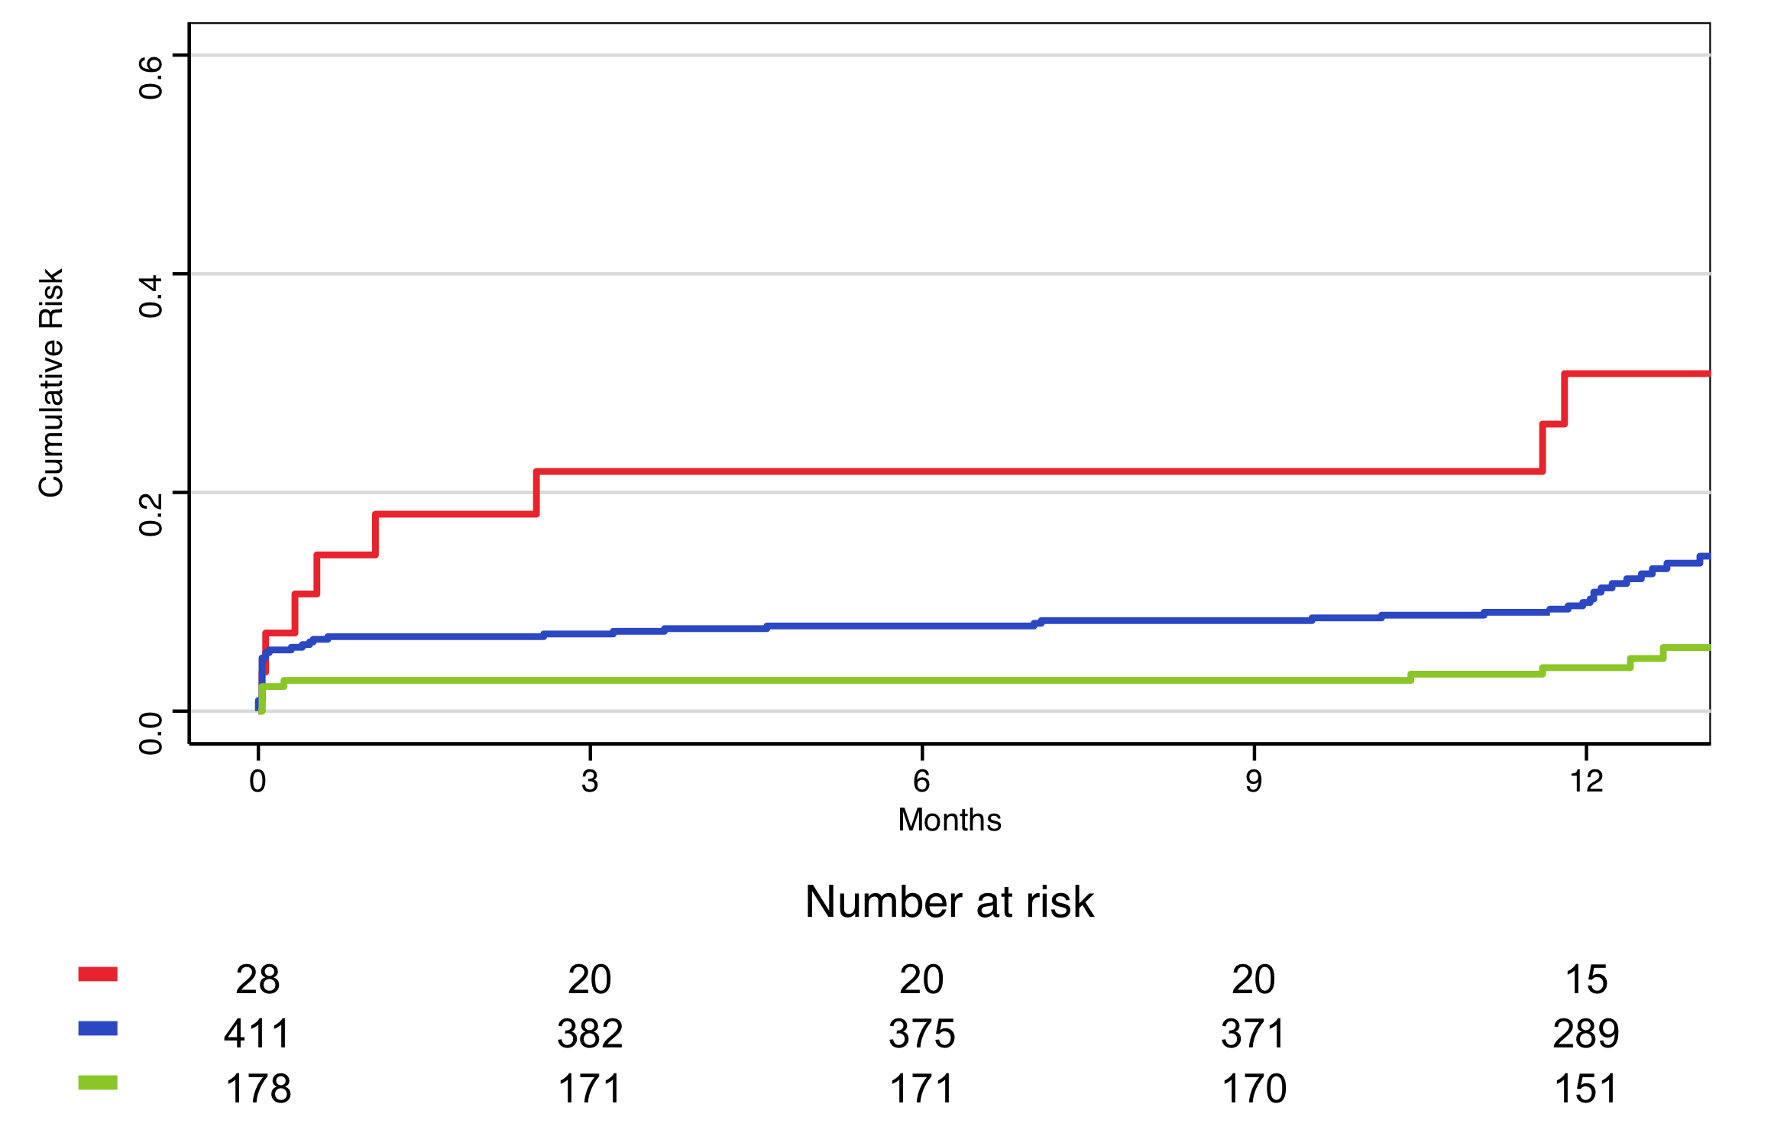
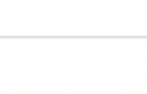

MACE stratified by ACS underlying causes
60
Log-rank p<0.0001
Calcified nodule: Unadjusted HR, 6.81 (95%CI 2.81-16.49), p<0.001
Plaque rupture: Unadjusted HR, 2.2 (95%CI 1.15-4.22), p=0.018
(Plaque erosion as reference)
40
Calcified Nodule
32.1%
Cumulative rate of MACE (%)
20
Plaque Rupture
12.4%
Plaque Erosion
6.2%
0

Slide 21
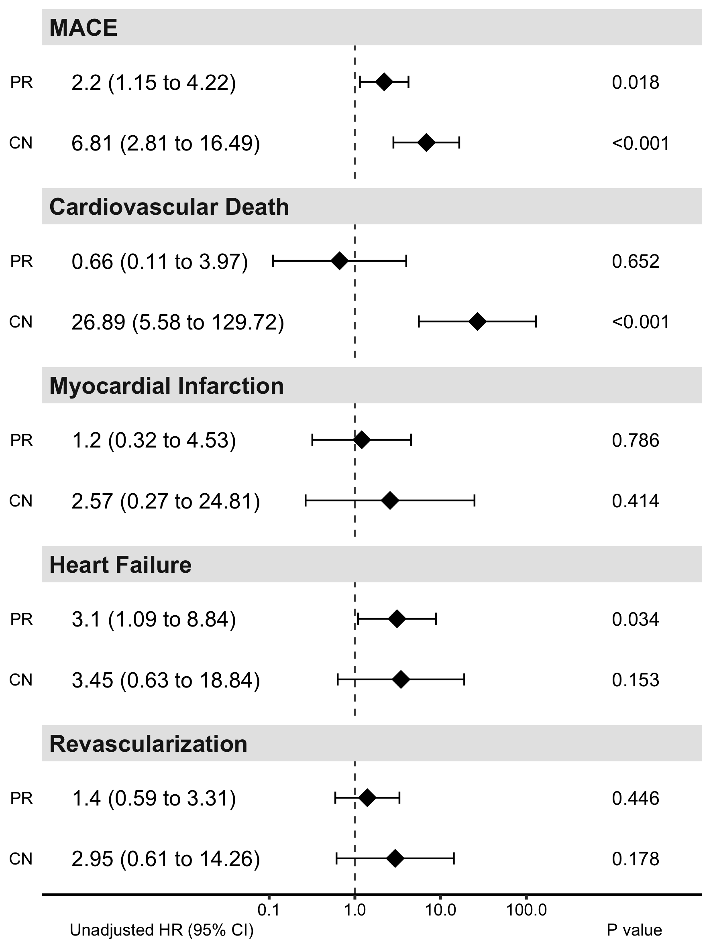
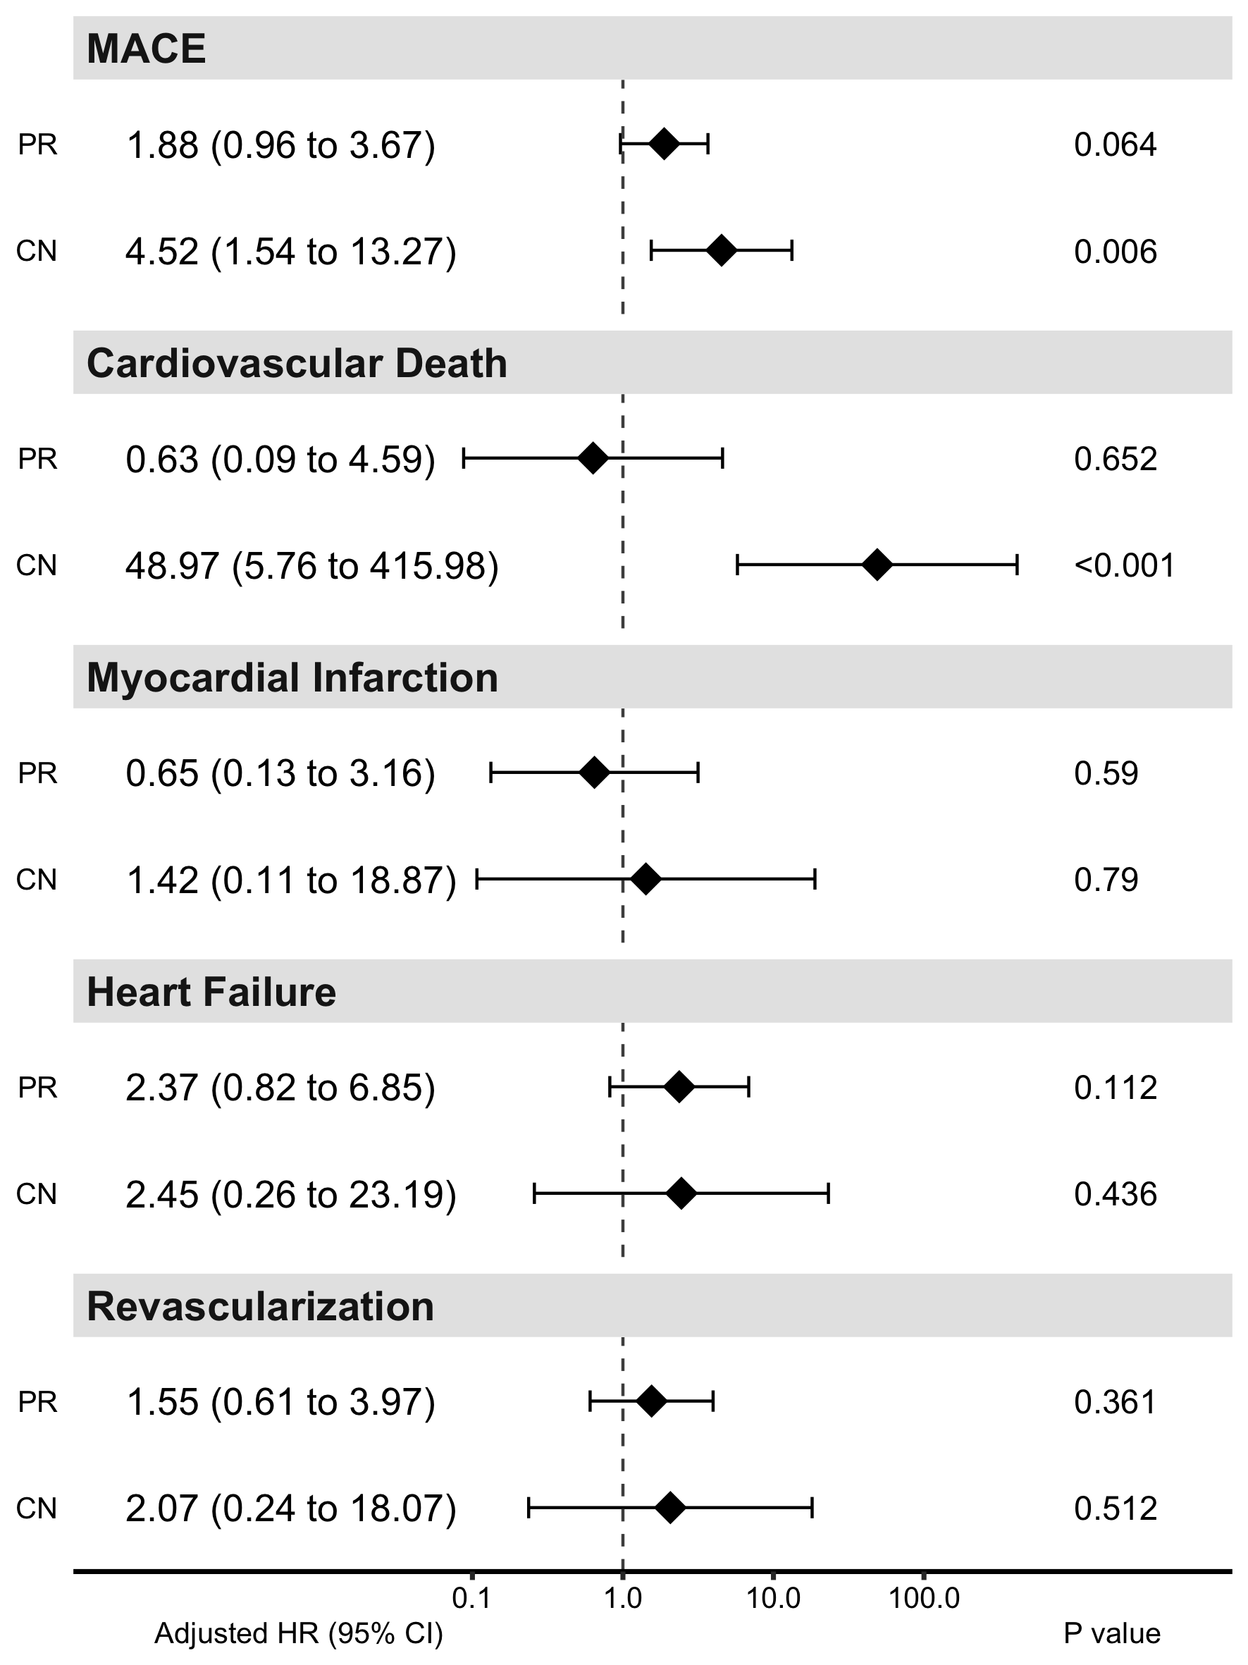
Hazard ratios for MACE
Unadjusted
Plaque rupture
Calcified nodule
Adjusted*
Plaque rupture
Calcified nodule
*Adjusted by age, gender, hemodialysis, ACS presentation, insulin use, LVEF, reference lumen area and stent length.
Decreased risk
Increased risk
(Plaque erosion as reference)

Slide 22
Impacts of OCT guidance on PCI
(%)
(%)
Frequency of PCI strategy changes based on OCT findings
58.1%
54.6%
Frequency
15.7%
16.0%
4.8%
5.6%
3.0%
Any strategy
change
Stentless
Additional
lesion
preparation
Stent
size
change
Stent
length
change
Additional
stent
implantation
Additional
post
dilatation
Morphology
Sizing
Optimization

Slide 23
Limitations
・Selection bias due to enrollment of only ACS patients underwent OCT-guided primary PCI may have influenced this study results.
・OCT-based assessment of underlying causes of ACS was not supported by histological definition of those mechanisms.
・This study was conducted as an observational study and OCT-guided PCI strategy was not standardized according to the underlying cause of ACS.

Slide 24
Take Home Message
・The proportions of the ACS underlying causes based on OCT-defined morphology were 59% of plaque rupture, 26% of plaque erosion, and 4% of calcified nodule in the present large-scale multicenter prospective study (n = 702).
・ACS underlying causes evaluated by OCT enable us to stratify the future risk of MACE.
・ OCT guidance affected the PCI strategy in 58% of the ACS patients.
・The further study to evaluate the possibility of OCT-guided optimization based on the ACS underlying cause is warranted.

Slide 25
Acknowledgements
・Division of Cardiovascular Medicine, Department of Internal
Medicine, Kobe University Graduate School of Medicine
(Kobe):
Hiromasa Otake
Yoichiro Sugizaki
Ken-ichi Hirata
・Division of Cardiology, Yokohama City University Medical
Center (Kanagawa):
Kiyoshi Hibi
・Department of Cardiology, Sakakibara Heart Institute (Tokyo):
Mamoru Nanasato
・Division of Clinical Pharmacology, Department of
Pharmacology, Showa University School of Medicine (Tokyo):
Takuya Mizukami
Takehiko Sambe
Sakiko Yasuhara
・Clinical Research Institute for Clinical Pharmacology &
Therapeutics, Showa University (Tokyo):
Myong Hwa Yamamoto
TACTICS Investigators
・Showa University Hospital (Tokyo) : Seita Kondo
・Nippon Medical School Chiba Hokusoh Hospital(Chiba):
Masamichi Takano,Nobuaki Kobayashi
・Showa University Koto-Toyosu Hospital (Tokyo): Kohei Wakabayashi
・Showa University Fujigaoka Hospital (Kanagawa):
Teruo Sekimoto , Hiroyoshi Mori, Hiroshi Suzuki
・Tsuchiura Kyodo General Hospital (Ibaraki): Tomoyo Sugiyama, Tsunekazu Kakuta
・Hitachi Medical Center Hospital (Ibaraki): Takeshi Kondo
・New Tokyo Hospital (Chiba): Satoru Mitomo, Sunao Nakamura
・Tokyo Medical and Dental University (Tokyo): Taishi Yonetsu
・Japanese Red Cross Musashino Hospital (Tokyo): Takashi Ashikaga
・Juntendo University Graduate School of Medicine (Tokyo): Tomotaka Dohi
・Teikyo University Hospital (Tokyo): Hirosada Yamamoto, Ken Kozuma
・Tokyo Medical University Hospital (Tokyo): Jun Yamashita
・Tokyo Women's Medical University (Tokyo): Junichi Yamaguchi
・Edogawa Hospital (Tokyo): Hiroshi Ohira
・Ayase Heart Hospital (Tokyo): Kaneto Mitsumata
・Kanto Rosai Hospital (Kanagawa): Ken Arai, Atsuo Namiki
・Yokohama Minami Kyosai Hospital (Kanagawa): Shigeki Kimura
・Kikuna Memorial Hospital (Kanagawa): Junko Honye
・St. Marianna University School of Medicine(Kanagawa): Nozomi Kotoku
・Kawasaki Municipal Tama Hospital (Kanagawa): Takumi Higuma
・Tokai University School of Medicine (Kanagawa): Makoto Natsumeda, Yuji Ikari
・Showa University Northern Yokohama Hospital (Kanagawa):
Naoei Isomura, Masahiko Ochiai
・Juntendo University Shizuoka Hospital (Shizuoka): Satoru Suwa

Slide 26
Thank you for your attention

