Slide 1

Endovascular Ultrasound Renal Denervation to Treat Uncontrolled Hypertension: Primary Results of the Randomized, Sham-Controlled RADIANCE II Pivotal Trial
Ajay J. Kirtane, MD, SM
Columbia University Irving Medical Center
New York-Presbyterian Hospital
On Behalf of Michel Azizi, Université Paris Cité, Hôpital Européen Georges Pompidou, Paris, France
and the RADIANCE II Investigators
@ajaykirtane

Slide 2
Disclosure Statement of Financial Interest
Dr. Kirtane reports Institutional funding to Columbia University and/or Cardiovascular Research Foundation from Medtronic, Boston Scientific, Abbott Vascular, Amgen, CSI, Philips, ReCor Medical, Neurotronic, Biotronik, Chiesi, Bolt Medical, Magenta Medical, Canon, SoniVie, Shockwave Medical, and Merck. In addition to research grants, institutional funding includes fees paid to Columbia University and/or Cardiovascular Research Foundation for consulting and/or speaking engagements in which Dr. Kirtane controlled the content. Personal: Consulting from IMDS; Travel Expenses/Meals from Medtronic, Boston Scientific, Abbott Vascular, CSI, Siemens, Philips, ReCor Medical, Chiesi, OpSens, Zoll, and Regeneron.

Slide 3
Background / Objective
Endovascular ultrasound renal denervation (uRDN) has been shown to reduce blood pressure in two sham-controlled randomized trials:
  RADIANCE-HTN SOLO (mild-moderate HTN, off medication design)
  RADIANCE-HTN TRIO (HTN resistant to single-pill combination therapy)
RADIANCE II is a larger, pivotal device IDE trial designed to confirm the effectiveness and safety of uRDN among patients with uncontrolled mild-to-moderate hypertension.

Slide 4
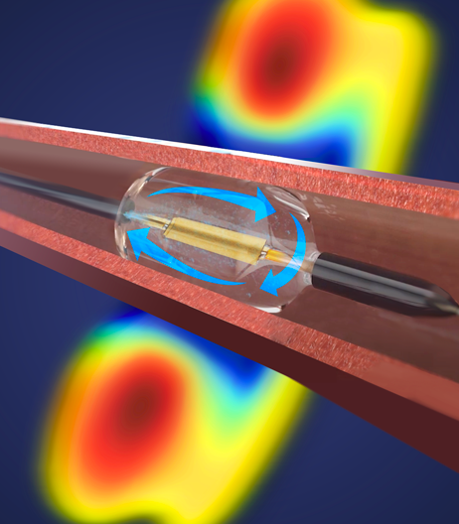
Paradise Ultrasound Renal Denervation System
Thermal Profile
Ultrasonic Heating + Water Cooling
Circumferential ring of ablative energy (depth of 1-6 mm) to interrupt renal nerve signaling
Arterial wall protected by water circulating through balloon
2-3 sonications each lasting 7 seconds are delivered to appropriately sized renal arteries

Slide 5
RADIANCE II: Study Design
Blinded, Sham-Controlled, Powered to Demonstrate BP Lowering Effectiveness at 2M
Key Entry Criteria:
Age 18-75 years
Uncontrolled HTN with a history of medication treatment on 0-2 anti-HTN meds
Off-med daytime ABP≥135/85 & <170/105 mmHg
No prior CV or cerebrovascular events
No Type I or uncontrolled Type II diabetes
eGFR ≥ 40mL/min/m²
Eligible renal artery anatomy
Office BP Screening
HTN Medication Washout (4 weeks)
Daytime ABP ≥135/85 and <170/105 mmHg
CTA/MRA, then Renal Angiography
No Meds unless Escape BP Criteria Exceeded Patients/Assessors Both Blinded
R
2:1
uRDN
(N = 150)
Sham
(N = 74)
Primary Efficacy Endpoint @ 2 Months
∆ Daytime Ambulatory Systolic BP
Blinded Med Titration Protocol
6 Month Follow-up
(ABP, home BP, office BP, CTA/MRA)
Blinded “Standard of Care” Meds
Escape BP criteria:
Home BP≥170/105 mmHg / Office BP≥180/110 mmHg with clinical symptoms
12 Month Follow-up
(ABP, home BP, office BP, CTA/MRA*)
Unblinded “Standard of Care” Meds
24, 36, 48, & 60 Month Follow-up
*uRDN group only

Slide 6
Patient Flow
1038 Patients Enrolled
(between January 14, 2019 and March 25, 2022)
778 Were excluded prior to renal angiography
Did not meet office BP criteria
198 Did not meet ambulatory BP criteria
113 Did not meet renal anatomic criteria on CTA/MRA
81 Withdrew consent
59 Other clinical exclusion criteria identified
33 Met BP safety escape criteria
25 COVID-19 enrollment suspension
20 Withdrawn per physician discretion
10 Adverse event related
8 Lost to follow-up
7 Other
260 Underwent renal angiography
36 Did not meet angiographic eligibility
224 Underwent randomization
150 Assigned to uRDN
74 Assigned to Sham
150 included in intention-to-treat population
145 Completed 2-month ABPM (observed data)*
5 Missing 2-month ABPM**
74 included in intention-to-treat population
73 Completed 2-month ABPM (observed data)*
1 Missing 2-month ABPM**
*4 patients in uRDN and 6 patients in Sham that started medications prior to 2 months meeting escape criteria had BP values from last observation carried forward to 2 months
**Multiple imputation used for missing data in comparison of treatment arms

Slide 7
Clinical Characteristics Upon Enrollment
 | uRDN (N=150) | Sham (N=74)
Age (years) | 55.1 ± 9.9 | 54.9 ± 7.9
Female sex, % (N) | 31.3% (47) | 23.0% (17)
Race, % (N)
White | 76.0% (114) | 75.7% (56)
Black | 14.0% (21) | 20.3% (15)
Other | 10.0% (15) | 4.1% (3)
Body mass index - kg/m² | 30.1 ± 5.2 | 30.6 ± 5.2
eGFR - ml/min/1.73m² | 81.4 ± 14.4 | 82.3 ± 14.9
Type 2 Diabetes, % (N) | 6.0% (9) | 6.8% (5)
Sleep apnea, % (N) | 14.0% (21) | 17.6% (13)
Prior Hospitalization for hypertensive crisis, % (N) | 6.0% (9) | 4.1% (3)
Office Blood Pressure
SBP (mmHg) | 155.8 ± 11.1 | 154.3 ± 10.6
DBP (mmHg) | 101.3 ± 6.7 | 99.1 ± 5.6
Number of Anti-hypertensive Medications | 0.9 ± 0.8 | 1.1 ± 0.9

Slide 8
Baseline Blood Pressures:
After 4-week Washout Period (off Anti-Hypertensive Medications)
 | uRDN (N=150) | Sham (N=74)
ABPM
Daytime SBP (mmHg) | 150.3 ± 8.6 | 151.2 ± 9.0
Daytime DBP (mmHg) | 93.8 ± 5.2 | 93.2 ± 5.5
Nighttime SBP (mmHg) | 132.2 ± 12.5 | 134.1 ± 13.3
Nighttime DBP (mmHg) | 79.9 ± 8.2 | 80.5 ± 8.4
24-h SBP (mmHg) | 143.4 ± 8.9 | 144.6 ± 9.6
24-h DBP (mmHg) | 88.4 ± 5.8 | 88.3 ± 5.9
Home BP
SBP (mmHg) | 152.6 ± 9.6 | 150.1 ± 10.4
DBP (mmHg) | 98.0 ± 6.5 | 96.0 ± 7.5
Office BP
SBP (mmHg) | 156.9 ± 13.1 | 156.3 ± 12.8
DBP (mmHg) | 102.3 ± 7.6 | 101.0 ± 7.5

Slide 9
Procedure Details
 | uRDN (N=150) | Sham (N=74)
Procedure time (sheath removal - sheath insertion) (min) | 76.7 ± 25.2 | 43.9 ± 16.6
Device time (catheter out - catheter in) (min)* | 33.4 ± 18.7 | NA
Total Emission Time (seconds)* | 38.9 ± 7.3 | NA
Sedation
Conscious Sedation | 76.0% (114/150) | 78.1% (57/73)
Monitored Anesthesia Care (e.g. propofol) | 12.7% (19/150) | 13.7% (10/73)
General Anesthesia | 11.3% (17/150) | 8.2% (6/73)
Contrast volume (cc) | 135.7 ± 67.4 | 64.6 ± 30.4 (73)
Fluoroscopy time (minutes) | 15.9 ± 8.6 (149) | 4.2 ± 4.6 (72)
Total Number of Sonications* | 5.6 ± 1.0 | NA
Left* | 2.7 ± 0.7 | NA
Right* | 2.8 ± 0.7 | NA
Percentage with Treated Accessory or Proximal Side Branch* | 20.0% (30/150) | NA
Treatment successfully delivered (≥2 sonications bilaterally) | 98.7% (148/150) | NA
*One patient in the uRDN group incorrectly treated as sham (receiving no treatment) not included

Slide 10
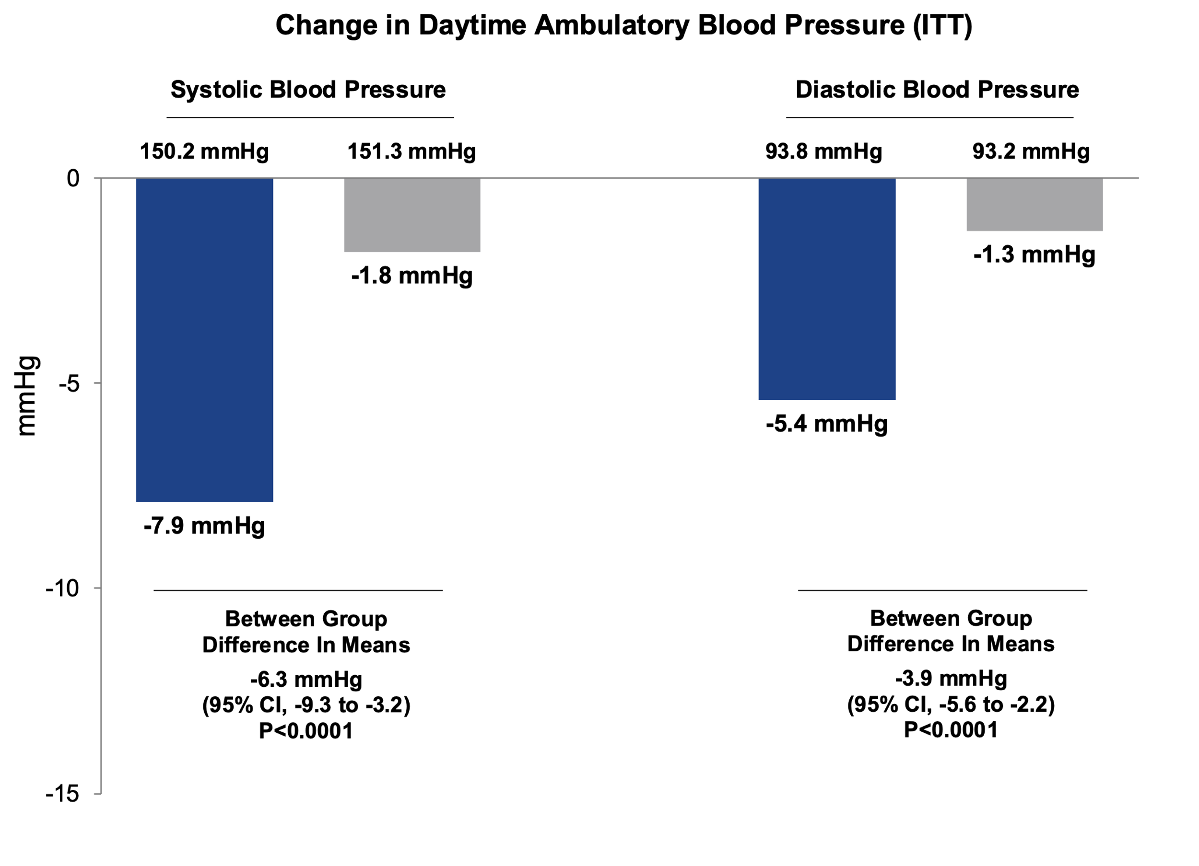
Primary Efficacy Endpoint (ITT):
Change in Daytime Ambulatory SBP at 2 Months
Baseline-Adjusted Change in Daytime Ambulatory SBP
uRDN
Sham
*
Individual group changes are based on observed values
Between group difference includes multiple imputation for missing values
*P<0.0001 using observed values or multiple imputation

Slide 11
ABPM profiles at Baseline and 2 Months
uRDN (N=145)
Sham (N=73)
Mean Between Group
Difference
24h Ambulatory SBP
-6.2 mmHg
(95% CI, -9.1 to -3.4)
P<0.0001
Nighttime Ambulatory SBP
-5.8 mmHg
(95% CI, -9.0 to -2.6)
P=0.0004
Patients that met escape criteria had baseline values carried forward

Slide 12
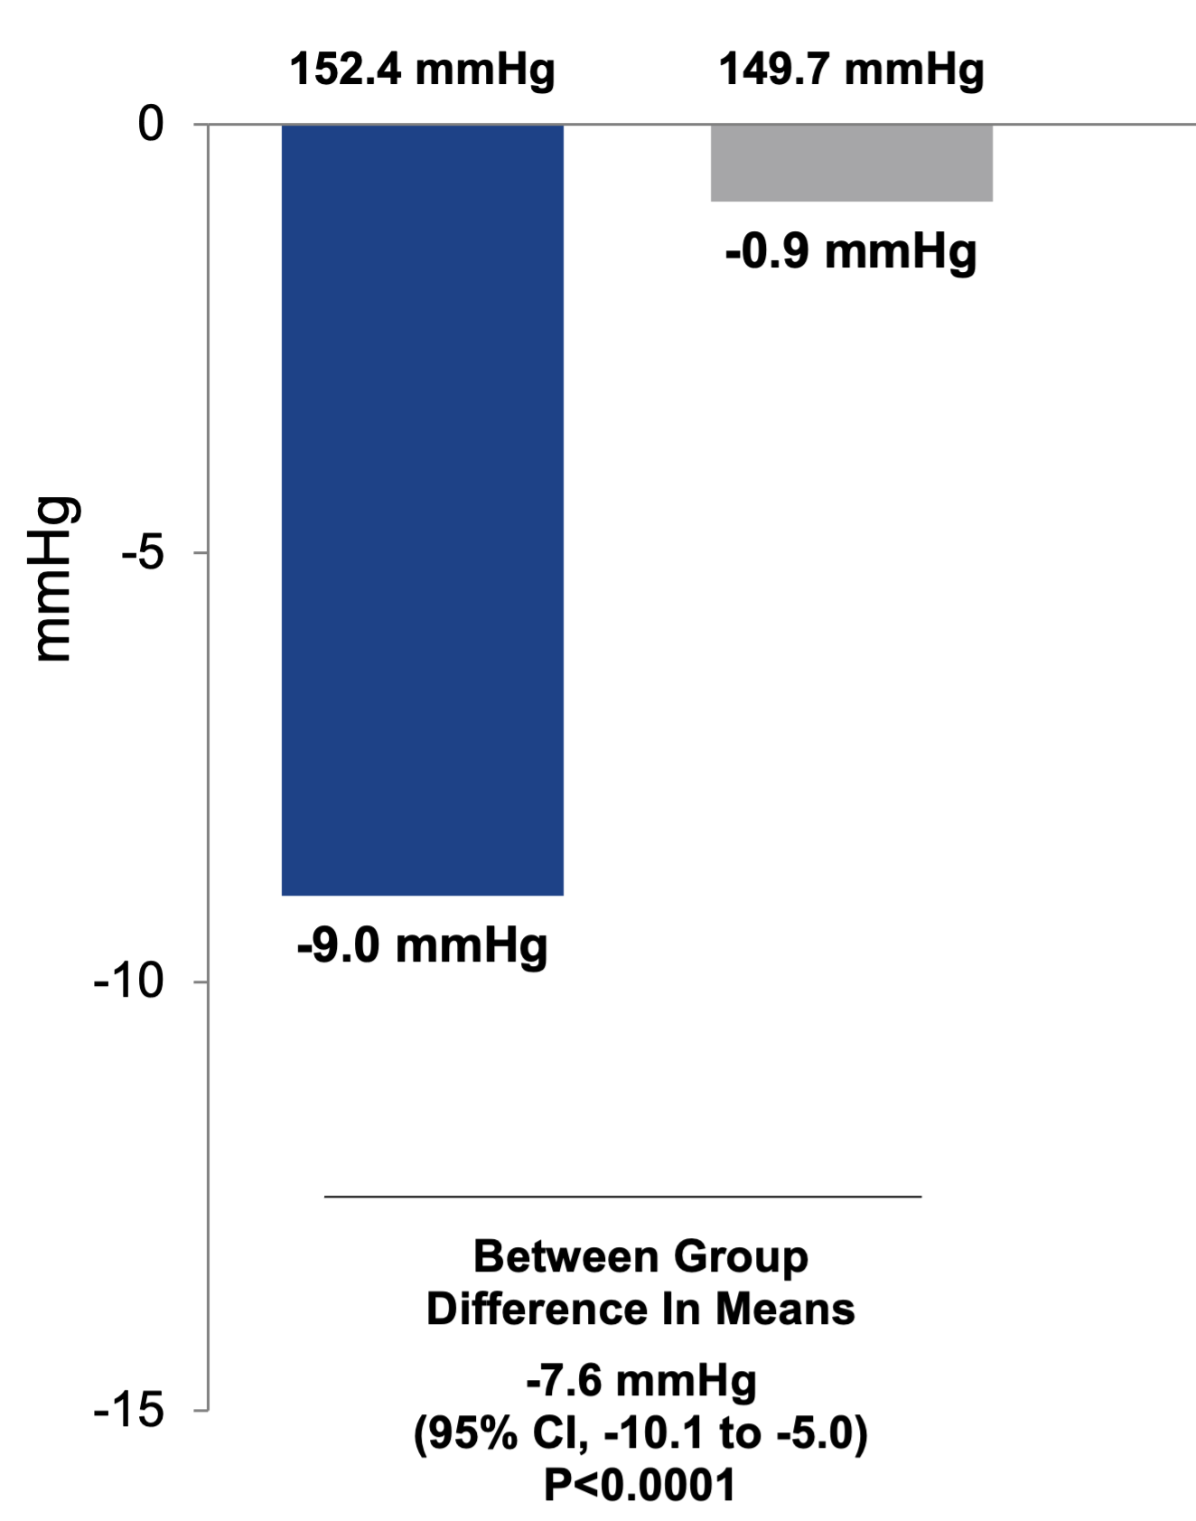
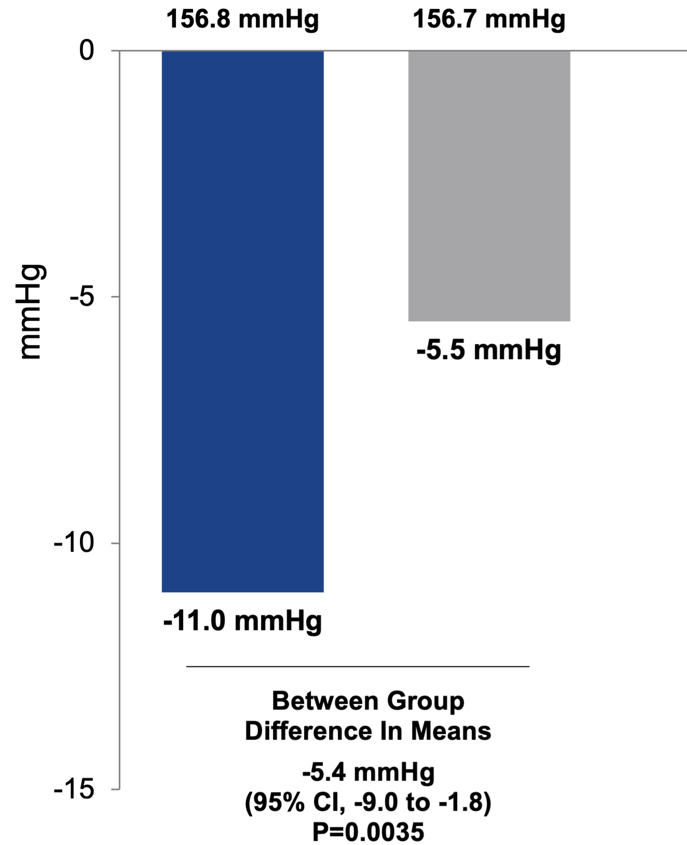
Change in Home and Office SBP at 2 Months
Baseline-Adjusted Change in Home SBP
Baseline-Adjusted Change in Office SBP
uRDN
(N=140)
Sham
(N=69)
uRDN
(N=137)
Sham
(N=71)
Home BP measured in 7 days prior to the office visit
Individual group changes are based on observed values
Between group difference includes multiple imputation for missing values

Slide 13
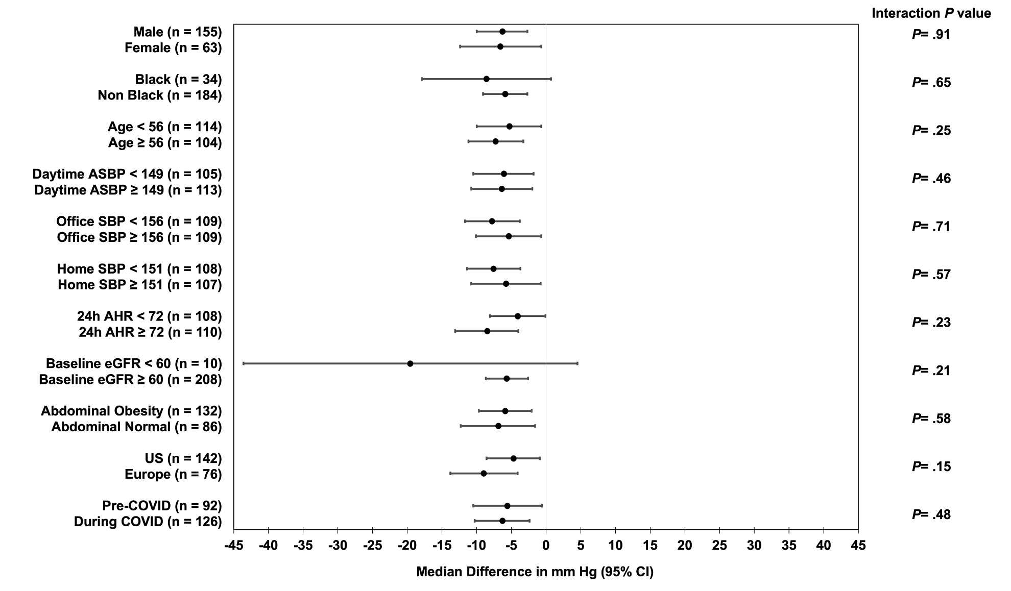
Subgroup Analysis:
Between Group Difference in 2M Change in Daytime Ambulatory SBP
AHR: ambulatory heart rate; ASBP: ambulatory systolic blood pressure; CI: confidence interval; SBP: systolic blood pressure; median baseline AHR, ASBP, home SBP, and office SBP are selected as cut-off points

Slide 14
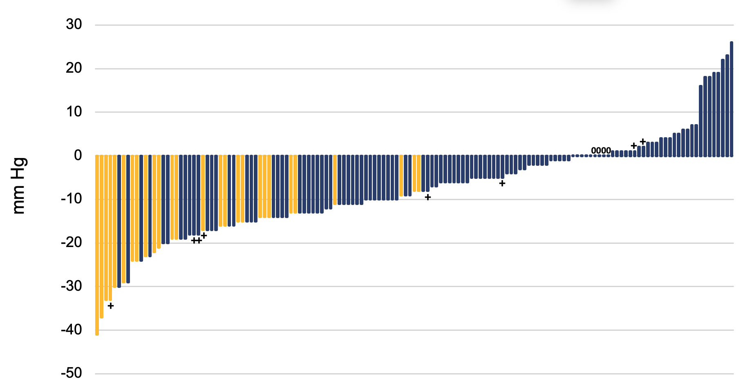
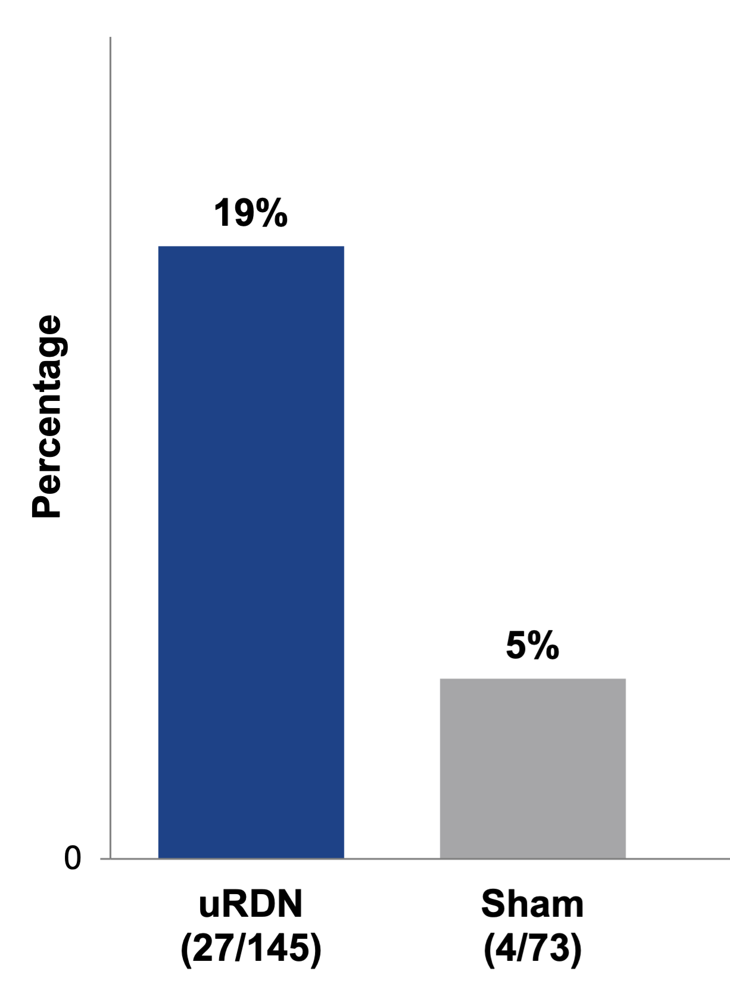
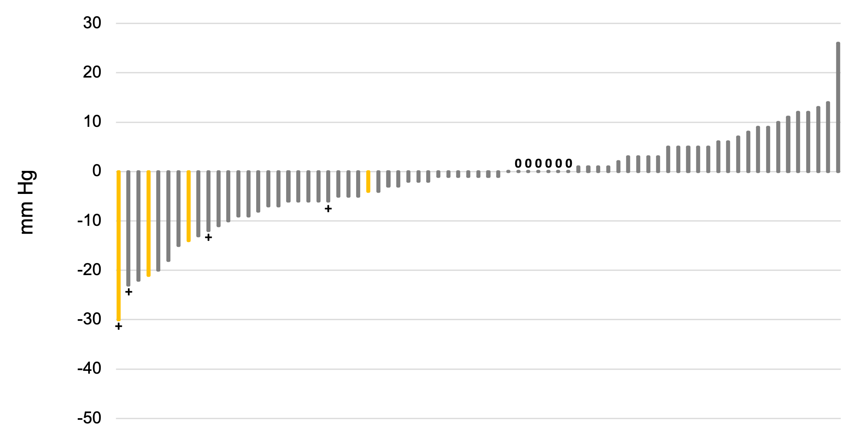
Individual Patient Responses and Proportion with Controlled BP:
Change in Daytime Ambulatory SBP at 2 Months (ITT - Observed Values)
RDN (N=145)
Daytime ABP
<135/85 mmHg
____________________________________
64% with 5 mmHg decrease
P=0.009
48% with 10 mmHg decrease
Between Group Differences:
5 mmHg decrease P<0.0001
10 mmHg decrease P<0.0001
Sham (N=73)
34% with 5 mmHg decrease
16% with 10 mmHg decrease
Orange bars show BP reductions for patients at control at 2 months (daytime ABP < 135/85 mmHg)
“+” indicates patients that resumed antihypertensives prior to 2 months (non-escape)
“0” indicates patients that met escape criteria and had last observation carried forward

Slide 15
Daytime ABP Control Rates and SBP Change at 2 Months
Stratified by Starting Daytime Ambulatory SBP
p for trend
uRDN: p=0.003
Sham: p=0.40
uRDN
Sham
p for trend = 0.045
ITT population with observed values, excluding all subjects that started medications prior to 2 months (uRDN N=133 and Sham N=63)

Slide 16
Change in Diastolic Blood Pressures at 2 Months
 | uRDN | Sham | Baseline Adjusted With Multiple Imputation*
 | Observed Difference (2M-Baseline) | Observed Difference (2M-Baseline) | Mean Between-Group Difference (95% CI) | P
Daytime Ambulatory DBP (mmHg) | N=145 -5.4 ± 6.5 | N=73 -1.3 ± 5.7 | -3.9 (-5.6, -2.2) | <0.0001
24h Ambulatory DBP (mmHg) | N=144 -5.3 ± 6.4 | N=72 -1.2 ± 5.4 | -4.1 (-5.7, -2.4) | <0.0001
Nighttime Ambulatory DBP (mmHg) | N=144 -4.7 ± 8.2 | N=72 -0.5 ± 6.7 | -4.2 (-6.3, -2.2) | <0.0001
Home DBP (mmHg) | N=140 -5.1 ± 6.0 | N=69 -0.3 ± 4.5 | -4.3 (-5.9, -2.8) | <0.0001
Office DBP (mmHg) | N=137 -5.9 ± 9.4 | N=71 -3.3 ± 9.2 | -2.3 (-4.9, 0.2) | 0.0755

Slide 17
eGFR at 2 Months
(Matched data at baseline and 2 months)
eGFR (mL/min/1.73 m²)
Baseline 2 months
Baseline 2 months
uRDN
(N=136)
Sham
(N=72)
Data are mean ± SD

Slide 18
Major Adverse Events (Complete through 30 days)
 | uRDN (N=150) | Sham (N=74)
30-day events
All-cause mortality | 0 (0.0%) | 0 (0.0%)
New onset ESRD (eGFR<15 mL/min/m² or need for renal replacement therapy) | 0 (0.0%) | 0 (0.0%)
Significant embolic event resulting in end-organ damage | 0 (0.0%) | 0 (0.0%)
Renal artery perforation or dissection requiring an invasive intervention | 0 (0.0%) | 0 (0.0%)
Major vascular complications requiring surgical repair, interventional procedure, thrombin injection, or blood transfusion | 0 (0.0%) | 0 (0.0%)
Hospitalization for hypertensive or hypotensive crisis | 0 (0.0%) | 0 (0.0%)
Hospitalization for major cardiovascular or hemodynamic related events | 0 (0.0%) | 0 (0.0%)
New onset stroke | 0 (0.0%) | 0 (0.0%)
New onset myocardial infarction | 0 (0.0%) | 0 (0.0%)
6-month events
New onset renal artery stenosis >70%, confirmed by CTA or MRA* | 0 (0.0%) | 0 (0.0%)
*At the time of analysis, 162 patients (117 RDN and 45 Sham) had completed the 6-month CTA/MRA

Slide 19
Limitations
Additional follow-up will be required to determine whether the BP lowering effect of uRDN remains durable and safe over time.
  Longer-term assessments for efficacy and safety are ongoing for 60 months.
These results apply to patients with mild-to-moderate hypertension at low CV risk, without significant comorbidities and CKD.
Without robust pre-procedural predictors of responsiveness and the absence of an intraprocedural marker of uRDN success, individual variability in treatment effect will continue to be observed.

Slide 20
Conclusions
The RADIANCE II pivotal trial is the largest individually powered randomized trial to demonstrate superiority of endovascular uRDN in lowering blood pressure compared with a sham procedure
The trial met primary/secondary efficacy BP lowering endpoints at 2 months, showing statistically and clinically significant reductions in:
  Daytime ambulatory SBP (↓7.9 mmHg from baseline, ∆6.3 mmHg vs. sham)
  24-h, nighttime, home and office SBP (∆5-7 mmHg vs. sham)
There were no major adverse events at 30 days
These results are concordant with those of RADIANCE-HTN SOLO and RADIANCE-HTN TRIO, confirming that uRDN lowers blood pressure across the spectrum of hypertension

Slide 21

Thank you to all the RADIANCE II Study Centers!
Europe (N=24) | United States (N=37)
Erasmus Medical Center-Joost Daemen, Hartlong Centrum, Alkmaar-Jan van Ramshorst, Hôpital Civil Marie Curie, Charleroi-Pascal Lefebvre, ZOL Genk-Bert Ferdinande, UMC Saint-Pierre-Panagiotis Xaplanteris, Hopital Européen Georges Pompidou-Michel Aziz, Hôpital Saint-André – CHU Bordeaux-Philippe Gosse, CHRU de Lille-Pascal Delsart, University Hospital Galway-Faisal Sharif, Hôpitaux Universitaires Genève-Juan Iglesias, Royal Bournemouth-Terry Levy, The Cardiothoracic Centre Basildon University, Essex-Firas Al-Janabi, St. Barts Health-Manish Saxena, The Queen Elizabeth University Hospital, Glasgow-Sandosh Padmanabhan, Freeman Hospital, Newcastle-Timothy Ellam, Kent and Canterbury Hospital-Neelan Das, University Hospital of Wales Cardiff-Andrew Sharp, University Clinic of Saarland – Homburg-Felix Mahfoud, University Clinic Erlangen-Roland Schmieder, Leipzig Heart Center-Philipp Lurz, Sana Kliniken Lübeck GmbH-Joachim Weil, UKSH Kiel-Matthias Lutz, Klinikum Konstanz-Nikolaos Dagkonakis, Klinikum Karlsruhe-Peter Reimer. | Columbia University Medical Center- Ajay Kirtane, Deborah Heart & Lung Center-Kintur Sanghvi, The University of North Carolina at Chapel Hill-Rick Stouffer, The Brigham and Women's Hospital-Naomi Fisher, Mass General Hospital-Joseph Garasic, Cleveland Clinic-Amar Krishnaswamy, Medical University of South Carolina-Thomas Todoran, Ochsner Heart and Vascular Institute-James Jenkins, Minneapolis Heart Institute-Yale Wang, Vanderbilt University Medical Center-Pete Fong, Cedars-Sinai Medical Center-Florian Rader, The Cardiac and Vascular Institute Research Foundation-Matheen Khuddus, University of Utah-Jo Abraham, Stamford Hospital-David His, Renown Regional Medical Center-Michael Bloch, Emory University School of Medicine-Chandan Devireddy, Franciscan Health-Atul Chugh, SIU Memorial Medical Center-John Flack, Penn Medicine-Debbie Cohen, San Diego Cardiac Center-Raghava Gollapudi. UT Memphis-Uzoma Ibebuogu, University of Pittsburg Medical Center-John Schindler, Hackensack University Med. Ctr.-David Landers. Munson Medical Center-Todd Adams, Cardiology PC-Farrell Mendelsohn, Bridgeport Hospital-Robert Fishman, Saint Luke’s Mid America Heart Institute-Jason Lindsey, University of Colorado-Kevin Rogers, MedStar Health Research-Nelson Bernardo, Stony Brook University Medicine-John Reilly, Northwestern University-Keith Benzuly, Swedish Medical Center-Paul Huang, Cardiology Associates of North Mississippi-Barry Bertolet, WakeMed Clinical Research Institute-Brian Go, Northwell Health, Inc./Lenox Hill-Yi-Ming Yang, Northwell Health, Inc./Staten Island-Yi-Ming Yang, Sparrow Clinical Research Institute-Joel Cohn.

