Slide 1

TCT Template
Title 30 pt Bold Arial
COPS
Cutting balloon to Optimize Predilatation for Stenting
Antonio Mangieri, MD
On behalf of Antonio Colombo and the COPS investigators
John Doe, MD
Subtitle 25 pt Arial Bold Italics

Slide 2
Disclosure Statement of Financial Interest
Within the past 12 months, I or my spouse/partner have had a financial interest/arrangement or affiliation with the organization(s) listed below.
Affiliation/Financial Relationship | Company
Grant/Research Support | Research grant from Boston Scientific
Consulting Fees/Honoraria | Abbott Vascular, Boston Scientific, Concept Medical

Slide 3
Background (i)
Coronary artery calcifications (CAC) represent a challenge to percutaneous coronary interventions (PCI) by limiting stent expansion and increasing the probability of stent failure at follow-up.
In the modern era, a number of calcium modification techniques have been introduced with variable success with the aim to improve acute and long-term outcomes of PCI.
Notes:
2
This is the Bulleted List slide.
To create this particular slide, click the NEW SLIDE button on your toolbar and choose the BULLETED LIST format. (Top row, second from left)
The Sub-Heading and footnote will not appear when you insert a new slide. If you need either one, copy and paste it from the sample slide.
If you choose not to use a Sub-Heading, let us know when you hand in your presentation for clean-up and we’ll adjust where the bullets begin on your master page.
Also, be sure to insert the presentation title onto the BULLETED LIST MASTER as follows:
Choose View / Master / Slide Master from your menu.
Select the text at the bottom of the slide and type in a short version of your presentation title.
Click the SLIDE VIEW button in the lower left hand part of your screen to return to the slide show. (Small white rectangle)

Slide 4
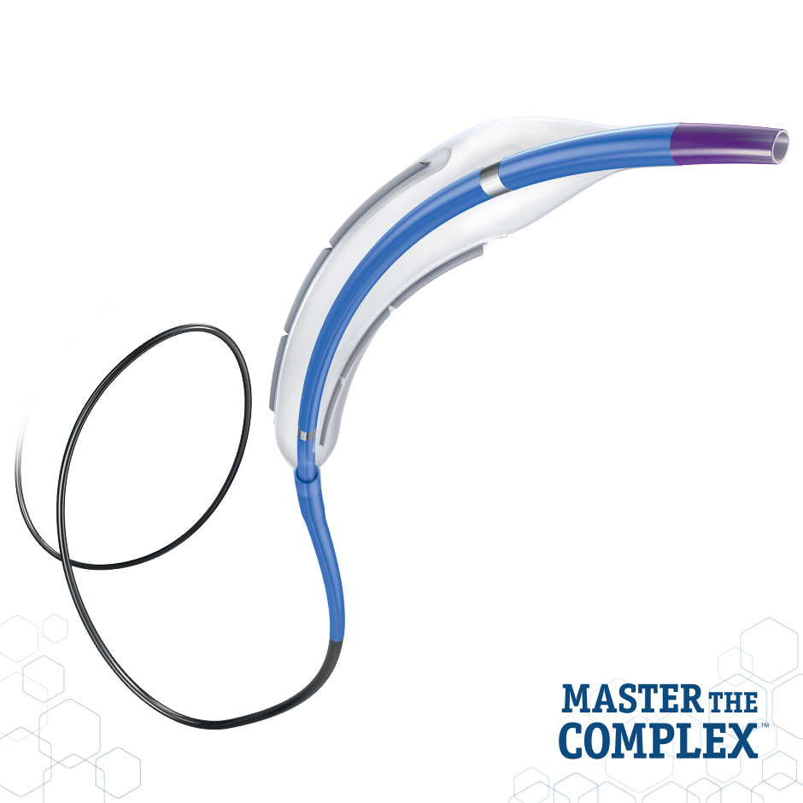
Background (ii)
The Wolverine cutting balloon (CB) is semi compliant, rapid-exchange balloon with three or four microblade mounted on its surface that facilitate calcium cracking
The actual recommendation for the usage of CB suggest inflations at nominal pressures.
Data comparing CB inflated at high pressure instead of nominal pressure in coronary calcifications are lacking

Slide 5
COPS trial
Cutting balloon to Optimize Predilatation for Stenting
Prospective, randomized, multicenter open-label trial which enrolled 100 patients with significant calcified lesions evaluated at IVUS
Randomization 1:1
Cutting
balloon
n=50
Non-compliant
Balloon
n=50

Slide 6
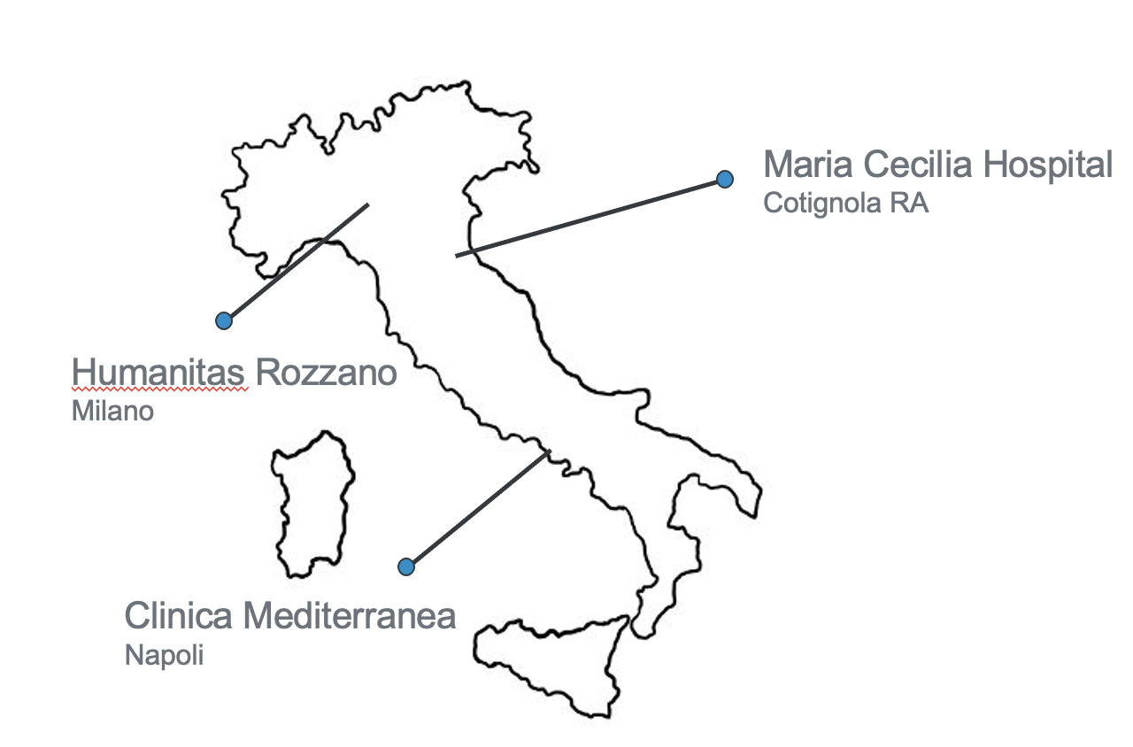
Study partecipants
Study PI: Antonio Mangieri, Roberto Nerla
Senior study PI: Antonio Colombo
Humanitas Rozzano: PI: Benrhard Reimers; Co PI: Damiano Regazzoli, Gabriele Gasparini
MCH Cotignola: Co PI: Fausto Castriota, Francesco Giannini
Clinical Mediterranea Napoli: PI: Carlo Briguori, Co PI: Andrea Bezzecheri, Fulvio Casale
Statistical Analysis: Pier Pasquale Leone, Montefiore Hospital
Corelab Analysis: Arif Khokhar, Hammersmith Hospital

Slide 7
Key inclusion criteria
Severe de novo calcified coronary lesions
A reference vessel diameter between 2.5 and 4.0 mm and deemed suitable for PCI
An arch of calcium at baseline IVUS of at least 100 degrees
Key exclusion criteria
In stent restenosis
Safenous vein graft lesions
STEMI
Comorbidities which preclude the achievement of one-year follow-up

Slide 8
Endpoints
Primary Endpoint :
Minimal stent area (MSA) at calcium site
Secondary Endpoints :
Eccentricity index : (LD _{max} – LD _{min}) / LD _{max}
MSA
Device failure: unsuccessful device delivery and/or inflation resulting in inadequate lesion preparation and/or damage of the vessel as consequence of device usage.
Vessel perforation, rate of major adverse cardiovascular events (MACE) and target lesion revascularization (TLR) at one-year follow-up.

Slide 9
Endpoints

Slide 10
Methods
Assumptions: we hypothesize a mean and standard deviation of MSA at calcium site of 5.0 ± 1.5 mm for the high-pressure CB lesion preparation vs. 4.0 ± 1.5 mm 2 for the NCB, a sample size of 36 patients per group was calculated to meet the primary endpoint requirements with a power of 80% and a two-sided alpha level of 0.05
The sample size proposed was 50 patients in each group to further increase the power and account for possible protocol deviations.
IVUS evaluation was performed by an independent corelab
A downsizing of 0.5 mm compared to the media-to-media diameter on IVUS was recommended when CB was inflated at high pressures
The COPS trial was supported by an institutional grant by Boston Scientific, who had no responsibility for study management, data collection and monitoring

Slide 11
Study Flow Chart
September 2019-June 2021
100 patients enrolled
n=13 patients excluded for major protocol deviations
n=6 in the CB group
n=7 un the NCB group
n=87 patients included in the final analysis
Per protocol analysis
n=44 patients treated with cutting balloon
n=43 patients treated with non-compliant balloon

Slide 12
Results
 | Overall | CB (n=44) | NCB (n=43) | P value
Age | 71±7.6 | 70.8±6.7 | 72.5±4.3 | 0.35
Female sex | 16 (18.3) | 11 ( 25) | 5 (11.6) | 0.166
Hypertension | 70 (82.3) | 31( 73.8) | 39 (90.7) | 0.051
Diabetes | 29 (34.5) | 16 ( 39.2) | 13 (30.2) | 0.491
Hypercholesterolemia | 63 (73.2) | 30 (71.4) | 33 (75) | 0.809
Prior MACE | 4 (4.71) | 2 (4.8) | 2 (4.5) | 0.874
Chronic renal failure | 9 (10.4) | 6 (14.2) | 3 (6.8) | 0.258
Previous PCI | 22 (25.8) | 11 (26.2) | 11 (25.5) | 0.49
Previous CABG | 10 (11.6) | 4 (9.5) | 6 (13.6) | 0.739
LVEF (%) | 54±5.6 | 55±8.8 | 53±3.9 | 0.343
UA/NSTEMI | 5 (5.9) | 4 (10.0) | (2.2) | 0.187

Slide 13
Results
 | Overall | CB (n=44) | NCB (n=43) | P value
Type of lesion 0.484 |  |  |  | 0.484
Type B1 | 25 (28.7) | 14 (32.5) | 11 (25)
Type B2/C | 62 (71.2) | 29 (67.4) | 33 (75)
Calcium distribution |  |  |  | 0.482
Mixed Calcium | 34 (40) | 15 (34.8) | 19 (45.2)
Deep Calcium | 25 (29.4) | 15 (34.8) | 10 (23.8)
Superficial Calcium | 26 (30.5) | 13 (30.2) | 13 (30.9)
Arch of calcium (degrees) | 266±84 | 274±84 | 258±85 | 0.373
Calcium length (mm) | 12±6.6 | 11.9±7.3 | 12.5±6 | 0.667
Lesion length (mm) | 24.3±9.7 | 23.5±9.6 | 25.1±9.8 | 0.442
Minimal lumen area (mm²) | 3.2±0.9 | 3.4±1.1 | 3±0.7 | 0.02
QCA evaluation
Reference vessel diameter (mm) | 3.4±0.4 | 3.51±0.3 | 3.39±0.4 | 0.112
Percentage of stenosis (%) | 81.2±8.1 | 79.4±7.6 | 82.7±8.3 | 0.97

Slide 14
Results
 | Overall | CB (n=44) | NCB (n=43) | P value
Type of lesion 0.484 |  |  |  | 0.484
Type B1 | 25 (28.7) | 14 (32.5) | 11 (25)
Type B2/C | 62 (71.2) | 29 (67.4) | 33 (75)
Calcium distribution |  |  |  | 0.482
Mixed Calcium | 34 (40) | 15 (34.8) | 19 (45.2)
Deep Calcium | 25 (29.4) | 15 (34.8) | 10 (23.8)
Superficial Calcium | 26 (30.5) | 13 (30.2) | 13 (30.9)
Arch of calcium (degrees) | 266±84 | 274±84 | 258±85 | 0.373
Calcium length (mm) | 12±6.6 | 11.9±7.3 | 12.5±6 | 0.667
Lesion length (mm) | 24.3±9.7 | 23.5±9.6 | 25.1±9.8 | 0.442
Minimal lumen area (mm²) | 3.2±0.9 | 3.4±1.1 | 3±0.7 | 0.02
QCA evaluation
Reference vessel diameter (mm) | 3.4±0.4 | 3.51±0.3 | 3.39±0.4 | 0.112
Percentage of stenosis (%) | 81.2±8.1 | 79.4±7.6 | 82.7±8.3 | 0.97

Slide 15
Results
 | Overall | CB (n=44) | NCB (n=43) | P value
Pre dilatation atmospheres | 18.6±4.7 | 18.3±5 | 19±4.5 | 0.463
Number of stent implanted | 1.3±0.4 | 1.3±0.5 | 1.2±0.4 | 0.314
Total Stent Length (mm) | 32.9±12 | 31.6±12 | 34.2±12 | 0.837
Stent Diameter (mm) | 3.3±0.4 | 3.4±0.3 | 3.3±0.4 | 0.737
Post dilatation | 67 (77) | 33 (75) | 34 (79) | 0.885
Diameter of the balloon for post dilatation | 3.5±0.5 | 3.6±0.6 | 3.5±0.4 | 0.497
Balloon to artery ratio | 0.89±0.2 | 0.86±0.1 | 0.92±0.2 | 0.057
Post dilatation atmospheres | 20.9±0.6 | 20±5.2 | 21.7±5.4 | 0.201

Slide 16
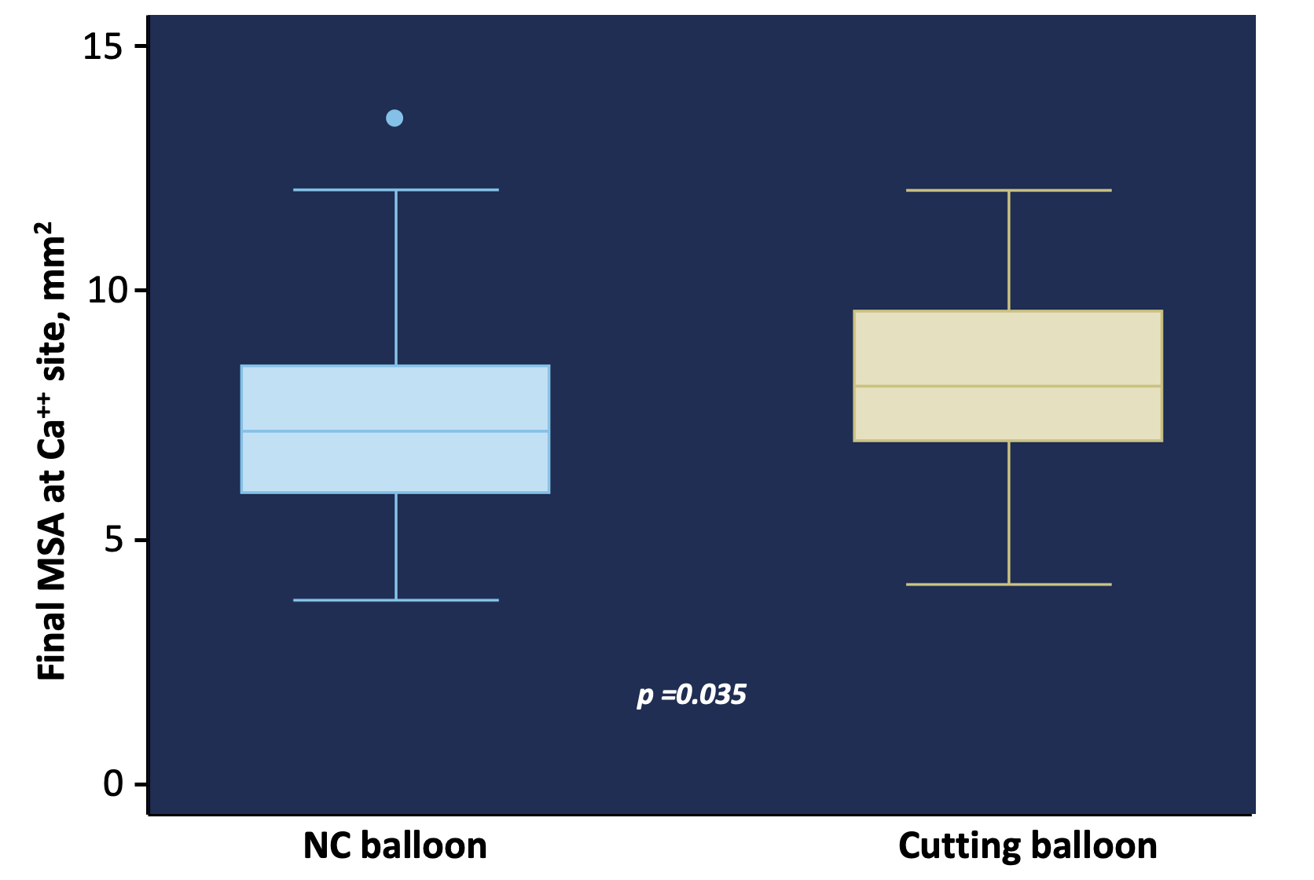
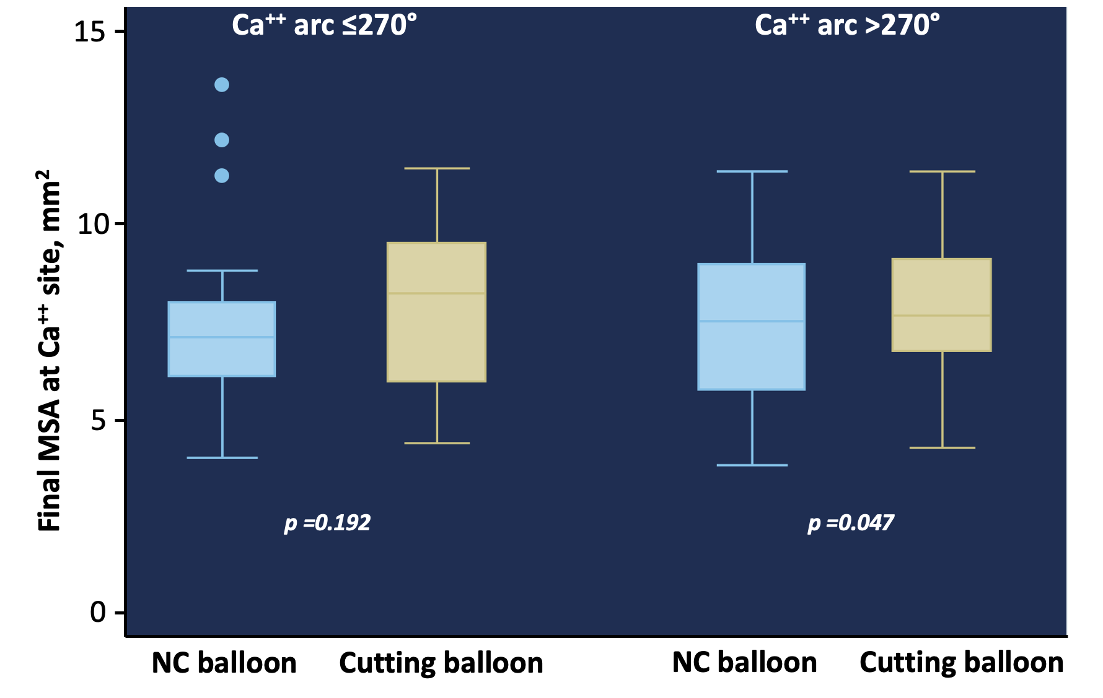
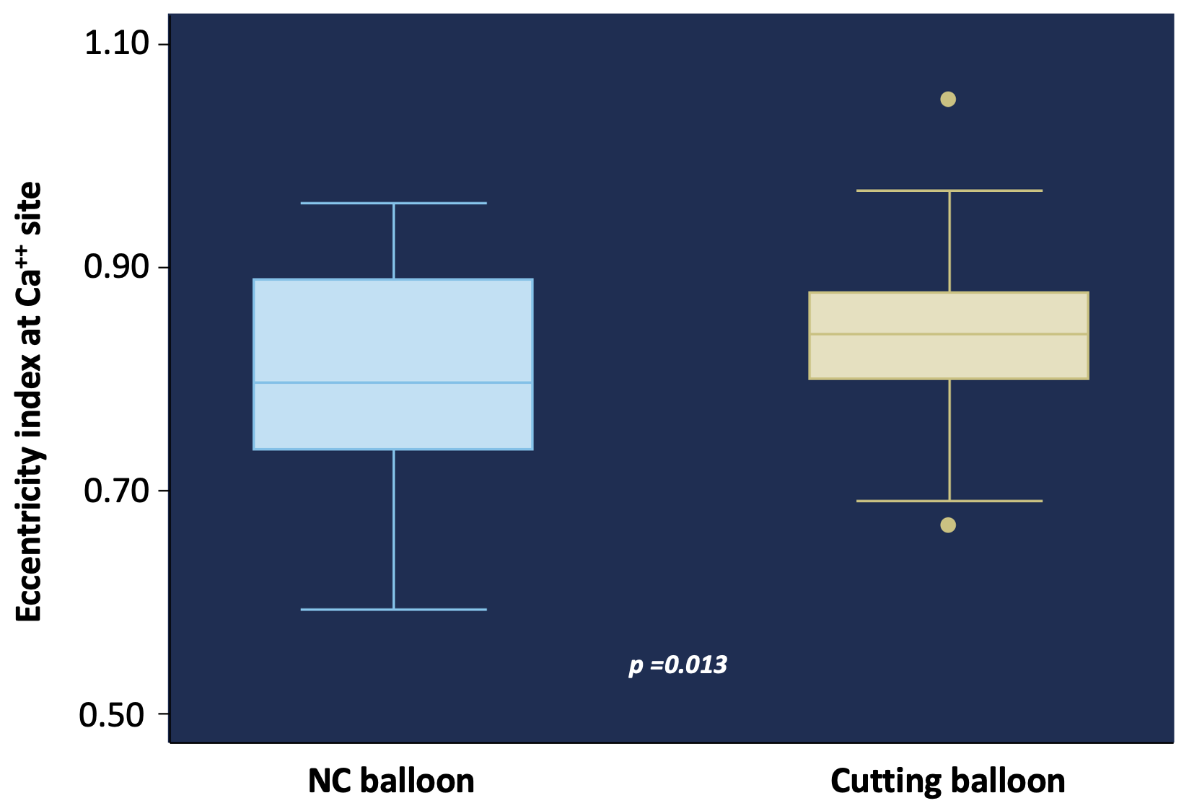
Results
 | CB (n=44) | NCB (n=43) | P value
Final MSA (mm²) | 7.1±1.7 | 6.5±2.1 | 0.116
Minimal Stent Diameter | 2.7±0.4 | 2.5±0.4 | 0.064
Maximal Stent Diameter | 3.2±0.4 | 3.1±0.4 | 0.189
Final MSA at calcium site | 8.1±2 | 7.3±2.1 | 0.035
Minimal stent diameter at calcium site | 2.9±0.7 | 2.7±0.4 | 0.016
Maximal stent diameter at calcium site | 3.5±0.5 | 3.3±0.4 | 0.132
Eccentricity index at calcium site | 0.84±0.7 | 0.8±0.8 | 0.013
Benefit of cutting balloon are evident in lesions with > 270º of calcium

Slide 17
Results
 | Overall | CB (n=44) | NCB (n=43) | P value
Device failure | 3 (3.4) | 3 (6.8) | 0 (0) | 0.517
Additional use of rotational atherectomy | 1 (1.1) | 1 (2.2) | 0 (0) | 0.79
Ellis type 1 vessel rupture | 2 (2.2) | 2 (4.4) | 0 (0) | 0.189
Implantation of a covered stent | 1 (1.1) | 1 (2.2) | 0 (0) | 0.65
Final TIMI flow >3 | 87 (100) | 44 (100) | 43 (100) | 0.854
One year Follow-up
Deaths | 3 (3.4) | 1 (1.1) | 2 (4.6) | 0.342
Cardiac deaths | 1 (1.1) | 0 (0) | 1 (2.3) | 0.887
Stroke | 0 (0) | 0 (0) | 0 (0) | 0.91
MI | 0 (0) | 0 (0) | 0 (0) | 0.96
TLR | 3 (3.4) | 1 (1.1) | 2 (4.6) | 0.49

Slide 18
Limitations
The study was performed in calcified lesions in which device crossability can be hampered. To perform baseline IVUS run, operators could pre dilatate the lesion with undersized balloons to facilitate the delivery of devices. This adjunctive maneuver could have biased the baseline IVUS findings.
The open-label nature of the study could have potentially created some bias in the treatment methodology. In particular some operators were not confident in using the CB at high pressure and this could have had a potential influence on the study results.
Potentially interesting variables such as fluoroscopy time, amount of contrast and some other complications such as periprocedural myocardial infarction were not reported in the database, thus potentially limiting the information about procedural complexity.

Slide 19
Conclusions
Treatment of calcified lesions with high pressure CB results in a larger MSA and more symmetric stent expansion at the level of the calcified segment compared to NCB.
The use of CB compared to standard NCB angioplasty appears to be feasible even when inflated at high pressure
The benefit of lesion preparation with CB is more pronouced in presence of severe calcifications
Larger studies should investigate the use of CB in different type of lesions (fibrotic lesions, bifurcations, mild-moderate calcifications?)

Slide 20
Back-up slides (i): ITT population
 | Overall n=100 | CB n=50 | NCB n=50 | P value
Age | 70±9.1 | 70.3±9.9 | 71.4±8.3 | 0.35
Female sex | 19 (19) | 6 (6) | 11 (11) | 0.125
Hypertension | 80 (80) | 38(76) | 42 (84) | 0.066
Diabetes | 31 (31) | 17 (34) | 14 (28) | 0.518
Hypercholesterolemia | 71 (71) | 35 (70) | 36 (72) | 0.95
Prior MACE | 4 (4) | 2 (4) | 2 (4) | 0.967
Chronic renal failure | 9 (9) | 6 (12) | 3 (6) | 0.258
Previous PCI | 26 (26) | 14 (28) | 12 (24) | 0.647
Previous CABG | 10 (10) | 4 (8) | 6 (6) | 0.526
LVEF (%) | 54±9.8 | 54±8.9 | 53±10.4 | 0.237
UA/NSTEMI | 6 (6) | 4 (8) | 2 (4) | 0.357
Vessel location |  |  |  | 0.409
RCA | 28 (100) | 16 (32) | 12 (29)
LAD | 60 60) | 32 (64) | 28 (56)
LM | 3 (3) | 2 (4) | 1 (2)
CX | 8 (8) | 2 (4) | 6 (12)
Ramus | 1 (1) | 0 | 1 (2)

Slide 21
Back-up slides (i): ITT population
 | Overall n=100 | CB n=50 | NCB n=50 | P value
Calcium distribution |  |  |  | 0.483
Mixed Calcium | 34 (34) | 15 (30) | 19 (38)
Deep Calcium | 25 (25) | 15 (30) | 10 (20)
Superficial Calcium | 39 (39) | 20 (40) | 19 (38)
Arch of calcium (degrees) | 240±103 | 245±106 | 234±101 | 0.299
Calcium length (mm) | 11±9.6 | 10.6±8.5 | 11.3±9.4 | 0.689
Lesion length (mm) | 23.3±10.1 | 22.5±10.1 | 24.1±10.1 | 0.787
Minimal lumen area (mm²) | 3.2±0.9 | 3.3±0.9 | 3±0.7 | 0.01
QCA evaluation
Reference vessel diameter (mm) | 3.3±0.2 | 3.38±0.1 | 3.34±0.3 | 0.221
Percentage of stenosis (%) | 80.1±7.4 | 79.1±7.7 | 80.6±7.9 | 0.65
Pre dilatation atmospheres | 18.5±4.9 | 17.6±5.1 | 19±4.5 | 0.952
Number of stent implanted | 1.3±0.5 | 1.3±0.5 | 1.2±0.4 | 0.134
Total Stent Length (mm) | 32.5±13 | 32.1±13 | 32.9±12 | 0.621
Stent Diameter (mm) | 3.3±0.4 | 3.3±0.3 | 3.3±0.4 | 0.395
Post dilatation | 79 (79) | 39 (78) | 40 (80) | 0.960
Diameter of the balloon for post dilatation | 3.5±0.5 | 3.5±0.5 | 3.5±0.4 | 0.285

Slide 22
Back-up slides (i): ITT population
 | Overall n=100 | CB n=50 | NCB n=50 | P value
Calcium distribution |  |  |  | 0.483
Mixed Calcium | 34 (34) | 15 (30) | 19 (38)
Deep Calcium | 25 (25) | 15 (30) | 10 (20)
Superficial Calcium | 39 (39) | 20 (40) | 19 (38)
Arch of calcium (degrees) | 240±103 | 245±106 | 234±101 | 0.299
Calcium length (mm) | 11±9.6 | 10.6±8.5 | 11.3±9.4 | 0.689
Lesion length (mm) | 23.3±10.1 | 22.5±10.1 | 24.1±10.1 | 0.787
Minimal lumen area (mm²) | 3.2±0.9 | 3.3±0.9 | 3±0.7 | 0.01
QCA evaluation
Reference vessel diameter (mm) | 3.3±0.2 | 3.38±0.1 | 3.34±0.3 | 0.221
Percentage of stenosis (%) | 80.1±7.4 | 79.1±7.7 | 80.6±7.9 | 0.65
Pre dilatation atmospheres | 18.5±4.9 | 17.6±5.1 | 19±4.5 | 0.952
Number of stent implanted | 1.3±0.5 | 1.3±0.5 | 1.2±0.4 | 0.134
Total Stent Length (mm) | 32.5±13 | 32.1±13 | 32.9±12 | 0.621
Stent Diameter (mm) | 3.3±0.4 | 3.3±0.3 | 3.3±0.4 | 0.395
Post dilatation | 79 (79) | 39 (78) | 40 (80) | 0.960
Diameter of the balloon for post dilatation | 3.5±0.5 | 3.5±0.5 | 3.5±0.4 | 0.285

Slide 23
Back-up slides (i): ITT population
 | Overall n=100 | CB n=50 | NCB n=50 | P value
Final results
Final MSA (mm²) | 6.7±1.8 | 6.9±1.7 | 6.4±2 | 0.132
Minimal Stent Diameter | 2.6±0.4 | 2.6±0.4 | 2.5±0.4 | 0.075
Maximal Stent Diameter | 3.1±0.4 | 3.2±0.4 | 3.1±0.4 | 0.201
Final MSA at calcium site | 7.6±2.1 | 7.9±2.1 | 7.2±2.1 | 0.061
Minimal stent diameter at calcium site | 2.8±0.4 | 2.9±0.5 | 2.7±0.4 | 0.031
Maximal stent diameter at calcium site | 3.4±0.5 | 3.4±0.5 | 3.3±0.4 | 0.197
Eccentricity index at calcium site | 0.82±0.08 | 0.84±0.06 | 0.81±0.08 | 0.01
Device failure | 3 (3) | 1 (2) | 0 (0) | 0.733
Additional use of rotational atherectomy | 1 (1) | 1 (2) | 0 (0) | 0.59
Ellis type 1 vessel rupture | 2 (2) | 2 (4) | 0 (0) | 0.23
Implantation of a covered stent | 1 (1) | 1 (2) | 0 (0) | 0.65
Final TIMI flow >3 | 100 (100) | 50 (100) | 50 (100) | 0.93
One year Follow-up
Deaths | 3 (3) | 1 (2) | 2 (4) | 0.43
Cardiac deaths | 1 (1) | 0 (0) | 1 (2) | 0.799
Stroke | 0 (0) | 0 (0) | 0 (0) | 0.96
TLR | 3 (3) | 1 (2) | 2 (4) | 0.49

