Slide 1






The BYPASS-CTCA Study: A Randomised Controlled Trial assessing the value of Computed Tomography Cardiac Angiography (CTCA) in Improving Patient-related Outcomes in Patients with prior CABG undergoing Invasive Coronary Angiography
Dr Daniel Jones
Queen Mary University of London

Slide 2
Disclosure Statement of Financial Interest
I, Daniel Jones DO NOT have a financial interest/arrangement
or affiliation with one or more organizations that could be perceived as a real or apparent conflict of interest in the context of the subject of this presentation.
Faculty disclosure information can be found on the app
Faculty disclosure information can be found on the app

Slide 3


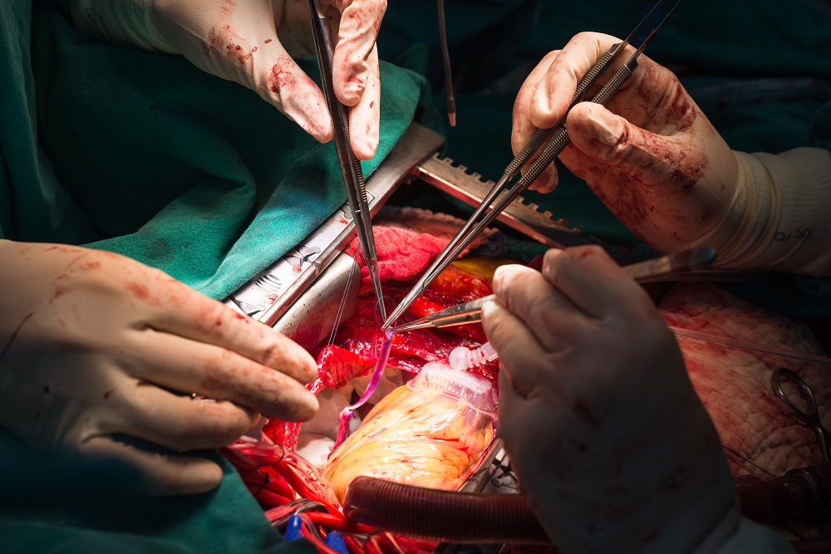
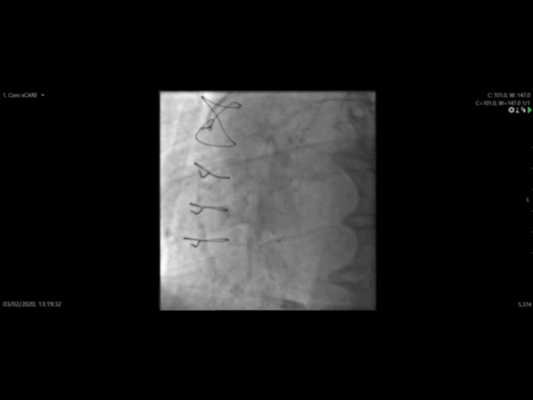
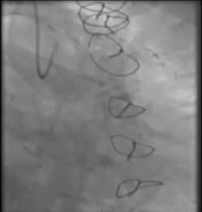
Coronary Artery Bypass Grafting (CABG)
CABG is the commonest adult cardiac procedure in the developed world
  Worldwide 1.6 million surgeries per year
  250,000 cases in the US/year
The long-term results are hampered by the gradual failure of bypass conduits and the progression of native atherosclerotic disease
Particularly true for Saphenous vein grafts (SVG)
  85% of surgeries each year
1 in 5 patients will require invasive coronary angiography within 3 years
Notes:
2
Up to 40% occluded by 1 year and 90% by 10 years

Slide 4
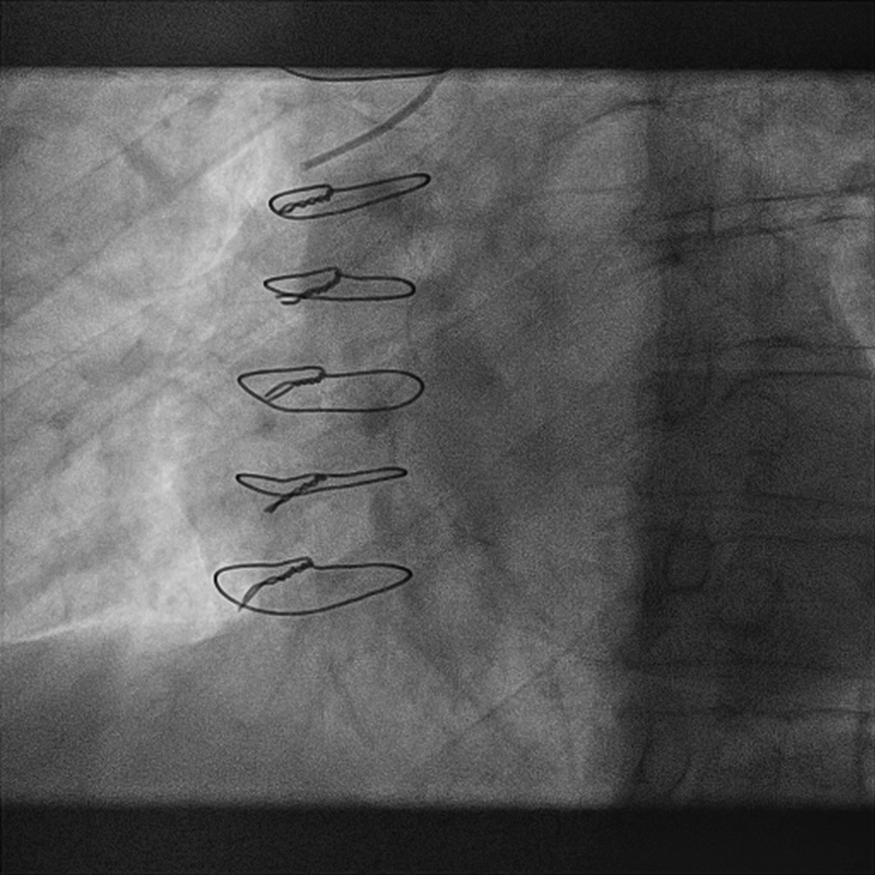
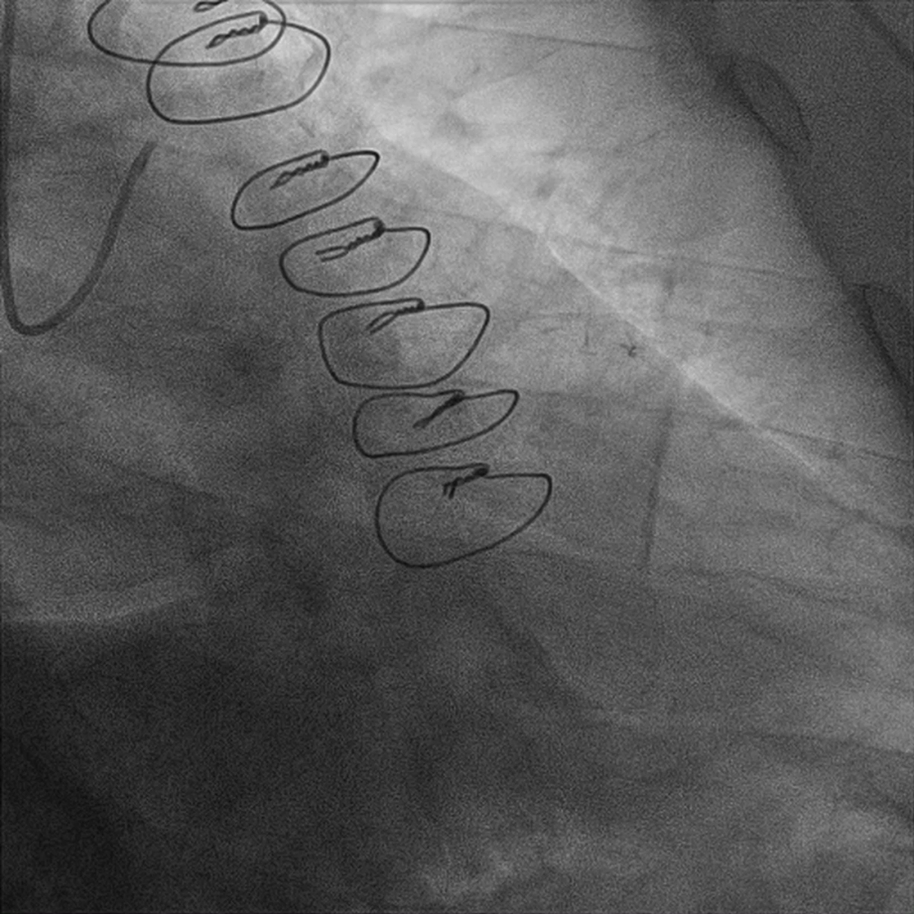
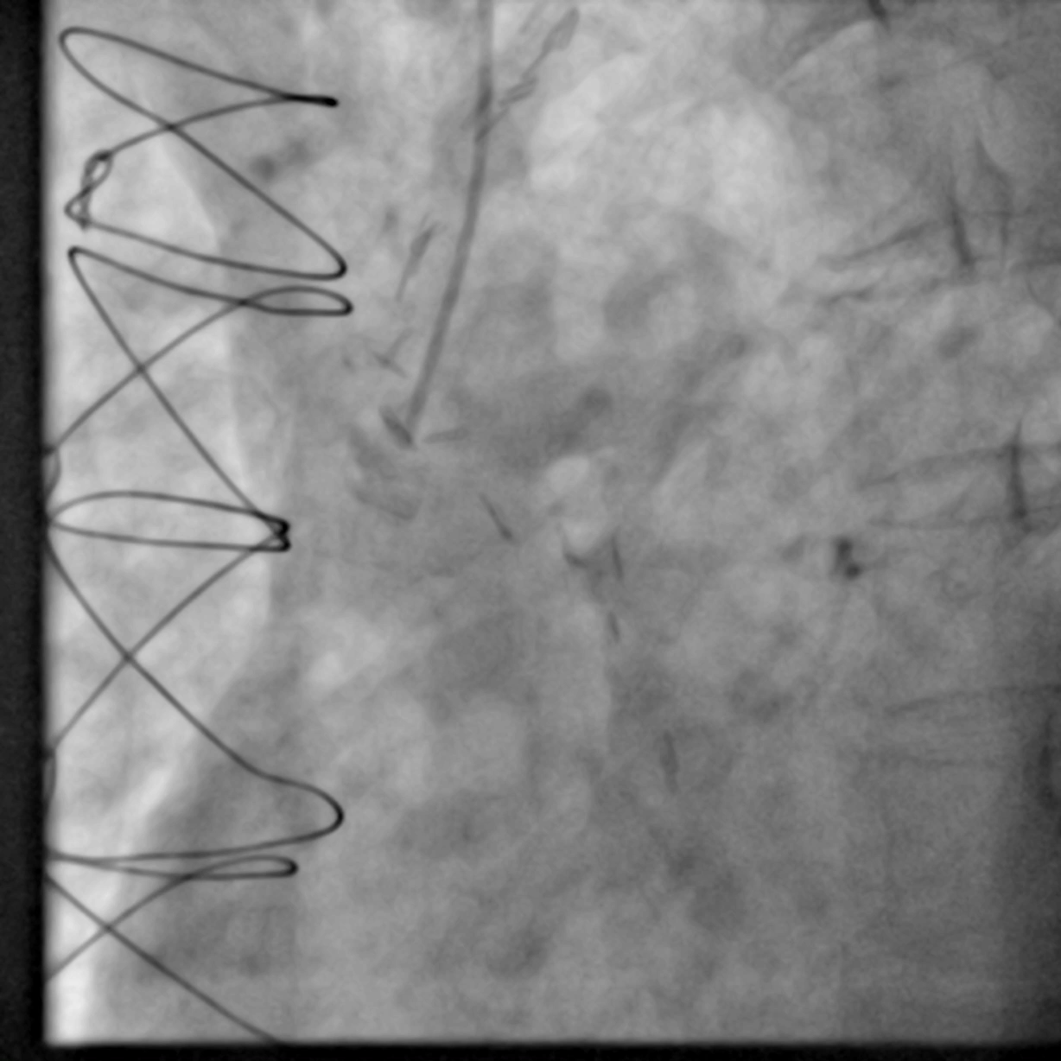
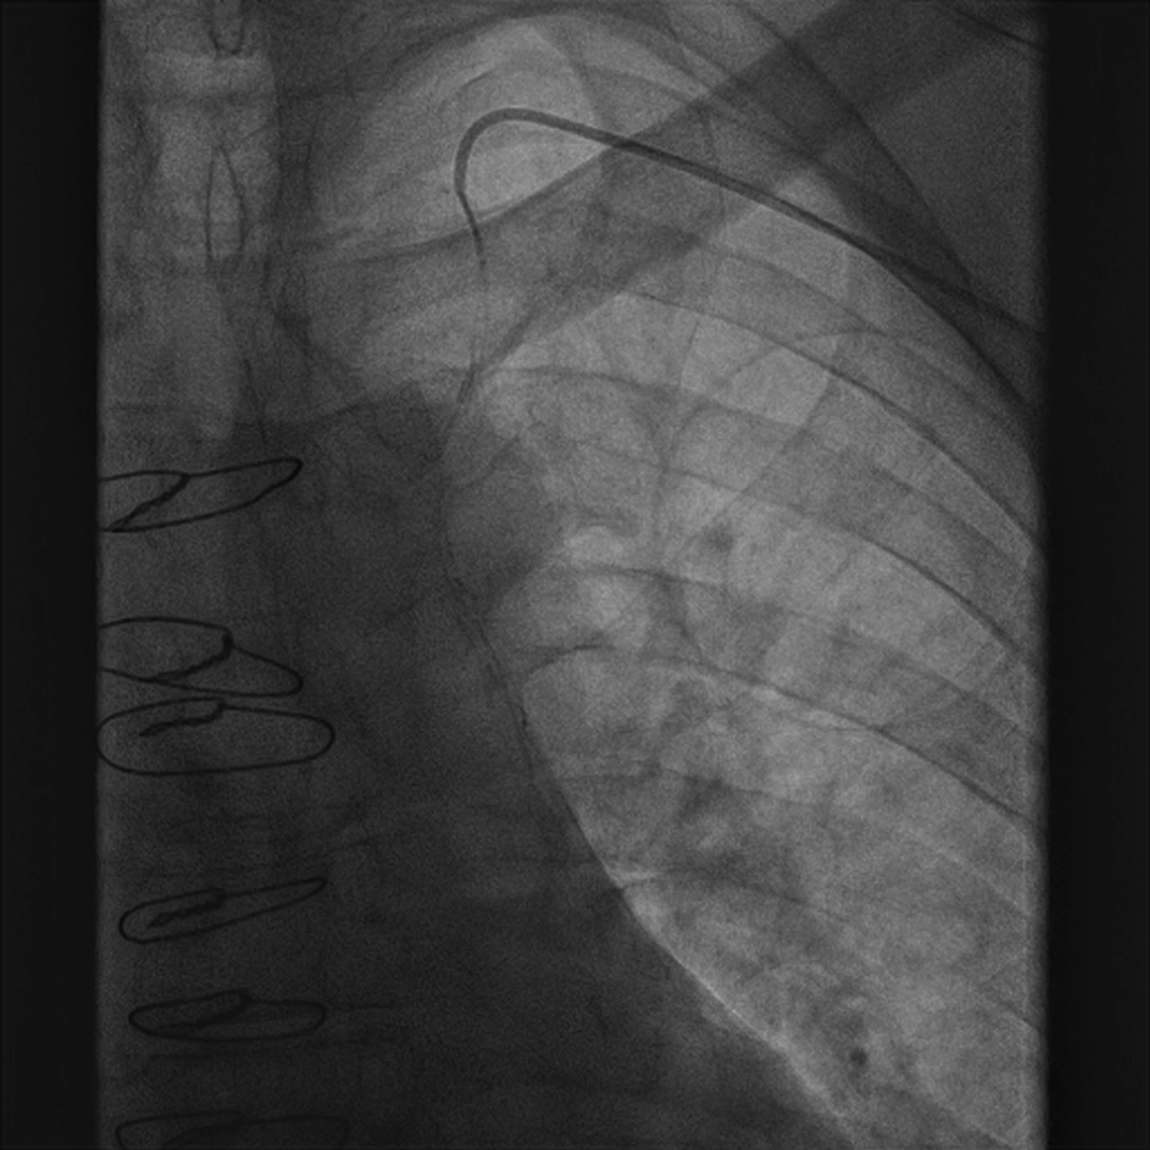

Angiography in the Post CABG Patient
Invasive Coronary Angiography in patients with previous CABG is more complex and challenging
No operation is the same
Longer Procedures
Greater Contrast
Subsequent Contrast-Induced Nephropathy
Femoral Access
Poor Patient satisfaction
Higher Radiation
Increased Complication Rates
Notes:
Techniques to facilitate safer and more efficient ICA, should therefore be sought.

Slide 5

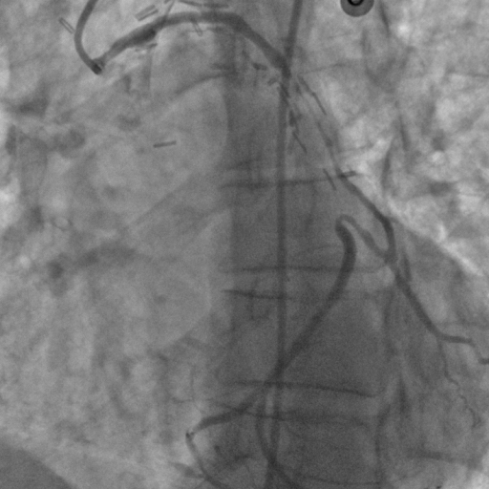
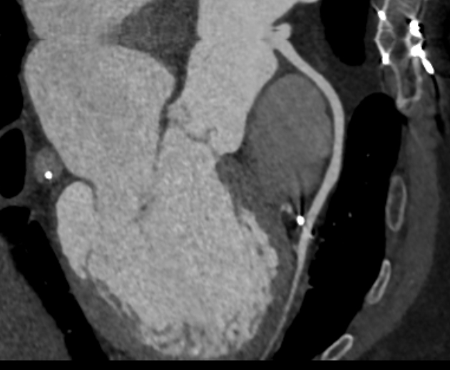
CTCA for Procedural Planning in the CABG Patient
Observational studies¹ suggest that Computerised Tomography Coronary Angiography (CTCA) may provide useful pre-procedural planning information prior to Invasive Coronary Angiography
The BYPASS-CTCA study was designed to test whether adjunctive CTCA can reduce procedure time, improve patient satisfaction and prevent procedural complications in patients with previous CABG undergoing planned ICA
Invasive Coronary Angiography Alone
VS
CTCA + Invasive Coronary Angiography
¹Jones DA, Castle EV, Beirne AM et al. .EuroIntervention. 2020 Feb 7;15(15):e1351-e1357.
Notes:
Recurrence of chest pain,
Heart failure, or
Pre-operative evaluation of cardiac valve replacement or non-cardiac surgery
Coronary angiography is a type of x-ray test which is used to look at the coronary arteries in the heart.

Slide 6



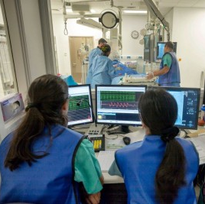




St Bartholomew's Hospital
688 patients
Single Centre Study, St Bartholomew's Hospital, London, UK.
3rd Generation Dual Source CT scanner
Sponsor: Queen Mary University of London
Adopted by Barts Cardiovascular CTU
Funded by National Institute of Health Research RfPB Scheme
Notes:
Over the past decade improvements in CTCA technology have allowed its emergence as a useful clinical tool in
CABG assessment. Technical advances such as the introduction of new 3rd generation dual
source CT scanners now means that bypass grafts can be visualized with minimal contrast etc

Slide 7
Eligibility Criteria
Inclusion Criteria
Patients undergoing invasive coronary angiography
Stable Angina and NSTE-ACS
Previous Coronary Artery Bypass Grafting (CABG)
Aged ≥18
Patients able and willing to give written informed consent.
Exclusion Criteria
ST segment myocardial infarction
Haemodynamic or Clinical Instability
Subjects with eGFR<20ml/min or on renal replacement therapy
Current life-threatening condition other than vascular disease
Pregnancy or unknown pregnancy status.
Inability to tolerate beta-blockers
Known contrast allergy.
Notes:
Over the past decade improvements in CTCA technology have allowed its emergence as a useful clinical tool in
CABG assessment. Technical advances such as the introduction of new 3rd generation dual
source CT scanners now means that bypass grafts can be visualized with minimal contrast etc

Slide 8
Primary Endpoints
Co-Primary Endpoints
  Procedural duration
  Patient satisfaction scores post ICA¹
  Incidence of Contrast-Induced Nephropathy (KDIGO criteria)²
Sample Size
Powered to detect all 3 primary study endpoints.
688 patients provides:
  80% power for CIN reduction of 60% assuming 12% CIN rate and allowing for a Bonferroni correction (a=0.017) and 10% drop-out
  90% power to detect 15% reduction in procedure time and improvement in patient satisfaction
1. Mangelsdorff AD. Patient satisfaction questionnaire. Med Care. 1979 Jan;17(1):86–90.
2. Fliser D, Laville M, et al. A. Nephrol Dial Transplant Off Publ Eur Dial Transpl Assoc - Eur Ren Assoc 2012 :4263–72.
Notes:
Over the past decade improvements in CTCA technology have allowed its emergence as a useful clinical tool in
CABG assessment. Technical advances such as the introduction of new 3rd generation dual
source CT scanners now means that bypass grafts can be visualized with minimal contrast etc

Slide 9
Secondary Endpoints
Major Secondary Endpoints
  Procedure Metrics
    Radial Access
    Fluoroscopy Time
    Number of Catheters
    Contrast Dose (mL)
    Effective Radiation Dose during ICA
  Procedural Complications
  MACE (All cause mortality, MI, Unscheduled Revascularisation) over 12 months
Notes:
Over the past decade improvements in CTCA technology have allowed its emergence as a useful clinical tool in
CABG assessment. Technical advances such as the introduction of new 3rd generation dual
source CT scanners now means that bypass grafts can be visualized with minimal contrast etc

Slide 10


Slide 11
Baseline Characteristics
 | CTCA + Angiogram N=344 | Angiogram only N=344
Age (years), mean (SD) | 68.99 (10.85) | 70.55 (9.82)
Sex, n (%) Female Male | 51 (14.83) 293 (85.17) | 57 (16.57) 287 (83.43)
Ethnicity, n (%) Asian Black White | 116 (33.72) 9 (2.62) 218 (63.37) | 144 (41.86) 15 (4.36) 184 (53.49)
Smoking status, n (%) Non-smoker Ex or Current smoker | 138 (40.12) 206 (59.88) | 161 (46.80) 183 (53.20)
Presentation, n (%) ACS Unstable angina NSTEMI Stable angina | 155 (45.06) 25 (7.27) 128 (37.21) 191 (55.52) | 155 (45.06) 27 (7.85) 127 (36.92) 188 (54.65)
Notes:
Over the past decade improvements in CTCA technology have allowed its emergence as a useful clinical tool in
CABG assessment. Technical advances such as the introduction of new 3rd generation dual
source CT scanners now means that bypass grafts can be visualized with minimal contrast etc

Slide 12
Baseline Characteristics
 | CTCA + Angiogram N=344 | Angiogram only N=344
BMI (kg/m²), mean (SD) | 28.61 (4.98) | 28.63 (4.52)
Systolic BP (mmHg), mean (SD) | 128.04 (16.78) | 130.00 (17.13)
LVEF (%), mean (SD) | 50.53 (11.62) | 49.40 (11.79)
Diabetes Mellitus, n (%) | 169 (49.13) | 201 (58.43)
Hypertension, n (%) | 293 (85.17) | 294 (85.47)
Hypercholesterolemia, n (%) | 262 (76.16) | 279 (81.10)
Family history, n (%) | 39 (11.34) | 53 (15.41)
Prior PCI, n (%) | 163 (47.38) | 169 (49.13)
Prior MI, n (%) | 231 (67.15) | 236 (68.60)
History of stroke, n (%) | 22 (6.40) | 27 (7.85)
Creatinine (umol/L), mean (SD) | 101.94 (34.62) | 99.90 (30.18)
eGFR (mL/min/1.73m²), mean (SD) | 65.79 (18.54) | 66.30 (17.73)
Number of Bypass Grafts, mean (SD) | 2.86 (1.23) | 2.86 (1.28)
Notes:
High Risk Group

Slide 13
Primary Endpoint (1): Procedure Duration
Adjusted difference-20.93 (98.3% CI: -23.50 to -18.35), p<0.001
Notes:
Over the past decade improvements in CTCA technology have allowed its emergence as a useful clinical tool in
CABG assessment. Technical advances such as the introduction of new 3rd generation dual
source CT scanners now means that bypass grafts can be visualized with minimal contrast etc

Slide 14
Primary Endpoint (1): Sensitivity Analysis
Notes:
Over the past decade improvements in CTCA technology have allowed its emergence as a useful clinical tool in
CABG assessment. Technical advances such as the introduction of new 3rd generation dual
source CT scanners now means that bypass grafts can be visualized with minimal contrast etc

Slide 15
Combined Procedure Duration
Notes:
Over the past decade improvements in CTCA technology have allowed its emergence as a useful clinical tool in
CABG assessment. Technical advances such as the introduction of new 3rd generation dual
source CT scanners now means that bypass grafts can be visualized with minimal contrast etc

Slide 16
Procedure Duration (Fluoroscopy Time)
Notes:
Over the past decade improvements in CTCA technology have allowed its emergence as a useful clinical tool in
CABG assessment. Technical advances such as the introduction of new 3rd generation dual
source CT scanners now means that bypass grafts can be visualized with minimal contrast etc

Slide 17


Primary Endpoint (2): Patient Satisfaction
40% relative improvement
Notes:
Over the past decade improvements in CTCA technology have allowed its emergence as a useful clinical tool in
CABG assessment. Technical advances such as the introduction of new 3rd generation dual
source CT scanners now means that bypass grafts can be visualized with minimal contrast etc

Slide 18
Primary Endpoint (3): Contrast Induced Nephropathy
3.4% vs 27.9%, p<0.0001
Notes:
Over the past decade improvements in CTCA technology have allowed its emergence as a useful clinical tool in
CABG assessment. Technical advances such as the introduction of new 3rd generation dual
source CT scanners now means that bypass grafts can be visualized with minimal contrast etc

Slide 19
Primary Endpoint (3): Sensitivity Analysis
Notes:
Over the past decade improvements in CTCA technology have allowed its emergence as a useful clinical tool in
CABG assessment. Technical advances such as the introduction of new 3rd generation dual
source CT scanners now means that bypass grafts can be visualized with minimal contrast etc

Slide 20
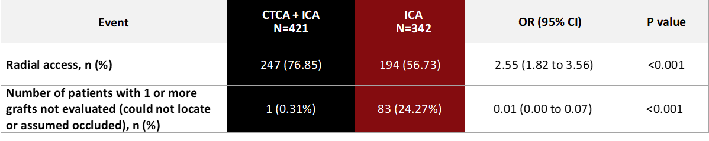
Secondary Endpoints
Notes:
Over the past decade improvements in CTCA technology have allowed its emergence as a useful clinical tool in
CABG assessment. Technical advances such as the introduction of new 3rd generation dual
source CT scanners now means that bypass grafts can be visualized with minimal contrast etc

Slide 21
Procedural Complications
Notes:
In the ICA group 85 pts 23% had grafts that were unable to locate
15% went onto have CTCA to locate these lost grafts

Slide 22
Time to 1st MACE (12 months)
Notes:
Over the past decade improvements in CTCA technology have allowed its emergence as a useful clinical tool in
CABG assessment. Technical advances such as the introduction of new 3rd generation dual
source CT scanners now means that bypass grafts can be visualized with minimal contrast etc

Slide 23
Time to 1st MACE (12 months)
 | Treatment group |  | Unadjusted |  | Covariate adjusted
Event | CTCA + ICA n (%) N=344 | ICA n (%) N=344 | OR (95% CI) | P value | OR (95% CI) | P value
MACE | 56 (16.28) | 101 (29.36) | 0.46 (0.32 to 0.66) | <0.001 | 0.44 (0.30 to 0.64) | <0.001
All-cause mortality | 21 (6.10) | 28 (8.14) | 0.73 (0.41 to 1.32) | 0.301 | 0.67 (0.36 to 1.22) | 0.190
Cardiovascular mortality | 6 (1.74) | 13 (3.78) | 0.45 (0.17 to 1.20) | 0.112 | 0.41 (0.15 to 1.11) | 0.079
Non-fatal MI | 33 (9.59) | 84 (18.60) | 0.45 (0.28 to 0.71) | <0.001 | 0.44 (0.28 to 0.70) | <0.001
Unscheduled revascularisation | 20 (5.81) | 32 (9.30) | 0.60 (0.34 to 1.07) | 0.086 | 0.61 (0.34 to 1.09) | 0.092
Notes:
Over the past decade improvements in CTCA technology have allowed its emergence as a useful clinical tool in
CABG assessment. Technical advances such as the introduction of new 3rd generation dual
source CT scanners now means that bypass grafts can be visualized with minimal contrast etc

Slide 24
Conclusions
In patients with previous CABG undergoing Invasive Coronary Angiography adjunctive prior CTCA
  Shortens procedure duration
  Improves patient satisfaction
  Lowers rates of CIN
CTCA use resulted in lower procedural complication rates, and reduced rates of MACE at 12 months
When logistically possible, CTCA should be considered for any stable post-bypass patient undergoing invasive coronary angiography
Notes:
COMMON

Slide 25

Acknowledgements
TMG
Anthony Mathur
Anne-Marie Beirne
Mervyn Andiapen
Lucinda Wynne
Barts CVCTU
Amrita Ahluwalia
Tom Godec
Jessica Adams
Victoria Hammond
Marian Benford
Shahana Chowdhury
Simon Menezes
Barts Heart Centre
Matthew Kelham
Krishnaraj Rathod
Nasim Forooghi
Francesca Pugliese
Charlotte Manisty
Emma Cheasty
Emily Castle
Andrew Wragg
TSC DSMC
Adam Timmis Andreas Baumbach
Paul Rees Ajay Gupta
Charlotte Manisty Thomas Treibal
Riyaz Patel Oliver Guttmann
Fizzah Choudhury

Slide 26
Quality of Life (EQ5D-5L at 12 months)
Adjusted difference at 3 months: 10.1 (95% CI: 7.1-13.1), p<0.001
Adjusted difference at 12 months:
7.7 (95% CI: 3.4 to 11.9), p<0.001
Adjusted for baseline creatinine & ACS.
Notes:
Over the past decade improvements in CTCA technology have allowed its emergence as a useful clinical tool in
CABG assessment. Technical advances such as the introduction of new 3rd generation dual
source CT scanners now means that bypass grafts can be visualized with minimal contrast etc

Slide 27
Time to 1st MACE (12 months)
Notes:
Over the past decade improvements in CTCA technology have allowed its emergence as a useful clinical tool in
CABG assessment. Technical advances such as the introduction of new 3rd generation dual
source CT scanners now means that bypass grafts can be visualized with minimal contrast etc

Slide 28

Notes:
Over the past decade improvements in CTCA technology have allowed its emergence as a useful clinical tool in
CABG assessment. Technical advances such as the introduction of new 3rd generation dual
source CT scanners now means that bypass grafts can be visualized with minimal contrast etc

