Slide 1

TCT Template
Title 30 pt Bold Arial
Routine ultrasound guidance for femoral vascular access for cardiac procedures: A randomized trial (UNIVERSAL)
John Doe, MD
Subtitle 25 pt Arial Bold Italics
Sanjit Jolly, MD, MSc
PHRI, McMaster University, Hamilton Health Sciences
Canada
On Behalf of UNIVERSAL investigators

Slide 2
Disclosure Statement of Financial Interest
Within the past 12 months, I or my spouse/partner have had a financial interest/arrangement or affiliation with the organization(s) listed below.
Affiliation/Financial Relationship | Company
Grant/Research Support | Boston Scientific
Consulting Fees/Honoraria | Medtronic, Penumbra
Major Stock Shareholder/Equity | None
Royalty Income | None
Ownership/Founder | None
Intellectual Property Rights | None
Other Financial Benefit | None
Faculty disclosure information can be found on the app

Slide 3
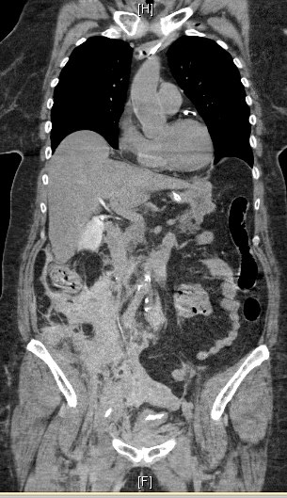
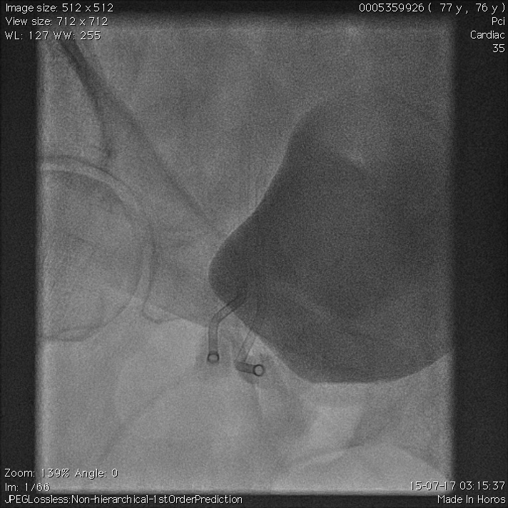
We need to avoid Femoral Access Bleeding
Notes:
We took this example from a previous presentation and we want to highlight here the angulation of the sheats, and this occurred with more frequence in longer tissue track.
This is our of the nightmares of the femoral access, by fundamentally this happen if we hit the target in a wrong target. If we have a short landing zone we need to be very precisely and hit just above the bifurcation. In medicine there are no absolutes, or almost. We could think that one of the absolutes is that if we are not into the retroperitoneal space we can not have a retroperitoneal puncture bleed. Could be other reasons but not related with the puncture.

Slide 4
Background and Rationale
Transradial first reduces access site bleeding by more than 60%
Still need femoral access for large bore, occluded radial
Randomized trials of US guidance have shown mixed results
US used in about a third of cases for femoral access in surveys
Gargiulo et al. Circ. 2022: online.
Seto et al. JACC Int, 2010;3(7):751-8.
Nguyen et al. Eurointervention. 2019:15(6):e22-30.

Slide 5
Design of UNIVERSAL Trial
Patients with planned femoral access for coronary procedures, N=621
14% Control event rate, 80% power for a 50% RRR
Randomized 1:1
US guided Access
No US guided Access
Fluoroscopy landmarking for both groups
Primary Outcome: BARC 2, 3 or 5 Bleeding and Major Vascular Complications within 30 days (blinded outcome assessment)

Slide 6
Eligibility Criteria
Inclusion
Patients were eligible if referred for coronary angiography or percutaneous coronary intervention (PCI) with planned femoral access
Exclusion
< 18 years
Acute ST-elevation myocardial infarction
Absence of a palpable femoral pulse

Slide 7
Requirement for Operators
Needed to demonstrate following prior to enrolling:
  Identifying femoral bifurcation and femoral head
  Real time tracking of needle including indentation of anterior wall
  Confirming wire position in orthogonal views prior to sheath insertion
Each operator was approved after performing 10 cases demonstrating these skills

Slide 8
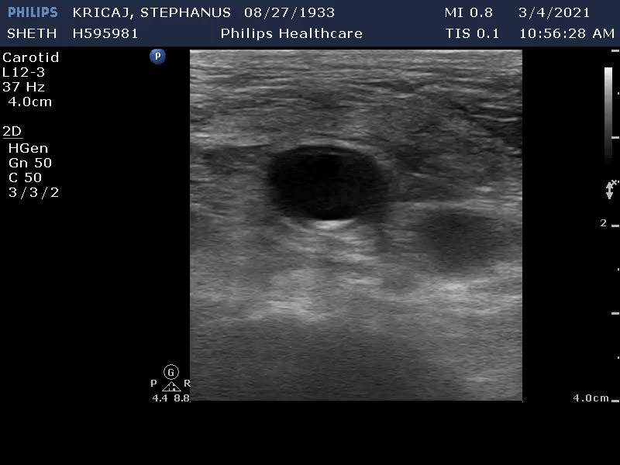
Ultrasound for femoral Access can potential reduce complications

Slide 9
Baseline Characteristics
 | US n = 311 | No US n = 310
Age | 70.5 | 70.7
Female Sex (%) | 25.7 | 25.2
Diabetes (%) | 42.8 | 41.3
Previous PCI (%) | 45.0 | 44.5
Previous CABG (%) | 57.2 | 56.5
Peripheral Artery Disease (%) | 18.3 | 17.1

Slide 10
Procedural Characteristics
 | US n = 311 | No US n = 310
PCI performed (%) | 43.1 | 41.3
CTO PCI (%) | 13.5 | 14.8
≥7 French used (%) | 20.0 | 18.0
Closure Device (%) | 53.8 | 50.5
Angioseal (%) | 44.1 | 45.1
Perclose (%) | 9.1 | 5.4

Slide 11
Procedural Outcomes
 | US* n = 320 | No US* n = 317 | P Value
First Attempt Access | 86.6% | 70.0% | <0.001
Number of Attempts | 1.16 | 1.43 | <0.001
Accidental Venipuncture | 3.1% | 11.7% | <0.001
Time local to sheath insertion (mean) | 114s | 129s | 0.34
*By Access

Slide 12
Clinical Outcomes
 | US N=311 | No US n = 310 | P Value
BARC 2, 3 or 5 bleeding or major vascular complications* | 12.9% | 16.1% | 0.25
BARC 2, 3 or 5 bleeding | 10.0% | 10.7% | 0.78
Major Vascular Complications | 6.4% | 9.4% | 0.18
BARC 2 Bleeding | 9.7% | 10.3% | 0.78

Slide 13
US and Fluoroscopy
Fluoroscopy
P value for
events/Total (%)
events/Total (%)
Odds Ratio (95% CI)
Interaction
OVERALL
40 /311 (12.9)
50 /310 (16.1)
0.77 (0.49 - 1.20)
Subgroups
Age
>=75
19 / 108 (17.6)
20 / 125 (16.0)
1.12 (0.53-2.37)
0.18
Sex
<75
21 / 203 (10.3)
30 / 185 (16.2)
0.60 (0.31-1.13)
Male
30 / 231 (13.0)
36 / 232 (15.5)
0.81 (0.46-1.42)
0.67
Female
10 / 80 (12.5)
14 / 78 (18.0)
0.65 (0.24-1.71)
BMI
>=30
19 / 133 (14.3)
17 / 119 (14.3)
1.00 (0.46-2.17)
0.34
<30
21 / 178 (11.8)
33 / 191 (17.3)
0.64 (0.34-1.20)
Peripheral Vascular Disease
Yes
8 / 57 (14.0)
10 / 53 (18.9)
0.70 (0.22-2.19)
0.85
No
32 / 254 (12.6)
40 / 257 (15.6)
0.78 (0.46-1.33)
Clinical Presentation
NSTE-ACS
12 / 91 (13.2)
14 / 87 (16.1)
0.79 (0.31-1.98)
0.93
Elective
28 / 220 (12.7)
36 / 223 (16.1)
0.76 (0.43-1.33)
Use of femoral access
PCI
27 / 134 (20.2)
32 / 128 (25.0)
0.76 (0.40-1.41)
0.92
Angiography alone
13 / 177 ( 7.3)
18 / 182 ( 9.9)
0.72 (0.31-1.62)
Type of Procedure
CTO
10 / 42 (23.8)
16 / 46 (34.8)
0.59 (0.20-1.64)
0.5
Non-CTO
30 / 269 (11.2)
34 / 264 ( 12.9)
0.85 (0.48-1.48)
Sheath Size
>=7
14 / 61 (23.0)
15 / 56 (26.8)
0.82 (0.32-2.06)
0.82
<7
26 / 250 (10.4)
35 / 254 ( 13.8)
0.73 (0.41-1.29)
Post randomization variable -
Actual Closure device use
Yes
20 / 170 (11.8)
37 / 158 (23.4)
0.44 (0.23-0.82)
0.004
No
20 / 141 (14.2)
13 / 152 ( 8.6)
1.76 (0.80-4.03)
Post hoc subgroup -
Staff position and fellow
Staff
16 / 157 (10.2)
26 / 146 (17.8)
0.52 (0.25-1.07)
0.12
Fellow
24 / 154 (15.6)
24 / 164 (14.6)
1.08 (0.56-2.09)
0
0.5
1
1.5
2
2.5
Odds Ratio(95% CI)

Slide 14
Subgroup finding with Closure devices
Biologically plausible
US allows for a single puncture
US helps choose a site without disease and Ca
Caution: Post randomization subgroup

Slide 15
Limitations
Not powered for modest 20-25% risk reductions
Likely trainees still on learning curve
Outcome driven by BARC 2 bleed (less important)

Slide 16
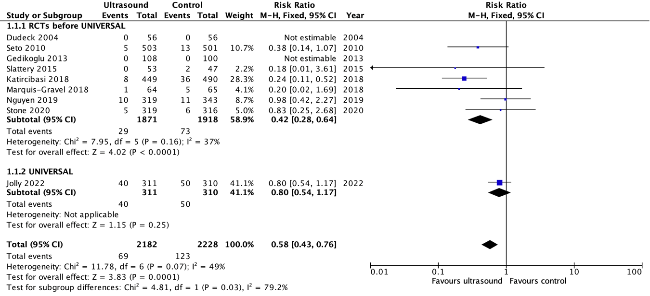
Meta-Analysis for Composite of Major Bleed or Major vascular complications
RR 0.58 ; 95% CI 0.43-0.76

Slide 17
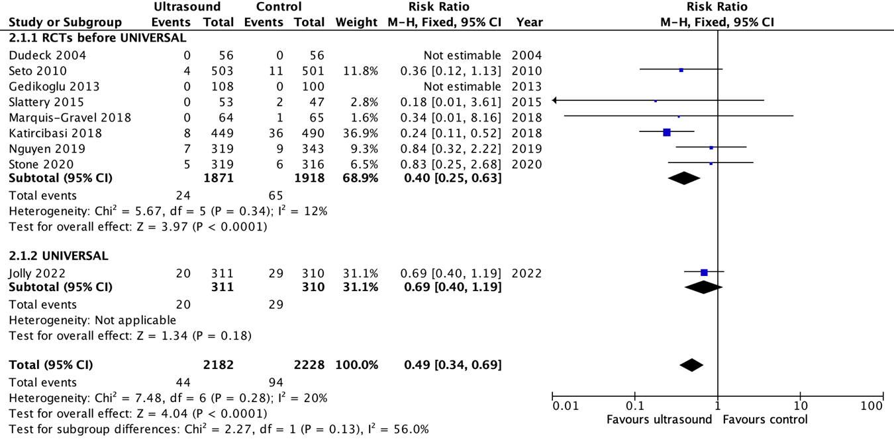
Meta-Analysis for Major vascular complications
RR 0.49 ; 95% CI 0.34-0.69

Slide 18
Conclusions
US improved first attempt success but did not reduce bleeding or vascular complications in UNIVERSAL
US beneficial when closure device used
Updated meta-analyses support the benefit of US guided femoral access

Slide 19
Perspective
US has no risks
Widely available
We need to focus on training and expertise
Transradial access is still safest approach

Slide 20
Acknowledgements
Study Team | Statistical Support | ICT Support
J Tyrwhitt MA d’Entremont E Skuriat C Agrippa | K Balasubramanian L Heenan A Wang | H Wilton J Orellana A Pineau
Site Staff
Investigators | E Akl, O Alansari, S Alradshidi, B Brochu, G Dutra, A Kelly, S Mehta, M Natarajan, N Pinilla-Echeverri, M Raco, JD Schwalm, T Sheth, M Sibbald, M Tsang, N Valettas, J Velianou, J Winter
Coordinators | S Tawadros, M Camargo, W Faidi, J Ferguson, B Sirotnik
Angiographic Core laboratory | J Bauer, R Moxham

Slide 21
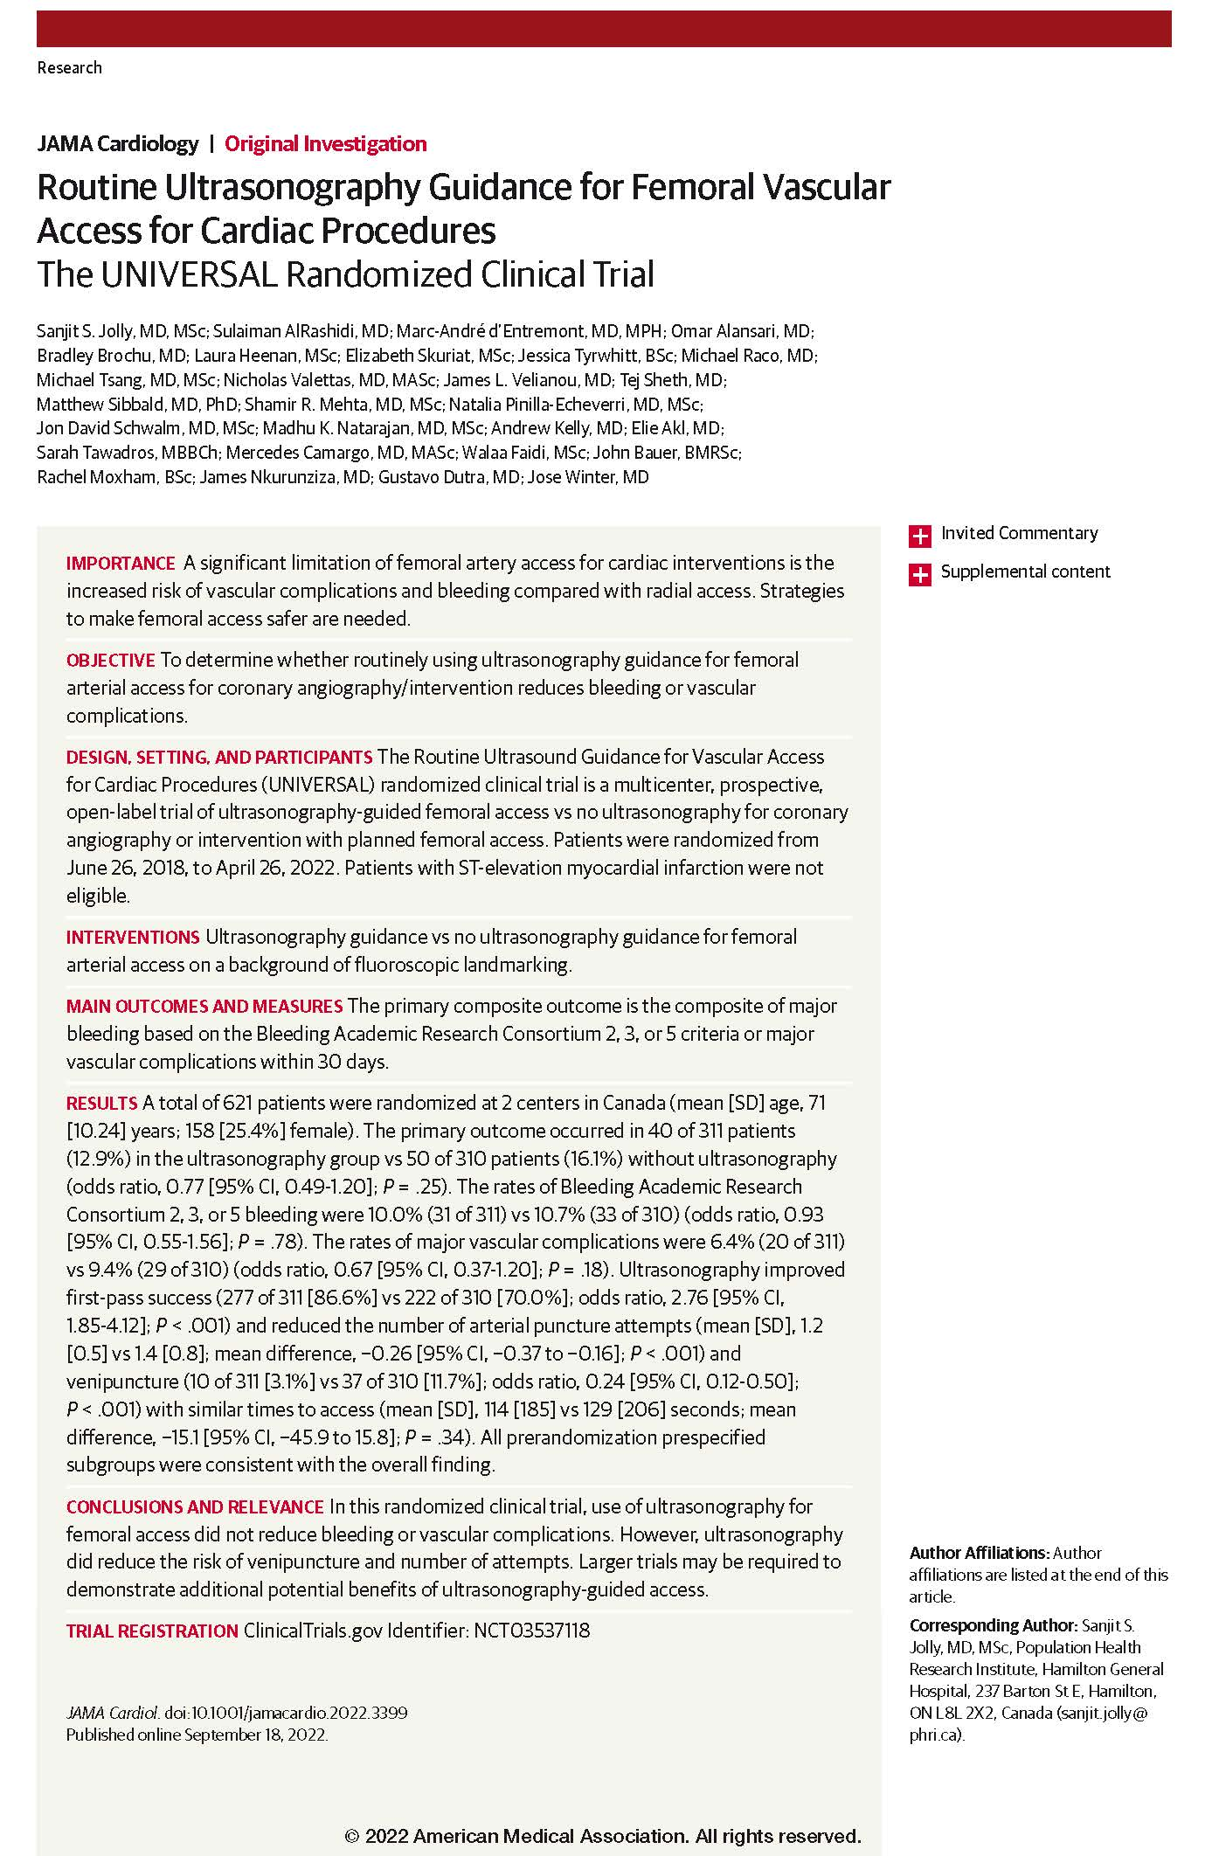
Sanjit S. Jolly, MD, MSc; Sulaiman AlRashidi, MD; Marc-André d’Entremont, MD, MPH; Omar Alansari, MD; Bradley Brochu, MD; Laura Heenan, MSc; Elizabeth Skuriat, MSc; Jessica Tyrwhitt, BSc; Michael Raco, MD; Michael Tsang, MD, MSc; Nicholas Valettas, MD, MASc; James L. Velianou, MD; Tej Sheth, MD; Matthew Sibbald, MD, PhD; Shamir R. Mehta, MD, MSc; Natalia Pinilla-Echeverri, MD, MSc; Jon David Schwalm, MD, MSc; Madhu K. Natarajan, MD, MSc; Andrew Kelly, MD; Elie Akl, MD; Sarah Tawadros, MBBCh; Mercedes Camargo, MD, MASc; Walaa Faidi, MSc; John Bauer, BMRSc; Rachel Moxham, BSc; James Nkurunziza, MD; Gustavo Dutra, MD; Jose Winter, MD
Routine Ultrasonography Guidance for Femoral Vascular Access for Cardiac Procedures
The UNIVERSAL Randomized Clinical Trial
Published September 18, 2022

