Slide 1

TCT Template
Title 30 pt Bold Arial
Long-term Outcomes Following Catheter-Based Renal Denervation in Patients with Uncontrolled Hypertension:
Final Follow-up of the SYMPLICITY HTN-3 Trial
John Doe, MD
Subtitle 25 pt Arial Bold Italics
Deepak L. Bhatt, MD, MPH, MSCAI
on Behalf of the SYMPLICITY HTN-3 Steering Committee and Investigators

Slide 2
Disclosure Statement of Financial Interest
Dr. Bhatt served as the co-Principal Investigator of SYMPLICITY HTN-3 with funding from Medtronic paid to Brigham and Women’s Hospital and discloses the following relationships –
Advisory Board: AngioWave, Bayer, Boehringer Ingelheim, Cardax, CellProthera, Cereno Scientific, Elsevier Practice Update Cardiology, High Enroll, Janssen, Level Ex, McKinsey, Medscape Cardiology, Merck, MyoKardia, NirvaMed, Novo Nordisk, PhaseBio, PLx Pharma, Regado Biosciences, Stasys;
Board of Directors: AngioWave (stock options), Boston VA Research Institute, Bristol Myers Squibb (stock), DRS.LINQ (stock options), High Enroll (stock), Society of Cardiovascular Patient Care, TobeSoft;
Chair: Inaugural Chair, American Heart Association Quality Oversight Committee;
Consultant: Broadview Ventures;
Data Monitoring Committees: Acesion Pharma, Assistance Publique-Hôpitaux de Paris, Baim Institute for Clinical Research (formerly Harvard Clinical Research Institute, for the PORTICO trial, funded by St. Jude Medical, now Abbott), Boston Scientific (Chair, PEITHO trial), Cleveland Clinic (including for the ExCEED trial, funded by Edwards), Contego Medical (Chair, PERFORMANCE 2), Duke Clinical Research Institute, Mayo Clinic, Mount Sinai School of Medicine (for the ENVISAGE trial, funded by Daiichi Sankyo; for the ABILITY-DM trial, funded by Concept Medical), Novartis, Population Health Research Institute; Rutgers University (for the NIH-funded MINT Trial);
Honoraria: American College of Cardiology (Senior Associate Editor, Clinical Trials and News, ACC.org; Chair, ACC Accreditation Oversight Committee), Arnold and Porter law firm (work related to Sanofi/Bristol-Myers Squibb clopidogrel litigation), Baim Institute for Clinical Research (formerly Harvard Clinical Research Institute; RE-DUAL PCI clinical trial steering committee funded by Boehringer Ingelheim; AEGIS-II executive committee funded by CSL Behring), Belvoir Publications (Editor in Chief, Harvard Heart Letter), Canadian Medical and Surgical Knowledge Translation Research Group (clinical trial steering committees), Cowen and Company, Duke Clinical Research Institute (clinical trial steering committees, including for the PRONOUNCE trial, funded by Ferring Pharmaceuticals), HMP Global (Editor in Chief, Journal of Invasive Cardiology), Journal of the American College of Cardiology (Guest Editor; Associate Editor), K2P (Co-Chair, interdisciplinary curriculum), Level Ex, Medtelligence/ReachMD (CME steering committees), MJH Life Sciences, Oakstone CME (Course Director, Comprehensive Review of Interventional Cardiology), Piper Sandler, Population Health Research Institute (for the COMPASS operations committee, publications committee, steering committee, and USA national co-leader, funded by Bayer), Slack Publications (Chief Medical Editor, Cardiology Today’s Intervention), Society of Cardiovascular Patient Care (Secretary/Treasurer), WebMD (CME steering committees), Wiley (steering committee);
Other: Clinical Cardiology (Deputy Editor), NCDR-ACTION Registry Steering Committee (Chair), VA CART Research and Publications Committee (Chair); Patent: Sotagliflozin (named on a patent for sotagliflozin assigned to Brigham and Women's Hospital who assigned to Lexicon; neither I nor Brigham and Women's Hospital receive any income from this patent.)
Research Funding: Abbott, Acesion Pharma, Afimmune, Aker Biomarine, Amarin, Amgen, AstraZeneca, Bayer, Beren, Boehringer Ingelheim, Boston Scientific, Bristol-Myers Squibb, Cardax, CellProthera, Cereno Scientific, Chiesi, CSL Behring, Eisai, Ethicon, Faraday Pharmaceuticals, Ferring Pharmaceuticals, Forest Laboratories, Fractyl, Garmin, HLS Therapeutics, Idorsia, Ironwood, Ischemix, Janssen, Javelin, Lexicon, Lilly, Medtronic, Merck, Moderna, MyoKardia, NirvaMed, Novartis, Novo Nordisk, Owkin, Pfizer, PhaseBio, PLx Pharma, Recardio, Regeneron, Reid Hoffman Foundation, Roche, Sanofi, Stasys, Synaptic, The Medicines Company, 89Bio;
Royalties: Elsevier (Editor, Braunwald’s Heart Disease);
Site Co-Investigator: Abbott, Biotronik, Boston Scientific, CSI, Endotronix, St. Jude Medical (now Abbott), Philips, SpectraWAVE, Svelte, Vascular Solutions;
Trustee: American College of Cardiology;
Unfunded Research: FlowCo, Takeda.
UNLABELED/UNAPPROVED USES DISCLOSURE
In the United States, the use of renal denervation in hypertensive patients is limited to investigational use only.

Slide 3
Background
SYMPLICITY HTN-3 is the first and largest randomized, sham-controlled clinical trial of renal denervation (RDN) for uncontrolled hypertension (HTN)
At 6 months, the primary safety endpoint was met, however the primary efficacy endpoint was not achieved in the overall trial¹
  Predictor analyses for these initial results identified potential confounding factors of medication changes, specific patient subgroups, and procedural factors²
Long term data from HTN-3 assessing progression of the RDN treatment effect, and the impact of sham control, have not been previously presented
¹ Bhatt DL, et al. N Engl J Med. 2014;370:1393–1401.
² Kandzari DE, et al. Eur Heart J. 2015;36(4):219–27.

Slide 4
Endpoints at 6 Months
Office SBP¹
(powered 1⁰ endpoint)
24-hour SBP¹
(powered 2⁰ endpoint)
Nighttime SBP²
(1-6 am)
BP change at 6 months (mmHg)
Δ -2.4 mmHg
P*=0.26
Δ -2.0 mmHg
P*=0.98
P=0.015
Met primary safety endpoint:¹ Major adverse event (MAE) 1.4% observed vs 9.8% performance goal; P<0.001
*P-value for superiority using a pre-specified superiority margin
¹ Bhatt DL, et al. N Engl J Med. 2014;370:1393–1401.
² Kario K, et al. Hypertension. 2015;66(6):1130-7.

Slide 5
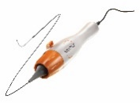




HTN-3 Trial Design
Randomized, sham-controlled, blinded trial at 88 US sites
Radiofrequency (RF) RDN using 1st gen. Symplicity Flex™ catheter
KEY INCLUSION CRITERIA
Patients with resistant HTN
  Office SBP ≥160 mm Hg
  24hr ABPM ≥135 mm Hg
On ≥3 anti-HTN medications
  Maximum tolerated dose
  Including a diuretic
  No drug testing
Sham control
(N=171)
1M
3M
6M
12M
24M
36M
4Y
Primary endpoint
2:1 Randomization
Unblinding¹
Crossover²
Medication changes allowed³
RDN
(N=364)
6M
5Y
1M
3M
12M
18M
24M
30M
36M
4Y
¹ Patients, BP assessors, and study personnel were all blinded to treatment assignment until 6-month primary endpoint
² Sham control patients were allowed to cross over to RDN therapy after 6 months if they still met inclusion/exclusion criteria
³ Until 6-month follow-up, antihypertensive medication changes were not allowed unless clinically required
Clinicaltrials.gov: NCT01418261
Bhatt DL, et al. N Engl J Med. 2014;370:1393-1401.
In the United States, the use of renal denervation in hypertensive patients is limited to investigational use only.

Slide 6
Methods
All clinicians and patients were un-blinded after the primary endpoint at 6 months
Sham control patients were allowed to cross over and receive the RDN procedure following the primary endpoint if they continued to meet inclusion/exclusion criteria
  For control subjects who crossed over to RDN, the last blinded 6-month BP and medication data pre-crossover were imputed out to 3 years by LOCF (last observation carried forward)^{1,2}
Notable protocol changes following the primary endpoint:
  Additional long-term 24-hr BP measurements were added, but not all patients re-consented
  Follow-up was reduced from 5 years to 3 years in consultation with the FDA; however, several patients had already completed a FU past 3 years
Here we present the final long-term outcomes out to at least 3 years
¹ Mahfoud F, et al. Lancet. 2022;399:1401-10.
² Papp KA, et al. Curr Med Res Opin. 2008;24(7):2001-8.

Slide 7
Patient Disposition
RDN
(N=364)
535 Patients randomized 2:1
Sham control
(N=171)
6M follow-up
97% (n=350/361)
Primary endpoint
6M follow-up
99% (n=169/171)
unblinding
Non-Crossover
(N=70)
Crossover to RDN
(N=101)
12M follow-up
91% (n=322/354)
Control group at f/u
12M follow-up
77% (n=48/62)
Imputation
using blinded 6-month BP & medication data
prior to crossover
(LOCF)
6M post-RDN f/u 97% (n=93/96)
12M post-RDN f/u
89% (n=84/94)
24M follow-up
79% (n=265/335)
24M follow-up
69% (n=37/54)
24M post-RDN f/u
80% (n=69/86)
36M follow-up
70% (n=219/311)
36M follow-up
69% (n=33/48)
36M post-RDN f/u
71% (n=53/75)
48M follow-up
37% (n=105/281)
48M follow-up
36% (n=16/44)
48M post-RDN f/u
26% (n=9/34)
54M follow-up
26% (n=38/147)
Due to the protocol change in final study duration, not all patients were eligible for continued follow-up after 36 months.

Slide 8
Patient Characteristics
mean ± SD or % | RDN N=364 | Crossover N=101 | Non-Crossover N=70 | P-value
Blood pressure (BP, mmHg) | baseline | pre-crossover*
Office systolic BP | 180 ± 16 | 184 ± 19* | 146 ± 25* | <0.0001
Office diastolic BP | 97 ± 17 | 102 ± 16* | 83 ± 13* | <0.0001
24-hr ambulatory systolic BP | 159 ± 13 | 163 ± 16* | 140 ± 15* | <0.0001
24-hr ambulatory diastolic BP | 88 ± 14 | 94 ± 14* | 78 ± 11* | <0.0001
Baseline demographics
Age (yrs) | 58 ± 10 | 55 ± 11 | 58 ± 12 | 0.08
Male sex | 59.1 | 62.4 | 67.1 | 0.19
Black race | 24.8 | 27.7 | 31.4 | 0.46
Baseline medical history
Coronary artery disease | 27.7 | 28.7 | 22.9 | 0.47
Diabetes type 2 | 47.3 | 37.6 | 47.1 | 0.24
Obstructive sleep apnea | 25.8 | 37.6 | 24.3 | 0.06
CKD (eGFR <60ml/min/1.73m²) | 9.6 | 10.9 | 10.0 | 0.90
Prior stroke | 8.5 | 11.9 | 10.0 | 0.54
History of hypertensive crisis | 23.1 | 20.8 | 24.3 | 0.84
Prescribed anti-hypertensive drugs >10 yrs | 68.1 | 72.3 | 62.9 | 0.44
*Measures for the crossover and non-crossover groups are the blinded, 6M f/u values used to determine eligibility for the crossover RDN procedure.
P-values for BP compare crossover with non-crossover only. All other P-values are three-way comparisons.

Slide 9
Safety Outcomes
% (n) | RDN | Crossover* | Non-Crossover
To 36 Months | (n=290) | (n=68) | (n=46)
Composite Safety Endpoint to 36 months** | 12.4% | 12.4% | 14.5%
Death | 4.1% (12) | 5.9% (4) | 10.9% (5)
New-onset end-stage renal disease | 3.4% (10) | 0 | 0
Sig. embolic event resulting in end-organ damage | 0.3% (1) | 0 | 0
Vascular complication | 0.3% (1) | 0 | 0
Renal artery re-intervention | 1.0% (3) | 0 | 0
Hypertensive crisis/emergency | 10.7% (31) | 11.8% (8) | 10.9% (5)
To 48 Months | (n=217) | (n=35) | (n=33)
Composite Safety Endpoint to 48 months** | 15.3% | 13.5% | 14.5%
Death | 8.3% (18) | 17.1% (6) | 15.2% (5)
New-onset end-stage renal disease | 5.1% (11) | 0 | 0
Sig. embolic event resulting in end-organ damage | 0.5% (1) | 0 | 0
Vascular complication | 0.5% (1) | 0 | 0
Renal artery re-intervention | 1.4% (3) | 0 | 0
Hypertensive crisis/emergency | 16.6% (36) | 22.9% (8) | 15.2% (5)
* Reported safety events in crossover patients begins at time of crossover.
** Defined as composite of death from any cause, end-stage renal disease, an embolic event resulting in end-organ damage, renal-artery or other vascular complications, hypertensive crisis, or new renal-artery stenosis >70% within 6 months

Slide 10
Prescribed Anti-Hypertensive Medications
Number of medication classes¹
Medication burden^{1,2}
(based on dose per day of a drug, DDD)
P=0.45 | P=0.35 | P=0.64 | P=0.41 | P=0.62
P=0.96 | P=0.16 | P=0.15 | P=0.01 | P=0.005
n: 364 | 355 | 335 | 292 | 242
n: 171 | 170 | 154 | 146 | 138
RDN
n: 364 | 355 | 335 | 292 | 242
n: 171 | 170 | 154 | 146 | 138
Control
¹ No drug testing performed to assess medication adherence.
² DDD is stated by WHO as the assumed average maintenance dose per day of a drug, based on class and daily dosage per AH medication.
P-value calculated at baseline using t-test and all follow-up comparisons using ANCOVA.
Control group include LOCF medication values for crossover patients from 6 months (blinded).
Notes:
World Health Organization Collaborating Centre for Drug Statistics Methodology. ATC Classification Index with DDDs. Accessed [2019 february 25]; Available from: https://www.whocc.no/use_of_atc_ddd/.

Slide 11
Change in Office Systolic BP
12mo
24mo
36mo
n=320
n=149
n=266
n=137
n=219
n=134
Δ -13.4 mmHg
P<0.0001
Δ -20.7 mmHg
P<0.0001
Δ -22.1 mmHg
P<0.0001
RDN (baseline 180 mmHg)
Control (baseline 180 mmHg)
Treatment differences and p-values are ANCOVA adjusted for baseline BP.
Control blood pressure measures include LOCF for crossover patients from 6 months (blinded).

Slide 12
Change in Office Systolic BP
12mo
24mo
36mo
48mo
54mo
n=320
n=149
n=266
n=137
n=219
n=134
n=104
n=39
Δ -13.4 mmHg
P<0.0001
Δ -20.7 mmHg
P<0.0001
Δ -22.1 mmHg
P<0.0001
RDN (baseline 180 mmHg)
Control (baseline 180 mmHg)
Treatment differences and p-values are ANCOVA adjusted for baseline BP.
Control blood pressure measures include LOCF for crossover patients from 6 months (blinded).
Data beyond 36 months are not reported for the control arm because sample size was too small for imputation.

Slide 13
Change in Office Diastolic BP
12mo
24mo
36mo
48mo
54mo
n=320
n=149
n=266
n=137
n=219
n=134
n=104
n=39
Δ -6.2 mmHg
P<0.0001
Δ -9.5 mmHg
P<0.0001
Δ -12.0 mmHg
P<0.0001
RDN (baseline 97 mmHg)
Control (baseline 99 mmHg)
Treatment differences and p-values are ANCOVA adjusted for baseline BP.
Control blood pressure measures include LOCF for crossover patients from 6 months (blinded).
Data beyond 36 months are not reported for the control arm because sample size was too small for imputation.

Slide 14
Change in 24-Hour Systolic BP
12mo
24mo
36mo
48mo
n=116
n=119
n=256
n=188
n=124
n=152
n=68
Δ -8.5 mmHg
P<0.0001
Δ -12.6 mmHg
P<0.0001
Δ -16.5 mmHg
P<0.0001
RDN (baseline 159 mmHg)
Control (baseline 159 mmHg)
Treatment differences and p-values are ANCOVA adjusted for baseline BP.
Control blood pressure measures include LOCF for crossover patients from 6 months (blinded).
Data beyond 36 months are not reported for the control arm because sample size was too small for imputation.

Slide 15
Change in 24-hour Diastolic BP
12mo
24mo
36mo
48mo
n=256
n=116
n=188
n=124
n=152
n=119
n=68
Δ -5.6 mmHg
P<0.0001
Δ -7.5 mmHg
P<0.0001
Δ -11.2 mmHg
P<0.0001
RDN (baseline 88 mmHg)
Control (baseline 91 mmHg)
Treatment differences and p-values are ANCOVA adjusted for baseline BP.
Control blood pressure measures include LOCF for crossover patients from 6 months (blinded).
Data beyond 36 months are not reported for the control arm because sample size was too small for imputation.

Slide 16
24-Hour Systolic BP
Baseline vs 36 Months
RDN
Control
170
Night-time
P<0.001
Morning
P<0.001
Daytime
P<0.001
170
Night-time
P=0.23
Morning
P=0.71
Daytime
P=0.36
160
160
150
150
24-hr systolic BP (mm Hg)
140
140
baseline (n=360)
baseline (n=169)
130
36 months (n=152)
130
36 months (n=120)
00:00
02:00
04:00
06:00
08:00
10:00
12:00
14:00
16:00
18:00
20:00
22:00
00:00
02:00
04:00
06:00
08:00
10:00
12:00
14:00
16:00
18:00
20:00
22:00

Slide 17
Office Systolic BP Distribution
(% Patients)
RDN
Crossover to RDN
RDN procedure
RDN procedure
P<0.001
P<0.001
≥180 mmHg
P=0.59
P<0.001
≥160 and <180 mmHg
≥150 and <160 mmHg
≥140 and <150 mmHg
<140 mmHg
Baseline
(N=364)
6 Mo
(n=350)
36 Mo
(n=219)
Baseline
(N=101)
6 Mo
(n=101)
36 Mo
(n=63)

Slide 18
Limitations
Patients were unblinded after 6 months; however, crossover patients’ BPs after 6 months were imputed utilizing blinded 6-month BP values
Due to crossover, the number of control patients at long term follow up was smaller, but sensitivity analyses in which all missing data were imputed showed consistent results
Drug testing (urine/serum) to assess patient adherence to antihypertensive medications was not performed; however, patients were on maximum tolerated doses of medications

Slide 19
Conclusion
The final follow-up from the SYMPLICITY HTN-3 trial, the largest and longest RCT of RDN to date, demonstrates:
RDN was safe through long-term follow-up, with no late-emerging complications
Despite potential confounding factors, significant reductions were seen after RDN vs control in office and 24-h BP out to 3 years, independent of medications
These findings support that durable blood pressure reductions with radiofrequency renal artery denervation in the presence of lifestyle modification and maximal medical therapy are safely achievable

Slide 20
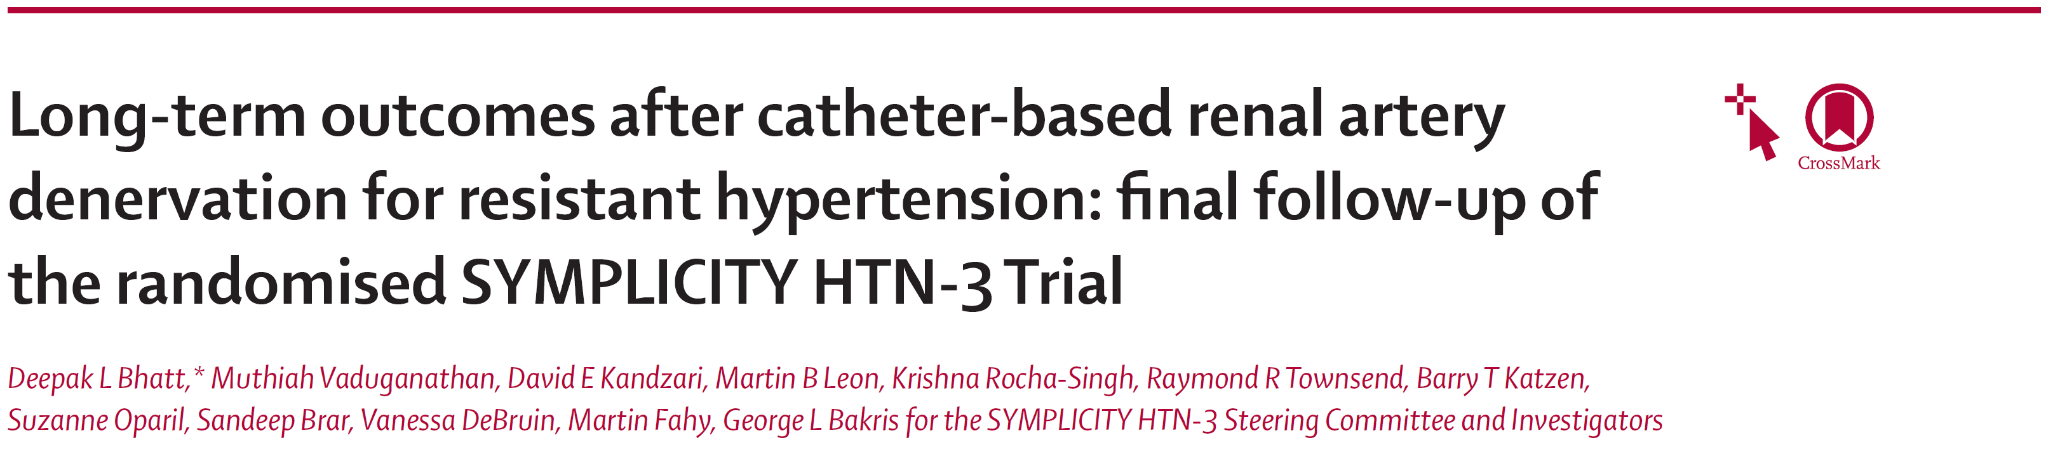
Simultaneous Publication
Bhatt DL, et al. Lancet. Published online September 18, 2022.

Slide 21
TCT Template
Title 30 pt Bold Arial
Long-term Outcomes Following Catheter-Based Renal Denervation in Patients with Uncontrolled Hypertension:
Final Follow-up of the SYMPLICITY HTN-3 Trial
John Doe, MD
Subtitle 25 pt Arial Bold Italics
Deepak L. Bhatt, MD, MPH, MSCAI
on Behalf of the SYMPLICITY HTN-3 Steering Committee and Investigators

Slide 22

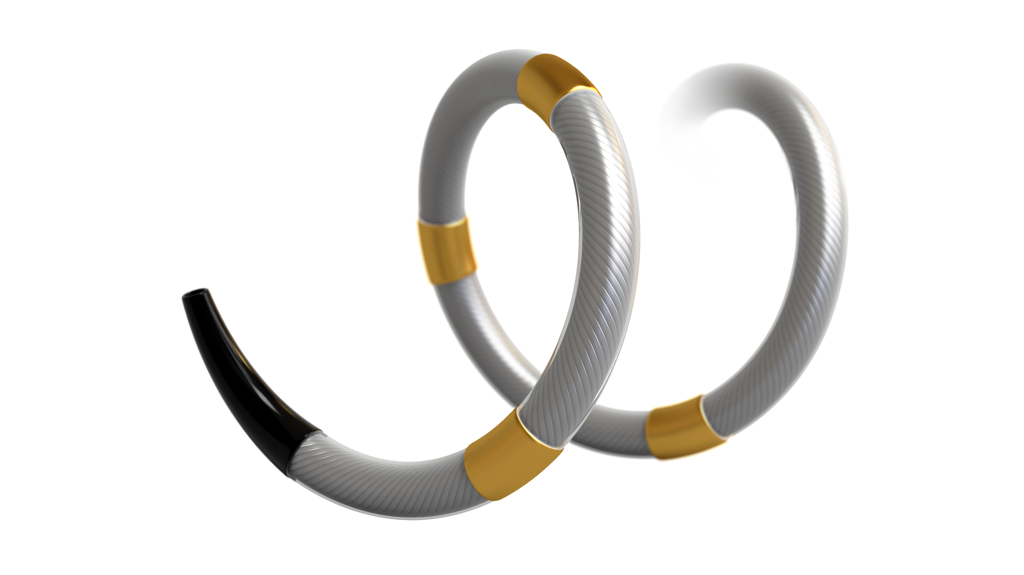
HTN-3 vs SPYRAL HTN – ON MED
Study Comparison
 | HTN-3 | SPYRAL HTN – ON MED¹
RDN technology | Radio-frequency ablation | Radio-frequency ablation
Catheter | 1st generation, Symplicity (Flex)™ 1 electrode | 2nd generation, Symplicity Spyral™ 4 electrodes
Treatment location | Main renal artery only | Main renal artery and branches
Mean number of ablations / pt | 11.2 ± 2.8 | 45.9 ± 13.7
¹ Mahfoud F, et al. Lancet. 2022;399:1401-10.

Slide 23

HTN-3 vs SPYRAL HTN-ON MED: RDN Patients
Office SBP
24hr SBP
12mo
24mo
36mo
12mo
24mo
36mo
n=320
n=38
n=266
n=34
n=219
n=33
n=256
n=36
n=188
n=33
n=152
n=30
Δ 1.1 mmHg
P=0.81
Δ 3.5 mmHg
P=0.46
Δ 3.2 mmHg
P=0.50
Δ 5.8 mmHg
P=0.08
Δ 9.3 mmHg
P=0.004
Δ 7.1 mmHg
P=0.06
SYMPLICITY HTN-3
SPYRAL HTN – ON MED¹
Results are ANCOVA adjusted for baseline BP and number of prescribed AH medications at each timepoint.
¹ Mahfoud F, et al. Lancet. 2022;399:1401-10.

