Slide 1
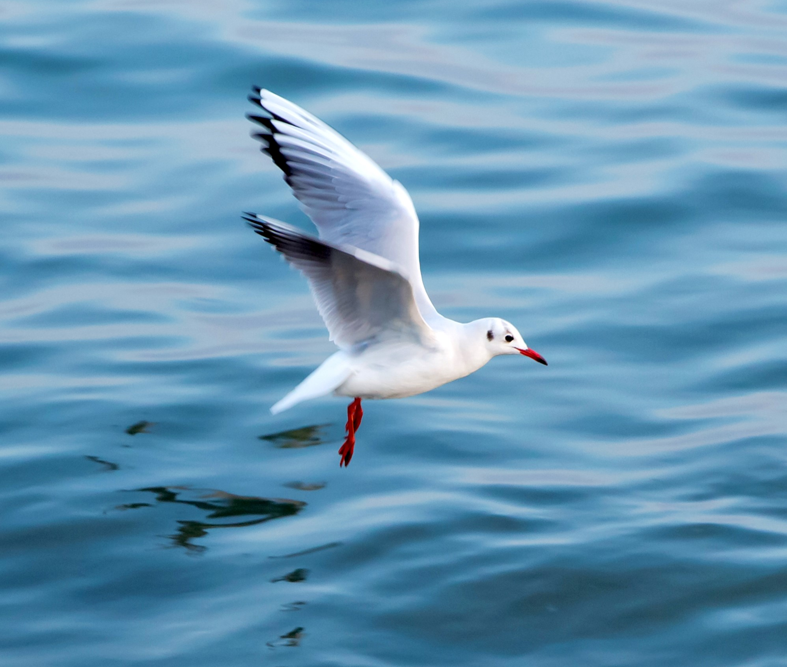


Phase 2 Program of AntiCoagulation via Inhibition of FXIa by the Oral Compound BAY 2433334 – Non-Cardioembolic Stroke Study
Main Results of the PACIFIC-Stroke Study
Ashkan Shoamanesh, MD, FRCPC
on behalf of the PACIFIC-Stroke Steering Committee and Investigators
August 28, 2022
NCT: 04304508

Slide 2
Disclosures
PACIFIC-Stroke: Bayer AG
Other Research Grants: Bayer AG, Bristol Myers Squibb, CaSTOR, Canadian Institute of Health Research, Canadian Stroke Prevention Intervention Network, Daiichi Sankyo Ltd, Heart and Stroke Foundation of Canada, Marta and Owen Boris Foundation, National Institutes of Health, Octapharma Canada, Portola Pharmaceuticals and Servier Canada Inc
Advisory Board/Consulting: ApoPharma Inc, AztraZeneca, Bayer AG, Bioxodes, Daiichi Sankyo Ltd, Ensho Inc, Javelin, Servier Canada Inc, Takeda Pharmaceutical Company and VarmX,

Slide 3
Ischemic Stroke
Cardioembolic
27%
Other
2%
Cryptogenic
35%
Small vessel disease
23%
Large artery atherosclerosis
13%
Non-Cardioembolic Ischemic Stroke
Non-cardioembolic: ~75% of all ischemic stroke¹
Substantial recurrence rate (>6%/yr) despite current guideline recommended treatment²⁻⁵
¹Kleindorfer, et al. Stroke 2021; 52: e364–467; ²Wang, et al. NEJM 2013; 369:11-9; ³Johnston, et al. NEJM 2018; 379:215-25; ⁴Johnston, et al. NEJM 2020;383:207-17; ⁵Dawson, et al. Eur Stroke J 2022

Slide 4
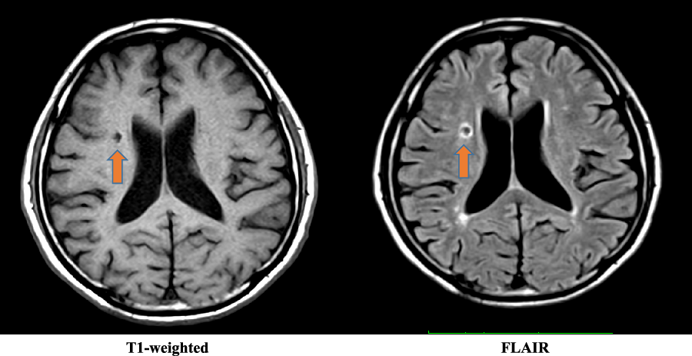
Covert brain infarction
Substantial burden of covert brain infarction
Contributor to post-stroke cognitive and functional decline^{1,2}
¹Vermeer SE, et al. NEJM 2003;348:1215-22; ²Durrani R, et al. Can J Neurol Sci 2020;47:456-63
Notes:
Sall vessel disease

Slide 5
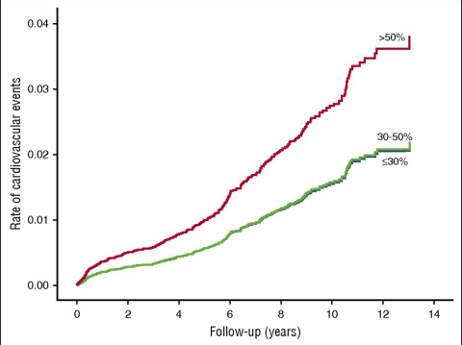




Human genetic data as well as clinical data support the testing of asundexian, a FXIa inhibitor, for secondary stroke prevention
Significant reduced risk for CV events and ischemic stroke in FXI-deficient individuals
Significant reduced risk for ischemic stroke in patients with CAD and PAD treated with dual pathway inhibition (Rivaroxaban and Aspirin)
HR for CV events
0.57 (95% CI 0.35-0.93) for ≤30% FXI activity
0.52 (95% CI 0.31-0.87) - for 30-50% FXI activity
Rivaroxaban plus aspirin:
HR 0.51 (95% CI, 0.38-0.69)
Preis M, et al. (Blood. 2017;129(9):1210-121)
Odds ratio for ischemic stroke 0.47 (95% CI 0.36-0.61)
Sharma, M, et al. (Circulation. 2019;139:1134–1145)
Georgi B, et al. (Stroke. 2019;50:3004-3012)

Slide 6


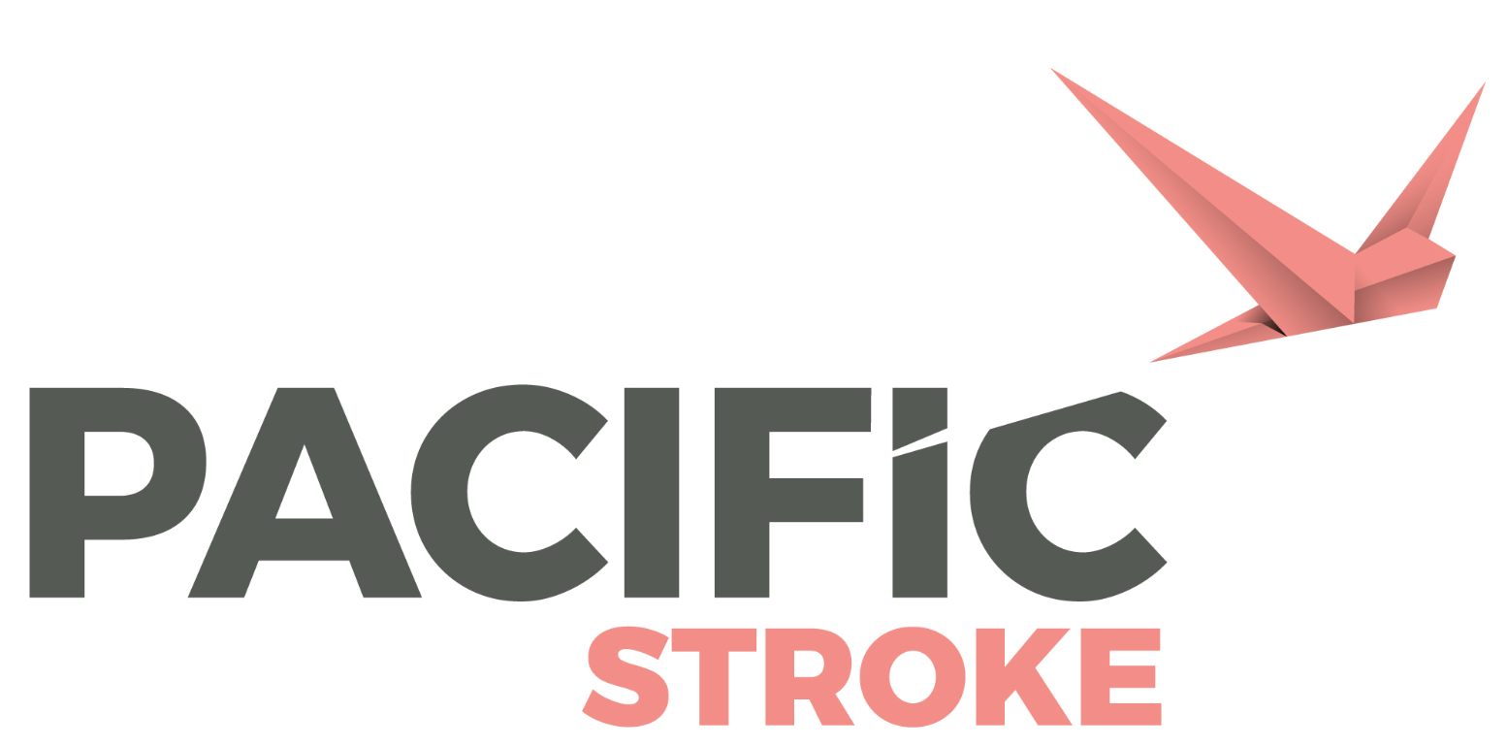
PACIFIC Program
Concerted evaluation across phase 2 programs
Atrial fibrillation
20mg asundexian
50mg asundexian
apixaban
Acute myocardial infarction
10mg asundexian
20mg asundexian
50mg asundexian
placebo
Non-cardioembolic ischemic stroke
10mg asundexian
20mg asundexian
50mg asundexian
placebo
+ dual antiplatelet therapy
+ single or dual antiplatelet therapy
~750 patients randomized
Results at ACC 2022
~ 1600 patients randomized
Results at ESC 2022
~ 1800 patients randomized
Results at ESC 2022
  Less bleeding with asundexian 20 or 50 mg QD than with apixaban in patients with AF¹
  No increase in bleeding on top of dual antiplatelet therapy
¹Piccini JP, et al. Lancet 2022; 399: 1383–90
Notes:
Asundexian is an attractive candidate to evaluate as a potential add-on to antiplatelet therapy in patients with acute ischemic stroke for secondary stroke prevention.

Slide 7

PACIFIC-Stroke study
Objectives:
  To assess the dose-response of 3 different dosages of asundexian compared with placebo on the primary efficacy outcome and, separately, to evaluate the incidence of the primary safety outcomes to determine the dosage that is most efficacious and safe for testing in a phase 3 trial.
Primary Efficacy Outcome:
  The incidence of symptomatic ischemic stroke or covert brain infarcts detected by MRI at 6 months following a non-cardioembolic ischemic stroke for each of the different doses of asundexian and placebo.
Primary Safety Outcome:
  The composite of ISTH¹ major bleeding and clinically relevant non-major bleeding pooled across all asundexian doses and compared to placebo.
Primary analysis:
  Dose response effect of asundexian on the primary efficacy outcome at 6 months.
¹Schulman, S et al. J Thromb Haemost 2005; 3:692-4

Slide 8
PACIFIC-Stroke: Schema
Prospective, randomized, double-blind, placebo-controlled, phase 2, dose-ranging study
Asundexian 50 mg QD n = 447
Patients with
Non-Cardioembolic Ischemic stroke ≤48 hrs from symptom onset
2 weeks
post study drug
observation period
Asundexian 20 mg QD n = 450
R
Asundexian 10 mg QD n = 455
Placebo QD n = 456
Background APT
Day 1
Randomization
MRI prior to or up to 72 hours post randomization
6-12 Months
EOT
MRI
EOS
Enrollment: 1808 patients between June 15, 2020 and July 22, 2021 at 196 sites in 23 countries

Slide 9

Results of
PACIFIC-Stroke

Slide 10
Study flow
Randomized
1808
Never received study drug 22 (1%)
Treatment Phase Started
1786
Did not complete treatment phase 205 (11%)
Discontinued study drug due to AF 85 (5%)
Withdrawal of consent 57 (3%)
Lost-to-follow up 19 (1%)
Death 44 (2%)
Treatment Phase Completed
1581
Included in Analysis
Efficacy 1808
Safety 1786
Did not have follow-up MRI 369 (20%)

Slide 11
Baseline and Qualifying Stroke Characteristics
Well Balanced Across Treatment Arms
 | All patients (n=1808)
Age (yrs), mean ± SD | 67 ±10
Female | 34%
Race - White - Asian | 83% 15%
Hypertension | 77%
Diabetes mellitus | 28%
Previous Stroke or TIA | 16%
Hours from qualifying stroke to randomization, mean ± SD | 36 ±10
Qualifying stroke subtype - Large artery atherosclerosis - Small vessel occlusion - Cryptogenic | 18% 45% 35%
Extra- or intracranial atherosclerosis | 34%
NIHSS score at randomization, mean ± SD | 3 ± 2
Thrombolysis for index stroke | 12%
Initial dual antiplatelet therapy | 43%

Slide 12
Primary Efficacy Outcome
Ischemic Stroke or Covert Infarcts at 6 months
No observed dose-response (Emax2 model t statistic: -0.68, p=0.80)

Slide 13
Secondary Efficacy Outcome
Incident covert brain infarct(s) on MRI at 6 months (75% of events; 69% small subcortical infarcts)
Outcome | Asundexian, 10 mg (N=455) | Asundexian, 10 mg vs. placebo | Asundexian, 20 mg (N=450) | Asundexian, 20 mg vs. placebo | Asundexian, 50 mg (N=447) | Asundexian. 50 mg vs. placebo | Placebo (N=456)
 | No. of patients (%) | CIR (90% CI) | No. of patients (%) | CIR (90% CI) | No. of patients (%) | CIR (90% CI) | No. of patients (%)
Incident covert brain infarct(s) on MRI | 63 (13.8%) | 0.99 (0.75 - 1.30) | 74 (16.4%) | 1.17 (0.90 - 1.51) | 74 (16.6%) | 1.17 (0.91 - 1.52) | 64 (14.0%)
No effect on covert brain infarct

Slide 14
Secondary Efficacy Outcomes
Total follow-up (median 10.6 months)
Outcome | Asundexian, 10 (N=455) | Asundexian, 10 vs. placebo | Asundexian, 20 (N=450) | Asundexian, 20 vs. placebo | Asundexian, 50 (N=447) | Asundexian, 50 vs. placebo | Placebo (N=456)
 | No. of patients (%) | HR (90% CI) | No. of patients (%) | HR (90% CI) | No. of patients (%) | HR (90% CI) | No. of patients (%)
Ischemic stroke | 26 (5.7%) | 0.93 (0.59-1.45) | 26 (5.8%) | 0.94 (0.60-1.47) | 22 (4.9%) | 0.80 (0.50-1.27) | 28 (6.1%)
Any recurrent stroke | 26 (5.7%) | 0.86 (0.56-1.34) | 26 (5.8%) | 0.88 (0.56-1.36) | 25 (5.6%) | 0.85 (0.54-1.32) | 30 (6.6%)
Ischemic stroke, vascular death or myocardial infarction | 33 (7.3%) | 0.94 (0.63-1.40) | 30 (6.7%) | 0.87 (0.58-1.30) | 33 (7.4%) | 0.96 (0.64-1.43) | 35 (7.7%)
All-cause mortality | 10 (2.2%) | 1.00 (0.48-2.09) | 6 (1.3%) | 0.60 (0.26-1.41) | 17 (3.8%) | 1.72 (0.89-3.32) | 10 (2.2%)
Positive trend shown for reduction in ischemic stroke with asundexian 50 mg

Slide 15
Secondary Exploratory Outcomes
Total follow-up (median 10.6 months)
Outcome | Asundexian, 10 (N=455) | Asundexian, 10 vs. placebo | Asundexian, 20 (N=450) | Asundexian, 20 vs. placebo | Asundexian, 50 (N=447) | Asundexian. 50 vs. placebo | Placebo (N=456)
 | No. of patients (%) | HR (90% CI) | No. of patients (%) | HR (90% CI) | No. of patients (%) | HR (90% CI) | No. of patients (%)
TIA | 10 (2.2%) | 0.91 (0.44-1.87) | 2 (0.4%) | 0.18 (0.05-0.64) | 2 (0.4%) | 0.18 (0.05-0.65) | 11 (2.4%)
Recurrent ischemic stroke or TIA | 35 (7.7%) | 0.92 (0.63-1.35) | 28 (6.2%) | 0.74 (0.49-1.12) | 24 (5.4%) | 0.64 (0.41-0.98) | 38 (8.3%)

Slide 16
Secondary Exploratory Outcomes
Total follow-up (median 10.6 months)
Outcome | Asundexian, 10 (N=455) | Asundexian, 10 vs. placebo | Asundexian, 20 (N=450) | Asundexian, 20 vs. placebo | Asundexian, 50 (N=447) | Asundexian 50 vs. placebo | Placebo (N=456)
 | No. of patients (%) | HR (90% CI) | No. of patients (%) | HR (90% CI) | No. of patients (%) | HR (90% CI) | No. of patients (%)
TIA | 10 (2.2%) | 0.91 (0.44-1.87) | 2 (0.4%) | 0.18 (0.05-0.64) | 2 (0.4%) | 0.18 (0.05-0.65) | 11 (2.4%)
Recurrent ischemic stroke or TIA | 35 (7.7%) | 0.92 (0.63-1.35) | 28 (6.2%) | 0.74 (0.49-1.12) | 24 (5.4%) | 0.64 (0.41-0.98) | 38 (8.3%)
Dose dependent reduction of composite of ischemic stroke or TIA with asundexian

Slide 17
Outcome: Recurrent stroke and TIA
Exploratory post-hoc subgroup analysis
A. Patients with large artery stroke (TOAST, N=320)
B. Patients with any extra-/intracranial atherosclerosis (vascular imaging, N= 791)
HR 0.56, 90% CI 0.26 – 1.19
HR 0.39, 90% CI 0.18 – 0.85
Patients with atherosclerosis had fewer recurrent stroke and TIA with asundexian 50

Slide 18
Bleeding Outcomes
A. Major or Clinically-Relevant Non-Major Bleeding (ISTH)¹
B. All Bleeding
HR 1.57, 90% CI 0.91 – 2.71
C. Hemorrhagic transformation in patients with baseline MRI after randomization
 | Asundexian 10 (N=277) | Asundexian 20 (N=265) | Asundexian, 50 (N=277) | Placebo (N=296)
HI1 and 2 | 29.6% | 29.4% | 30.3% | 32.8%
PH1 and 2 | 1.1% | 0.4% | 0% | 1.4%
No significant increase in bleeding and hemorrhagic transformation of index stroke
ASU = Asundexian, HI = hemorrhagic infarct, PH = parenchymal hematoma
¹Schulman, S et al. J Thromb Haemost 2005; 3:692-4

Slide 19
Conclusions
  In this phase 2 trial, inhibition of factor XIa with asundexian did not reduce the composite of covert brain infarction or ischemic stroke and no dose response could be shown in patients with acute, non-cardioembolic ischemic stroke.
    Driven by lack of effect on covert brain infarction (largely due to small vessel disease)
  Treatment with asundexian 50mg reduced recurrent symptomatic ischemic strokes and TIAs, particularly among those with atherosclerosis
  No significant increase in the risk of major or intracranial bleeding with asundexian
  The promising results from this phase 2 trial require validation in an adequately-powered phase 3 randomised trial

Slide 20
Acknowledgements
Steering Committee
Bayer
Robert Hart (Co-PI)
Stuart J. Connolly (Co-PI)
Hardi Mundl (Sponsor lead)
Pablo Colorado (Sponsor)
Eric Smith (MRI Corelab)
Jaime Masjuan (Spain, n=216)
Ivan Malinov (Bulgaria, n=177)
Terry Hirano (Japan, n=173)
Alina Agafina (Russia, n=123)
Bruce Campbell (Australia, n=116)
Valeria Caso (Italy, n=87)
Jean-Louis Mas (France, n=84)
Qian Dong (China, n=81)
Peter Turcani (Slovakia, n=80)
Hanne Christensen (Demark, n=79)
Jose Ferro (Portugal, n=79)
Roland Veltkamp (Germany, n=73)
Robert Mikulik (Czech Republic, n=68)
Gian Marco De Marchis (Switzerland, n=64)
Thompson Robinson (UK, n=55)
Robin Lemmens (Belgium, n=51)
Adam Stepien (Poland, n=47)
Stefan Greisenegger (Austria, n=40)
Risto Roine (Finland, n=39)
Laslo Csiba (Hungary, n=29)
Pooja Khatri (USA, n=23)
Jonathan Coutinho (Netherlands, n=18)
Arne Lindgren (Sweden, n=9)
Andrew Demchuk (Canada)
Christoph Neumann
Bodo Kirsch
Vicki Clarke
Karen Ho
Gerlind Holberg
PHRI
Amanda Taylor
Laura Heenan
Elham Ramezani
Kumiko Stefani
Lizhen Xu
IDMC
Jonathan Halperin
Steven Greenberg
Thomas Cook
Saskia Middeldorp
Christoph Bode

Slide 21
Thank you!

