Slide 1


Percutaneous Revascularisation for Ischaemic Left Ventricular Dysfunction
A randomised trial of percutaneous coronary intervention versus optimal medical therapy for severe ischaemic cardiomyopathy
Prof Divaka Perera MD FRCP
King’s College London, UK
On behalf of the REVIVED investigators
Saturday 27th August 2022

Slide 2

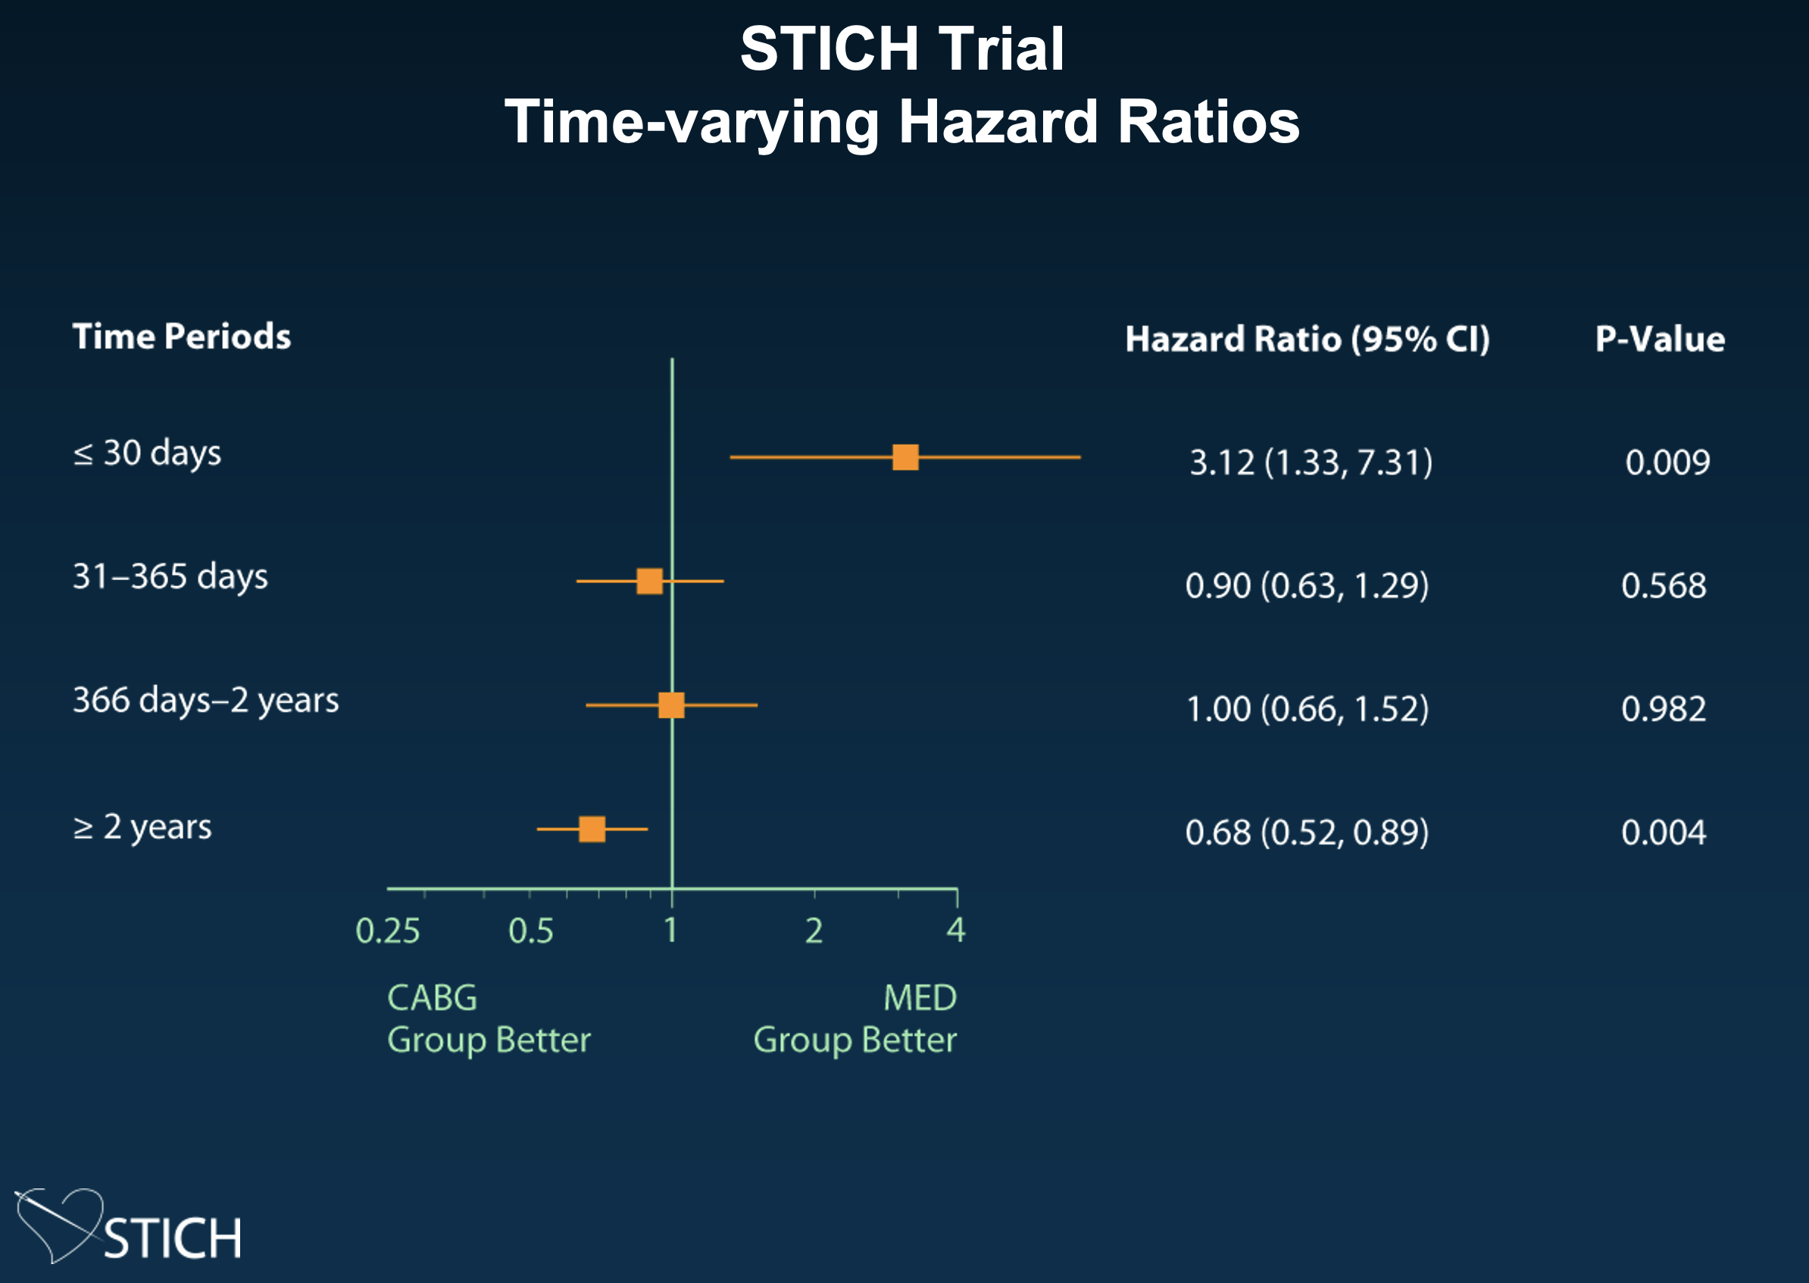
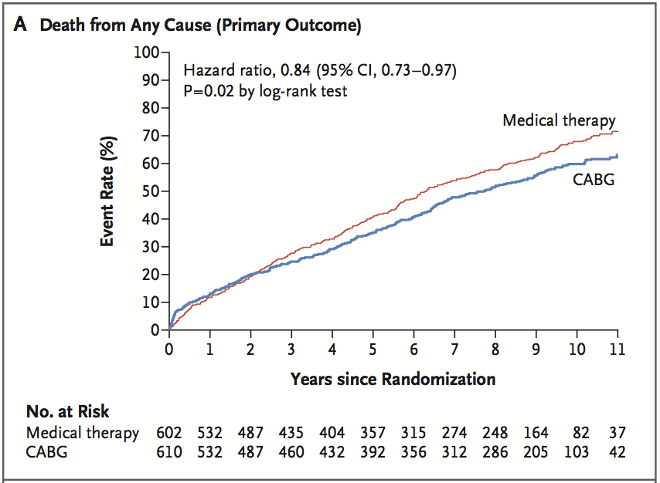
Background: CABG for ischaemic cardiomyopathy
Velazquez EJ et al, NEJM 2011;364:1607–16
Velazquez EJ et al, NEJM 2016; 374:1511–20

Slide 3
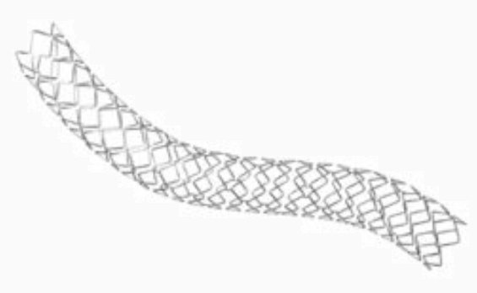
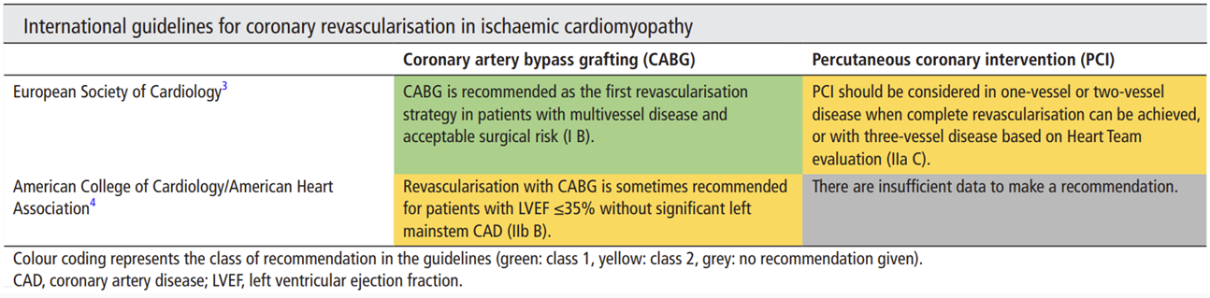
Background: PCI for ischaemic cardiomyopathy
No randomised evidence to date , guidelines based on consensus opinion
Ryan M et al, Heart 2021; 107: 612-618

Slide 4




HYPOTHESIS
Revascularisation with PCI improves event-free survival in patients with severe ischaemic left ventricular systolic dysfunction, compared to optimal medical therapy alone
ISRCTN45979711; NCT01920048

Slide 5

Inclusion Criteria
Left ventricular ejection fraction ≤ 35%
Extensive coronary artery disease (BCIS-Jeopardy Score ≥ 6)
Viability in ≥ 4 myocardial segments that can be revascularised by PCI
Exclusion Criteria
Acute myocardial infarction < 4 weeks previously
Acute decompensated heart failure or sustained ventricular arrhythmias

Slide 6
LV Ejection Fraction ≤ 35%
Extensive Coronary Disease (BCIS-JS ≥6)
Viable Myocardium
on CMR, DSE, SPECT or PET
PCI feasible to lesions subtending ≥4 dysfunctional but viable segments
RANDOMISE
PCI
Optimal Medical Therapy
Echocardiography at 6m, 12m
Clinical, ICD, biochemical follow up at 6m, 12m, 24m+
Perera D et al, JACC HF 2018

Slide 7
Primary Outcome
All-cause death or hospitalisation for heart failure
at a minimum of 24 months
Sample Size
700 patients would provide > 85% power to detect a hazard ratio of 0.70 for the primary outcome, if 300 experience a primary event
at 5% significance, allowing for up to 5% losses

Slide 8
Major Secondary Outcomes
Left ventricular ejection fraction at 6- and 12-months
by blinded core laboratory analysis
Quality of life outcomes at 6-, 12- and 24-months
Kansas City Cardiomyopathy Questionnaire, EQ-5D-5L Index, NHYA class
Other Secondary Outcomes
All-cause death, hospitalisation for heart failure, cardiovascular death, acute myocardial infarction, unplanned revascularisation, serial NT-proBNP levels, appropriate ICD therapies, angina class, major bleeding

Slide 9
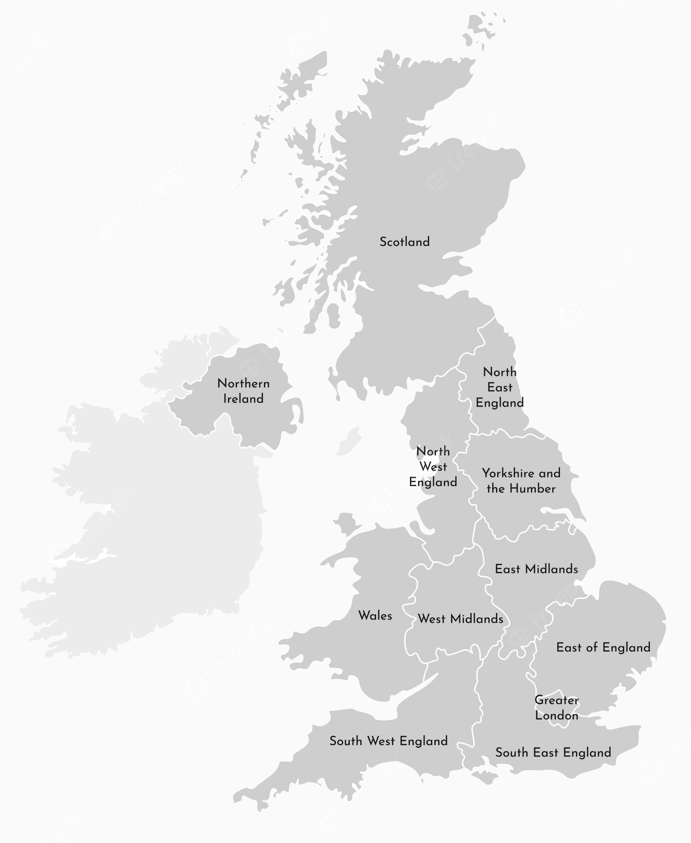
700 patients
40 UK centres
2
Recruited between
August 2013 and March 2020
10
83
26
32
Follow-up ended
March 2022
6
3
54
1
9
2
16
10
12
12
2
1
18
10
15
2
13
5
6
63
18
8
13
2
124
1
17
8
3
25
3
56
2
5
9
5

Slide 10
Randomisation
347 Assigned to
Receive PCI
353 Assigned to
Receive OMT
Min 24 months follow up
Primary outcome available in 343 (98.8%)
Min 24 months follow up
Primary outcome available in 351 (99.4%)
Final follow-up at median
41 [28 to 60] months
Primary outcome available in 343 (98.8%)
Final follow-up at median
41 [28 to 60] months
Primary outcome available in 351 (99.4%)

Slide 11
 | PCI (N = 347) | OMT (N = 353)
Age – yrs | 70.0 ± 9.0 | 68.8 ± 9.1
Male sex – no. (%) | 302 (87) | 312 (88)
Hypertension – no. (%) | 184 (53) | 207 (59)
Diabetes – no. (%) | 136 (39) | 153 (43)
Left ventricular ejection fraction - % | 27.0 ± 6.6 | 27.0 ± 6.9
Viability assessment – no. (%)
Cardiac MRI | 246 (71) | 247 (70)
Stress echocardiography | 91 (26) | 93 (26)
SPECT/PET | 14 (4) | 17 (5)
Coronary artery disease characteristics
Median BCIS jeopardy score (IQR) | 10 (8 to 12) | 10 (8 to 12)
Left main coronary artery disease – no. (%) | 50 (14) | 45 (13)
3-vessel coronary artery disease – no. (%) | 133 (38) | 148 (42)
2-vessel coronary artery disease – no. (%) | 178 (51) | 166 (47)

Slide 12
 | PCI (N = 347) | OMT (N = 353)
Hospitalization for heart failure ≤ 2 years before randomization – no. (%) | 112 (32) | 121 (34)
NYHA functional class – no. (%)
Class I/II | 265 (77) | 248 (71)
Class III/IV | 80 (23) | 102 (29)
Heart failure medication – no. (%)
ACEi/ARB/ARNI | 305 (88) | 315 (89)
Beta-blocker | 315 (91) | 319 (90)
Mineralocorticoid receptor antagonist | 176 (51) | 170 (48)
Heart failure device - no. (%) | 85 (24) | 77 (22)
ICD | 47 (55) | 35 (45)
CRT-D | 32 (38) | 35 (45)
CRT-P | 6 (7) | 7 (9)
Median NT-proBNP - pg/ml (IQR) | 1376 (697 to 3426) | 1461 (712 to 3365)

Slide 13
Primary Outcome

Slide 14
129 events (37.2%)
134 events (38.0%)
Primary Outcome
Hazard Ratio 0.99
95% CI 0.78 to 1.27
p=0.96

Slide 15
Components of primary outcome
HR 0.90; 95% CI 0.75 to 1.26
HR 0.97; 95% CI 0.66 to 1.43

Slide 16
Primary outcome by prespecified subgroups

Slide 17
Major secondary outcome:
LVEF
Difference: -1.6%
95% CI: -3.7% to 0.5%
Difference: 0.9%
95% CI: -1.7% to 3.4%

Slide 18
Major secondary outcome:
KCCQ Score
Difference: 6.5
95% CI: 3.5 to 9.5
Difference: 2.6
95% CI: -0.7 to 5.8
score ranges from
0 (very poor health) to 100 (excellent health)

Slide 19
Major secondary outcome:
EQ-5D-5L
Difference: 0.04
95% CI: 0.01 to 0.07
Difference: 0.02
95% CI: -0.02 to 0.06
score of 1: perfect health,
score <1: declining health

Slide 20
Secondary outcome:
NT-proBNP

Slide 21
HR 0.27; 95% CI 0.13 to 0.53
Secondary outcome:
Unplanned Revascularisation

Slide 22
HR 1.01; 95% CI 0.64 to 1.60
Secondary outcome:
Acute Myocardial Infarction

Slide 23
Conclusions
Patients with ischaemic cardiomyopathy continue to have high rates of mortality and hospitalisation for heart failure, even with contemporary medical and device therapy
Percutaneous coronary intervention did not reduce the composite incidence of
all-cause death or hospitalisation for heart failure at a median of 3.4 years
Percutaneous coronary intervention did not incrementally improve left ventricular ejection fraction or provide a sustained difference in quality of life

Slide 24
Acknowledgements
The Patients
who selflessly volunteered

Slide 25
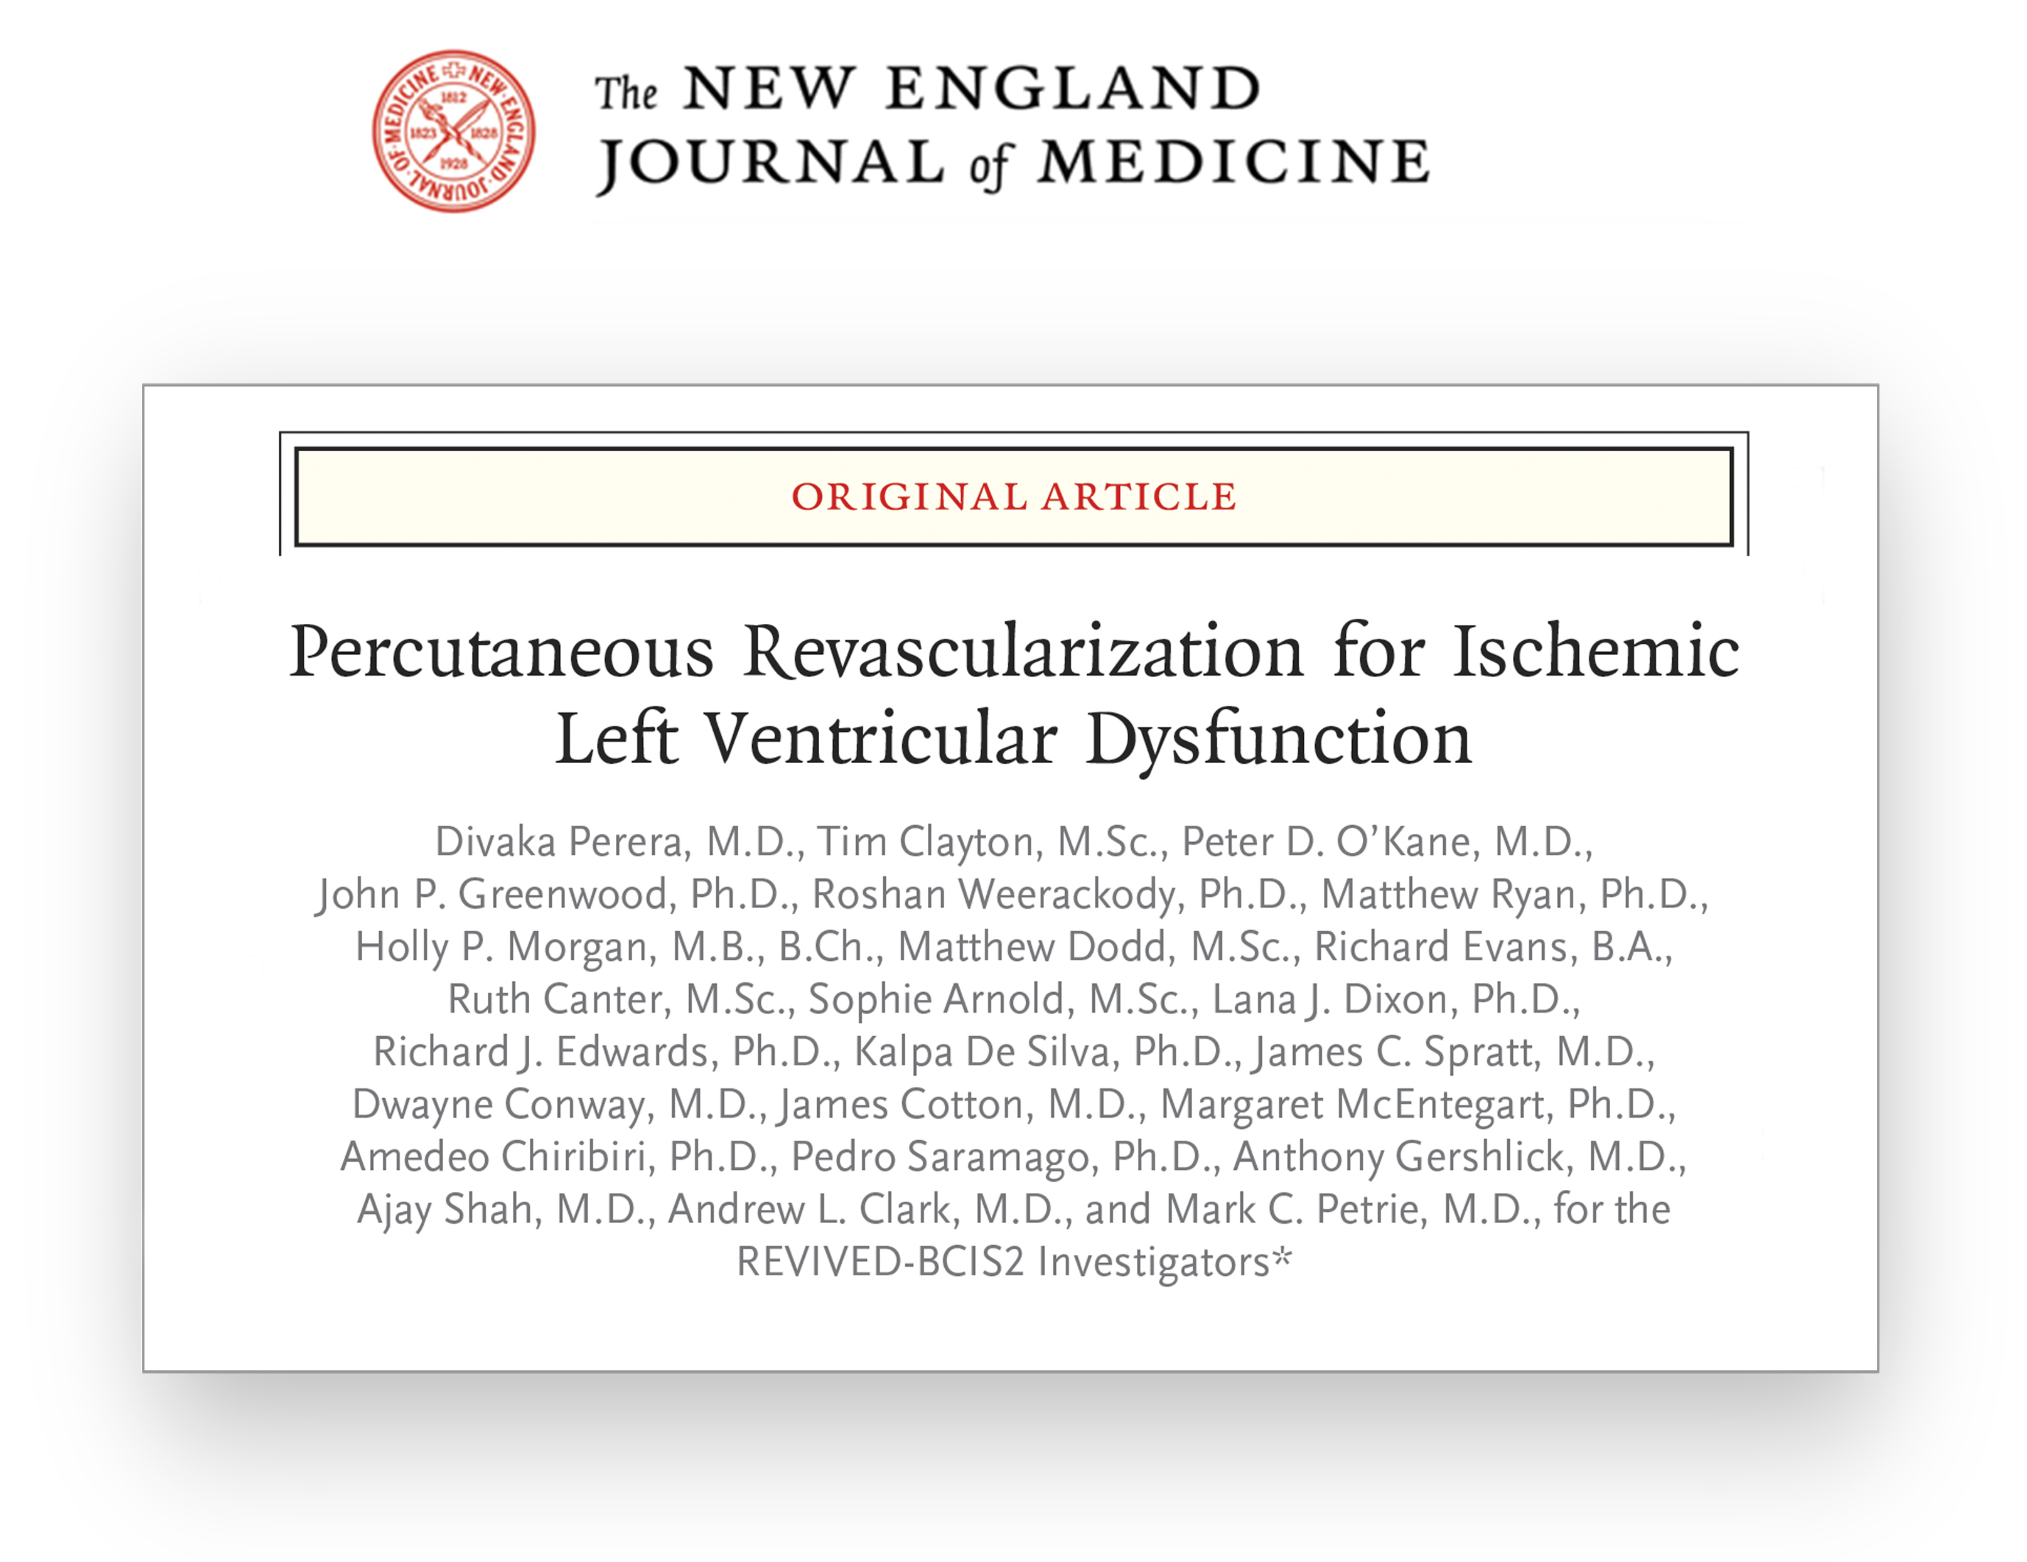
NEJM doi
@REVIVED_BCIS2
@divaka_perera
Divaka.Perera@kcl.ac.uk

