Slide 1
Coronary Atherosclerotic Plaque Activity and Future Coronary Events
David Newby, University of Edinburgh
Hot Line Session 7
28th August 2022
Prediction of Recurrent Events with 18F-Fluoride to Identify Ruptured and High-risk Coronary Artery Plaques in Patients with Myocardial Infarction
EudraCT: 2014-004021-41
Trial Registration: NCT02278211

Slide 2
Declarations
Funder
Wellcome Trust (WT103782AIA)
Sponsors
University of Edinburgh and NHS Lothian
Clinical Trial Authorisation
MHRA (EudraCT 2014-004021-41)
Conflicts of Interest
DEN has held unrestricted research grant awards from Siemens Healthineers.
PS developed FusionQuant (1R01HL135557)

Slide 3
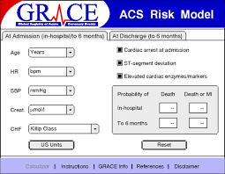
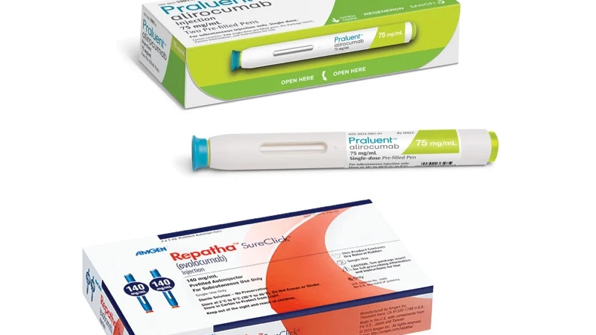
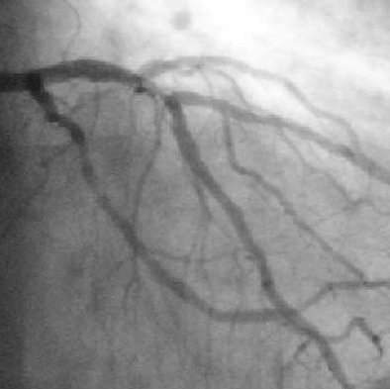
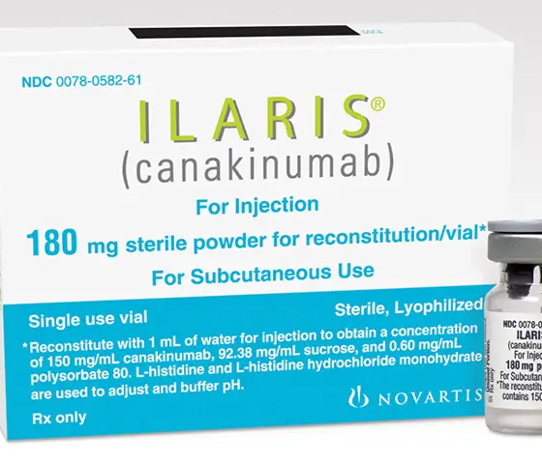
Prediction of Coronary Events after Myocardial Infarction
“'It's tough to make predictions, especially about the future’”
Yogi Berra

Slide 4
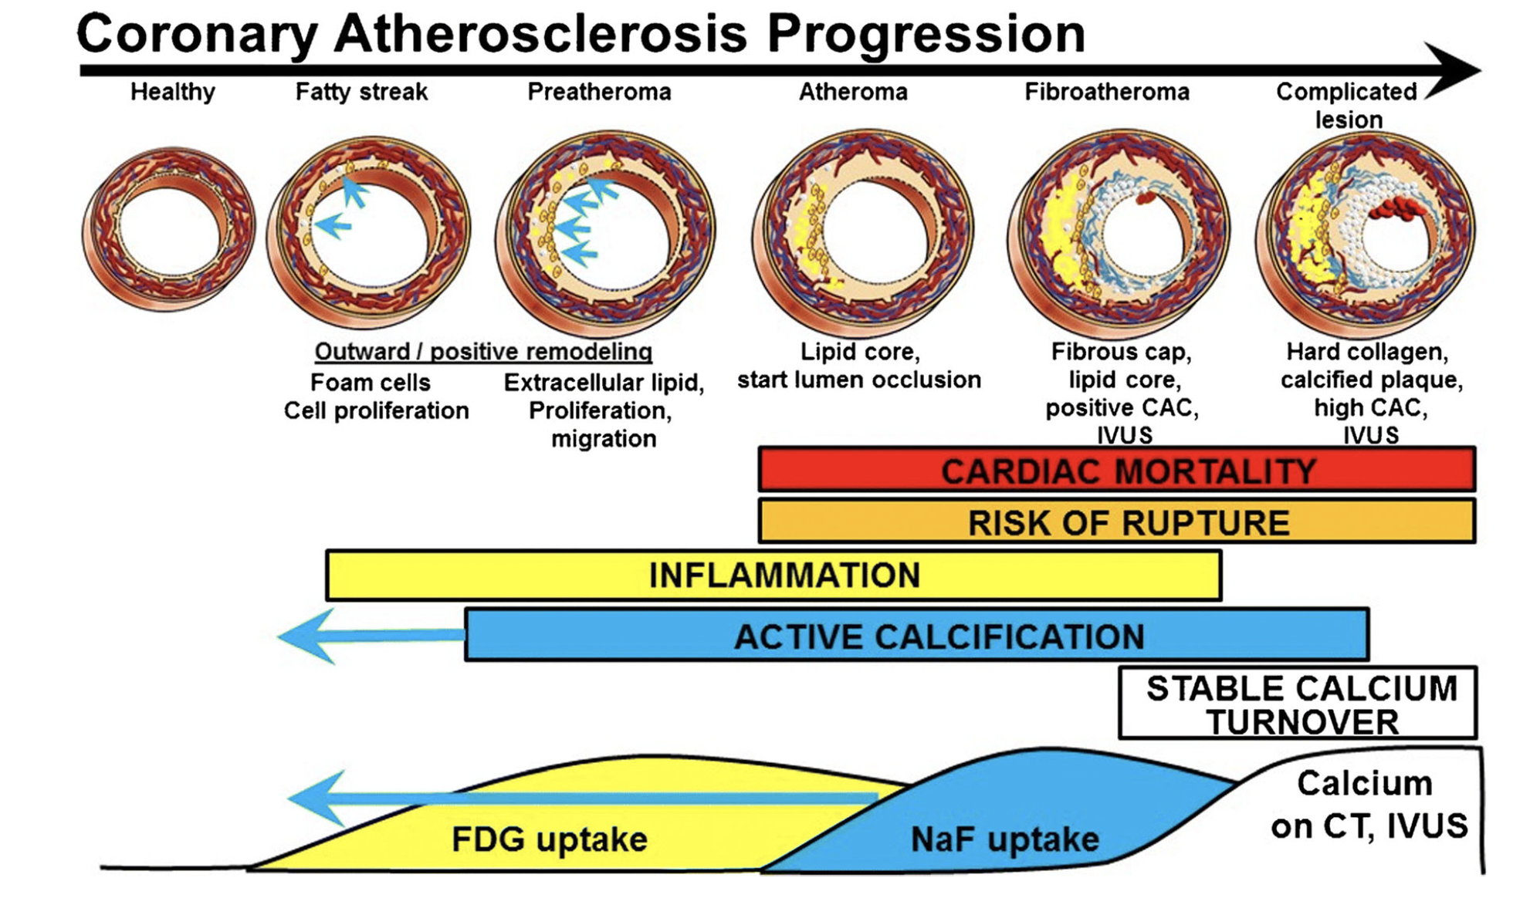
Coronary ¹⁸F-Sodium Fluoride Uptake
Raynor et al. J Nucl Cardiol 2021;28:2706-2711

Slide 5
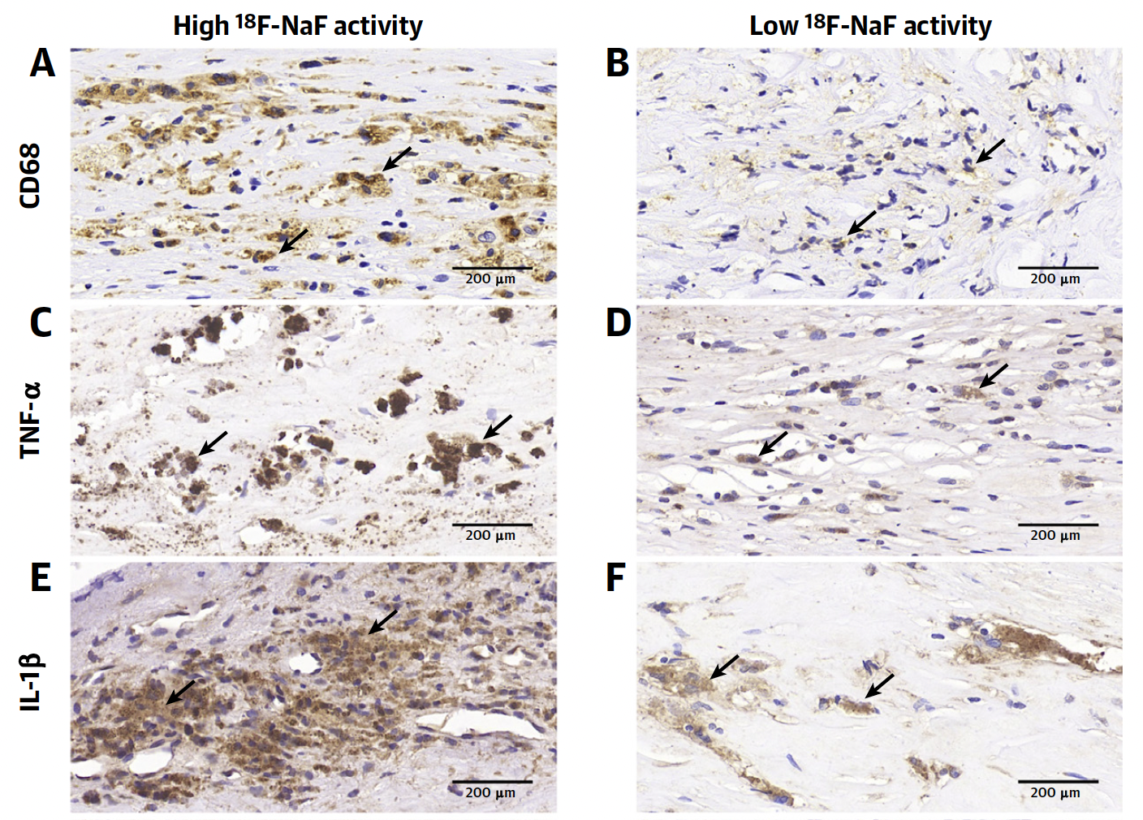
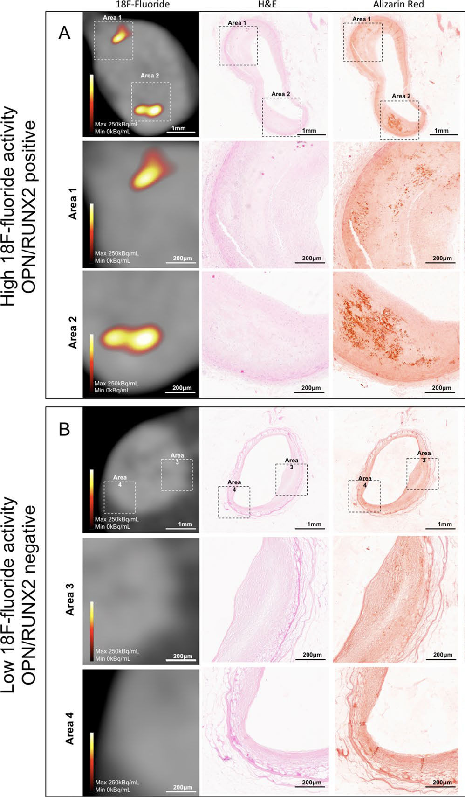
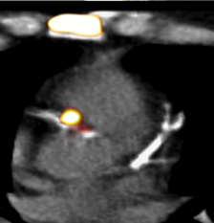
Coronary ¹⁸F-Sodium Fluoride Uptake
High Activity
Low Activity
Histology of Coronary Endarterectomy
IVUS
Wen et al. JACC Cardiovasc Imaging 2022; in press
Moss et al. Sci Rep 2020;10:21072
Joshi et al. Lancet 2014;383:705-713

Slide 6
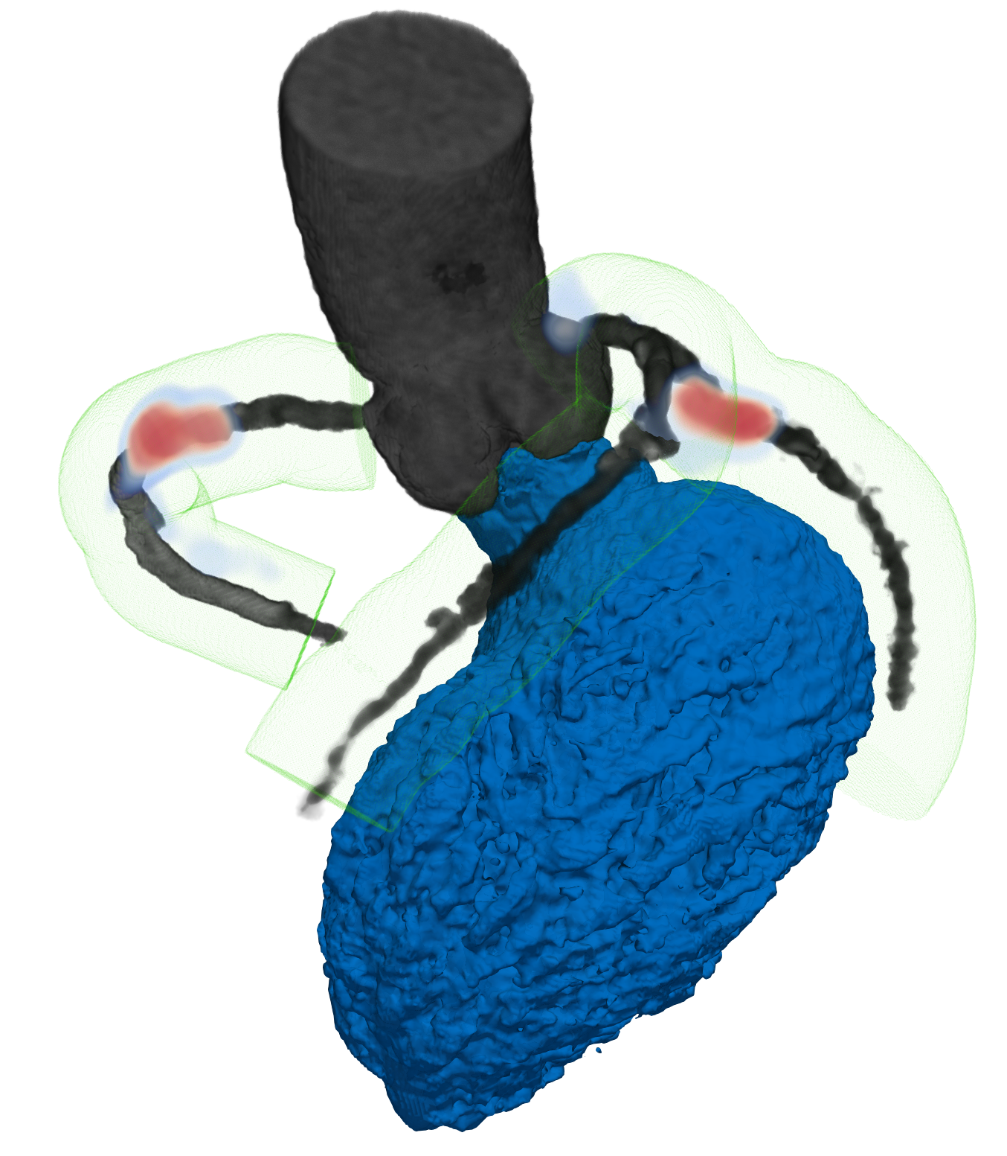
Coronary ¹⁸F-Sodium Fluoride Uptake Coronary Microcalcification Activity
Stable Patients with
Cardiovascular Disease
Coronary Microcalcification Activity
(CMA)
Fletcher et al. JACC Cardiovasc Imaging 2022;15:1274-1288

Slide 7
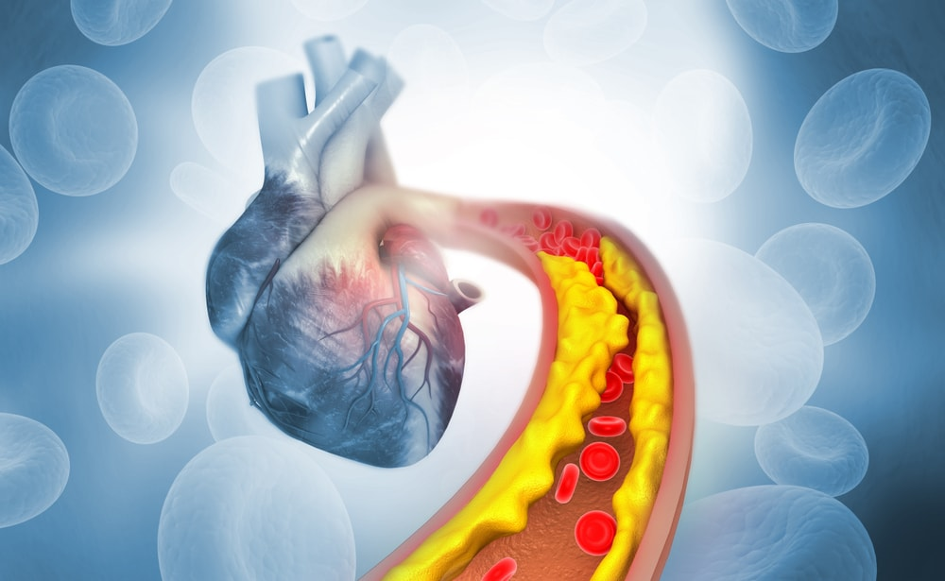
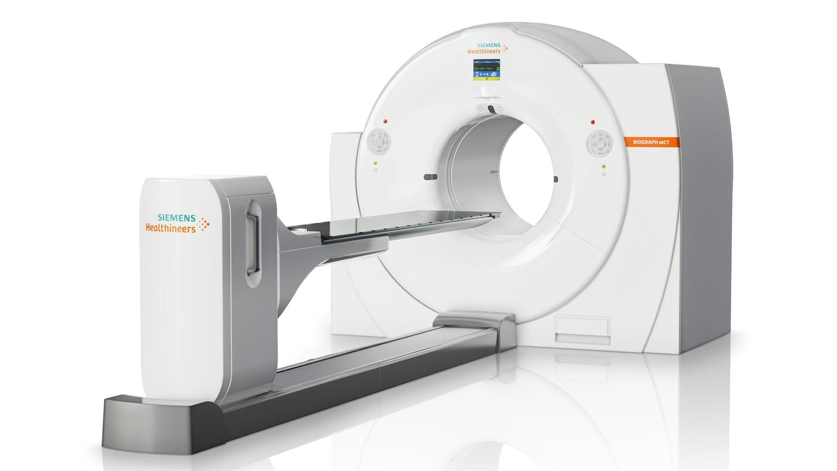
Prediction of Recurrent Events with ¹⁸F-Sodium Fluoride to Identify Ruptured and High-risk Coronary Artery Plaques in Patients with Myocardial Infarction
Study Design: International multicentre prospective longitudinal cohort trial
Regulation: Clinical Trial Authorisation by MHRA
Study Population: Patients with recent myocardial infarction and multivessel coronary artery disease
Intervention: ¹⁸F-sodium fluoride positron emission tomography and coronary computed tomography angiography
Follow up: Minimum of 2 years follow up
Clinical Endpoints: Cardiac death, non-fatal myocardial infarction, coronary revascularisation, all-cause death.

Slide 8
Primary Endpoint and Study Power
Primary Endpoint: Cardiac death or non-fatal myocardial infarction
Assuming event rate of 20-30% and effect size of 50%, 692 patients were required for 80% power and P<0.05.
Despite inclusion of multivessel disease, review of event rate at mid-point of the trial suggested an event rate of ~10%.
Trial Steering Committee recommended inclusion of unscheduled coronary revascularisation into the combined primary endpoint as increased coronary activity could lead to plaque expansion.
Revised Primary Endpoint: Cardiac death, non-fatal myocardial infarction or unscheduled coronary revascularisation.

Slide 9
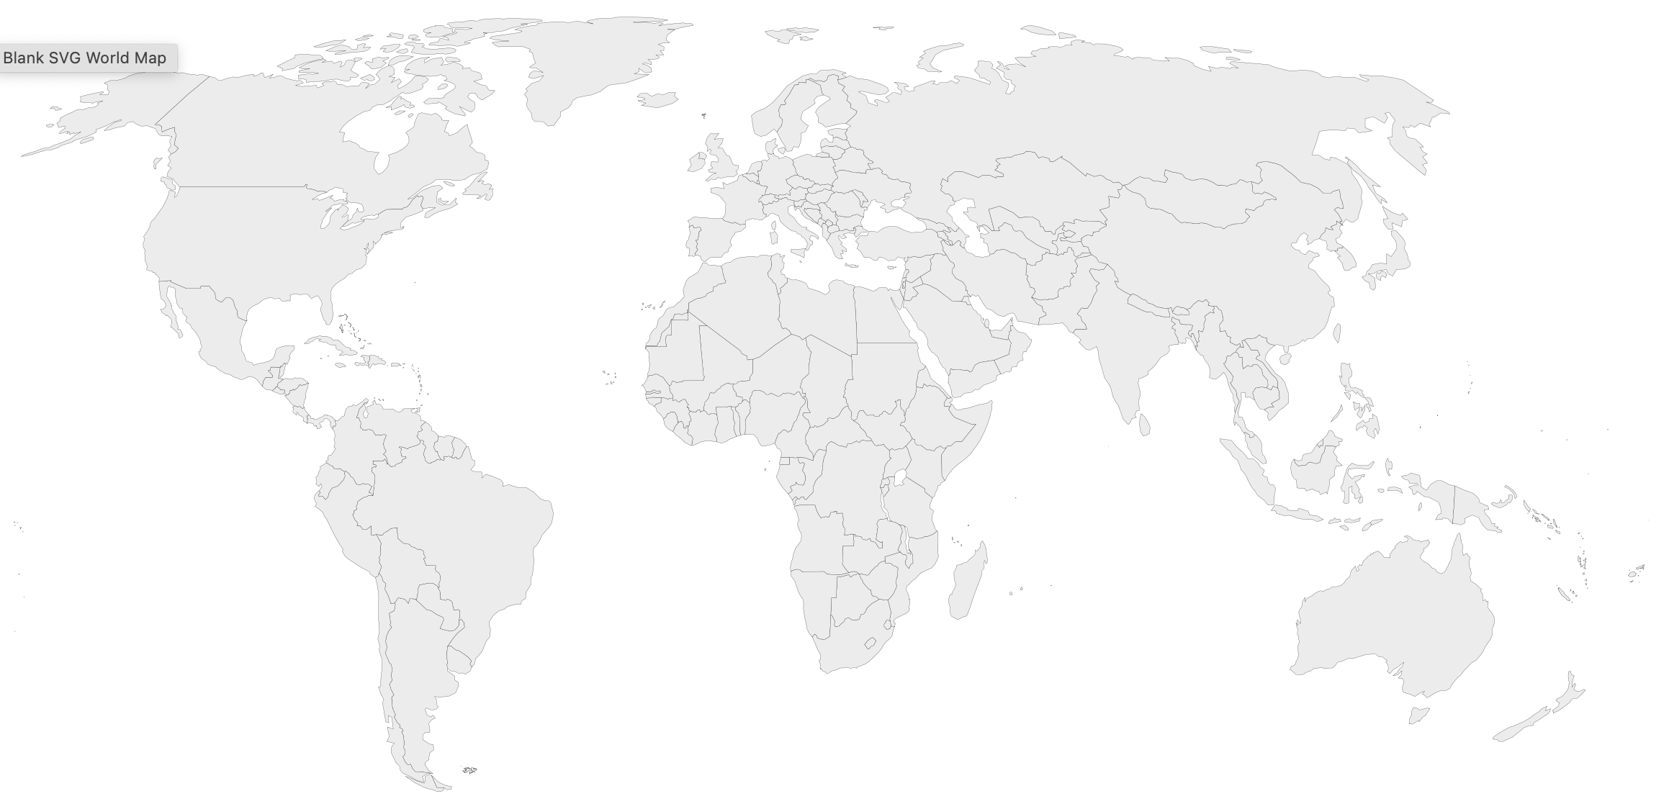
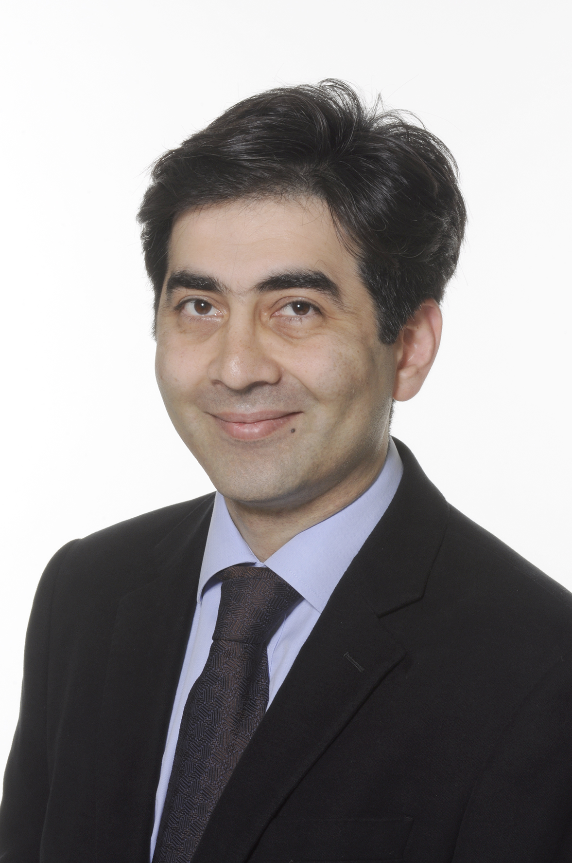
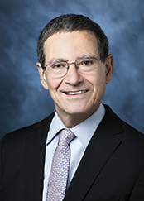
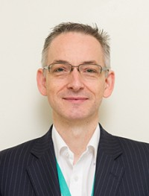
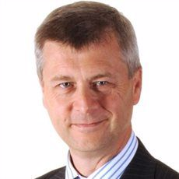
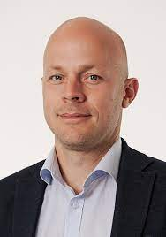
PRE¹⁸FIR Investigator Sites 9 Sites, 4 Countries
Dana Dawson, Aberdeen Royal Infirmary
Dave Newby, Royal Infirmary of Edinburgh
Parthiban Arumugam, Manchester Royal Infirmary
Nikant Sabharwal, John Radcliffe Hospital
John Greenwood, Leeds General Infirmary
Patrick Calvert, Addenbrookes & Papworth Hospitals
Jon Townend, Queen Elizabeth Hospital
Dan Berman, Cedars-Sinai
Piotr Slomka, Cedars-Sinai
Johan Verjans, Royal Adelaide Hospital

Slide 10
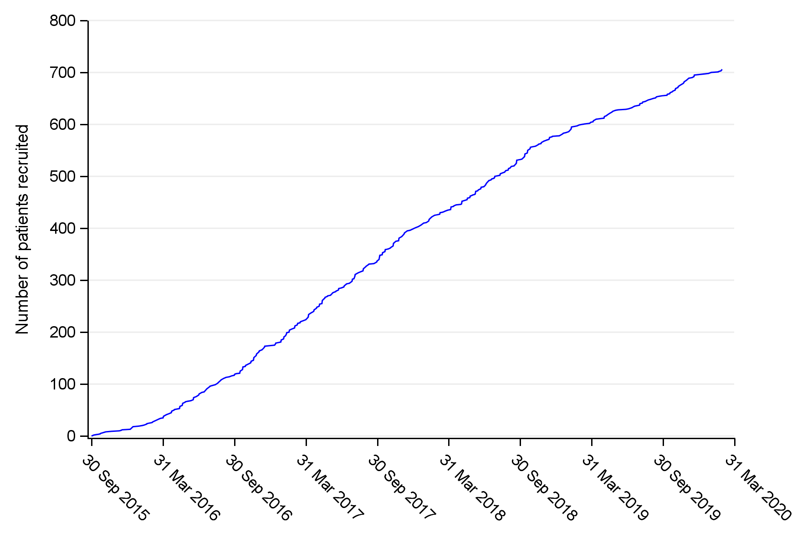
Trial Recruitment and Population
Patients approached to participate in study
(n = 2,684)
Excluded (n = 1,689)
Ineligible (n = 388)
Declined to participate (n = 812)
Clinician/investigator decision (n = 197)
Other (n = 292)
Initially assessed as eligible, written informed consent obtained, and screening visit done
(n = 995)
Excluded (n = 283)
Changed their mind about participating (n = 142)
Unable to scan within protocol window (n = 82)
Health subsequently deteriorated precluding inclusion (n = 22)
Unable to contact patient (n = 19)
Ineligible (n = 10)
Deceased (n = 6)
Clinician/investigator decision (n = 2)
Attended baseline visit and received
radioactive tracer [¹⁸F-NaF]
(n = 712)
PET-CT scan incomplete (n = 6)
Claustrophobia (n = 3)
Panic attack (n = 1)
Patient very anxious (n = 1)
Scanner malfunction (n = 1)
PET-CT scan completed
(n = 706)
At study completion, follow up was available in 693 (98·2%) participants
Follow-up discontinued prematurely (n = 13)
Withdrew consent to any further follow-up (n = 3)
Withdrawn from study by clinician (n = 4)
Lost to follow-up (n = 2)
Final annual follow-up not completed (n = 4)
Analysis population for the primary outcome
(n = 704)

Slide 11
Trial Population Characteristics
 | Total Population | Low coronary atherosclerotic plaque activity CMA = 0 | High coronary atherosclerotic plaque activity CMA > 0
Number | 704 | 283 | 421
Age (years) | 63·8±8·2 | 61·8±7·4 | 65·1±8·4
Sex (female) | 103 (15%) | 61 (22%) | 42 (10%)
Body-mass index (kg/m²) | 28·3±4·4 | 28·6±4·7 | 28·1±4·2
Cardiovascular risk factors
Smoking habit Current Smoker | 193 (27%) | 90 (32%) | 103 (24%)
Ex-smoker | 225 (32%) | 91 (32%) | 134 (32%)
Non-smoker | 286 (41%) | 102 (36%) | 184 (44%)
Hypertension | 351 (50%) | 119 (42%) | 232 (55%)
Hypercholesterolaemia | 398 (57%) | 162 (58%) | 236 (56%)
Diabetes mellitus | 118 (17%) | 40 (14%) | 78 (19%)
Prior cardiovascular disease
Coronary artery disease | 139 (20%) | 41 (14%) | 98 (23%)
Myocardial infarction | 102 (14%) | 36 (13%) | 66 (16%)
Percutaneous coronary intervention | 100 (14%) | 28 (10%) | 72 (17%)
Coronary artery bypass graft surgery | 31 (4%) | 12 (4%) | 19 (5%)
Peripheral vascular disease | 21 (3%) | 12 (4%) | 9 (2%)
Cerebrovascular disease | 33 (5%) | 10 (4%) | 23 (5%)

Slide 12
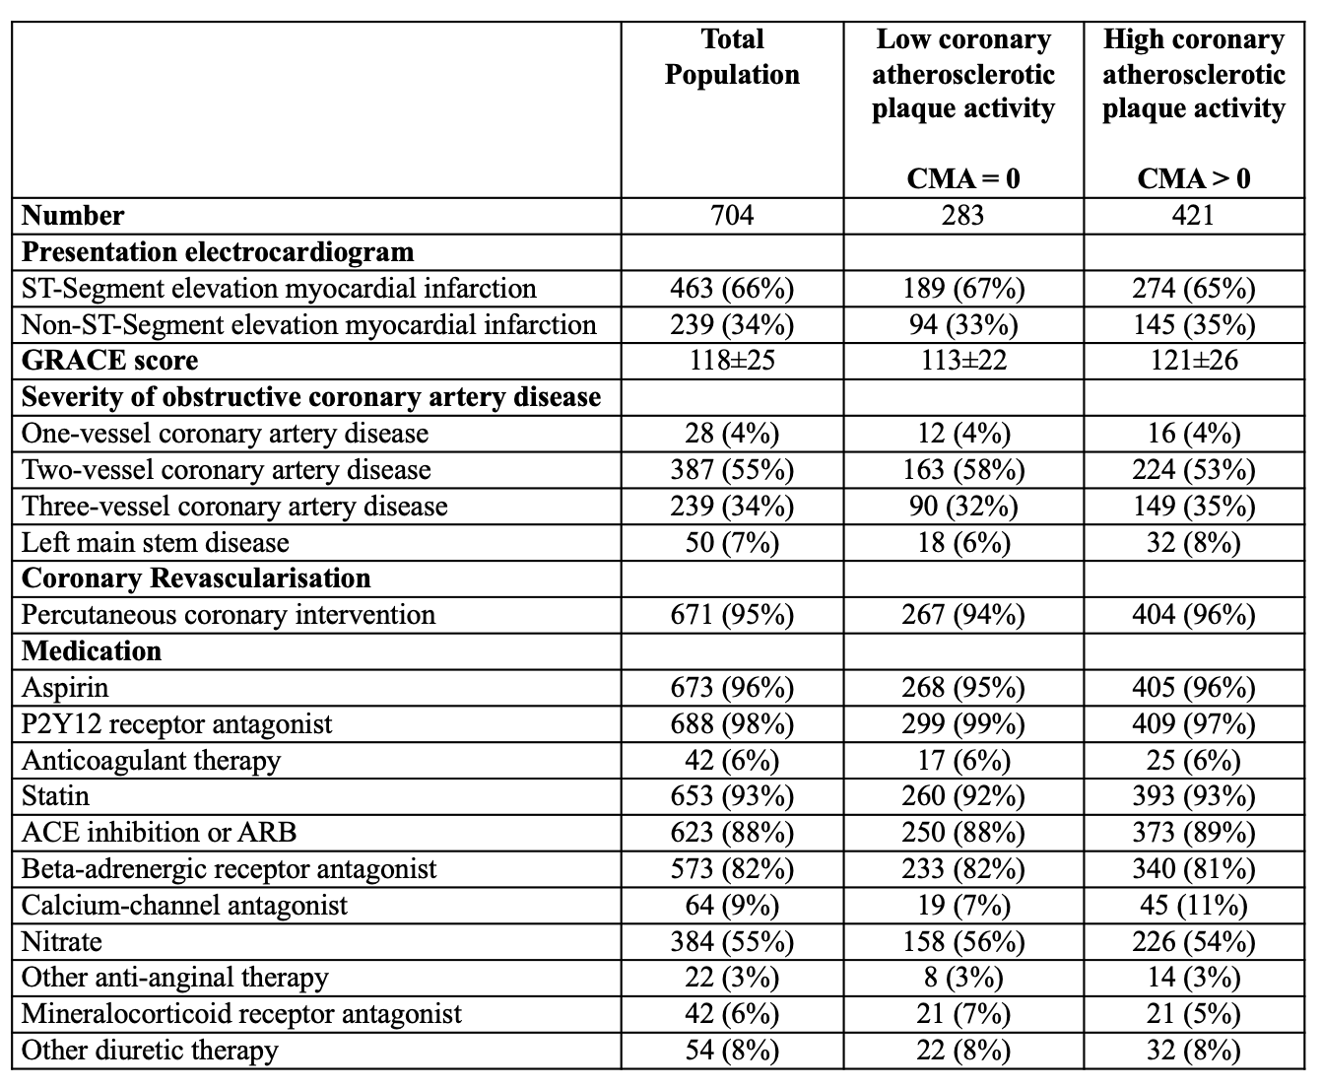
Trial Population Characteristics

Slide 13
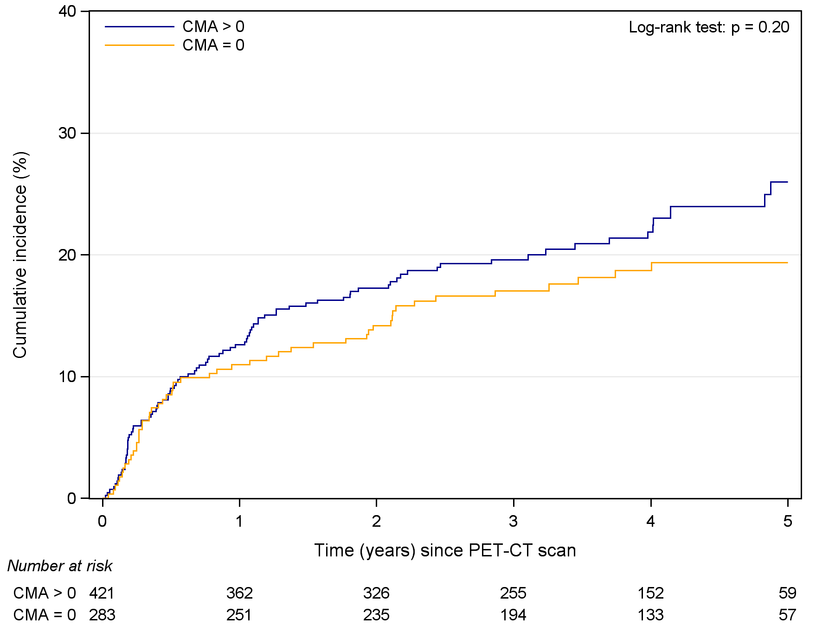
Primary Endpoint
High plaque activity (CMA>0)
Low plaque activity (CMA=0)
Hazard Ratio 1.25 (0.89 to 1.76), P=0.20

Slide 14
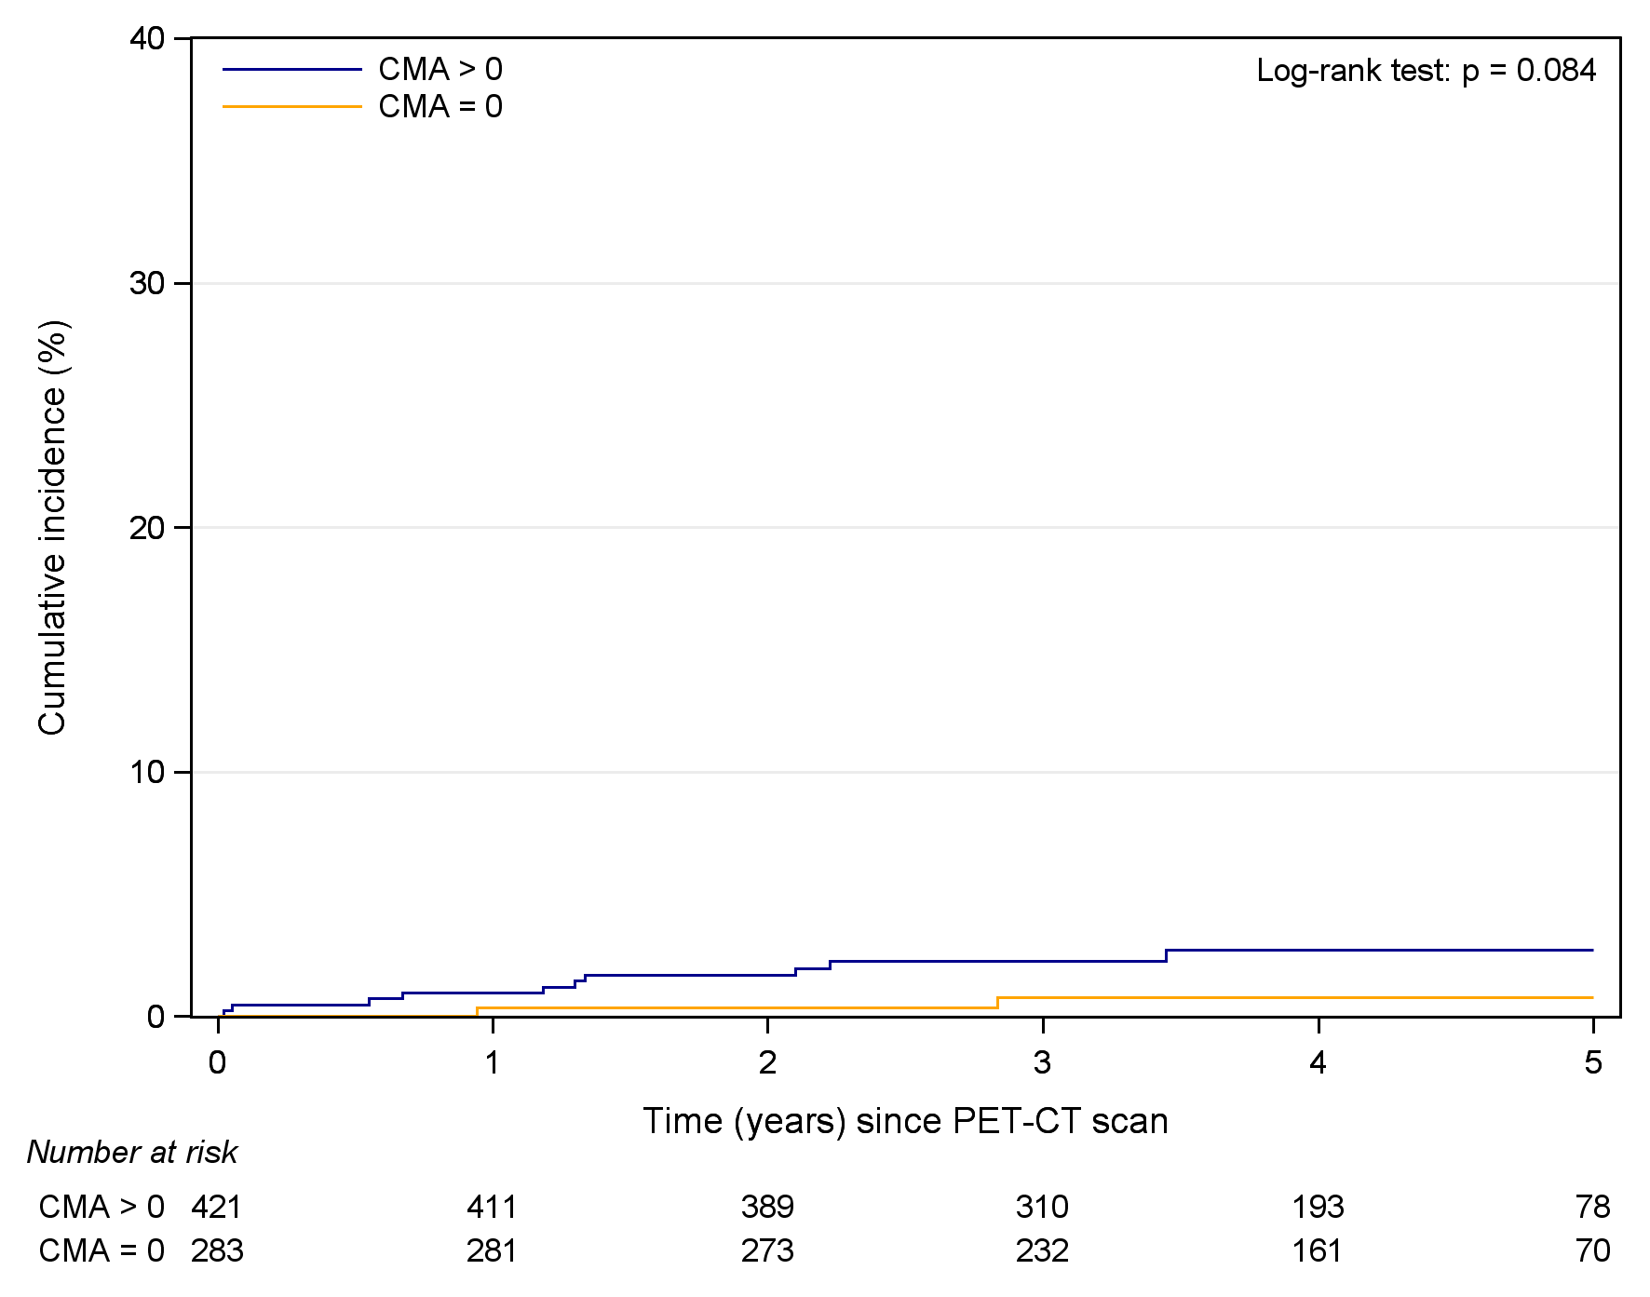
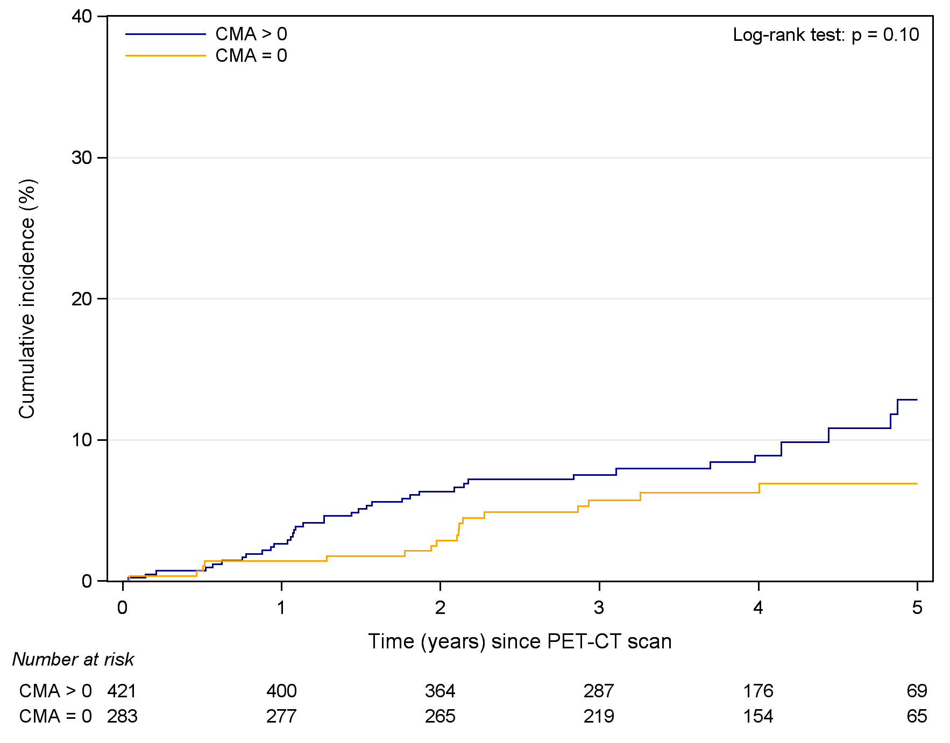
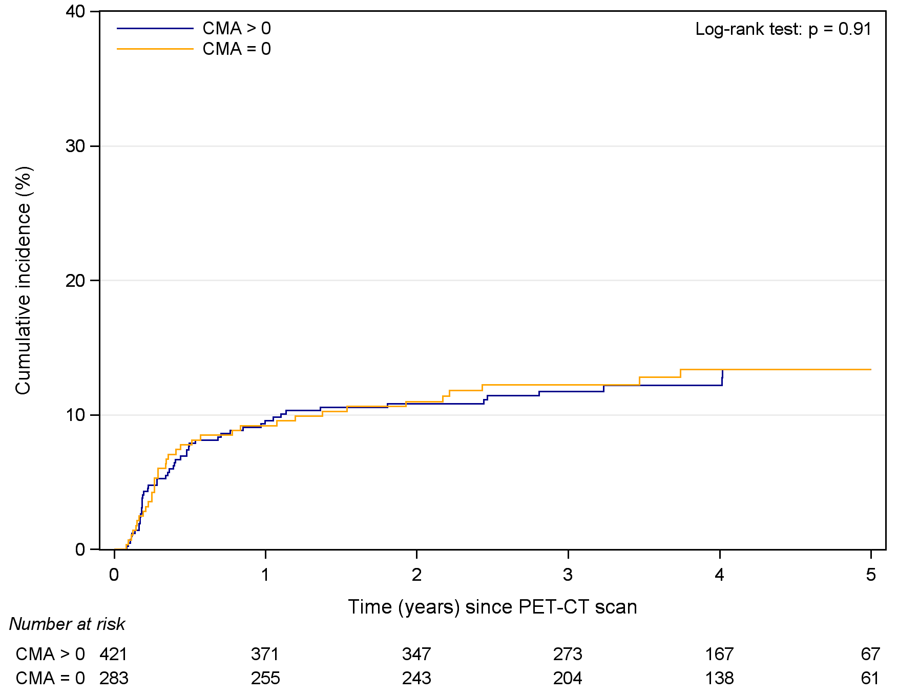
Components of the Primary Endpoint
Cardiac death
Non-fatal
myocardial infarction
Unscheduled Coronary
Revascularisation
High plaque activity (CMA>0)
Low plaque activity (CMA=0)
High plaque activity (CMA>0)
Low plaque activity (CMA=0)
High plaque activity (CMA>0)
Low plaque activity (CMA=0)
Hazard Ratio 3.51 (0.77 to 16.04), P=0.10
Hazard Ratio 1.61 (0.91 to 2.86), P=0.10
Hazard Ratio 0.98 (0.64 to 1.49), P=0.91

Slide 15
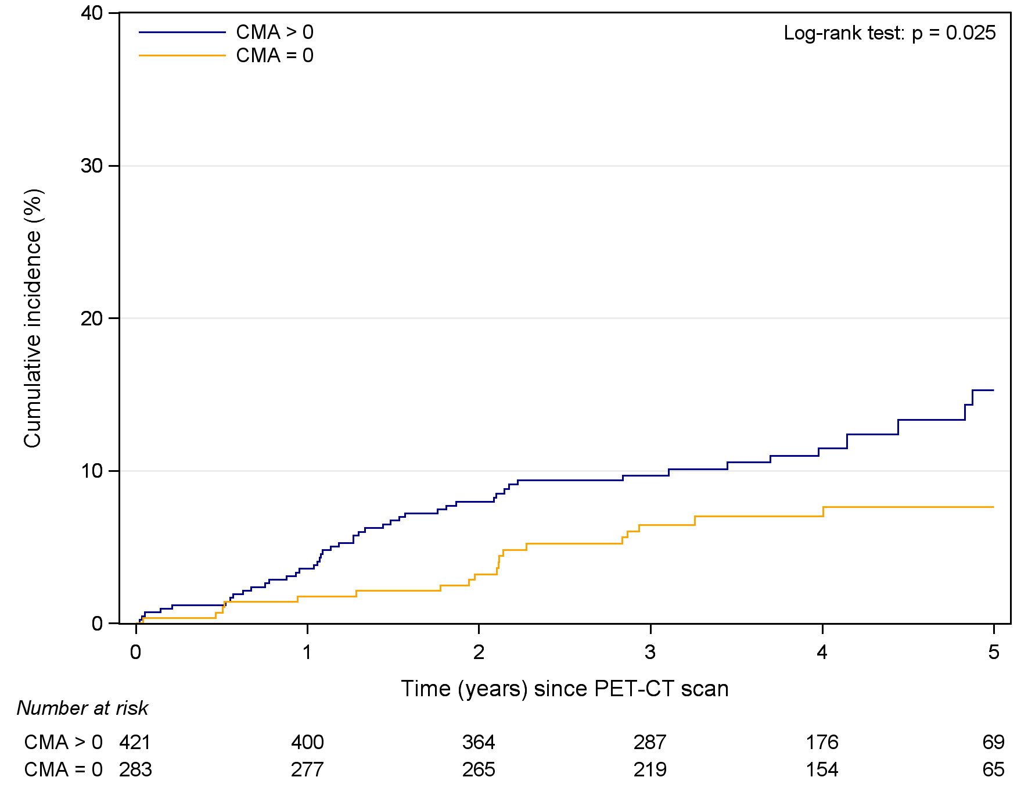
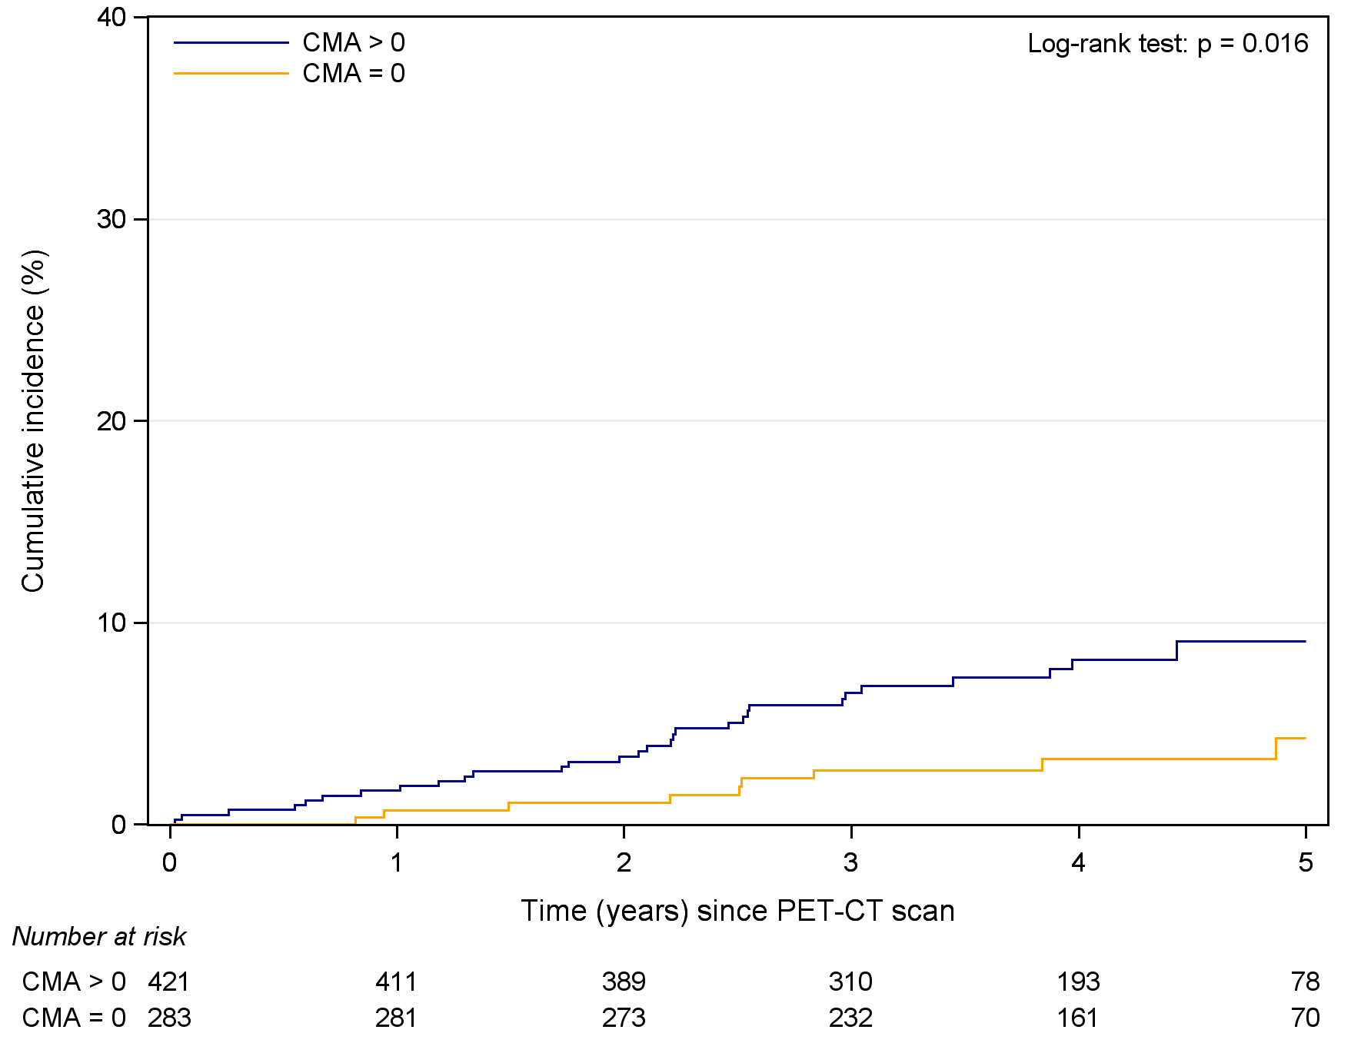
Original Primary Endpoint and All-cause Death
Cardiac death or
non-fatal myocardial infarction
All-cause death
High plaque activity (CMA>0)
Low plaque activity (CMA=0)
High plaque activity (CMA>0)
Low plaque activity (CMA=0)
Hazard Ratio 1.82 (1.07 to 3.10), P=0.03
Hazard Ratio 2.43 (1.15 to 5.12), P=0.02

Slide 16
Original Primary Endpoint and All-cause Death
 | Adjusted Hazard Ratio (95% Confidence Interval) | P value
Cardiac death or non-fatal myocardial infarction
CMA > 0 versus CMA = 0 adjusting for:
GRACE score* | 1.73 (1.01 to 2.97) | 0.048
Severity of obstructive coronary artery disease | 1.76 (1.03 to 3.00) | 0.038
GRACE score and severity of obstructive coronary artery disease | 1.69 (0.98 to 2.91) | 0.058
All-cause death
CMA > 0 versus CMA = 0 adjusting for:
GRACE score† | 1.80 (0.84 to 3.86) | 0.13
Severity of obstructive coronary artery disease | 2.25 (1.06 to 4.74) | 0.034
GRACE score and severity of obstructive coronary artery disease | 1.75 (0.82 to 3.73) | 0.15
*GRACE risk score for prediction of death or myocardial infarction at 6 months after discharge
†GRACE risk score for prediction of death at 6 months after discharge

Slide 17
Safety: Radiation Exposure
Radiotracer*:
6·0±0·3 mSv
CT attenuation correction, calcium score and angiogram†:
4·9±3·0 mSv
*conversion factor 0·024 mSv/MBq
†conversion factor 0·014 mSv/Gy·cm

Slide 18
Safety: Adverse Events
 | Possibly Related to IMP | Possibly Related to NIMP | Number of Events | Number of Patients
All Adverse Events |  |  | 15 | 15
Serious Adverse Events | 0 | 2 | 2 | 2
Palpitation | 0 | 1 | 1 | 1
Beta-blocker induced bradycardia | 0 | 1 | 1 | 1
Non-serious Adverse Events | 3 | 9 | 13 | 13
Contrast reaction* | 3 | 7 | 8 | 8
Cannula access site | 0 | 2 | 5 | 5
*Two reactions were felt to be possibly related to either the IMP or the NIMP

Slide 19
Coronary Atherosclerotic Plaque Activity and Future Coronary Events
Coronary atherosclerotic plaque activity:
Does not predict all coronary events.
Has no association with subsequent coronary revascularisation.
Predicts cardiac death or non-fatal myocardial infarction.
Predicts all-cause death.
Long-term outcomes from acute myocardial infarction are determined by residual coronary atherosclerotic plaque activity.

Slide 20
Acknowledgements
All participating patients.
The PRE¹⁸FFIR Investigators.
Chief Investigator: David E. Newby.
Site Principal Investigators: Dana Dawson (Valerie Harries; Aberdeen), Parthiban Arumugam (Thabitha Charles, Martin Sherwood; Manchester) , Nikant Sabharwal (Rachel Bates; Oxford), John Greenwood (Kathryn Somers, Hemant Kumar Chumun; Oxford), Jon Townend (Annette Nilsson; Birmingham), Patrick Calvert (Victoria Warnes, Catherine Galloweay; Cambridge), Dan Berman (Rebekah Park; Los Angeles), Johan Verjans (Denise Healy, Adelaide).
Trial Fellows: Alastair Moss, Marwa Daghem.
Core Laboratory: Piotr Slomka, Damini Dey, Evangelos Tzolos, Mohammed Meah, Kang-Ling Wang, Anda Bularga, Philip D. Adamson, Jacek Kwiecinski, David Senyszak.
Trial Team: Alison Fletcher, Christophe Lucatelli, James Rudd, Nicholas L. Mills, Edwin J.R. van Beek, Michelle C. Williams, Marc R. Dweck
Edinburgh Clinical Trials Unit: Laura Forsyth, Lauren Murdoch, Anny Briola, Ruth Armstrong, Alix Macdonald, Gill Scott, Garry Milne, Lynsey Milne, Claire Battison, Robert Lee, Steff Lewis
Trial Steering Committee: Martin R. Wilkins (Chair), David Newby, Robert F. Storey, Reza Razavi, Marc R. Dweck, Steff Lewis, Maja Wallberg, Rodney Mycock.

