Slide 1
Apixaban for PrOphyLaxis of thromboemboLic Outcomes in COVID-19 — The Primary Results of the APOLLO Randomized Trial
Renato D. Lopes, Pedro Gabriel Melo de Barros e Silva, Ariane Vieira Scarlatelli Macedo, Bruna Bronhara, Alexandre B. Cavalcanti, Regis G. Rosa, Otávio Berwanger, Viviane C. Veiga, Luciano C.P. Azevedo, Murillo O. Antunes, Otávio Celso Eluf Gebara, Eduardo Ramacciotti, Christopher B. Granger, John H. Alexander, Alvaro Avezum, on behalf of the APOLLO Investigators

Slide 2
Declaration of Interest
The APOLLO trial was was an investigator-initiated study led by the Brazilian Clinical Research Institute (BCRI) and the COALITION COVID-19 with financial support from Pfizer. The funding sources had no role in the study conduct, analysis, interpretation of data, or decision to publish the results
Research grants or contracts from Amgen, Bristol Myers Squibb, GlaxoSmithKline, Medtronic, Pfizer, Sanofi-Aventis
Funding for educational activities or lectures from Pfizer, Bristol Myers Squibb, Novo Nordisk, AstraZeneca
Funding for consulting or other services from Bayer, Boehringer Ingelheim, Bristol Myers Squibb, Novo Nordisk, AstraZeneca

Slide 3
Background
Patients with coronavirus disease 2019 (COVID-19) have a higher risk of thrombotic events.
Randomized trials have shown inconsistent results with different antithrombotic regimens in hospitalized patients.
INSPIRATION (n=562): no clinical benefit (composite of venous or arterial thrombosis, treatment with extracorporeal membrane oxygenation, or mortality) AND potentially more complications (e.g. severe thrombocytopenia) in the intermediate-dose group compared with standard prophylaxis in ICU patients.
ACTION (n=615): no clinical benefit (hierarchical analysis of time to death, duration of hospitalization, or duration of supplemental oxygen) AND more bleeding in the full-dose group compared with standard prophylaxis.
ATTACC, ACTIV-4a, and REMAP-CAP (N=1098 patients critically ill): The trial was stopped due to futility.
ATTACC, ACTIV-4a, and REMAP-CAP (n=2219 noncritically Ill patients): Stopped early for superiority (organ support–free days).
Observational studies suggest a potential benefit of anticoagulation in the outpatient setting, however, there is limited randomized evidence to assess the efficacy and safety of anticoagulation in the early phase of COVID-19.
INSPIRATION Investigators. JAMA. 2021 Apr 27;325(16):1620-1630.
Lopes RD, et al. Lancet. 2021 Jun 12;397(10291):2253-2263.
The ATTACC, ACTIV-4a, and REMAP-CAP Investigators. N Engl J Med 2021; 385(9):777-789.
The ATTACC, ACTIV-4a, and REMAP-CAP Investigators. N Engl J Med 2021; 385(9):790-802.

Slide 4
Study Hypotheses
In outpatients with confirmed COVID-19 and additional risk factors for complication:
Low dose apixaban improves the number of days alive and out of the hospital at 30 days compared with placebo.

Slide 5
Trial Design
Multicenter, double-blinded, randomized clinical trial
RANDOMIZED
N: 1000 patients
KEY INCLUSION CRITERIA
Patients aged ≥ 18 years
Outpatient setting with a confirmed diagnosis of COVID-19 and symptoms up to 10 days
Additional risk factors (D dimer ≥ 2 x ULN, CRP ≥ 10 mg/L or ≥ 2 risk factors)
MAIN EXCLUSION CRITERIA
Formal indication for anticoagulation
Contraindications to apixaban
Patients at high risk for bleeding
Apixaban 2.5 mg bid for 30 days
PLACEBO
PRIMARY OUTCOME
Days alive and out of the hospital at 30 days

Slide 6
Trial Organization
EXECUTIVE COMMITTEE OF APOLLO TRIAL
Renato D. Lopes (Chair)
Ariane Vieira Scarlatelli Macedo (Brazil)
Lilian Mazza Barbosa (Brazil)
Lucas Damiani (Brazil)
Pedro Gabriel Melo de Barros e Silva (Brazil)
Eduardo Ramacciotti (Brazil)
Christopher B. Granger (USA)
John H. Alexander (USA)
EXECUTIVE COMMITTEE OF COALITION COVID-19
Renato D. Lopes
Alexandre Biasi
Alvaro Avezum
Flavia Machado
Otavio Berwanger
Régis Rosa
Viviane Cordeiro Veiga
Luciano Azevedo
DATA SAFETY MONITORING BOARD
Mark Crowther (Chair)
Leticia Kawano Dourado (Member)
Karen Pieper (Statistician)
Athos Damiani (BCRI - Statistician)
CLINICAL EVENTS CLASSIFICATION (CEC) COMMITTEE
Brazilian Clinical Research Institute (BCRI)
ACADEMIC COORDINATING CENTER
Brazilian Clinical Research Institute (BCRI)
SPONSOR
COALITION COVID-19 Brazil
FUNDING
Pfizer S.A.*
*Unrestricted research grant from Pfizer S.A., which was not involved in design, conduct or interpretation of the study

Slide 7
Primary Outcome
Number of days alive and outside of the hospital through 30 days
This endpoint represents the follow-up time (30 days) minus days outside hospital/emergency department and for those who die, the days between death and 30 days.
Lopes RD et al. Am Heart J 2020;226:1-10
Fanaroff AC et al. Circ-cardiovasc Qual 2018;11:e004755.

Slide 8
Statistical Analysis
The primary analysis followed the intention-to-treat principle.
The primary outcome was analyzed comparing means of days alive and out of the hospital or emergency department (DAOH) with generalized additive models assuming beta-binomial distribution in 30 days. Mean differences were presented with their 95% CI and p-values.
Binary secondary outcomes were assessed with logistic regression and odds ratio were presented with their respective 95% CI and p-values.
Lopes RD et al. Am Heart J 2020;226:1-10

Slide 9
Study Diagram
624 patients with confirmed COVID-19 assessed for eligibility
42 Without COVID-19 confirmation
37 Negative test 5 Not tested
4 > 10 days of symptoms
4 Patient needed hospitalization
8 Pregnant
137 Without ≥2 risk factors, with normal D-dimer and/or C-reactive protein
18 Declined to participate
411
41% of initial sample size
207 were assigned to the apixaban group
204 were assigned to the placebo group
204 completed 30 days alive 0 patients died 3 patients withdrew informed consent
100% complete 30-day follow-up
203 completed 30 days alive 1 patient died 0 patients withdrew informed consent
100% complete 30-day follow-up

Slide 10
Study Interruption
The trial was stopped prematurely due to slower than expected recruitment and low overall event rates. DAOH was expected to be a mean of 27.0 days (SD=6); however only 6% needed hospitalization or visited the emergency department leading to a 29.5 DAOH (SD=2.0).
Lopes RD et al. Am Heart J 2020;226:1-10
Fanaroff AC et al. Circ-cardiovasc Qual 2018;11:e004755.

Slide 11
Baseline Characteristics
 | Apixaban (n=207) | Placebo (n=204) | Total (n = 659)
Age, mean ± SD, yrs | 44.3 ± 14.8 (n = 207) | 43.7 ± 13.1 (n = 204) | 44.0 ± 14.0 (n = 411)
Women, n (%) | 120/207 (58.0%) | 120/204 (58.8%) | 240/411 (58.4%)
BMI, mean ± SD, kg/m² | 28.7 ± 5.4 (n = 207) | 28.8 ± 5.6 (n = 204) | 28.7 ± 5.5 (n = 411)
Symptom onset [interquartile range] | 6.0 [4.0, 8.0] (n = 207) | 6.0 [4.0, 8.0] (n = 204) | 6.0 [4.0, 8.0] (n = 411)
COVID-19 VACCINE
At lease 1 dose | 180/206 (87.4%) | 174/204 (85.3%) | 354/410 (86.3%)
NUMBER OF DOSES
1 dose | 20/180 (11.1%) | 13/174 (7.5%) | 33/354 (9.3%)
2 doses | 156/180 (86.7%) | 157/174 (90.2%) | 313/354 (88.4%)
3 doses | 4/180 (2.2%) | 4/174 (2.3%) | 8/354 (2.3%)

Slide 12
Baseline Characteristics
 | Apixaban (n=207) | Placebo (n=204) | Total (n = 411)
RISK FACTORS
D dimer above limit, n(%) | 21/207 (10.1%) | 23/204 (11.3%) | 44/411 (10.7%)
C-reactive protein > 10 mg/L, n(%) | 163/207 (78.7%) | 164/204 (80.4%) | 327/411 (79.6%)
C-reactive protein above limit, n(%) | 15/207 (85.0%) | 17/204 (85.3%) | 32/411 (82.2%)
Hypertension, n (%) | 69/207 (33.3%) | 60/204 (29.4%) | 129/411 (31.4%)
Heart failure, n (%) | 1/207 (0.5%) | 0/204 (0.0%) | 1/411 (0.2%)
Diabetes, n (%) | 24/207 (11.6%) | 25/204 (12.3%) | 49/411 (11.9%)
Asthma, n (%) | 6/207 (2.9%) | 7/204 (3.4%) | 13/411 (3.2%)
Known kidney disease, n (%) | 0/207 (0.0%) | 0/204 (0.0%) | 0/411 (0.0%)
History of VTE, n (%) | 2/207 (1.0%) | 3/204 (1.5%) | 5/411 (1.2%)
Coronary artery disease, n (%) | 5/207 (2.4%) | 3/204 (1.5%) | 8/411 (1.9%)
History of VTE | 2/207 (1.0%) | 3/204 (1.5%) | 5/411 (1.2%)
BMI ≥ 30 | 81/207 (39.1%) | 77/204 (37.7%) | 158/411 (38.4%)

Slide 13
Primary Outcome: Days Alive and Out of the Hospital at 30 Days
Placebo mean days ± SD: 29.5 ± 2.4
Apixaban mean days ± SD: 29.6 ± 1.6
Mean difference (95%CI): 0.18 [-0.22 - 0.58]

Slide 14
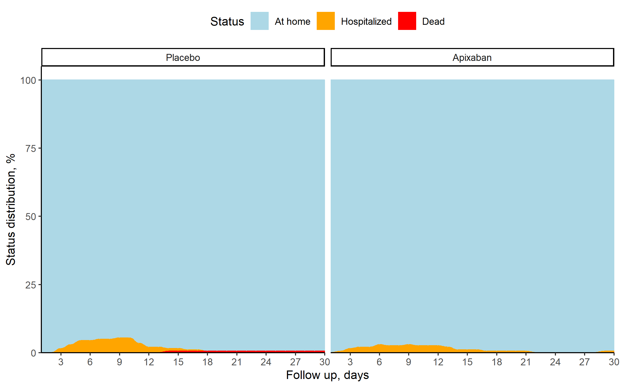
Clinical Status at 30 Days
Hospitalized patients within 30 days
n/N (%) Apixaban 10/204 (4.9%) Placebo 14/204 (6.9%)
Odds Ratio [IC 95%] 0.70 [0.30 to 1.61]

Slide 15
Secondary Endpoints
 | Apixaban (n=207) | Placebo (n=204) | Odds Ratio
RISK FACTORS
Hospitalization | 10/204 (4.9%) | 14/204 (6.9%) | 0.70 [0.30 - 1.61]
Due to bleeding | 0/204 (0.0%) | 0/204 (0.0%) | -
Due to cardiovascular/pulmonary causes | 9/204 (4.4%) | 14/204 (6.9%) | 0.63 [0.26 - 1.48]
Due to cardiovascular causes | 1/204 (0.5%) | 0/204 (0.0%) | -
Due to pulmonary causes | 8/204 (3.9%) | 14/204 (6.9%) | 0.55 [0.23 -1.35]
Other | 1/204 (0.5%) | 0/204 (0.0%) | -
Composite endpoint of arterial and venous thrombosis | 0/204 (0.0%) | 0/204 (0.0%) | -
Death | 0/204 (0.0%) | 1/204 (0.5%) | -
Cardiovascular death | 0/204 (0.0%) | 0/204 (0.0%) | -
Intrahospital death | 0/204 (0.0%) | 1/204 (0.5%) | -
Any bleeding | 4/204 (2.0%) | 2/204 (1.0%) | 2.02 [0.37 - 11.15]

Slide 16
Conclusion
In symptomatic, but clinically stable outpatients with COVID-19 and additional risk factors for thrombotic complications, treatment with apixaban 2.5 mg twice daily compared with placebo did not improve the number of days alive and out of the hospital.
No major bleeding was observed in the trial population.

Slide 17
Clinical Implication
Our results do not support the routine use of low-dose apixaban for outpatients COVID-19.

Slide 18
Acknowledgement
Thank you to the BCRI team, investigators, study coordinators, sponsor, and study participants who made the APOLLO trial possible.

