Slide 1
FFR vs. Angiography-guided PCI in AMI with multivessel disease
FRAME-AMI trial
Joo-Yong Hahn
Samsung Medical Center, Seoul, Korea
28 August

Slide 2
Background
In patients with acute myocardial infarction (AMI) and multivessel coronary artery disease, percutaneous coronary intervention (PCI) of non-infarct related artery (IRA) lesions for complete revascularization improves clinical outcomes.
However, optimal strategy to select targets for non-IRA PCI has not been clarified.

Slide 3
Objective
To compare fractional flow reserve (FFR)-guided PCI with angiography-guided PCI for non-IRA lesions among patients with AMI and multivessel disease
Hypothesis
Selective PCI guided by FFR is superior to routine PCI guided by angiography alone for treatment of non-IRA lesions in patients with AMI and multivessel disease.

Slide 4
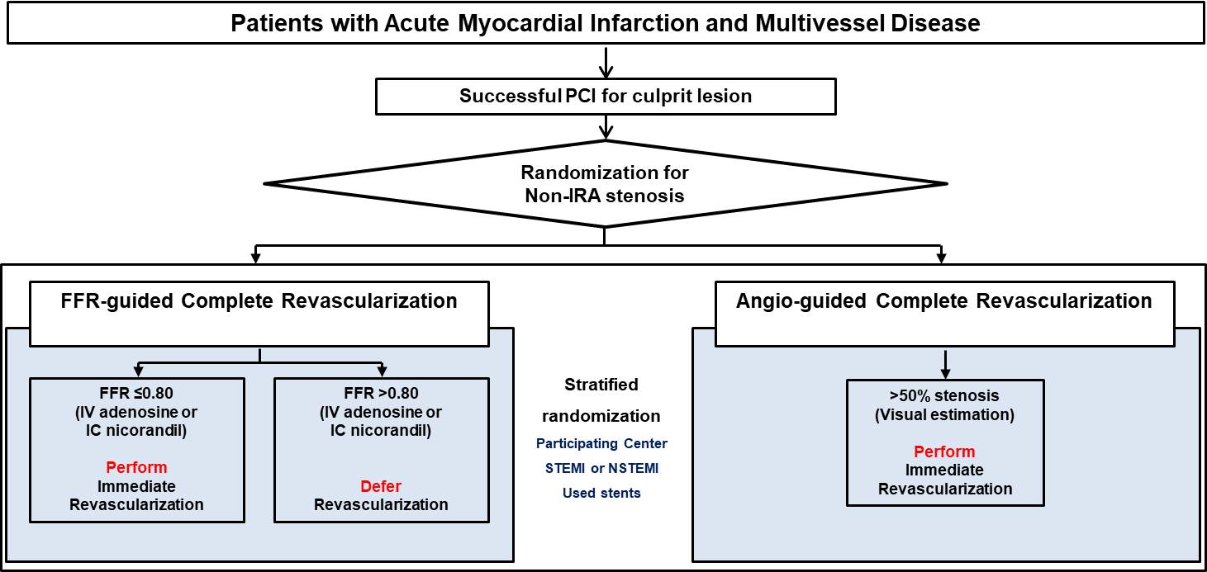
FRAME-AMI Trial (NCT02715518)
Study design
An investigator-initiated, randomized trial at 14 sites in Korea

Slide 5
Study Organization
PI | Joo-Yong Hahn
Executive Committee | Joo-Yong Hahn, Joo Myung Lee, Young Bin Song, Changwook Nam, Joonhyung Doh
DSMB | Jun-Hee Lee (Chair), Seon Woo Kim, Sang-Ho Cho
CEAC | Jin-Man Cho (Chair), Sung-Woo Cho, Eun-Kyung Kim
Centers | 14 centers in Korea
Sponsors | Medtronic, BIOTRONIK, Chong Kun Dang Pharmaceutical, and JW Pharmaceutical

Slide 6
Enrollment criteria
Key inclusion criteria
Patients (≥19 years of age) with STEMI or NSTEMI undergoing successful primary or urgent PCI of an IRA
At least one non-IRA lesion with diameter stenosis >50% in major epicardial coronary artery or major side branch with vessel diameter of ≥2.0 mm by visual estimation to be amenable to PCI
Key exclusion criteria
Single-vessel disease
Target lesion located in the left main coronary artery
Cardiogenic shock
Chronic total occlusion in non-IRA

Slide 7
Study end points
Primary end point
A composite of death, MI, or repeat revascularization
Key secondary end points
The individual components of the primary end point
Cardiac death
Procedure-related MI
Spontaneous MI
Revascularization for non-IRA
Definite stent thrombosis

Slide 8
Sample size calculation
Expected annual event rate of the primary end point
3.5% with the FFR-guided strategy and 6.0% with the angiography-guided strategy
Accrual time: 3 years
Additional follow-up time after the end of recruitment 1 year
Sampling ratio of 1:1
Drop-out rate: 1%
A total of 1292 patients (646 per group) would provide 90% power at a 2-sided type I error of 5%.

Slide 9
Early termination of the study
During the study period, the Covid-19 pandemic occurred, and enrollment became substantially slow.
The incidence of hospitalization for AMI decreased globally by as much as 50 percent during the pandemic.
Several centers halted the trial due to temporary unavailability of facility, lack of personnel, and concerns about the spread of Covid-19.
December 2020, the executive committee made the decision to terminate the trial early because of difficulty in recruitment and the DSMB agreed to this closing.
Scheduled follow-up of enrolled patients was continued.

Slide 10
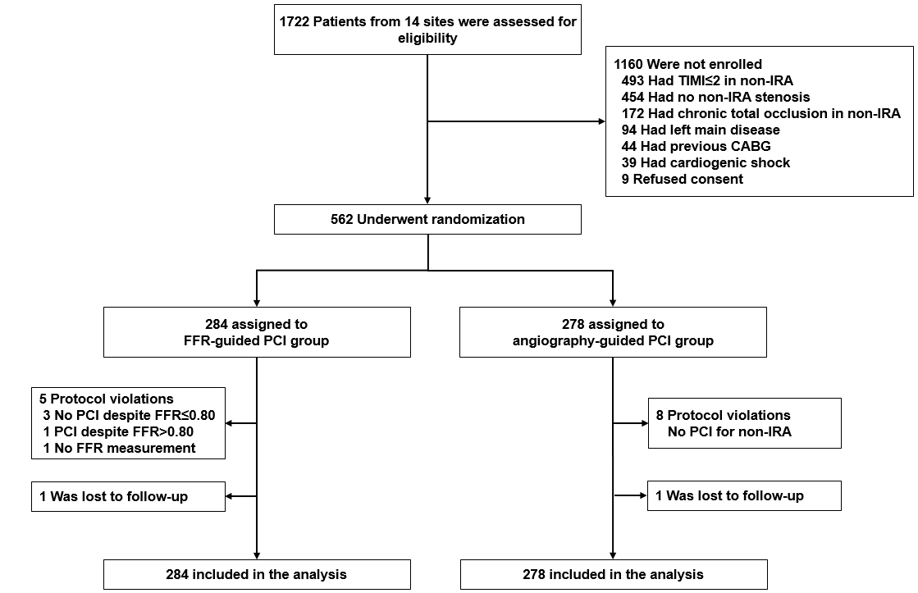
Enrollment and follow-Up

Slide 11
Baseline characteristics (I)
 | FFR-guided PCI (N=284) | Angiography-guided PCI (N=278)
Age, years | 63.9±11.4 | 62.7±11.5
Male, n (%) | 240 (84.5%) | 234 (84.2%)
Body mass index, kg/m² | 24.7±3.1 | 24.9±3.4
Hypertension | 151 (53.2%) | 152 (54.7%)
Diabetes mellitus | 97 (34.2%) | 86 (30.9%)
Dyslipidemia | 121 (42.6%) | 107 (38.5%)
Current smoking | 91 (32.0%) | 105 (37.8%)
Chronic renal disease | 8 (2.8%) | 8 (2.9%)
Previous stroke | 9 (3.2%) | 15 (5.4%)
Previous MI | 7 (2.5%) | 7 (2.5%)
Previous PCI | 17 (6.0%) | 20 (7.2%)

Slide 12
Baseline characteristics (II)
 | FFR-guided PCI (N=284) | Angiography-guided PCI (N=278)
LV ejection fraction, % | 53.2±9.8 | 53.6±10.2
Initial presentation, no. (%)
ST-segment elevation MI | 131/284 (46.1%) | 134/278 (48.2%)
Non-ST-segment elevation MI | 153/284 (53.9%) | 144/278 (51.8%)
Discharge medication, no. (%)
Aspirin | 279 (98.2%) | 277 (99.6%)
P2Y₁₂ inhibitor | 280 (98.6%) | 276 (99.3%)
Clopidogrel | 85 (29.9%) | 74 (26.6%)
Ticagrelor | 122 (43.0%) | 133 (47.8%)
Prasugrel | 73 (25.7%) | 69 (24.8%)
Statin | 273 (96.1%) | 272 (97.8%)
Beta blocker | 210 (73.9%) | 221 (79.5%)
ACE inhibitor or ARB | 191 (67.3%) | 194 (69.8%)

Slide 13
Lesion and procedural characteristics: IRA
 | FFR-guided PCI (N=284) | Angiography-guided PCI (N=278)
Location of infarct related artery, no. (%)
Left anterior descending artery | 90 (31.7%) | 105 (37.8%)
Left circumflex artery | 69 (24.3%) | 61 (21.9%)
Right coronary artery | 125 (44.0%) | 112 (40.3%)
Radial access, no. (%) | 242 (85.2%) | 229 (82.4%)
Thrombus aspiration, no. (%) | 52 (18.3%) | 45 (16.2%)
GPIIbIIIa inhibitor use, no. (%) | 61 (21.5%) | 45 (16.2%)
Use of drug-eluting stent, no. (%) | 277 (97.5%) | 276 (99.6%)
Intravascular imaging used, no. (%) | 63 (22.5%) | 59 (21.2%)
Mean stent diameter (mm) | 3.1±0.5 | 3.2±0.5
Total stent length (mm) | 36.3±18.2 | 34.7±15.4
Procedural success, no. (%) | 284 (100.0%) | 277 (99.6%)

Slide 14
Lesion and procedural characteristics: non-IRA (I)
Per patient
 | FFR-guided PCI (N=284) | Angiography-guided PCI (N=278) | P Value
Timing of non-infarct related artery PCI, no. (%) |  |  | 0.770
Immediate PCI during same procedure | 172 (60.6%) | 165 (59.4%)
Staged intervention during same hospitalization | 112 (39.4%) | 113 (40.6%)
Number of non-IRA lesions | 1.4 ± 0.6 | 1.3 ± 0.6 | 0.068
At least 1 non-IRA lesion treated, no. (%) | 182 (64.1%) | 270 (97.1%) | <0.001
Use of drug-eluting stent | 177/182 (97.3%) | 256/270 (94.8%) | 0.385
Intravascular imaging used, no. (%) | 57/182 (31.3%) | 77/270 (28.5%) | 0.593
Mean no. of stents used for non-IRA | 0.9±0.9 | 1.3±0.7 | <0.001
Procedural success, no. (%) | 182/182 (100.0%) | 270/270 (100.0%) | NA

Slide 15
Lesion and procedural characteristics: non-IRA (II)
Per lesion
 | FFR-guided PCI (N=388 lesions) | Angiography-guided PCI (N=366 lesions)
Location of non-IRA lesions, no. (%)
Left anterior descending artery | 189/386 (49.0%) | 143/366 (39.1%)
Left circumflex artery | 105/386 (27.2%) | 113/366 (30.9%)
Right coronary artery | 92/386 (23.8%) | 110/366 (30.1%)
QCA in non-IRA
Reference vessel diameter, mm | 3.1 ± 0.5 | 3.1 ± 0.5
Minimum lumen diameter, mm | 0.9 ± 0.4 | 0.7 ± 0.4
Diameter stenosis, % | 71.5 ± 13.1 | 75.4 ± 11.5
Lesion length, mm | 22.3 ± 12.5 | 21.1 ± 10.4
FFR data
FFR | 0.79 ± 0.11 | -
Post-PCI FFR | 0.88 ± 0.06 | -
Non-IRA PCI | 226/386 (58.5%) | 345/366 (94.3%)

Slide 16
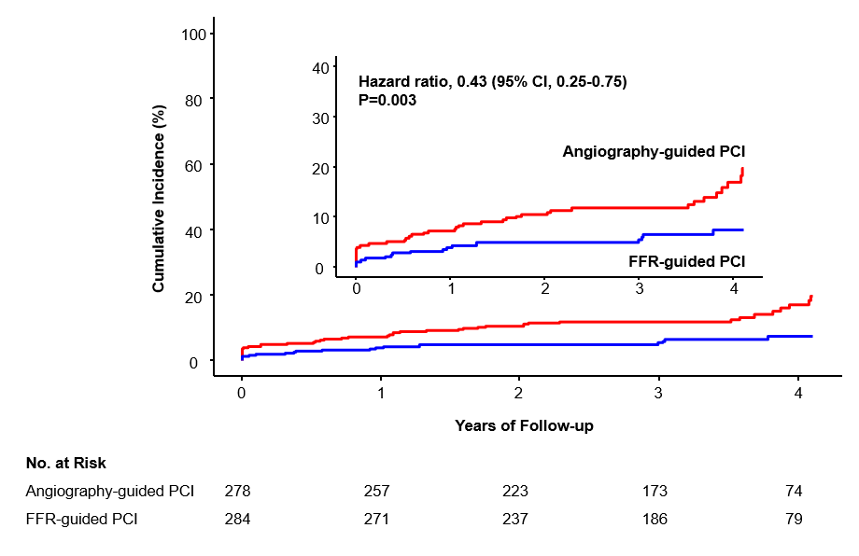
Primary end point
A composite of death, MI, or repeat revascularization
19.7%
7.4%

Slide 17
Clinical outcomes
End Point | FFR-guided PCI (N=284) | Angiography-guided PCI (N=278) | Hazard Ratio (95% CI) | P Value
Death, myocardial infarction, and repeat revascularization | 18 (7.4%) | 40 (19.7%) | 0.43 (0.25-0.75) | 0.003
All-cause Death | 5 (2.1%) | 16 (8.5%) | 0.30 (0.11-0.83) | 0.020
Cardiac death | 3 (1.4%) | 15 (8.2%) | 0.19 (0.06-0.67) | 0.010
Myocardial infarction | 7 (2.5%) | 21 (8.9%) | 0.32 (0.13-0.75) | 0.009
Procedure-related myocardial infarction | 3 (1.1%) | 11 (4.0%) | 0.26 (0.07-0.94) | 0.041
Spontaneous myocardial infarction | 4 (1.4%) | 10 (5.0%) | 0.39 (0.12-1.23) | 0.108
Repeat revascularization | 10 (4.3%) | 16 (9.0%) | 0.61 (0.28-1.34) | 0.216
Infarct-related artery | 4 (2.2%) | 8 (5.0%) | 0.49 (0.15-1.61) | 0.237
Non-infarct related artery | 7 (2.6%) | 12 (5.7%) | 0.56 (0.22-1.43) | 0.230
Definite stent thrombosis | 0 (0.0%) | 1 (0.4%) | NA | NA
Cerebrovascular accident | 4 (1.4%) | 3 (1.1%) | 1.30 (0.29-5.81) | 0.730
Contrast induced nephropathy | 2 (0.7%) | 1 (0.4%) | 1.97 (0.18-21.67) | 0.581

Slide 18
Clinical outcomes
End Point | FFR-guided PCI (N=284) | Angiography-guided PCI (N=278) | Hazard Ratio (95% CI) | P Value
Death, myocardial infarction, and repeat revascularization | 18 (7.4%) | 40 (19.7%) | 0.43 (0.25-0.75) | 0.003
All-cause Death | 5 (2.1%) | 16 (8.5%) | 0.30 (0.11-0.83) | 0.020
Cardiac death | 3 (1.4%) | 15 (8.2%) | 0.19 (0.06-0.67) | 0.010
Myocardial infarction | 7 (2.5%) | 21 (8.9%) | 0.32 (0.13-0.75) | 0.009
Procedure-related myocardial infarction | 3 (1.1%) | 11 (4.0%) | 0.26 (0.07-0.94) | 0.041
Spontaneous myocardial infarction | 4 (1.4%) | 10 (5.0%) | 0.39 (0.12-1.23) | 0.108
Repeat revascularization | 10 (4.3%) | 16 (9.0%) | 0.61 (0.28-1.34) | 0.216
Infarct-related artery | 4 (2.2%) | 8 (5.0%) | 0.49 (0.15-1.61) | 0.237
Non-infarct related artery | 7 (2.6%) | 12 (5.7%) | 0.56 (0.22-1.43) | 0.230
Definite stent thrombosis | 0 (0.0%) | 1 (0.4%) | NA | NA
Cerebrovascular accident | 4 (1.4%) | 3 (1.1%) | 1.30 (0.29-5.81) | 0.730
Contrast induced nephropathy | 2 (0.7%) | 1 (0.4%) | 1.97 (0.18-21.67) | 0.581

Slide 19
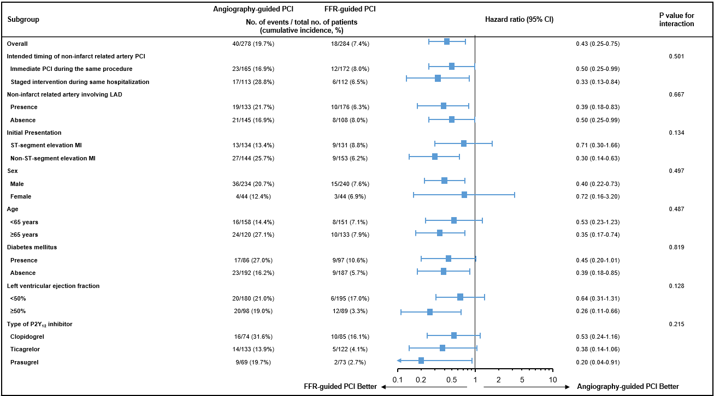
Prespecified Subgroup Analysis of Primary End Point

Slide 20
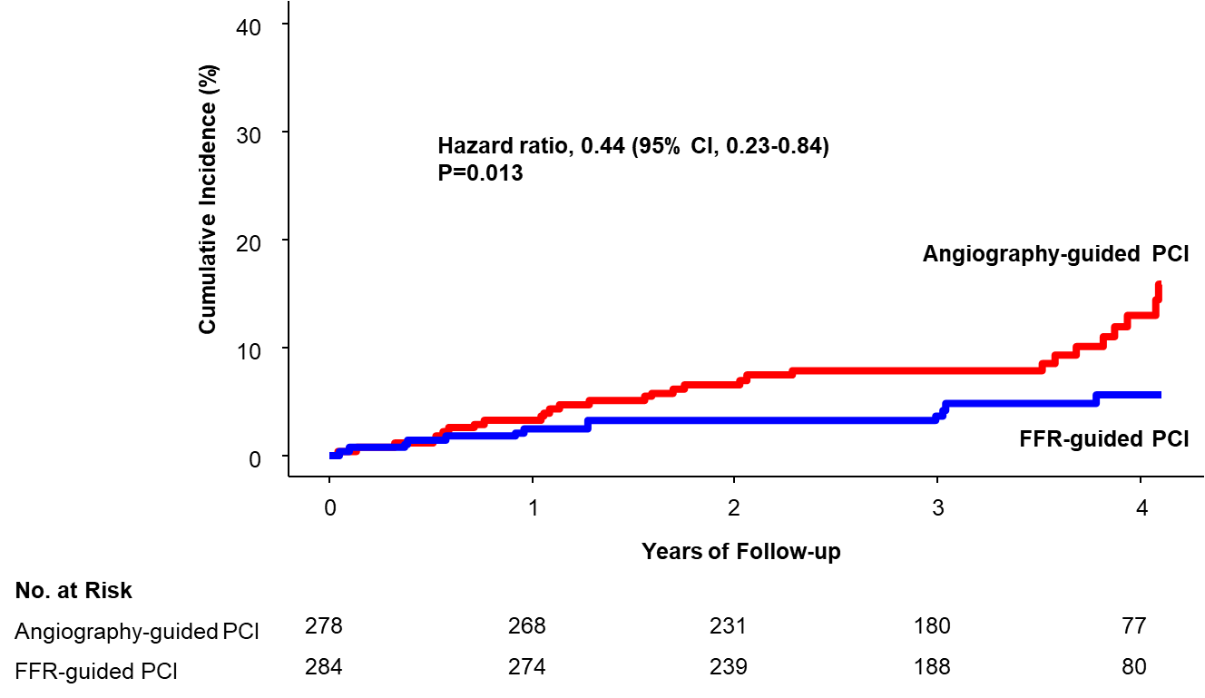
Cardiac death, spontaneous MI, or Repeat Revascularization
15.8%
5.7%

Slide 21
Study limitations
Early termination
Given the observed event rates, median follow-up duration, and number of enrolled patients, the actual power of our trial to show the difference in the primary end point between the 2 groups would be 95.3%.
Both STEMI and NSTEMI patients with multivessel disease were evaluated in the present study.
Randomization was stratified according to the type of MI, and there was no significant interaction between treatment effect of FFR-guided PCI and type of MI for the primary end point between the 2 groups.

Slide 22
Conclusions
Among patients with AMI and multivessel disease, a strategy of selective PCI using FFR-guided decision making was superior to a strategy of routine PCI based on angiographic diameter stenosis for treatment of non-IRA lesions regarding a composite of death, MI, or repeat revascularization.

Slide 23
Acknowledgement 감사합니다
I would like to thank patients enrolled, research nurses, study coordinators, and participating investigators.
FRAME-AMI investigators
Joo-Yong Hahn, Joo Myung Lee, Hyeon-Cheol Gwon, Seung-Hyuk Choi, Young Bin Song, Jeong Hoon Yang, Taek-Kyu Park, Ki-Hong Choi , Hyun Sung Joh , David Hong (Samsung Medical Center, Sungkyunkwan University School of Medicine, Seoul), Hyun Kuk Kim, Keun Ho Park (Chosun University Hospital, Gwangju), Eun Ho Choo, Chan Joon Kim (Uijeongbu St. Mary’s Hospital, Uijeongbu), Min Chul Kim, Seung Hun Lee, Young Joon Hong (Chonnam National University Hospital, Gwangju), Sung Gyun Ahn (Wonju Severance Christian Hospital, Wonju), Joonhyung Doh (Inje university Ilsan Paik hospital, Goyang), Sang Yeob Lee (Chungbuk National University Hospital, Cheongju), Sang Don Park (Inha University Hospital, Incheon), Hyun Jong Lee, Ki Hyun Jeon (Sejong General Hospital, Bucheon), Jin-Sin Koh, Min Kyu Kang (Gyeongsang National University Hospital, Jinju), Chang-Wook Nam, Yun-Kyeong Cho (Keimyung University Dongsan Medical Center, Daegu), Bon-Kwon Koo (Seoul National University Hospital), Bong-Ki Lee (Kangwon National University Hospital, Chuncheon), Kyung Ho Yoon (Wonkwang University Hospital, Iksan) – All in Korea.

