Slide 1
Efficacy and Safety of an External Support Device for Saphenous Vein Coronary Bypass Grafts: The VEST Trial
John Puskas, MD
Icahn School of Medicine at Mount Sinai, New York
For the NHLBI Cardiothoracic Surgical Trials Network

Slide 2
Disclosures
Consultation agreements with Medtronic for OPCAB training
Royalty payments from Scanlan for coronary surgery instruments
Educational speaker’s honoraria from Edwards Life Sciences and Cryolife Inc
No conflicts of interest related to the present work.

Slide 3
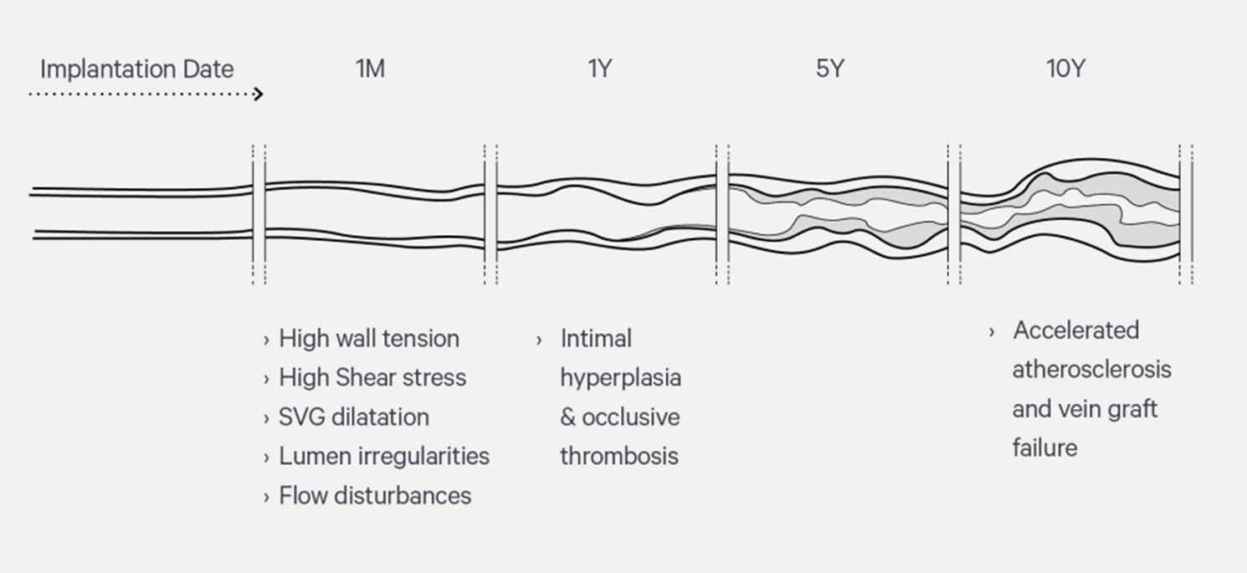
Background
Proliferative intimal hyperplasia of saphenous vein grafts after CABG predisposes to the later development of graft atherosclerosis and occlusion, resulting in adverse clinical outcomes
15% SVGs fail one
month after CABG
50% of all SVGs
fail by 10 years
External support of SVGs has the potential to prevent SVG dilation, slow the rate of intimal hyperplasia and increase long-term vein patency by
Reducing SVG wall tension
Reducing lumen irregularities
Preventing SVG dilatation
Improving hemodynamics and shear stress

Slide 4
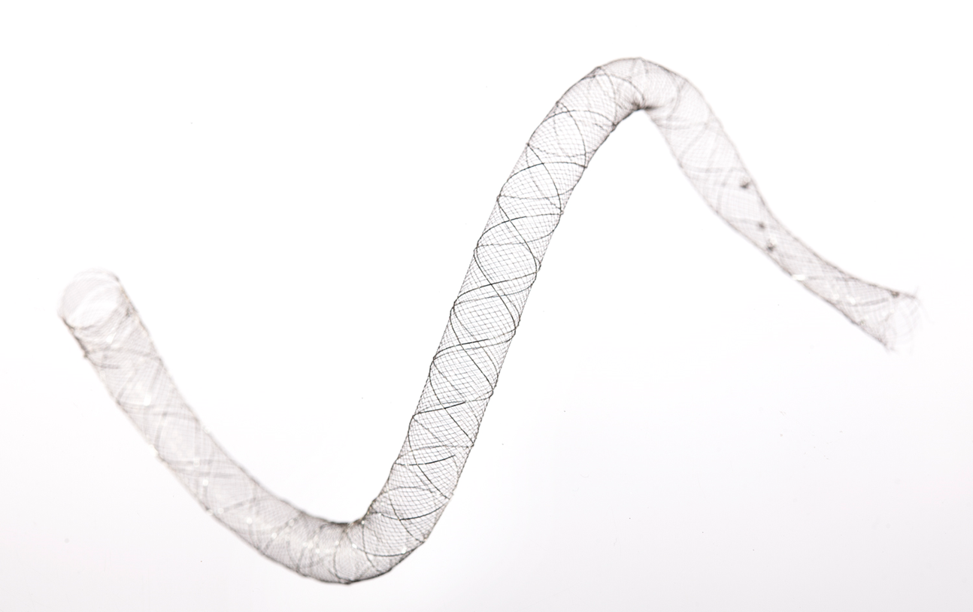
STUDY OBJECTIVES
To determine the efficacy of an external support device in limiting intimal hyperplasia by providing permanent support to saphenous vein grafts in patients who undergo CABG
To assess safety of the external support device
THE DEVICE
Braid of 42 cobalt chromium wires
Available in 16 dimensional models

Slide 5
Study Population
Multi-vessel CAD
Planned and scheduled on-pump CABG
Two or more vein grafts:
1 for the right coronary artery
1 or more non LAD for the left coronary arteries
Native vessels with ≥75% stenosis
IMA graft indicated for the LAD
Appropriately sized and accessible target coronary arteries as assessed by pre-operative cardiac angiography

Slide 6
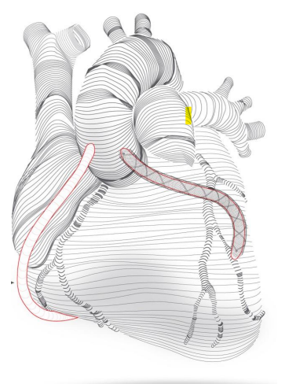
Study Design and intervention
Randomized, within-patient-controlled trial
One SVG bypass randomized to be supported
and another serves as control
Central core lab for reading of IVUS and cardiac angiography

Slide 7
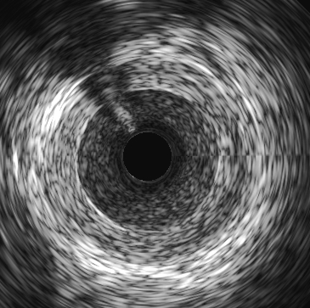
ENDPOINTS
PRIMARY: Intimal hyperplasia area assessed by IVUS at 1 year
SECONDARY CONFIRMATORY:
Lumen diameter uniformity by cardiac angiography at 1 year, by the Fitzgibbon
classification, on a 3-point ordinal scale :
– No intimal irregularity
– Irregularity of <50% of estimated intimal surface
– Irregularity of >50% of estimated intimal surface
Graft Failure (≥50% stenosis) by cardiac angiography/QCA at 1 year
SAFETY: MACCE over 12 months
External Elastic Membrane
Media
AREA OF INTIMAL AND MEDIAL HYPERPLASIA (I + M)
Lumen
Intima

Slide 8
STATISTICAL ANALYSIS
Missing values of intimal hyperplasia due to occluded/diseased vessels preventing IVUS were imputed as non-ignorable missing data
These vessels were penalized by higher imputed values
Anticipated 13% of patients with occluded vessels
Modified Wilcoxon signed-rank test was used to compare supported and unsupported vessel on intimal hyperplasia favoring non occluded/non diseased vessels
Hierarchical testing of primary and secondary confirmatory endpoints:
No testing of secondary endpoints is conducted if the null hypothesis is not rejected on the primary endpoint analysis

Slide 9
PATIENT POPULATION
224 SVGs randomized to external support
223 Received external support
224 SVGs randomized to control
224 Patients Enrolled
448 SVGs Randomized
21 excluded from analysis due to death, loss to follow-up or refusal to undergo IVUS
203 SVGs with device support
143 SVGs IVUS
55 SVGs occluded/severely diseased
5 SVGs technical issues with IVUS
203 SVGs without device support
142 SVGs with IVUS
56 SVGs occluded/severely diseased
5 SVGs technical issues with IVUS
Primary Analysis of IH
203 Patients
IH area by IVUS
113 SVGs with device support
113 Patients
Completed IVUS of both grafts
113 SVGs without device support

Slide 10
PATIENT CHARACTERISTICS
 | All Patients (N=224)
Age (years) | 65.8 ± 8.3
Female | 20.5%
White | 92.1%
Hispanic or Latino | 9.1%
Medical History
Current smoker or ex-smoker | 54.9%
Diabetes | 50.9%
Hypertension | 85.3%
Hyperlipidemia | 83.9%
Prior stroke in past year | 0.9%
Prior myocardial infarction | 41.5%
Prior PCI | 24.6%
Cardiac Measures
NYHA Class III/IV | 12.1%
CCS Class III/IV | 37.1%
Left ventricular ejection fraction (%) | 54.4 ± 10.6
Operative Characteristics
Surgery time (min) | 268.5 ± 68.5
Clamp time (min) | 83.0 ± 25.8

Slide 11
GRAFT CHARACTERISTICS
 | Device Supported (N=224) | Unsupported (N=224)
Native artery % stenosis
50%-74% stenosis | 0.4% | 0.0%
75%-99% occlusion | 87.5% | 83.5%
100% occlusion | 12.1% | 16.5%
Coronary artery diameter (mm%) | 1.8 ± 0.4 | 1.8 ± 0.4
Graft length (cm%) | 14.4 ± 3.2 | 14.7 ± 3.7
Systolic pressure at TTFM (mm Hg%) | 100.0 ± 22.3 | 100.6 ± 22.3
Final TTFM flow (mL/min%) | 47.8 ± 28.0 | 46.5 ± 30.2
Final TTFM pulsatility index | 2.6 ± 1.4 | 3.0 ± 1.7
Coronary target vessels
Diagonal | 14.7% | 12.9%
CRX | 0.4% | 2.2%
OM | 34.8% | 31.7%
RI | 4.5% | 3.6%
RCA | 12.1% | 7.1%
PDA/PLB | 33.5% | 42.4%
TTFM = Transit time flow measurement

Slide 12
Angiography and IVUS AT 12 MONTHS
~ 42% of patients had at least one SVG occluded/diffuse disease

Slide 13
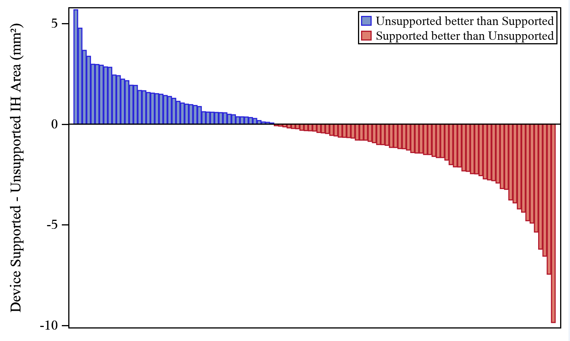
PRIMARY ENDPOINT: INTIMAL HYPERPLASIA AREA at 12 months
 | Device Supported | Unsupported | P Value
Intimal hyperplasia area mm² (Primary analysis with imputation, N=203) | 5.11 ± 0.16 SE | 5.79 ± 0.20 SE | 0.072
Intimal hyperplasia area mm² (Sensitivity analysis based on IVUS of both grafts, N=113) | 4.58 ± 1.90 SD | 5.12 ± 2.47 SD | 0.043

Slide 14
LUMEN DIAMETER UNIFORMITY BY FITZGIBBON CLASSIFICATION at 12 months

Slide 15
GRAFT FAILURE AT 12 MONTHS
≥50% stenosis by angiography/QCA

Slide 16
12 MONTH SAFETY
Protocol defined MACCE (N = 224) | # of Patients (%)
Mortality | 5 (2.2)
Stroke | 6 (2.7)
Myocardial Infarction | 7 (3.1)
Ischemic driven target vessel revascularization of supported graft or associated target coronary artery | 3 (1.3)
Composite MACCE | 16 (7.1)
Revascularizations of non supported grafts/non ischemic territories | 10 (4.5)

Slide 17
CONCLUSIONS
Difference in intimal hyperplasia between supported and unsupported SVGs did not reach statistical significance while accounting for the occluded/severely diseased SVGs
Higher than expected rate of occlusion/diseased vessels
Lower intimal hyperplasia area in a sensitivity analysis of patients who completed IVUS of both SVGs
No safety signals observed in the study
Further investigation of external graft support devices intended to improve long-term graft patency and clinical outcomes --in conjunction with novel measures to mitigate early graft occlusion-- is warranted

Slide 18
ACKNOWLEDGMENTS
Participating Centers Hôpital Laval
University of Maryland
Dartmouth-Hitchcock Medical Center
Montefiore - Einstein
University of Virginia Health System
London Health Sciences Centre
Baylor Research Institute
Mount Sinai Health System
Lutheran Hospital
University of Pennsylvania
WakeMed Health & Hospitals
Mayo Clinic
Montreal Heart Institute
Duke University
Columbia University Medical Center
University of Southern California
Cleveland Clinic Foundation
All study participants
Conducted within the NHLBI sponsored Cardiothoracic Surgical Trials Network (CTSN)
Coordinating Center, Icahn School of Medicine at Mount Sinai, NY
Supported by Vascular Graft Solutions (Tel Aviv, Israel)

Slide 19
THANK YOU

