Slide 1
Tricuspid Valve Replacement in Patients with Tricuspid Regurgitation: 6-Month Outcomes from the TRISCEND Study
Susheel Kodali, MD
Columbia University Irving Medical Center
On Behalf of the TRISCEND Study Investigators

Slide 2
Disclosure Statement of Financial Interest
Within the past 12 months, I or my spouse/partner have had a financial interest/arrangement or affiliation with the organization(s) listed below.
Affiliation/Financial Relationship | Company
Grant/Research Support | Edwards Lifesciences, Medtronic, BSC, Abbott Vascular, JenaValve
Consulting Fees/Honoraria | Admedus, Dura Biotech, TriCares
Major Stock Shareholder/Equity | Thubrikar Aortic Valve, Inc, Adona, Dura Biotech, Supira, MID, Admedus, TriFlo
Royalty Income | N/A
Ownership/Founder | N/A
Intellectual Property Rights | N/A
Other Financial Benefit | N/A
Faculty disclosure information can be found on the app

Slide 3
Tricuspid Regurgitation Challenges
Mortality Increases with TR Severity
Prevalent
Undertreated
Medical Therapy Limited Benefit
U.S. Prevalence:​
2.4 million
10,000 TR surgeries/​
year
Medical therapy options limited
Transcatheter Therapies Are Emerging
Benfari et al. 2019 Circulation; 140:196-206.
E
Enriquez-Sarano, et al. 2019 Prog Cardiovasc Dis, 62: 447-51.

Slide 4
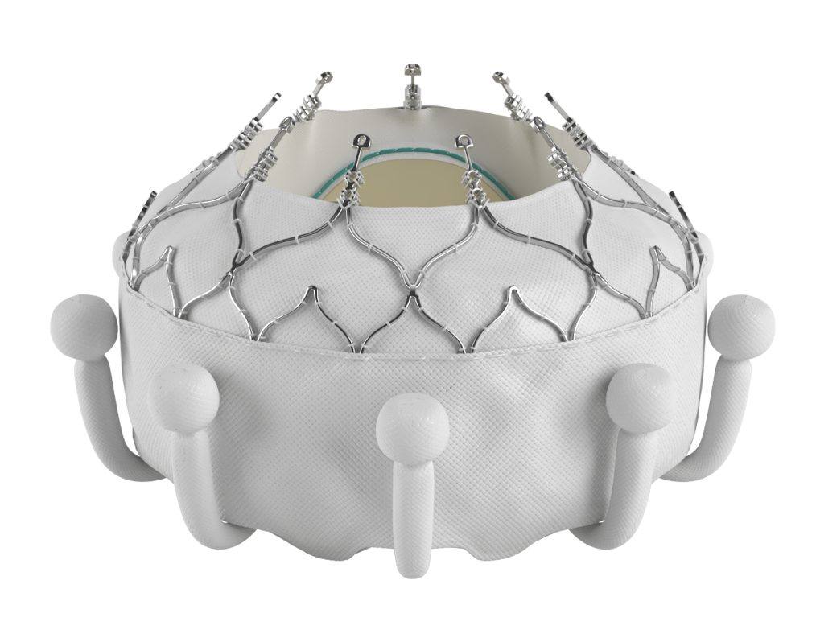
EVOQUE Tricuspid Valve Replacement System
Unique valve design engages leaflets, chords, and annulus to achieve secure placement
Anchors compatible with pre-existing leads and respect the native anatomy
Conforming frame designed to achieve optimal retention force
Multiple sizes offer treatment for a broad range of tricuspid pathologies and anatomies (44, 48, 52 mm)
28F transfemoral delivery system compatible with all valve sizes
CAUTION: Investigational device. Limited by Federal (or United States) law to investigational use.

Slide 5
Patients with symptomatic ≥moderate tricuspid regurgitation
Heart team assessment
Functional or degenerative TR
Signs and/or symptoms or prior heart failure hospitalizations from TR despite optimal medical therapy
Prospective, single-arm, multicenter study
Purpose: Evaluate the safety and performance of the transfemoral EVOQUE tricuspid valve replacement system in tricuspid regurgitation
Trial oversight
Central screening committee
Echocardiographic core laboratory
Clinical events committee
Data safety monitoring board
EVOQUE valve replacement system
Endpoints:
Device and procedural success
Composite of major adverse events (MAEs) at 30 days
TR reduction
Follow-up: 30 days, 6 months, 1 year, and annually up to 5 years
NCT04221490

Slide 6
Participating Sites
CA | Cedars Sinai Medical Center
IL | Northwestern Medical Center
OR | Oregon Health & Science University
NY | Columbia University Medical Center/NYPH
MI | Henry Ford Hospital
GA | Piedmont Heart Institute
TX | Baylor Heart Hospital Plano
GA | Emory University Hospital
CA | Stanford University
PA | Hospital of the University of Pennsylvania
MA | Massachusetts General Hospital
VA | University of Virginia Health System
NY | Montefiore Medical Center
MA | Brigham and Women’s Hospital
Reflects patient enrollment in the current data set

Slide 7
Study Enrollment
Baseline characteristics | N=132 N (%) or Mean ± SD
Age, years | 79.2 ± 7.39
Female | 97 (74%)
EuroSCORE II (%) | 5.3 ± 4.3
STS score (MV repair)¹ | 7.4 ± 5.39
NYHA functional class III or IV | 76%
TR grade ≥severe² | 113 (88%)
Atrial fibrillation | 119 (90%)
Pulmonary hypertension (sPAP ≥30 mmHg) | 104 (79%)
Diabetes | 25 (19%)
Chronic kidney disease | 73 (55%)
History of ascites | 26 (20%)
Prior stroke | 16 (12%)
CABG surgery | 26 (20%)
Prior valve surgery/intervention | 50 (38%)
Pacemaker or ICD | 46 (35%)
TR etiology
Functional | 93 (70.5%)
Degenerative | 9 (6.8%)
Mixed/other | 30 (22.7%)
Enrolled patients N=132
Follow up not due n=29
Pending visit n=27
Missed visit n=10
All-cause mortality n=5
Exited for other reasons n=5
6 month follow up
n=56
¹n=130 ²Core lab: Baylor, Scott and White Research Institute; n=129. CABG, coronary artery bypass graft; ICD, implantable cardioverter defibrillator; NYHA, New York Heart Association; sPAP, systolic pulmonary artery pressure; STS, Society of Thoracic Surgeons; TR, tricuspid regurgitation

Slide 8
Procedural Characteristics and Hospital Disposition
Procedural Characteristics | n/N (%) or Mean ± SD (N)
Percutaneous Right femoral vein access Left femoral vein access | 132/132 (100%) 125/132 (94.7%) 7/132 (5.3%)
Device success (per device)* | 128/133 (96.2%)
Device time (implant insertion to release), mins | 72.8 ± 28.15 (130)
Hospital Disposition | n/N (%) or Median (Min,Max)
Length of Stay (days) | 3 (0,35)
Discharge Location
Home | 114/129 (88.4%)
Home with Services | 6/129 (4.7%)
Skilled Nursing Facility | 6/129 (4.7%)
Other | 3/129 (2.4%)
*Device deployed and delivery system retrieved at exit from the cardiac catheterization laboratory. One patient had two device attempts.

Slide 9
CEC Adjudicated Major Adverse Events at 30 Days
Major Adverse Events | N=124ª N (%)
Cardiovascular mortality | 3 (2.4%)
Myocardial infarction | 0 (0%)
Stroke | 0 (0%)
Renal complications requiring unplanned dialysis or renal replacement therapy | 1 (0.8%)
Severe bleeding^{b} | 22 (17.7%)
Major access site and vascular complications | 2 (1.6%)
Non-elective tricuspid valve re-intervention, percutaneous or surgical | 2 (1.6%)
Major cardiac structural complications | 1 (0.8%)
Device-related pulmonary embolism | 0 (0%)
Composite MAE Rate | 23 (18.5%)
Other Events | N=124ª N (%)
All cause mortality | 4 (3.2%)
Site-Reported Events | N=76^{c} N (%)
New permanent pacemaker | 8 (10.5%)
81.5% of patients had no MAEs at 30 days
ªDenominator for % calculation includes all patients who reached 30-day follow-up as well as any patients who experienced an MAE prior to follow-up. ^{b}Severe bleeding is defined as major, extensive, life-threatening, or fatal bleeding per Mitral Valve Academic Research Consortium (MVARC).

Slide 10
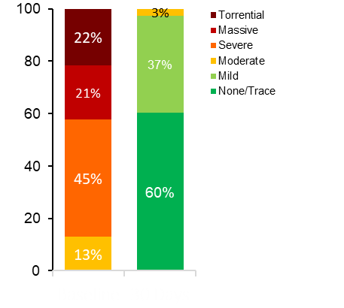
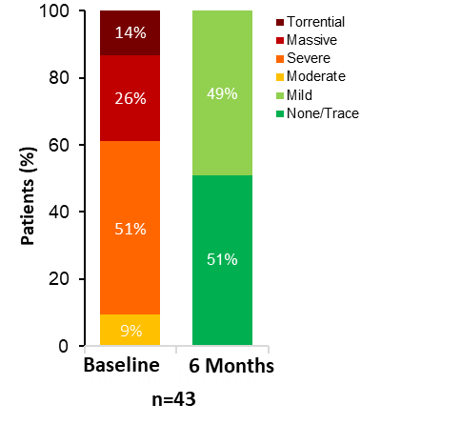
Significant Reduction in TR Severity by Core Lab¹ at 6 Months
TR Severity at Discharge
TR Severity at 6 Months
p < 0.001ª
p < 0.001ª
Patients (%)
97%
100%
No residual TR post implant with EVOQUE valve
≥1 grade reduction in 100% at discharge and 6 months
Baseline
Discharge
≥2 grade reduction in 95% at discharge and 98% at 6 months
n=116
¹Core lab: Baylor, Scott and White Research Institute; ªWilcoxon signed-rank test. TR, tricuspid regurgitation

Slide 11
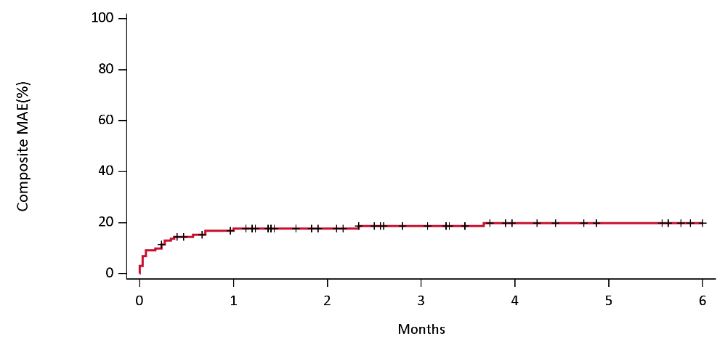
Composite Major Adverse Events (%) to 6 Months
Kaplan-Meier Analysis
18±3%
20±4%
At Risk
102
55
CEC adjudicated MAEs between 30 days and 6 months included: 2 non-elective tricuspid valve re-interventions (PODs 49 and 110), 2 severe bleeds (traumatic hematoma at POD 32 and GI bleed at POD 127), 1 cardiovascular death (cardiac arrest POD 70)

Slide 12
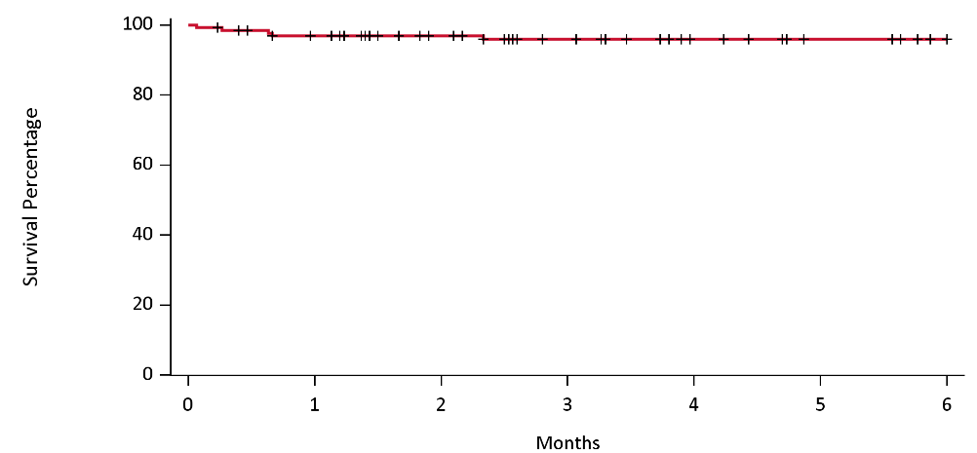
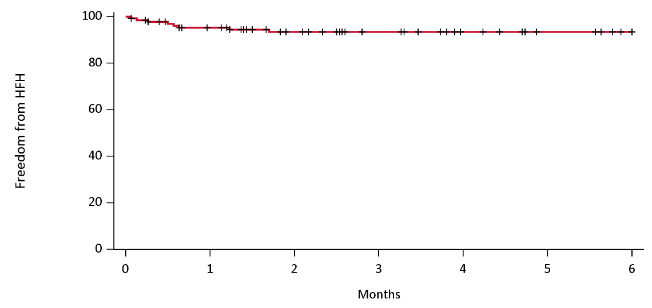
High Survival Rate and Freedom from Heart Failure Hospitalization to 6 Months
Survival
Freedom from Heart Failure Hospitalization
97±2%
96±2%
95±2%
94±2%
At Risk
120
66
At Risk
114
61
Kaplan-Meier analysis

Slide 13
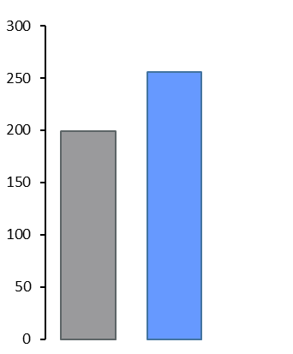
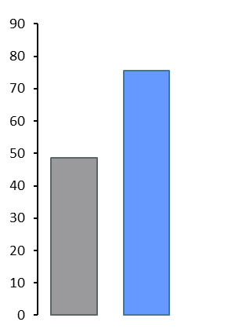
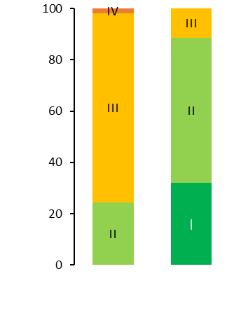
Significantly Improved Functional and Quality of Life Outcomes at 6 Months
6MWD - Distance Walked (m)
NYHA Class
6MWD
KCCQ Score
p < 0.001ª
p < 0.001^{b}
Δ=56 m
p < 0.001^{b}
Δ=27 points
KCCQ - Overall Score
75.6
± 20.8
NYHA - Patients (%)
255.8
± 109.9
199.5
± 123.4
48.6
± 22.8
89%
Baseline
6 Months
Baseline
6 Months
Baseline
6 Months
n=53
n=53
n=53
ªWilcoxon signed-rank test; ^{b}Paired t-test. NYHA Class, New York Heart Association functional classification; 6MWD, 6-minute walk distance; KCCQ, Kansas City Cardiomyopathy Questionnaire

Slide 14
Conclusions
Transfemoral tricuspid valve replacement with the EVOQUE system demonstrated favorable 30-day outcomes sustained at 6 months
Significant TR reduction by core laboratory assessment, with 100% of patients having mild or less TR at 6 months
Six month results demonstrated 96% survival and 94% freedom from heart failure hospitalization
Significant improvements in NYHA class, KCCQ score, and 6MWD
Randomized pivotal trial (TRISCEND II, NCT04482062) is underway

