Slide 1
iFR vs FFR-guided coronary revascularization iFR-Swedeheart 5-year outcome
Matthias Götberg, MD, PhD
Skane University Hospital, Lund University, Sweden
- on behalf of the iFR-Swedeheart investigators

Slide 2
Disclosure Statement of Financial Interest
Within the past 12 months, I or my spouse/partner have had a financial interest/arrangement or affiliation with the organization(s) listed below.
Affiliation/Financial Relationship | Company
Grant/Research Support | Boston Scientific, Philips Healthcare
Consulting Fees/Honoraria | Abbott, Boston Scientific, Medtronic
Faculty disclosure information can be found on the app

Slide 3
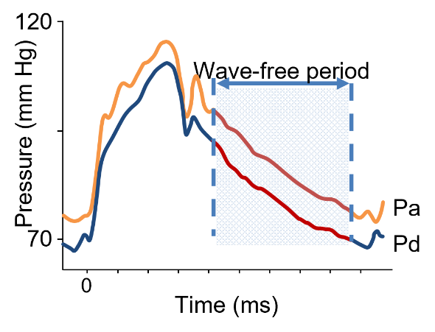
Background
Instantaneous Wave-free ratio (iFR) is a non-hyperemic (resting) index for assessment of coronary lesion severity
Previous validation studies have demonstrated similar or improved ability to accurately detect ischemia compared with Fractional Flow Reserve (FFR)
Sen S et al. Circ. Int. 2014;7:492-502, van de Hoef TP et al. Circ Cardiovasc Interv. 2012;5:508-14
de Waard G et al. J Am Coll Cardiol. 2014;63:A1692
Notes:
2
This is the Bulleted List slide.
To create this particular slide, click the NEW SLIDE button on your toolbar and choose the BULLETED LIST format. (Top row, second from left)
The Sub-Heading and footnote will not appear when you insert a new slide. If you need either one, copy and paste it from the sample slide.
If you choose not to use a Sub-Heading, let us know when you hand in your presentation for clean-up and we’ll adjust where the bullets begin on your master page.
Also, be sure to insert the presentation title onto the BULLETED LIST MASTER as follows:
Choose View / Master / Slide Master from your menu.
Select the text at the bottom of the slide and type in a short version of your presentation title.
Click the SLIDE VIEW button in the lower left hand part of your screen to return to the slide show. (Small white rectangle)

Slide 4
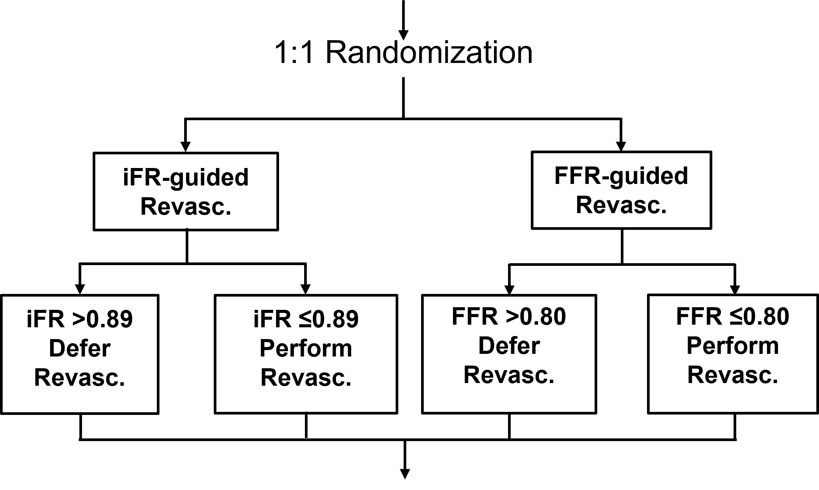
Study Design iFR-Swedeheart
Hypothesis : iFR is non-inferior to FFR at 1 year regarding a composite of all-cause death, MI, and unplanned revascularization
Non-inferiority margin of 1.4 (3.2%) (upper 1-sided 97.5% CI)
2000 patients with 85% power to test hypothesis
Primary endpoint at 1 year
Final follow-up at 5 years
Final follow-up at 5 years
Notes:
3
This is the Bulleted List slide.
To create this particular slide, click the NEW SLIDE button on your toolbar and choose the BULLETED LIST format. (Top row, second from left)
The Sub-Heading and footnote will not appear when you insert a new slide. If you need either one, copy and paste it from the sample slide.
If you choose not to use a Sub-Heading, let us know when you hand in your presentation for clean-up and we’ll adjust where the bullets begin on your master page.
Also, be sure to insert the presentation title onto the BULLETED LIST MASTER as follows:
Choose View / Master / Slide Master from your menu.
Select the text at the bottom of the slide and type in a short version of your presentation title.
Click the SLIDE VIEW button in the lower left hand part of your screen to return to the slide show. (Small white rectangle)

Slide 5
Study Design iFR-Swedeheart
Registry based Randomized Clinical Trial (RRCT)
Trial design utilizing national quality registers as an electronic CRF:
baseline characteristics
data-input
online randomization
follow-up
Proven pragmatic and cost-effective trial design facilitated by use of unique personal identifiers in Scandinavia allowing for 100% tracking of patients
Notes:
4
This is the Bulleted List slide.
To create this particular slide, click the NEW SLIDE button on your toolbar and choose the BULLETED LIST format. (Top row, second from left)
The Sub-Heading and footnote will not appear when you insert a new slide. If you need either one, copy and paste it from the sample slide.
If you choose not to use a Sub-Heading, let us know when you hand in your presentation for clean-up and we’ll adjust where the bullets begin on your master page.
Also, be sure to insert the presentation title onto the BULLETED LIST MASTER as follows:
Choose View / Master / Slide Master from your menu.
Select the text at the bottom of the slide and type in a short version of your presentation title.
Click the SLIDE VIEW button in the lower left hand part of your screen to return to the slide show. (Small white rectangle)

Slide 6
Major inclusion and exclusion criteria
Patients with suspected stable angina pectoris or unstable angina pectoris/NSTEMI
A clinical indication for physiology-guided assessment of coronary lesions (30-80% stenosis grade)
Known terminal disease with a life expectancy <1 year
Unstable hemodynamics (Killip class III-IV)
Inability to tolerate adenosine
Previous CABG with patent graft to the interrogated vessel
Heavily calcified or tortuous vessel where inability to cross the lesion with a pressure wire was expected
Previous randomization in iFR-SWEDEHEART trial
Notes:
5
This is the Bulleted List slide.
To create this particular slide, click the NEW SLIDE button on your toolbar and choose the BULLETED LIST format. (Top row, second from left)
The Sub-Heading and footnote will not appear when you insert a new slide. If you need either one, copy and paste it from the sample slide.
If you choose not to use a Sub-Heading, let us know when you hand in your presentation for clean-up and we’ll adjust where the bullets begin on your master page.
Also, be sure to insert the presentation title onto the BULLETED LIST MASTER as follows:
Choose View / Master / Slide Master from your menu.
Select the text at the bottom of the slide and type in a short version of your presentation title.
Click the SLIDE VIEW button in the lower left hand part of your screen to return to the slide show. (Small white rectangle)

Slide 7
15 Participating sites in Scandinavia
Lund/Malmö
Helsingborg
Halmstad
Kalmar
Göteborg
Linköping
Örebro
St Göran
Uppsala
Västerås
Karlstad
Sundsvall
Aarhus (Denmark)
Reykjavik (Iceland)
Steering committee
Matthias Götberg (PI)
Evald H. Christiansen
David Erlinge
Elmir Omerovic
Stefan K. James
Ole Fröbert (chairman)

Slide 8
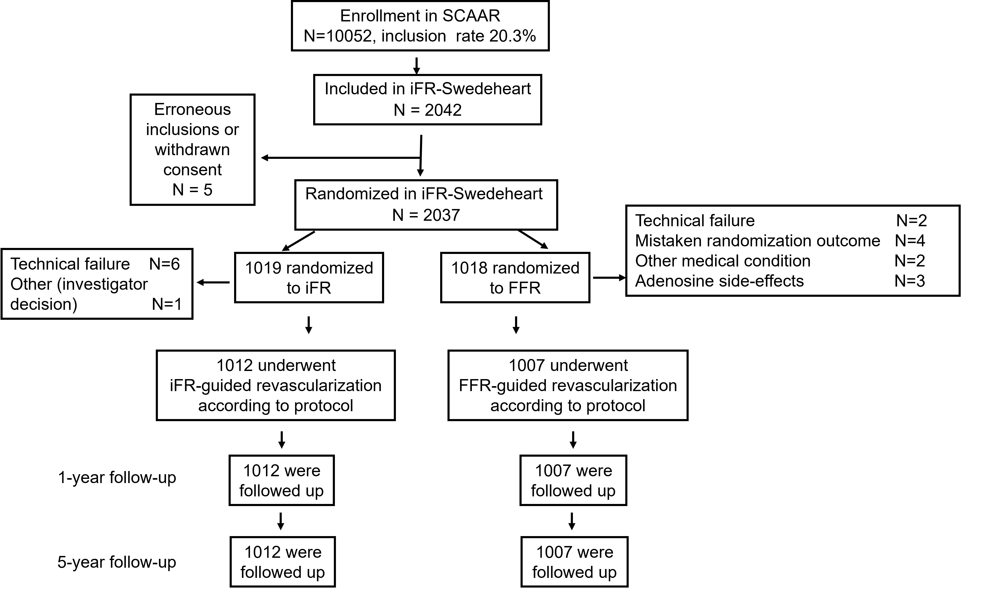
Enrollment
2037 patients enrolled between May 2014- Oct 2015
No patients were lost to follow-up

Slide 9
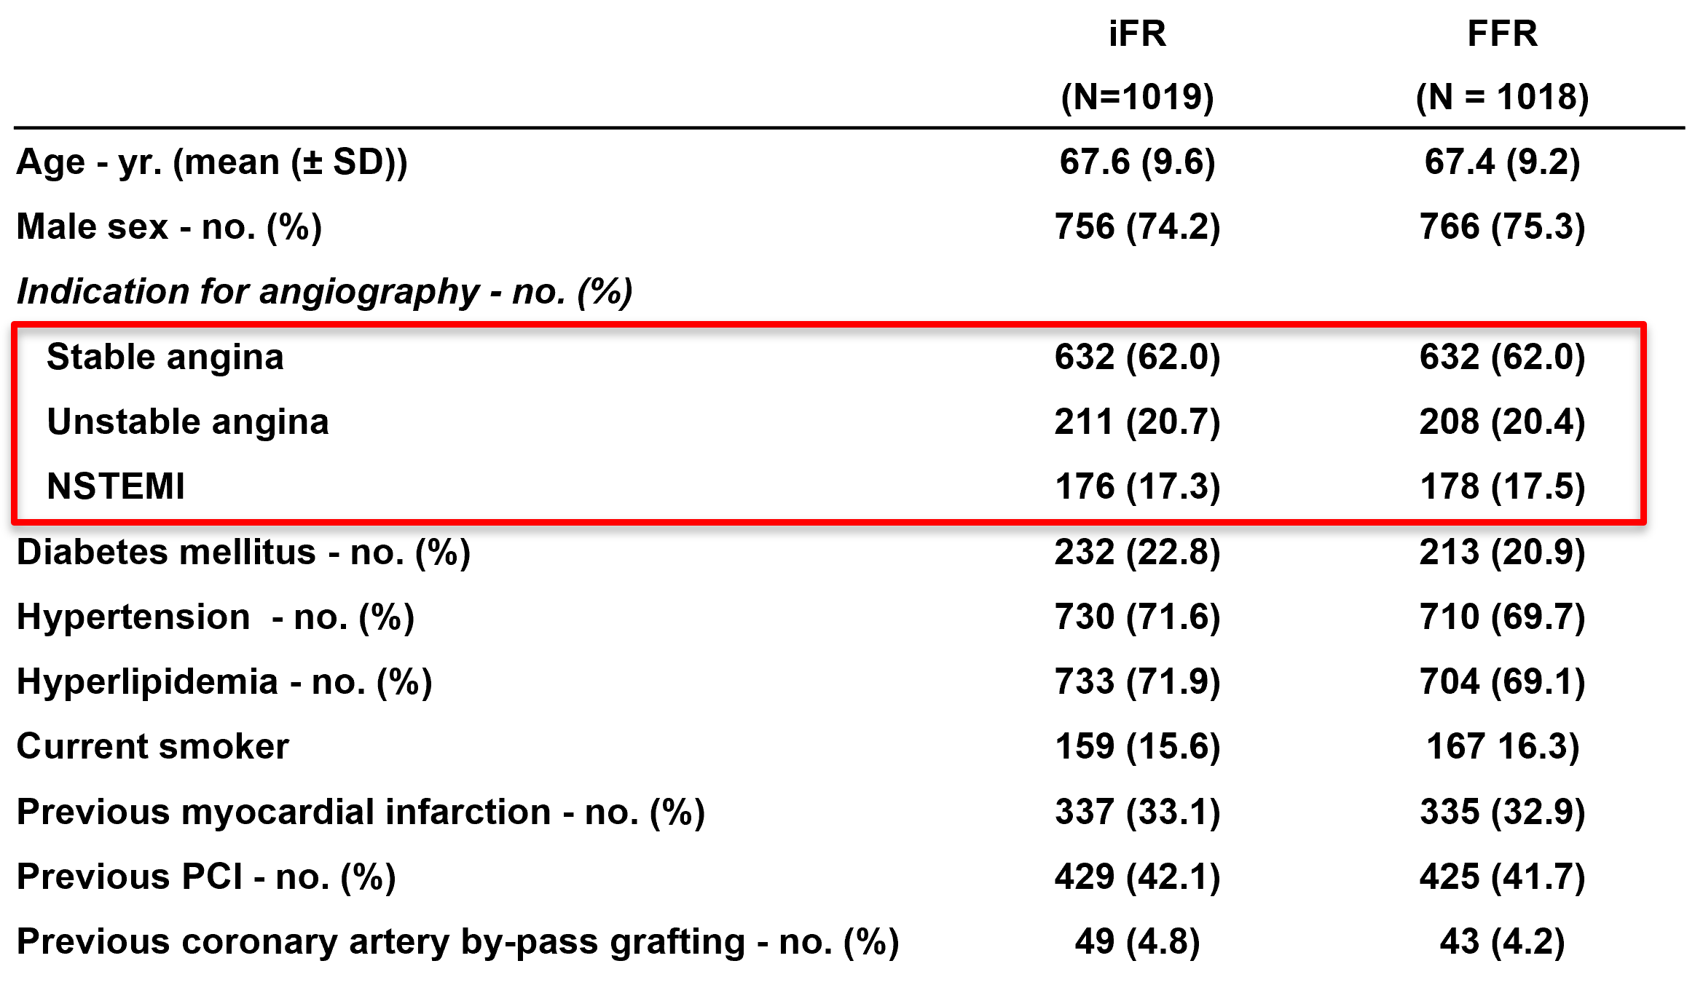
Baseline clinical characteristics

Slide 10
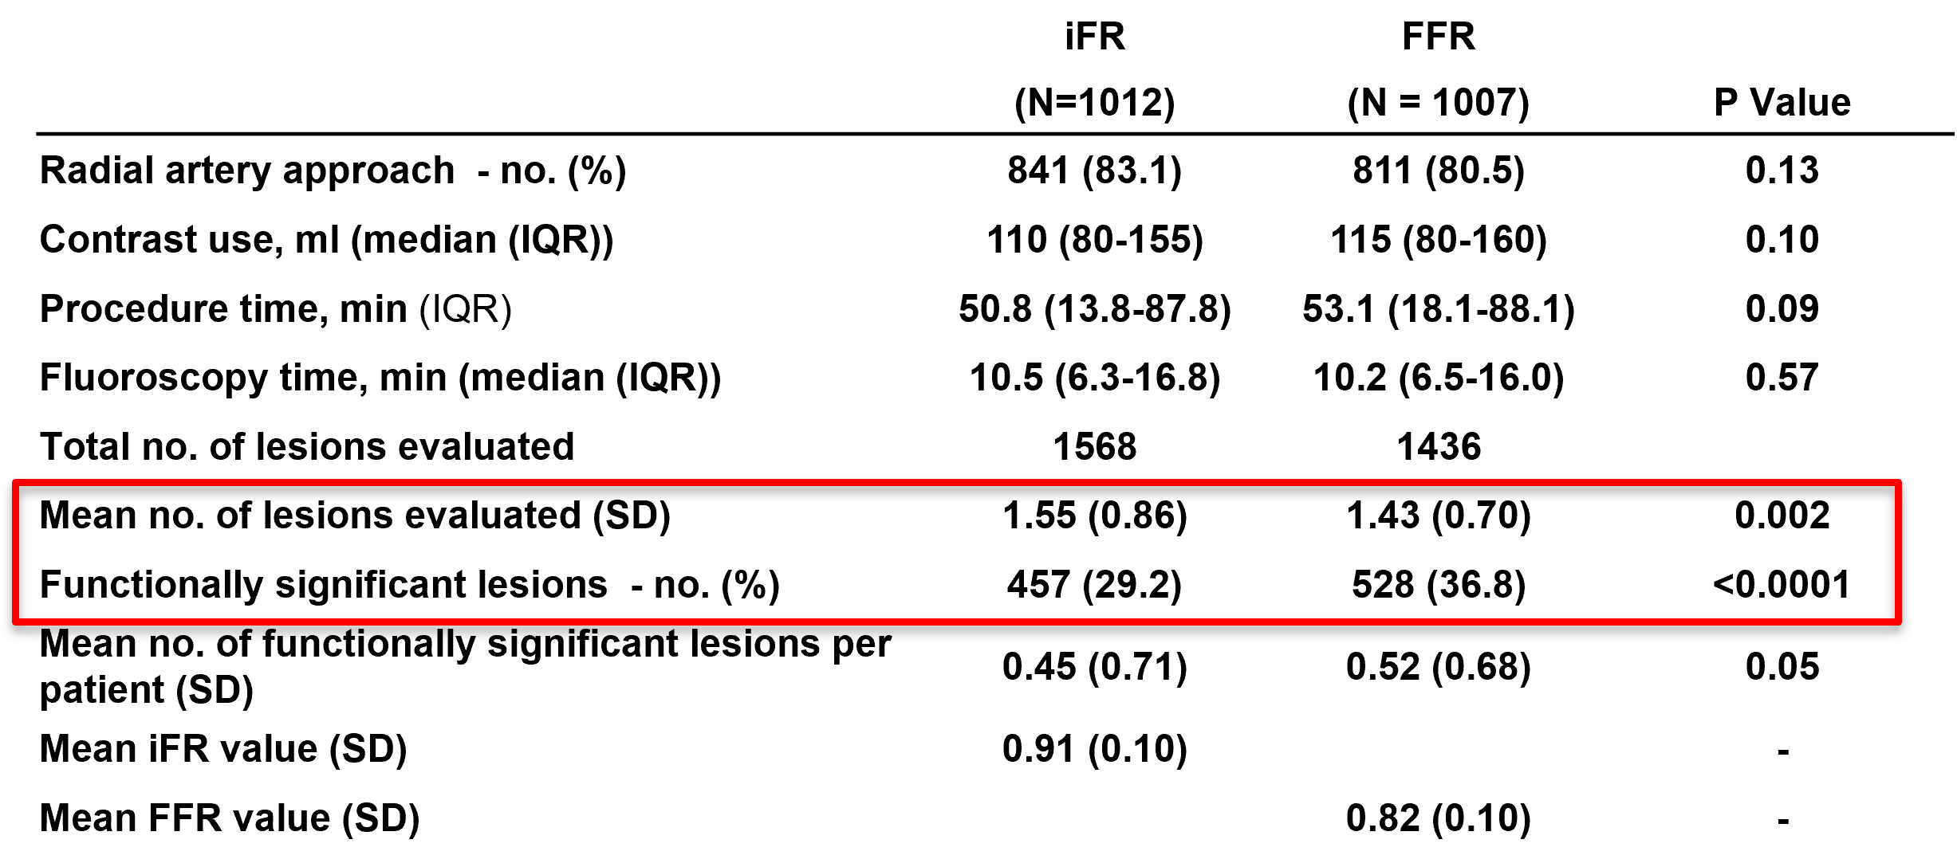
Procedural characteristics
More lesions evaluated in iFR-group but fewer significant lesions

Slide 11
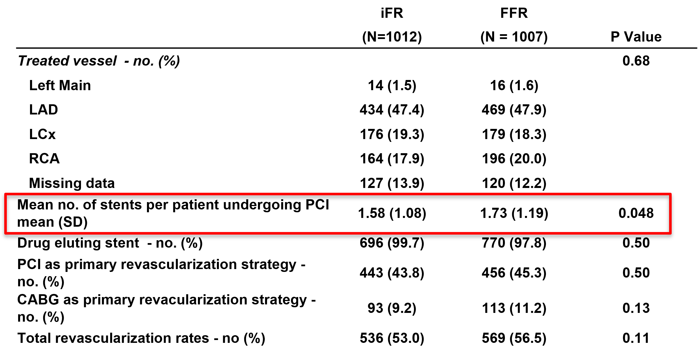
Procedural characteristics (ii)
More stents deployed in FFR-group

Slide 12
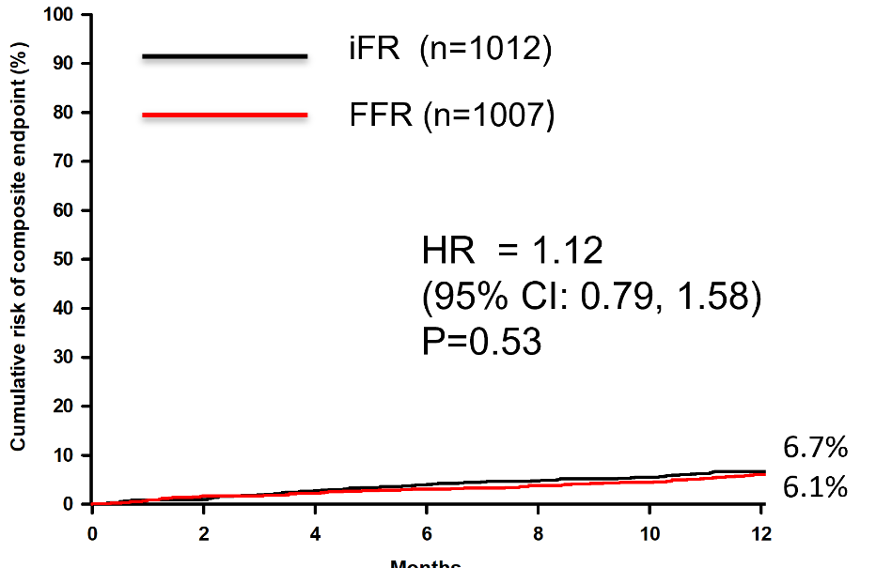
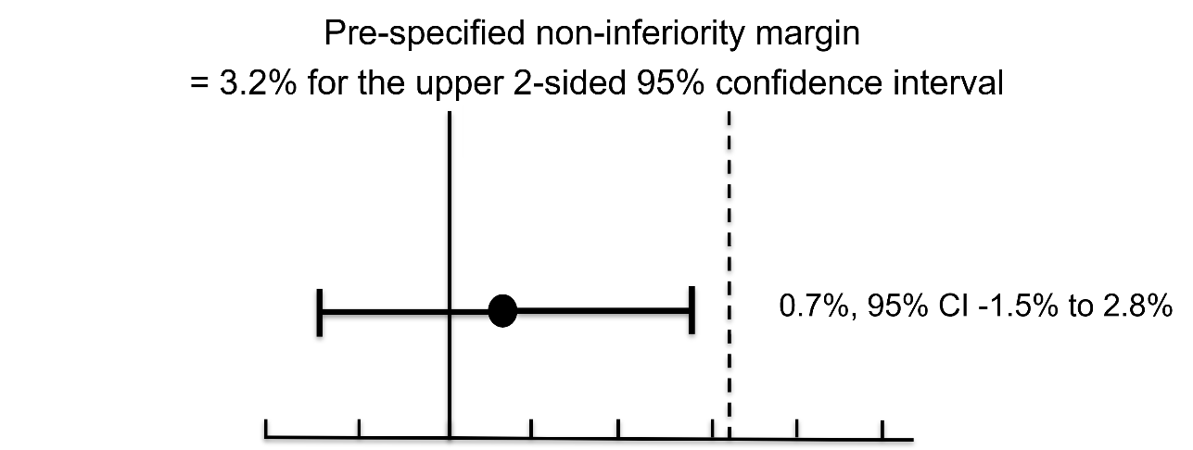
Primary Composite Endpoint at 12 months all-cause death, MI, unplanned revascularization
iFR was non-inferior to FFR regarding primary composite endpoint at 12 months
Götberg et al. N Engl J Med 2017; 376:1813-1823

Slide 13
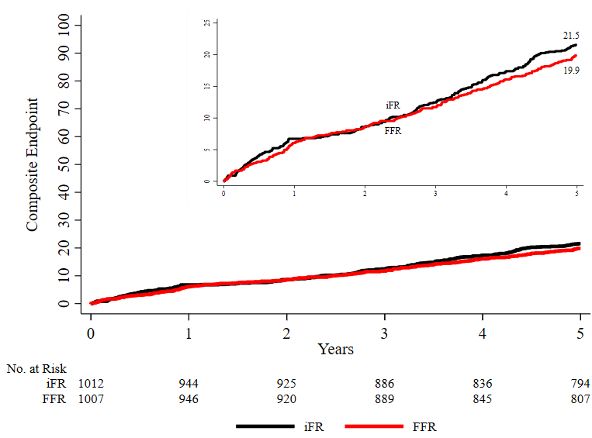
Composite Endpoint at 5 years all-cause death, MI, unplanned revascularization
iFR 21.5%
FFR 19.9%
HR 1.09; 95% CI: 0.90, 1.33
iFR no difference in composite outcome compared with FFR at 5 years

Slide 14
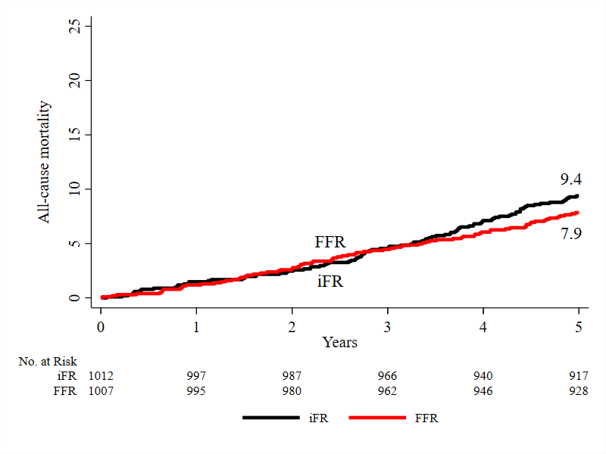
All-cause mortality at 5 years
iFR 9.4%
FFR 7.9%
HR 1.20; 95% CI: 0.89, 1.62
iFR no difference in all-cause mortality compared with FFR

Slide 15
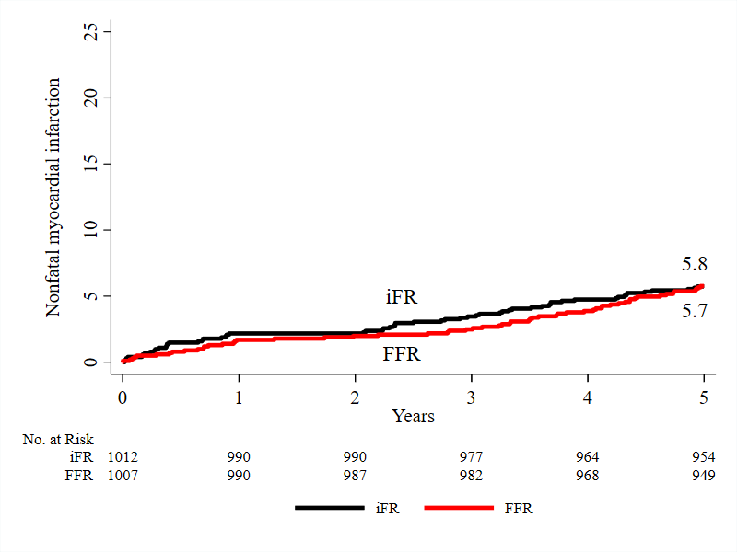
Myocardial infarction at 5 years
iFR 5.8%
FFR 5.7%
HR 1.00; 95% CI: 0.70, 1.44
iFR no difference in non-fatal myocardial infarction compared with FFR

Slide 16
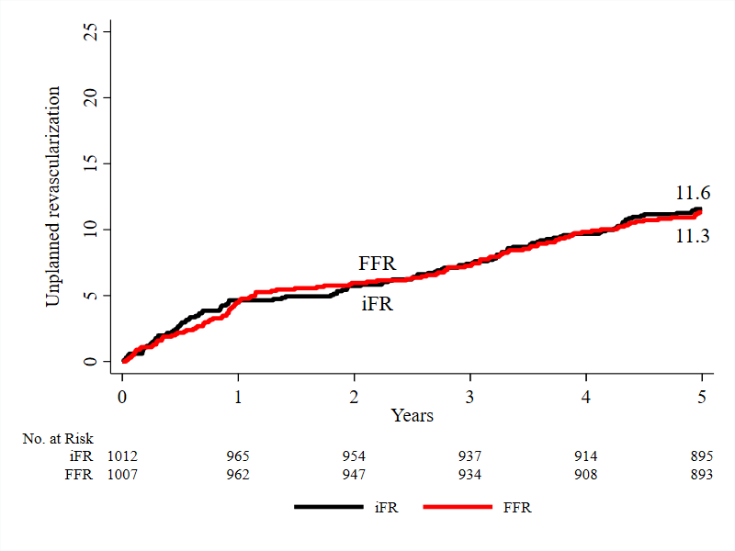
Unplanned revascularization at 5 years
iFR 11.6%
FFR 11.3%
HR 1.02; 95% CI: 0.79, 1.32
iFR no difference in unplanned revascularization compared with FFR

Slide 17
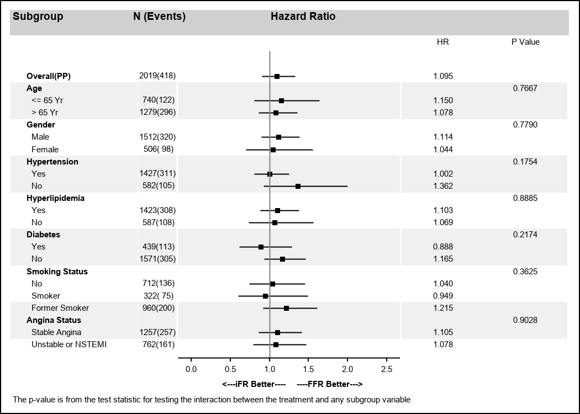
Composite endpoint at 5-years Subgroup analysis
No difference in outcome in any of the pre-specified subgroups

Slide 18
Summary iFR-Swedeheart
In patients with stable angina or acute coronary syndrome
iFR provides no difference in outcome at 5-years compared with FFR
The composite endpoint (all-cause death, MI, unplanned revasc)
All-cause death
Non-fatal myocardial infarction
Unplanned revascularization
Composite endpoint in pre-specified subgroups

Slide 19
Conclusions
The 5-year follow-up of iFR-SWEDEHEART showed no difference in outcome, confirming the long-term safety and efficacy of revascularization guided by iFR compared with FFR
Notes:
18
This is the Bulleted List slide.
To create this particular slide, click the NEW SLIDE button on your toolbar and choose the BULLETED LIST format. (Top row, second from left)
The Sub-Heading and footnote will not appear when you insert a new slide. If you need either one, copy and paste it from the sample slide.
If you choose not to use a Sub-Heading, let us know when you hand in your presentation for clean-up and we’ll adjust where the bullets begin on your master page.
Also, be sure to insert the presentation title onto the BULLETED LIST MASTER as follows:
Choose View / Master / Slide Master from your menu.
Select the text at the bottom of the slide and type in a short version of your presentation title.
Click the SLIDE VIEW button in the lower left hand part of your screen to return to the slide show. (Small white rectangle)

