Slide 1
Left Atrial Appendage Occlusion Study (LAAOS) III
Richard Whitlock MD PhD
On Behalf of the LAAOS III Investigators
  Professor of Surgery
  Twitter: @RichardWhitloc2

Slide 2
Background and Hypothesis
Left atrial appendage occlusion (LAAO) is hypothesized to prevent ischemic stroke in AF
Performed easily during cardiac surgery for other indications
We tested if LAAO at the time of other cardiac surgery reduces ischemic stroke or systemic embolism

Slide 3
LAAOS III Intervention
  Epicardial Occlusion Techniques
CHA₂DS₂-VASc ≥ 2
LAA occlusion
    R
No occlusion
Blinding of:
Patient
Research team
Treating team
VS.

Slide 4
LAAOS III Methods
Primary outcome is ischemic stroke or systemic embolism
Intention-to-treat analysis of all patients who had surgery
Secondary landmark analysis, starting 30 days post-op
Primary safety outcome was hospitalization for heart failure

Slide 5
LAAOS III Follow-up
Follow-up every 6 months with validated stroke questionnaire
All patients received usual care, including anticoagulation, during follow-up
DSMB recommended termination at planned interim analysis
Mean follow-up 3.8 years

Slide 6
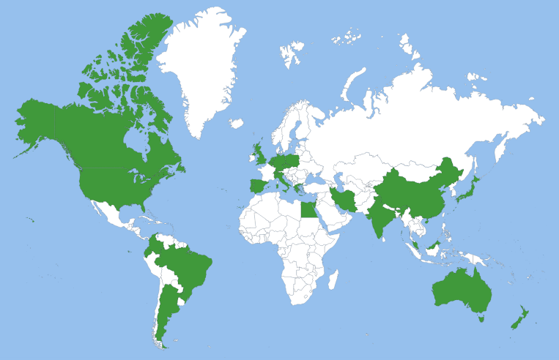
LAAOS III Network
4811 patients
105 centres
27 countries
North America (2)
Europe (14)
Asia 5)
Africa (1)
South America (3)
Oceania (2)
Notes:
primary analysis 4770

Slide 7
Patient Characteristics
 | LAAO (n=2379) | No LAAO (n=2391)
Age, mean (SD) | 71.3 (8.4) | 71.1 (8.3)
CHA₂DS₂-VASc, mean (SD) | 4.2 (1.5) | 4.2 (1.5)
Permanent atrial fibrillation (%) | 692 (29.1%) | 707 (29.6%)
Male (%) | 1617 (68.0%) | 1601 (67.0%)
Myocardial infarction (%) | 567 (23.8%) | 583 (24.4%)
History of stroke (%) | 214 (9.0%) | 219 (9.2%)
History of heart failure (%) | 1348 (56.7%) | 1372 (57.4%)
Peripheral arterial disease (%) | 236 (9.9%) | 256 (10.7%)
Diabetes mellitus (%) | 770 (32.4%) | 765 (32.0%)
Hypertension (%) | 1960 (82.4%) | 1941 (81.2%)

Slide 8
Surgical Characteristics
 | LAAO (n=2379) | No LAAO (n=2391)
Procedure (%)
Isolated CABG | 482 (20.3%) | 522 (21.8%)
Isolated Valve | 552 (23.2%) | 572 (23.9%)
Valve Procedure | 1565 (65.8%) | 1614 (67.5%)
Mitral | 856 (36.0%) | 880 (36.8%)
Aortic | 837 (35.2%) | 858 (35.9%)
Tricuspid | 397 (16.7%) | 427 (17.9%)
Aorta | 146 (6.1%) | 134 (5.6%)
Atrial fibrillation ablation | 809 (34.0%) | 753 (31.5%)

Slide 9
Operative Safety Outcomes
 | LAAO n=2379 | No LAAO n=2391 | p-value*
Bypass time, mean (SD) | 119 min (48) | 113 min (47) | <0.001
Cross clamp time, mean (SD) | 86 min (37) | 82 min (37) | <0.001
Chest tube output, median (IQR) | 520 ml (350-790) | 500 ml (340-760) | 0.06
Re-operation for bleeding | 94 (4.0%) | 95 (4.0%) | 0.97
Prolongation of hospitalization due to heart failure | 5 (0.2%) | 14 (0.6%) | 0.04
30-day mortality | 89 (3.7%) | 95 (4.0%) | 0.68
*Not adjusted for multiplicity

Slide 10
Oral Anticoagulation Use
During Follow-up
 | LAAO | No LAAO
Discharge | 83% | 81%
1 year | 80% | 79%
2 years | 77% | 78%
3 years | 75% | 78%

Slide 11
Primary Outcome at 3.8 Years
 | LAAO (%) | No LAAO (%) | HR (95% CI) | p-value
Ischemic stroke or systemic embolism | 4.8 | 7.0 | 0.67 (0.53-0.85) | 0.001
Landmark analysis
Before 30 days | 2.2 | 2.7 | 0.82 (0.57-1.18)
After 30 days | 2.7 | 4.6 | 0.58 (0.42-0.80)

Slide 12
Stroke or Systemic Embolism
0.20
0.15
LAA Occlusion
No LAA Occlusion
Cumulative Incidence(%)
HR 0.67, 95%CI 0.53-0.85, p=0.001
0.10
0.05
0.0
0
6
12
18
24
30
36
42
48
54
60
66
72
Time since surgery(months)
# at Risk
LAA Occlusion
2379
2163
2105
2059
2020
1948
1642
1322
1046
781
550
349
199
No LAA Occlusion
2391
2134
2081
2030
1981
1897
1607
1291
1016
751
540
348
205

Slide 13
Stroke or Systemic Embolism < 30 Days
0.10
0.08
0.06
LAA Occlusion
No LAA Occlusion
Cumulative Incidence(%)
0.04
0.02
0.0
0
3
6
9
12
15
18
21
24
27
30
Time since surgery(days)

Slide 14
LAA Occlusion
NO LAA Occlusion
P value for
events/Total (%)
events/Total (%)
Hazard Ratio (95% CI)
Interaction
OVERALL
114 / 2379 (4.8)
168 / 2391 (7.03)
0.67 (0.53 - 0.85)
Sex
Subgroups
Female
46 / 762 (6.0)
63 / 790 (8.0)
0.75 (0.52 - 1.10)
0.48
Age
Male
68 / 1617 (4.2)
105 / 1601 (6.6)
0.63 (0.47 - 0.86)
< 72
40 / 1075 (3.7)
62 / 1137 (5.5)
0.67 (0.45 - 1.00)
0.95
>=72
74 / 1304 (5.7)
106 / 1254 (8.5)
0.66 (0.49 - 0.89)
Rheumatic heart disease
No
110 / 2214 (5.0)
155 / 2229 (7.0)
0.71 (0.55 - 0.90)
0.10
Yes
4 / 165 (2.4)
13 / 162 (8.0)
0.28 (0.09 - 0.87)
Type of OAC at baseline
Neither
59 / 1164 (5.1)
73 / 1144 (6.4)
0.81 (0.58 - 1.15)
0.30
DOAC
27 / 674 (4.0)
51 / 705 (7.2)
0.54 (0.34 - 0.86)
VKA
28 / 541 (5.2)
44 / 542 (8.1)
0.62 (0.39 - 1.00)
CHA2DS2-VASc Score
<=4
45 / 1417 (3.2)
77 / 1403 (5.5)
0.57 (0.40 - 0.82)
0.22
>4
69 / 962 (7.2)
91 / 988 (9.2)
0.77 (0.56 - 1.06)
Surgery Type
Any Valve
87 / 1565 (5.6)
134 / 1614 (8.3)
0.66 (0.50 - 0.86)
0.62
All Others
27 / 814 (3.3)
34 / 777 (4.4)
0.76 (0.46 - 1.26)
AF ablation
No
80 / 1570 (5.1)
117 / 1638 (7.1)
0.71 (0.54 - 0.95)
0.51
Yes
34 / 809 (4.2)
51 / 753 (6.8)
0.60 (0.39 - 0.92)
History of Hypertension
No
16 / 419 (3.8)
33 / 450 (7.3)
0.51 (0.28 - 0.93)
0.33
Yes
98 / 1960 (5.0)
135 / 1941 (7.0)
0.71 (0.55 - 0.92)
History of Heart Failure
No
38 / 1031 (3.7)
55 / 1019 (5.4)
0.67 (0.45 - 1.02)
0.99
Yes
76 / 1348 (5.6)
113 / 1372 (8.2)
0.68 (0.51 - 0.90)
LVEF
>=50
74 / 1508 (4.9)
107 / 1519 (7.0)
0.68 (0.51 - 0.92)
0.87
<50
32 / 671 (4.8)
44 / 669 (6.6)
0.72 (0.46 - 1.13)
Prior stroke/TIA/SE
No
86 / 1988 (4.3)
126 / 1998 (6.3)
0.67 (0.51 - 0.89)
0.99
Yes
28 / 391 (7.2)
42 / 393 (10.7)
0.67 (0.42 - 1.09)
AF/Flutter
Others
40 / 904 (4.4)
55 / 958 (5.7)
0.76 (0.51 - 1.14)
0.46
AF/Flutter
74 / 1470 (5.0)
112 / 1429 (7.8)
0.63 (0.47 - 0.85)
0.40
0.50
0.70
1.0
1.2
1.5
Favors LAA Occlusion
HR (95% CI)
Favors No LAA Occlusion

Slide 15
Secondary Outcomes at 3.8 years
 | LAAO (%) | No LAAO (%) | HR (95% CI)
Ischemic stroke | 4.2 | 6.6 | 0.62 (0.48-0.80)
Systemic embolism | 0.3 | 0.3 | 0.86 (0.29-2.55)
Death | 22.6 | 22.5 | 1.00 (0.89-1.13)
Hospitalization for heart failure | 7.7 | 6.8 | 1.13 (0.92-1.40)

Slide 16
Conclusions
Surgical LAA occlusion reduces ischemic stroke by 33%
  After first 30 perioperative days, by 42%
No evidence of adverse effects
Benefit additive to oral anticoagulation

Slide 17

www.nejm.org

