Slide 1
Sex-specific outcomes in
high-risk patients receiving ticagrelor with or without
aspirin after PCI: Results from
the TWILIGHT trial
Birgit Vogel, MD
on behalf of Roxana Mehran, MD,
Kurt Huber, MD
and the TWILIGHT investigators

Slide 2
Disclosure statement of financial interest
I, Birgit Vogel, have no conflict of interest to declare

Slide 3
TWILIGHT – Sex Analysis: Background
Compared with men, women are characterized by an increased risk for bleeding after PCI.^{1,2}
While these associations may reflect differences in baseline risk factors (i.e. older age, renal impairment) that are more prevalent in women, other data suggest an independent biological effect of female sex on hemorrhagic risk.
¹Chichareon et al, JAMA Cardiol. 2020; ²Mrdovic et al, Can J Cardiol. 2013
Notes:
With respect to background

Slide 4
TWILIGHT – Sex Analysis: Background
The Ticagrelor With AspIrin or ALone In HiGH-Risk Patients after Coronary InTervention (TWILIGHT) study showed that monotherapy with a potent P2Y₁₂ inhibitor following a short period of dual antiplatelet therapy (DAPT) compared with continued DAPT leads to reduced bleeding without an increase in ischemic events among patients at high risk for bleeding or ischemic events after PCI.¹
Whether these effects vary in relation to sex remains unknown.
¹Mehran et al., N Engl J Med. 2019

Slide 5
TWILIGHT – Sex Analysis: Objective
To explore sex differences in the TWILIGHT population and to evaluate the association of sex and outcomes among patients treated with
ticagrelor alone vs ticagrelor plus aspirin
after PCI with implantation of DES and
completion of a 3-month course of DAPT
Notes:
An therefore the objective of this pre-specified subgroup analysis was

Slide 6
TWILIGHT – Sex Analysis: Study Design
Randomized, double-blind placebo controlled trial in 187 sites and 11 countries
High-risk patients underwent PCI and were treated with ticagrelor plus aspirin for 3 months
Event-free and adherent patients were randomized to aspirin vs placebo and continued ticagrelor for and additional year
9006 pts enrolled
(28.5% women)
Ticagrelor + Aspirin
852 women
2712 men
Standard of Care
7119 pts randomized
(23.9% women)
Ticagrelor + Placebo
846 women
2709 men
Standard of Care
Enrollment period 3 Months
Randomization period
12 Months
Observation period 3 Months
3 M
15 M
18 M

Slide 7
TWILIGHT – Sex Analysis: Inclusion/Exclusion Criteria Must meet at least one clinical AND one angiographic criterion
Clinical criteria | Angiographic criteria
Age ≥65 years | Multivessel CAD
Female sex | Target lesion requiring total stent length >30 mm
Troponin-positive ACS | Thrombotic target lesion
Established vascular disease (previous MI, documented PAD or CAD/PAD revasc) | Bifurcation lesion(s) with Medina classification X, 1, 1 requiring ≥2 stents
DM treated with medications or insulin | Left main (≥50%) or proximal LAD (≥70%) lesions
CKD (eGFR<60 ml/min/1.73m2 or CrCl<60 ml/min) | Calcified target lesion(s) requiring atherectomy
Key Exclusions: STEMI; Salvage PCI; need for chronic oral anticoagulation; planned coronary revascularization

Slide 8
TWILIGHT – Sex Analysis: Methods
Target Population
Randomized TWILIGHT participants by sex
Endpoints
Primary: BARC type 2, 3, or 5 bleeding
Primary ischemic: All-cause death, nonfatal MI, or nonfatal stroke
between 0-12 months post randomization

Slide 9
TWILIGHT – Sex Analysis: Methods
Analytic approach
Survival analyses using the Kaplan-Meier method
Hazard ratios (HR) and 95% confidence intervals (CI) generated using Cox regression
Models were adjusted for variables displaying baseline differences or other known biological confounders
Analyses stratified by sex

Slide 10
TWILIGHT – Sex Analysis: Patient Characteristics by Sex (I)
Clinical Parameters | Women (N=1698; 23.9%) | Men (N=5421; 76.1%) | P value
Age, years (mean±SD) | 65.5±9.6 | 63.4±10.3 | <.001
Non-white race | 33.7% | 30.0% | .004
BMI, kg/m² (mean±SD) | 28.8±6.4 | 28.5±5.3 | .12
DM | 36.4% | 36.9% | .69
Insulin-treated DM | 33.5% | 25.1% | <.001
CKD | 21.2% | 14.7% | <.001
Anemia | 23.2% | 18.3% | <.001
Current smoker | 17.0% | 23.3% | <.001
Hypercholesterolemia | 58.9% | 60.9% | .13
Hypertension | 76.5% | 71.1% | <.001

Slide 11
TWILIGHT – Sex Analysis: Patient Characteristics by Sex (I)
Clinical Parameters | Women (N=1698; 23.9%) | Men (N=5421; 76.1%) | P value
Age, years (mean±SD) | 65.5±9.6 | 63.4±10.3 | <.001
Non-white race | 33.7% | 30.0% | .004
BMI, kg/m² (mean±SD) | 28.8±6.4 | 28.5±5.3 | .12
DM | 36.4% | 36.9% | .69
Insulin-treated DM | 33.5% | 25.1% | <.001
CKD | 21.2% | 14.7% | <.001
Anemia | 23.2% | 18.3% | <.001
Current smoker | 17.0% | 23.3% | <.001
Hypercholesterolemia | 58.9% | 60.9% | .13
Hypertension | 76.5% | 71.1% | <.001

Slide 12
TWILIGHT – Sex Analysis: Patient Characteristics by Sex (II)
Clinical Parameters | Women (N=1698; 23.9%) | Men (N=5421; 76.1%) | P value
Peripheral arterial disease | 6.6% | 7.0% | .61
Previous MI | 20.9% | 31.1% | <.001
Previous PCI | 32.5% | 45.1% | <.001
Previous CABG | 6.4% | 11.1% | <.001
Previous major bleed | 1.1% | 0.8% | .24
Indication for PCI |  |  | <.001
ACS | 68.4% | 63.7%
Stable CAD | 31.6% | 36.3%

Slide 13
TWILIGHT – Sex Analysis: Patient Characteristics by Sex (II)
Clinical Parameters | Women (N=1698; 23.9%) | Men (N=5421; 76.1%) | P value
Peripheral arterial disease | 6.6% | 7.0% | .61
Previous MI | 20.9% | 31.1% | <.001
Previous PCI | 32.5% | 45.1% | <.001
Previous CABG | 6.4% | 11.1% | <.001
Previous major bleed | 1.1% | 0.8% | .24
Indication for PCI |  |  | <.001
ACS | 68.4% | 63.7%
Stable CAD | 31.6% | 36.3%

Slide 14
TWILIGHT – Sex Analysis: Patient Characteristics by Sex (III)
Procedural Parameters | Women (N=1698; 23.9%) | Men (N=5421; 76.1%) | P value
Radial artery access | 70.4% | 73.6% | .01
Multivessel CAD | 55.4% | 65.0% | <.001
Target vessel
Left Main | 4.4% | 5.1% | .24
LAD | 60.7% | 54.8% | <.001
LCX | 26.2% | 34.2% | <.001
RCA | 34.9% | 35.2% | .85
Number of vessels treated (mean±SD) | 1.26±0.50 | 1.29±0.53 | .044
Number of lesions treated (mean±SD) | 1.47±0.71 | 1.54±0.76 | <.001

Slide 15
TWILIGHT – Sex Analysis: Patient Characteristics by Sex (IV)
Procedural Parameters | Women (N=1698; 23.9%) | Men (N=5421; 76.1%) | P value
Lesion morphology†
Moderate/severe calcification | 14.7% | 13.6% | .24
Bifurcation | 11.8% | 12.3% | .58
Total occlusion | 5.4% | 6.5% | .10
Thrombotic | 10.5% | 10.5% | .95
Total stent length, mm‡ (mean±SD) | 37.6±22.1 | 40.6±24.9 | <.001
Minimum stent diameter, mm (mean±SD) | 2.8±0.5 | 2.9±0.5 | <.001
†Lesion morphology assessed by operators
‡Stent length calculated by operators

Slide 16
TWILIGHT – Sex Analysis: BARC 2, 3 or 5 Bleeding by Sex at 1 Year
10
Women vs Men
HR 1.32 (95% CI 1.06 – 1.64)
P = .013
8
6.8%
6
5.2%
Cumulative incidence (%)
4
Women
2
Men
0
0
60
120
180
240
300
360
Number at risk
Days after randomization
Women
1698
1663
1642
1621
1584
1567
1549
Men
5421
5323
5242
5171
5102
5043
4987

Slide 17
TWILIGHT – Sex Analysis: Pre-specified Bleeding Endpoints by Sex
P = .03
P = .06
1-year event rate (%)
P = .06
P = .79

Slide 18
TWILIGHT – Sex Analysis: Adjusted Bleeding Outcomes by Sex
Women
N=1698
Men*
N=5421
Hazard Ratio
(95% CI)
Adjusted
Hazard Ratio (95% CI)†
P value
BARC 2,3 or 5
6.8% vs. 5.2% 1.32 (1.06 - 1.64)
1.20 (0.95- 1.52) .12
BARC 3 or 5
2.0% vs. 1.3% 1.57 (1.04 - 2.37)
1.49 (0.96 - 2.32) .08
TIMI major
0.8% vs. 0.7% 1.09 (0.58 – 2.04)
1.20 (0.62 - 2.31) .59
GUSTO
moderate or severe
1.5% vs. 0.9% 1.60 (0.99 - 2.58)
1.57 (0.95 - 2.61) .08
ISTH major
2.1% vs. 1.4% 1.47 (0.99 - 2.20)
1.37 (0.89 - 2.11) .16
Men at higher risk
Women at higher risk
Bleeding outcomes were evaluated in the intention-to-treat cohort
*reference, †Model adjusted for age (years), nonwhite race, region of enrollment, insulin-treated diabetes, CKD, anemia, current smoker, hypertension, previous MI, previous coronary revascularization (previous PCI or CABG), multivessel CAD, indication for PCI, radial artery access, whether LAD was treated, whether LCX was treated, number of lesions treated, and minimum stent diameter (mm).

Slide 19
TWILIGHT – Sex Analysis: Death, MI or stroke by Sex at 1 Year
10
8
Women vs. Men
HR 0.86 (95% CI 0.65 – 1.15)
P = .32
6
Cumulative incidence (%)
4.0%
4
3.5%
Women
2
Men
0
0
60
120
180
240
300
360
Days after randomization
Number at risk
Women
1676
1656
1644
1635
1614
1605
1596
Men
5363
5293
5246
5199
5143
5106
5057

Slide 20
TWILIGHT – Sex Analysis: Pre-specified Ischemic Endpoints by Sex
P = .30
1-year event rate %
P = .45
P = .31
P = .23
P = .55
P = .44

Slide 21
TWILIGHT – Sex Analysis:
Adjusted Ischemic Outcomes by Sex
Women
N=1676
Men*
N=5363
Hazard Ratio
(95% CI)
Adjusted
Hazard Ratio (95% CI) †
P value
Death, MI or stroke
3.5% vs 4.0% 0.86 (0.65-1.15)
0.87 (0.64-1.18) .36
CV death, MI or
ischemic stroke
3.2% vs 3.8% 0.85 (0.63-1.15)
0.85 (0.62-1.17) .32
all-cause death
0.9% vs 1.2% 0.75 (0.43-1.31)
0.64 (0.35-1.15) .14
CV death
0.7% vs 1.0% 0.67 (0.35-1.29)
0.55 (0.27-1.09) .09
MI
2.5% vs 2.8% 0.88 (0.62-1.24)
0.93 (0.64-1.33) .68
Ischemic stroke
0.4% vs 0.3% 1.31 (0.54-3.17)
0.94 (0.38-2.35) .90
Stent thrombosis
(definite or probable)
0.4% vs 0.5% 0.71 (0.29-1.71)
0.72 (0.29-1.78) .47
Men at higher risk
Women at higher risk
Ischemic outcomes were evaluated in the per-protocol cohort
*reference, †Model adjusted for age (years), nonwhite race, region of enrollment, insulin-treated diabetes, CKD, anemia, current smoker, hypertension, previous MI, previous coronary revascularization (previous PCI or CABG), multivessel CAD, indication for PCI, radial artery access, whether LAD was treated, whether LCX was treated, number of lesions treated, and minimum stent diameter (mm).

Slide 22
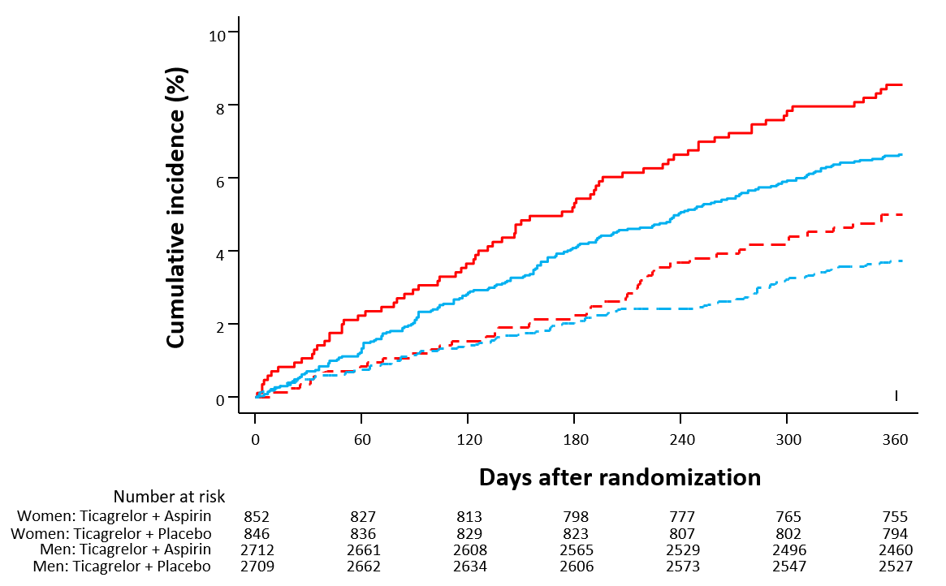
TWILIGHT – Sex Analysis: BARC 2, 3 or 5 Bleeding by Sex and Randomized Treatment
 | Ticagrelor +placebo | Ticagrelor +aspirin* | Adjusted hazard ratio (95% CI)† | P value | Interaction P value
Women | 42 (5.0%) | 72 (8.6%) | 0.62 (0.42 - 0.92) | 0.018 | 0.69
Men | 99 (3.7%) | 178 (6.6%) | 0.57 (0.44 - 0.73) | <.001
8.6%
6.6%
5.0%
3.7%
Women: Ticagrelor + Aspirin
Women: Ticagrelor + Placebo
Men: Ticagrelor + Aspirin
Men: Ticagrelor + Placebo
*reference
†Model adjusted for age (years), non-white race, region of enrollment, insulin-treated diabetes, CKD, current smoking, hypercholesterolemia, previous PCI, multivessel CAD, indication for PCI, lesion calcification.

Slide 23
TWILIGHT – Sex Analysis: Pre-specified Bleeding Endpoints by Sex and
Randomized Treatment
Ticagrelor
+placebo
N (%)
Ticagrelor
+aspirin*
N (%)
Adjusted
Hazard Ratio
(95% CI)†
Interaction
P value
P value
BARC 3 or 5
14 (1.7) vs 20 (2.4)
20 (0.8) vs 49 (1.8)
0.78 (0.39 - 1.58) .49
0.42 (0.25 - 0.71) .001
.18
3 (0.4) vs 10 (1.2)
14 (0.5) vs 24 (0.9)
0.31 (0.09 - 1.15) .08
0.62 (0.32 - 1.21) .16
TIMI major
.34
GUSTO
moderate or severe
9 (1.1) vs 16 (1.9)
17 (0.6) vs 33 (1.2)
0.59 (0.26 - 1.34) .21
0.53 (0.29 - 0.95) .03
.85
15 (1.8) vs 20 (2.4)
24 (0.9) vs 52 (1.9)
0.78 (0.39 - 1.58) .49
0.48 (0.29 - 0.77) .003
ISTH major
.26
Tica+placebo lower risk
Tica+aspirin lower risk
Bleeding outcomes were evaluated in the intention-to-treat cohort
*reference, †Model adjusted for age (years), non-white race, region of enrollment, insulin-treated diabetes, CKD, current smoking, hypercholesterolemia, previous PCI, multivessel CAD, indication for PCI, lesion calcification.

Slide 24
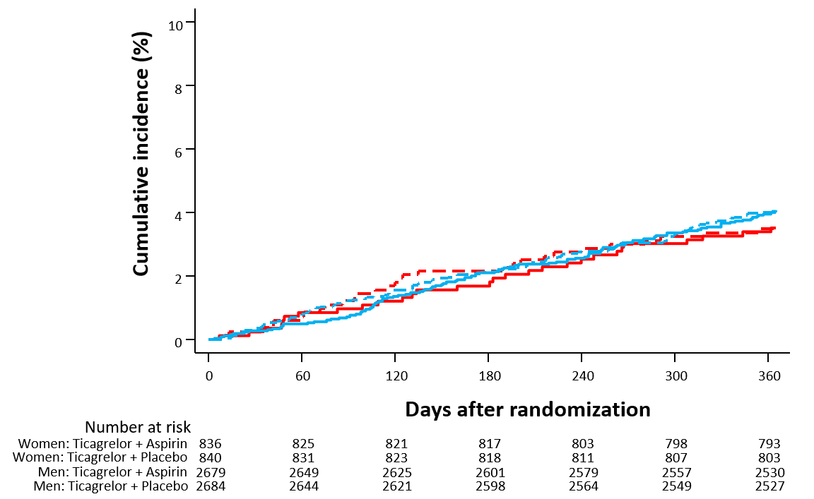
TWILIGHT – Sex Analysis: Death, MI, or Stroke by Sex and Randomized Treatment
 | Ticagrelor +Placebo | Ticagrelor +Aspirin* | Adjusted hazard ratio (95% CI)† | P value | Interaction P value
Women | 29 (3.5%) | 29 (3.5%) | 1.04 (0.61 – 1.77) | 0.88 | 0.95
Men | 106 (4.0%) | 108 (4.1%) | 1.06 (0.80 - 1.39) | 0.69
4.1%
4.0%
3.5%
3.5%
Women: Ticagrelor + Aspirin
Women: Ticagrelor + Placebo
Men: Ticagrelor + Aspirin
Men: Ticagrelor + Placebo
*reference
†Model adjusted for age (years), non-white race, region of enrollment, insulin-treated diabetes, CKD, current smoking, hypercholesterolemia, previous PCI, multivessel CAD, indication for PCI, lesion calcification.

Slide 25
TWILIGHT – Sex Analysis: Pre-specified Ischemic Endpoints by Sex and Randomized Treatment
Ticagrelor
+placebo
N (%)
Ticagrelor
+aspirin*
N (%)
Adjusted
Hazard Ratio
(95% CI)†
Interaction
P value
P value
CV death, MI or
ischemic stroke
27 (3.2) vs 27 (3.3)
99 (3.7) vs 103 (3.9)
1.06 (0.61 - 1.84) .84
1.03 (0.78 - 1.36) .85
>.99
3 (0.4) vs 12 (1.4)
31 (1.2) vs 33 (1.2)
0.17 (0.04 - 0.78) .022
1.00 (0.61 - 1.64) >.99
All-cause death
.03
CV death
2 (0.2) vs 9 (1.1)
24 (0.9) vs 28 (1.1)
0.12 (0.02 - 0.97) .046
0.89 (0.51 - 1.54) .68
.07
MI
21 (2.5) vs 20 (2.4)
74 (2.8) vs 75 (2.8)
1.14 (0.60 - 2.15) .69
1.07 (0.77 - 1.49) .68
.98
Ischemic stroke
5 (0.6) vs 2 (0.2)
11 (0.4) vs 6 (0.2)
2.15 (0.41 - 11.3) .36
1.87 (0.69 - 5.06) .22
.66
Stent thrombosis
(definite or probable)
2 (0.2) vs 4 (0.5)
12 (0.5) vs 15 (0.6)
0.58 (0.10 - 3.29) .54
0.83 (0.39 - 1.77) .62
.67
Tica+placebo lower risk
Tica+aspirin lower risk
Ischemic outcomes were evaluated in the per-protocol cohort
*reference, †Model adjusted for age (years), non-white race, region of enrollment, insulin-treated diabetes, CKD, current smoking, hypercholesterolemia, previous PCI, multivessel CAD, indication for PCI, lesion calcification.

Slide 26
TWILIGHT – Sex Analysis: BARC 2, 3, or 5 Bleeding: Absolute Risk Reduction
Women (N=1698)
Men (N=5421)
- 3.6%
- 2.9%
BARC 2, 3, or 5 bleeding (%)

Slide 27
TWILIGHT – Sex Analysis: Limitations
Neither of the sex-specific subgroups were individually powered to draw definitive conclusions on effect of ticagrelor monotherapy vs ticagrelor plus aspirin on outcome.
Randomization was not stratified by sex.
Findings are specific to a PCI population at high risk for bleeding or ischemic events.
Our analyses considered only patients who tolerated an initial 3 months of DAPT with ticagrelor plus aspirin without any major adverse events.
Notes:
There were not only substantial differences in baseline risk between sexes, but also some imbalances between sex-specific treatment groups.
Despite multivariate adjustment residual confounding cannot be excluded.
and may not apply to the broad population of patients undergoing PCI.

Slide 28
TWILIGHT – Sex Analysis: Conclusions
Women had a higher bleeding risk compared with men, which was mostly attributable to baseline differences.
Ischemic events were similar between sexes.
In this high-risk PCI population, the benefits of early aspirin withdrawal with continuation of ticagrelor were generally comparable in women and men.
Our findings should motivate dedicated studies to further explore the benefits of early aspirin withdrawal in women.

Slide 29
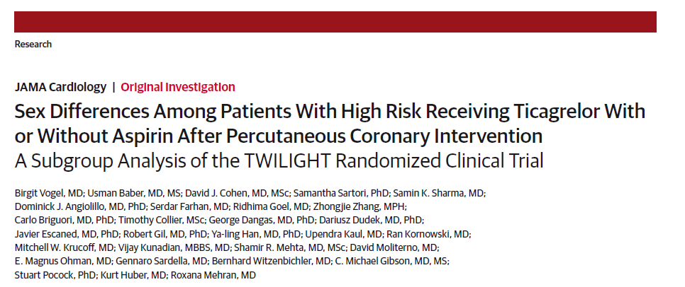
We thank all country leaders, investigators, coordinators and study participants who made TWILIGHT possible!

