Slide 1
Impact of Completeness of Revascularization on Clinical Outcomes in Patients With Stable Ischemic Heart Disease Treated With an Invasive Versus Conservative Strategy: The ISCHEMIA Trial
Gregg W. Stone, MD
On behalf of the ISCHEMIA Research Group

Slide 2
Disclosures
The ISCHEMIA trial and my role as co-principal investigator were supported by NHLBI grants
General Disclosures
Consultant to Valfix, TherOx, Robocath, HeartFlow, Ablative Solutions, Miracor, Neovasc, Abiomed, Ancora, Vectorious, Elucid Bio, Occlutech, CorFlow, Cardiomech, Gore; Equity/options from Ancora, Cagent, Applied Therapeutics, Biostar family of funds, SpectraWave, Orchestra Biomed, Aria, Cardiac Success, Valfix

Slide 3
Background
From a systematic review of >50 prior observational studies of pts with chronic coronary disease (CCD), the achievement of anatomic or ischemic (functional) complete revascularization (CR) after PCI and CABG has been associated with improved survival and freedom from MI
However, not all studies have shown this association
Few studies have adjusted for imbalances in baseline clinical and anatomic covariates
No studies have used a comprehensive QCA core laboratory analysis to assess CR after both PCI and CABG
The impact of CR in pts with CCD undergoing an invasive (INV) compared with a conservative (CON) management strategy has not been reported
Gaba P et al. Nat Rev Cardiol. 2021;18:155-68

Slide 4
Objectives
Among patients with CCD and at least moderate ischemia enrolled in the ISCHEMIA trial, we therefore sought to:
Objective 1: Assess the frequency and outcomes of anatomic CR (ACR) and ischemic/functional CR (FCR) compared with incomplete revascularization (ICR) in pts treated with an INV management strategy
Objective 2: Assess the impact that achieving CR in all pts randomized to an INV strategy might have had compared with CON management

Slide 5
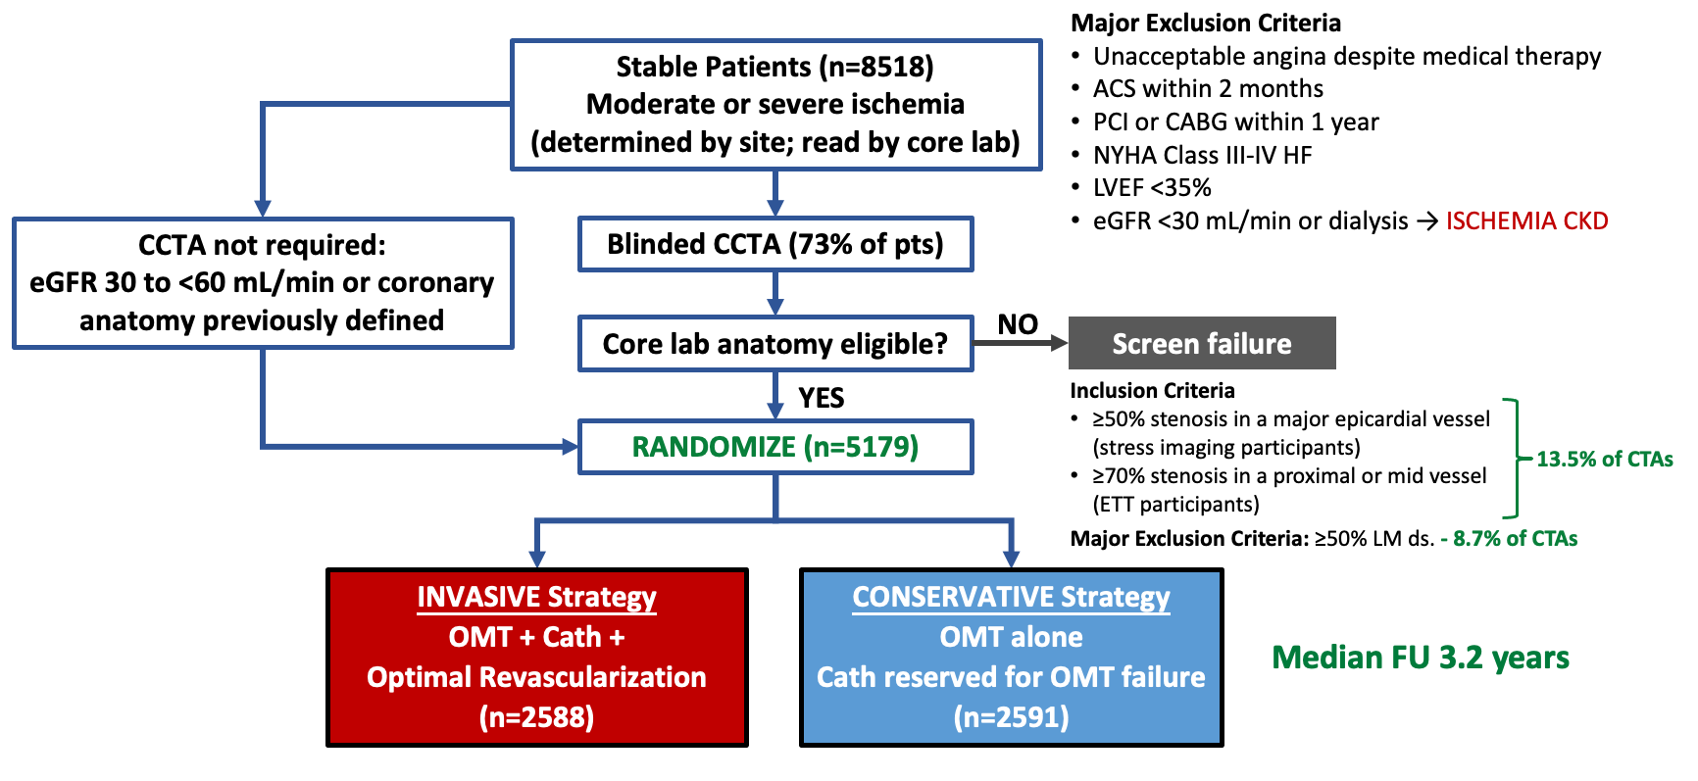
The ISCHEMIA Trial
20.6% of CCTAs
7.3% of CCTAs
Primary endpoint: CV death, MI or hospitalization for cardiac arrest, HF or UA
Maron DJ et al. N Engl J Med. 2020;382:1395-1407

Slide 6
Angiographic Core Laboratory* Assessment of Anatomic and Functional Completeness of Revascularization After PCI and CABG
PCI: CR assessed by review of pre- and post-procedure angiograms (includes planned staged procedures)
CABG: CR assessed by review of pre-procedure angiograms and CABG procedure reports; accounts for diseased vessel segments and side branches
Anatomic CR: Revasc of all lesions with QCA RVD ≥2.0 mm and QCA DS ≥50%
Functional CR: Revasc of all lesions with QCA RVD ≥2.0 mm and:
Localizing FFR/iFR ≤0.80/0.89 plus QCA DS ≥30%, or
Localizing non-invasive ischemia in the vessel distribution plus QCA DS ≥50%, or
Non-localizing severe ischemia by ETT plus QCA DS ≥60%, or
QCA DS ≥70%
*Cardiovascular Research Foundation, NY
Modified from Ali Z et al. J Am Heart Assoc. 2021:e020110. doi: 10.1161/JAHA.120.020110

Slide 7
Objective 1: Patient Flow and Methods
Objective 1 analysis: CR vs. ICR (INV only)
Randomized to INV
N=2588
Had CR assessment
N=2296
Evaluable
N=1825
N=1802 (ACR)
N=1743 (FCR)
Prior CABG
N=110
Films/reports
absent or incomplete
N=182
No revasc
N=384
1st revasc after 6 mo
N=54
Primary endpoint
before revasc
N=33
No anatomic lesions
N=23
No ischemic lesions
N=82
CR vs. ICR
Cox model starting at the time of revasc, stratified by PCI vs CABG
Methods Objective 1 - INV arm only, CR vs. ICR: Outcomes were compared in Cox multivariable models stratified by PCI vs. CABG, with follow-up beginning at the time of first revascularization
Anatomic complete revascularization (ACR) versus anatomic ICR (n=1802)
Functional complete revascularization (FCR) versus functional ICR (n=1743)

Slide 8
Objective 1: Completeness of Revascularization (INV)
Among 1825 pts randomized to INV in whom a revasc procedure was performed within 6 months, prior to a primary endpoint event
Mode of revasc
Complete revascularization rate (%)
ACR assessment
(n=1802)
FCR assessment
(n=1743)

Slide 9
Multivariable Predictors of CR
 | Anatomic CR |  | Functional CR
 | OR (95% CI) | P value | OR (95% CI) | P value
Clinical covariates
Diabetes | 1.42 (1.10 - 1.84) | 0.006 | 1.35 (1.06 - 1.72) | 0.02
BMI (per 5 kg/m²) | 0.85 (0.74 - 0.98) | 0.02 | 0.80 (0.70 - 0.92) | 0.001
Angiographic covariates (ACL)
Diseased vessels (2 vs 1) | 0.41 (0.29 - 0.57) | <0.0001 | 0.55 (0.40 - 0.77) | 0.0003
Diseased vessels (3 vs 1) | 0.37 (0.22 - 0.62) | 0.0002 | 0.55 (0.36 - 0.83) | 0.005
# lesions (anatomic for ACR, ischemic for FCR) | 0.37 (0.31 - 0.44) | <0.0001 | 0.41 (0.35 - 0.48) | <0.0001
CTOs (1 vs 0) | 0.53 (0.39 - 0.71) | <0.0001 | 0.46 (0.35 - 0.60) | <0.0001
CTOs (≥2 vs 0) | - | - | 0.54 (0.32 - 0.91) | 0.02
# lesions with mod/sev calcification | 1.16 (1.05 - 1.29) | 0.005 | - | -
Left main disease | 2.60 (1.23 - 5.48) | 0.01 | - | -
Proximal LAD disease | 1.41 (1.06 - 1.88) | 0.02 | 1.47 (1.13 - 1.93) | 0.005
SYNTAX score (per 5 units) | 0.89 (0.79 - 1.00) | 0.05
Duke Jeopardy score (per 1 unit) | 1.20 (1.07 - 1.34) | 0.001 | - | -
Revascularization modality
First procedure CABG (vs PCI) | 2.30 (1.64 - 3.21) | <0.0001 | 1.90 (1.39 - 2.59) | <0.0001
Logistic regression model. OR >1→CR more likely. Other covariates that were not significantly associated with CR included region of enrollment (NA, EU, Asia, LA/other), age, sex, HTN, smoking, prior MI, h/o HF, h/o stroke or cerebrovascular ds, PAD, prior PCI, LVEF, eGFR, SAQ-AF, NYHA class, stress test type (imaging vs other), ischemia severity (core lab), SYNTAX score, tortuosity, use of FFR or IVUS.

Slide 10
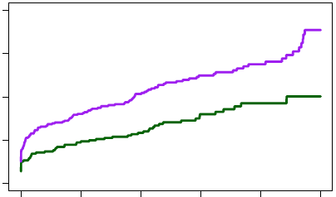
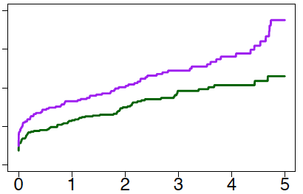
Relationship Between CR and Outcomes (INV) - Unadjusted
Primary endpoint: CV death, MI or hospitalization for arrest, HF or UA
Complete revascularization Incomplete revascularization
Anatomic CR assessment
Functional CR assessment
20
20
15
15
13.8%
14.0%
10
10
Cumulative incidence (%)
Cumulative incidence (%)
10.3%
9.3%
5
5
4-year difference
-4.5% (-7.9% to -1.2%)
4-year difference
-3.7% (-7.2% to -0.2%)
0
0
0
1
2
3
4
5
0
1
2
3
4
5
Years from revascularization
Years from revascularization

Slide 11
Relationship Between CR and Long-term Outcomes (INV)
Anatomic CR Assessment | Anatomic CR Assessment |  | ACR
 | CR | ICR | Unadjusted |  | Adjusted
Endpoint |  |  | HR (95% CI) | P value | HR (95% CI) | P value
Primary endpoint | 9.3% | 13.8% | 0.61 (0.45 - 0.82) | 0.001 | 0.79 (0.55 - 1.15) | 0.22
CV death or MI | 8.1% | 12.6% | 0.60 (0.44 - 0.83) | 0.002 | 0.76 (0.52 - 1.13) | 0.18
- CV death | 2.5% | 4.3% | 0.41 (0.22 - 0.79) | 0.007 | 0.56 (0.27 - 1.15) | 0.11
- MI | 6.2% | 9.8% | 0.64 (0.45 - 0.92) | 0.02 | 0.80 (0.51 - 1.25) | 0.32
All-cause death | 5.7% | 6.8% | 0.65 (0.42 - 1.02) | 0.06 | 0.66 (0.39 - 1.14) | 0.13

Slide 12
Relationship Between CR and Long-term Outcomes (INV)
Anatomic CR Assessment | Anatomic CR Assessment |  | ACR
 | CR | ICR | Unadjusted |  | Adjusted
Endpoint |  |  | HR (95% CI) | P value | HR (95% CI) | P value
Primary endpoint | 9.3% | 13.8% | 0.61 (0.45 - 0.82) | 0.001 | 0.79 (0.55 - 1.15) | 0.22
CV death or MI | 8.1% | 12.6% | 0.60 (0.44 - 0.83) | 0.002 | 0.76 (0.52 - 1.13) | 0.18
- CV death | 2.5% | 4.3% | 0.41 (0.22 - 0.79) | 0.007 | 0.56 (0.27 - 1.15) | 0.11
- MI | 6.2% | 9.8% | 0.64 (0.45 - 0.92) | 0.02 | 0.80 (0.51 - 1.25) | 0.32
All-cause death | 5.7% | 6.8% | 0.65 (0.42 - 1.02) | 0.06 | 0.66 (0.39 - 1.14) | 0.13
Functional CR Assessment | Functional CR Assessment
 | CR | ICR | Unadjusted |  | Adjusted
Endpoint |  |  | HR (95% CI) | P value | HR (95% CI) | P value
Primary endpoint | 10.3% | 14.0% | 0.71 (0.54 - 0.95) | 0.02 | 0.96 (0.68 - 1.34) | 0.80
CV death or MI | 9.0% | 13.2% | 0.67 (0.50 - 0.91) | 0.01 | 0.85 (0.60 - 1.22) | 0.38
- CV death | 2.8% | 4.6% | 0.57 (0.33 - 0.99) | 0.05 | 0.83 (0.44 - 1.56) | 0.55
- MI | 6.9% | 10.5% | 0.67 (0.48 - 0.94) | 0.02 | 0.83 (0.55 - 1.25) | 0.37
All-cause death | 6.0% | 7.0% | 0.80 (0.53 - 1.22) | 0.30 | 0.90 (0.55 - 1.47) | 0.68

Slide 13
Principal ISCHEMIA Trial Results
Primary endpoint: CV death, MI or hospitalization for arrest, HF or UA
Adjusted HR (95% CI) = 0.93 (0.80, 1.08)
P-value = 0.34
CON
15.5%
INV
6 months:
Δ = 1.9% (0.8%, 3.0%)
352
vs.
318
events
13.3%
5.3%
4 years:
Δ = -2.2% (-4.4%, 0.0%)
3.4%
Subjects at Risk
CON | 2591 | 2431 | 1907 | 1300 | 733 | 293
INV | 2588 | 2364 | 1908 | 1291 | 730 | 271
Maron DJ et al. N Engl J Med. 2020;382:1395-1407

Slide 14
Objective 2: Patient Flow
Objective 2 analysis: INV-CR vs. all CON
Randomized to INV
N=2588
Had CR assessment
N=2296
Evaluable
N=1825
N=1802 (ACR)
N=1743 (FCR)
Prior CABG
N=110
Films/reports
absent or incomplete
N=182
No revasc
N=384
1st revasc after 6 mo
N=54
Primary endpoint
before revasc
N=33
No anatomic lesions
N=23
No ischemic lesions
N=82
IPW
analysis
CR vs. ICR
Cox model starting at the time of revasc, stratified by PCI vs CABG
Randomized to CON
N=2591
CON part 2 cohort
N=2498
Prior CABG
N=93

Slide 15
Methods Part 2
Part 2 - INV vs. CON: Marginal structural modeling with CR as a time-dependent variable was used to estimate the hypothetical ideal treatment effect had all INV pts received CR at the time of randomization, compared with CON management
INV group: All INV pts without prior CABG were included; If med Rx only with no significant lesions → count as CR, if with significant lesions → count as ICR
Inverse probability weighting (IPW) was used to construct a propensity weighted CR group, adjusted so the prevalence of measured risk factors among the weighted CR pts was similar to the overall INV group, and by randomization to the CON group
CON group: Nonparametric Kaplan-Meier analysis of all CON pts without prior CABG, weighted for chance covariate imbalances between INV and CON
Sensitivity analysis: Multivariable Cox model adjusted for baseline covariates

Slide 16
Objective 2: Completeness of Revascularization (INV)
Among 2296 pts randomized to INV
Mode of revascularization
Complete revascularization rate (%)
Anatomic CR (%)
58.5%
Functional CR (%)

Slide 17
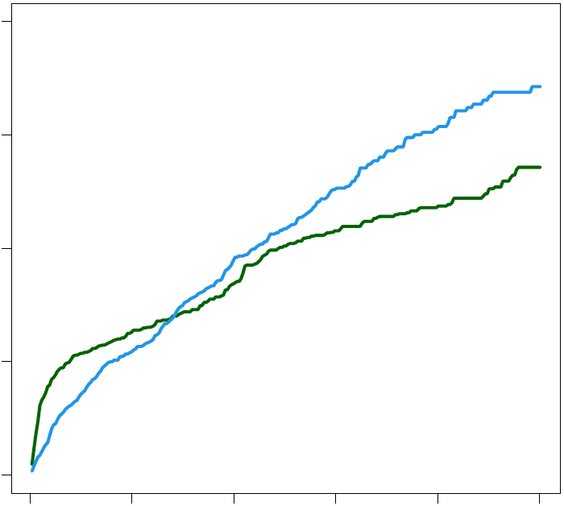
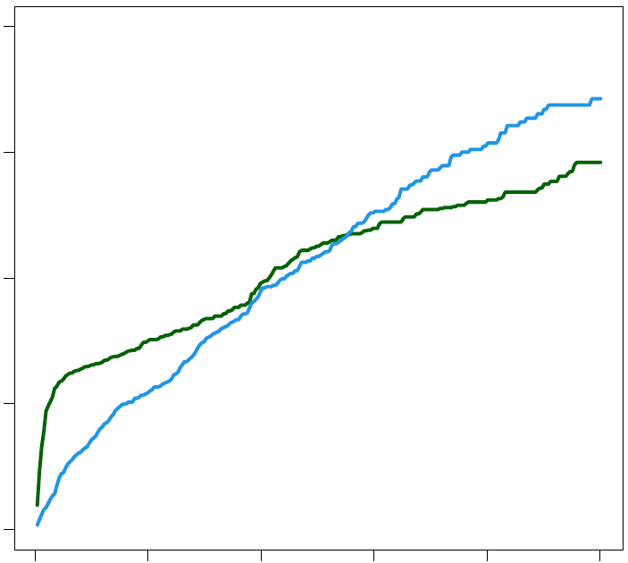
Outcomes for INV-CR versus CON: Primary endpoint
INV IPW-adjusted, marginal structural model using natural splines
Anatomic CR achieved
Functional CR achieved
20
20
6-month difference
INV-ACR vs. CON
1.8% (-0.9% to 4.1%)
6-month difference
INV-FCR vs. CON
3.0% (0.6% to 5.2%)
CON
CON
15.4%
15.4%
15
15
13.1%
INV
FCR
INV
ACR
10
11.9%
Cumulative incidence (%)
Cumulative incidence (%)
10
6.5%
5.4%
5
5
3.6%
4-year difference
INV-ACR vs. CON
-3.5% (-7.4% to 0.1%)
3.6%
4-year difference
INV-FCR vs. CON
-2.3% (-5.4% to 0.8%)
0
0
0
1
2
3
4
5
0
1
2
3
4
5
Years from randomization
Years from randomization

Slide 18
Adjusted 4-Year Outcomes for INV-ACR versus CON
Anatomic CR Assessment - Marginal structural model using natural splines
Endpoint | INV-ACR | CON | Adj Difference (95% CI)
Primary endpoint | 11.9% | 15.4% | -3.5% (-7.4% to 0.1%)
CV death or MI | 10.3% | 13.8% | -3.5% (-7.4% to -0.2%)
- CV death | 3.2% | 5.0% | -1.8% (-4.3% to 0.3%)
- MI | 7.9% | 10.1% | -2.3% (-5.4% to 0.8%)
All-cause death | 6.3% | 6.4% | -0.1% (-4.2% to 3.2%)
Anatomic CR Assessment - Covariate-adjusted Cox model | Anatomic CR Assessment - Covariate-adjusted Cox model
Endpoint | INV-ACR | CON | Adj Difference (95% CI)
Primary endpoint | 11.8% | 15.4% | -3.6% (-6.9% to -0.7%)
CV death or MI | 10.8% | 13.8% | -3.0% (-6.5% to -0.1%)
- CV death | 2.8% | 5.0% | -2.2% (-4.5% to -0.5%)
- MI | 9.1% | 10.1% | -1.0% (-4.2% to 1.7%)
All-cause death | 5.6% | 6.4% | -0.8% (-3.9% to 1.5%)
*
*
*
*

Slide 19
Adjusted 4-Year Outcomes for INV-FCR versus CON
Functional CR Assessment - Marginal structural model using natural splines
Endpoint | INV-FCR | CON | Adj Difference (95% CI)
Primary endpoint | 13.1% | 15.4% | -2.3% (-5.4% to 0.8%)
CV death or MI | 10.9% | 13.8% | -2.9% (-6.1% to 0.2%)
- CV death | 3.4% | 5.0% | -1.6% (-3.6% to 0.3%)
- MI | 8.2% | 10.1% | -1.9% (-4.5% to 0.7%)
All-cause death | 6.3% | 6.4% | -0.1% (-2.7% to 2.3%)
Functional CR Assessment - Covariate-adjusted Cox model | Anatomic CR Assessment - Covariate-adjusted Cox model
Endpoint | INV-FCR | CON | Adj Difference (95% CI)
Primary endpoint | 12.9% | 15.4% | -2.5% (-5.7% to 0.3%)
CV death or MI | 11.2% | 13.8% | -2.6% (-5.7% to 0.1%)
- CV death | 3.4% | 5.0% | -1.6% (-3.7% to 0.0%)
- MI | 9.0% | 10.1% | -1.2% (-4.1% to 1.3%)
All-cause death | 6.3% | 6.4% | -0.0% (-2.6% to 2.0%)
*

Slide 20
Randomized ISCHEMIA 4-Year Outcomes vs. CR Analysis
 | ISCHEMIA Trial* | ISCHEMIA Anatomic CR Substudy Analysis
4-year events | INV vs CON Adj Difference (95% CI) | INV-ACR vs CON (model 1)† Adj Difference (95% CI) | INV-ACR vs CON (model 2)† Adj Difference (95% CI)
Primary endpoint | -2.5% (-4.6% to -0.2%) | -3.5% (-7.4% to 0.1%) | -3.6% (-6.9% to -0.7%)
CV death or MI | -2.4% (-4.4% to -0.1%) | -3.5% (-7.4% to -0.2%) | -3.0% (-6.5% to -0.1%)
- CV death | -0.9% (-2.2% to 0.5%) | -1.8% (-4.3% to 0.3%) | -2.2% (-4.5% to -0.5%)
- MI | -1.3% (-3.2% to 0.6%) | -2.3% (-5.4% to 0.8%) | -1.0% (-4.2% to 1.7%)
All-cause death | 0.0% (-1.6% to 1.7%) | -0.1% (-4.2% to 3.2%) | -0.8% (-3.9% to 1.5%)
*Excluding prior CABG pts from both groups (INV: n=2478, CON: n=2498), adjusted for differences in baseline covariates.
†Model 1 = Marginal structural model; Model 2 = Covariate-adjusted Cox model

Slide 21
Randomized ISCHEMIA 4-Year Outcomes vs. CR Analysis
 | ISCHEMIA Trial* | ISCHEMIA Functional CR Substudy Analysis
4-year events | INV vs CON Adj Difference (95% CI) | INV-FCR vs CON (model 1)† Adj Difference (95% CI) | INV-RCR vs CON (model 2)† Adj Difference (95% CI)
Primary endpoint | -2.5% (-4.6% to -0.2%) | -2.3% (-5.4% to 0.8%) | -2.5% (-5.7% to 0.3%)
CV death or MI | -2.4% (-4.4% to -0.1%) | -2.9% (-6.1% to 0.2%) | -2.6% (-5.7% to 0.1%)
- CV death | -0.9% (-2.2% to 0.5%) | -1.6% (-3.6% to 0.3%) | -1.6% (-3.7% to 0.0%)
- MI | -1.3% (-3.2% to 0.6%) | -1.9% (-4.5% to 0.7%) | -1.2% (-4.1% to 1.3%)
All-cause death | 0.0% (-1.6% to 1.7%) | -0.1% (-2.7% to 2.3%) | -0.0% (-2.6% to 2.0%)
*Excluding prior CABG pts from both groups (INV: n=2478, CON: n=2498), adjusted for differences in baseline covariates.
†Model 1 = Marginal structural model; Model 2 = Covariate-adjusted Cox model

Slide 22
Limitations
The 95% CIs around the point estimates for CR were wide; a larger sample size or higher CR rates would have afforded greater precision
The present findings represent associations and not causality; the ability to achieve CR is not always predictable, and whether striving for CR in all cases of PCI and CABG would safely improve outcomes is unknown; the present results are therefore hypothesis-generating
Given the ISCHEMIA trial entry criteria and baseline characteristics of enrolled pts, the trial results do not apply to:
Highly symptomatic pts
Acute coronary syndromes within 2 months
Left main disease
Heart failure or reduced LVEF

Slide 23
Conclusions and Implications
The present results suggest that among selected pts with CCD and at least moderate ischemia, the outcomes of an INV strategy may be improved if anatomic CR is achieved
The likelihood of safely achieving anatomic CR should therefore be considered when selecting between an INV and CON approach in pts with CCD

Slide 24
Back-up Slides

Slide 25
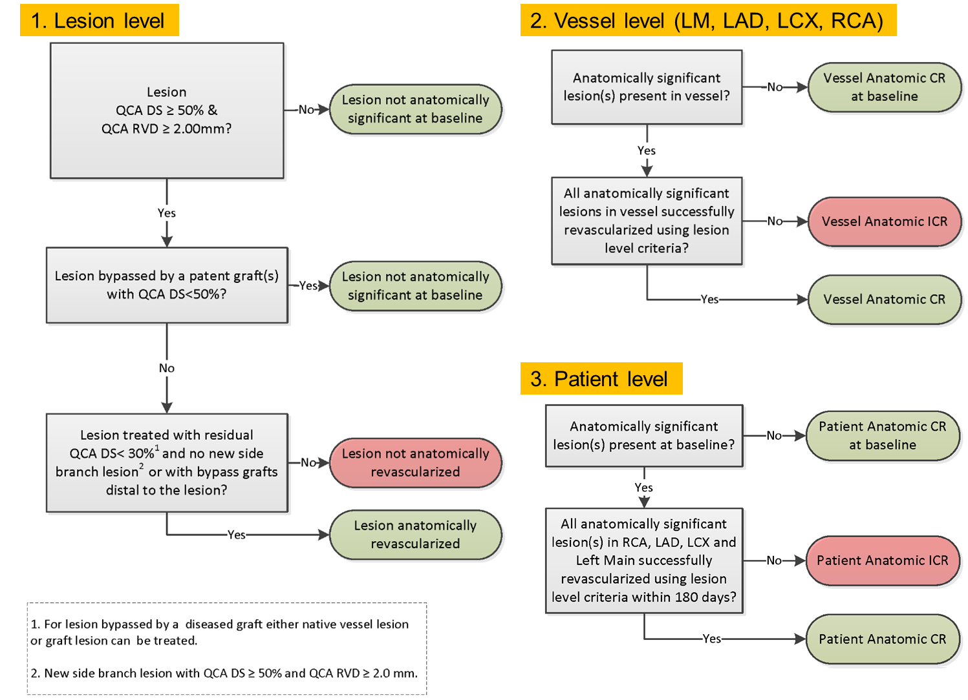
Angiographic Core Laboratory* Assessment of Anatomic Completeness of Revascularization After
PCI and CABG
*Cardiovascular
Research Foundation, NY
Modified from Ali Z et al. J Am Heart Assoc. 2021:e020110. doi: 10.1161/JAHA.120.020110

Slide 26
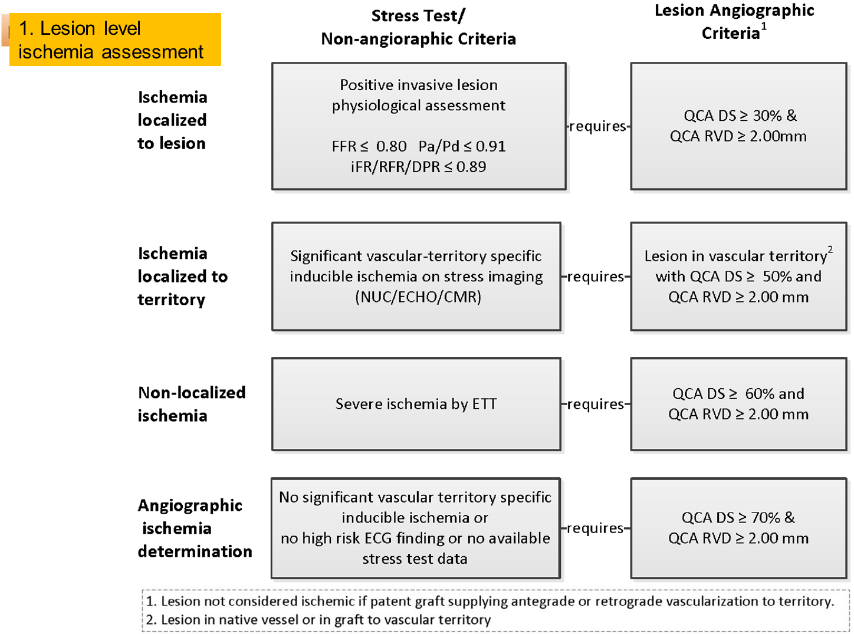
Angiographic Core Laboratory* Assessment of Ischemic/Functional
Completeness of Revascularization After
PCI and CABG
*Cardiovascular
Research Foundation, NY
Modified from Ali Z et al. J Am Heart Assoc. 2021:e020110. doi: 10.1161/JAHA.120.020110

Slide 27
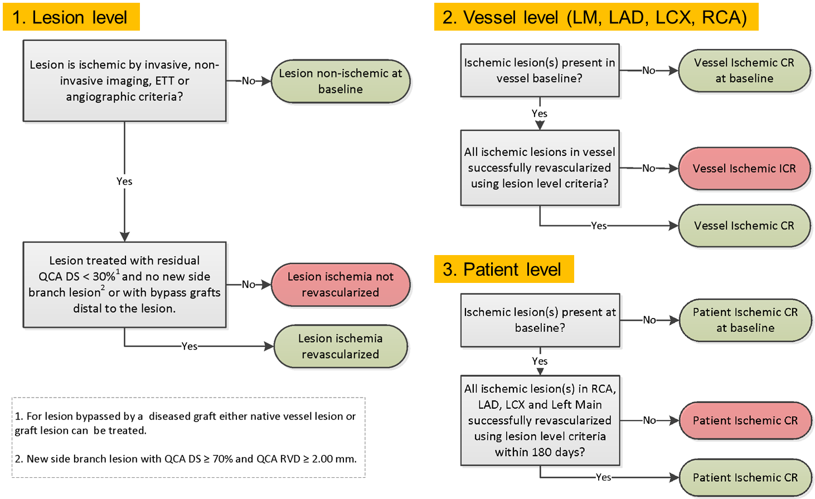
Angiographic Core Laboratory* Assessment of Ischemic/Functional
Completeness of Revascularization After
PCI and CABG
*Cardiovascular
Research Foundation, NY
Modified from Ali Z et al. J Am Heart Assoc. 2021:e020110. doi: 10.1161/JAHA.120.020110

Slide 28
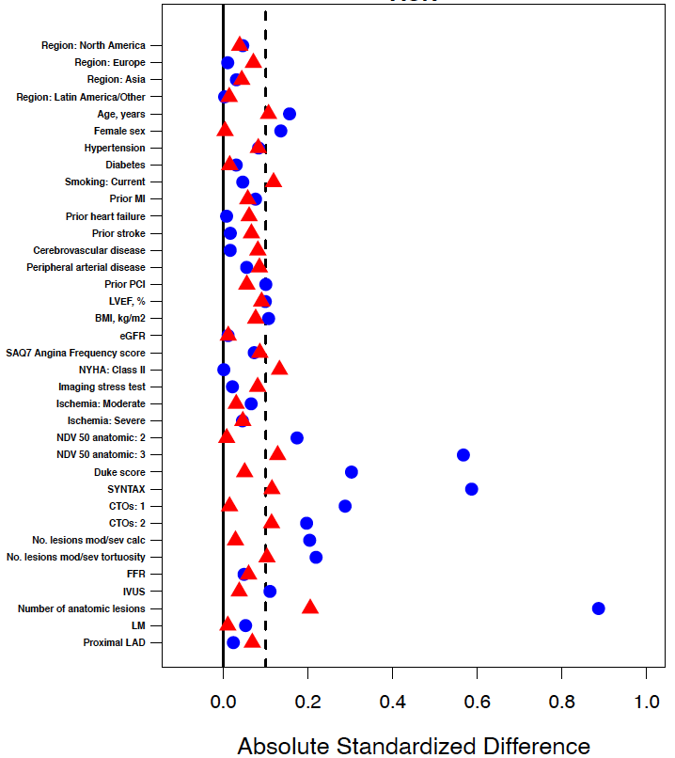
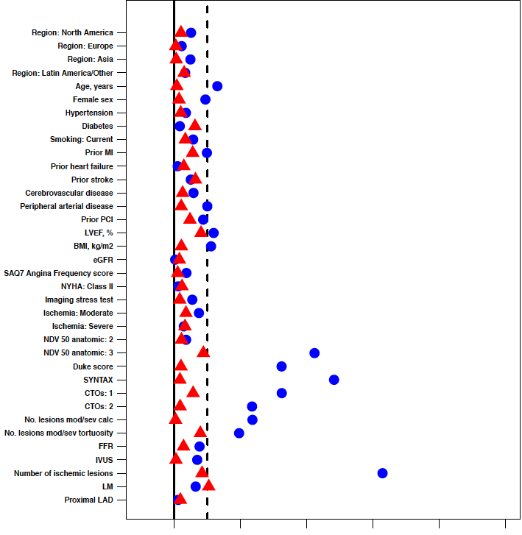
Covariate Balance Before and After Inverse Probability Weighting (INV)
ACR
FCR
Unadjusted
Post IPW
Unadjusted
Post IPW
0.0
0.2
0.4
0.6
0.8
1.0
0.0
0.2
0.4
0.6
0.8
1.0
Absolute standardized difference
Absolute standardized difference

Slide 29
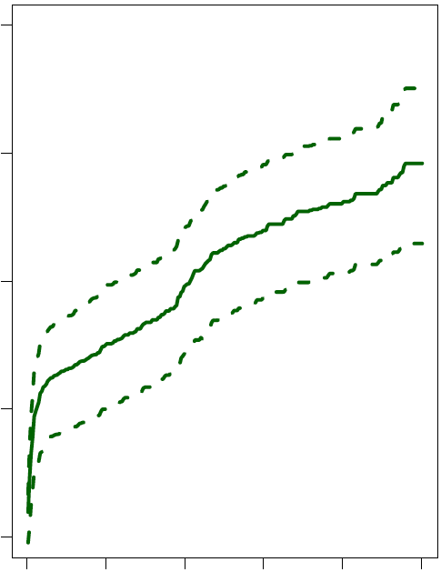
Outcomes for INV-CR versus CON: Primary endpoint
INV IPW-adjusted, marginal structural model using natural splines
INV - ACR achieved
INV - FCR achieved
CON
20
20
20
15
15
15
10
10
10
Cumulative incidence (%)
Cumulative incidence (%)
Cumulative incidence (%)
5
5
5
0
0
0
0
1
2
3
4
5
0
1
2
3
4
5
0
1
2
3
4
5
Years from randomization
Years from randomization
Years from randomization

Slide 30
Summary and Conclusions
In the ISCHEMIA trial, among pts assigned to an INV strategy in whom revascularization was performed, anatomic and functional CR were achieved in 43.3% and 58.3% of pts respectively; CR rates were similar in the entire INV population by ITT (43.6% and 58.5% respectively)
CR was associated with improved 4-year clinical outcomes compared with ICR, although the differences were attenuated after adjustment for baseline covariates
ACR was more strongly associated with improved outcomes than was FCR
After IPW, the 4-year difference in the primary endpoint was 3.5% lower among INV pts achieving ACR compared with pts treated with a CON approach
In contrast, this difference was 2.5% at 4 years among all randomized ISCHEMIA pts*
The improved outcomes in pts achieving ACR was driven by lower rates of CV death and MI; all-cause mortality remained similar between the INV and CON groups even if CR was achieved
*excluding pts with prior CABG

