Slide 1



Angiotensin Receptor Neprilysin Inhibition (ARNI) Following Acute Myocardial Infarction:
Primary Results of the PARADISE-MI Trial
Marc A. Pfeffer, MD, PhD
Distinguished Dzau Professor of Medicine
Harvard Medical School
Cardiovascular Division, Brigham and Women’s Hospital
for the PARADISE-MI Committees, National Leaders and Investigators

Slide 2
Disclosures
Dr. Pfeffer has received research grant support (through Brigham and Women’s Hospital) from Novartis and
Consulting fees from AstraZeneca, Boehringer Ingelheim and Eli Lilly Alliance, Corvidia, DalCor, GlaxoSmithKline, NHLBI CONNECTs (Master Protocol Committee), Novartis, Novo Nordisk, Peerbridge and Sanofi; and has equity in DalCor and Peerbridge.

Slide 3
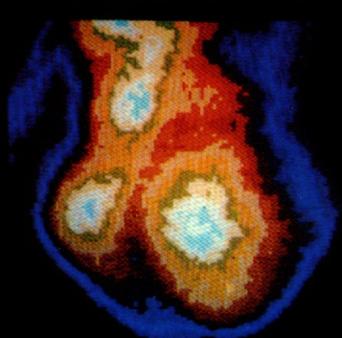
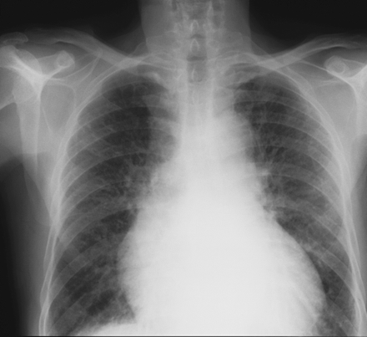
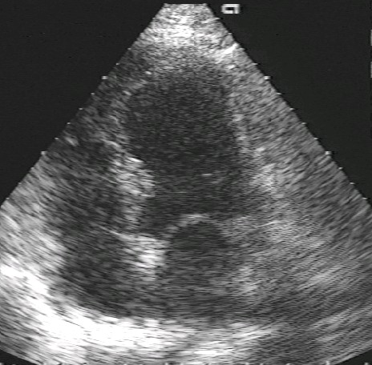
All-Cause Mortality
SAVE
Radionuclide
EF ≤ 40%
(1992)
AIRE
Clinical and/or radiographic signs of HF (1993)
TRACE
Echocardiographic
EF ≤ 35%
(1995)
0.4
0.35
0.3
0.25
Placebo
Probability of Event
ACE-I
0.2
0.15
Placebo: 866/2971 (29.1%)
0.1
ACE-I: 702/2995 (23.4%)
0.05
OR: 0.74 (0.66–0.83)
0
Years
0
1
2
3
4
ACE-I 2995 2250 1617 892 223
Placebo 2971 2184 1521 853 138
Flather MD, et al. Lancet. 2000;355:1575–1581

Slide 4
Mortality in SAVE, TRACE, AIRE, and VALIANT
Favors
Active Drug
Pfeffer, McMurray, Velazquez, et al. N Engl J Med 2003;349
Pfeffer, McMurray, Velazquez, et al. N Engl J Med 2003;349

Slide 5
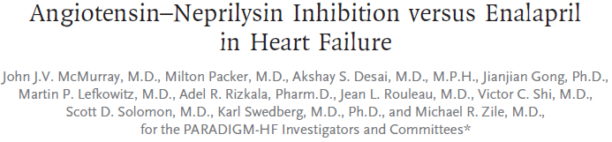

2014
40
Enalapril
(n=4212)
1117
32
914
24
LCZ696
(n=4187)
Kaplan-Meier Estimate of
Cumulative Rates (%)
16
HR = 0.80 (0.73-0.87)
P = 0.0000002
Number needed to treat = 21
8
0
0
180
360
540
720
900
1080
1260
Patients at Risk
Days After Randomization
LCZ696
Enalapril
4187
4212
3922
3883
3663
3579
3018
2922
2257
2123
1544
1488
896
853
249
236
McMurray, N Engl J Med. 2014
Notes:
Paradigm

Slide 6
AMI (0.5-7 days with LVEF ≤40% and/or pulmonary congestion)
PLUS any risk enhancer
Age ≥70 years | Atrial fibrillation
eGFR <60 | LVEF < 30%
Diabetes | Killip class ≥III
Prior MI | STEMI without reperfusion
Major Exclusions:
Prior HF Clinical instability eGFR <30
Sacubitril/Valsartan
Target 97/103 mg BID
N=2830
Ramipril
Target 5 mg BID
N=2831
No run-in
double-blind active-controlled
Event driven: 711 primary endpoints
Median follow-up: 23 months
Primary Endpoint: CV death, HF hospitalization, outpatient development of HF
Secondary Endpoint: CV death or first HF hospitalization
ACC.21
Jering, Eur J Heart Fail. 2021

Slide 7
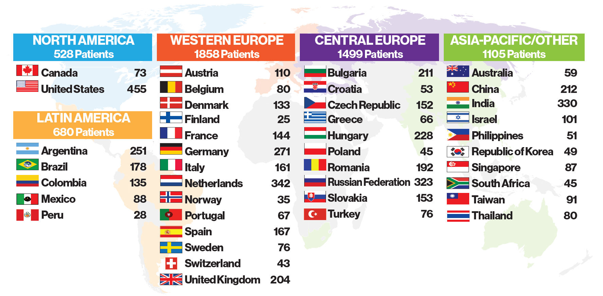
5,669 patients from 495 Sites in 41 Countries
(December 9, 2016 – March 16, 2020; last follow-up on December 31, 2020)
ACC.21

Slide 8
5,669 Randomized Patients
Ineligible and no drug
N = 4
Ineligible and no drug
N = 4
Validly Randomized Patients
N = 5,661
Sacubitril/valsartan
97/103 mg bid
N = 2830
Ramipril
5 mg bid
N = 2831
Vital status unknown
n = 4
Vital status unknown
n = 9
Median duration of follow-up
23 months
Median duration of follow-up
23 months
Average dose (at 4 months)
139.2 (74.9) mg bid
Average dose (at 4 months)
3.8 (1.8) mg bid
ACC.21

Slide 9
Baseline Characteristics
Characteristic | Sacubitril/Valsartan N = 2830 | Ramipril N = 2831
Age (years), mean (SD) | 64 (12) | 64 (11)
Female sex (%) | 23 | 25
Race – Asian/Black/Caucasian (%) | 17 / 1 / 75 | 17 / 1 / 76
Prior heart failure | excluded | excluded
Prior MI (%) | 16 | 16
Prior stroke (%) | 4 | 5
Hypertension (%) | 65 | 65
Diabetes (%) | 43 | 42
Smoking (%) | 22 | 21
Atrial fibrillation / flutter (%) | 14 | 13
eGFR (ml/min/1.73m²), mean (SD) | 72 (22) | 72 (23)
ACC.21

Slide 10
Index MI | Sacubitril/Valsartan N = 2830 | Ramipril N = 2831
STEMI / NSTEMI (%) | 76 / 24 | 76 / 24
Reperfusion (PCI / lytics) (%) | 89 (88 / 4) | 89 (88 / 5)
Location – Anterior / inferior (%) | 68 / 19 | 68 /18
Time to randomization (days), mean (SD) | 4.3 (1.8) | 4.3 (1.7)
LVEF (%), mean (SD) | 36 (9) | 37 (10)
Killip class ≥II (%) | 56 | 57
Medications at baseline:
Dual antiplatelet therapy (%) | 92 | 92
Beta blocker (%) | 85 | 85
Aldosterone antagonist (%) | 41 | 42
Statin (%) | 94 | 95
ACEi/ARB (%) | 78 | 78
ACC.21

Slide 11
PARADISE-MI Primary Outcome
CV death, first HF hospitalization or outpatient HF
Ramipril
373 events, 7.4 per 100 pt-years
Patients at risk, n
Ramipril
ACC.21

Slide 12
PARADISE-MI Primary Outcome
CV death, first HF hospitalization or outpatient HF
Ramipril
373 events, 7.4 per 100 pt-years
Sacubitril/valsartan
338 events, 6.7 per 100 pt-years
Patients at risk, n
Ramipril
Sacubitril/valsartan
ACC.21

Slide 13
PARADISE-MI Primary Outcome
CV death, first HF hospitalization or outpatient HF
Ramipril
373 events, 7.4 per 100 pt-years
Sacubitril/valsartan
338 events, 6.7 per 100 pt-years
HR 0.90 (95% CI, 0.78-1.04)
p = 0.17
Patients at risk, n
Ramipril
Sacubitril/valsartan
ACC.21

Slide 14
CEC Adjudicated Primary Outcome | Events (%) and Event Rate [per 100 pt-yrs] |  | Hazard Ratio (95% CI) p-value
 | Sacubitril/valsartan (N = 2830) | Ramipril (N = 2831)
Primary Outcome Event rate | 338 (11.9%) [6.7] | 373 (13.2%) [7.4] | 0.90 (0.78-1.04) P=0.17
Patients with:
CV Death | 168 (5.9%) [3.1] | 191 (6.7%) [3.6] | 0.87 (0.71-1.08) P=0.20
HF Hospitalization | 170 (6.0%) [3.3] | 195 (6.9%) [3.8] | 0.87 (0.70-1.06) P=0.17
Outpatient HF* | 39 (1.4%) [0.7] | 57 (2.0%) [1.1] | 0.68 (0.45-1.03) P=0.07
*outpatient development of HF with documented signs and symptoms requiring initiation/intensification of diuretic therapy maintained over ≥28 days
ACC.21

Slide 15
Pre-Specified Subgroups for Primary Endpoint
ACC.21

Slide 16
Secondary Endpoints | Events (%) and Event Rate [per 100 pt-yrs] |  | Hazard Ratio (95% CI) p-value
 | Sacubitril/valsartan (N = 2830) | Ramipril (N = 2831)
CV Death or HF hospitalization Event rate | 308 (10.9%) [6.0] | 335 (11.8%) [6.6] | 0.91 (0.78-1.07) P=0.25
HF hospitalization or outpatient heart failure | 201 (7.1%) [4.0] | 237 (8.4%) [4.7] | 0.84 (0.70-1.02) P=0.07
CV death, non-fatal MI or non- fatal stroke | 315 (11.1%) [6.1] | 349 (12.3%) [6.8] | 0.90 (0.77-1.05) P=0.18
CV death and total hospitalizations for heart failure, MI or stroke | 591 [11.0] | 682 [12.8] | 0.84* (0.70-1.00) P=0.045
All-cause death | 213 (7.5%) [4.0] | 242 (8.5%) [4.5] | 0.88 (0.73-1.05) P=0.16
ACC.21
*Rate ratio derived from negative binomial regression with Weibull baseline intensity function

Slide 17
Total (first and recurrent) CEC Adjudicated Events
Total (first and recurrent) CEC Adjudicated Events | Events and Event Rate [per 100 pt-yrs] |  | Ratio (95% CI) p-value
 | Sacubitril/valsartan (N = 2830) | Ramipril (N = 2831)
Total HF hospitalizations, outpatient HF events and CV death | 452 [8.4] | 539 [10.1] | RR* 0.79 (0.65-0.97) P=0.02
Components
CV Death | 168 [3.1] | 191 [3.6] | HR 0.87 (0.71-1.08) P=0.20
Total HF Hospitalizations | 240 [4.5] | 286 [5.4] | RR* 0.81 (0.64-1.04) P=0.10
Total Outpatient HF Events | 44 [0.8] | 62 [1.2] | RR* 0.70 (0.46-1.06) P=0.10
ACC.21
*Rate ratio derived from negative binomial regression with Weibull baseline intensity function

Slide 18
Investigator Reported Outcomes
Investigator Reported Primary Outcome | Events (%) and Event Rate [per 100 pt-yrs] |  | Hazard Ratio (95% CI) p-value
 | Sacubitril/valsartan (N = 2830) | Ramipril (N = 2831)
Primary Outcome Event rate | 443 (15.7%) [9.1] | 516 (18.2%) [10.8] | 0.85 (0.75-0.96) P=0.01
Patients with:
CV Death | 155 (5.5%) [2.9] | 179 (6.3%) [3.4] | 0.86 (0.69-1.07) P=0.17
HF Hospitalization | 252 (8.9%) [5.0] | 285 (10.1%) [5.8] | 0.88 (0.74-1.04) P=0.12
Outpatient HF | 111 (3.9%) [2.1] | 160 (5.7%) [3.1] | 0.69 (0.54-0.88) P=0.003
ACC.21

Slide 19
Total (first and recurrent)
CEC Adjudicated Primary Events
Investigator Reported
Primary Endpoint
30
0.30
25
0.25
Ramipril
539 events, 10.1 per 100 pt-years
Ramipril
516 events, 10.8 per 100 pt-years
20
0.20
Mean Cumulative Events per 100 Patients
Cumulative Incidence
15
0.15
Sacubitril/valsartan
452 events, 8.4 per 100 pt-years
Sacubitril/valsartan
443 events, 9.1 per 100 pt-years
10
0.10
5
RR* 0.79 (95% CI, 0.65-0.97)
p = 0.02
0.05
HR 0.85 (95% CI, 0.75-0.96)
p = 0.01
0
0.00
0
0.5
1
1.5
2
2.5
3
0
0.5
1
1.5
2
2.5
3
Years since Randomization
Years since Randomization
*Rate ratio derived from negative binomial regression with Weibull baseline intensity function
ACC.21

Slide 20
PARADISE-MI All Deaths
Ramipril
242 events, 4.5 per 100 pt-years
Sacubitril/valsartan
213 events, 4.0 per 100 pt-years
HR 0.88 (95% CI, 0.73-1.05)
p = 0.16
Patients at risk, n
Ramipril
Sacubitril/valsartan
ACC.21

Slide 21
Adverse Events
Reports (%) | Sacubitril/Valsartan N = 2830 | Ramipril N = 2831
Angioedema (adjudicated) | 14 (0.5%) | 17 (0.6%)
SAE | 1146 (40.5%) | 1126 (39.8%)
AE | 2352 (83.1%) | 2325 (82.1%)
Hypotension | 802 (28.4%)* | 620 (22.0%)
Cough | 255 (9.0%)* | 371 (13.1%)
Renal impairment | 329 (11.7%) | 326 (11.6%)
Hyperkalemia | 301 (10.7%) | 285 (10.1%)
Liver abnormalities | 132 (4.7%)* | 167 (5.9%)
ACC.21
*p<0.05

Slide 22
Laboratory Abnormalities
Patients having (%) | Sacubitril/Valsartan N = 2830 | Ramipril N = 2831
Serum creatinine ≥2.0mg/dl | 162 (5.9%) | 171 (6.3%)
≥2.5 mg/dl | 67 (2.4%) | 65 (2.4%)
≥3.0 mg/dl | 23 (0.8%) | 34 (1.2%)
Potassium >5.5 mmol/l | 403 (14.7%) | 361 (13.2%)
>6.0 mmol/l | 92 (3.4%) | 95 (3.5%)
AST >3x ULN | 23 (0.9%) | 27 (1.0%)
>5x ULN | 8 (0.3%) | 13 (0.5%)
ALT >3x ULN | 32 (1.2%) | 38 (1.4%)
>5x ULN | 11 (0.4%) | 12 (0.5%)
ACC.21

Slide 23
Permanent Study Drug Discontinuation (excluding deaths)
Discontinuation (%) | Sacubitril/Valsartan N = 2830 | Ramipril N = 2831
Discontinuation (excluding death) | 501 (17.8%) | 517 (18.4%)
Discontinuation due to AE | 356 (12.6%) | 379 (13.4%)
Cough | 35 (1.2%)* | 65 (2.3%)
Hypotension | 37 (1.3%)* | 16 (0.6%)
Renal impairment | 19 (0.7%) | 18 (0.6%)
Hyperkalemia | 12 (0.4%) | 14 (0.5%)
ACC.21
*p<0.005

Slide 24
Summary
In a vigorously managed enhanced risk AMI population compared to active therapy with ramipril:
Sacubitril/valsartan did not result in a significantly lower rate of CV death, heart failure hospitalization or outpatient heart failure requiring treatment.
Pre-specified observations of reductions in both the investigator reports of the primary composite as well as in the total (recurrent) adjudicated events support incremental clinical benefits of sacubitril/valsartan.
The safety and tolerability of sacubitril/valsartan in this AMI population was comparable to that of the ACEi.
ACC.21

Slide 25
Deaths in
SAVE, AIRE, TRACE (1990s),
VALIANT (2003) and
PARADISE-MI (2021)
35
Placebo
30
25
ACE Inhibitor
Valsartan
20
Mortality (%)
15
Ramipril
10
Sacubitril/valsartan
HR 0.88 (95% CI, 0.73-1.05)
p = 0.16
5
0
0
6
12
18
24
30
36
ACC.21
Months

Slide 26
Thank you, gracias, merci, grazie, danke, děkuju, obrigada, 谢谢你, tack, ขอขอบคุณ, takk skal du ha, Спасибо, köszönöm teşekkür ederim, תודה σας, ευχαριστώ, Благодаря ти, 감사합니다, hvala vam, जी शुक्रिया, dank u, Salamat
to all study participants
Steering Committee
Marc Pfeffer (Chair), Eugene Braunwald, Christopher B. Granger, Lars Kober, Douglas Mann, Aldo P. Maggioni, John J.V. McMurray, Jean L. Rouleau, Scott D. Solomon, Philippe Gabriel Steg
Clinical Events Committee
Eldrin Lewis (Chair), Ebrahim Barkoudah, Simon Correa-Gaviria, Abdel Brahimi, Jon Cunningham, Peter Finn, Howard Hartley, Karola Jering, Finnian R. Mc Causland, Martina M. McGrath, Muthiah Vaduganathan, Chau Duong, Renee Mercier, Anthonette Roach, Barbara Saunders-Correa, Amanda Wivagg, David Charytan, Jacob Joseph
Angioedema Committee
Allen Kaplan (Chair), Nancy Brown, Bruce Zuraw
National Lead Investigators
Alberto Fernandez , Argentina Carmine De Pasquale, Australia Dirk von Lewinski , Austria
Marc Claeys, Belgium Otavio Berwanger, Brazil Ivo Petrov, Bulgaria
Jean-Francois Tanguay, Canada Yaling Han, China Alberto Jose Cadena Bonfanti, Colombia
Maja Cikes, Croatia Petr Widimský, Czech Republic Morten Schou, Denmark
Saila Vikman, Finland Gabriel Steg, France Ulf Landmesser, Germany
Gerasimos Filippatos, Greece Bela Merkely, Hungary Prafulla Kerkar, India
Offer Amir, Israel Michele Senni, Italy Jorge Carrillo-Calvillo, Mexico
Peter van der Meer, Netherlands Lars Gullestad, Norway Alberto Jose Cadena Bonfanti, Peru
John Anonuevo, Philippines Grzegorz Opolski, Poland Myeong-Chan Cho, Republic of Korea
João Morais, Portugal Dragos Vinereanu , Romania Olga Barbarash, Russian Federation
David Sim Kheng Leng, Singapore Martin Studencan, Slovakia Mpiko Ntsekhe, South Africa
Julio Nuñez Villota Spain Christina Christersson, Sweden Tiziano Moccetti, Switzerland
Hsien-Li Kao, Taiwan Songsak Kiatchoosakun, Thailand Mehmet Birhan Yilmaz, Turkey
Mark Petrie, United Kingdom Azfar Zaman, United Kingdom Cara East, United States
Roxana Mehran, United States Freny Mody, United States
Data Safety Monitoring Committee
Henry Dargie (Chair), Robert Foley, Gary Francis, Michele Komajda, Stuart Pocock
Independent Statistician
Brian Claggett
Novartis
Yinong Zhou, Katherine Carter, Margaret Wernsing, Denise Ott, Jim Gong, Yi Wang, Abhijeet Kulkarni, Siva Ponugumati, Ghionul Ibram, Raghava Ramesh Narayana, Marty Lefkowitz, Sven Godtfredsen
ACC.21
Notes:
Heart: slower

