Slide 1

Impact Of Completeness Of Revascularization On
Quality-of-life In Patients With Stable Ischemic Heart Disease:
Insights From The ISCHEMIA Trial
Kreton Mavromatis, MD
  On Behalf of the ISCHEMIA Investigators

Slide 2
Disclosures
None

Slide 3



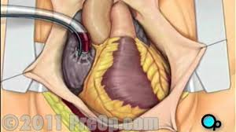




Design of the ISCHEMIA Trial
PCI
CABG
> Moderate-Risk Stress Test
or
+
Angina-related
QoL

Slide 4
Key Clinical Question
Does the Completeness of Revascularization
(Anatomic or Functional) Influence Outcomes?
PCI
CABG
> Moderate-Risk Stress Test
or
+
Angina-related
QoL

Slide 5
Angiographic Core Laboratory* Assessment of Anatomic and Functional Completeness of Revascularization After PCI and CABG
  PCI: CR assessed by review of pre- and post-procedure angiograms (includes planned staged procedures)
  CABG: CR assessed by review of pre-procedure angiograms and CABG procedure reports; accounts for diseased vessel segments and side branches
  Anatomic CR: Revasc of all lesions with QCA RVD ≥2.0 mm and QCA DS ≥50%
  Functional CR: Revasc of all lesions with QCA RVD ≥2.0 mm and:
    Localizing FFR/iFR ≤0.80/0.89 plus QCA DS ≥30%
    Localizing non-invasive ischemia in the vessel distribution plus QCA DS ≥50%
    Non-localizing severe ischemia by ETT plus QCA DS ≥60%
    QCA DS ≥70%
*Cardiovascular Research Foundation, NY
Modified from Ali Z et al. J Am Heart Assoc. 2021:e020110. doi: 10.1161/JAHA.120.020110

Slide 6
Key Outcome Measures
Seattle Angina Questionnaire – 7
  Angina Frequency
  Quality of Life
  Physical Limitations
SAQ Summary Score
Rose Dyspnea Score (RDS)
Primary Outcome
Adjusted SAQ Summary Score at 1 year

Slide 7
Objectives
Objective 1: Compare complete (CR) vs. incomplete revascularization (ICR) among invasively managed, revascularized patients
  Proportional odds model used to adjust for 24 clinical and angiographic variables
  Results expressed as odds ratio of better QOL for CR vs. ICR
Objective 2: Compare the expected outcomes of CR vs. conservative management in the overall ISCHEMIA population
  Propensity weighting used to rebalance patient characteristics for CR to mirror the overall population
  Results expressed as expected difference in mean QOL scores.

Slide 8
Objectives (cont)
Analyses were performed for all patients and patients stratified by:
  Baseline angina frequency
  Baseline ischemia
  Presence of CTOs

Slide 9
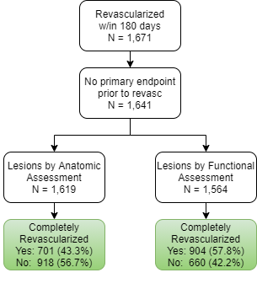
Objective 1: CR vs ICR in Invasively Managed Patients
Randomized to INV
Brief QoL
Angiographic core lab
No Prior CABG
Revasc. within 180 days
No event before revasc
N=1641
Patient Flow

Slide 10
CR vs ICR in Invasively Managed Patients
Select Baseline Clinical Characteristics
 | Anatomic CR |  | P-Value | Functional CR |  | P-Value
 | CR n = 701 | ICR n = 918 |  | CR n = 904 | ICR n = 660
Age | 63.4 ± 9.7 | 64.1 ± 9.2 | 0.147 | 63.6 ± 9.5 | 64.1 ± 9.3 | 0.403
Female | 181 (25.8%) | 174 (19.0%) | < 0.001 | 208 (23.0%) | 125 (18.9%) | 0.052
Hypertension | 509 (72.9%) | 721 (78.7%) | 0.006 | 671 (74.5%) | 523 (79.5%) | 0.021
Diabetes | 295 (42.1%) | 367 (40.0%) | 0.393 | 370 (40.9%) | 264 (40.0%) | 0.711
Prior MI | 125 (17.9%) | 197 (21.5%) | 0.074 | 161 (17.8%) | 146 (22.2%) | 0.034
Peripheral vascular disease | 31 (4.4%) | 46 (5.0%) | 0.582 | 34 (3.8%) | 42 (6.4%) | 0.017
Ejection fraction | 61.0 ± 8.0 | 60.0 ± 8.1 | 0.005 | 60.9 ± 8.0 | 59.7 ± 8.0 | 0.001
Body mass index | 28.3 ± 4.8 | 29.0 ± 4.8 | 0.003 | 28.3 ± 4.6 | 29.2 ± 5.0 | 0.001
SAQ-7 Summary Score | 72.1 ± 18.8 | 73.3 ± 19.0 | 0.158 | 72.6 ± 19.0 | 73.2 ± 18.7 | 0.624
SAQ-7 Angina Frequency Score | 79.5 ± 19.7 | 79.8 ± 20.8 | 0.334 | 79.9 ± 20.2 | 79.5 ± 20.4 | 0.838
Rose Dyspnea Scale | 1.2 ± 1.3 | 1.2 ± 1.3 | 0.293 | 1.2 ± 1.3 | 1.2 ± 1.3 | 0.327
No difference in completeness of revascularization by baseline symptoms or QoL

Slide 11
More Complex Anatomy Associated with ICR
Select Baseline Anatomy and Revascularization Strategy
 | Anatomic CR |  | P-Value | Funtional CR |  | P-Value
 | CR n = 701 | ICR n = 918 |  | CR n = 904 | ICR n = 660
# of vessels > 70% (CCTA) 0 1 2 3 | 48 (8.7%) 171 (31.1%) 82 (14.9%) 39 (7.1%) | 25 (3.6%) 178 (25.5%) 144 (20.7%) 114 (16.4%) | < 0.001 | 48 (6.8%) 220 (31.1%) 111 (15.7%) 61 (8.6%) | 16 (3.2%) 122 (24.1%) 110 (21.7%) 92 (18.2%) | < 0.001
SYNTAX score <23 23 to <33 >= 33 | 577 (82.3%) 99 (14.1%) 25 (3.6%) | 499 (54.4%) 250 (27.2%) 169 (18.4%) | < 0.001 | 697 (77.1%) 159 (17.6%) 48 (5.3%) | 329 (49.8%) 186 (28.2%) 145 (22.0%) | < 0.001
Number of CTOs 0 1 2 >3 | 475 (67.9%) 194 (27.7%) 30 (4.3%) 1 (0.1%) | 411 (44.8%) 401 (43.7%) 87 (9.5%) 18 (2.1%) | < 0.001 | 587 (65.0%) 275 (30.5%) 39 (4.3%) 2 (0.2%) | 249 (37.7%) 315 (47.7%) 78 (11.8%) 17 (2.8%) | < 0.001
First revascularization PCI CABG | 551 (78.6%) 150 (21.4%) | 651 (70.9%) 267 (29.1%) | < 0.001 | 697 (77.1%) 207 (22.9%) | 455 (68.9%) 205 (31.1%) | < 0.001

Slide 12
Adjusted QoL Outcomes Favor CR,
Particularly with Functional CR
Adjusted Outcomes at 1 year
Favors ICR
Favors CR
Favors ICR
Favors CR

Slide 13
CR improves health status more than ICR for patients with daily/weekly angina
Covariate adjusted odds ratios for better health status-CR vs ICR at 1 year
 | Baseline Daily/Weekly Angina | Baseline Monthly Angina | Baseline No Angina | Interaction P-value
Anatomic CR vs ICR SAQ-7 Summary Score SAQ-7 Angina Frequency Score | 1.62 (1.07, 2.44) 2.20 (1.28, 3.77) | 0.89 (0.66, 1.19) 1.03 (0.70, 1.52) | 1.13 (0.78, 1.63) 1.44 (0.80, 2.61) | 0.04 0.04
Functional CR vs ICR SAQ-7 Summary Score SAQ-7 Angina Frequency Score | 1.55 (1.03, 2.34) 2.01 (1.22, 3.31) | 1.18 (0.88, 1.59) 1.13 (0.76, 1.69) | 1.14 (0.80, 1.63) 1.19 (0.67, 2.10) | 0.44 0.14
No association of CR benefit with ischemia burden or number of CTOs

Slide 14
Objective 2: Invasive-CR vs Conservative
Patient Flow
Randomized N=5179
Brief QoL Data N=4617
No Prior CABG N=4421
Randomized to CON
N=2232
Randomized to INV
N=2189
Core Lab
N=2059
No Core Lab
N=130
+ Sig. Lesions
Anat: N = 1853
Func: N = 1755
No Sig. Lesions
Anat: N = 206
Func: N = 304
CR.
Anat: N = 704
Func: N = 912
ICR
Anat: N = 943
Func: N = 681
No Revasc
Anat: N = 206
Func: N = 162
Notes:
.

Slide 15
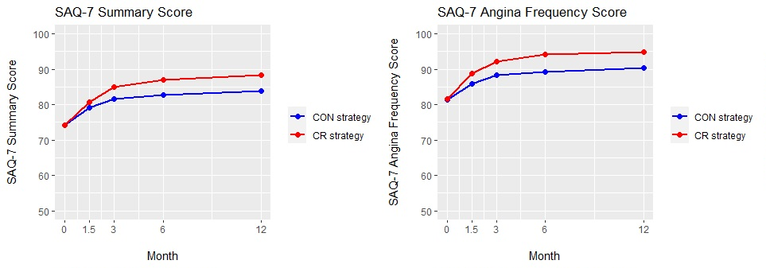
Objective 2: INV-FCR vs CON
Propensity weighted SAQ scores
CON
CON
INV-FCR
INV-FCR

Slide 16
INV-CR vs CON vs. Randomized ISCHEMIA
Adjusted mean difference in QoL scores at 1 year
ISCHEMIA CR Substudy Analysis
ISCHEMIA Trial*
 | INV-ACR vs. CON | INV-FCR vs. CON | INV vs. CON
SAQ-7 Summary Score | 4.3 (3.2, 5.6) | 4.3 (3.1, 5.5) | 3.7 (2.9, 4.6)
SAQ-7 Angina Frequency Score | 4.3 (3.3, 5.2) | 4.7 (3.6, 5.6) | 3.7 (2.8, 4.6)
SAQ-7 Quality of Life Score | 5.6 (3.8, 7.6) | 5.9 (3.7, 7.8) | 4.6 (3.3, 6.0)
SAQ-7 Physical Limitation Score | 3.0 (1.4, 4.7) | 3.3 (1.8, 4.8) | 2.6 (1.5, 3.8)
Rose Dyspnea Scale | -0.2 (-0.3, -0.1) | -0.2 (-0.3, -0.1) | -0.1 (-0.2, -0.1)
*Excluded: Pts with prior CABG
Notes:
The adjusted mean differences in all the QoL scores favored the INV-CR as compared to the conservatively managed patients.
Further, the differences seen between the CR pts and the CON cohort were consistently greater than the differences seen between the overall INV and CON cohorts from the main trial.

Slide 17
Freedom from Angina Highest in INV-CR

Slide 18
Benefits differ by Baseline Angina, but Not by Ischemia
 | Daily/Weekly Angina | Monthly Angina | No Angina | Interaction P-value
INV-FCR vs CON SAQ-7 Summary Score SAQ-7 Angina Frequency Score Freedom from angina (OR) | 7.0 (4.3, 9.9) 7.7 (4.8, 10.8) 2.31 (1.55, 3.44) | 5.4 (3.5, 7.1) 4.9 (3.5, 6.3) 2.35 (1.65, 3.14) | 1.8 (0.3, 3.4) 1.9 (0.9, 3.0) 1.62 (1.15, 2.26) | <0.001 <0.001 <0.001
Baseline
Angina
 | No-Mild Ischemia | Moderate Ischemia | Severe Ischemia | Interaction P-value
INV-FCR vs CON SAQ-7 Summary Score SAQ-7 Angina Frequency Score Freedom from angina (OR) | 3.9 (1.2, 6.6) 2.8 (-0.0, 5.5) 1.69 (1.13, 2.59) | 4.9 (3.1, 6.9) 4.8 (3.1, 6.6) 2.17 (1.58, 2.92) | 4.4 (2.4, 6.0) 4.7 (3.5, 5.9) 2.36 (1.69, 3.14) | 0.83 0.43 0.41
Baseline
Ischemia

Slide 19
Limitations
Observational comparison, so association cannot be equated with causality
  Methods to match/adjust used 24 prospectively-collected, clinical and angiographic factors
  However, we acknowledge likely residual confounding
No sham group—cannot exclude placebo effect--however, benefit in QoL comparable to the sham-controlled ORBITA Trial

Slide 20
Conclusions (1)
CR is associated with a greater improvement in angina-related quality of life than ICR, particularly in patients with baseline weekly/daily angina
Functional CR is at least as effective as anatomic CR in improving angina-related quality of life

Slide 21
Conclusions (2)
Invasive management achieving CR improves angina-related quality of life more than conservative management, with greater benefits in the patients with more angina.
Stress-induced ischemia burden on non-invasive testing and presence of CTOs do not identify patients who benefit more or less from CR.

Slide 22
Clinical Implications
These results suggest that, for patients with chronic coronary disease and angina who are being managed invasively, the safe achievement of CR will optimize quality of life.

Slide 23
Thank you…..
John Spertus, Gregg Stone
Quality of Life Core Lab: Philip Jones
ISCHEMIA Trial Chair & Co-Chair: Judith Hochman, David Maron
ISCHEMIA Quantitative Coronary Angiography Core Lab: Ziad Ali, Jennifer Horst
ISCHEMIA Analytic Center: Sean O’Brien, Ovidiu Dressler, Grace Rhodes

