Slide 1
Delayed-Enhancement MRI (DE-MRI) Determinant of Successful Radiofrequency Catheter Ablation of Atrial Fibrillation (DECAAF II)
Nassir F. Marrouche, MD, Oussama Wazni, MD, Tom Greene, PhD, J Michael Dean, MD, Eugene Kholmovski, PhD, Moussa Mansour, MD, Hugh Calkins, MD, Francis Marchlinski, MD, David Wilber, MD, Gerhard Hindricks, MD, Christian Mahnkopf, MD, Pierre Jais, MD, Prashanthan Sanders, MD, Johannes Brachmann, MD, Jereon Bax, MD, Lilas Dagher, MD, Nazem Akoum, MD;
On Behalf of The DECAAF II Investigators

Slide 2


Slide 3
DECAAF II: Background
Persistent AF
Multiple approaches:
PVI
CFAE
Additional linear lesions
Fibrosis homogenization
Ablation of ganglionated plexi
Low voltage mapping
Rotor modulation
Success Rate
1st Procedure
25-50%
Multiple Procedures
～60%

Slide 4
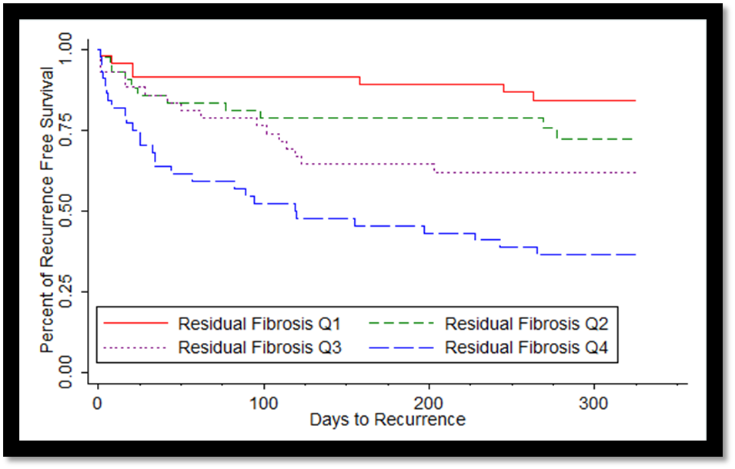
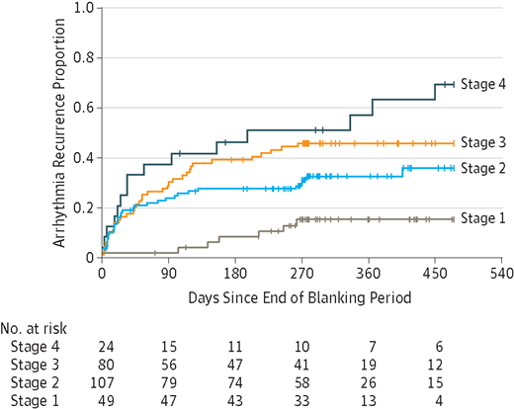
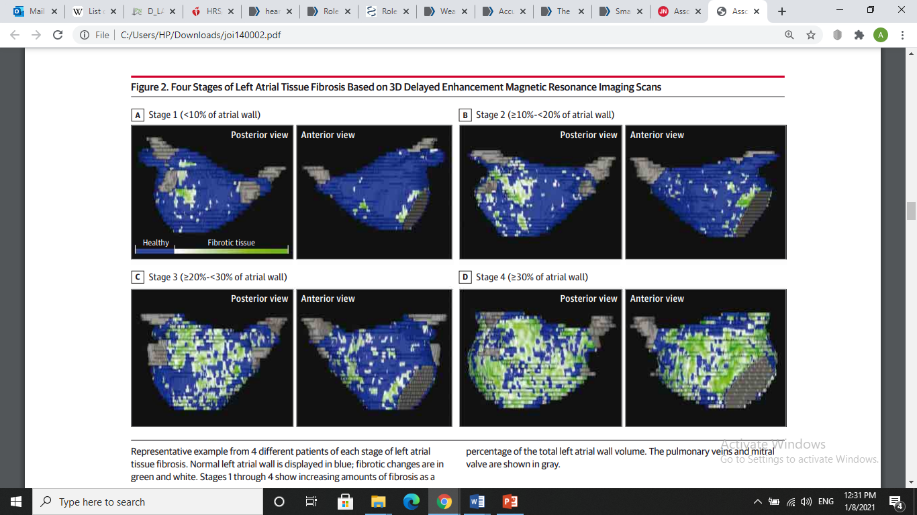
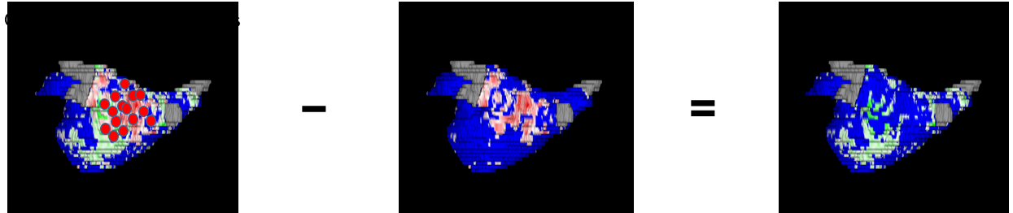
DECAAF II: Background
Higher Degree of Atrial Fibrosis Predicts Ablation Procedure Outcome
Higher Degree of Atrial Fibrosis Covered by Ablation Scar Improves Ablation Procedure Outcome
Marrouche et al. DECAAF JAMA. 2014
Akoum et al. JCE. 2015

Slide 5
DECAAF II: Hypothesis And Objectives
Hypothesis:
  Targeting atrial fibrosis detected on MRI is superior to PVI alone in decreasing Atrial Arrhythmia recurrence in persistent AF.
Objectives:
  Evaluate the efficacy and safety of targeting atrial fibrosis detected on MRI in suppressing atrial arrhythmia in persistent AF
  Assess ablation lesion formation and its impact on AA recurrence

Slide 6
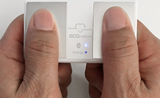
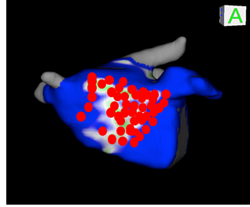
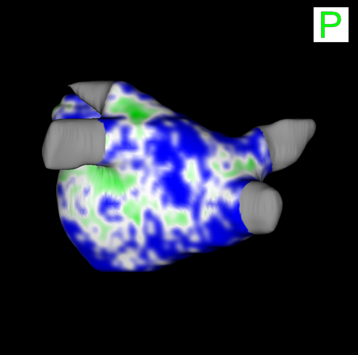
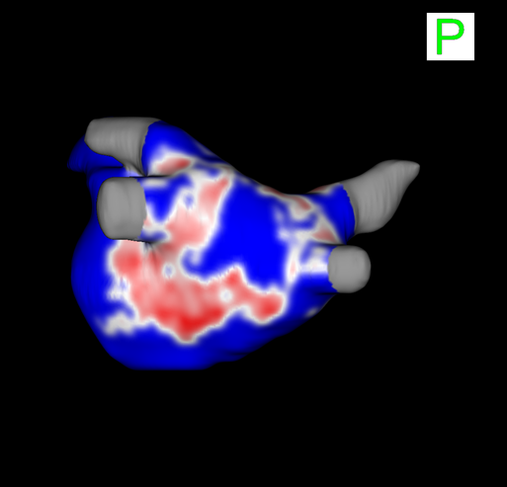
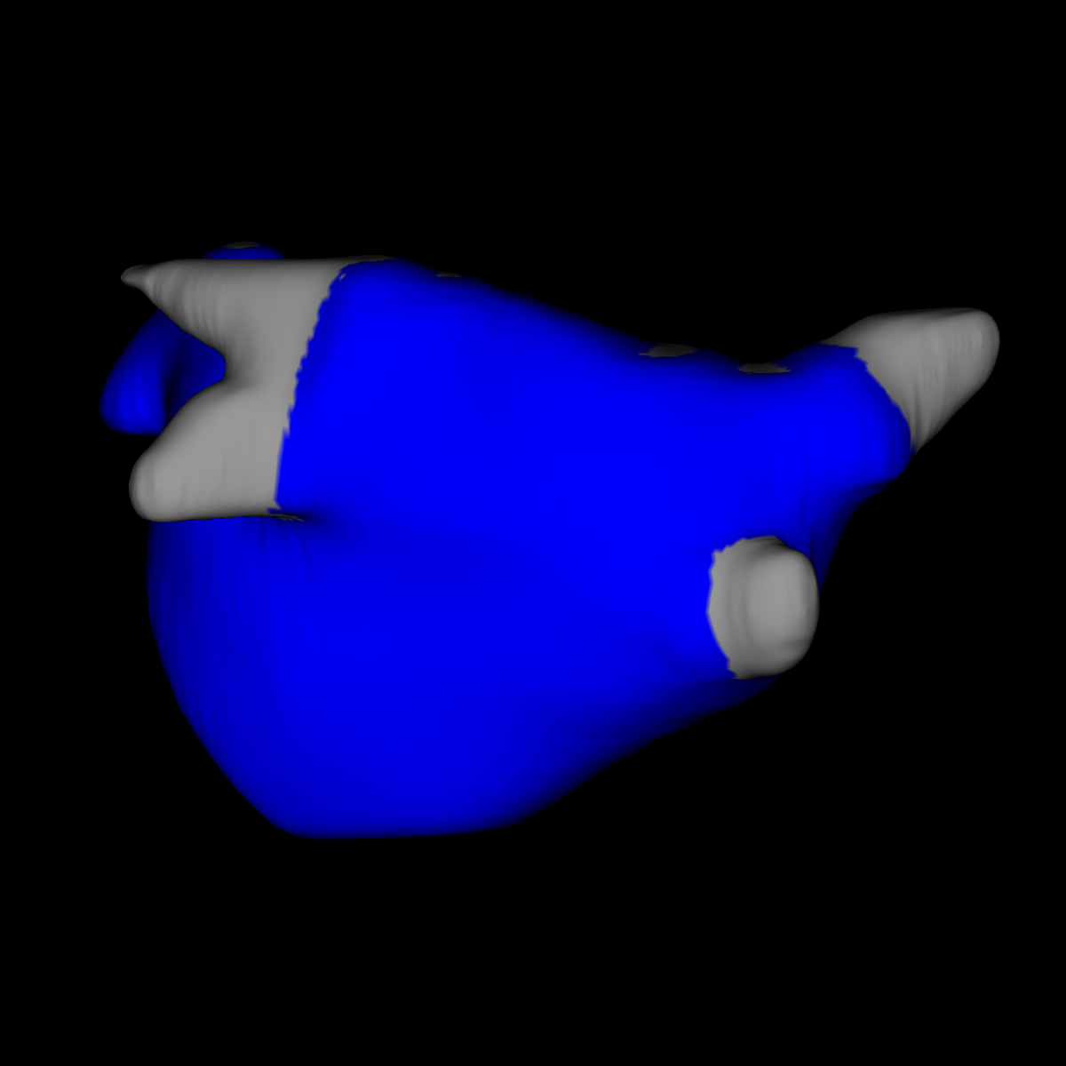

DECAAF II : Study Design
  Investigator initiated, industry-sponsored, prospective, Multicenter ( 44 sites, 3 continents), Randomized, Controlled
12-18 months Follow-up
Consented
Persistent AF
421 pts
1024 pts
3M-Follow-up MRI
AA Recurrence
Baseline MRI
Randomized
Persistent AF
MRI Guided
Within 4 weeks
Atrial Fibrillation Atrial Flutter
Atrial Tachycardia
843 pts
422 pts
PVI
PVI Only

Slide 7
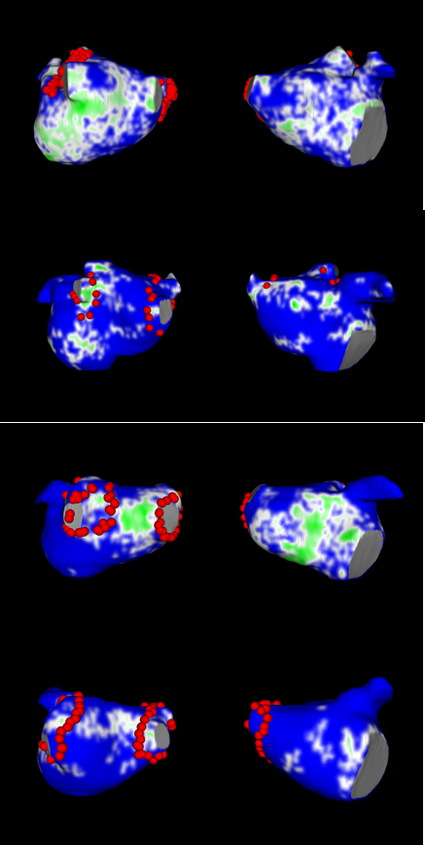
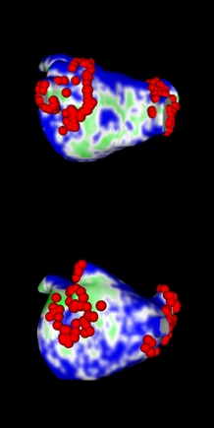
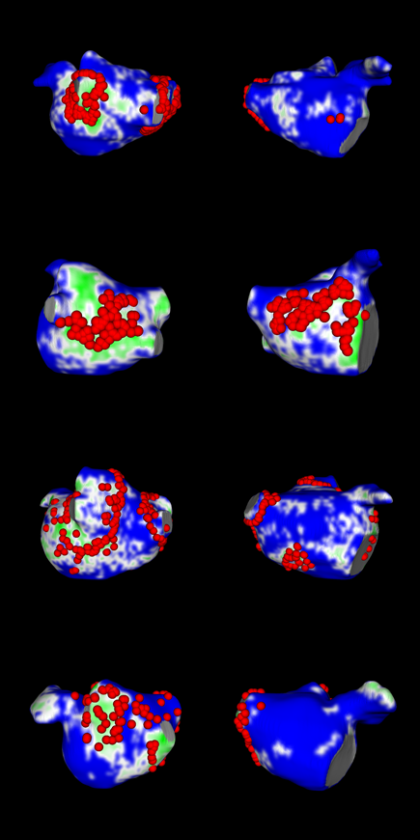
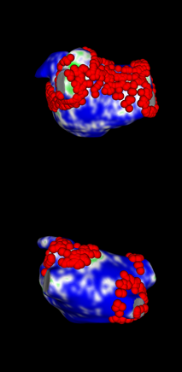
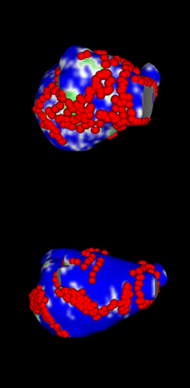
Assessment of Targeted Fibrosis
DECAAF II: Methods
Ablation points
Level 1: <20%
Level 2: >20%
Level 3: 40-60%
Level 4: >60%
Level 5: >80%

Slide 8
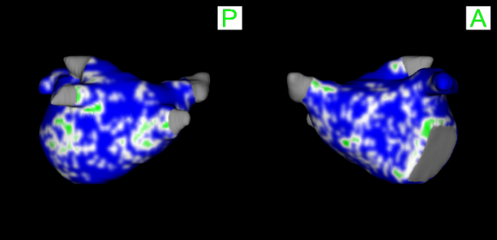
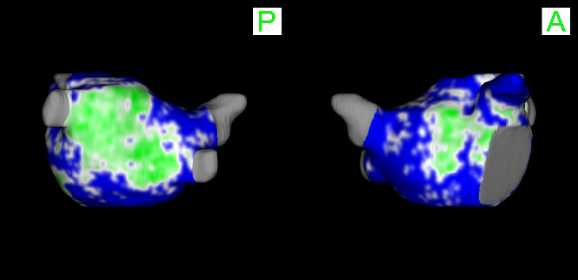
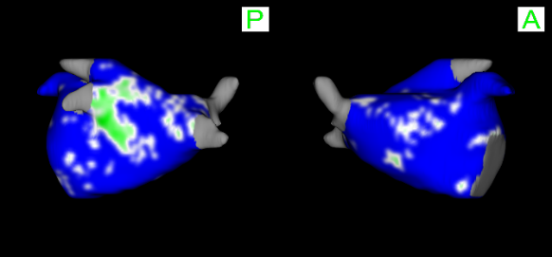
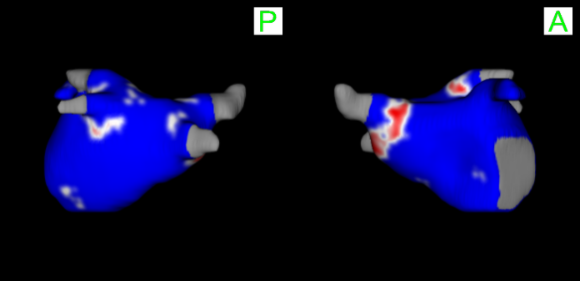
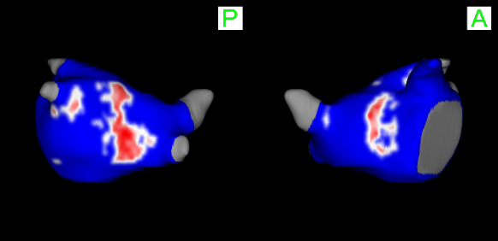
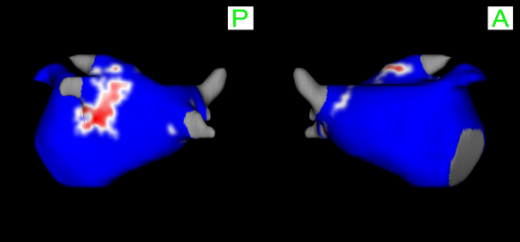
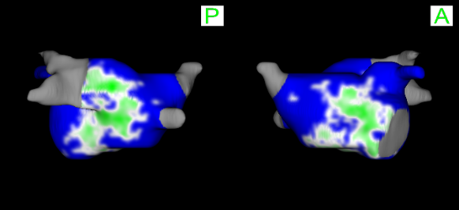
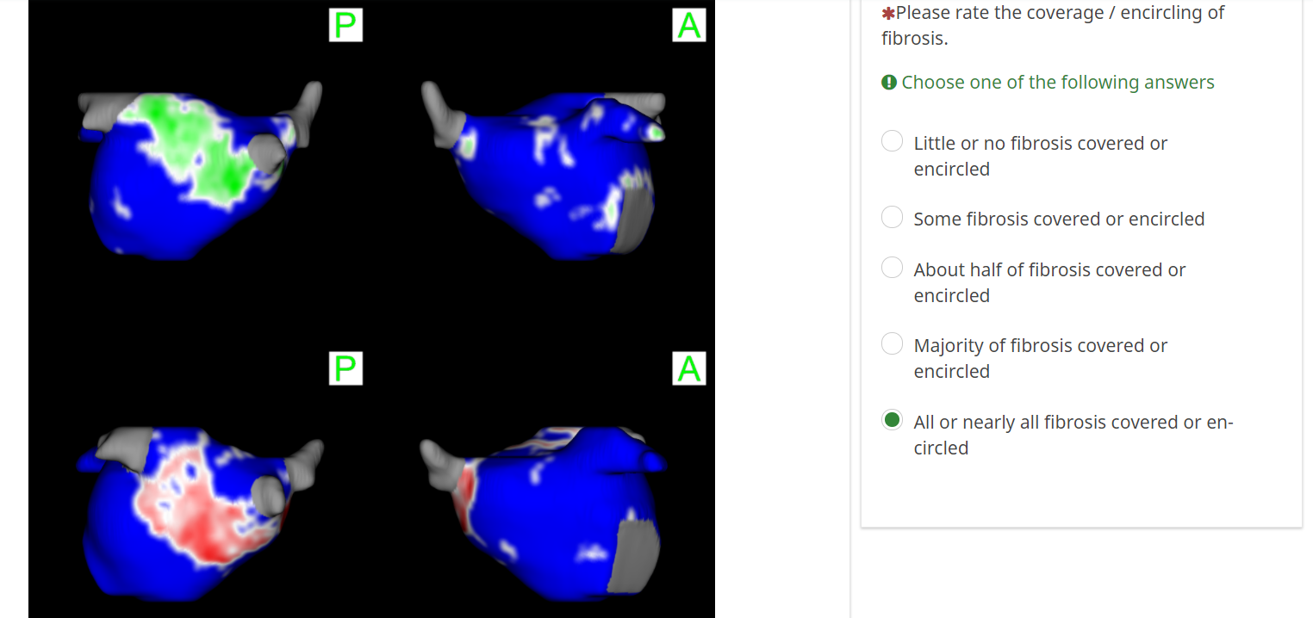
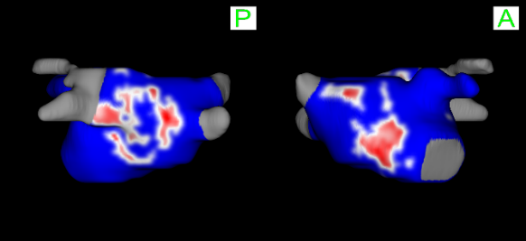
Assessment of Scar-Covered Fibrosis
DECAAF II: Methods
Level 1: <20%
Level 2: >20%
Level 3: 40-60%
Ablation scar formed at 3 months
Level 4: >60%
Level 5: >80%

Slide 9
DECAAF II: Endpoint
Primary Efficacy:
Time from end of 90-day blanking period to atrial arrhythmia recurrence
Smartphone ECG (2 recurrences within 7 days), Clinical ECG, Ambulatory Monitoring
Safety Outcomes:
Within 30 days of ablation:
Stroke
Pulmonary vein stenosis
Bleeding requiring transfusion
Heart failure
Death
Tamponade

Slide 10
DECAAF II: Statistical Analysis
Modified Intent-to-treat: Stratified log-rank test to compare the time to the first AA recurrence after the blanking period between the randomized treatment groups.
  Primary analysis
  Performed in
    Full cohort
    Separately by atrial fibrosis stages: <20% (Stages I-II) and ≥20% (Stages III-IV)
As-treated: Relate primary outcome to treatment achieved (level of scar covered fibrosis), irrespective of randomized groups
  Not a randomized comparison, but statistically adjusted for % baseline fibrosis, baseline left atrial volume index, age and sex
  Shown separately by atrial fibrosis stages as above.

Slide 11
DECAAF II: Results
Baseline Characteristics
 |  | MRI-guided ablation (n=421) | Conventional PVI (n=422)
Fibrosis Stage at Baseline | I | 48 (11.4%) | 50 (11.8%)
 | II | 198 (47%) | 196 (46.4%)
 | III | 144 (34.2%) | 137 (32.5%)
 | IV | 31 (7.4%) | 39 (9.2%)
Age at Randomization (years) | Mean (SD) | 61.9 (9.0) | 62.3 (9.2)
Sex | Male | 332 (78.9%) | 333 (78.9%)
Hypertension |  | 247 (58.7) | 247 (58.5)
Diabetes |  | 40 (9.5) | 45 (10.7)
CHF/ left ventricular dysfunction |  | 91 (21.6%) | 70 (16.6%)
Cerebrovascular accident |  | 36 (8.6%) | 34 (8.1%)
Previous use of AADs |  | 201 (47.7%) | 195 (46.2%)
Days from Afib diagnosis to ablation | Median (Q1, Q3) | 451 (159, 1147) | 405 (188, 1124)
Notes:
Need the other components of chadsvasc

Slide 12
DECAAF II: Results
ITT Analysis of Primary Endpoint
HR (95% CI): 0.95 (0.77 – 1.17)
P-Value 0.63
Proportion Free of
AA-Recurrence

Slide 13
DECAAF II: Results
ITT Analysis of Efficacy Endpoint
 | MRI-guided N=407 N (%) | Conventional PVI N=408 N (%)
 |  |  | Hazard Ratio (95% Confidence Interval) | p value
AA Recurrence or Repeat Ablation (Primary Outcome) | 175( 43) | 188( 46.1) | 0.95 ( 0.77- 1.17) | p= 0.63
AA Recurrence, Repeat ablation, Cardioversion, New AA medication) | 187( 45.9) | 198( 48.5) | 0.96 ( 0.79- 1.17) | p= 0.68
Atrial Arrhythmia Type
Atrial fibrillation | 130( 31.8) | 148( 35.7)
Atrial flutter | 33( 8.1) | 26( 6.3)
Atrial tachycardia | 7( 1.71) | 6( 1.45)
Repeat Ablation | 57( 14) | 73( 17.9) | 0.80 ( 0.56- 1.12) | p= 0.20

Slide 14
DECAAF II: Results
Safety Outcomes within 30 Days Post Ablation
 | MRI-Guided | Conventional PVI
 | N=403 | N=428
Safety Outcomes | N (%) | N (%) | P-Value
Bleeding requiring transfusion | 1 (0.2%) | 0 (0%) | 0.485
Heart Failure | 1 (0.2%) | 0 (0%) | 0.485
Pulmonary Vein Stenosis | 0 (0%) | 0 (0%) | NA
Stroke/TIA | 6 (1.5%) | 0 (0%) | 0.013
Death | 2 (0.5%) | 0 (0%) | 0.235
Perforation/Tamponade | 5 (1.2%) | 5 (1.2%) | 1.000

Slide 15
DECAAF II: Results
Primary Endpoint AA recurrence ITT: Fibrosis Stage Subgroups
Stage I-II: <20%
Stage III-IV: ≥20%
HR = 0.88 (0.67-1.16)
P-value = 0.38
HR = 1.04 (0.76-1.43)
P-value = 0.78

Slide 16
DECAAF II: Results
Safety Outcomes within 30 Days Post Ablation: Fibrosis Stages
 | Low fibrosis stages (<20%) |  |  | High fibrosis stages (≥20%)
 | MRI Guided (N = 234) | PVI Only (N = 250) | P-Value | MRI Guided (N = 169) | PVI Only (N = 178) | P-Value
Bleeding requiring transfusion | 1 (0.4%) | 0 (0%) | 0.48 | 0 (0%) | 0 (0%) | NA
Heart Failure | 0 (0%) | 0 (0%) | NA | 2 (1.2%) | 0 (0%) | 0.24
Perforation/Tamponade | 2 (0.9%) | 4 (1.6%) | 0.69 | 3 (1.8%) | 1 (0.6%) | 0.36
Pulmonary Vein Stenosis | 0 (0%) | 0 (0%) | NA | 0 (0%) | 0 (0%) | NA
Stroke/TIA | 2 (0.9%) | 0 (0%) | 0.23 | 4 (2.4%) | 0 (0%) | 0.06
Death | 2 (0.9%) | 0 (0%) | 0.23 | 0 (0%) | 0 (0%) | NA

Slide 17
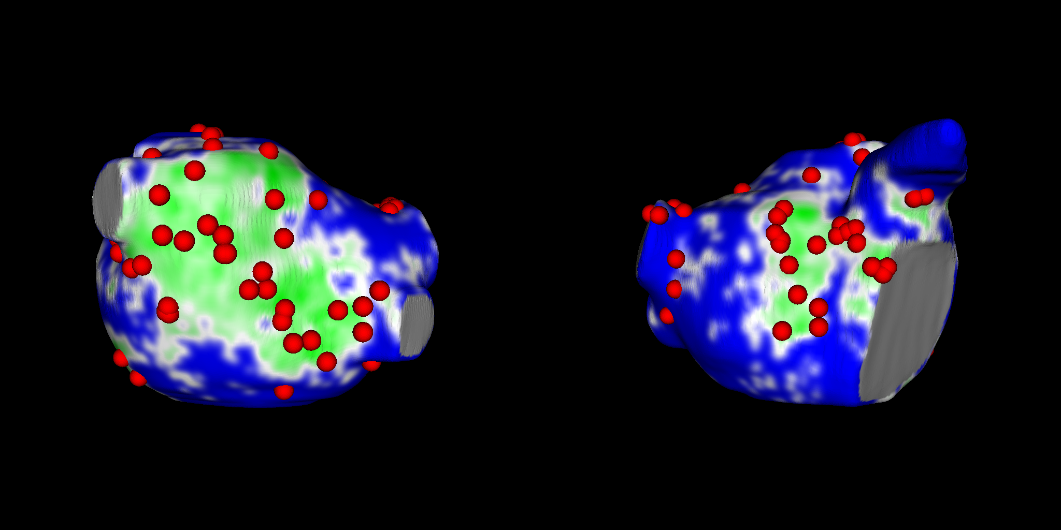
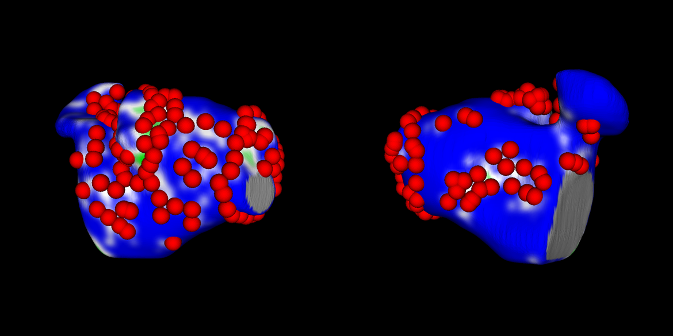
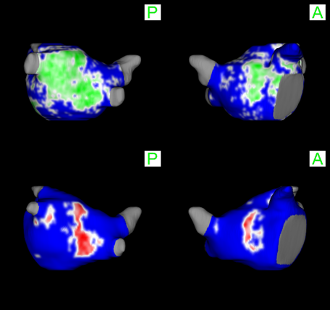

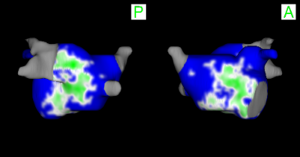


DECAAF II: Results
Targeted Fibrosis
Scar Covered or Encircled Fibrosis
MRI-Guided Group
MRI-Guided Group
80.9 % with at least half fibrosis targeted
44.8 % with at least half fibrosis scar covered
PVI Group
PVI Group
16.7% with at least half fibrosis targeted
15.5 % with at least half fibrosis scar covered

Slide 18
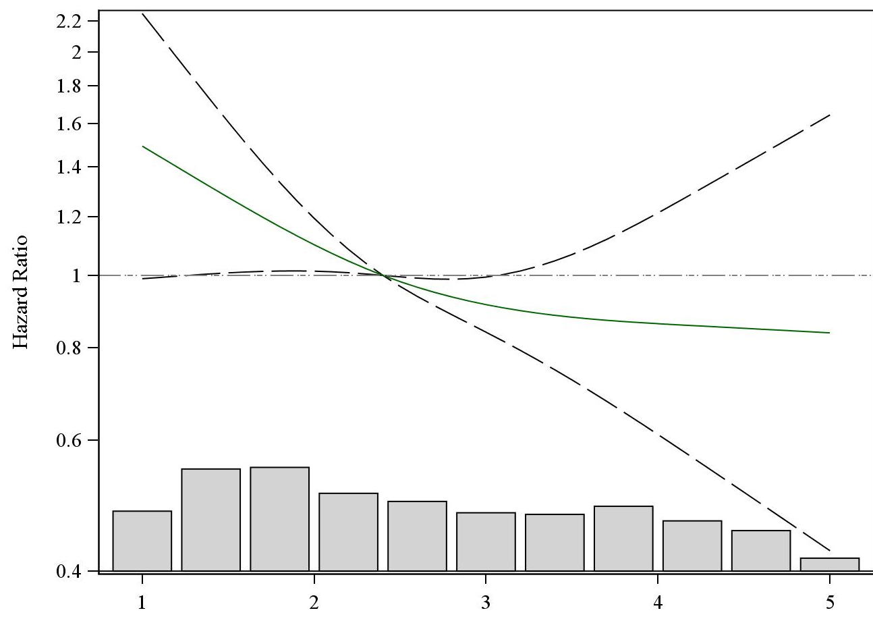
DECAAF II: Results
AS-TREATED: Fibrosis Stage <20%
Relationship of Primary Outcome to Level of Scarring Achieved
HR 0.84* (0.73-0.96)
P-Value 0.01
Each 1 unit increase in the level of fibrosis covered or encircled was associated with a 16% reduction in the hazard for AA recurrence
<20%
>20%
40%-60%
>60%
> 80%
* Adjusted for % baseline fibrosis, baseline left atrial volume index, age and sex.
Level of fibrosis covered or encircled

Slide 19
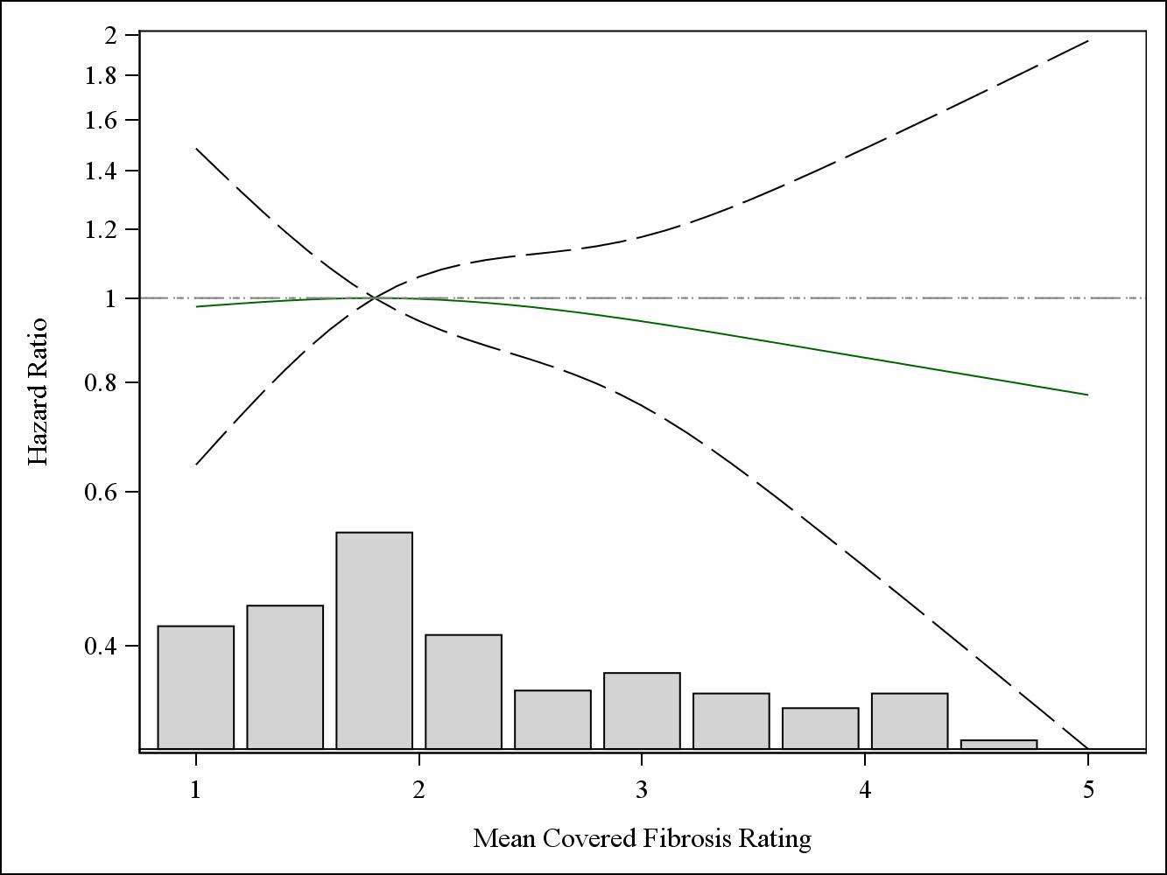
DECAAF II: Results
AS-TREATED: Fibrosis Stage ≥20%
Relationship of Primary Outcome to Level of Scarring Achieved
HR 1.06 (0.92-1.24)
P-Value 0.42
<20%
>20%
40%-60%
>60%
> 80%
Level of fibrosis covered or encircled
* Adjusted for % baseline fibrosis, baseline left atrial volume index, age and sex.

Slide 20
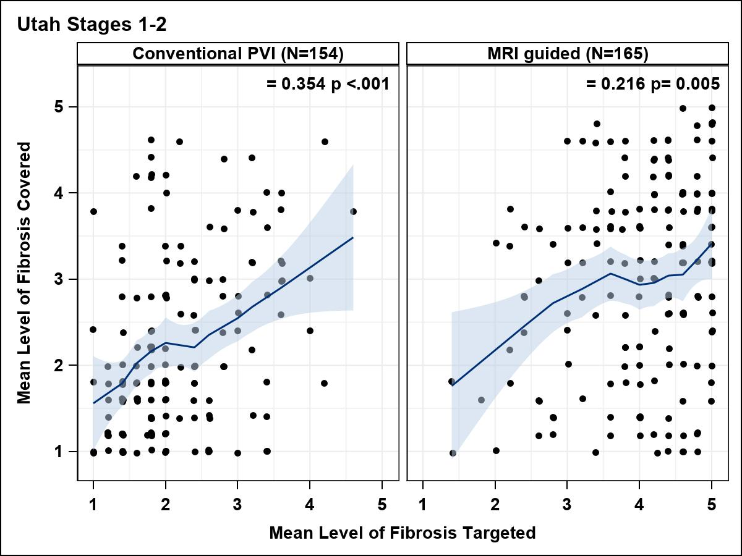
DECAAF II: Results
Assessing Lesion Formation: Fibrosis Stage <20%
Conventional PVI
MRI Guided
ρ
ρ
>80%
>60%
>40-60%
>20%
<20%
<20%
>20%
40-60%
>60%
>80%
<20%
>20%
40-60%
>60%
>80%
Good lesion formation in low fibrosis

Slide 21
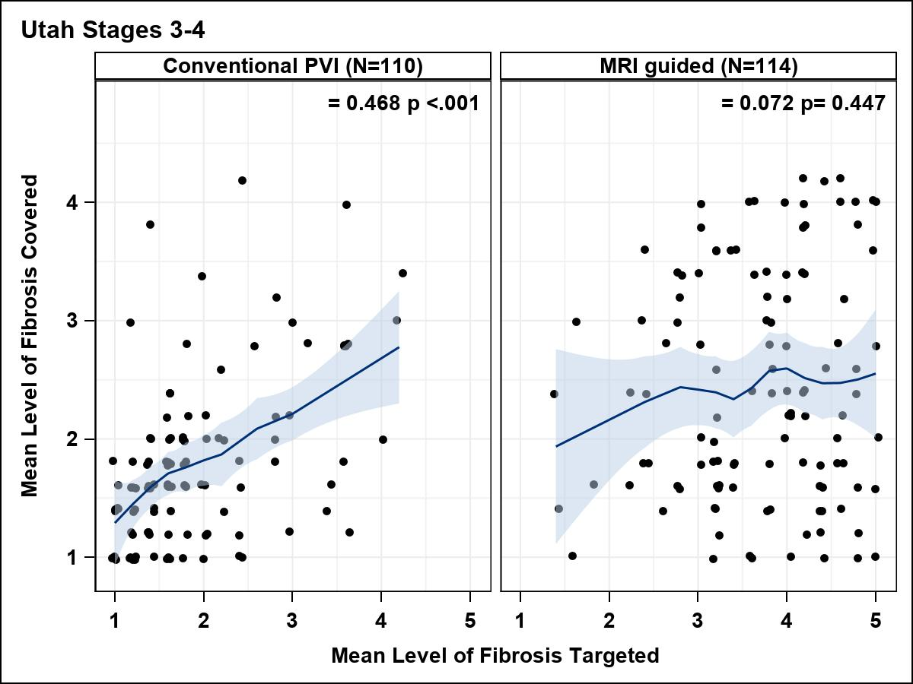
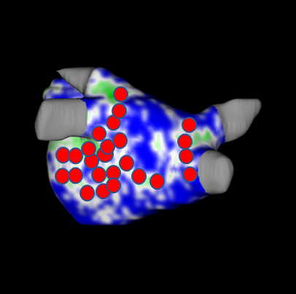
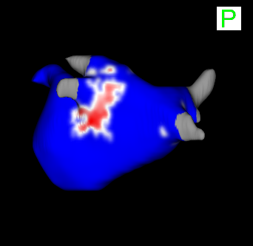
DECAAF II: Results
Assessing Lesion Formation: Fibrosis ≥20%
Conventional PVI
MRI Guided
ρ
ρ
>60%
40-60%
>20%
<20%
<20%
>20%
40-60%
>60%
>80%
<20%
>20%
40-60%
>60%
>80%
Lesion delivered but not formed in advanced fibrotic stages

Slide 22
DECAAF II: Summary
In patients with persistent AF:
Intention to treat analysis shows that fibrosis guided ablation was not superior to conventional PVI in reducing atrial arrhythmia recurrence
There was an increased number of adverse events with MRI guided ablation driven by advanced stages of fibrosis (>20%)
Failure to achieve a higher level of fibrosis coverage or encirclement may have diminished the effect of the treatment.
As-treated analyses suggest more successful fibrosis coverage/encirclement might reduce recurrence for early stages of fibrosis (<20%)
More advanced fibrosis (≥20%) was associated with altered ablation lesion formation

Slide 23






Thank you DECAAF II industry partners

Slide 24
Thank You
William Spear
Thomas Maurer
Mont, Lluís
Bruce Koplan
Peter Kistler
Christian Sohns
Pierre Jais
Juergen Siebels
Chris Jones
Saman Nazarian
Mattias Duytschaever
Felipe Atienza
Hemanth Ramanna
Thomas Deneke
Felipe Bisbal
Arif Elvan
Bengt Herweg
Suneet Mittal
Marco Gotte
Thomas Neumann
Heidi Estner
Andrzej Lubinski
Doug Packer
Sandep Gautam Gianluca Pontone
Vivek Reddy
Rukshen Weerasooriya Alexander Leber
Emile Daoud
Helmut Puererfellner Ahmad Abdul Karim Prash Sanders
Margot Vloka
Lucas Boersma
Darryl Wells
Alexander Costea
Reza Wakili
Jon Kalman
DCC:
Leonie Morrison-DeBoer
Tom Greene
Mike Dean
Steering Committee:
Nazem Akoum
Moussa Mansour Francis Marchlinski David Wilber
Gerhard Hindricks Christian Mahnkopf Pierre Jais
Johannes Brachmann Prash Sanders
Oussama Wazni
Hugh Calkins
Members of Adverse Events Monitoring:
Dhiraj Gupta
Jason G. Andrade
Boris Schmidt
DSMB:
James D. Thomas
Maria Mori Brooks Ralph Damiano
John DiMarco

