Slide 1
MEDICALLY ILL HOSPITALIZED PATIENTS FOR COVID –19
THROMBOSIS EXTENDED PROPHYLAXIS WITH RIVAROXABAN THERAPY: THE MICHELLE TRIAL
Eduardo Ramacciotti, Leandro Barile Agati, Daniela Calderaro, Valéria Cristina Resende Aguiar, Alex C. Spyropoulos, Giuliano Giova Volpiani, Caroline Candida Carvalho de Oliveira, Marcone Lima Sobreira, MD, Edwaldo Edner Joviliano, Cesar Dusilek, Kengi Itinose, Rogério Aparecido Dedivitis, André Sementilli Cortina, Suzanna Maria Viana Sanches, Nara Franzin de Moraes, Paulo Fernando Guimarães Morando Marzocchi Tierno, André Luiz Malavasi Longo de Oliveira, Adriano Tachibana, Rodrigo Caruso Chate, Marcus Vinícius Barbosa Santos, Bruno Bezerra de Menezes Cavalcante, Ricardo Cesar Rocha Moreira, Chang Chiann, Alfonso Tafur, Renato D. Lopes
On Behalf of The Michelle Trial Investigators
HMB
Hospital Municipal de Barueri

Slide 2
DECLARATION OF INTEREST
FOR EDUARDO RAMACCIOTTI
RESEARCH SUPPORT/P.I. | BMS/PFE, BAYER, MCTI
EMPLOYEE | No relevant conflicts of interest to declare
CONSULTANT | No relevant conflicts of interest to declare
MAJOR STOCKHOLDER | No relevant conflicts of interest to declare
SPEAKERS BUREAU | BMS/PFE, ASPEN, BAYER, Daiichi-Sankyo, BIOMM
HONORARIA | No relevant conflicts of interest to declare
SCIENTIFIC ADVISORY BOARD | BMS/PFE, BAYER, Daiichi-Sankyo

Slide 3
TRIAL ORGANIZATION
EXECUTIVE/STEERING COMMITTEE
CLINICAL EVENTS CLASSIFICATION (CEC) COMMITTEE
Eduardo Ramacciotti | Science Valley Research Institute
Leandro Barile Agati | Science Valley Research Institute
Daniela Calderaro| Heart Institute (InCor) and Clinics Hospital
Alfonso Tafur | Northshore University Health System
Alex C. Spyropoulos | Northwell Institutes for Medical Research
Renato D. Lopes | Brazilian Clinical Research Institute (BCRI) Duke Clinical Research Institute (DCRI)
Science Valley Research Institute
COORDINATING CENTER
Science Valley Research Institute
SPONSOR/ FUNDING
DATA SAFETY MONITORING BOARD
Science Valley Research Institute
Rogério Krakauer (Santa Casa de São Paulo School of Medical Sciences)
Oswaldo De Lima (General Surgery, Leforte Hospital)
COLLABORATION
Bayer ^{(*)}
STATISTICAL ANALYSIS
Chang Chiann (University of São Paulo)
^{(*)} Unrestricted research grant from Bayer S.A., which was not involved in design, conduct or interpretation of the study

Slide 4
BACKGROUND
1
The devastating Coronavirus disease (COVID-19) pandemic is associated with a high prothrombotic state ¹
2
It is unclear if the coagulation abnormalities occur because of the direct effect of SARS-CoV-2 or indirectly by the cytokine storm and endothelial damage or by a combination of mechanisms ²
3
There is a clear indication of in-hospital pharmacological thromboprophylaxis for every patient with COVID-19 after bleeding risk assessment ³
4
There is no consensus on the role of extended thromboprophylaxis ⁴
5
Current antithrombotic statements are conflicting for the need (or not) for post-hospital discharge thromboprophylaxis in hospitalized COVID-19 patients ⁵
1. Klok et al. Thromb Res 2020;191:145-147; 2. Ackermann et al. N Engl J Med 2020;383(2):120-128; 3. Spyropoulos et al. J Thromb Haemost 2020;18(8):1859-1865; 4. Moores et al. Chest 2020;158(3):1143-1163; 5. Gerotziafas et al. Thromb Haemost 2020;120(12):1597-1628.

Slide 5
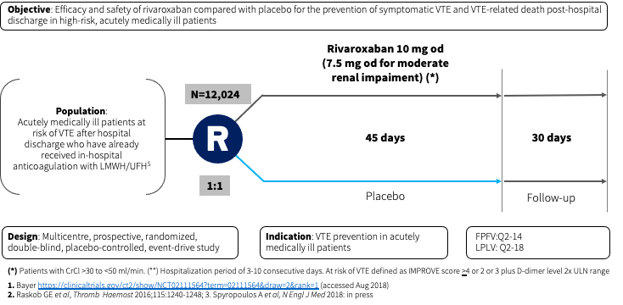
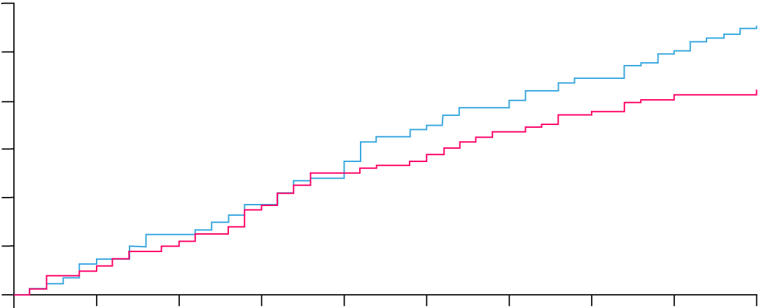
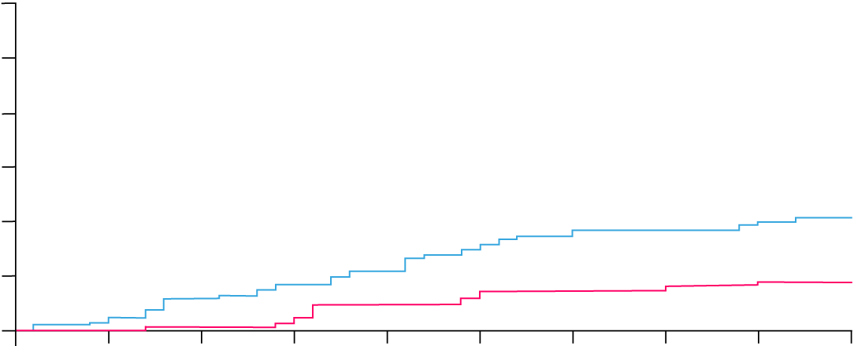
↓56% symptomatic VTE
No ↑Bleeds
MARINER Evaluated Rivaroxaban Versus Placebo for Prophlaxis of VTE After Hospital Discharge in Acutely Medically Ill Patients
VTE-Related Death Rates with Rivaroxaban Were Not Significantly Different vs Placebo
Cumulative event rates for composite of symptomatic VTE or VTE-related death (*)
1.2
Rivaroxaban
1.1%
1.0
Placebo
0.8
0.83%
Patients with event (%)
0.6
Significant Reduction of Symptomatic VTE with Rivaroxaban After Discharge in Acutely Medically Ill Patients
0.4
HR=0.76 (95% CI 0.52-1.09)
p=0.14
0.2
1.2
Rivaroxaban
0.0
1.0
Placebo
0
5
10
15
20
25
30
35
40
45
0.8
HR=0.44 (95% CI 0.22-0.89)
Time since randomization (days)
Patients with event (%)
0.6
0.4
0.42%
0.2
0.18%
0.0
0
5
10
15
20
25
30
35
40
45
Time since randomization (days)
Spyropoulos A et al, N Engl J Med 2018

Slide 6
STUDY DESIGN
Design: Prospective, randomized, open-label, controlled, multi-center trial
Rivaroxaban
(10 mg/day)
~320 COVID+
Medically Ill hospitalized
with IMPROVE ≥4
or
IMPROVE 2-3 with
Ddimer >500 ng/mL receiving LMWH or UFH
R
Doppler US + pulmonary angioCT
at day 35+4
No anticoagulation
Discharge
Follow-up
Screening
Day
35±4
Day 75
(phone call)
Primary endp: symptomatic VTE, VTE-related death, VTE detected by mandatory bilateral lower limbs venous duplex scan and pulmonary angioCT on day 35±4 post-hospital discharge and (myocardial infarction [MI], non-hemorrhagic stroke, major adverse limb events [MALE] and cardiovascular [CV] death + all cause death up to day 35±4 post-hospital discharge.
Power: 80%, Two sided alpha 0.05 (Control 15%, Treatment 5%; 67% RRR)
Rivaroxaban is not approved for patients admitted or discharged for an acute medical illness by EMEA

Slide 7
KEY INCLUSION AND EXCLUSION CRITERIA
KEY INCLUSION CRITERIA
Patients ≥ 18 years hospitalized for minimum of 3 days with standard dose thromboprophylaxis (LMWH, fondaparinux or UFH) prior to randomization for SARS-CoV-2 infection (COVID-19) Total modified IMPROVE VTE Risk Score ≥ 4 OR total modified IMPROVE VTE Risk Score 2 or 3 and D dimer > 500 ng/ml during index hospitalization
KEY EXCLUSION CRITERIA
Bleeding Risks Any bleeding within 3 months Surgery, biopsy or trauma 4 weeks prior or planned Active gastroduodenal ulcer Active cancer Required anticoagulation after discharge Use of dual antiplatelet therapy during the index hospitalization Creatinine clearance < 30 ml/min Concomitant Medications Combined P-gp and strong CYP3A4 inhibitors Combined P-gp and strong CYP3A4 inducers

Slide 8
CLINICAL OUTCOMES
PRIMARY OUTCOME
Composite of symptomatic VTE, VTE-related death, and VTE detected at bilateral lower limbs venous duplex scan and computed tomography pulmonary angiogram and symptomatic arterial thromboembolism, myocardial infarction (MI), non-hemorrhagic stroke, major adverse limb event (MALE), and cardiovascular (CV) death at day 35
KEY SAFETY OUTCOME
Incidence of major bleeding according to ISTH criteria
SECONDARY OUTCOMES
Symptomatic and fatal VTE
Symptomatic VTE + all cause mortality
Symptomatic VTE, MI, stroke and cardiovascular death
Clinical outcomes were adjudicated by an independent committee in a blinded fashion

Slide 9
STATISTICAL ANALYSIS
SAMPLE SIZE CALCULATIONS
1
Power of 80% and ⍺ =0.05
2
Anticipated occurrence of the primary efficacy endpoint of 15% of patients in the control group and 5% of patients in the treatment group (RRR = 67%)
3
If there is a true difference in favor of the proposed treatment of an absolute risk reduction of 10%
(15% vs. 5%), then 282 patients were required
4
With a drop-out rate of 10%, a total of 320 patients was necessary (160 per arm)
5
The primary analysis was performed using the intention-to-treat principle

Slide 10
STUDY FLOW-DIAGRAM
RANDOMIZED (N=320)
Allocated to rivaroxaban (n=160)
-
-Received allocated intervention (n=158)
- Did not receive allocated intervention (n=2)
- 1 patient allocated to another study
- 1 patient prolonged hospitalization
Allocated to no anticoagulation (n= 160)
ALLOCATION
Lost to follow-up (n=1)
(withdrawn informed consent)
Lost to follow-up (n=1)
(withdrawn informed consent)
FOLLOW-UP
Analyzed (n= 159) Intention-to-treat-analysis
AngioCT scans available = 114 (73%)
Doppler US available = 134 (85%)
Analyzed (n= 159) Intention-to-treat-analysis
AngioCT scans available = 90 (57%)
Doppler US available = 118 (75%)
ANALYSIS

Slide 11
BASELINE CHARACTERISTICS
CHARACTERISTICS | RIVAROXABAN (N=159) | CONTROL (N=159)
Mean age(yr) – mean(SD) | 57.8 (14.8) | 56.4 (15.6)
Age ≥75 yr — nº (%) | 18 (11.3%) | 15 (9.4%)
Female sex — nº (%) | 62 (39.0%) | 65 (40.9%)
BMI – mean(SD) | 29.6 (5.6) | 29.9 (6.0)
Clearance n./total(%)
30 to <50 ml/min | 6/158 (3.8%) | 5/157 (3 .2%)
≥50 ml/min | 152/158 (96.2%) | 152/157 (96.8%)
Mean duration of index hospitalization — days -mean(SD) | 16.4 (46.7) | 12.6 (28.5)
ICU or CCU stay — nº (%) | 86 (54.1%) | 79 (49.7%)
In-hospital enoxaparin 40 mg use — nº (%) | 136 (85.5%) | 137 (86.2%)
In-hospital unfractionated heparin use — nº (%) | 23 (14.5%) | 22 (13.8%)
IMPROVE score n.(%)
2-3 | 98 (61.6%) | 99 (62.3%)
≥4 | 61 (38.4%) | 60 (37.7%)
D-Dimer level above the UNL during index hospitalization — nº/total (%) | 106/115 (92.2%) | 108/118 (91.5%)
Antiplatelets use — nº (%) | 8 (5.0%) | 8 (5.0%)

Slide 12
PRIMARY EFFICACY/SAFETY OUTCOMES
RR = 0.33 (0.13—0.90)
p=0.03 (superiority)
NNT = 16
RRR =67%
*Composite of composite of symptomatic VTE, VTE-related death, asymptomatic VTE (Doppler and AngioCT scan) and symptomatic ATE, MI, non-hemorrhagic stroke, (MALE), and cardiovascular death at day 35.

Slide 13
SECONDARY EFFICACY OUTCOMES
Secondary efficacy outcomes | RIVAROXABAN (N = 159) | CONTROL (N = 159) | RELATIVE RISK (95% CI)
Symptomatic + fatal VTE | 1/159 (0.63%) | 8/159 (5.03%) | 0.13 (0.02 – 0.99)
Symptomatic VTE + all cause mortality | 4/159 (2.52%) | 9/159 (5.66%) | 0.44 (0.14 – 1.41)
A composite of Symptomatic VTE, MI, stroke and cardiovascular deaths | 1/159 (0.63%) | 9/159 (5.66%) | 0.11 (0.01 – 0.87)
Components of the primary outcome
Symptomatic DVT | 0 | 3 (1.89%) | 0.14 (0.01 – 2.74)
Symptomatic PE | 1 (0.63%) | 2 (1.26%) | 0.50 (0.05 – 5.46)
Fatal PE | 0 | 3 (1.89%) | 0.14 (0.01 – 2.74)
Asymptomatic DVT detected at duplex scan | 3 (1.89%) | 1 (0.63%) | 3.00 (0.32 – 28.53)
Asymptomatic PE detected at CT pulmonary angiogram | 1 (0.63%) | 4 (2.52%) | 0.25 (0.03– 2.21)
Symptomatic arterial thrombosis | 0 | 1 (0.63%) | 0.33 (0.01 – 8.12)
Myocardial infarction | 0 | 0 | -
Non-hemorrhagic stroke | 0 | 0 | -
Major adverse limb event (MALE) | 0 | 0 | -
Cardiovascular deaths | 0 | 1 (0.63%) | 0.33 (0.01 – 8.12)

Slide 14
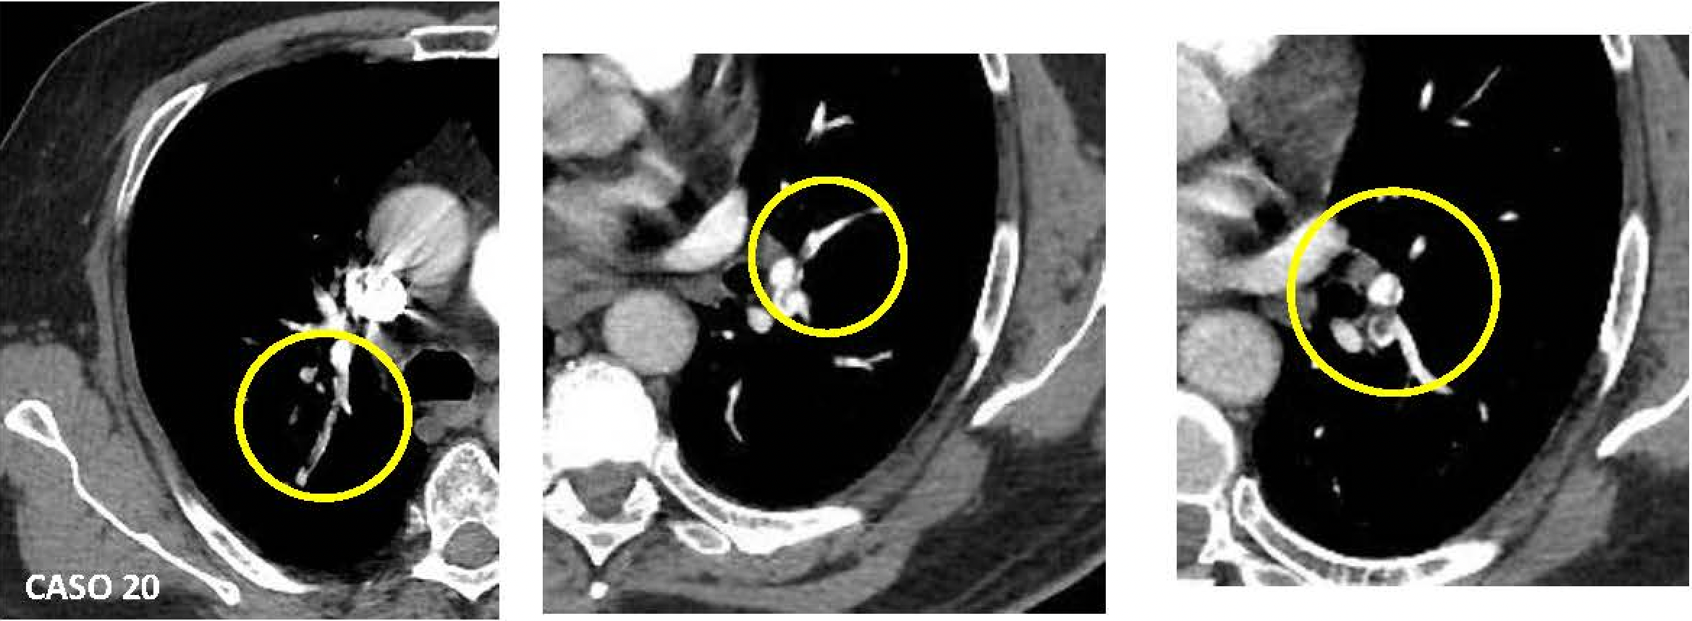
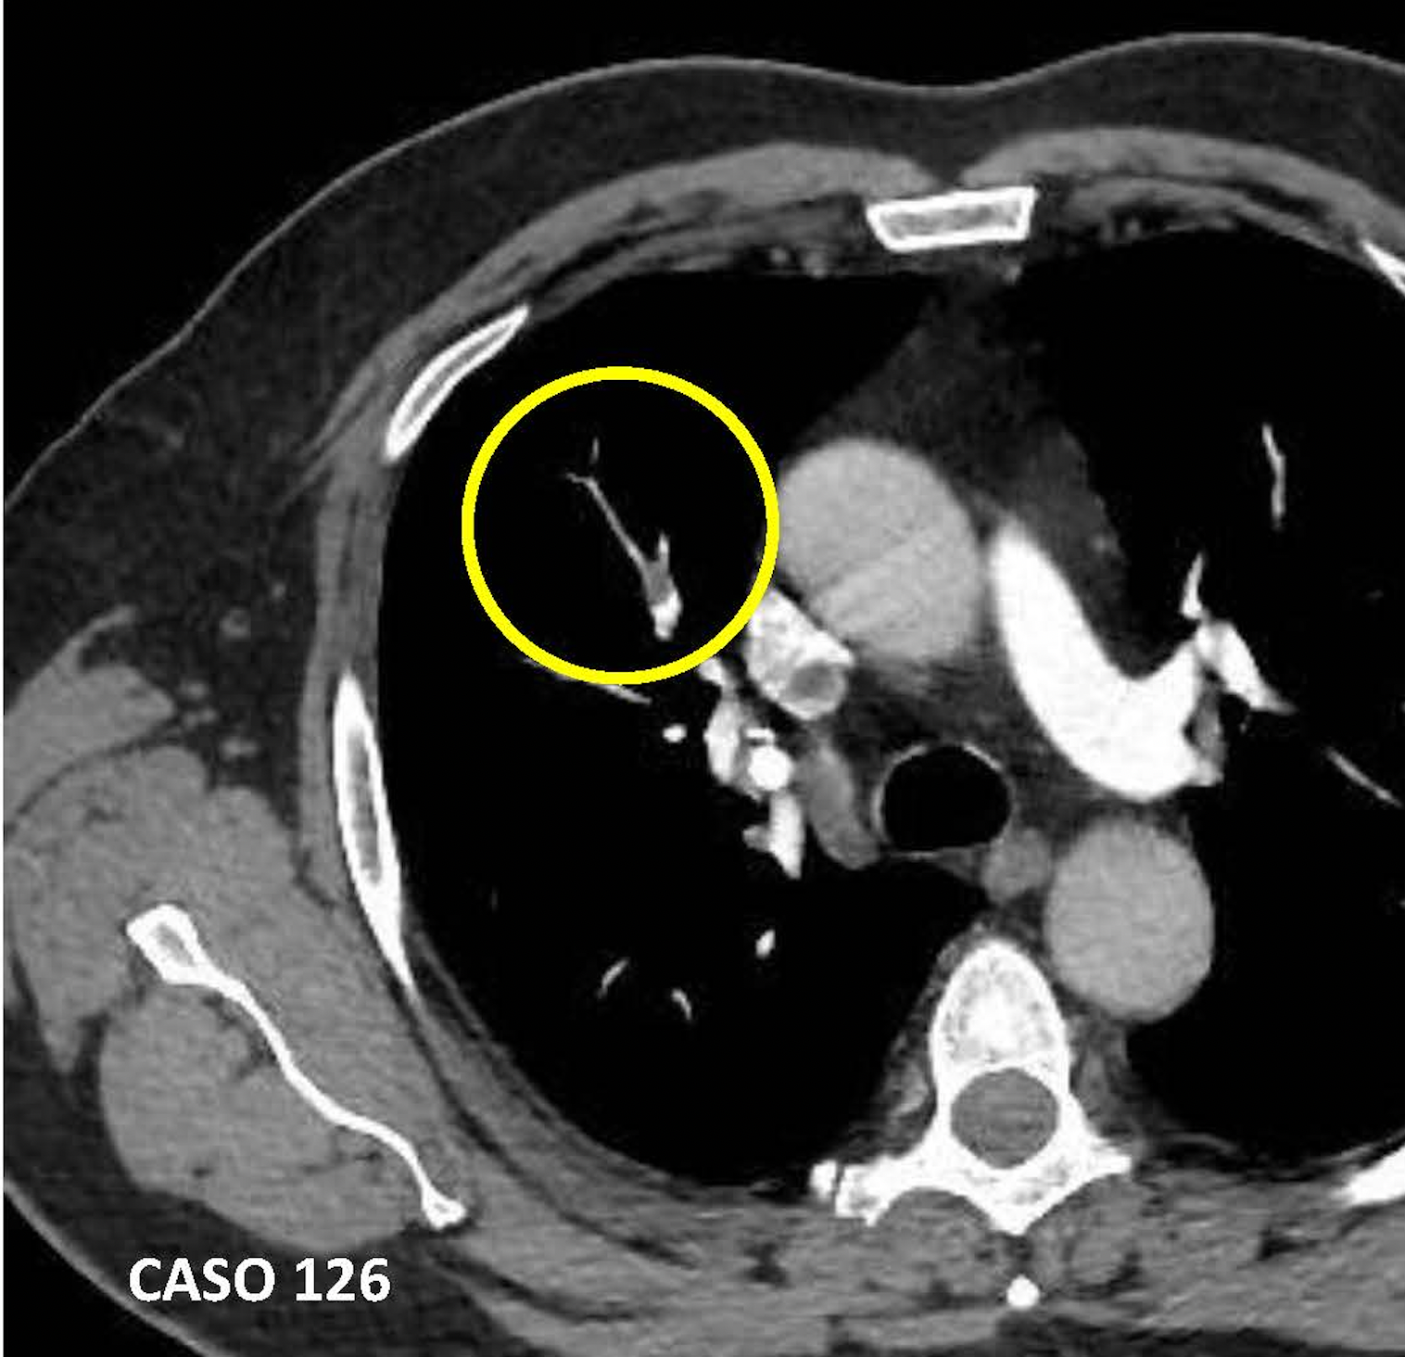
SECONDARY EFFICACY OUTCOMES

Slide 15
SAFETY OUTCOMES
 | Rivaroxaban (n=159) | Control (n=159)
Principal safety outcome: major bleeding | 0 | 0
Clinically relevant nonmajor bleeding | 2 (1.26%) | 2 (1.26%)
Another bleeding | 2 (1.26%) | 1 (0.63%)
A combination of major and clinically relevant non-major bleeding and other bleeding | 4 (2.51%) | 3 (1.89%)

Slide 16
SUBGROUP ANALYSIS
SUBGROUP |  | RIVAROXABAN n./total(%) | CONTROL n./total(%) |  | RR (IC 95%)
Age (yrs) | ≤60 | 2/77 (2.60%) | 4/92 (4.35%) |  | 0.60 (0.11 – 3.17)
 | >60 | 3/82 (3.66%) | 11/67 (16.42%) |  | 0.22 (0.07 – 0.77)
BMI | ≤30 | 3/105 (2.86%) | 10/88 (11.36%) |  | 0.25 (0.07 – 0.89)
 | >30 | 2/54 (3.70%) | 5/71 (7.04%) |  | 0.53 (0.11 – 2.61)
Creatinine Clearance ml/min | 30 to <50 ml/min | 0/6 | 0/5 |  | ---
 | ≥50 ml/min | 5/152 (3.29%) | 15/154 (9.74%) |  | 0.34 (0.13 – 0.91)
Modified IMPROVE VTE risk score | 2-3 | 2/98 (2.04%) | 9/99 (9.09%) |  | 0.22 (0.05 – 1.01)
 | ≥4 | 3/61(4.92%) | 6/60 (10.0%) |  | 0.49 (0.13 – 1.88)
D-Dimer level above the UNL | ≤500 ng/ml | 0/9 (0.00%) | 1/10 (10.00%) |  | 0.37 (0.02 – 7.99)
 | >500 ng/ml | 4/106 (3.77%) | 10/108 (9.26%) |  | 0.41 (0.13 – 1.26)
Antiplatelets use — no. (%) | no | 5/151 (3.31%) | 14/151 (9.27%) |  | 0.36 (0.13 - 0.97)
 | yes | 0/8 (.00%) | 1/8(12.5% |  | 0.33 (0.02 – 7.02)
1
Favors rivaroxaban
Favors control

Slide 17
CONCLUSION
In patients discharged after hospitalization due to COVID-19 with increased IMPROVE score, thromboprophylaxis with rivaroxaban 10 mg once-daily for 35 days improved clinical outcomes, without increasing bleeding compared with no out-of-hospital anticoagulation

Slide 18
ACKNOWLEDGMENTS
Science Valley Research Institute, Bayer Brazil team, investigators, hospitals, study coordinators, DSMB, CEC, core-lab, and study participants who made the MICHELLE trial possible.
THANKYOU
CEARÁ
Fortaleza
BAHIA
Salvador
SÃO PAULO
Ribeirão Preto
Botucatu
Campo Largo
PARANÁ
São Paulo
Curitiba
HMB
Hospital Municipal de Barueri

