Slide 1
Influenza Vaccination after Myocardial Infarction - a randomized, double-blind, placebo-controlled, multicenter trial
Ole Fröbert, MD, PhD, FESC - on behalf of the IAMI investigators
Örebro University Hospital, Sweden
ClinicalTrials.gov Identifier: NCT02831608

Slide 2
Background
During influenza epidemics more people die from cardiovascular causes
Numerous observational studies suggest a protective effect from influenza vaccination on cardiovascular events
Three, smaller single-center randomized trials support registry findings
Influenza vaccination carries a class I, level of Evidence B recommendation in both AHA/ACC and ESC secondary prevention guidelines but uptake is low and vaccination timing undecided
Notes:
ESC recommendation at study start: Class IIb, level of evidence C.

Slide 3
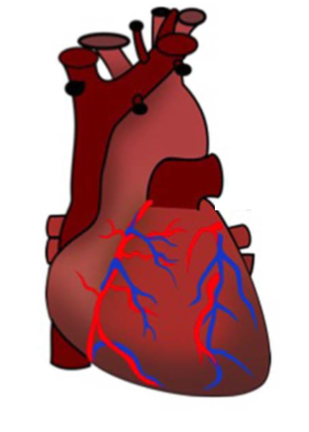
Influenza and cardiovascular disease
Fever
Tachycardia
Metabolic demand
Oxygen saturation
BT
Vasoconstriction
Cytokines
Plaque destabilization
Plaque rupture
Prothrombotic state
Influenza virus infection
Atherosclerosis
AMI
Adaptad from Barnes M, Heart. 2016;102:1953

Slide 4
Outline
Objective. To determine whether influenza vaccination (Vaxigrip, Vaxigrip Tetra, FluQuadri, Sanofi Pasteur) improves clinical outcomes in patients with recent myocardial infarction or high-risk coronary disease
Design. Investigator-initiated, international, multicenter, double blind, randomized controlled trial
Enrollment. Thirty hospitals across 8 countries, over 4 influenza seasons between 1 Oct 2016 and 1 Mar 2020. Target: 4400 patients

Slide 5
Inclusion and exclusion criteria
Inclusion criteria
STEMI Or NSTEMI Or high risk stable patients >75 y
Coronary angiography/PCI (not Bangladesh)
Male or female subjects ≥18 y
Written informed consent
Exclusion criteria
Influenza vaccine during the current flu season
Intention to be vaccinated during the current flu season
Indication for influenza vaccination (as per investigator discretion)
Severe allergy to eggs or previous allergic reaction to influenza vaccine
Febrile illness or acute, ongoing infection
Endogenic or iatrogenic immunosuppression
Inability to provide informed consent
Age below 18 y
Previous randomization in the iami trial
Notes:
High risk: previous MI, previous PCI, previous CABG, diabetes mellitus, current smoking or an eGFR <40.

Slide 6
Endpoints
Primary endpoint
Composite of all-cause death, MI, or stent thrombosis at 12 months
Key secondary endpoints
All-cause death
Cardiovascular death
MI
Stent thrombosis
A hierarchical testing approach was pre-specified for the key secondary endpoints (in the order shown) if the primary endpoint was statistically significant

Slide 7
8 countries and 30 centers
Denmark
Aarhus University Hospital
Odense University Hospital
Aalborg University Hospital
Rigshospitalet
Bispebjerg Hospital
Norway
LHL-sykehuset Gardermoen Oslo
Latvia
Pauls Stradins University Hospital Riga
Sweden
Sahlgrenska University Hospital
Örebro University Hospital
University Hospital Linköping
Centrallasarettet Västerås
Jönköping Hospital
Skåne University Hospital
Umeå University Hospital
Karolinska University Hospital
Danderyd University Hospital
Uppsala University Hospital
Karlstad Central Hospital
Stockholm South General Hospital
Bangladesh
National Institute of CV Diseases
National Heart Foundation
Scotland
Golden Jubilee National Hospital
Royal Infirmary of Edinburgh
Victoria Hospital, Kirkcaldy
Aberdeen Royal Infirmary
University Hospital Hairmyres
Ninewells Hospital, Dundee
Australia
Blacktown Hospital Sydney
Czech Republic
University Hospital Kralovske Vinohrady
St. Anne University Hospital

Slide 8
Challenges during the course of the study
Slow recruitment
Additional centers and countries
Broader inclusion criteria
Enrichment group: stable high-risk coronary disease (>75y + at least one additional risk factor)
Trial halted prematurely on April 7, 2020 by the DSMB due to the COVID-19 pandemic after enrollment of 2571 patients (58% of target)

Slide 9
Enrollment and randomization
6696 patients were screened
4125 patients were not enrolled
1439 already vaccinated or intending vaccination
1202 patients declined
580 patients not eligible
430 other medical reasons
326 logistical reasons
148 other
2571 were randomized
1290 assigned to vaccine
1281 assigned to placebo
18 did not receive study treatment
4 transferred
11 withdrew consent
3 incorrectly randomized
21 did not receive study treatment
3 transferred
10 withdrew consent
5 incorrectly randomized
3 other
Follow-up 12 months. Final vital status known in 99.5%
1272 (98.6%) received vaccine
1260 (98.4%) received placebo

Slide 10
Baseline data

Slide 11
Primary composite endpoint
HR 0.72; 95% CI 0.52-0.99; P=0.040
Placebo 91 vs vaccine 67

Slide 12
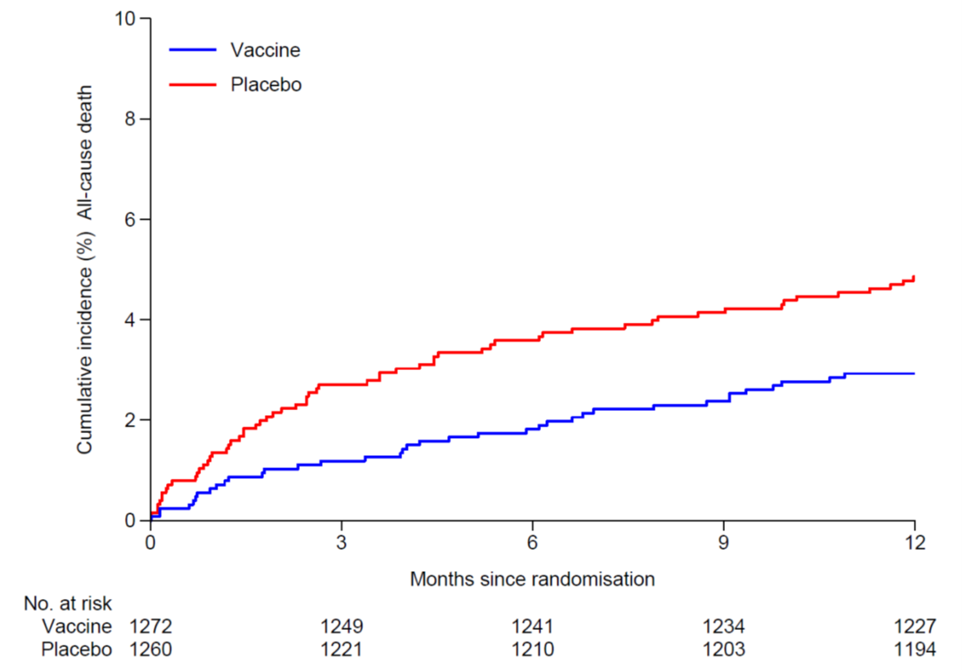
Key secondary endpoints
All-cause death
CV death
MI
HR 0.59; 95% CI 0.39-0.89; P=0.010
Placebo 61 vs vaccine 37
HR 0.59; 95% CI 0.39-0.90; P=0.014
Placebo 56 vs vaccine 34
HR 0.86; 95% CI 0.50-1.46; P=0.57
Placebo 29 vs vaccine 25

Slide 13
All endpoints

Slide 14
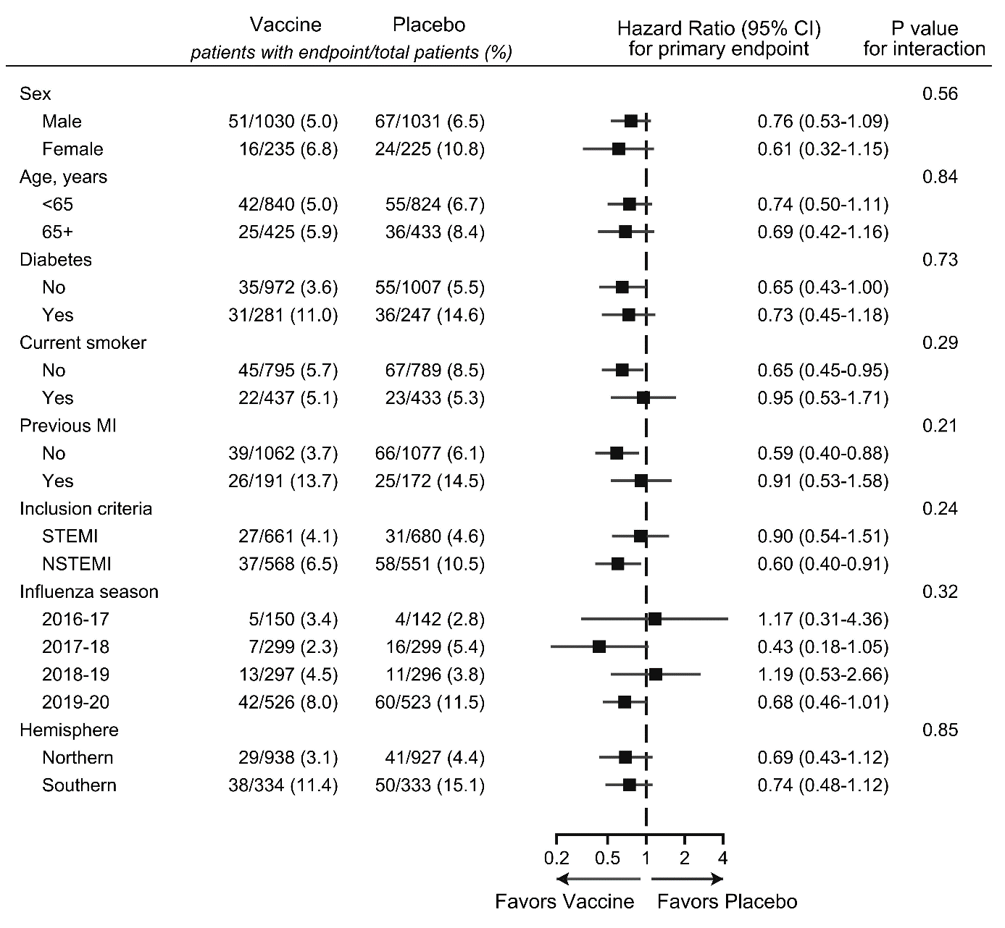
Pre-specified subgroups

Slide 15
Safety, self-reported 7-day questionnaire

Slide 16
Safety, site-reported (no differences)
System Organ Class, no. (%) | Vaccine | Placebo | P-value
 | (N=1272) | (N=1260)
Cardiac disorders | 4 (0.3) | 3 (0.2) | 1.00
Gastrointestinal | 1 (0.1) | 5 (0.4) | 0.12
General disorders | 0 | 3 (0.2) | 0.12
Infections and infestations | 5 (0.4) | 3 (0.2) | 0.73
Investigations | 0 | 1 (0.1) | 0.50
Musculoskeletal | 4 (0.3) | 3 (0.2) | 1.00
Neoplasms | 0 | 1 (0.1) | 0.50
Nervous system | 5 (0.4) | 2 (0.2) | 0.45
Renal and urinary disorders | 0 | 1 (0.1) | 0.50
Respiratory | 4 (0.3) | 2 (0.2) | 0.60
Skin and administration site | 11 (0.9) | 5 (0.4) | 0.21
Numbers in table are frequency (percentage) of patients with an adverse event within 12 months of randomization; p-value from Fisher's exact test

Slide 17
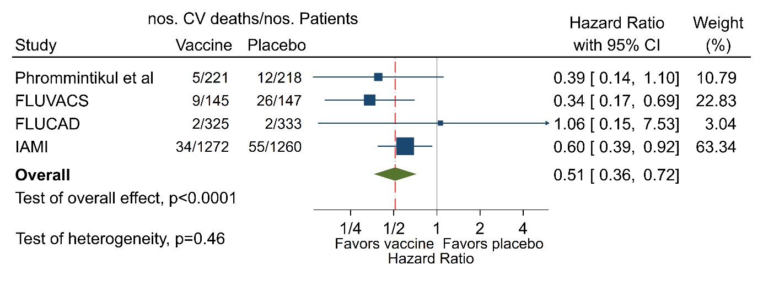
CV death exploratory meta-analysis
Phrommintikul A et al. Eur Heart J 2011;32:1730
Gurfinkel EP et al. Eur Heart J 2004;25:25
Ciszewski A et al. Eur Heart J 2008;29:1350
Notes:
We identified three other randomized trials with 1-year follow-up data on CV-death comparing influenza vaccine with no vaccine or placebo in high-risk patients with cardiovascular disease. In an exploratory meta-analysis a pooled estimate from a fixed-effects model suggested a protective effect of influenza vaccination with a HR of all four trials of 0.51. There was no evidence of between study heterogeneity.
(A fixed-effects model assumes that all studies included in a meta-analysis are estimating a single true underlying effect). I-squared=9.7% [<50% considered ‘convincing’].

Slide 18
Summary
In patients with MI or high-risk coronary disease influenza vaccination
Reduced the risk of:
The primary composite endpoint:
All-cause death, MI and stent thrombosis
Key secondary endpoints:
All-cause death and CV death
Was well-tolerated and safe
Serious adverse events were rare and of similar type and incidence in both groups
Influenza vaccination should be considered as part of in-hospital treatment after MI

