Slide 1
Edoxaban Versus Vitamin K Antagonists After Transcatheter Aortic Valve Implantation in Patients with Atrial Fibrillation – The ENVISAGE-TAVI AF Trial
George D. Dangas, MD, PhD
for the ENVISAGE-TAVI AF Investigators
Zena and Michael A. Wiener Cardiovascular Institute, Mount Sinai Hospital, New York, NY, USA; National and Kapodistrian University of Athens, School of Medicine, Athens, Greece

Slide 2
Background
Approximately 33% of patients post TAVI present with prevalent or incident atrial fibrillation¹⁻⁴
Evidence for various antithrombotic strategies for AF after TAVI is typically not studied
Need to conduct sufficiently powered RCT to investigate the efficacy and safety of a NOAC-based vs a VKA-based OAC approach in TAVI patients with AF
Edoxaban was noninferior to VKA in the prevention of stroke and other thromboembolic events with lower rates of bleeding and cardiovascular death in a general population of AF patients at moderate- to high-thrombo-embolic risk⁵
AF, atrial fibrillation; NOAC, non-vitamin K OAC; OAC, oral anticoagulant; RCT, randomized controlled trials; TAVI, transcatheter aortic valve implantation; VKA, vitamin K antagonist.
1. Adams, DH et al. N Engl J Med 2014;370:1790-8. 2. Leon, MB et al. N Engl J Med 2010;363:1597-607. 3. Smith, CR et al. N Engl J Med 2011;364:2187-98. 4. Leon, MB et al. N Engl J Med 2016;374:1609-20. 5. Giugliano, RP et al. N Engl J Med 2013;369:2093-104.

Slide 3
Trial objective and outcomes
Objective: To compare the efficacy and safety of edoxaban vs. VKA in patients with prevalent or incident AF and indication for chronic OAC therapy after successful TAVI
Primary efficacy outcome
NACE (ie, all-cause death, MI, ischaemic stroke, systemic thromboembolic event, valve thrombosis, and ISTH-defined major bleeding)
ITT population (all randomised patients)
Primary safety outcome
ISTH-defined major bleeding (clinically overt bleeding associated with reduced haemoglobin, blood transfusion, symptomatic bleeding at a critical site, or a fatal outcome)
ITT population (all randomised patients)
AF, atrial fibrillation; ISTH, International Society on Thrombosis and Haemostasis; ITT, intent-to-treat; MI, myocardial infarction; NACE, net adverse clinical events; OAC, oral anticoagulant; TAVI, transcatheter aortic valve implantation; VKA, vitamin K antagonist Schulman S, et al. J Thromb Haemost. 2005;3:692-94. Van Mieghem NM, et al. Am Heart J. 2018;205:63–69.
Notes:
21-11016-Dangas-AHR-MVH_13July2021_clean_v2_withfigs.docx, pg 7-8

Slide 4
Study design
Prospective, randomised, open-label, blinded evaluation, edoxaban-based regimen vs VKA-based regimen in AF patients
R A N D O M I S E
Edoxaban 60 mg/day*
TAVI
w/o severe complications at randomisation
with or without antiplatelet therapy***
From evening of TAVI
to 5 days (7 days for PPM)
Vitamin K antagonist**
with or without antiplatelet therapy***
Time to first dose of OAC ≤24h postrandomisation
Minimum 12-mo treatment up to 36 mo, event driven (≥6 mo for last pts enrolled)
*Edoxaban dose reduction to 30 mg in AF patients, if:
CrCl 15–≤50 ml/min
BW ≤60 kg†
P-gp inhibitors per local label†
†No dose reduction criteria in the US for AF
** VKA patients target INR 2–3
In Japan: pts ≥70 yrs 1.6–2.6
*** Stratification variable: specified use of APT for coronary stent
APT was allowed per the treating physician’s discretion including
DAPT up to 3 months, or
SAPT indefinitely
AF, atrial fibrillation; AP, antiplatelet; APT, antiplatelet therapy; ASA, aspirin; BW, body weight; CrCl, creatinine clearance; DAPT, dual antiplatelet therapy; INR, international normalised ratio; mo, month; OAC, oral anticoagulant; PCI, percutaneous intervention; PPM, permanent pacemaker; P-gp, P-glycoprotein; pt, patient; SAPT, single antiplatelet therapy; TAVI, transcatheter aortic valve implantation; VKA, vitamin K antagonist, yr, year.
Notes:
ENVISAGE Topline Results Master Deck_11July2021, slide 3

Slide 5
Statistical analyses
Estimated 320 NACE needed to occur in ~1400 patients to demonstrate noninferiority of edoxaban vs VKAs with 80% power and a 2-sided significance level of 0.05
Noninferiority was satisfied if the upper boundary of the 2-sided 95% CI for the HR fell below 1.38
Four-step hierarchical testing strategy
Noninferiority test for NACE (in ITT), α = 0.05
Continue if noninferiority is supported
Noninferiority test for MB (in ITT), α = 0.05
Continue if noninferiority is supported
Superiority* test for MB (in ITT), α = 0.05
Continue if superiority is supported*
Superiority* test for NACE (in ITT), α = 0.05
*Superiority was accepted if the upper boundary of the 2-sided 95% CI of the HR falls below 1.00.
CI, confidence interval; HR, hazard ratio; ITT, intent-to-treat population; MB, major bleeding; NACE, net adverse clinical events; VKA, vitamin K antagonist.
Van Mieghem NM, et al. Am Heart J. 2018;205:63–69.
Notes:
21-11016-Dangas Appendix_13July2021.docx, Fig S1 and pgs 21-22

Slide 6
Consort diagram
1451 patients were assessed for eligibility
25 patients
failed screening
14 did not meet inclusion/exclusion criteria
2 had adverse event
2 withdrew
3 physicians advised withdrawal
4 other
1426 patients were randomised
713 patients
assigned to the edoxaban group
(ITT analysis)
713 patients
assigned to the VKA group
(ITT analysis)
ITT, intention-to-treat; VKA, vitamin K antagonist.
Notes:
21-11016-Dangas-AHR-MVH_13July2021_clean_v2_withfigs.docx, Fig 1

Slide 7
Enrollment: 173 centers, 14 countries, 3 continents
North America
n=168
Europe
n=1080
Asia
n=178
Canada
USA
Austria
Belgium
France
Germany
Italy
Japan
South Korea
Netherlands
Poland
Spain
Switzerland
United Kingdom
Executive Committee: George Dangas, Nicolas Van Mieghem (Global Lead Investigators), Cathy Chen, Christian Hengstenberg, Roxana Mehran, Shigeru Saito, Martin Unverdorben, Marco Valgimigli, Roland Veltkamp, Pascal Vranckx
Data Monitoring Committee: Bernard Gersh (Chairperson), Deepak Bhatt, Jonathan Halperin, Freek Verheugt, Timothy Collier
Clinical Events Committee: Steven Marx (Chairperson), Nicola Corvaja, Douglas DiStefano, Newsha Ghodsi, Jose Meller, Jesse Weinberger, David Kaufman, Mark Milstein

Slide 8
Key baseline characteristics
 | Edoxaban (n = 713) | VKA (n = 713)
Age [yrs], mean (SD) | 82.1 (5.4) | 82.1 (5.5)
Female | 347 (48.7) | 331 (46.4)
Race Asian Caucasian Other | 92 (12.9) 593 (83.2) 17 (2.4) | 89 (12.5) 594 (83.3) 25 (3.5)
Weight [kg], mean (SD) | 74.6 (17.9) | 76.0 (17.3)
Creatinine clearance (Cockcroft-Gault formula, mL/min), mean (SD) | 57.9 (24.0) | 58.6 (24.3)
Hypertension | 647 (90.7) | 657 (92.2)
Diabetes mellitus | 270 (37.9) | 257 (36.0)
Congestive heart failure | 591 (82.9) | 619 (86.8)
History of stroke or TIA | 123 (17.3) | 116 (16.3)
History of coronary artery disease | 293 (41.1) | 297 (41.7)
Incident atrial fibrillation | 7 (1.0) | 8 (1.1)
CHA₂DS₂-VASc, mean (SD) | 4.5 (1.4) | 4.5 (1.3)
STS score, mean (SD) | 4.8 (3.5) | 5.0 (4.1)
Gastrointestinal disorder | 264 (37.0) | 242 (33.9)
Criteria for dose adjustment (+)* | 330 (46.28) | 331 (46.42)
Data presented as n (%), unless otherwise indicated.
*Criteria include creatinine clearance ≤50 ml/min, body weight ≤60 kg,† or concomitant P-gp inhibitor therapy.†
†No dose reduction criteria in the US for AF.
AF, atrial fibrillation; P-gp; P-glycoprotein; PPI, proton pump inhibitor; SD, standard deviation; STS, Society of Thoracic Surgeons; TIA, transient ischaemic attack; VKA, vitamin K antagonist; yr, year.
Notes:
21-11016-Dangas-AHR-MVH_13July2021_clean_v2_withfigs.docx, Table 1

Slide 9
Trial population
Mean time from TAVI to randomisation: 67 and 70 h for edoxaban and VKA arms
OAP specified before randomization in 328 patients (46.0%) in the edoxaban arm and 359 patients (50.4%) in the VKA arm
46.4% of the trial population fulfilled ≥1 edoxaban dose adjustment criteria
CrCl 15–≤50 ml/min (edoxaban: 83.6%; VKA: 85.8%)
BW ≤60 kg (edoxaban: 44.2%; VKA: 40.2)*
P-gp inhibitors per local label (edoxaban: 7.0%; VKA: 6.0%)*
Median follow-up duration was 548 days (554 days edoxaban; 530 days VKA)
Administration of PPIs was similar in edoxaban (71.7%) and VKA (69.0%) arms
*No dose reduction criteria in the US for AF
AF, atrial fibrillation; BW, body weight; CrCl, creatinine clearance; h, hours; OAP, oral antiplatelets; PPI, proton pump inhibitors; TAVI, transcatheter aortic valve implantation; VKA, vitamin K antagonist.
Notes:
21-11016-Dangas-AHR-MVH_13July2021_clean_v2_withfigs.docx, pg 9-10 trial population, pg 11 para 1

Slide 10
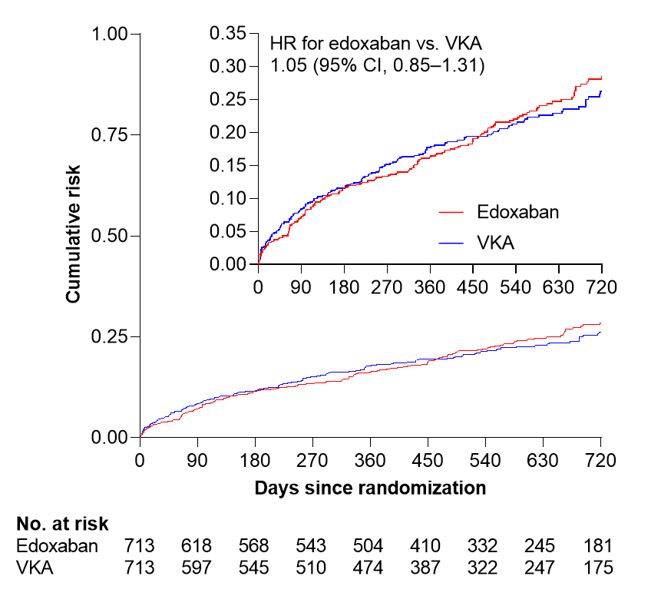
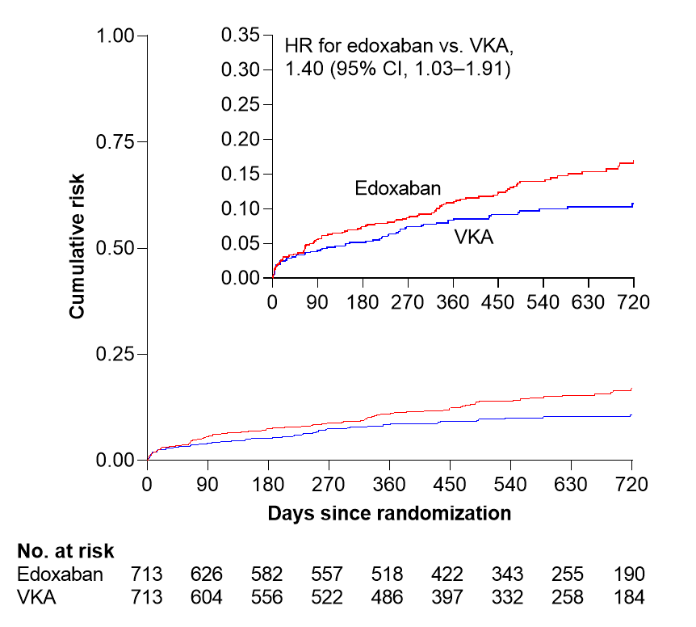
Primary efficacy and safety outcomes
NACE
Major bleeding
P = 0.014*
P = 0.927*
*Noninferiority P-value
CI, confidence interval; HR, hazard ratio; NACE, net adverse clinical events; VKA, vitamin K antagonist.
Notes:
21-11016-Dangas-AHR-MVH_13July2021_clean_v2_withfigs.docx, Fig 2

Slide 11
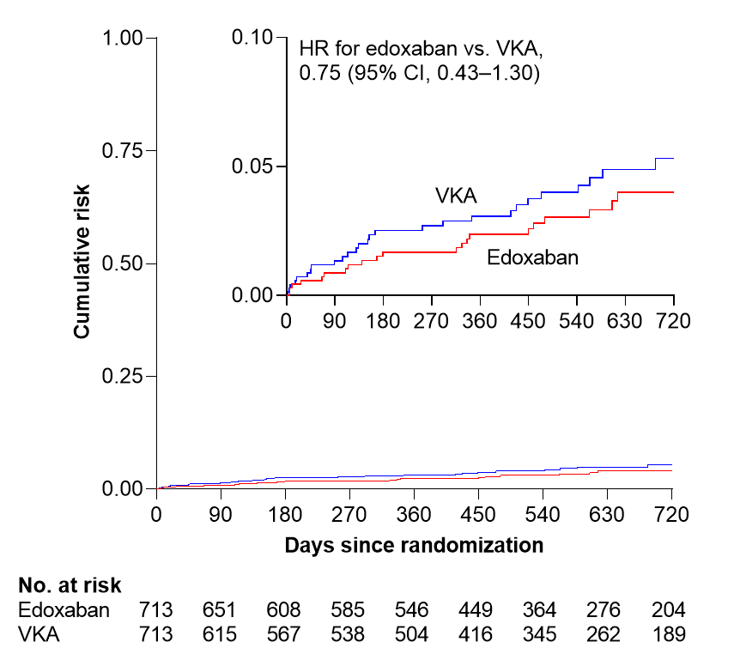
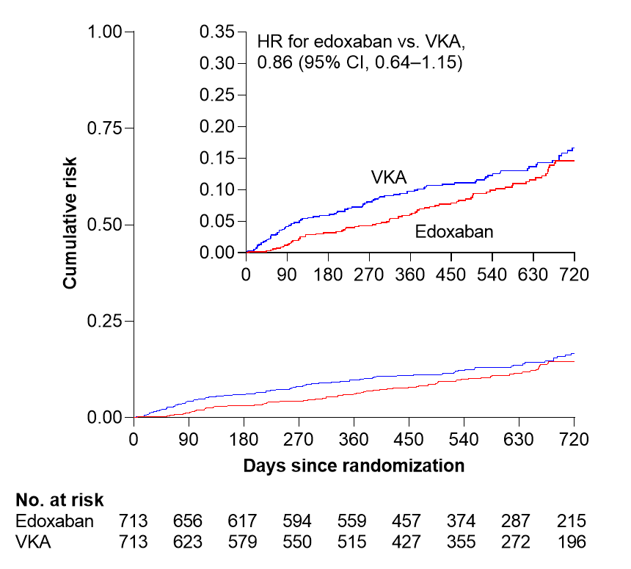
Ischaemic stroke and all-cause death
Ischaemic stroke
All-cause death
CI, confidence interval; HR, hazard ratio; No, number; VKA, vitamin K antagonist.
Notes:
21-11016-Dangas-AHR-MVH_13July2021_clean_v2_withfigs.docx, Fig 2

Slide 12
Primary efficacy outcome and components
*HR and CI for treatment comparison vs. VKA are based on the Cox proportional hazard regression model including treatment group, transcatheter aortic valve replacement procedure undergone with stenting (yes, no), and requirement for dose adjustment as covariates.
†ISTH definition.
SEE and valve thrombosis are not shown because n≥5 events did not occur in either treatment group.
CI, confidence interval; EDO, edoxaban; ISTH, International Society on Thrombosis and Haemostasis; NACE, net adverse clinical events, defined as a composite of all-cause death, myocardial infarction, ischaemic stroke, systemic thromboembolic event, valve thrombosis, and ISTH-defined major bleeding; VKA, vitamin K antagonist.

Slide 13
Efficacy and safety outcomes
 | Edoxaban (n=713) | VKA (n=713) | HR (95% CI)
NACE (Primary efficacy outcome) | 170 (17.3) | 157 (16.5) | 1.05 (0.85 to 1.31)*
Major bleeding (Primary safety outcome)‡ | 98 (9.7) | 68 (7.0) | 1.40 (1.03 to 1.91)†
Secondary outcomes
All-cause death | 85 (7.8) | 93 (9.1) | 0.86 (0.64 to 1.15)
Cardiovascular death | 49 (4.5) | 46 (4.5) | 1.00 (0.67 to 1.50)
Ischaemic stroke | 22 (2.1) | 28 (2.8) | 0.75 (0.43 to 1.30)
Myocardial infarction | 12 (1.1) | 7 (0.7) | 1.65 (0.65 to 4.14)
Systemic thromboembolic event | 2 (0.2) | 3 (0.3) | Not calculated
Valve thrombosis‡ | 0 | 0 | Not calculated
Any stroke | 29 (2.7) | 35 (3.5) | 0.78 (0.48 to 1.28)
MACCE | 86 (8.2) | 80 (8.1) | 1.02 (0.76 to 1.39)
MACE | 61 (5.7) | 53 (5.2) | 1.10 (0.76 to 1.58)
Fatal bleeding‡ | 11 (1.0) | 10 (1.0) | Not calculated
Life threatening bleeding | 17 (1.6) | 19 (1.9) | Not calculated
Intracranial haemorrhage | 16 (1.5) | 21 (2.1) | 0.72 (0.38 to 1.39)
CRNM bleeding‡ | 164 (18.2) | 142 (16.4) | 1.13 (0.90 to 1.14)
Data presented as n (%/yr). *Noninferiority P = 0.014; †Noninferiority P = 0.927; ‡ISTH definition. Valve thrombosis was defined as any thrombus attached to or near an implanted valve that occludes part of the blood flow path, interferes with valve function, or is sufficiently large to warrant treatment.
CI, confidence interval; CRNM, clinically relevant nonmajor; HR, hazard ratio; ISTH, International Society on Thrombosis and Haemostasis; MACCE, major adverse cardiac and cerebrovascular events, defined as the composite of adjudicated cardiovascular-related death, myocardial infarction, any stroke, or repeat coronary revascularisation; MACE, major adverse cardiac events; NACE, net adverse clinical events; NC, not calculated; VKA, vitamin K antagonist.
Notes:
21-11016-Dangas-AHR-MVH_13July2021_clean_v2_withfigs.docx, Table 2

Slide 14
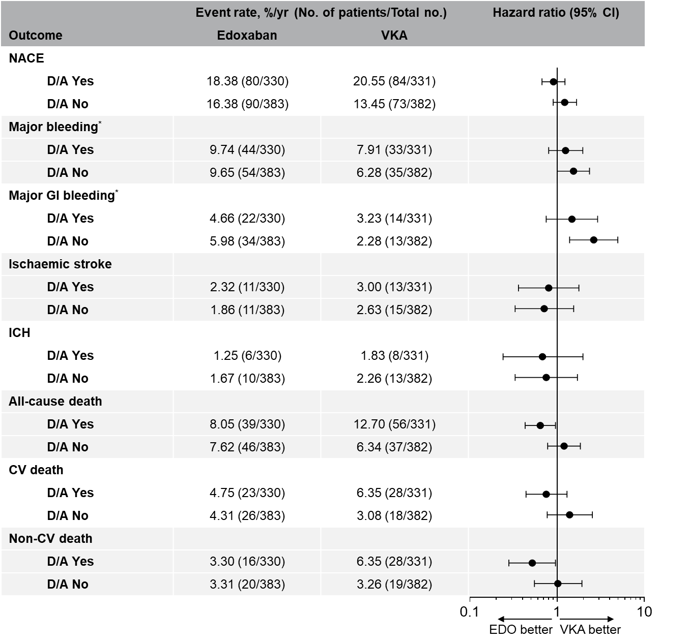
Outcome Event rate, %/yr (No. of total patients/Total No.) Hazard ratio (95% CI)
Edoxaban VKA
Outcomes by dose adjustment criteria
Edoxaban dose reduction to 30 mg in AF patients, if:
CrCl 15–≤50 ml/min
BW ≤60 kg†
P-gp inhibitors per local label†
†No dose reduction criteria in the US for AF
*ISTH definition
AF, atrial fibrillation; BW, body weight, CI, confidence interval; CrCl, creatinine clearance; CV, cardiovascular; D/A, dose adjustment; EDO, edoxaban; GI, gastrointestinal; ICH, intracerebral haemorrhage; ISTH, International Society on Thrombosis and Haemostasis; NACE, net adverse clinical events; VKA, vitamin K antagonist.
Notes:
21-11016-Dangas Appendix_13July2021.docx, Fig S6

Slide 15
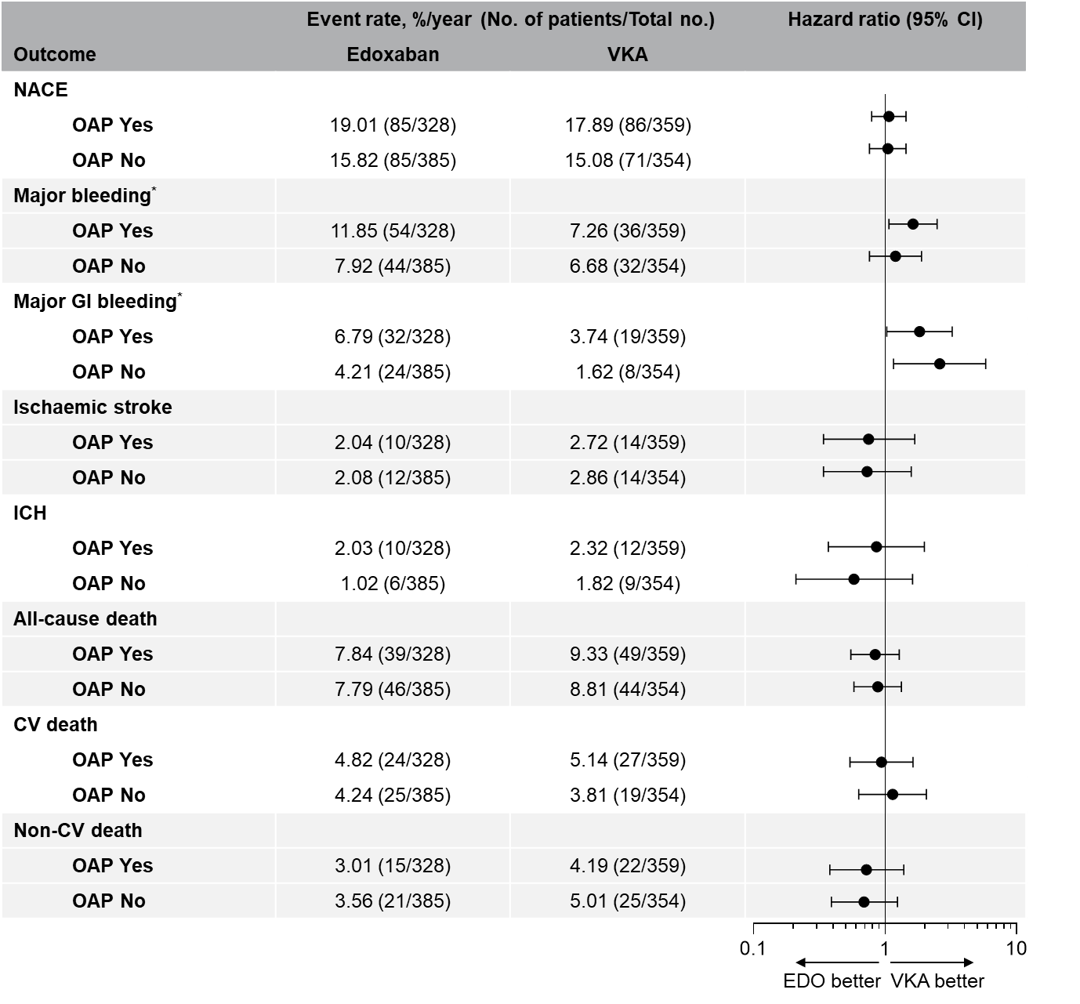
Outcome Event rate, %/yr (No. of total patients/Total No.) Hazard ratio (95% CI)
Edoxaban VKA
Outcomes by specified OAP
*ISTH definition
CI, confidence interval; CV, cardiovascular; EDO, edoxaban; GI, gastrointestinal; ICH, intracerebral haemorrhage; ISTH, International Society on Thrombosis and Haemostasis; NACE, net adverse clinical events; OAP, oral antiplatelet therapy; VKA, vitamin K antagonist.
Notes:
21-11016-Dangas-AHR-MVH_13July2021_clean_v2_withfigs.docx, Fig 3B

Slide 16
Results overview
Noninferiority criteria met for NACE primary endpoint
Higher rates of major bleeding with edoxaban were driven by major GI bleeding
One major GI bleed was fatal in the edoxaban arm
Rates of intracranial haemorrhage or fatal bleeding were similarly rare in both trial arms
Patients who fulfilled dose adjustment criteria and received edoxaban 30 mg had similar NACE and major bleeding rates as compared to patients with VKA
Among patients with prespecified antiplatelet therapy, edoxaban was associated with higher rates of major bleeding compared with VKA
GI, gastrointestinal; NACE, net adverse clinical events; VKA, vitamin K antagonist.
Notes:
21-11016-Dangas-AHR-MVH_13July2021_clean_v2_withfigs.docx, pgs 10-11, p 12 para 2, p 13 last para

Slide 17
Conclusions
In ENVISAGE-TAVI AF, in patients with an indication for OAC for atrial fibrillation after successful TAVI, edoxaban was noninferior to VKA for the composite primary composite outcome of adverse clinical events
In these patients, edoxaban was associated with higher major bleeding risk in the overall population
Sub-analyses suggest that patients fulfilling dose adjustment criteria and patients without concomitant oral antiplatelet therapy may be reasonable/appropriate candidates for edoxaban based on attenuating bleeding differences vs. control
Further investigations into this topic are underway
OAC, oral anticoagulation; TAVI, transcatheter aortic valve implantation; VKA, vitamin K antagonist.
Notes:
21-11016-Dangas-AHR-MVH_13July2021_clean_v2_withfigs.docx, p 14

Slide 18
