Slide 1



Hyperinvasive Approach in Refractory
Out-of-Hospital Cardiac Arrest. Prague OHCA study.
A Randomized Clinical Trial
ClinicalTrials.gov: NCT01511666.
Supported by a research grant from the Internal Grant Agency Ministry of Health, Czech Republic, NT 13225-4/2012 and by the Progres Q38/LF1 institutional support.
COI: consultant for ABIOMED and Getinge
J Belohlavek, J Smalcova, D Rob, O Franek, et al.
2nd Department of Medicine – Cardiovascular Medicine,
1st Faculty of Medicine, Charles University in Prague
and General University Hospital in Prague, Czech Republic
Emergency Medical Service Prague, Czech Republic

Slide 2
Introduction and methods
r-OHCA has poor outcome
ECPR is promising
Despite encouraging results in nonRCTs and one small RCT (ARREST), benefit of ECPR in refractory OHCA remains uncertain
We compared „Hyperinvasive approach“ (early transport to hospital under mechanical CPR, ECPR and immediate invasive evaluation) to Standard ACLS in refractory OHCA
Adults with OHCA of presumed cardiac cause were electronically randomized to H or S during on scene ongoing chest compressions
Study conducted from Mar-1-2013 to Oct-25-2020
Prematurely stopped by DSMB due to benefit in subgroups

Slide 3
Study flow and baseline characteristics

Slide 4
Procedural characteristics

Slide 5
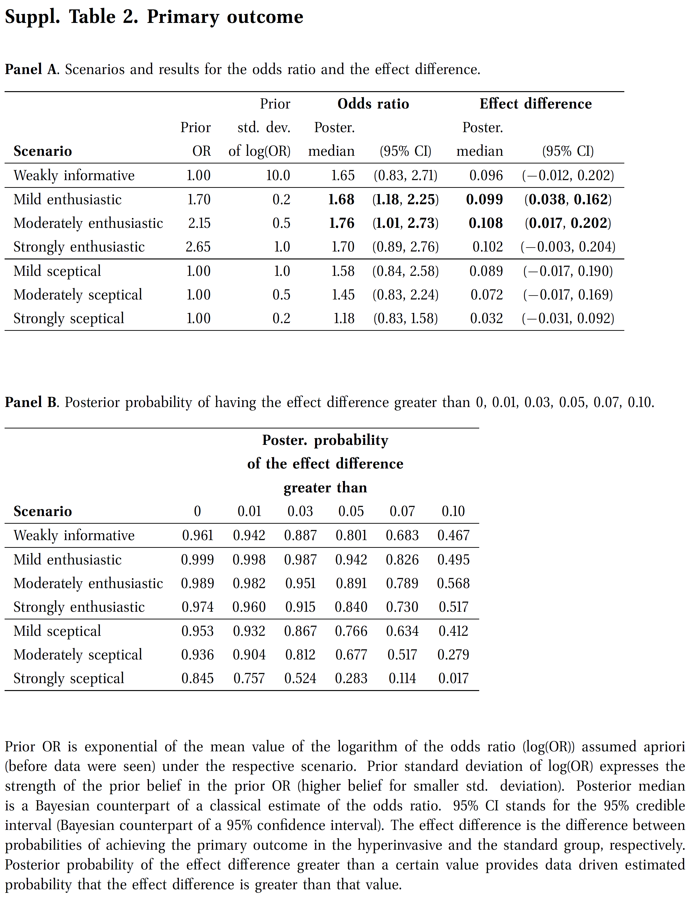
Outcomes
Bayesian analysis of the primary outcome

Slide 6
Survival related to time of CPR
4 of 6 survivors
In S arm were actually crossovers to H arm

Slide 7
Conclusions
Hyperinvasive approach is feasible and effective treatment strategy in refractory OHCA
Although we did not demonstrate statistically significant improvement in primary outcome, Bayesian analysis of primary endpoint suggests benefit of the H approach under a broad set of scenarios.
Study showed a beneficial effect in 30-day neurological outcome, 180 day mortality, and benefit in patients resuscitated for more than 45 minutes.
Prerequisites include highly effective prehospital care, high percentage of bystander CPR, dispatch center directed CPR and close cooperation with experienced CA center

