Slide 1
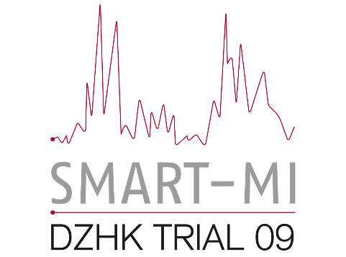
Implantable cardiac monitors in high-risk post-infarction patients with cardiac autonomic dysfunction and moderately reduced left ventricular ejection fraction – A randomized trial
A. Bauer, N. Sappler, L. von Stülpnagel, M. Klemm, M. Schreinlechner, F. Wenner, J. Schier, A. Al Tawil, T. Dolejsi, A. Krasniqi, E. Eiffener, C. Bongarth, M. Stühlinger, M. Huemer, T. Gori, R. Wakili, R. Sahin, R. Schwinger, M. Lutz, A. Luik, N. Gessler, P. Clemmensen, A. Linke, L. S. Maier, M. Hinterseer, M. C. Busch , F. Blaschke, S. Sack, C. Lennerz, M. Licka, R. R. Tilz, C. Ukena, J. R. Ehrlich, M. Zabel, G. Schmidt, U. Mansmann, S. Kääb, K. D. Rizas, S. Massberg
for the SMART-MI investigators
Amsterdam, 27th August 2021

Slide 2
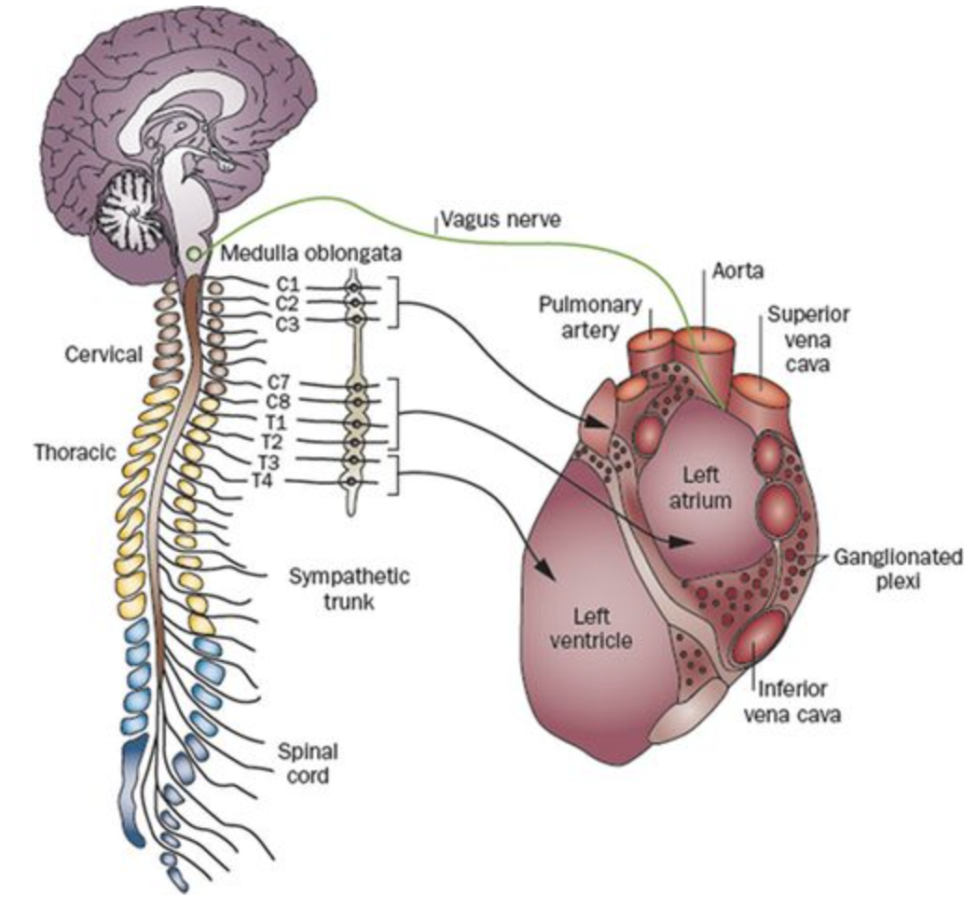
SMART-MI-DZHK9
Background
Most cardiovascular complications after myocardial infarction (MI) occur in patients with left ventricular ejection fraction (LVEF) >35%¹
A MI can cause profound damage to the autonomic nervous system at various levels of the cardiac neuroaxis²
Cardiac autonomic dysfunction after MI is associated with poor prognosis, irrespective of LVEF
Cardiovascular complications may be preceded by subclinical arrhythmic events³
Early detection of these arrhythmias by telemedical monitoring may identify patients at very high risk for impending complications
¹ISAR RISK, Eur Heart J 2009
²Circulation Research 2014
³CARISMA-ICM, Circulation 2010

Slide 3
SMART-MI-DZHK9
Hypothesis
Telemedical monitoring with implantable cardiac monitors (ICMs) is superior to conventional follow-up in early detection of serious arrhythmic events (SArE) in post-MI patients with cardiac autonomic dysfunction and LVEF 36-50%

Slide 4
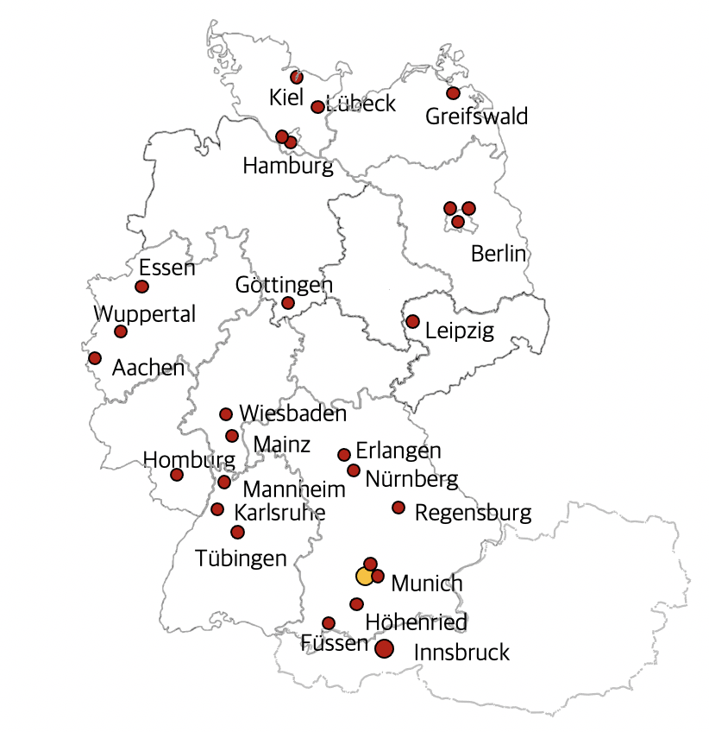
SMART-MI-DZHK9
Study design
Investigator-initiated, randomized, multicentre study
33 tertiary centres in Germany and Austria
Funded by the German Center for Cardiovascular Research (DZHK) and the Medtronic Bakken Research Centre
Enrolment from May 2016 and February 2021
Coordination, ECG and ICM core labs by the Munich University Hospital

Slide 5
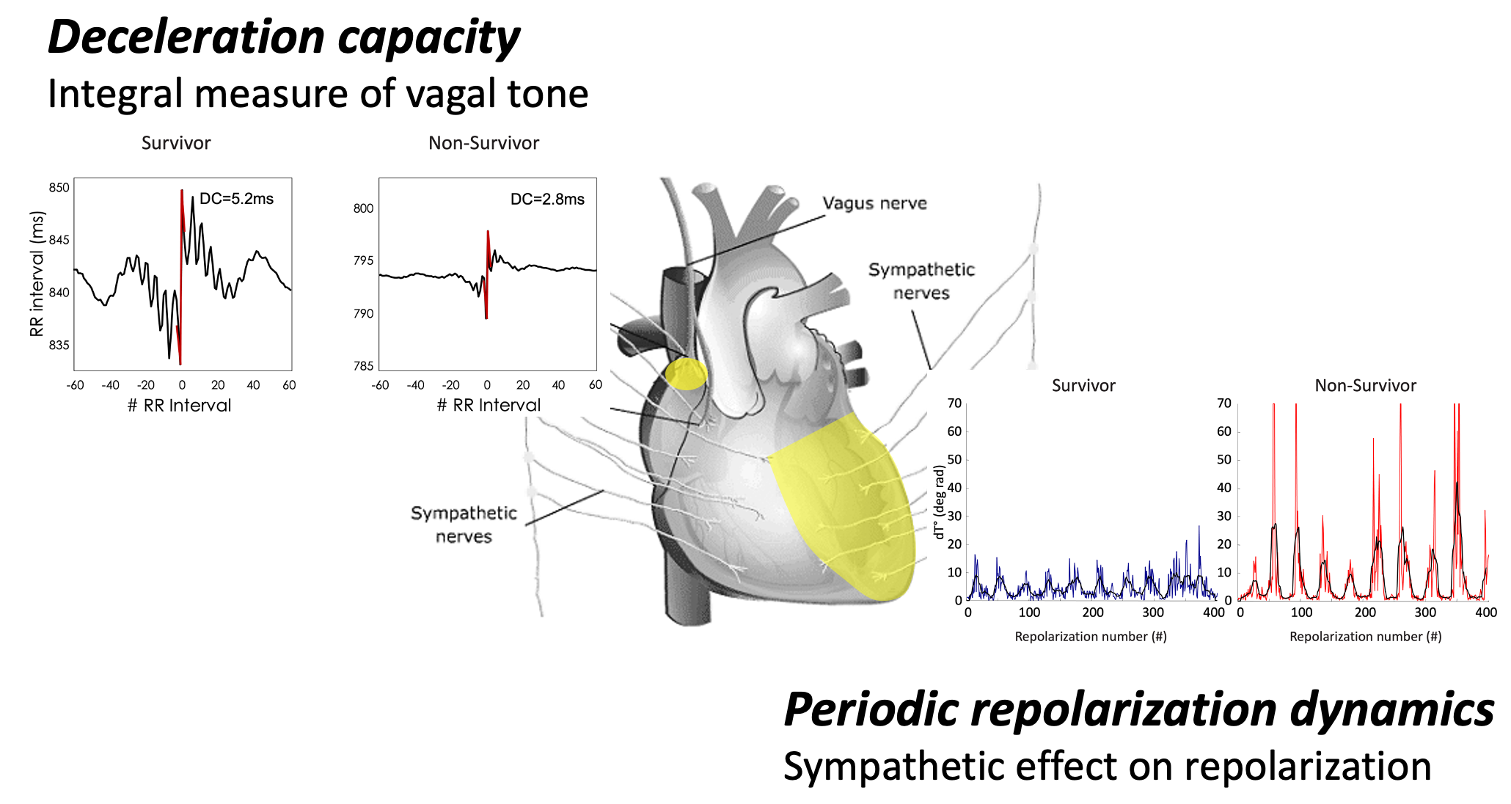
SMART-MI-DZHK9
Study participants & procedures
Eligible patients
Survivors of acute MI (<40 days) requiring primary PCI
LVEF 36-50% (>48h or when CK-MB normalized)
Sinus rhythm
20-min ECG for assessment of digital biomarkers
Cardiac autonomic dysfunction considered present if deceleration capacity (DC)¹ and/or periodic repolarization dynamics (PRD)² were abnormal
1:1 randomization of 400 high-risk patients
Biosignal Analysis
-
Registry
(n=905)
+
n=400
R
ICM-implantation
Conventional follow-up
¹Lancet 2006; ²J Clin Invest 2014 & Lancet 2019

Slide 6
SMART-MI-DZHK9
Study participants & procedures
Eligible patients
ICM-implantation (Reveal LINQ, Medtronic) and connection to Carelink system
Daily data transmission to ICM core lab in Munich
Predefined SArE reported to study centres within 48h
Response to SArE at discretion of treating physicians
Median follow-up 21 months (IQR 11–34)
Biosignal Analysis
-
Registry
(n=905)
+
n=400
R
ICM-implantation
Conventional follow-up
Primary diagnostic endpoint

Slide 7
SMART-MI-DZHK9
Endpoints
Primary composite endpoint: Serious arrhythmic events (SArE)
Atrial fibrillation (AF) ≥6min¹
AV block ≥IIb²
Fast non-sustained VT (CL ≤320ms for ≥ 40 beats)³ / sustained VT/VF
Secondary endpoints (selection)
Death
Major adverse cardiac and cerebrovascular events (MACCE)
¹ ASSERT, NEJM 2012; ²CARISMA, Circulation 2010; ³ADVANCE III, JAMA 2013

Slide 8
SMART-MI-DZHK9
Patients’ characteristics and treatments
 | ICM group (N=201) | Control group (N=199)
Age (years) | 64 (57-73) | 65 (57-73)
Females (%) | 24% | 15%
CHA₂DS₂-VASc | 3 (2–4) | 3 (2–4)
STEMI (vs. NSTEMI) | 61% | 57%
LVEF (%) | 45 (40-48) | 45 (40-48)
PCI | 100% | 99%
Aspirin | 98% | 97%
P2Y12 inhibitor | 100% | 100%
Betablocker | 95% | 89%
RAS inhibition | 97% | 93%
Statins | 95% | 98%

Slide 9
SMART-MI-DZHK9
Primary efficacy endpoint
50
ICM-group
60 SArE
43 AFiB
10 AVB ≥IIb
7 VT/VF
Control group
40
HR 6.3 (3.4–11.8)
p < 0.0001
30
Serious arrhythmic events (%)
20
12 SArE
11 AFiB
1 VT/VF
10
0
0
6
12
18
24
30
36
Months since randomization
ICM
201
145
104
76
57
37
25
Control
199
177
139
110
84
57
41

Slide 10
SMART-MI-DZHK9
Exploratory analysis: SArE excluding AFiB
50
ICM-group
Control group
40
HR 12.2 (2.9–51.7)
p < 0.0001
30
23 SArE
14 AVB ≥IIb
9 VT/VF
Serious arrhythmic events (%)
20
10
2 SArE
2 VT/VF
0
0
6
12
18
24
30
36
Months since randomization
ICM
201
165
122
93
72
53
39
Control
199
182
142
113
84
58
43

Slide 11
SMART-MI-DZHK9
Diagnostic and therapeutic interventions
 | ICM group (n=201) | Control group (n=199) | P-value
ICD-implantation | 13 | 5 | 0.056
Pacemaker implantation | 6 | 0 | 0.041
EP study | 12 | 3 | 0.019
Catheter ablation | 10 | 3 | 0.051
Revascularization | 40 | 43 | 0.37
Initiation of OAK for AF | 37* | 11 | <0.001
* median AF duration 4.5 hours

Slide 12
SMART-MI-DZHK9
Secondary clinical endpoints
 | ICM (n=201) | Control (n=199) | Hazard Ratio (95% CI) | P-value
Clinical endpoints
Death | 11 | 9 | 1.3 (0.5-3.1) | 0.580
MACCE | 25 | 26 | 1.0 (0.6-1.8) | 0.910

Slide 13
SMART-MI-DZHK9
Time dependent Cox regression analysis
ICM group (N = 201; 60 SArE; 25 MACCE)
1.0
Hazard ratio, 6.82 (95% CI, 2.86 – 16.22)
0.8
p < 0.001
0.6
SArE
Do ICM-detected SArE predict subsequent cardiovascular complications ?
MACCE
0.4
0.2
No SArE
0.0
0
6
12
18
24
30
36
Months since Randomization
No SArE
192
136
95
71
54
33
21
SArE
9
34
31
27
18
20
14
Event rates according to the Simon and Makuch method

Slide 14
SMART-MI-DZHK9
SArE as predictors of subsequent MACCE
ICM group
(n=201)
Control group
(n=199)
Positive predictive accuracy
60%
61%
P = 0.990
SArE-predicted MACCE
61%
20%
Sensitivity
P = 0.007

Slide 15
SMART-MI-DZHK9
Limitations
SMART-MI is a diagnostic study not powered to detect differences in clinical outcomes (small sample size, short follow-up)
Therefore, no conclusions can be drawn about whether early detection of and response to prognostically relevant SArE leads to better outcomes

Slide 16
SMART-MI-DZHK9
Conclusions
Post-MI patients with cardiac autonomic dysfunction and LVEF 36-50% develop a high number of subclinical brady- and tachyarrhythmic SArE that can be effectively detected by telemonitoring with ICMs.
ICM-detected SArE are highly predictive of subsequent cardiovascular complications.
Early detection of subclinical SArE may open a window of opportunity for preemptive interventions.
Future studies powered for clinical endpoints are needed.

Slide 17
SMART-MI-DZHK9
Thanks to all SMART-MI investigators
LMU University Hospital Munich
Medical University of Innsbruck
Klinik Höhenried, Bernried
Charité-Universitätsmedizin Berlin, CBF
University Medical Center Mainz
University Duisburg-Essen
Paracelsus Medical University Nürnberg
Hospital Weiden
University Hospital Schleswig Holstein
University Medical Center Göttingen
Städtisches Klinikum Karlsruhe
Asklepios Hospital St. Georg, Hamburg
University Heart Center Hamburg
Herzzentrum Dresden, TU Dresden
University Hospital Regensburg
University Medicine Greifswald
Kliniken Ostallgaeu-Kaufbeuren, Fuessen
Klinikum Neuperlach, Munich
Charité - Universitätsmedizin Berlin, CVK
DHZ, Technische Universität München
University of Heidelberg
University Medical Centre Mannheim
St. Josefs-Hospital Wiesbaden
University Hospital Lübeck
Saarland University Medical Center, Homburg
University Hospital rechts der IsarTU Munich
Heart Center Leipzig at University Leipzig
University Hospital Aachen, RWTH Aachen University
University Hospital Münster
Heart Center Leipzig at University of Leipzig
HELIOS Heart Center Wuppertal
University Clinic of Tuebingen
Kiel
Lübeck
Greifswald
Hamburg
Essen
Berlin
Göttingen
Wuppertal
Leipzig
Aachen
Wiesbaden
Homburg
Mainz
Erlangen
Mannheim
Nürnberg
Karlsruhe
Regensburg
Tübingen
Munich
Medtronic Bakken Research Centre
Füssen
Höhenried
Innsbruck

Slide 18
SMART-MI-DZHK9
Thank you for your attention.

