Slide 1
A Fully Magnetically Levitated Left Ventricular Assist Device
Final Report of the MOMENTUM 3 Trial
Mandeep R. Mehra, MD, Nir Uriel, MD, Joseph C. Cleveland, Jr., MD, Daniel J. Goldstein, MD,
National Principal Investigators, on behalf of the MOMENTUM 3 Investigators

Slide 2
Disclosures
Dr. Mandeep R. Mehra:
Consultant for Abbott, Portola, Bayer, and Xogenex. Trial steering committee member for Medtronic and Janssen. Scientific advisory board member for NupulseCV and FineHeart. DSMB member for Mesoblast. Travel support from Abbott.
Dr. Nir Uriel:
Research grants from Abbott and Medtronic. Consultant for Abbott and Medtronic.
Dr. Joseph C. Cleveland, Jr.:
Institutional research grants from Abbott.
Dr. Daniel J. Goldstein:
Proctor and educator for Abbott. Travel support from Abbott. DSMB member for TERUMO Inc.
MOMENTUM 3 is sponsored by Abbott (ClinicalTrials.gov NCT02224755)

Slide 3
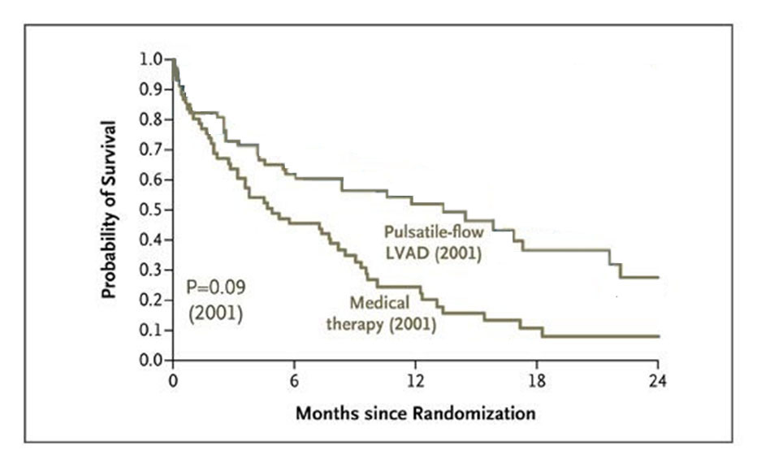
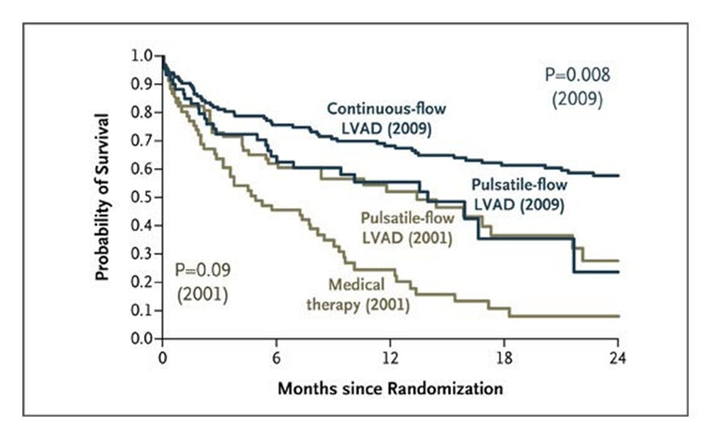
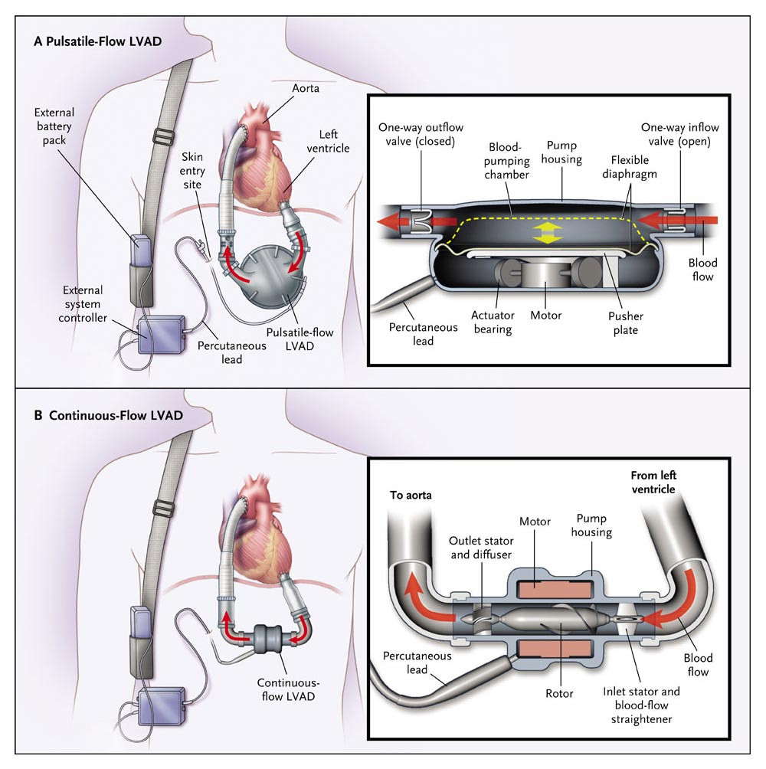
Background
Left Ventricular Assist Systems (LVAS) improve survival and quality of life in patients with advanced heart failure refractory to medical therapy^{1,2}
HeartMate XVE: Pulsatile-flow LVAD
Fang JC. N Engl J Med 2009;361(23):2282-5
HeartMate II: Continuous-flow LVAD
¹Rose EA et al. Long-Term Use of a Left Ventricular Assist Device for End-Stage Heart Failure. N Engl J Med 2001;345(20):1435-43
²Slaughter MS et al. Advanced Heart Failure Treated with Continuous-Flow Left Ventricular Assist Device. N Engl J Med 2009;361(23):2241-51
Notes:
Animate

Slide 4

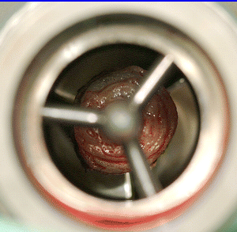
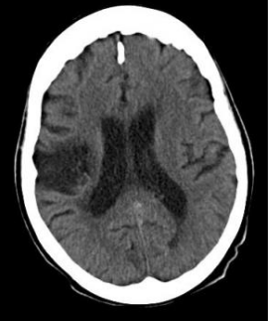
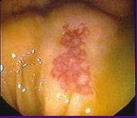
Background
Pump Thrombosis
Despite improving survival and quality of life, patients with continuous-flow LVADs are burdened with hemocompatibility-related complications¹
Consequences of adverse interactions between the pump and circulating blood elements
  Pump thrombosis
  Stroke
  Gastrointestinal bleeding
Stroke
Gastrointestinal Bleeding
¹Mehra MR. The burden of haemocompatibility with left ventricular assist systems: a complex weave. Eur Heart J 2019;40(8):673-7

Slide 5
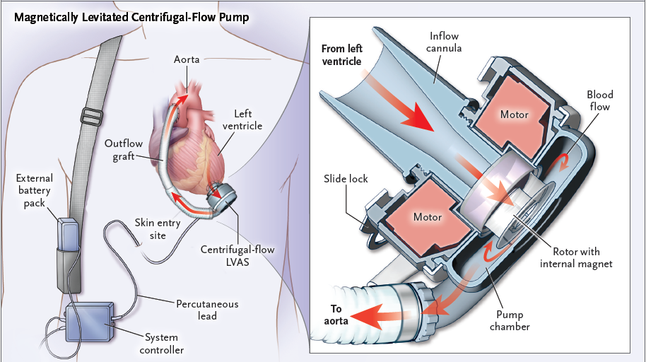
HeartMate 3 LVAS
The HeartMate 3 LVAS is a centrifugal-flow, fully magnetically levitated blood pump engineered to minimize destruction of red blood cells and thrombosis
Wide blood-flow passages to reduce shear stress
Frictionless with absence of mechanical bearings
Intrinsic Pulse designed to reduce stasis and avert thrombosis
Mehra MR et al. A Fully Magnetically Levitated Circulatory Pump for Advanced Heart Failure. N Engl J Med 2017;376(5):440-50

Slide 6
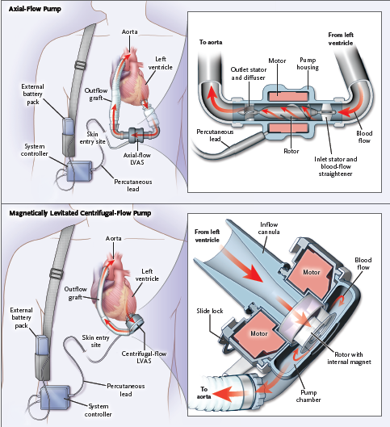
Adaptive Trial Design
Advanced Heart Failure Irrespective of Intended Goal of Therapy
(Bridge to Transplant or Destination Therapy)
Net Trial Experience
24
HeartMate 3
HeartMate II
Randomization 1:1
Final analysis of the Full Cohort
(100%)
Short Term (ST) Cohort¹
N=294
6-month follow-up
2nd interim analysis of the LT cohort²
(35.6%)
Additional 72 patients enrolled
Months of Follow-Up
Long Term (LT) Cohort²
N=366
2-year follow-up
6
1st interim analysis of the ST cohort¹
(7.1%)
Additional 662 patients enrolled
Full Cohort
N=1028
2-year follow-up
0
294
366
1028
Number of Patients
¹Mehra MR et al. A Fully Magnetically Levitated Circulatory Pump for Advanced Heart Failure. N Engl J Med 2017;376(5):440-50
²Mehra MR et al. Two-Year Outcomes with a Magnetically Levitated Cardiac Pump in Heart Failure. N Engl J Med 2018;378(15):1386-95
.

Slide 7
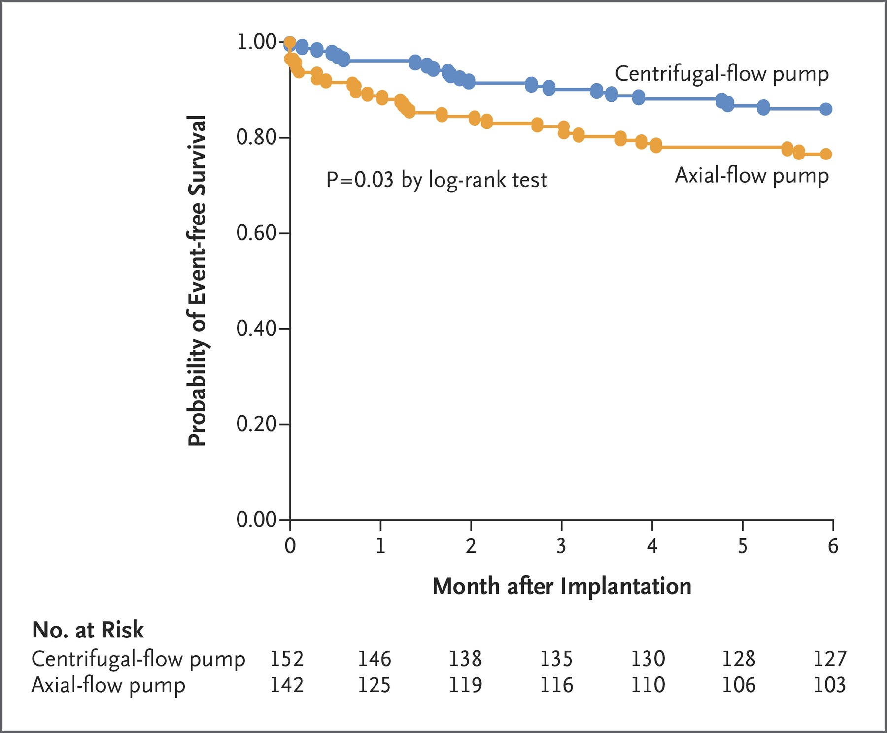
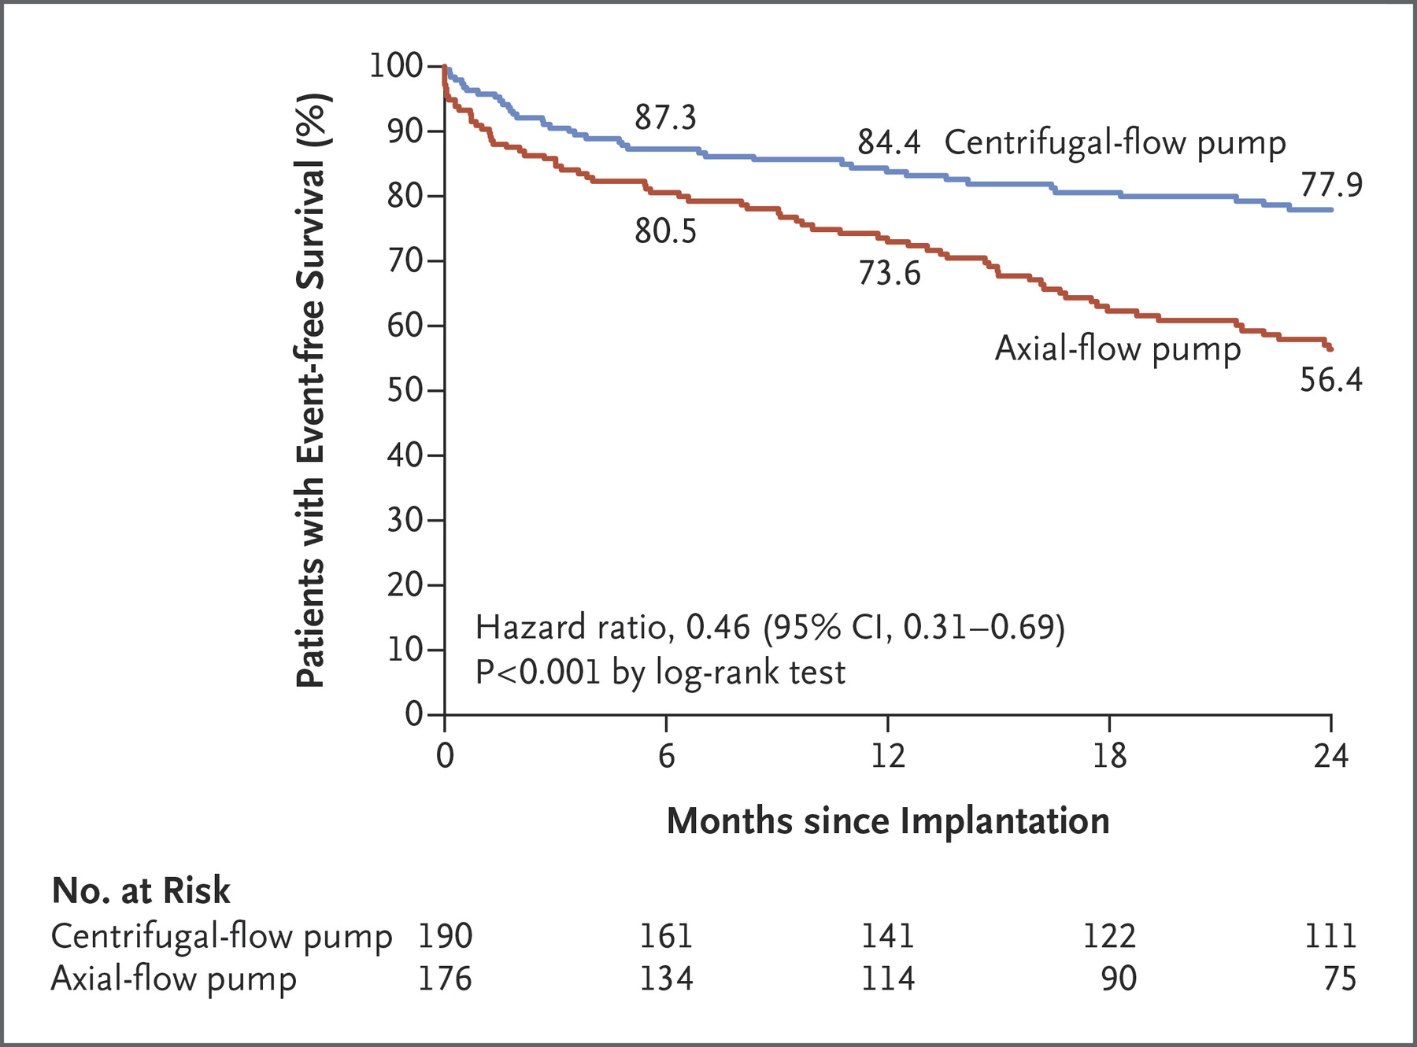
Two Interim Analyses
  ST Cohort: 294 Patients at 6 Months¹
  LT Cohort: 366 Patients at 2 Years^{2,3}
HeartMate 3 superiority driven by reduction in pump thrombosis
Lower incidence of non-disabling stroke with HeartMate 3
¹Mehra MR et al. A Fully Magnetically Levitated Circulatory Pump for Advanced Heart Failure. N Engl J Med 2017;376(5):440-50.
²Mehra MR et al. Two-Year Outcomes with a Magnetically Levitated Cardiac Pump in Heart Failure. N Engl J Med 2018;378(15):1386-95
³Colombo PC et al. Comprehensive Analysis of Stroke in the Long-Term Cohort of the MOMENTUM 3 Study. Circ 2019;139 (2):155-68

Slide 8
Full Cohort
Full Cohort
N=1028
24-month follow-up
Intent-to-Treat (ITT) Population
N=1028
HeartMate 3
N=516
HeartMate II
N=512
Withdrawn before implant
N = 7
Death: 2
No LVAD implant: 2
Withdrawal of consent: 1
Transplant: 1
Implanted with non-study LVAD: 1
Withdrawn before implant
N = 1
Death: 1
As-Treated Population
N=1020
Implanted with HeartMate 3
N=515
Implanted with
HeartMate II
N=505
Withdrawn after implant
N = 6
Implanted with non-study device: 2
Withdrawal of consent: 1
Non-compliance: 1
Other reason: 2
Withdrawn after implant
N = 15
Implanted with non-study device: 5
Withdrawal of consent: 1
Implanted with HM3: 6
Other reason: 3
Completed study follow-up
N=509
Completed study follow-up
N=490

Slide 9
Baseline Characteristics
Characteristic | HeartMate 3 (n=516) | HeartMate II (n=512)
Mean age - years | 59 ± 12 | 60 ± 12
Male - no. (%) | 411 (79.7) | 419 (81.8)
Race - no. (%)
White | 342 (66.3) | 367 (71.7)
Black or African American | 145 (28.1) | 120 (23.4)
Asian | 8 (1.6) | 3 (0.6)
Native Hawaiian or Pacific islander | 0 (0) | 4 (0.8)
Other | 21 (4.1) | 18 (3.5)
Ischemic cause of heart failure - no. (%) | 216 (41.9) | 240 (46.9)
Intravenous inotropic agents - no. (%) | 445 (86.2) | 423 (82.6)
Intra aortic balloon pump - no. (%) | 64 (12.4) | 79 (15.4)
Serum creatinine - mg/dl | 1.4 ± 0.4 | 1.4 ± 0.4
Serum sodium – mmol/liter | 135.4 ± 4.1 | 135.5 ± 4.2
Mean arterial pressure - mmHg | 79.2 ± 10.4 | 79.2 ± 10.1
INTERMACS profile - no. (%)
1 | 11 (2.1) | 18 (3.5)
2 | 156 (30.2) | 146 (28.5)
3 | 272 (52.7) | 251 (49.0)
4 | 67 (13.0) | 82 (16.0)
5-7 or not provided* | 10 (1.9) | 15 (2.9)
Intended goal of pump support - no. (%)
Bridge to transplantation (BTT) | 113 (21.9) | 121 (23.6)
Bridge to candidacy for transplantation | 86 (16.7) | 81 (15.8)
Destination therapy (DT) | 317 (61.4) | 310 (60.5)
There were significant differences between groups for race (P=0.04). *Assessments were not performed in 2 HeartMate 3 patients and 5 HeartMate II patients.

Slide 10
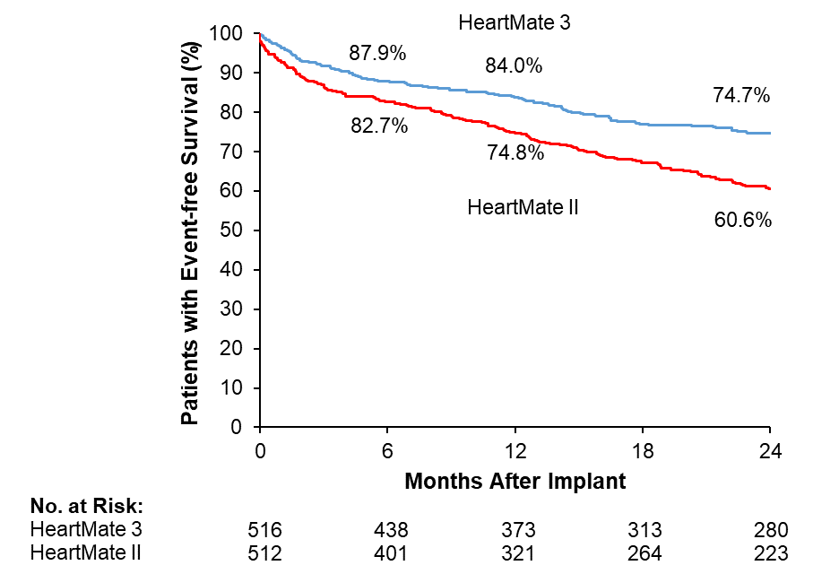
Primary End Point (ITT)
  Survival at 2 years free of disabling stroke (>3 mRS) or
  reoperation to replace or remove a malfunctioning device
HR = 0.60 (95%CI: 0.47-0.75)
P<0.0001 by log-rank test
mRS denotes modified Rankin Score; HR, hazard ratio; CI, confidence interval

Slide 11
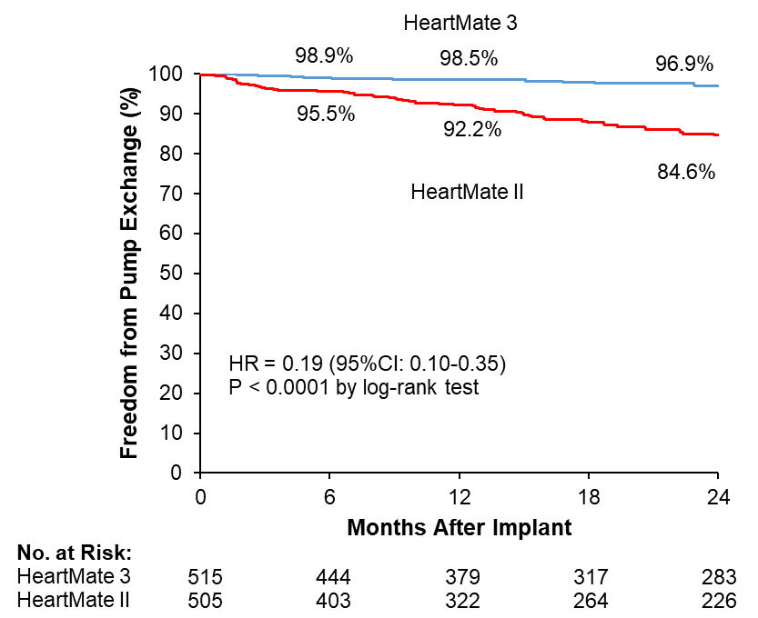
Principal Secondary End Point
  Pump replacement at 2 years
RR (95%CI) = 0.21 (0.11 - 0.38)
P<0.0001
HeartMate 3
(N=515)
HeartMate II
(N=505)
RR denotes relative risk; CI, confidence interval; HR, hazard ratio

Slide 12
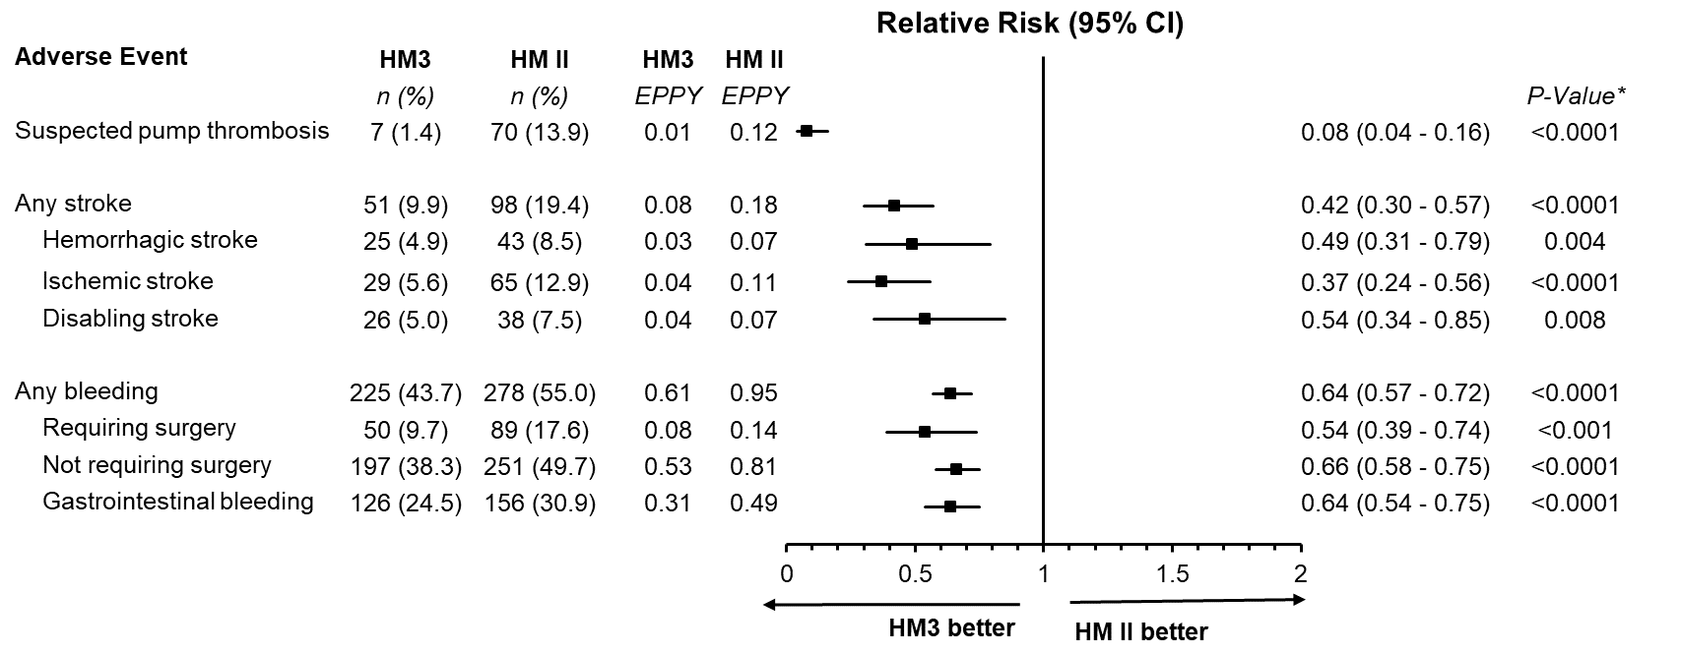
Principal Hemocompatibility-Related Adverse Events
HM3 denotes HeartMate 3; HMII HeartMate II; EPPY events per patient year; CI, confidence interval. *P values were calculated with Poisson regression.

Slide 13
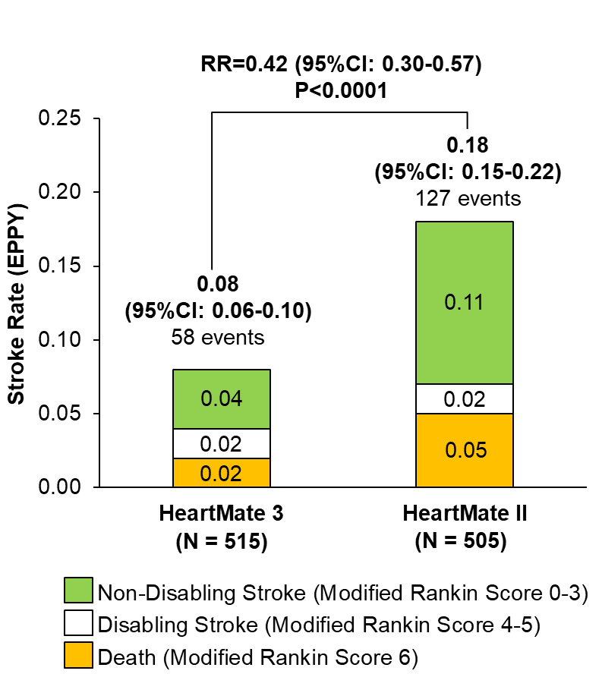
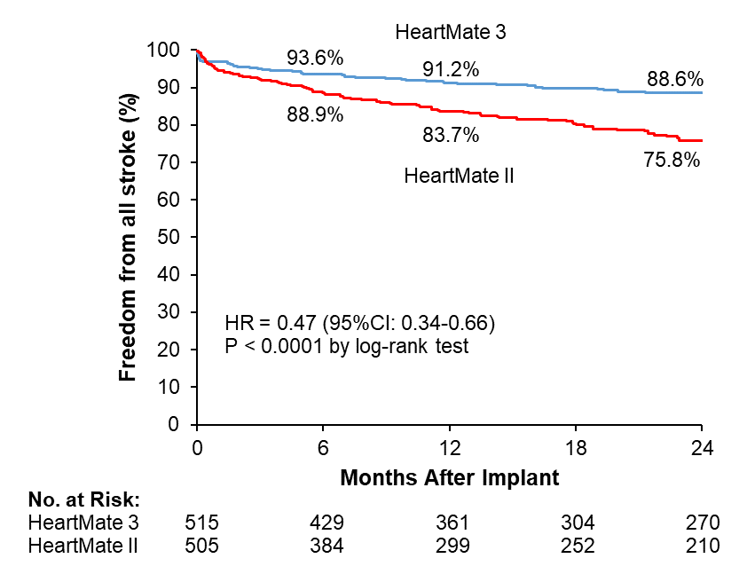
Stroke
Freedom from All Stroke
Stroke Severity
HR denotes hazard ratio; CI, confidence interval; RR, relative risk; EPPY, events per patient year

Slide 14
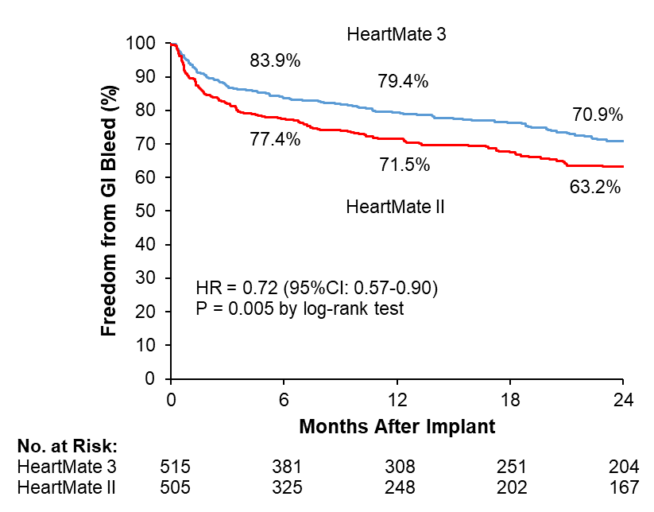
Gastrointestinal Bleeding
Freedom from Gastrointestinal Bleeding
GI denotes gastrointestinal; HR hazard ratio; CI, confidence interval

Slide 15
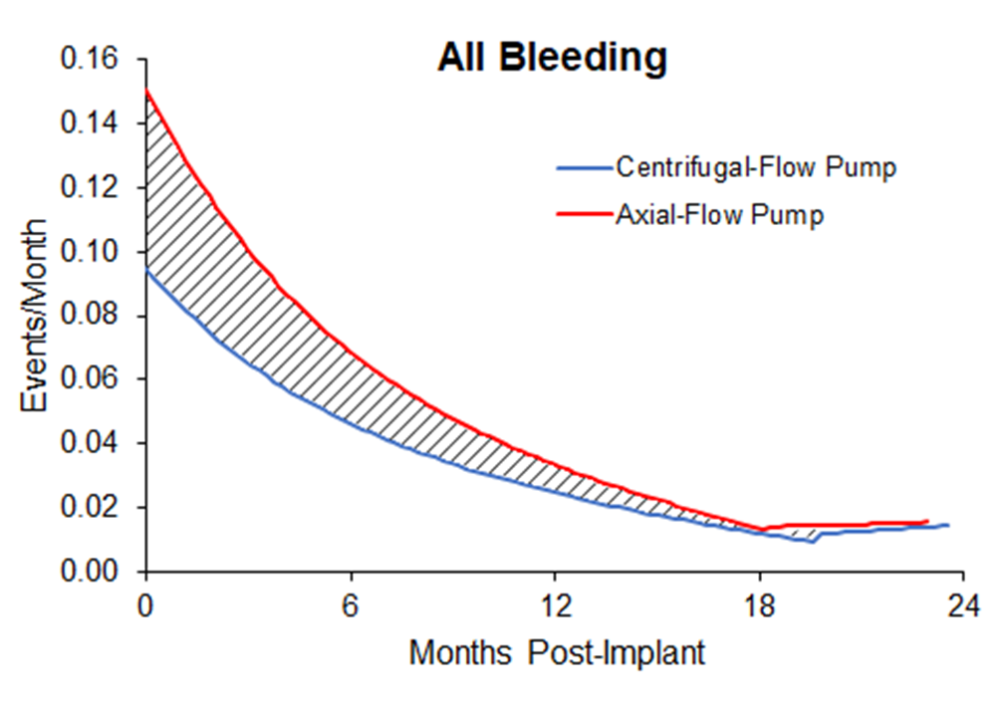
Stroke and Bleeding Hazard Functions
Hazard Function for All Stroke
Hazard Function for All Bleeding
HeartMate 3
HeartMate II
HeartMate 3
HeartMate II
Events per Month
HR = 0.47 (95%CI: 0.34 – 0.66)
Events per Month
HR = 0.68 (95%CI: 0.57 – 0.81)
Months After Implant
Months After Implant
Mean arterial blood pressure, aspirin usage, and INR did not differ between the treatment arms during the trial
HR denotes hazard ratio; CI confidence interval

Slide 16
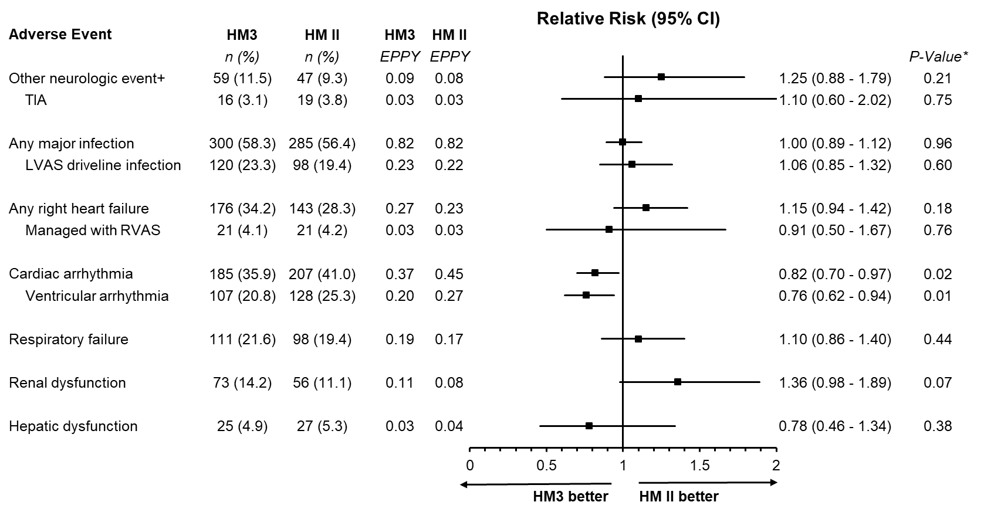
Other Adverse Events
HM3 denotes HeartMate 3; HMII HeartMate II; EPPY events per patient year; CI, confidence interval; TIA transient ischemic attack; RVAS right ventricular assist system.
*P values were calculated with Poisson regression. +Includes TIA, encephalopathy, seizure and neurologic events other than stroke

Slide 17
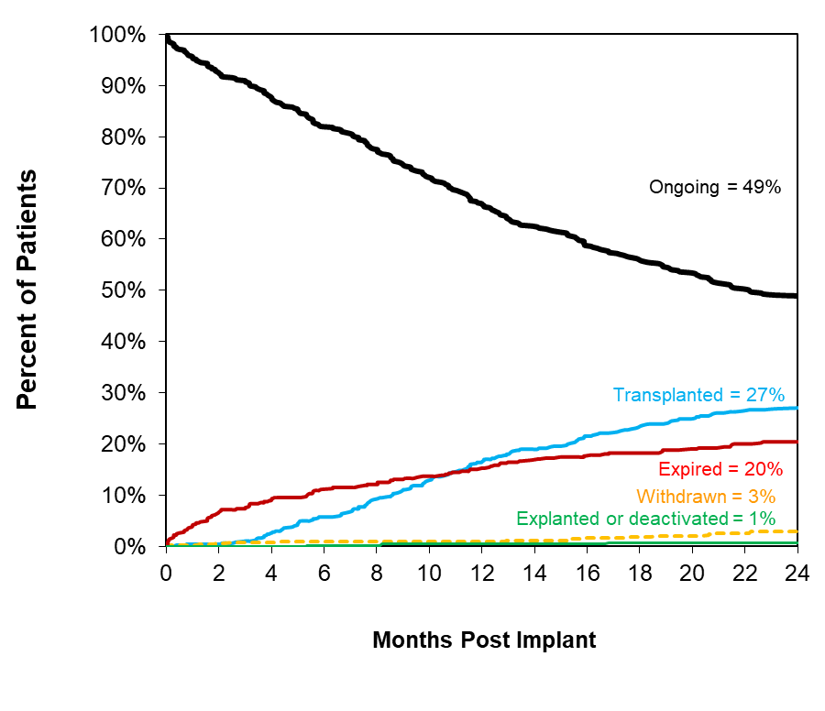
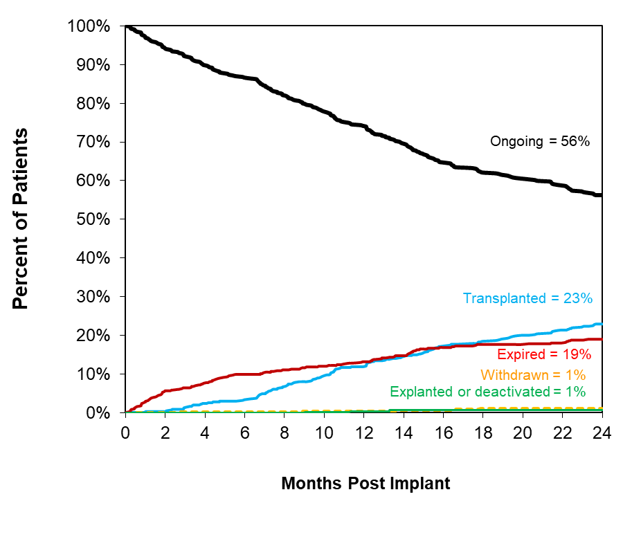
Competing Outcomes
HeartMate 3
HeartMate II
81.0% survival for HeartMate 3 at 2-years
Overall survival at 2-years was not significantly different between the groups

Slide 18
Hospitalization Profiles, Days Out of the Hospital and Readmissions
Patients who Underwent LVAD Implant | HeartMate 3 (N=515) | HeartMate II (N=505) | P
Discharged on LVAD support- no. (%) | 485 (94.2%) | 471 (93.3%) | 0.61
Patients Discharged on LVAD Support | HeartMate 3 (N=485) | HeartMate II (N=471) | Difference or HR (95%CI) | P*
Implant Hospitalization
Median length of stay [interquartile range] - days | 19 [14 to 25] | 17 [14 to 24] | 2 (0.7 to - 3.3) | 0.11
Post-Discharge
Median duration of rehospitalization [interquartile range] - days | 13 [4 to 37] | 18 [6 to 40] | -5 (-8.7 to -1.3) | 0.02
Median duration on LVAD support outside of hospital [interquartile range] - days | 653 [333 to 696] | 605 [259 to 690] | 48 (-0.8 to 96.8) | 0.008
Rate of rehospitalization for any cause - EPPY | 2.26 | 2.47 | 0.92 (0.86 - 0.99)⁺ | 0.03
EPPY denotes events per patient year; HR, hazard ratio; CI, confidence interval.
*P values for differences in duration are from Wilcoxon Rank Sum test. ⁺HR was calculated from the Andersen-Gill model.

Slide 19
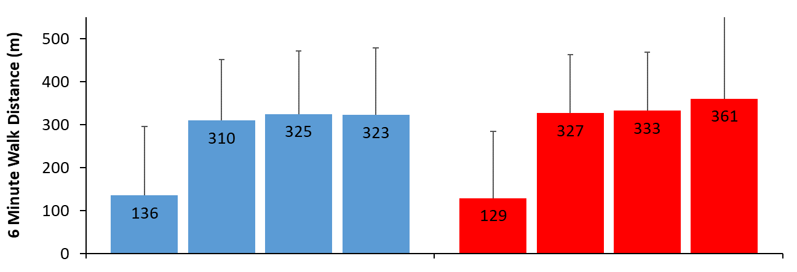
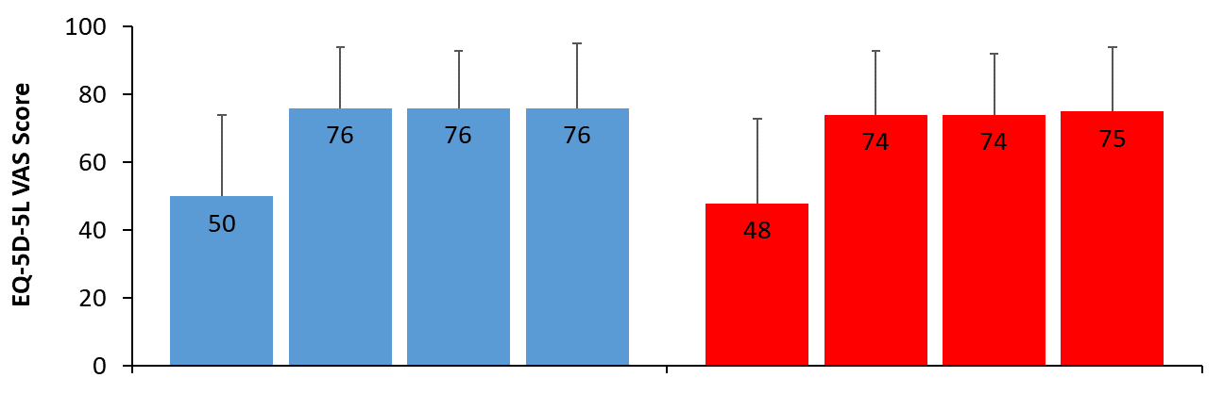
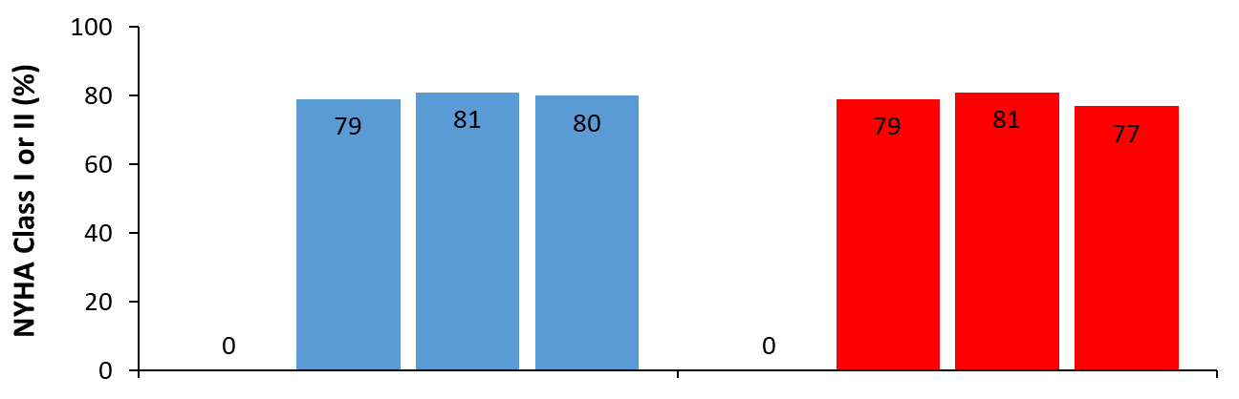
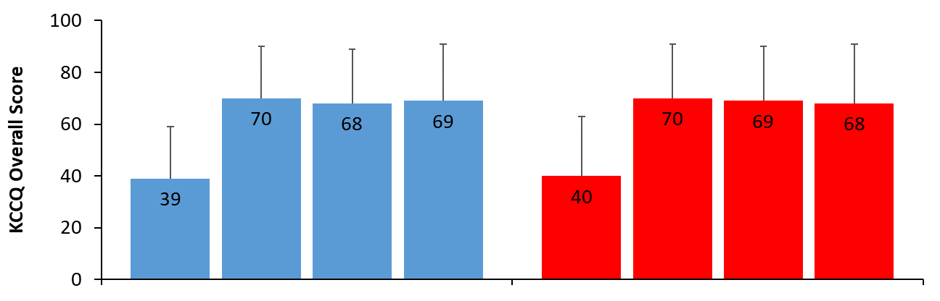
Functional Status and Quality of Life
6 Minute Walk Distance
EQ-5D-5L Visual Analogue Scale
P*=0.15
P*=0.15
P**<0.0001
P**<0.0001
P**<0.0001
P**<0.0001
Baseline
N=471
6 Mo
N=365
12 Mo
N=306
24 Mo
N=211
Baseline
N=452
6 Mo
N=333
12 Mo
N=268
24 Mo
N=174
Baseline
N=486
6 Mo
N=420
12 Mo
N=358
24 Mo
N=276
Baseline
N=475
6 Mo
N=386
12 Mo
N=311
24 Mo
N=227
NYHA Class I or II
KCCQ Overall Summary Score
P*=0.61
P*=0.34
P**<0.0001
P**<0.0001
P**<0.0001
P**<0.0001
Baseline
N=514
6 Mo
N=428
12 Mo
N=359
24 Mo
N=275
Baseline
N=504
6 Mo
N=392
12 Mo
N=321
24 Mo
N=229
Baseline
N=493
6 Mo
N=421
12 Mo
N=357
24 Mo
N=277
Baseline
N=482
6 Mo
N=388
12 Mo
N=311
24 Mo
N=227
HeartMate 3
HeartMate II
HeartMate 3
HeartMate II
*P-value between treatment arms over time. **P-value for treatment over time. Longitudinal changes were analyzed with linear mixed-effects models using data from baseline, 3, 6, 12, 18, and 24 month visits.

Slide 20
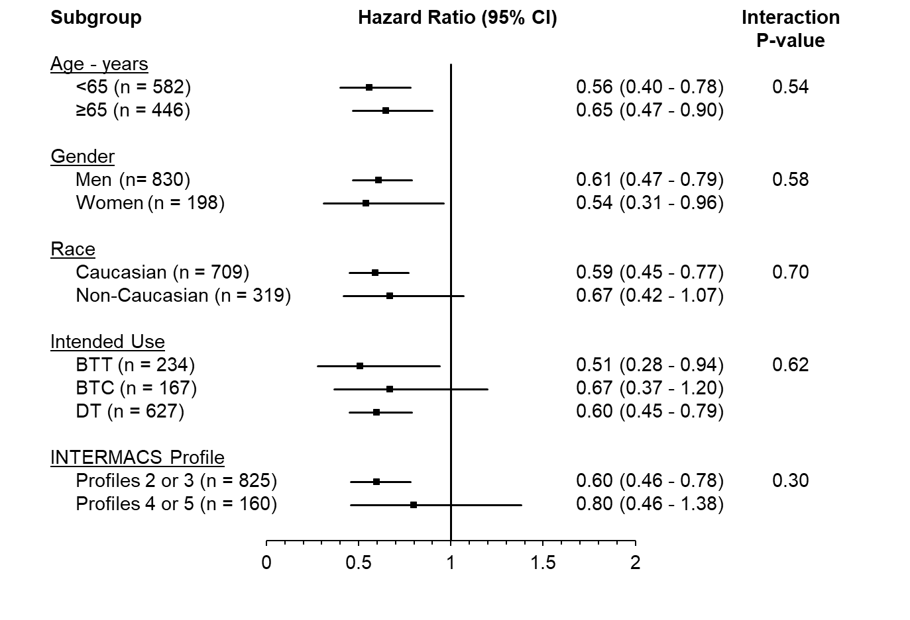
Subgroup Analyses of the Primary Endpoint (ITT)
Favors HeartMate 3
Favors HeartMate II
BTT denotes bridge to transplant; BTC, bridge to candidacy; DT, destination therapy
Notes:
Will reformat without horizontal lines

Slide 21
Net Clinical Benefit
The Number Needed to Treat over two years to avert at least 1 hemocompatibility-related adverse event (pump thrombosis, stroke, or bleed) is less than 1
For every 100 patients implanted with HeartMate 3 rather than HeartMate II over a two-year period 108 such events are averted
Hemocompatibility-related adverse events averted
Pump Thrombosis
22 events averted
Stroke
20 events averted
Bleeding
68 events averted
(36 gastrointestinal)

Slide 22
Summary: A More Forgiving Pump
In the largest LVAD study performed, the centrifugal-flow HeartMate 3 LVAS has demonstrated superior performance compared to the axial-flow HeartMate II pump with respect to:
  Reduction in Pump Thrombosis and need for Pump replacement
  Reduction in Strokes of any type and of any severity
  Reduction in any Bleeding, particularly gastrointestinal bleeds
  Reduction in Cardiac Arrhythmias, particularly ventricular arrhythmias
  Reduction in re-hospitalizations and days spent in the hospital

Slide 23
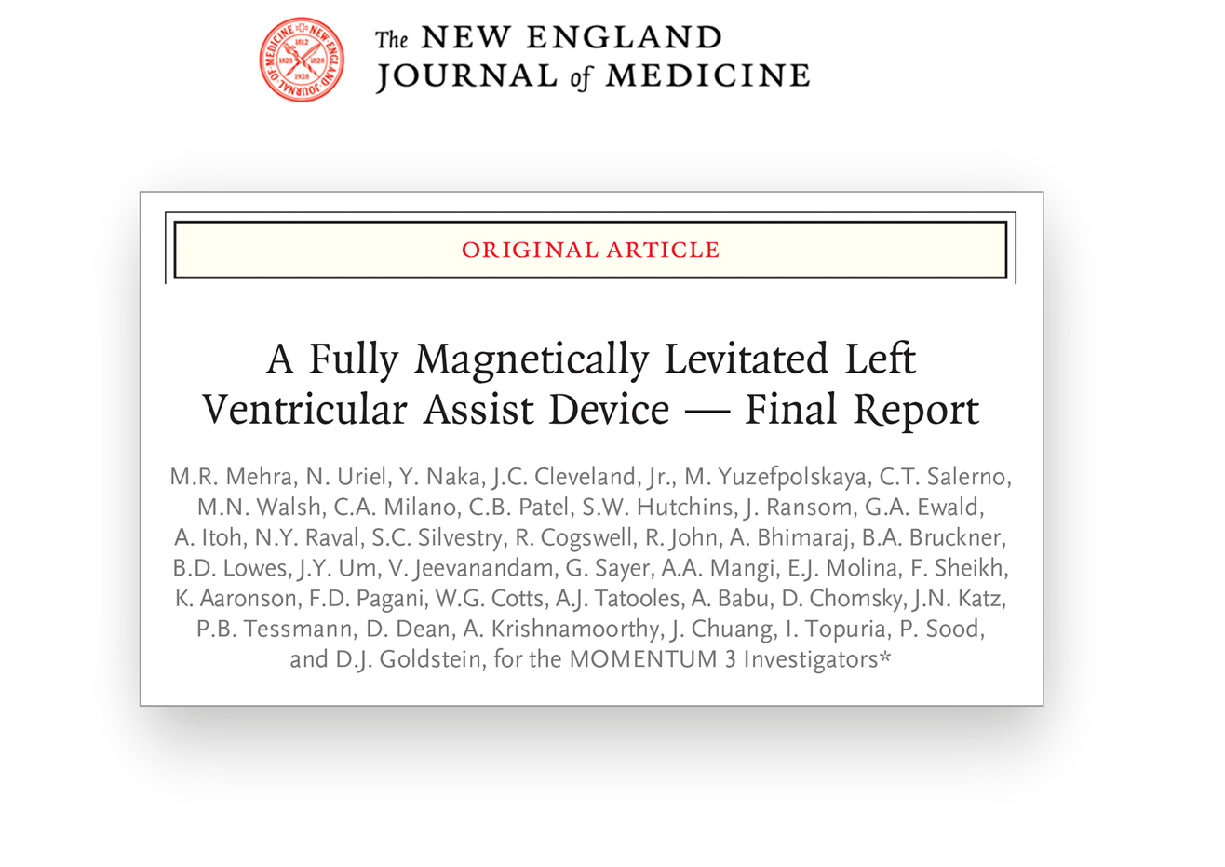
Links to all prior publications and presentations from the MOMENTUM 3 trial are available at
www.MOMENTUM3investigators.com

Slide 24
We THANK all the patients, our investigators, clinical nurse coordinators, and allied health personnel for their dedication to the conduct of the MOMENTUM 3 trial

