Slide 1
Effect of pre-hospital crushed prasugrel tablets in patients with STEMI planned for primary percutaneous coronary intervention
The COMPARE CRUSH trial
George J. Vlachojannis
on behalf of the COMPARE CRUSH Investigators

Slide 2
Disclosure
Speaker`s name: George Vlachojannis
☑ I have the following potential conflicts of interest to declare:
Receipt of grants / research supports: Daiichi Sankyo, MicroPort
Receipt of honoraria or consultation fees: Abbott, Terumo, AstraZeneca
Notes:
1

Slide 3
Background
Dual antiplatelet therapy consisting of aspirin and potent oral P2Y₁₂ receptor inhibitor prasugrel or ticagrelor constitute the cornerstone of medical treatment of ST-segment elevation myocardial infarction and are critical in reducing intra- and post-procedural ischemic complications in patients undergoing pPCI ¹
High platelet reactivity during the acute phase of myocardial infarction correlates with the extent of myocardial damage, suboptimal flow in the infarct-related artery after pPCI, and extent of microvascular obstruction ²⁻⁴
However, onset of platelet inhibition by oral P2Y₁₂ antagonist in patients presenting with STEMI is delayed for several hours due to slow gastrointestinal absorption ^{5,6}
Crushing tablets of the loading dose of P2Y₁₂ inhibitors has been shown to increase bioavailability and to induce faster onset of platelet inhibition in STEMI patients ^{7,8}
¹ Capodanno D. et al, JACC 2018;72:2915-31
² Frossard M. et al, Circulation 2004;110:1392-7
³ Aitmokhtar O. et al, Arch CV Dis. 2017;110:626-33
⁴ Zalewski J. et al, Kardiol Pol 2012;70:677-84
⁵ Heestermans A. et al, Thromb Res 2008; 122:776-81
⁶ Alexopoulos D. et al, Circ Cardiovasc Interv 2012;5:797-804
⁷ Parodi G. et al, JACC 2015; 65:511-2
⁸ Rollini F. et al, JACC 2016; 67:1994-2004
Notes:
2

Slide 4
Objective
To assess efficacy of pre-hospital administration of crushed tablets of a loading dose of prasugrel
in improving markers of coronary reperfusion
in STEMI patients planned for primary PCI
Notes:
3

Slide 5
COMPARE CRUSH Study design
Prospective, multicenter, randomized-controlled trial
STEMI patients with symptom onset ≤6 hours planned for primary PCI
In the ambulance
Aspirin, heparin
Prasugrel 60mg
Crushed tablets
1:1 randomization
2 interventional centers of Rotterdam / NL Enrollment Nov 2017 – Feb 2020
Prasugrel 60mg
Integral tablets
Transfer to PCI center
Primary PCI

Slide 6
COMPARE CRUSH Study Population
Inclusion criteria
Symptoms of acute MI of more than 30 min but less than 6 hours
New persistent ST-segment elevation ≥ 1 mm in two or more contiguous ECG leads
Exclusion criteria
Contraindication to prasugrel (e.g., history of intracranial bleeding or CVA including TIA, etc.)
Need for chronic oral anticoagulation therapy
Cardiogenic shock with severe hemodynamic instability
Patients requiring dialysis
Patients unable to swallow oral medication

Slide 7
Study Endpoints
Independent Primary Endpoints:
TIMI 3 flow in the infarct-related artery at first angiography
≥70% ST-segment resolution 1 hour after primary PCI
Key Secondary Endpoints:
Platelet Reactivity Assessment (VerifyNow™)
Clinical outcomes death, MI, urgent revascularization, stent thrombosis
Safety endpoint - Bleeding events TIMI major or BARC ≥3
Notes:
6

Slide 8
Sample Size Estimation
 | 1st primary efficacy endpoint | 2nd primary efficacy endpoint
Definition | TIMI 3 flow in IRA at first angiography | Complete ST-segment resolution at one hour post-PCI
Expected event rate | No TIMI 3 flow - 83% ¹ | No complete STR - 43% ¹
Expected effect size of study treatment | 11% | 13%
Two-sided type I error (⍺) | 0.025
Power | 80%
Drop-outs | 10% for patients with absence of final STEMI diagnosis & 12% for missing IC or primary endpoint data
Total sample size: 674 patients
¹ Montalescot G. et al N Engl J Med 2014; 371:1016-1027

Slide 9
Trial Organization
Principle Investigators | George J. Vlachojannis (Lead PI), Jeroen Wilschut (Co-PI)
Study Chair | Pieter C. Smits
Advisory Panel | Nicolas van Mieghem (Chair), Dominick J. Angiolillo, Gilles Montalescot, Dimitrios Alexopoulos, Mitchell W. Krucoff, Miguel Lemmert, Roberto Diletti
DSMB | Freek W.A. Verheugt (Chair), Jan G.P. Tijssen, Michiel Voskuil
CEC | Karel T. Koch (Chair), Martijn Meuwissen
Statistics | Ronak Delewi (Lead), Rosanne Vogel
Data Management & Monitoring | Ria Van Vliet, Claudia Van Vliet, Arno Ruiter
Study coordinator ambulance service | Nancy van der Waarden, Marileen Biekart
Sponsor | Maasstad Hospital
Funding | MicroPort Medical, Daiichi Sankyo

Slide 10
Patient Flowchart
1669 patients were considered for enrolment between Nov 2017 and March 2020 in the region of Rotterdam / the Netherlands
Ineligible n=942
Reasons for exclusion:
No FMC with ambulance n=462
Presented with OHCA n=134
Subacute presentation n=55
Medical history CVA/TIA n=52
Unstable clinical situation n=39
Chronic OAC use n=24
Nausea/vomiting n=14
Neurological symptoms n=9
Other reasons n=153
727 patients were randomized
369 patients received 60mg of
CRUSHED prasugrel loading dose
358 patients received 60mg of
INTEGRAL prasugrel loading dose
15 no IC
21 no STEMI
33 no IC
25 no STEMI
333 patients entered the modified ITT
300 patients entered the modified ITT
Notes:
9

Slide 11
Baseline characteristics
 | Crushed n = 333 | Integral n = 300
Mean age ± SD – yr | 62 ±12 | 63 ±12
Female sex – no. (%) | 76 (23) | 71 (24)
Diabetes mellitus – no. (%) | 60 (18) | 34 (11)
Hypertension – no. (%) | 126 (38) | 111 (37)
Dyslipidemia – no. (%) | 75 (23) | 77 (26)
Previous PCI – no. (%) | 35 (11) | 40 (13)
Killip class I – no. (%) | 320 (96) | 283 (94)
Opioid administration in ambulance – no. (%) | 53 (16) | 56 (19)

Slide 12
Procedural characteristics
 | Crushed n = 333 | Integral n = 300
Radial access – no. (%) | 312 (94) | 281 (94)
Culprit vessel – no. (%)
LAD | 135 (41) | 126 (42)
RCA | 133 (40) | 122 (41)
Multivessel disease at presentation – no. (%) * | 142 (43) | 115 (38)
Primary PCI – no. (%) | 323 (97) | 288 (96)
DES | 311 (93) | 276 (92)
Thrombectomy | 68 (20) | 55 (18)
GPI IIb/IIIa inhibitor use – no. (%) | 39 (12) | 39 (13)
* ≥ 50% stenosis in a non-infarct-related artery

Slide 13
Time metrics
 | Crushed n = 333 | Integral n = 300
Onset complaints – FMC | 55 [31 – 130] | 61 [28 – 145]
FMC – study treatment | 22 [15 – 29] | 21 [15 – 29]
Study treatment – pPCI (wire crossing) | 57 [47 – 72] | 57 [46 – 68]
Total ischemic time (onset – pPCI) | 150 [112 – 220] | 147 [105 – 248]
FMC – pPCI (wire crossing) | 79 [70 – 93] | 80 [68 – 91]

Slide 14
Primary endpoint
TIMI 3 flow in the infarct-related artery (IRA) at first angiography
Notes:
13

Slide 15
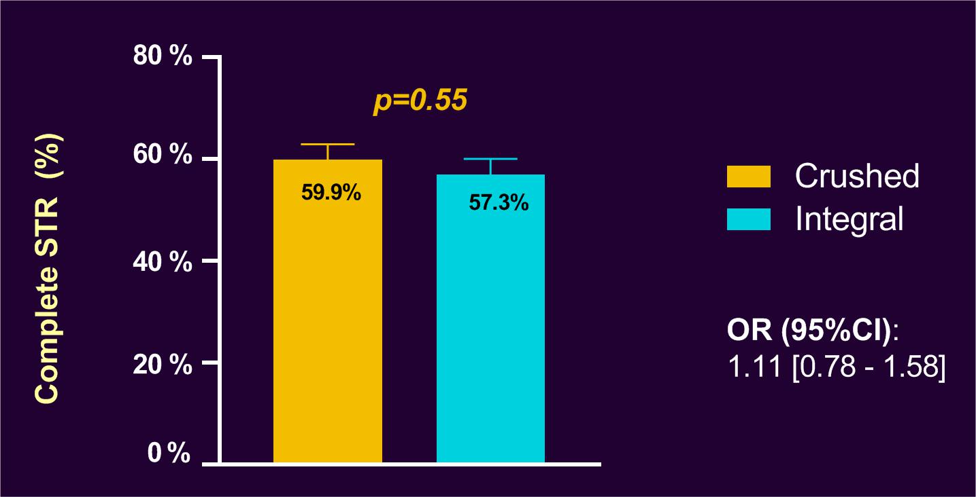
Primary endpoint
Complete ST-segment resolution (STR) 1 hour post-pPCI
Notes:
14

Slide 16
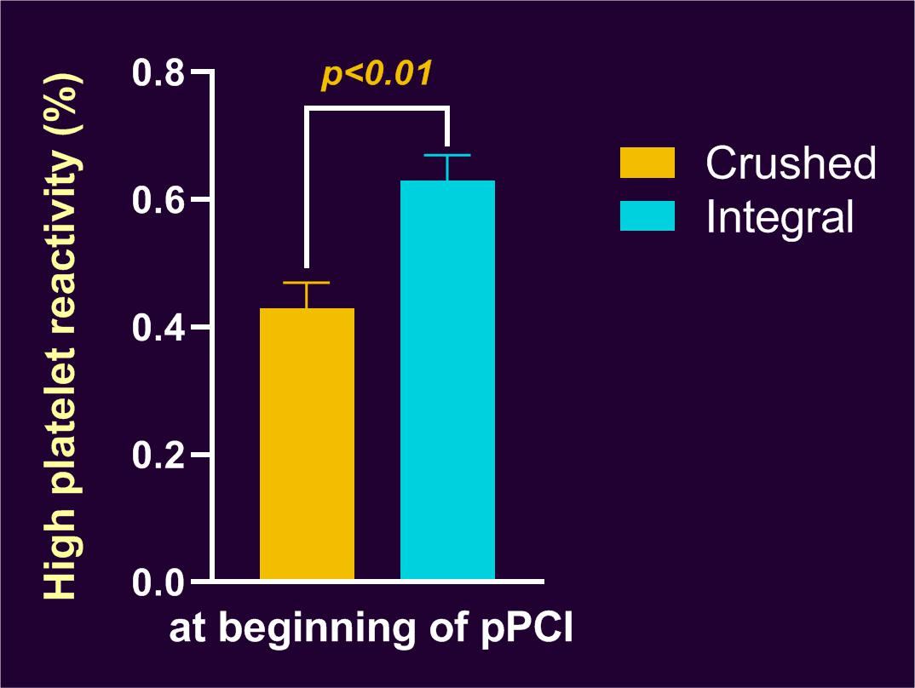
Key secondary endpoints
Platelet reactivity at the beginning of pPCI
Median time between study treatment– beginning pPCI 45 [34 – 57] minutes
High platelet reactivity is defined as P2Y₁₂ reactivity units >208
Notes:
15

Slide 17
Key secondary endpoints
Clinical outcomes at 30 days
Notes:
16

Slide 18
Key secondary endpoints
Safety analysis – bleeding events (48 hours)
Notes:
17

Slide 19
Subgroup analysis
TIMI 3 flow in the infarct-related artery at first angiography
Notes:
18

Slide 20
Subgroup analysis
Complete ST-segment resolution 1h post-pPCI
Notes:
19

Slide 21
Limitations
These results must be interpreted in the context of a robust STEMI network including short intervals between FMC and pPCI and might not reflect routine practice around the world
This study was neither blinded nor placebo-controlled
However, angiographic and electrocardiographic analysis and clinical endpoints were assessed by a blinded and independent core laboratory and clinical event committee, respectively
Trial was not powered for low frequency 2° endpoints (e.g. ST, MI, death)
Powered for angio- and electrocardiographic markers of coronary reperfusion
Notes:
20

Slide 22
Conclusion
Pre-hospital administration of crushed tablets of prasugrel loading dose in STEMI patients planned for pPCI does not improve TIMI 3 flow in the IRA at first angiography, or ST-segment resolution at 1 hour post-PCI
These findings hold in spite of the fact that crushed tablets of prasugrel lead to more potent platelet inhibition compared with integral tablets
Whether faster and more potent antiplatelet therapy can improve coronary reperfusion in contemporary STEMI treatment regimen warrants further investigation
Notes:
21

Slide 23
Notes:
22

Slide 24
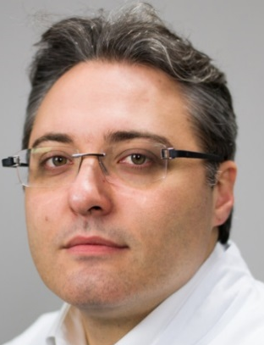
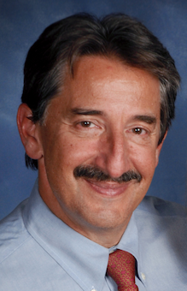
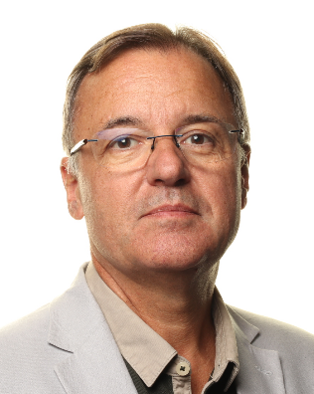
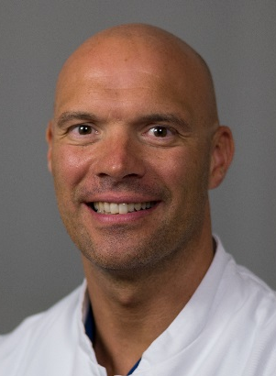
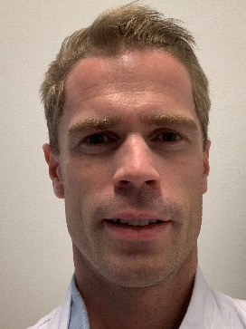
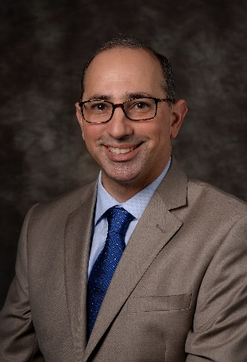
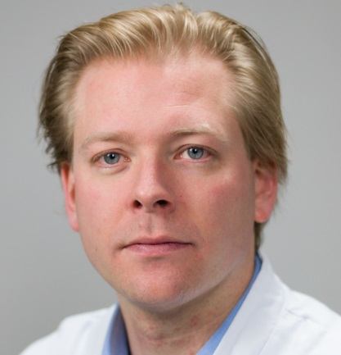
Notes:
23

