Slide 1
POPULAR TAVI TRIAL
Aspirin With or Without Clopidogrel after Transcatheter Aortic Valve Implantation
(cohort A)
Jorn Brouwer, MD
Coordinating investigator
St. Antonius Hospital, Nieuwegein, the Netherlands
on behalf of the POPULAR TAVI investigators
PI Dr. Jurrien ten Berg, MD, PhD, FACC, FESC
Notes:
Chair person, ladies and gentlemen, on behalf of the POPULAR TAVI investigators, I would like to present cohort A of the Popular TAVI Trial: Aspirin with or without clopidogrel after transcatheter aortic valve implantation.

Slide 2
Disclosures Jorn Brouwer
none

Slide 3
Background
Transcatheter aortic valve implantation (TAVI) remains associated with frequent complications¹⁻⁵:
Major and life threatening bleeding: 3-15%
Stroke: 1-8%
Antithrombotic treatment after TAVI is not completely determined yet
Currently treated as PCI patients
TAVI population is more at risk for bleeding than general PCI population⁶
The key may be reducing antithrombotic treatment after TAVI
Mack et al. Transcatheter Aortic-Valve Replacement with a Balloon-Expandable Valve in Low-Risk Patients. N Engl J Med 2019;380(18):1695–705.
Popma et al. Transcatheter Aortic-Valve Replacement with a Self-Expanding Valve in Low-Risk Patients. N Engl J Med 2019;380(18):1706–15.
Leon et al. Transcatheter or Surgical Aortic-Valve Replacement in Intermediate-Risk Patients. N Engl J Med 2016;374(17):1609–20.
Reardon et al. Surgical or Transcatheter Aortic-Valve Replacement in Intermediate-Risk Patients. N Engl J Med 2017;376(14):1321–31.
Thyregod et al. 1-year results from the all-comers NOTION randomized clinical trial. J Am Coll Cardiol 2015;65(20):2184–94.
Urban P, Mehran R, Colleran R, et al. Defining high bleeding risk in patients undergoing percutaneous coronary intervention: a consensus document from the Academic Research Consortium for High Bleeding Risk. Eur Heart J 2019;40(31):2632–53.
Notes:
Transcather aortic valve implantation is an established treatment in patients with severe symptomatic aortic valve stenosis. Despite the fact that TAVI procedures are more successful nowadays, the average incidences of major and life-threatening bleeding and stroke remain high.
On the other hand, antithrombotic treatment after TAVI is not completely determined yet. Dual antiplatelet therapy or oral anticoagulation with additional antiplatelet therapy is thought to reduce thromboembolic risk based on trials that investigated ischemic events following coronary artery stenting.
However, the TAVI population is different from the PCI population and is more at risk for bleeding due to an advanced age, more comorbidities, higher incidence of van willenbrand deficiency, the use of large bore catheters
The key may be reducing the antithrombotic treatment after TAVI in order to decrease the bleeding risk, while not increasing the thromboembolic risk.

Slide 4
Background
In patients with a chronic indication for oral anticoagulation:
“Combination of oral anticoagulation and aspirin or clopidogrel”
thienopyridine = clopidogrel
Notes:
For patients with a indication for chronic oral anticoagulation undergoing TAVI, the ESC guidelines recommend a combination of oral anticoagulation with aspirin of clopidogrel.

Slide 5
Background
In cohort B of the POPULAR TAVI Trial (patients on chronic oral anticoagulation), omission of clopidogrel for 3 months was associated with⁷:
Reduction of bleeding events (reduction of 41%)
No increase of thromboembolic events
Most patients (50-70%) do not have an indication for chronic oral anticoagulation
Nijenhuis VJ, Brouwer J, Delewi R, et al. Anticoagulation with or without Clopidogrel after Transcatheter Aortic-Valve Implantation. N Engl J Med. 2020;382:1696–1707.
Notes:
In cohort B of the trial, we have investigated the omission of clopidogrel in patients on chronic oral anticoagulation, which was associated with an reduction of roughly 40% for bleeding events, without a increase of thromboembolic events.
However, most patients undergoing TAVI do not have an indication for chronic oral anticoagulation therapy.

Slide 6
Background
In patients without a chronic indication for oral anticoagulation:
“Dual antiplatelet therapy, followed by aspirin or clopidogrel alone”
Small RCTs suggested an aspirin alone strategy⁸⁻¹⁰
thienopyridine = clopidogrel
Rodés-Cabau J, Masson J-B, Welsh RC, et al. Aspirin Versus Aspirin Plus Clopidogrel as Antithrombotic Treatment Following Transcatheter Aortic Valve Replacement With a Balloon-Expandable Valve. JACC Cardiovasc Interv 2017;10(13):1357–65.
Stabile E, Pucciarelli A, Cota L, et al. SAT-TAVI (single antiplatelet therapy for TAVI) study: a pilot randomized study comparing double to single antiplatelet therapy for transcatheter aortic valve implantation. Int J Cardiol 2014;174(3):624–7.
Ussia GP, Scarabelli M, Mul M, et al. Dual antiplatelet therapy versus aspirin alone in patients undergoing transcatheter aortic valve implantation. Am J Cardiol 2011;108(12):1772–6.
Notes:
For these patients, the ESC guidelines recommend dual antiplatelet therapy with aspirin and clopidogrel, followed by aspirin or clopidogrel alone.
However, small RCTs, in patients without an chronic indication for anticoagulation, suggested that an aspirin alone strategy without clopidogrel, may also reduce bleeding events, without increasing thromboembolic events after TAVI.

Slide 7
Hypothesis
Aspirin alone, as compared to aspirin + 3 months clopidogrel, is:
Superior for bleeding (primary outcome),
Non-inferior for the composite of cardiovascular (CV) mortality, non-procedural bleeding, stroke, or myocardial infarction (MI) (secondary outcome)
Non-inferior for the composite of CV mortality, ischemic stroke, or MI (secondary outcome)
Notes:
In cohort A of the POPular TAVI trial, we hypothesized that aspirin alone as compared to aspirin plus 3 months of clopidogrel is:
Superior for bleeding , the primary outcome
Non-inferior for the composite of cardiovascular (CV) mortality, non-procedural bleeding, stroke, or myocardial infarction (MI) (secondary outcome)
Non-inferior for the composite of CV mortality, ischemic stroke, or MI (secondary outcome)

Slide 8
Trial Organization
Trial Design
Investigator initiated, randomized, open-label, blinded clinical endpoint committee
Sponsor and coordinating center
St. Antonius Hospital, Nieuwegein, The Netherlands
Funding and Support
﻿Dutch Organization for Health Research and Development ZonMw (project no. 836031014)
Participating Sites (17)
The Netherlands, Belgium, Luxembourg, Czech Republic
Notes:
The trial organization is shown on this slide.
The POPular TAVI trial was an investigator initiated, randomized, open label trial, with a blinded endpoint committee, conducted in 17 sites across the Netherlands, Belgium, Luxembourg and Czech Republic
The trial was coordinated by the St Antonius Hospital sponsored by the Dutch Organization for Health Research and Development

Slide 9
Study Population
Inclusion criteria
Exclusion criteria
Written informed consent
Chronic indication for oral anticoagulation
Drug eluting stenting within 3 months before TAVI
Bare metal stenting within 1 month before TAVI
Allergy or contraindication to aspirin or clopidogrel
Notes:
All patients with written informed consent undergoing TAVI were included in the Trial.
The exclusions criteria were: Long-term indication for OAC, coronary artery stenting early before TAVI, and allergy or contraindication to aspirin or clopidogrel

Slide 10
PLANNED TAVI (COHORT A)
RANDOMIZATION 1:1
N=690
PRIOR TO TAVI
ASPIRIN ALONE
N=343
ASPIRIN + 3M CLOPIDOGREL
N=347
12 EXCLUDED
5 Screen failure
4 Died before TAVI procedure
2 TAVI not initiated/completed
1 Withdrew consent
13 EXCLUDED
6 TAVI not initiated/completed
4 Screen failure
3 Withdrew consent
Modified ITT ANALYSIS
N=331
Modified ITT ANALYSIS
N=334
FOLLOW-UP: 1 YEAR
CO-PRIMARY OUTCOMES: 1. All bleeding (VARC-2)
2. Non-procedural bleeding (BARC)
CO-SECONDARY OUTCOMES: 1. CV mortality, non-procedural bleeding, stroke, or MI
2. CV mortality, ischemic stroke, or MI
Notes:
The flowchart is shown on this slide.
In total 690 patient with a planned were randomized prior to TAVI, to either aspirin alone or aspirin plus clopidogrel follow by aspirin alone.
On the left side the aspirin alone group, 343 patients were randomized to aspirin alone, and after exclusion 331 were included in the modified intention-to-treat analysis
On the right side the aspirin plus clopidogrel group, 347 patients were randomized to aspirin plus 3 months clopidogel, and after exclusions, 334 were included in the modified intention-to-treat analysis
Follow-up was 1 year.
The co-primary outcomes were All bleedings according to VARC-2 and non-procedural bleeding according to BARC
The co-secondary outcomes consisted of the composite CV mortality, non-procedural bleeding, all-cause stroke, or MI and the composite of CV mortality, ischemic stroke, or MI

Slide 11
Study Power
Primary outcomes:
Superiority, power 80%, alpha 0.05
Expected event rate aspirin vs. aspirin + clopidogrel: 24% vs. 36%
Secondary outcomes:
Non-inferiority, non-inferiority margin: 7.5%
Expected event rate aspirin vs. aspirin + clopidogrel: 34% vs. 39%
Notes:
The primary outcomes were tested for superiority of aspirin alone compared to aspirin plus 3 months clopidogrel, with a power of 80% and a alpha of 0,05.
The secondary outcomes were tested for non-inferiority, with a non-inferiority margin of 7,5%, and for superiority when the criteria for non-inferiority were met

Slide 12
Study Drug Adherence
Adherence for 3 months clopidogrel: 89.2%
Duration clopidogrel: median 92 days [interquartile range 90-92]
Initiation of oral anticoagulation
13.3% in aspirin alone group
9.6% in aspirin + clopidogrel group
Main reason was atrial fibrillation: 11.4% in total study population
Notes:
The adherence to clopidogrel for the recommended 3 months after TAVI was 89.2%, with a median duration of 92 days.
During follow-up, we observed that oral anticoagulation was initiated, mostly for atrial fibrillation, in roughly 13% in the aspirin alone group and in 10% in the aspirin plus clopidogrel group.

Slide 13
Baseline Characteristics
 | Aspirin (N=331) | Aspirin + Clopidogrel (N=334)
Age - yr | 80.4±6.2 | 79.5±6.4
Female - no. (%) | 164 (49.5) | 160 (47.9)
NYHA class III or IV – no. (%) | 212 (64.0) | 220 (65.9)
STS risk score - % [IQR] | 2.6 [1.6 - 3.7] | 2.4 [1.7 - 3.7]
Coronary artery disease - no. (%) | 134 (40.5) | 138 (41.3)
Peripheral artery disease - no. (%) | 47 (14.2) | 68 (20.4)
Previous stroke - no. (%) | 18 (5.4) | 12 (3.6)
Estimated GFR - ml/min/1.73 m² | 57.5±18.1 | 57.9±19.7
LVEF – no. (%)
>50% | 244 (73.7) | 245 (73.4)
30-50% | 74 (22.4) | 65 (19.5)
≤30% | 13 (3.9) | 24 (7.2)
Notes:
The main baseline characteristics are shown on this slide.
These characteristics are compatible with the general TAVI population, which are elderly with a mean age of 80 years, an STS score of 2,5, a history of coronary artery disease in roughly 40 percent and an severely impaired left ventricle function in around 5% .

Slide 14
Procedural Characteristics
 | Aspirin (N=331) | Aspirin + Clopidogrel (N=334)
Approach
Transfemoral | 302 (91.2) | 292 (87.4)
Other | 29 (8.8) | 42 (12.6)
Unfractionated heparin – no. (%) | 331 (100.0) | 334 (100.0)
Maximal ACT – seconds [IQR] | 272 (218-306) | 259 (224-312)
Prosthesis – no. (%)
Sapien 3, Edwards Lifesciences | 149 (45.0) | 147 (44.0)
CoreValve Evolut R/Pro, Medtronic | 127 (38.4) | 120 (35.9)
Other | 55 (16.6) | 67 (20.1)
Embolic protection device use – no. (%) | 19 (5.7) | 17 (5.1)
Notes:
The procedural characteristics are shown on this slide.
Most TAVI procedures were performed using the transfemoral route, with a Sapien 3 or an Evolut R/pro device.
Cerebral embolic protection devices were infrequently used.

Slide 15
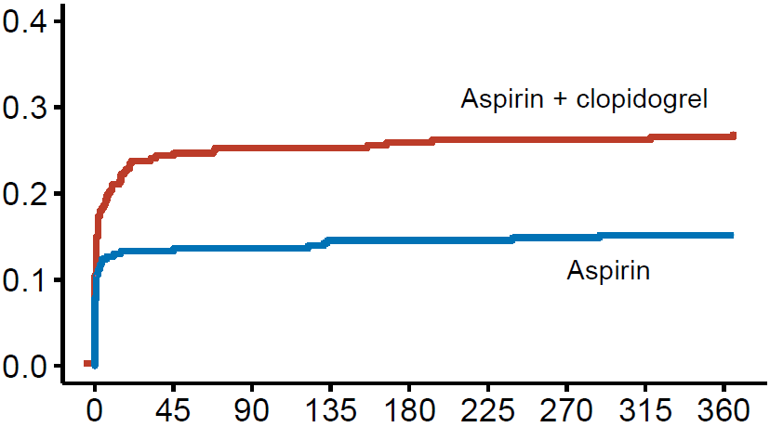
All Bleeding
26.6%
15.1%
RR 0.57
95% CI 0.42 to 0.77
P = 0.001
Days since TAVI−procedure
Notes:
The primary outcome all bleeding is shown on this slide.
All bleeding occurred in 15,1% of patients on aspirin alone and 26,6% of patients receiving aspirin plus clopidogrel, and was significantly reduced with a aspirin alone strategy, with a risk ratio of 0,57 and a p-value of 0.001

Slide 16
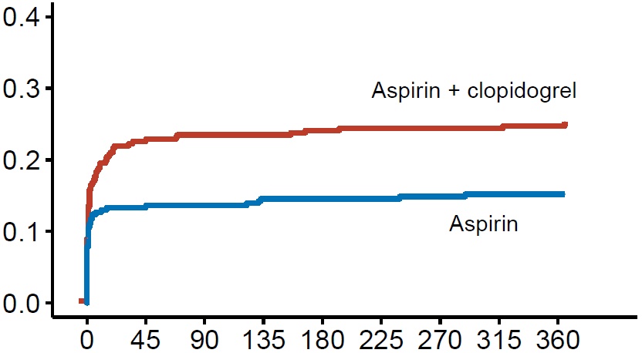
Non-Procedural Bleeding
24.9%
15.1%
RR 0.61
95% CI 0.44 to 0.83
P = 0.005
Days since TAVI−procedure
Notes:
All bleeding occurred in 15.1% of patients on aspirin alone and 24.9% of patients receiving aspirin plus clopidogrel, Also non-procedural bleeding was significantly reduced with a aspirin alone strategy, with a risk ratio of 0,61 and a p-value of 0.005

Slide 17
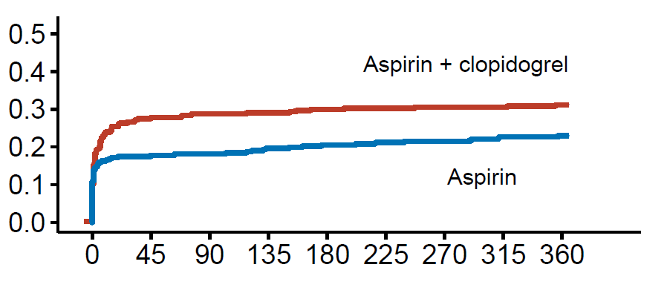
CV Mortality, Non-Procedural Bleeding, Stroke, MI
RR 0.74
95% CI 0.57 to 0.95
-8.2% (-14.9 to -1.5)
Non-inferiority margin +7.5%
P = <0.001 (noninferiority)
P = 0.04 (superiority)
31.1%
23.0%
Days since TAVI−procedure
Notes:
The composite of CV mortality, non-procedural bleeding, stroke, or MI is shown on this slide.
The secondary outcome occurred in 23% of patients receiving aspirin alone and in 31.% of patients receiving aspirin plus clopidgrel, with a risk ratio of 0.74 and met the criteria for non-inferiority of aspirin alone with a absolute difference of -8.2 percent and a p-value of <0.001, and also reached superiority with a p-value of 0.04

Slide 18
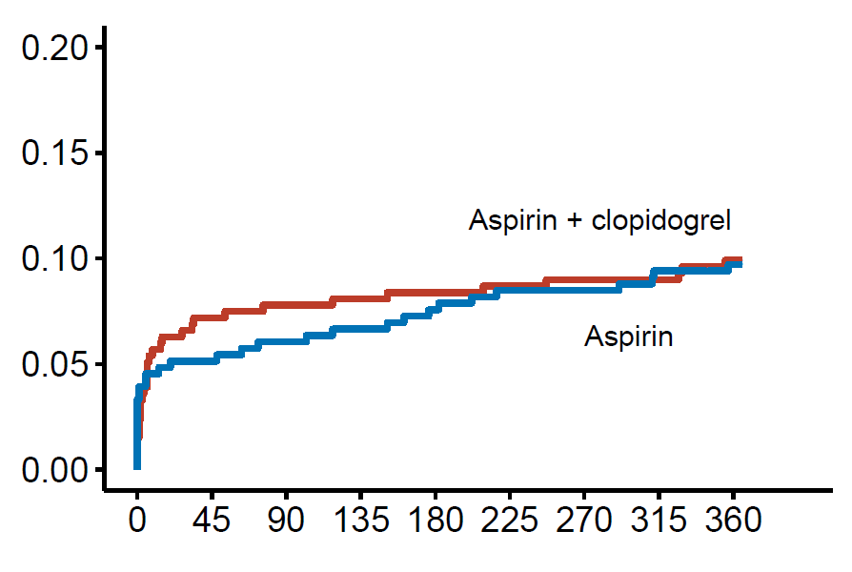
CV Mortality, Ischemic Stroke, MI
9.9%
RR 0.98
95% CI 0.62 to 1.55
-0.2% (-4.7 to 4.3)
Non-inferiority margin +7.5%
P = 0.04 (noninferiority)
P = 0.93 (superiority)
9.7%
Days since TAVI−procedure
Notes:
The second secondary outcome, a composite of CV mortality, ischemic stroke, or MI is shown on this slide and occurred in 9.1% of patients receiving aspirin alone and in 9.9% of patients receiving aspirin plus clopidogrel, with a risk ratio of 0.98 and met the criteria for non-inferiority of aspirin alone with a absolute difference of -8.2 percent and a p-value of 0.04, but not for superiority.

Slide 19
Primary and Secondary Outcome Components
 | Aspirin (N=331) | Aspirin + Clopidogrel (N=334) | Risk Ratio (95% CI)
Death
Death from any cause | 21 (6.3) | 19 (5.7) | 1.12 (0.61 to 2.04)
Death from cardiovascular causes | 14 (4.2) | 13 (3.9) | 1.09 (0.52 to 2.28)
Stroke
Ischemic | 17 (5.1) | 18 (5.4) | 0.95 (0.50 to 1.82)
Hemorrhagic | 0 (0) | 1 (0.3)
Myocardial infarction | 4 (1.2) | 6 (1.8) | 0.67 (0.19 to 2.36)
VARC-2 bleeding
Major, life-threatening, or disabling | 17 (5.1) | 36 (10.8) | 0.48 (0.27 to 0.83)
Minor | 33 (10.0) | 56 (15.9) | 0.63 (0.42 to 0.94)
VARC-2 vascular complications
Major | 11 (3.3) | 23 (6.9)
Minor | 22 (6.6) | 33 (9.9)
Notes:
The absolute event rates of the components of the primary and secondary outcomes are shown on this slide.
The individual incidences of cardiovascular mortality, ischemic stroke, and myocardial infarction were comparable between both groups.

Slide 20
Primary and Secondary Outcome Components
 | Aspirin (N=331) | Aspirin + Clopidogrel (N=334) | Risk Ratio (95% CI)
Death
Death from any cause | 21 (6.3) | 19 (5.7) | 1.12 (0.61 to 2.04)
Death from cardiovascular causes | 14 (4.2) | 13 (3.9) | 1.09 (0.52 to 2.28)
Stroke
Ischemic | 17 (5.1) | 18 (5.4) | 0.95 (0.50 to 1.82)
Hemorrhagic | 0 (0) | 1 (0.3)
Myocardial infarction | 4 (1.2) | 6 (1.8) | 0.67 (0.19 to 2.36)
VARC-2 bleeding
Major, life-threatening, or disabling | 17 (5.1) | 36 (10.8) | 0.48 (0.27 to 0.83)
Minor | 33 (10.0) | 56 (15.9) | 0.63 (0.42 to 0.94)
VARC-2 vascular complications
Major | 11 (3.3) | 23 (6.9)
Minor | 22 (6.6) | 33 (9.9)
Notes:
Major, life threatening, or disabling bleeding was more observed in the aspirin + clopidogrel group than in the aspirin alone group, 10.8% versus 5.1%
Vascular complications occurred in 10% percent in the aspirin alone group and in 17% in the aspirin + clopidogrel group.

Slide 21
Conclusions POPULAR TAVI - COHORT A
As with cohort B of the POPULAR TAVI trial
In patients without a chronic indication for oral anticoagulation
Aspirin alone as compared to aspirin + 3 months clopidogrel:
Reduces the rate of bleeding events, including major, life-threatening, or disabling bleeding
Does not increase the rate of thromboembolic events
Notes:
The conclusions of Cohort A of the POPular TAVI trial
As with cohort B of the trial, were an oral anticoagulation alone strategy without clopidogrel was associated with a reduction of bleeding events, and no increase of thromboembolic events after TAVI.
In cohort A, including patients without a chronic indication for oral anticoagulation, we show that an aspirin alone strategy without clopidogrel also reduces the rate of bleeding events, including major, life-threatening, or disabling bleeding and does not increase the rate of thromboembolic events.

Slide 22
Acknowledgments
Investigators
Vincent J Nijenhuis
(Coordinating Investigator)
Ronak Delewi
Renicus S. Hermanides
Wouter Holvoet
Christophe L.F. Dubois
Peter Frambach
Bernard De Bruyne
Gert K. van Houwelingen
Jan A.S. Van Der Heyden
Petr Toušek
Frank van der Kley
Ian Buysschaert
Carl E. Schotborgh
(Continued)
Bert Ferdinande
Pim van der Harst
John Roosen
Joyce Peper
Frederick W.F. Thielen
Leo Veenstra
Dean R.P.P. Chan Pin Yin
Martin J. Swaans
Benno J.W.M. Rensing
Arnoud W.J. van ‘t Hof
Leo Timmers
Johannes C. Kelder
Pieter R. Stella
(Continued)
Jan Baan
Jurriën M. ten Berg (PI)
Data Safety Monitoring Board
Thijs Plokker
Freek Verheugt
J.J. Koolen
Endpoint Adjudication Committee
Egbert Bal
B.M. Swinkels
Bert Everaert
Steering Committee
Jurrien M. Ten Berg
Pieter R. Stella
Jan Baan
Arie P. Kappetein
Funding
ZonMW
Notes:
I want to thank all the members of the Trial, in particularly shared coordinating investigator Vincent Nijenhuis and principle investigator Jurrien ten Berg

Slide 23
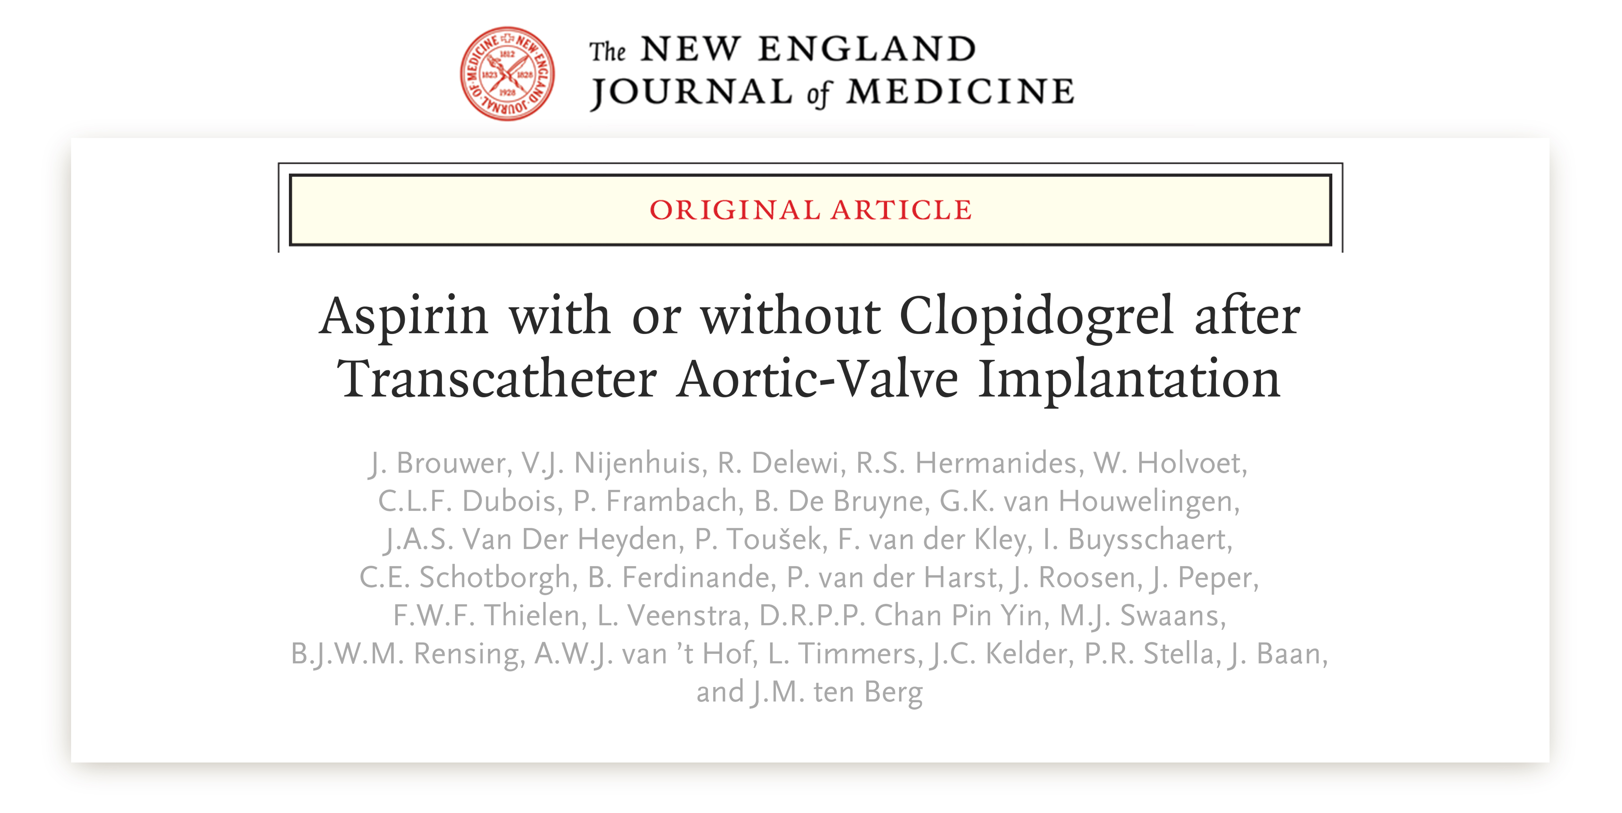
Research Publication
“ Authors Name”
Article Name
JOURNAL NAME ,
Volume XX, Issue XX, Date , Page Ref
https://doi.org/XXX/yyj/zzzz

