Slide 1
Primary Results From the Evolut Low Risk Bicuspid Study
Basel Ramlawi, MD, FACC
Valley Health System, Winchester, Virginia For the Evolut Low Risk Bicuspid Investigators

Slide 2
Disclosure Statement of Financial Interests
Within the past 12 months, I have had a financial interest/arrangement or affiliation with the organization(s) listed below.
Financial Relationship | Company
Research grants, consulting fees | AtriCure, Liva Nova, Medtronic
Medtronic personnel performed all statistical analyses and assisted with the graphical display of the data presented.

Slide 3
Background
TAVR with Evolut supra-annular self-expanding valves has demonstrated excellent outcomes in tricuspid aortic stenosis and is currently approved in the US for patients across all risk classes.
Patients with bicuspid aortic stenosis have been generally excluded from prior TAVR trials, due to concerns of:
Asymmetric calcification, elliptical shape, potential incomplete valve expansion, procedural technical concerns, etc.
Annular vs. supra-annular measurements
There have been no prospective studies assessing TAVR in low risk patients with bicuspid aortic stenosis.

Slide 4
Objective
To assess the safety and efficacy of TAVR in patients with bicuspid aortic valve stenosis and low surgical risk

Slide 5
Participating Sites
Oregon Health & Science University Portland, OR
University of Michigan Ann Arbor, MI
Beth Israel Deaconess Mass General Boston, MA
Abbott Northwestern Minneapolis, MN
Spectrum Health Grand Rapids, MI
Case Medical Center Cleveland, OH
Yale New Haven Hospital, New Haven, CT
Northwell Health, Manhasset, NY
St. Lukes/Aurora Milwaukee, WI
St. Francis Hospital, Roslyn, NY
The Mount Sinai Medical Center New York, NY
Mercy Medical Center– Iowa Heart Des Moines, IA
University Pittsburg Pinnacle Health Harrisburg, PA
OhioHealth/Riverside Methodist Columbus, OH
Valley Health Winchester, VA
Los Robles Hospital Thousand Oaks, CA
Abrazo Arizona Heart Hospital Phoenix, AZ
Piedmont Heart Institute Atlanta, GA
Scripps Memorial La Jolla, CA
Baylor Heart & Vascular Dallas, TX
Houston Methodist DeBakey Heart & Vascular Center Houston, TX
Tallahassee Research Institute Tallahassee, FL
Morton Plant Clearwater, FL
Lee Memorial Health System Ft. Myers, FL

Slide 6
Study Administration
Principal Investigators: John Forrest, Basel Ramlawi
Executive Committee: John Forrest, Jeffrey Popma, Basel Ramlawi, Michael Reardon
Screening Committee: G. Michael Deeb (Chair), John Forrest, Jeffrey Popma, Basel Ramlawi, Michael Reardon, Steven Yakubov
Echo Core Laboratory: Jae Oh, Mayo Clinic, Rochester, MN
Data & Safety Monitoring Board: David Faxon (Chair), William Holman, John Lopez, Scott Kasner, John Orav
Clinical Events Committee: Cliff Berger, Scott Bortman, Manish Chauhan, Donald Cutlip, Torin Fitton, Eli Gelfand, David Grossman, Claudia Hochberg (Chair), Carey Kimmelstiel, Daniel Kramer, Megan Leary, Robert Rodriguez, Sanjay Samy, Jonathan Silver, Gregory Smaroff, David Thaler, Jonathan Waks, Sergio Waxman, David Weiss, Jeffrey Veluz
Sponsor: Medtronic, Minneapolis, MN
5

Slide 7
Study Methods
Multicenter, prospective, interventional, single-arm study
Baseline MSCT to confirm bicuspid morphology
Patient eligibility reviewed by local Heart Team & Screening Committee
Implant Procedure
Annular sizing recommended for all patients
Pre-TAVR balloon valvuloplasty strongly encouraged
CEC adjudicated all endpoint-related adverse events
Hemodynamics centrally assessed by echocardiographic core laboratory
Patient follow-up planned for 10 years
6

Slide 8
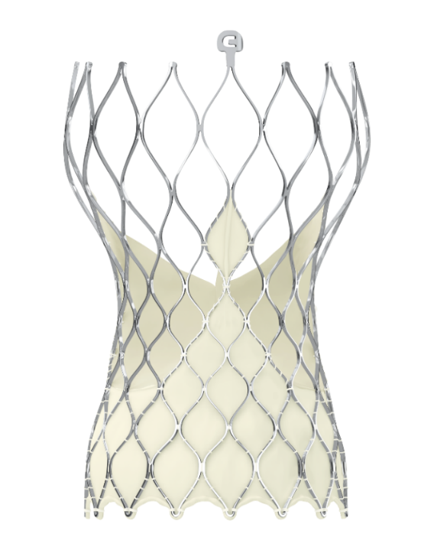
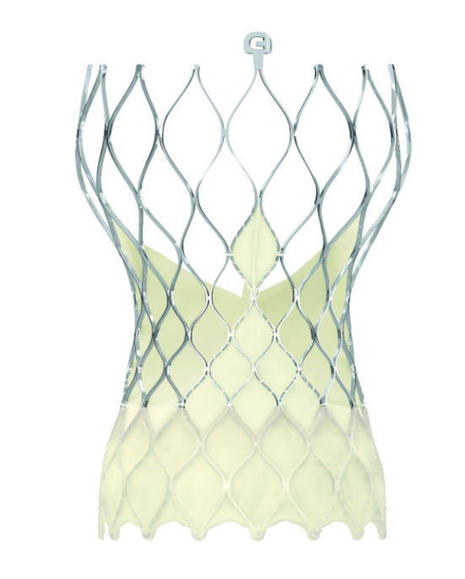
Valves Studied
Evolut R Valve [43%] | Evolut PRO Valve [57%]
23, 26, 29 and 34 mm | 23, 26 and 29 mm

Slide 9
Key Inclusion Criteria
Bicuspid aortic valve anatomy confirmed by MSCT
Symptomatic and asymptomatic severe AS¹
A predicted risk of 30-day mortality <3% per multidisciplinary local Heart Team assessment
¹Nishimura RA, et al. Circulation. 2014;129:2440-92.

Slide 10
Key Exclusion Criteria
Age < 60 years
Multivessel coronary artery disease (SYNTAX score >22)
Ascending aorta diameter > 4.5 cm
Aortopathy requiring surgical intervention
Prohibitive LVOT calcification
Trileaflet aortic valve on MSCT
Anatomic dimensions outside recommended range
SOV (≥ 25 mm)
Annulus (18 to 30 mm)

Slide 11
Study Endpoints
Primary Safety Endpoint
All-cause mortality or disabling stroke at 30 days
Primary Efficacy Endpoint
Device Success
Absence of procedural mortality AND
Correct position of 1 valve in the proper anatomical location AND
Absence of > mild aortic valve regurgitation
10

Slide 12
Patient Flow
Patients screened (n=222)
Excluded (n=72):
Exclusion criteria met (n=60)
Patient withdrawal (n=2)
Physician withdrawal (n=3)
Other (n=7)
Attempted procedure (n=150)
Aborted procedure (n=1)
Implanted TAV (n=149)
Conversion to surgery (n=1)
Discharged with TAV (n=148)
Death (n=1)
30-Day follow-up (n=147)
11

Slide 13
Reasons for Study Exclusion
Reason | N = 60
Anatomical reasons | 46
Tricuspid aortic valve | 17
Aortic root dimensions: annular perimeter/diameter | 15
Mean ascending aorta > 45 mm | 9
Aortic root dimensions: SOV diameter | 4
Prohibitive LVOT calcification | 1
Risk of mortality outside protocol (> low risk) | 5
Contraindication for placement of bioprosthetic valve | 3
Allergies | 2
Did not meet severe AS criteria | 2
Age less than 60 years | 1
Other condition excluding from study per investigator | 1

Slide 14
RESULTS

Slide 15
Baseline Clinical Characteristics
Mean ± SD or no. (%) | N = 150
Age, years | 70.3 ± 5.5
Male sex | 78 (52.0)
Body surface area, m² | 1.9 ± 0.2
STS PROM, % | 1.4 ± 0.6
NYHA Class III or IV | 41 (27.3)
Peripheral arterial disease | 14 (9.3)
Chronic lung disease/ COPD | 26 (17.7)
Prior coronary artery bypass grafting | 2 (1.3)
Mean gradient, mm Hg | 48.0 ± 16.1
Aortic valve area, cm² | 0.8 ± 0.2

Slide 16
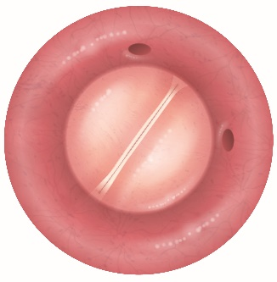
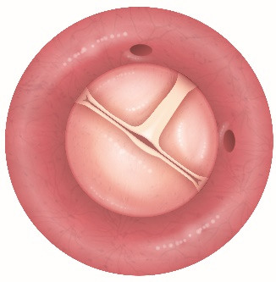
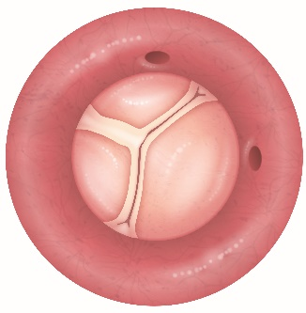
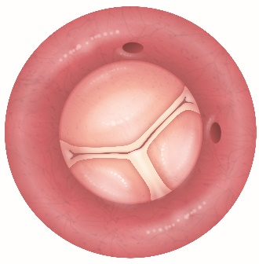
Bicuspid Valve Sievers Subtypes
Type 0 N = 14 | Type I Left-Right N = 107 | Type I Right-Non N=27 | Type I Non-Left N= 2
9.3%
71.3%
18.0%
1.3%
No patients had Sievers Type 2.

Slide 17
Procedural Characteristics
No. (%) | N = 150
General anesthesia | 95 (63.3)
Iliofemoral access | 147 (98.7)
Embolic protection | 45 (30.0)
Pre-TAVR balloon dilation | 137 (91.3)
Post-TAVR balloon dilation | 55 (36.9)
> 1 valve implanted | 5 (3.3)
No. (%) | N = 150
Resheath or recapture | 49 (32.9)
Implanted valve size
23 mm | 0 (0.0)
26 mm | 32 (21.5)
29 mm | 55 (36.9)
34 mm* | 62 (41.6)
*Only Evolut R

Slide 18
Primary Endpoint
Death or Disabling Stroke
1.3%
Days Post Procedure
No. at Risk | 150 | 143

Slide 19
Outcomes at 30 Days
No. of patients (KM estimates as %) | N = 150
All-cause mortality or disabling stroke | 2 (1.3)
All-cause mortality | 1 (0.7)
Disabling stroke | 1 (0.7)
Non-disabling stroke | 5 (3.3)
Major vascular complication | 2 (1.3)
Aortic dissection | 0 (0.0)
Annular rupture | 0 (0.0)
Permanent pacemaker* | 22 (14.7)
Permanent pacemaker† | 22 (15.1)
Coronary artery obstruction | 1 (0.7)
*Includes patients with baseline permanent pacemaker. †Excludes patients with baseline permanent pacemaker.

Slide 20
Additional Outcomes at 30 Days
No. of patients (%)
Device success | 141/148 (95.3)
Patient-prosthesis mismatch*
None | 115 (87.1)
Moderate | 10 (7.6)
Severe | 7 (5.3)
Mean gradient > 20 mm Hg | 2/146 (1.4)
*N=132 patients per VARC-2.

Slide 21
Valve Hemodynamics
No. of Echos
EOA | 135 | 124 | 132
AVG | 148 | 146 | 146

Slide 22
Valve Hemodynamics by Subtypes
Type 0
Type 1
21

Slide 23
Total Aortic Valve Regurgitation at 30 Days
Patients w/Echo (%)
Implant population. Core lab assessments.

Slide 24
New York Heart Association
Proportion of Patients (%)

Slide 25
Discussion
Study performed at high volume expert centers
Non-randomized study design
Standardized implant technique
Annular sizing
Pre-TAVR balloon dilation
Rigorous adherence to patient selection parameters

Slide 26
Summary
TAVR with Evolut supra-annular self-expanding valve in low-risk bicuspid patients achieved excellent early results:
Annular sizing achieved 95.3% device success
Low mortality and stroke at 30 days (1.3%)
Low rates of PVL (no moderate/severe)
Consistent hemodynamics across Sievers Classification
Patients will be followed for 10 years

Slide 27
Clinical Implications
In low-risk AS patients with bicuspid morphology, TAVR with the Evolut platform is a safe and effective treatment option.
The choice between TAVR and surgery should be based on a multidisciplinary heart team discussion that includes anatomic, clinical and patient social factors.

