Slide 1


Ten-year Outcomes After Drug-Eluting Stents Versus Coronary Artery Bypass Grafting For Left Main Coronary Disease
- Extended FU of PRECOMBAT
Duk-Woo Park, MD
On behalf of the PRECOMBAT Investigators,
Asan Medical Center,
University of Ulsan College of Medicine, Seoul, Korea
Twitter (@dukwoo_park)

Slide 2
Disclosures: Dr. Duk-Woo Park
Dr D.W. Park reports grants from Daiichi-Sankyo, ChongKunDang Pharm, and Daewoong Pharm, personal fees from Edwards, grants and personal fees from Abott Vascular, and personal fees from Medtronic, all outside this work.

Slide 3
Background
Data are still limited on very long-term (beyond 5 years) outcomes of PCI or CABG in patients with left main coronary artery (LMCA) disease.
Available long-term studies showed conflicting results, and some studies reported a trend of late catch-up or crossover in the incidence of the primary composite outcome or all-cause mortality favoring CABG over PCI during extended follow-up.
Therefore, there remains uncertainty about long-term outcomes warranting additional longer-term follow-up studies.

Slide 4
PRECOMBAT: Trial Design
1454 patients with LMCA disease
from April 2004 to August 2009
Clinical and anatomic eligibility considered by the cardiologists and surgeons
Yes
No
(N=854)
Randomized
(N=600)
Enrollment
registry
Stratified by participating center
R
PCI (Cypher)
(N=300)
CABG
(N=300)
Follow-up: 1 month, 6 months, 1 year, annually through 5 years
Primary endpoint: Major adverse cardiac or cerebrovascular events (MACCE)

Slide 5
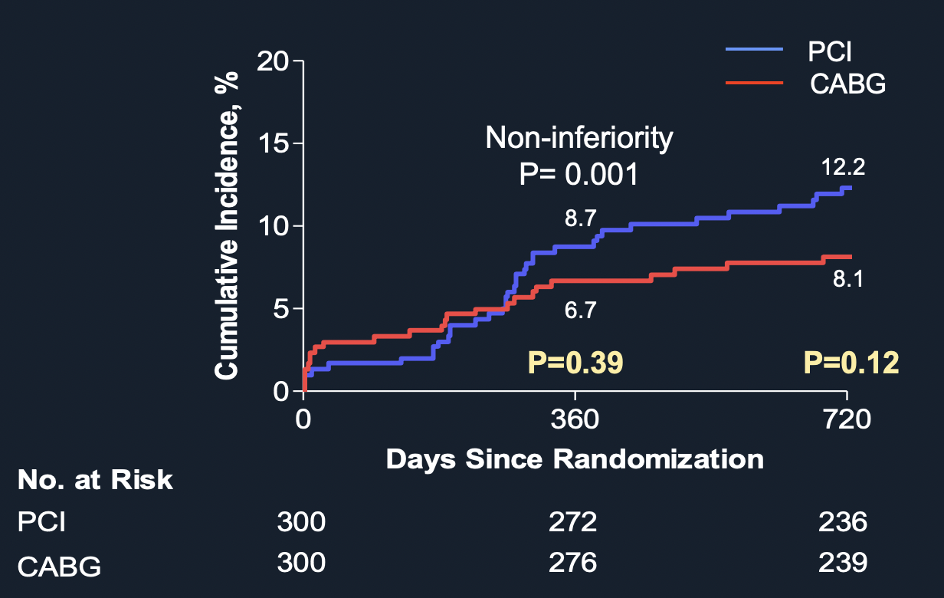
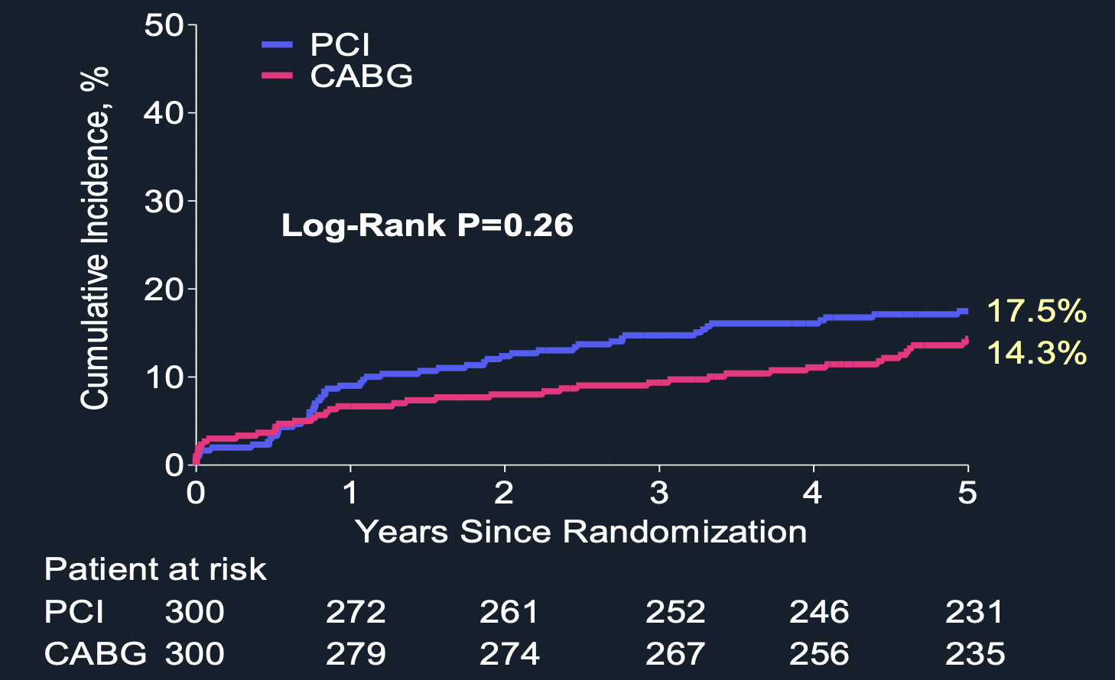
PRECOMBAT Trial at 2 Year and at 5 Year
Primary endpoint: MACCE (a composite of death from any cause, MI, stroke, or ischemia-driven target-vessel revascularization)
2-Year Report
5-Year Report
NEJM 2011;364:1718-27
J Am Coll Cardiol. 2015;65:2198-206
Notes:
5
This is the Bulleted List slide.
To create this particular slide, click the NEW SLIDE button on your toolbar and choose the BULLETED LIST format. (Top row, second from left)
The Sub-Heading and footnote will not appear when you insert a new slide. If you need either one, copy and paste it from the sample slide.
If you choose not to use a Sub-Heading, let us know when you hand in your presentation for clean-up and we’ll adjust where the bullets begin on your master page.
Also, be sure to insert the presentation title onto the BULLETED LIST MASTER as follows:
Choose View / Master / Slide Master from your menu.
Select the text at the bottom of the slide and type in a short version of your presentation title.
Click the SLIDE VIEW button in the lower left hand part of your screen to return to the slide show. (Small white rectangle)

Slide 6
Major
Inclusion Criteria
Major
Exclusion Criteria
≥ 18 years of age.
Significant de novo ULMCA stenosis (>50%)
Left main lesion and lesions outside ULMCA (if present) potentially comparably treatable with PCI and CABG, determined by physician and operators
Objective evidence of ischemia or ischemic symptom with angina or NSTEMI
Any contraindication to DAPT
Any previous PCI within 1 year
Previous CABG
Chronic total occlusion > 1
AMI within 1 week
Shock or LV EF < 30%
Planed surgery
Disabled stroke
Other comorbidity, such as CRF, liver disease, etc
Notes:
6
This is the Bulleted List slide.
To create this particular slide, click the NEW SLIDE button on your toolbar and choose the BULLETED LIST format. (Top row, second from left)
The Sub-Heading and footnote will not appear when you insert a new slide. If you need either one, copy and paste it from the sample slide.
If you choose not to use a Sub-Heading, let us know when you hand in your presentation for clean-up and we’ll adjust where the bullets begin on your master page.
Also, be sure to insert the presentation title onto the BULLETED LIST MASTER as follows:
Choose View / Master / Slide Master from your menu.
Select the text at the bottom of the slide and type in a short version of your presentation title.
Click the SLIDE VIEW button in the lower left hand part of your screen to return to the slide show. (Small white rectangle)

Slide 7
Primary Outcome
Definition
Cumulative rate of major adverse cardiac or cerebrovascular events (MACCE) at 10-year after randomization
  Death from any cause
  Myocardial infarction
  Stroke
  Ischemia-driven TVR
Myocardial Infarction
  ≤48 H: new Q waves and CK-MB ≥ 5 times
  >48 H: Any CK-MB elevation and
  ischemic symptoms/signs
Stroke: confirmed by imaging and neurologist
TVR (target-vessel revascularization)
  Ischemia-driven: angiographic stenosis >50% and ischemic symptom/sign or angiographic stenosis >70%
Notes:
7
This is the Bulleted List slide.
To create this particular slide, click the NEW SLIDE button on your toolbar and choose the BULLETED LIST format. (Top row, second from left)
The Sub-Heading and footnote will not appear when you insert a new slide. If you need either one, copy and paste it from the sample slide.
If you choose not to use a Sub-Heading, let us know when you hand in your presentation for clean-up and we’ll adjust where the bullets begin on your master page.
Also, be sure to insert the presentation title onto the BULLETED LIST MASTER as follows:
Choose View / Master / Slide Master from your menu.
Select the text at the bottom of the slide and type in a short version of your presentation title.
Click the SLIDE VIEW button in the lower left hand part of your screen to return to the slide show. (Small white rectangle)

Slide 8
Major Secondary Outcomes
Individual components of the primary composite outcome,
A composite of death, MI, or stroke,
Any revascularization, or
Definite stent thrombosis or symptomatic graft occlusion.

Slide 9
10-Year Follow-Up
Although the PRECOMBAT was initially planned to complete FU at 5 years in the original protocol, all participating centers agreed to participate in an investigator-driven extension of follow-up of 10 years.
Information on adverse clinical events and survival data was obtained through (electronic) healthcare record review and national death registry checks of the Korean National Health Insurance Service (NHIS) database.
The NHIS is a single-payer program of a universal health coverage system and provides mandatory health care for all Korean citizens, with an enrollment rate of more than 97%.

Slide 10
Participating Centers
Site (13 major hospitals in Korea) | Investigators
Asan Medical Center | Seung-Jung Park, Duk-Woo Park
Korea University Anam Hospital | Do-Sun Lim
Korea University Guro Hospital | Seung-Woon Rha
Ulsan University Hospital | Kyung-Min Park
Samsung Medical Center | Hyeon-Cheol Gwon
Seoul National University Hospital | Hyo-Soo Kim
Seoul National University Hospital, Bundang | In-Ho Chae
Yonsei University Severance Hospital | Yangsoo Jang
Chonnam National University Hospital | Myung-Ho Jeong
Ajou University Medical Center | Seung-Jea Tahk
Catholic University of Korea, St. Mary’s Hospital | Ki Bae Seung
Notes:
10

Slide 11
Statistical Analysis
This report provides descriptive information on all end-point events that occurred during 10-year FU: therefore, we did not perform formal hypothesis testing for the non-inferiority comparison between PCI and CABG for the primary end point of MACCE.
Kaplan-Meier method to estimate cumulative event rates, and log-rank test to compare them.
Cox proportional hazards model to calculate hazard ratios and 95% CI.
Primary analysis based on an intention-to-treat principle.
The consistency of treatment effects were also assessed in the prespecified subgroups using Cox regression models with tests for interaction.

Slide 12
Baseline Clinical Characteristics
 | PCI (N=300) | CABG (N=300)
Age, years | 61.8±10.0 | 62.7±9.5
Male gender | 228 (76.0) | 231 (77.0)
Body-mass index | 24.6±2.7 | 24.5±3.0
Diabetes mellitus
Any | 102 (34.0) | 90 (30.0)
Requiring insulin | 10 (3.3) | 9 (3.0)
Hypertension | 163 (54.3) | 154 (51.3)
Hyperlipidemia | 127 (42.3) | 120 (40.0)
Current smoker | 89 (29.7) | 83 (27.7)
Previous PCI | 38 (12.7) | 38 (12.7)
Previous myocardial infarction | 13 (4.3) | 20 (6.7)
Previous congestive heart failure | 0 (0) | 2 (0.7)
*Data are presented as mean ± SD or n (%)
Notes:
12
This is the Bulleted List slide.
To create this particular slide, click the NEW SLIDE button on your toolbar and choose the BULLETED LIST format. (Top row, second from left)
The Sub-Heading and footnote will not appear when you insert a new slide. If you need either one, copy and paste it from the sample slide.
If you choose not to use a Sub-Heading, let us know when you hand in your presentation for clean-up and we’ll adjust where the bullets begin on your master page.
Also, be sure to insert the presentation title onto the BULLETED LIST MASTER as follows:
Choose View / Master / Slide Master from your menu.
Select the text at the bottom of the slide and type in a short version of your presentation title.
Click the SLIDE VIEW button in the lower left hand part of your screen to return to the slide show. (Small white rectangle)

Slide 13
Baseline Clinical Characteristics
 | PCI (N=300) | CABG (N=300)
Chronic renal failure | 4 (1.3) | 1( 0.3)
Peripheral vascular disease | 15 (5.0) | 7 (2.3)
Chronic pulmonary disease | 6 (2.0) | 10 (3.3)
Family history of CAD | 31 (10.3) | 19 (6.3)
Clinical manifestation
Stable angina or silent ischemia | 160 (53.3) | 137 (45.7)
Unstable angina | 128 (42.7) | 144 (48.0)
Recent myocardial infarction | 12 (4.0) | 19 (6.3)
Ejection fraction, % | 61.7±8.3 | 60.6±8.5
Electrocardiographic findings
Sinus rhythm | 286 (96.6) | 289 (97.3)
Atrial fibrillation | 5 (1.7) | 5 (1.7)
Others | 5 (1.7) | 3 (1.0)
EuroSCORE | 2.6±1.8 | 2.8±1.9
*Data are presented as mean ± SD or n (%)
Notes:
13
This is the Bulleted List slide.
To create this particular slide, click the NEW SLIDE button on your toolbar and choose the BULLETED LIST format. (Top row, second from left)
The Sub-Heading and footnote will not appear when you insert a new slide. If you need either one, copy and paste it from the sample slide.
If you choose not to use a Sub-Heading, let us know when you hand in your presentation for clean-up and we’ll adjust where the bullets begin on your master page.
Also, be sure to insert the presentation title onto the BULLETED LIST MASTER as follows:
Choose View / Master / Slide Master from your menu.
Select the text at the bottom of the slide and type in a short version of your presentation title.
Click the SLIDE VIEW button in the lower left hand part of your screen to return to the slide show. (Small white rectangle)

Slide 14
Baseline Angiographic Characteristics
 | PCI (N=300) | CABG (N=300)
Extent of disease vessel
LM only | 27 (9.0) | 34 (11.3)
LM plus 1-vessel | 50 (16.7) | 53 (17.7)
LM plus 2-vessel | 101 (33.7) | 90 (30.0)
LM plus 3-vessel | 122 (40.7) | 123 (41.0)
Bifurcation left main involvement | 200 (66.9) | 183 (62.2)
SYNTAX score | 24.4±9.4 | 25.8±10.5
Low ( ≤22) | 131 / 291 (45.0) | 109 / 275 (39.6)
Intermediate (23 to 32) | 102 / 291 (35.1) | 98 / 275 (35.6)
High (≥33) | 58 / 291 (19.9) | 68 / 275 (24.7)
Complete revascularization | 205 (68.3) | 211 (70.3)
*Data are presented as mean ± SD or n (%)
Notes:
14
This is the Bulleted List slide.
To create this particular slide, click the NEW SLIDE button on your toolbar and choose the BULLETED LIST format. (Top row, second from left)
The Sub-Heading and footnote will not appear when you insert a new slide. If you need either one, copy and paste it from the sample slide.
If you choose not to use a Sub-Heading, let us know when you hand in your presentation for clean-up and we’ll adjust where the bullets begin on your master page.
Also, be sure to insert the presentation title onto the BULLETED LIST MASTER as follows:
Choose View / Master / Slide Master from your menu.
Select the text at the bottom of the slide and type in a short version of your presentation title.
Click the SLIDE VIEW button in the lower left hand part of your screen to return to the slide show. (Small white rectangle)

Slide 15
Procedural or Operative Characteristics
PCI (N=300) CABG (N=300)
Stents number in LM | 1.6±0.8
Stent length in LM, mm | 44.0±31.9
Stents per pt | 2.7±1.4
Stent length per pt, mm | 60.0±42.1
IVUS guidance | 250 (91.2)
Bifurcation treatment
1-stent technique | 87 (46.3)
2-stent technique
Crush | 33 (17.9)
Kissing | 33 (17.9)
T stent | 25 (13.6)
V stent | 4 (2.2)
Final kissing balloon | 129 (70.1)
Grafts per patient | 2.7±0.9
Arterial grafts | 2.1±0.9
Vein graft | 0.7±0.8
Use of LIMA | 233 (93.6)
Off-pump surgery | 155 (63.8)
*Data are presented as mean ± SD or n (%)
Notes:
15
This is the Bulleted List slide.
To create this particular slide, click the NEW SLIDE button on your toolbar and choose the BULLETED LIST format. (Top row, second from left)
The Sub-Heading and footnote will not appear when you insert a new slide. If you need either one, copy and paste it from the sample slide.
If you choose not to use a Sub-Heading, let us know when you hand in your presentation for clean-up and we’ll adjust where the bullets begin on your master page.
Also, be sure to insert the presentation title onto the BULLETED LIST MASTER as follows:
Choose View / Master / Slide Master from your menu.
Select the text at the bottom of the slide and type in a short version of your presentation title.
Click the SLIDE VIEW button in the lower left hand part of your screen to return to the slide show. (Small white rectangle)

Slide 16
10-Year Follow-Up of PRECOMBAT Trial
1454 Patients assessed for eligibility
854 Ineligible
335 enrolled in CABG registry
475 enrolled in PCI registry
44 underwent medical treatment
600 Patients underwent randomization
300 Were assigned to receive PCI
276 Received assigned treatment
24 Did not receive assigned treatment
24 Underwent CABG
300 Were assigned to receive CABG
248 Received assigned treatment
52 Did not receive assigned treatment
51 Underwent PCI
1 Underwent medical treatment
300 From sites that participated in 10-year FU
288 With complete FU data at 10 years (96%)
241 Followed-up and alive
47 Died
12 With incomplete follow-up data at 10 years
12 Lost to follow-up
300 From sites that participated in 10-year FU
288 With complete FU data at 10 years (96%)
244 Followed-up and alive
44 Died
12 With incomplete follow-up data at 10 years
12 Lost to follow-up
300 Were included in primary analysis
300 Were included in primary analysis

Slide 17
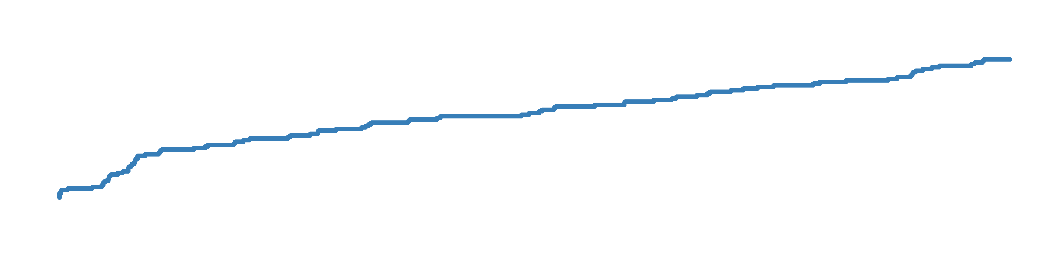
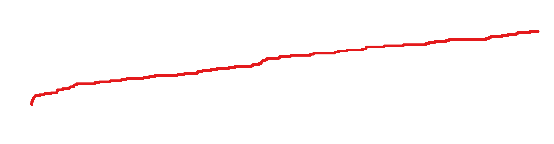
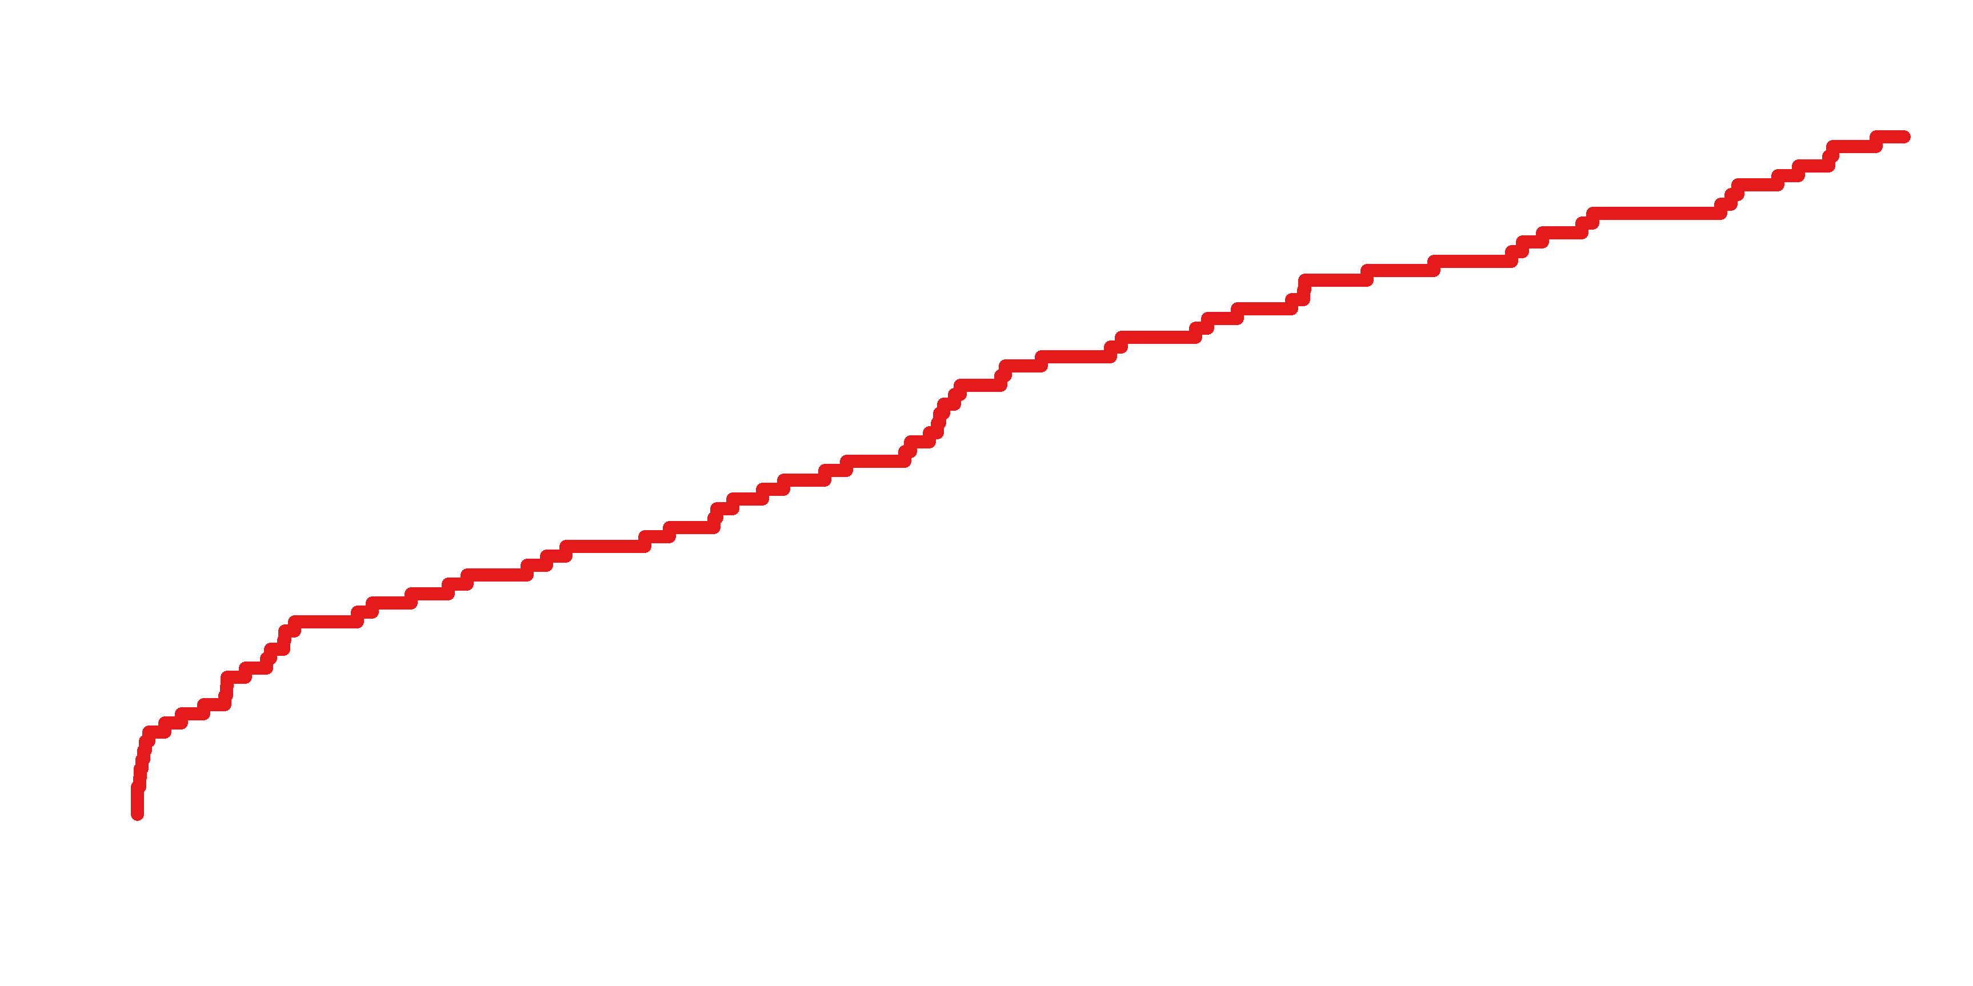
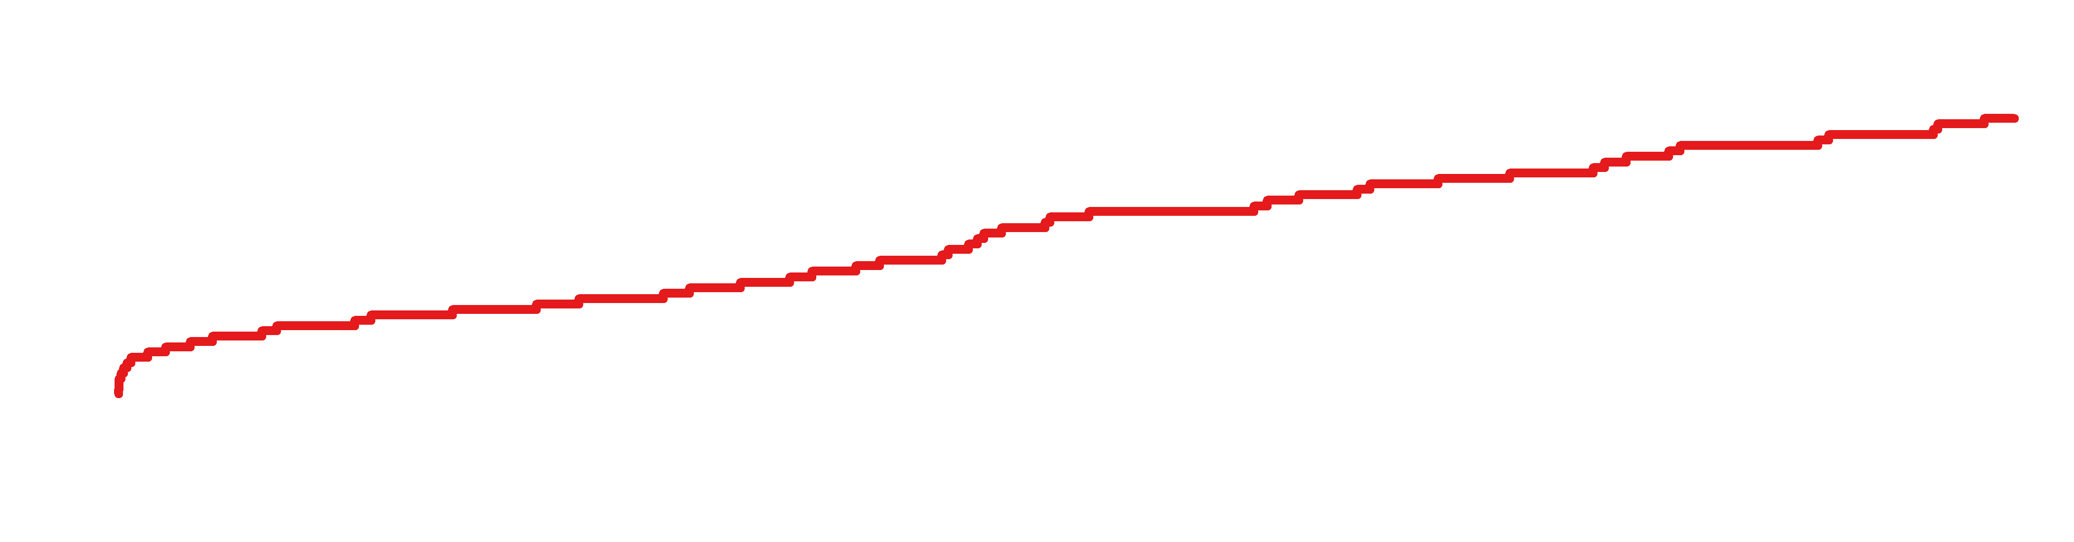
Primary Endpoint of MACCE: ITT Population
50
PCI
HR 1.25
(95% CI 0.93 – 1.69)
40
CABG
30
29.8%
Patients (%)
24.7%
20
10
0
0
2
4
6
8
10
Years since procedure
Number at risk
PCI | 300 | 256 | 239 | 226 | 214 | 195
CABG | 300 | 265 | 253 | 237 | 227 | 210
Primary endpoint: MACCE (death, MI, stroke, or ischemia-driven TVR)
Notes:
논문 Figure 1A

Slide 18
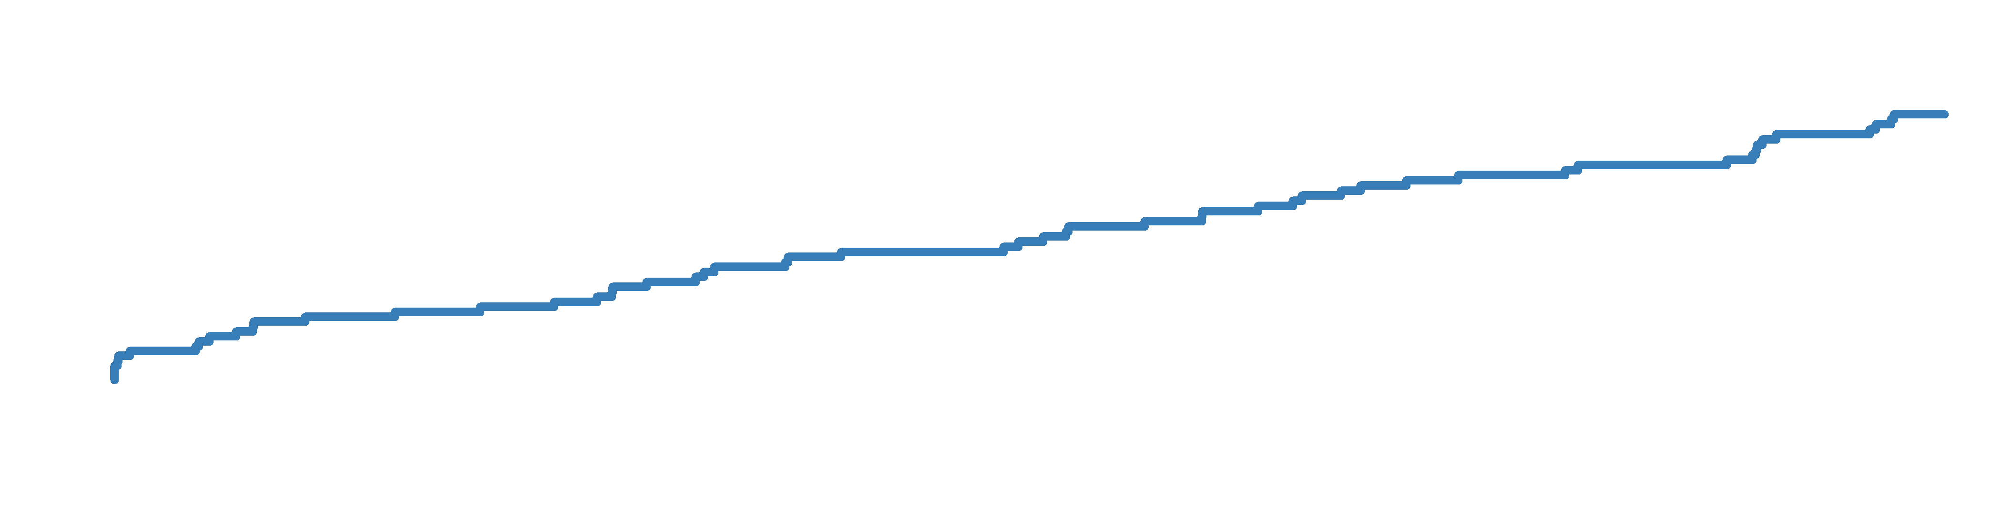

Composite of Death, MI, or Stroke
30
PCI
HR 1.00
(95% CI 0.70 – 1.44)
CABG
20
18.2%
17.5%
Patients (%)
10
0
0
2
4
6
8
10
Years since procedure
Number at risk
PCI | 300 | 279 | 264 | 253 | 244 | 226
CABG | 300 | 274 | 265 | 253 | 244 | 228
Notes:
논문 Figure 1B

Slide 19
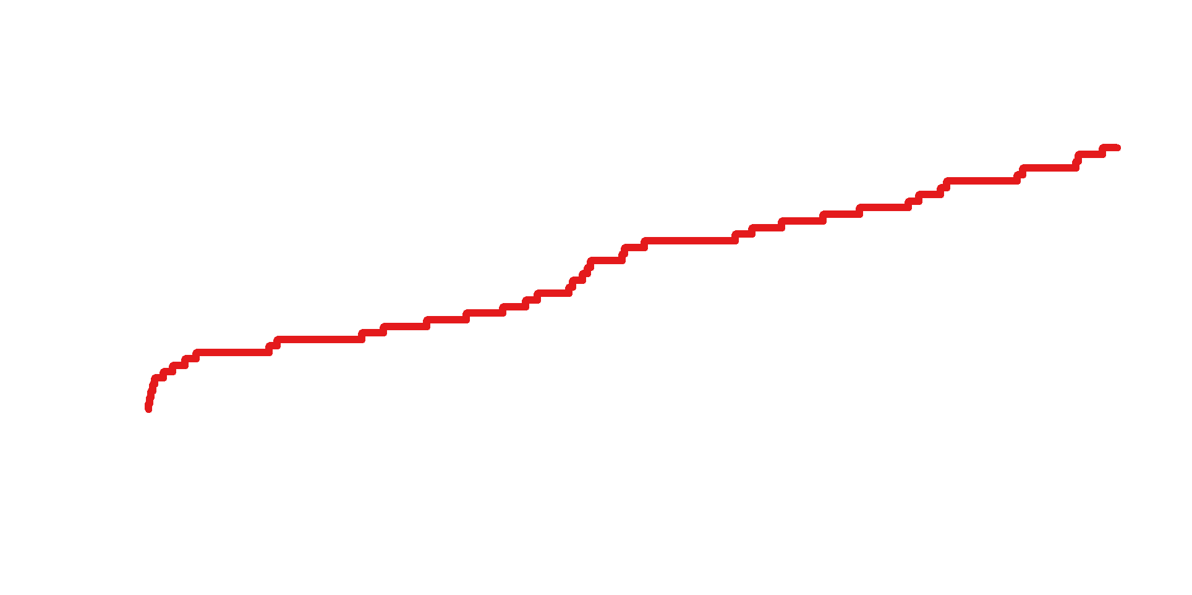
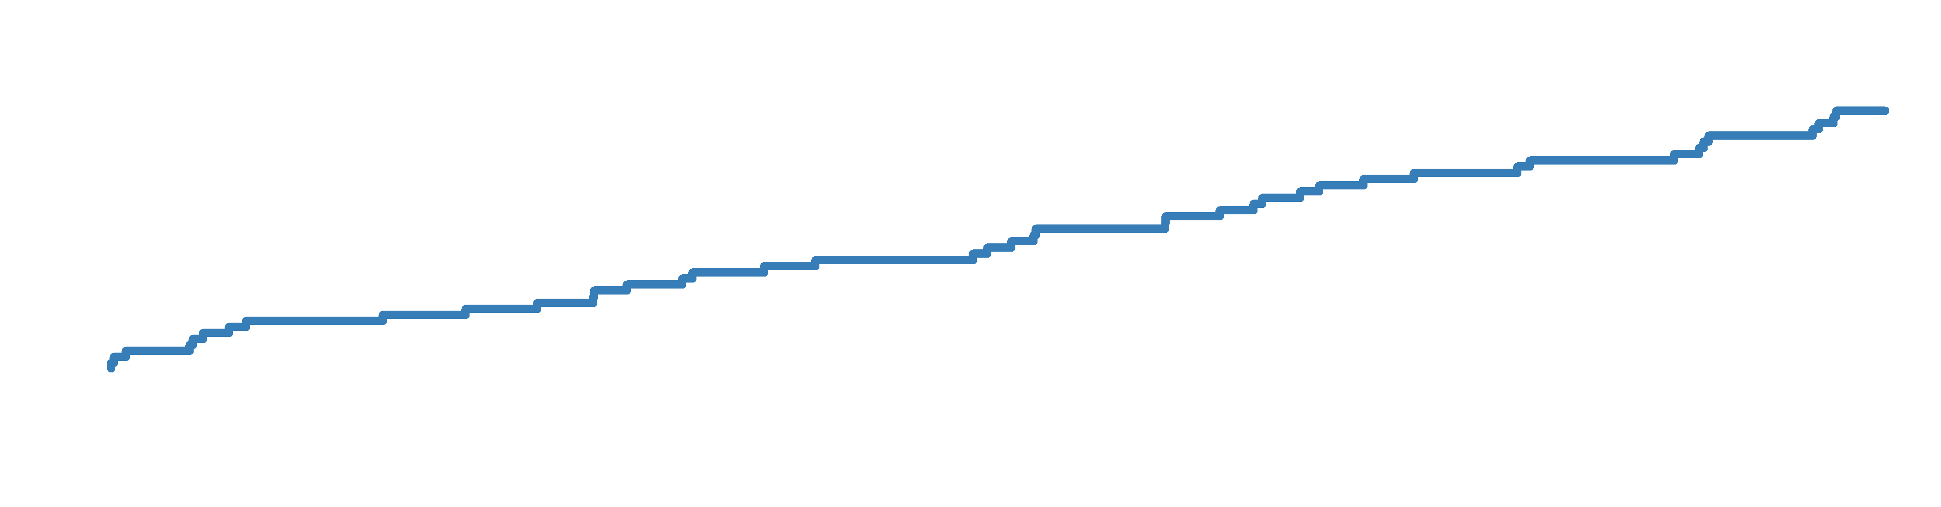
Death from Any Cause
30
PCI
HR 1.13
(95% CI 0.75 – 1.70)
CABG
20
Patients (%)
14.5%
13.8%
10
0
0
2
4
6
8
10
Years since procedure
Number at risk
PCI | 300 | 284 | 272 | 262 | 253 | 237
CABG | 300 | 279 | 272 | 262 | 254 | 238
Notes:
논문 Figure 1C

Slide 20
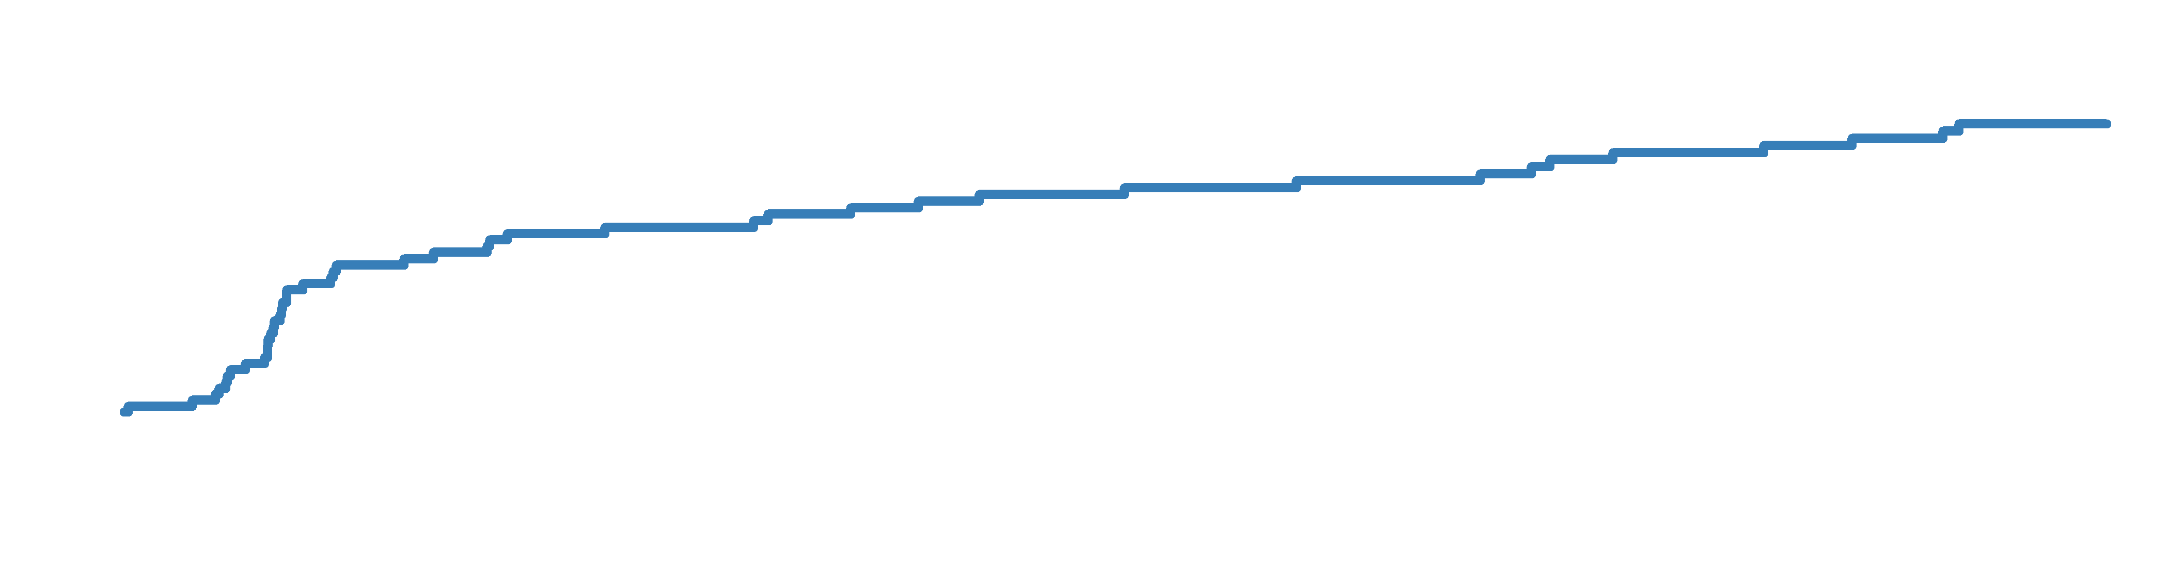

Ischemic-Driven Target-Vessel Revascularization
30
PCI
HR 1.98
(95% CI 1.21 – 3.21)
CABG
20
Patients (%)
16.1%
10
8.0%
0
0
2
4
6
8
10
Years since procedure
Number at risk
PCI | 300 | 255 | 240 | 227 | 214 | 199
CABG | 300 | 270 | 260 | 246 | 237 | 220
Notes:
논문 Figure 1D

Slide 21
Primary and Secondary Outcomes at 10 Years
Outcomes | PCI (N=300) | CABG (N=300) | Risk Difference (95% CI) | HR (95% CI)*
MACCE | 87 (29.8%) | 72 (24.7%) | 5.2 (-2.1 to 12.4) | 1.25 (0.93–1.69)
Death, MI, or stroke | 53 (18.2%) | 51 (17.5) | 0.7 (-5.6 to 6.9) | 1.00 (0.70–1.44)
Death from any cause | 42 (14.5%) | 40 (13.8%) | 0.7 (-5.0 to 6.4) | 1.13 (0.75–1.70)
Cardiovascular cause | 22 (7.8%) | 25 (8.7%) | -0.9 (-5.5 to 3.6) | 0.96 (0.56–1.65)
Non-cardiovascular cause | 11 (3.9%) | 8 (2.9%) | 1.0 (-2.0 to 4.0) | 1.55 (0.63–3.81)
Undetermined cause | 9 (3.4%) | 7 (2.7%) | 0.8 (-2.2 to 3.7) | 1.27 (0.50–3.22)
MI | 9 (3.2%) | 8 (2.8%) | 0.4 (-2.4 to 3.2) | 0.76 (0.32–1.82)
Q-wave | 4 (1.4%) | 4 (1.4%) | -0.02 (-1.9 to 1.9) | 0.82 (0.22–3.06)
Non-Q-wave | 5 (1.8%) | 4 (1.4%) | 0.4 (-1.7 to 2.5) | 0.71 (0.22–2.26)
Stroke | 5 (1.9%) | 6 (2.2%) | -0.3 (-2.7 to 2.1) | 0.71 (0.22–2.23)
Ischemia-driven TVR | 45 (16.1%) | 22 (8.0%) | 8.1 (2.8 to 13.5) | 1.98 (1.21–3.21)
Any revascularization | 59 (21.3%) | 29 (10.6%) | 10.7 (4.6 to 16.7) | 2.04 (1.33–3.11)
Stent thrombosis or symptomatic graft occlusion | 4 (1.4%) | 10 (3.7%) | -2.3 (-4.9 to 0.3) | 0.56 (0.20–1.55)
*Hazard ratios (HR) are for the PCI group as compared with the CABG group

Slide 22
Key Subgroup Analyses: Forest Plot for Primary Endpoint
Notes:
논문 Figure 2

Slide 23
Limitations
Owing to the limited number of patients and low event rates, this trial did not have sufficient statistical power to detect a clinically significant difference in end-points.
Blinding of PCI vs. CABG was not possible; some degree of event ascertainment bias cannot be excluded.
We did not capture detailed information on concurrent cardiovascular medications during long-term follow-up.
Because we evaluated the first-generation DES (Cypher stent), our findings should be confirmed or refuted through longer follow-up of the trials involving contemporary DES (i.e., EXCEL or NOBLE).

Slide 24
Summary
PRECOMBAT was a first RCT specifically targeting patients with unprotected LMCA disease.
In this longest extended follow-up, we did not detect significant difference between PCI with SES and CABG in the primary composite of death, MI, stroke, or ischemic-driven TVR at 10 years.
The 10-year incidence of composite of death, MI, or stroke and all-cause mortality were also similar between the two groups.
The 10-year rate of ischemia-driven target-vessel revascularization was 8 percentage points higher with PCI than with CABG.

Slide 25
Conclusions
Ten-year follow-up of the PRECOMBAT trial of patients with LMCA disease randomized to PCI or CABG did not demonstrate significant difference in the incidence of major adverse cardiac or cerebrovascular events.
Because the study was underpowered, the results should be considered hypothesis-generating highlighting the need for further research.

Slide 26
Park DW, Park SJ et al. Circulation 2020:March 30th, On-line

