Slide 1
How Long To Continue Aspirin After ACS/PCI In Patients With Atrial Fibrillation? Insights From AUGUSTUS
John H. Alexander, MD, MHS
Daniel Wojdyla MS, Laine Thomas PhD, Christopher B. Granger, MD, Shaun G. Goodman, MD, MSc, Ronald Aronson, MD, Stephan Windecker, MD, Roxana Mehran, MD, Renato D. Lopes, MD, PhD
On Behalf of the AUGUSTUS Investigators

Slide 2
Disclosures
The AUGUSTUS trial and these analyses were funded by the Bristol-Myers Squibb/Pfizer Alliance
Research support: Boehringer Ingelheim, Bristol-Myers Squibb, CryoLife, CSL Behring, Glaxosmithkline, US FDA, US NIH, XaTek
Consultant: AbbVie, Bayer, Bristol-Myers Squibb, CryoLife, CSL Behring, Novo Nordisk, Pfizer, Portola, Quantum Genomics, US VA, XaTek, Zafgen
Conflict-of-interest disclosures available at http://www.dcri.duke.edu/research/coi

Slide 3
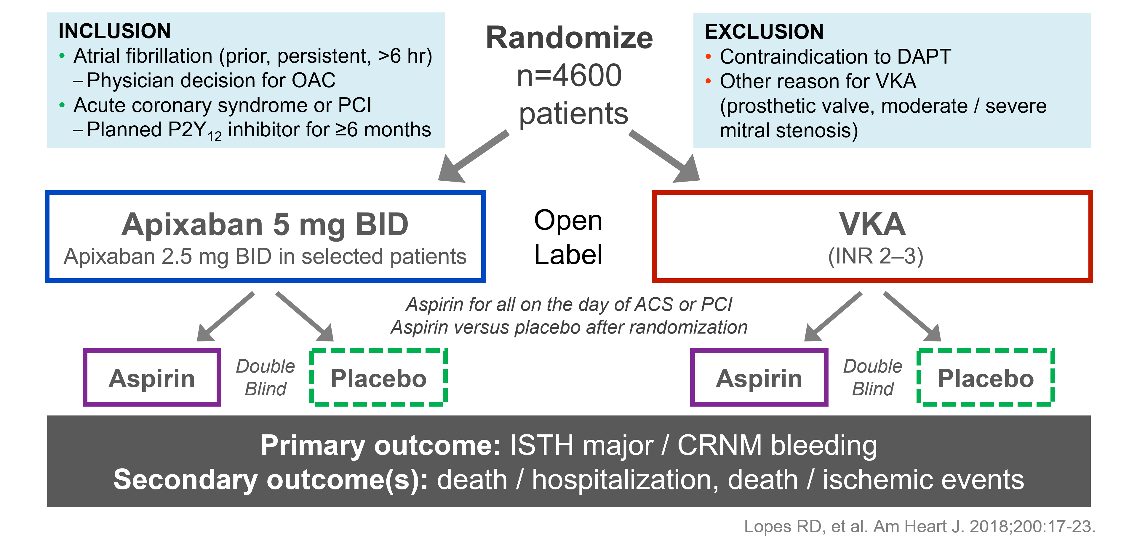
AUGUSTUS Trial Design

Slide 4
Background
AUGUSTUS demonstrated that, in patients with atrial fibrillation and recent ACS or PCI on a P2Y₁₂ inhibitor and oral anticoagulant (apixaban or warfarin), placebo resulted in significantly less bleeding than aspirin
There was no significant difference between patients assigned aspirin and placebo in the secondary outcomes of the composites of…
death or hospitalization
ischemic events [death, stroke, myocardial infarction, stent thrombosis (definite or probable), or urgent revascularization]
Lopes RD, et al. N Engl J Med 2019;380:1509-24

Slide 5
Ischemic Events With Placebo vs. Aspirin
Though not statistically significant, there were numerically more of some ischemic events in patients assigned placebo than aspirin:
Aspirin Placebo
Death 72 (3.1%) vs. 79 (3.4%)
Cardiovascular Death 53 (2.3%) vs. 58 (2.5%)
Stroke 20 (0.9%) vs. 19 (0.8%)
Stent thrombosis (definite or probable) 11 (0.5%) vs. 21 (0.9%)
Myocardial infarction 68 (2.9%) vs. 84 (3.6%)
Urgent revascularization 37 (1.6%) vs. 47 (2.0%)
Analysis of the stent thrombosis events suggested that most of the increased risk was early, within 30 days of randomization
Lopes RD, et al. N Engl J Med 2019;380:1509-24
Lopes RD, et al. Circulation 2020; 141:781-783

Slide 6
Tradeoff Between Bleeding and Ischemic Events
There is a temporal component to the balance of bleeding and ischemic risk
Recurrent ischemic events (specifically stent thrombosis) tend to occur early after ACS/PCI
Bleeding risk is cumulative and is higher with long-term, potent antithrombotic therapy
Schomig A, et al. Heart 2009;95:1280–1285

Slide 7
Objective
Assuming that there might be a risk/benefit trade off that changes over time...
To explore the balance of risk (bleeding) and benefit (ischemic events) between randomization and 30 days and between 30 days and 6 months, with aspirin and placebo, among patients enrolled in AUGUSTUS

Slide 8
Composite Clinical Outcomes
The AUGUSTUS primary bleeding (ISTH major or CRNM bleeding) and secondary ischemic event outcome (death, stroke, myocardial infarction, stent thrombosis, or urgent revascularization) are not of comparable severity
 | Bleeding | Ischemic Event
Severe | Fatal, intracranial, ISTH major | CV death, stent thrombosis, MI, stroke
Intermediate | Fatal, intracranial, ISTH major, bleeding hospitalization | CV death, stent thrombosis, MI, stroke, urgent revascularization
Broad | Fatal, intracranial, ISTH major, bleeding hospitalization, CRNM | CV death, stent thrombosis, MI, stroke, urgent revascularization, CV hospitalization

Slide 9
Statistical Analysis
Kaplan-Meier method used to estimate event probabilities for each composite bleeding and ischemic outcome from randomization to 30 days and from 30 days to 6 months
Absolute differences in bleeding and ischemic events between aspirin and placebo were compared
All analyses were done using intention-to-treat principle and included all randomized patients and all events

Slide 10
Baseline Characteristics (n=4614)
Age (yrs)* 71 (64, 77)
Weight (kg)* 83 (74, 95)
CHA₂DS₂-VASc* 4 (3, 5)
HAS-BLED* 3 (2, 3)
Female 29%
Cr >1.5 mg/dl 8%
Hypertension 88%
Heart Failure 43%
Diabetes 36%
Stroke/TIA 4%
Prior OAC 49%
P2Y12 inhibitor
Clopidogrel 93%
Prasugrel 1%
Ticagrelor 6%
Enrolling indication
ACS + PCI 37%
ACS + Med 24%
Elective PCI 39%
Time Event to Rand (d)* 6 (3, 10)
*Median (25th, 75th)

Slide 11
Bleeding and Ischemic Outcomes: Aspirin vs. Placebo Randomization to 30 Days
3.42
(2.07, 4.76)
-0.07
(-1.53, 1.39)
1.58
(0.67, 2.49)
-0.78
(-1.65, 0.09)
-0.91
(-1.74, -0.08)
0.97
(0.23, 1.70)
Bleeding Outcomes
Ischemic Outcomes
Numbers are absolute risk differences (95% confidence intervals) for aspirin - placebo

Slide 12
Bleeding and Ischemic Outcomes: Aspirin vs. Placebo 30 Days to 6 Months
0.03
(-2.05, 2.11)
4.88
(3.14, 6.62)
2.47
(1.22, 3.73)
-0.31
(-1.52, 0.90)
-0.17
(-1.33, 0.98)
1.25
(0.23, 2.27)
Bleeding Outcomes
Ischemic Outcomes
Numbers are absolute risk differences (95% confidence intervals) for aspirin - placebo

Slide 13
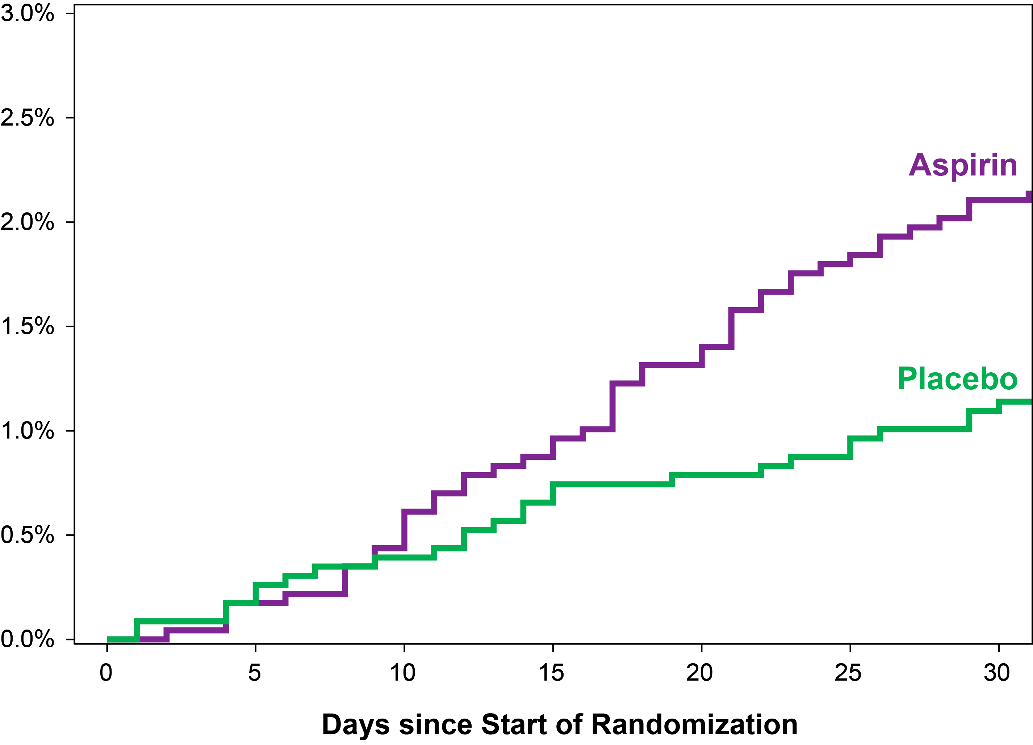
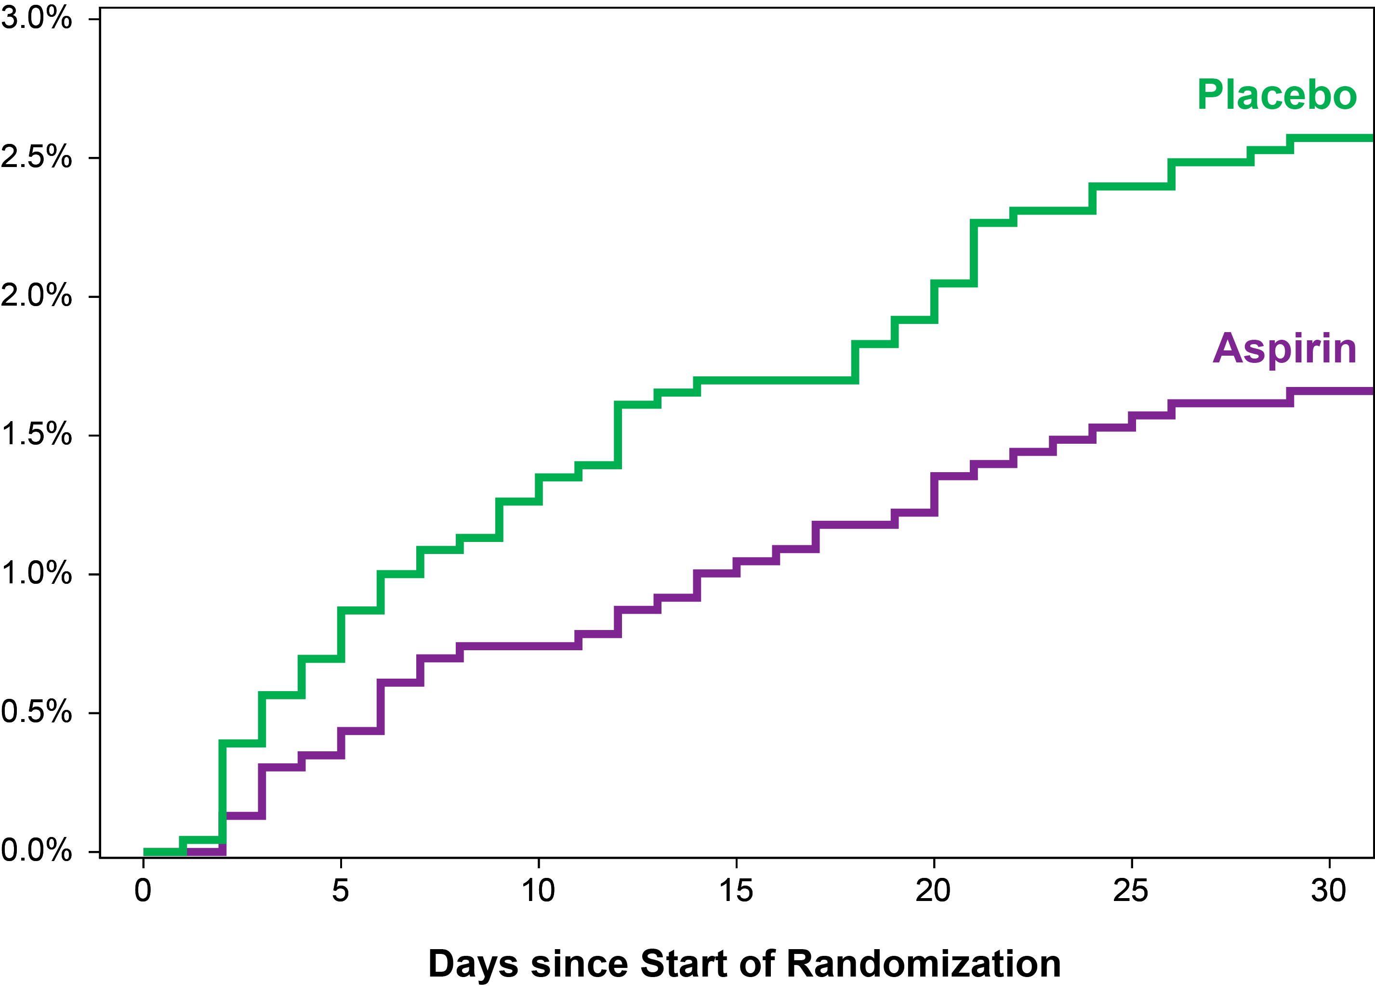
Severe Bleeding and Ischemic Outcomes Randomization to 30 Days
Fatal, ICH, Major Bleeding
CV Death, Stroke, MI, Stent Thrombosis

Slide 14
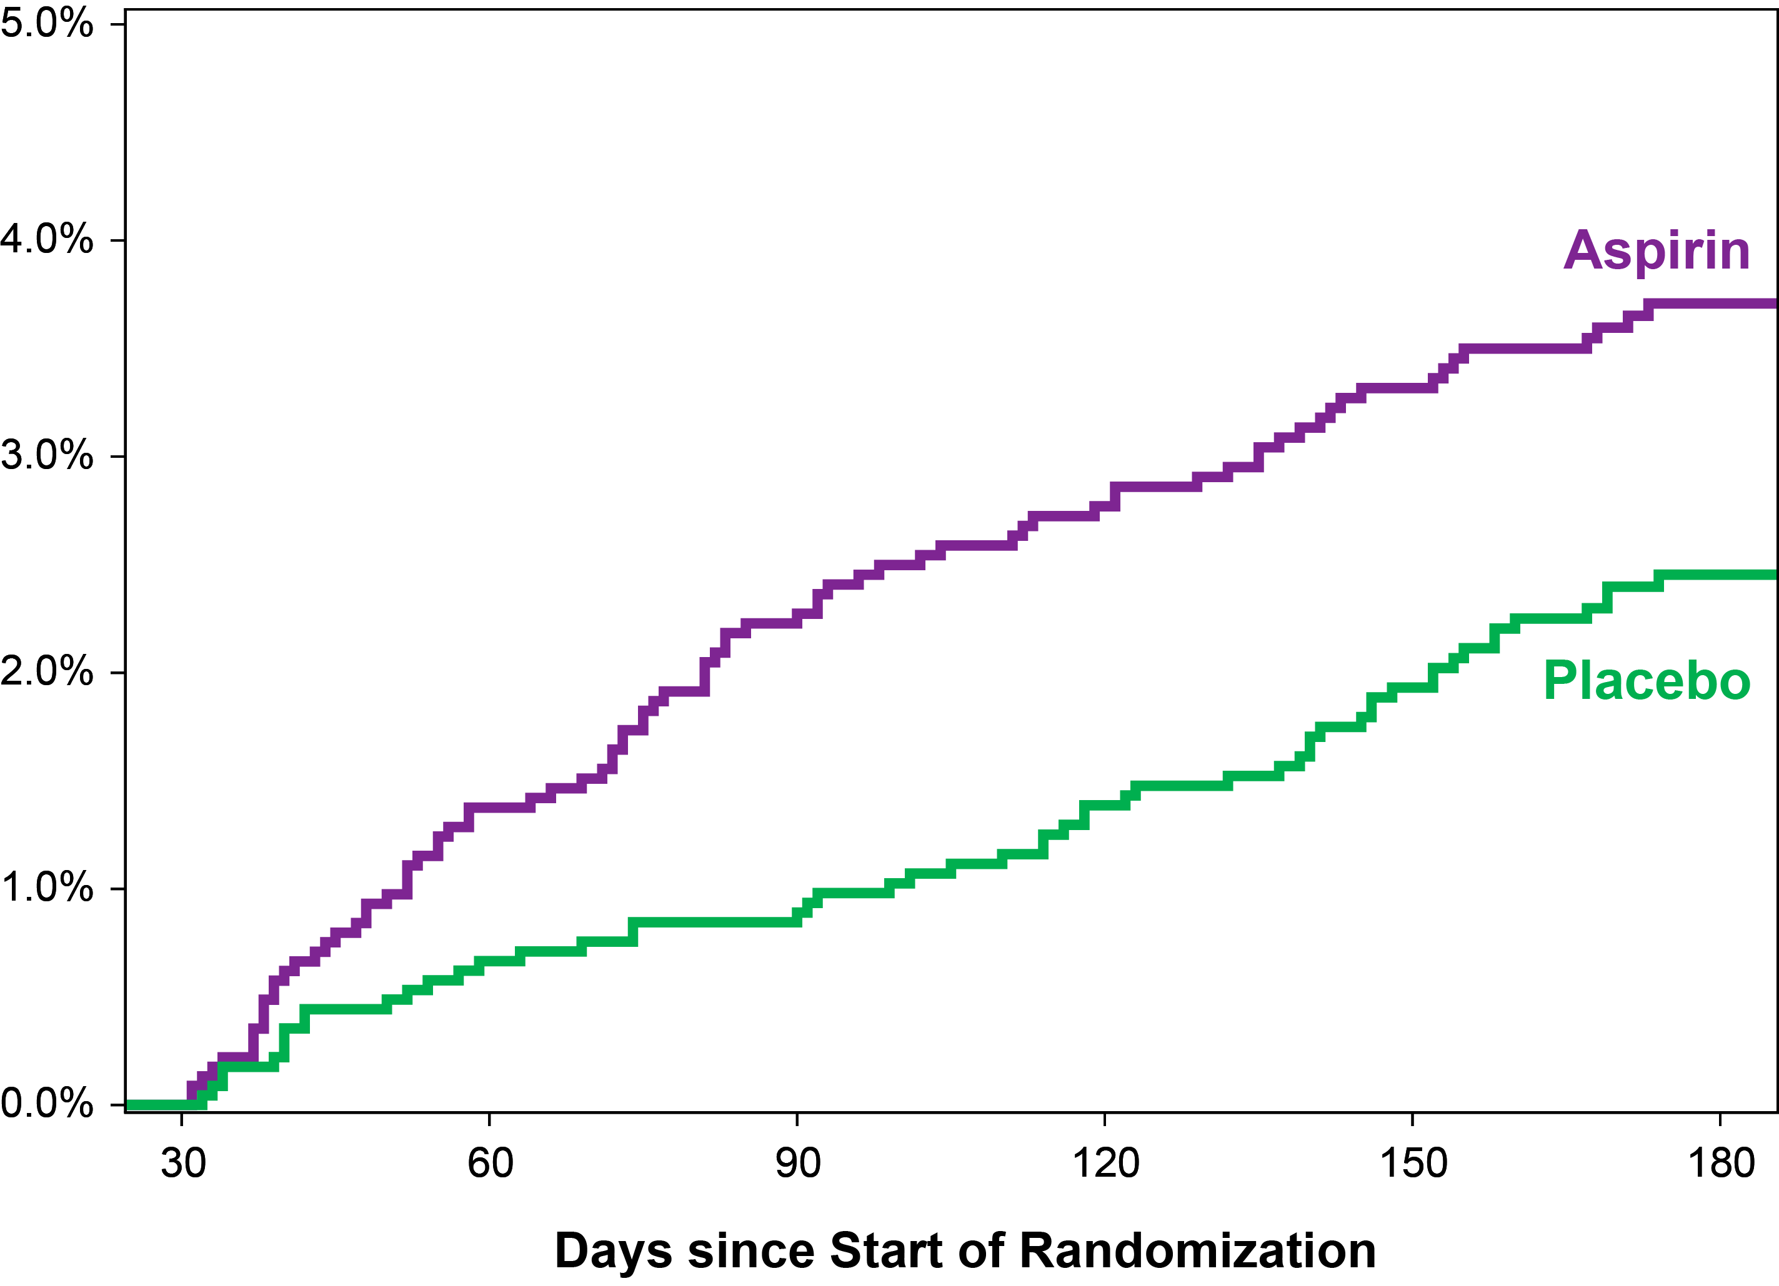
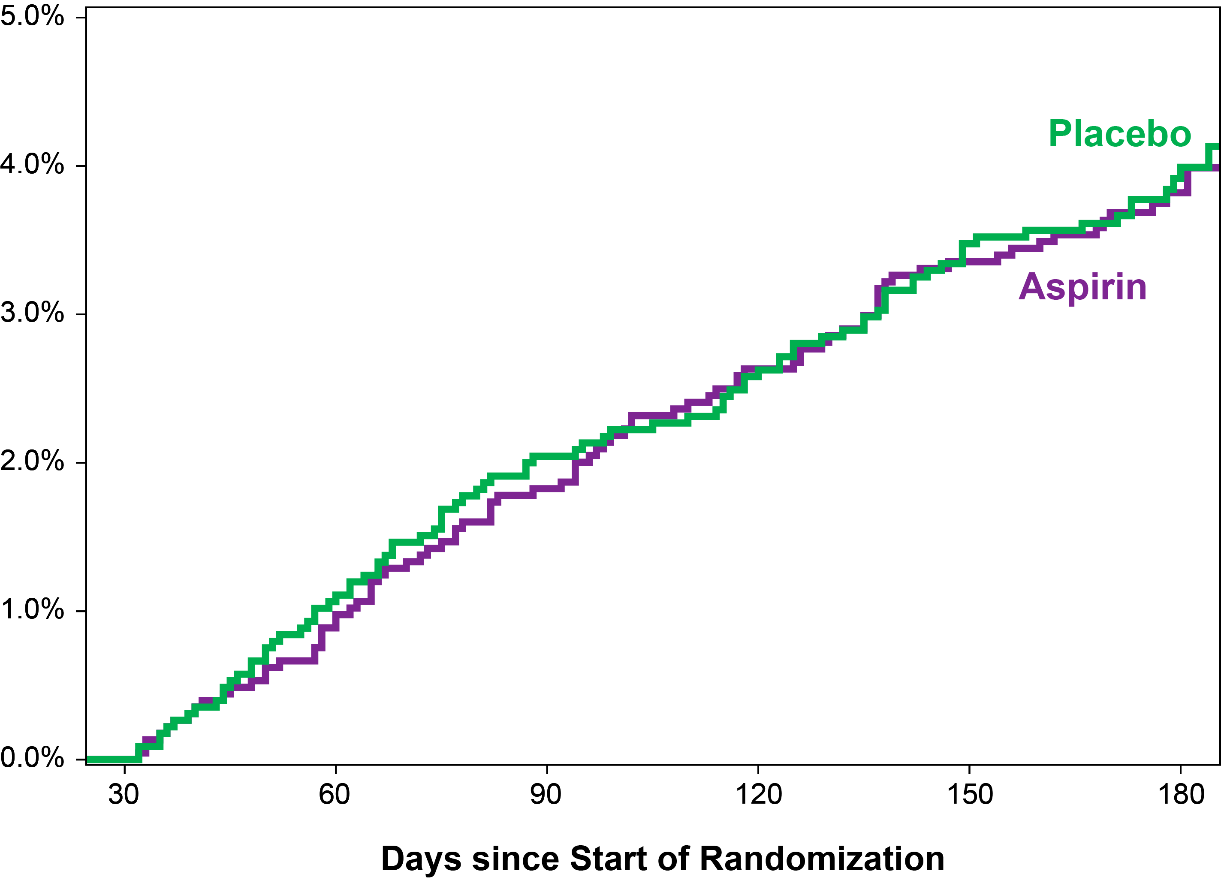
Severe Bleeding and Ischemic Outcomes 30 Days to 6 Months
Fatal, ICH, Major Bleeding
CV Death, Stroke, MI, Stent Thrombosis

Slide 15
Limitations
Patients received aspirin prior to randomization (median 6 days) in both arms and this could have influenced subsequent bleeding or ischemic outcomes
The severe, intermediate, and broad composite bleeding and ischemic event outcomes may not be of completely comparable severity
This is a post-hoc secondary analysis and the analysis plan, composite outcomes, and time windows (randomization to 30 days and 30 day to 6 months) were developed after seeing the initial AUGUSTUS results
The number of events is small, particularly for the more severe outcomes and when subdivided by time window, creating the potential for type II error

Slide 16
Conclusions
Among patients with atrial fibrillation and a recent ACS or PCI receiving a P2Y₁₂ inhibitor and oral anticoagulation with apixaban or warfarin…
The use of aspirin acutely and for up to approximately 30 days results in an equal increase in severe bleeding and reduction in severe ischemic events
After 30 days, aspirin continues to increase bleeding without significantly reducing ischemic events
These results should inform patient-centric, shared decision making regarding the ideal duration of aspirin after an ACS or PCI in patients with atrial fibrillation receiving oral anticoagulation

Slide 17
The Risk / Benefit Tradeoff of Antithrombotic Therapy in Patients with Atrial Fibrillation Early and Late After an Acute Coronary Syndrome or Percutaneous Coronary Intervention: Insights from AUGUSTUS

