Slide 1
Advancing Cell Therapies for
Coronary Microvascular Dysfunction:
Experts Roundtable
Stable Angina: State of the Art
November 16, 2019
Peter H. Stone, M.D.
Professor of Medicine
Cardiovascular Division
Brigham & Women’s Hospital
Harvard Medical School
Disclosure: Research support from NIH,
AstraZeneca, St Jude Medical; Infraredx;

Slide 2
Goals of Pharmacologic/Revascularization Therapy in Stable CAD
I.
Disease Modification/Secondary Prevention: Reduce/stabilize atherosclerotic plaque, reducing likelihood of rupture ACS, Death
  Moderate/High intensity statin therapy
  β-blockers
  Aspirin
  ACE inhibitors
  Revascularization Therapy (CABG or PCI)
Improve Anginal Symptoms and Quality of Life:
  A. Optimizing myocardial O₂ supply:demand balance:
  1. Reduce HR, BP, Preload (venous pressure)
  (β-blockers, Ca⁺⁺ blockers, nitrates)
  B. Other Mechanistic Approaches:
    1. Inhibition of late Na⁺ influx (Ranolazine)
  C. Revascularization Therapy (CABG or PCI)
II.

Slide 3
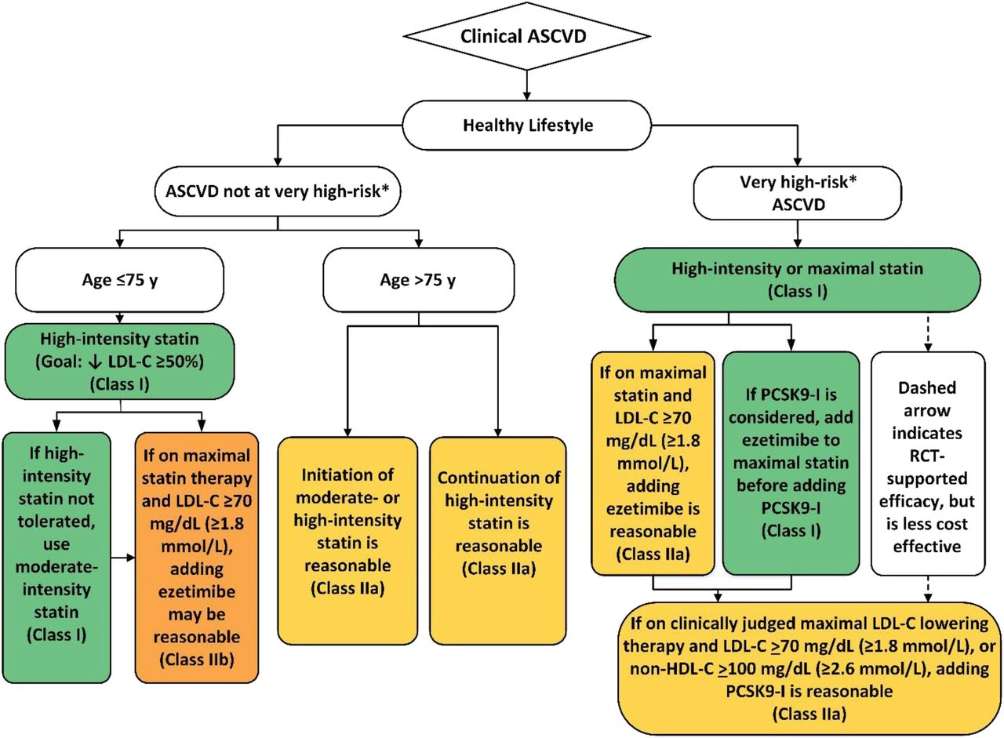
2018 AHA/ACC Guidelines for Management of Blood Cholesterol
(Grundy SM, et al. JACC 2019;73:e285-350)

Slide 4
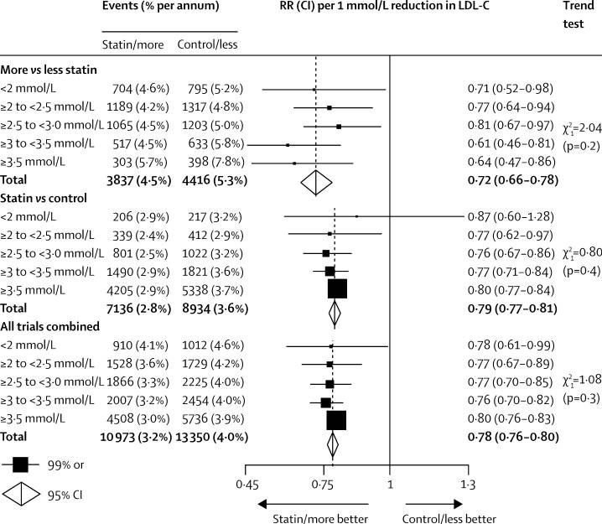
Linear Relationship Between Absolute
Reduction in LDL and Major Vascular Events
Meta-analysis of 26 Randomized Trials, n= 169,000 patients
Risk Ratio per 39 mg/dl LDL reduction
(1.0 mmol/L)
For every 39 mg/dl
(1 mmol/L)
LDL reduction:
22% in major
vascular events
(Cholesterol Treatment Trialists’ Collaboration. Lancet 2010;376:1670)

Slide 5
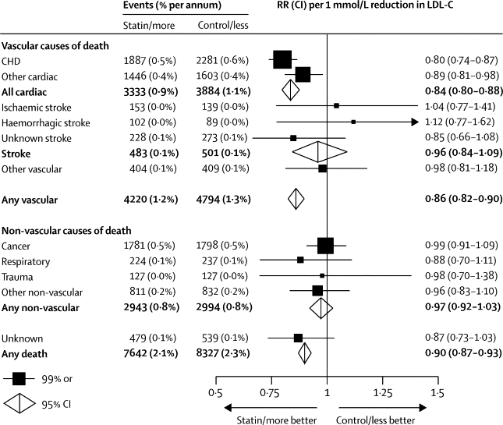
Linear Relationship Between Absolute Reduction in LDL and Mortality
Meta-analysis of 26 Randomized Trials, n= 169,000 patients
Risk Ratio per 39 mg/dl LDL reduction
(1.0 mmol/L)
For every 39 mg/dl
(1mmol/L)
LDL reduction:
18% in
vascular mortality,
10% in
total mortality
(Cholesterol Treatment Trialists’ Collaboration. Lancet 2010;376:1670)

Slide 6
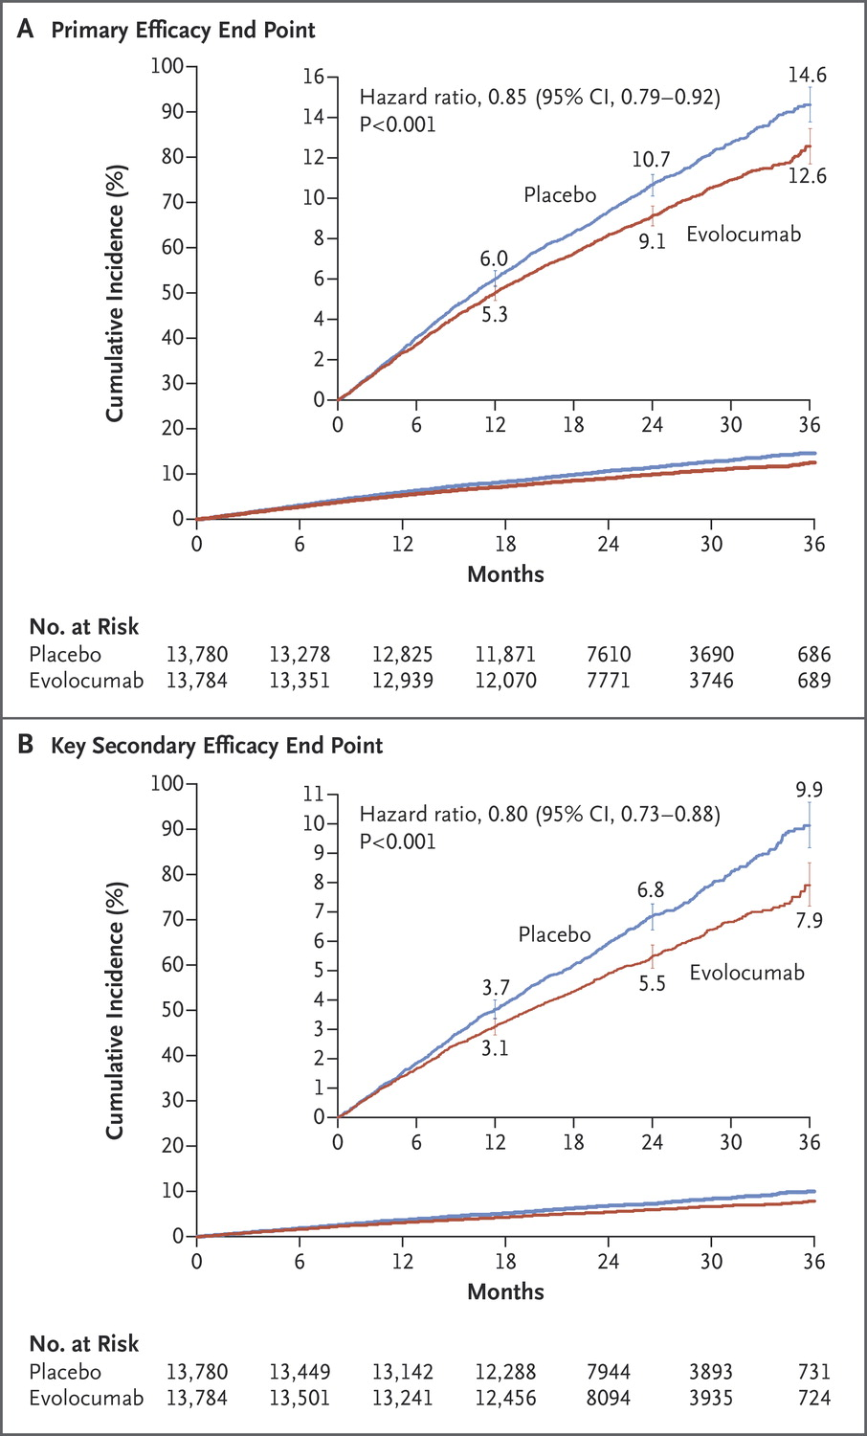
Clinical Inadequacy of Even Maximal
LDL-Lowering to Prevent Plaque Events
MACE in pts treated with high-intensity statin plus Evolocumab
CV Death/MI/CVA/Hosp for UA/Revasc CV Death/MI/CVA
14%
Relative
Risk
20%
Relative
Risk
Absolute 12.6%
Residual Risk
Absolute 7.9%
Residual Risk
Most plaques remain at risk for destabilization despite LDL values 30 mg/dl !
(Sabatine MS, et al. NEJM 2017;376:1713)

Slide 7
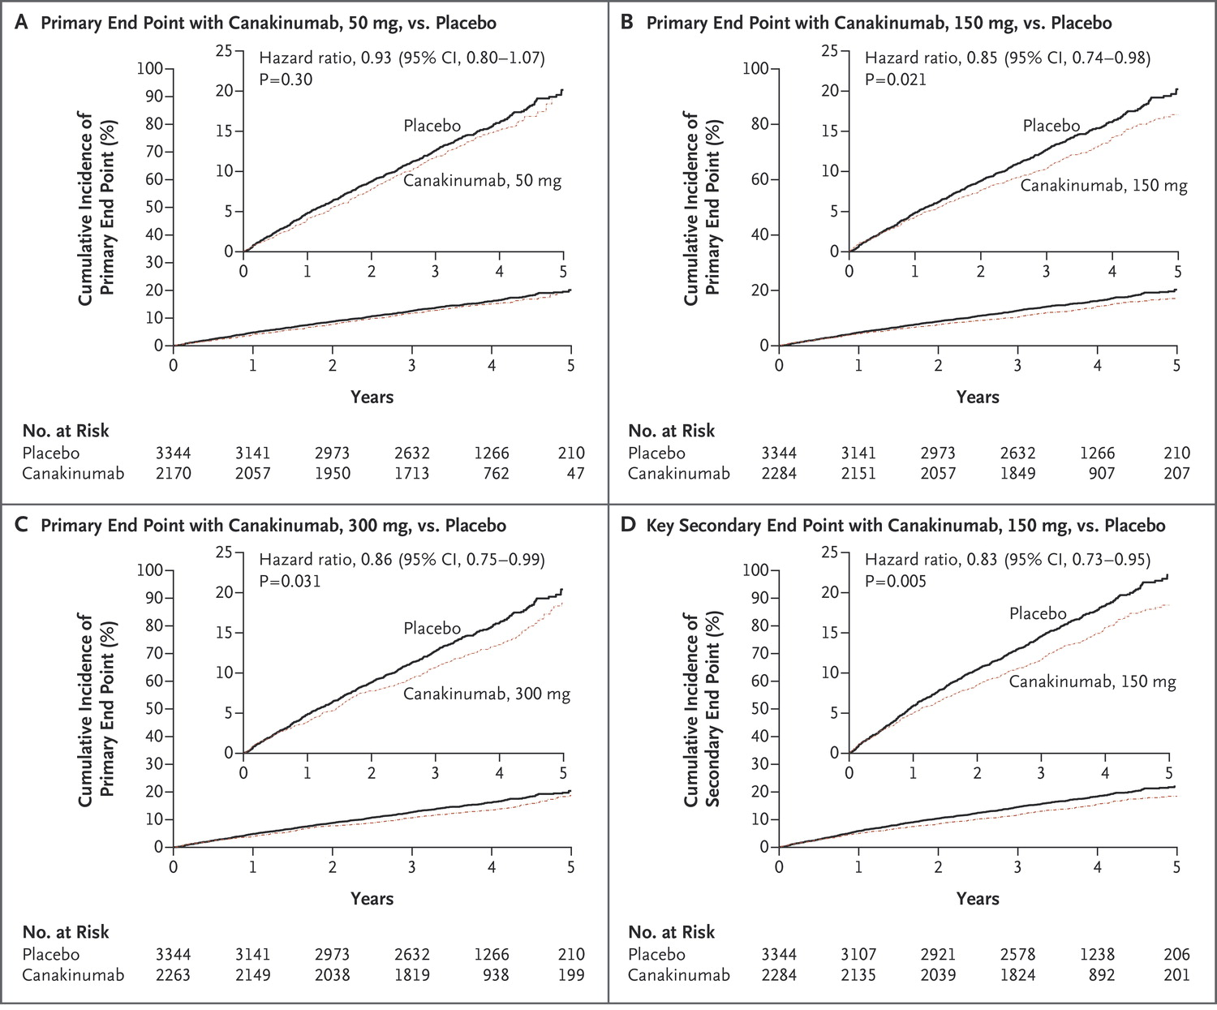
Direct Anti-Inflammatory Treatment of Atherosclerotic Disease (CANTOS)
10,061 pts with prior MI and CRP > 2.0 mg/L treated with
high-dose statins and Canakinumab, IL-1β antibody
Nonfatal MI/CVA/CV Death/
Nonfatal MI/CVA/CV Death UA/Revasc
15%
Relative
Risk
17%
Relative
Risk
Absolute ~16%
Residual Risk
Absolute ~17%
Residual Risk
Most plaques remain at risk for destabilization despite statin + Canakinumab
(Ridker PM, et al. NEJM 2017;377:1119)

Slide 8
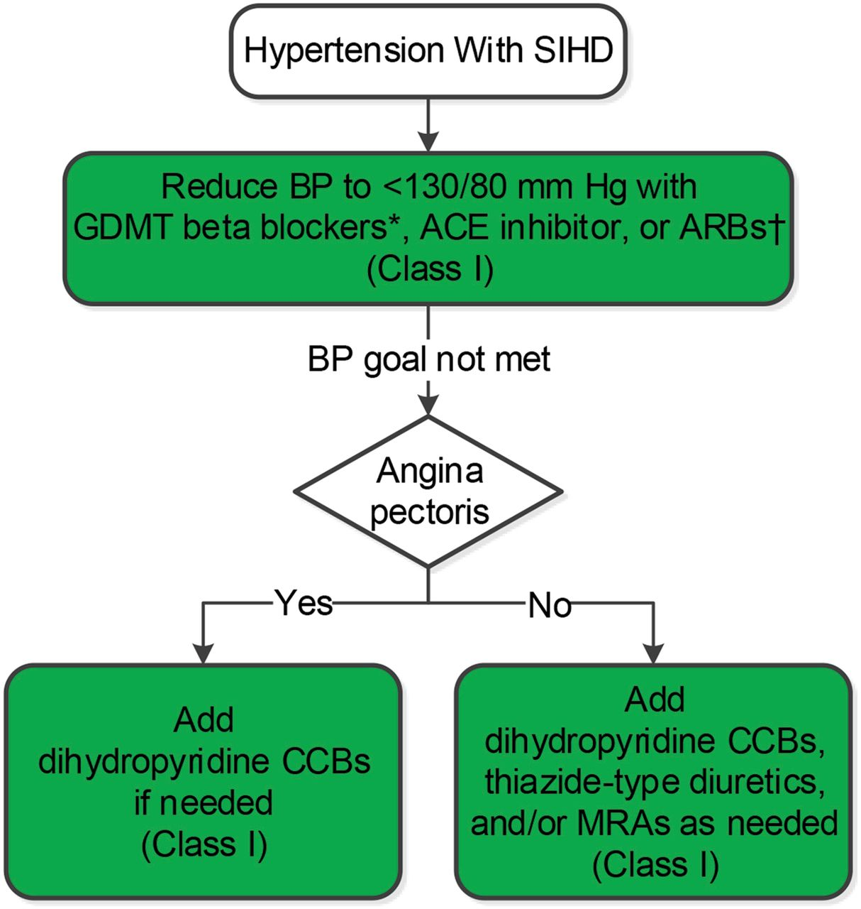
2017 ACC/AHA Guidelines for Management of High Blood Pressure
(Whelton PK, et al. JACC 2018;71:e127-248)

Slide 9
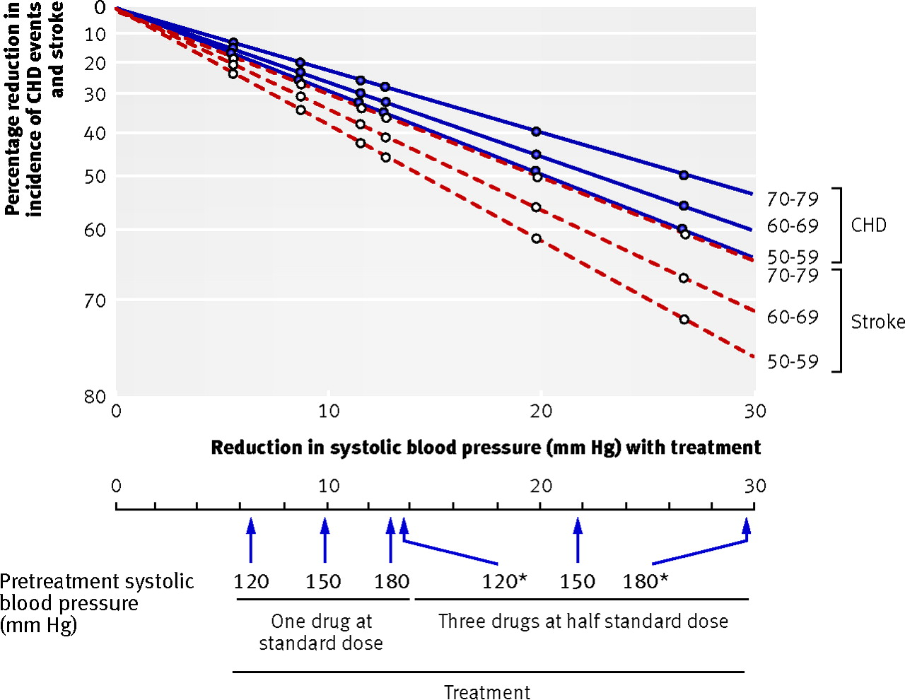
Reduction in Incidence of CHD and Stroke In Relation to Reduction in BP
Meta-analysis of 147 Randomized Trials, n= 958,000 patients
For every
10 mmHg systolic
or 5 mmHg diastolic
BP reduction:
22% in CHD
incidence;
41% in stroke
incidence
Age
CHD
Stroke
(Law MR, et al. BMJ 2009;338:1665)

Slide 10
Guideline Based β-Blocker Therapy
Secondary Prevention
I
IIa
IIb
III
β-blocker therapy should be started and continued for 3 years in all patients with normal LV function after MI or ACS.
β-blocker therapy should be used in all patients with LVEF ≤40% with heart failure or prior MI, unless contraindicated. (Documented benefit with carvedilol, metoprolol succinate, or bisoprolol)
β-blockers may be considered as chronic therapy for all other patients with coronary or other vascular disease.
B
I
IIa
IIb
III
A
I
IIa
IIb
III
(Fihn SD, et al. JACC 2012;60:e44-e164)

Slide 11
β-Blockers for Secondary Prevention of CV Disease
Meta-Analysis of Selective and Non-Selective β-Blockers
33 Trials, 34,622 Patients
~ 20-30% reduction in mortality and vascular events
Group of Pts: Outcome | β1 Blockers Relative Risk (95% CI) | β1+2 Blockers Relative Risk (95% CI)
ACS: Total mortality | 0.84 (0.67-1.05) | 0.72 (0.63-0.81)
ACS: Vascular Events | 0.68 (0.42-1.11) | 0.74 (0.66-0.84)
Heart Failure: Total mortality | 0.75 (0.66-0.85) | 0.74 (0.56-0.96)
Heart Failure: Vascular Events | 1.34 (0.82-2.18) | 0.79 (0.61-1.03)
(de Peuter OR, et al. Neth J Med 2009;67:284)

Slide 12
Guideline-Based Antiplatelet Therapy
Secondary Prevention
I
IIa
IIb
III
Aspirin 75 to 162 mg daily indefinitely.
Clopidogrel is reasonable when aspirin is contraindicated.
Aspirin 75 to 162 mg daily and clopidogrel 75 mg daily might be reasonable in certain high-risk patients with SIHD.
Dipyridamole is not recommended as antiplatelet therapy.
A
I
IIa
IIb
III
B
I
IIa
IIb
III
B
I
IIa
IIb
III
B
(Fihn SD, et al. JACC 2012;60:e44-e164)

Slide 13
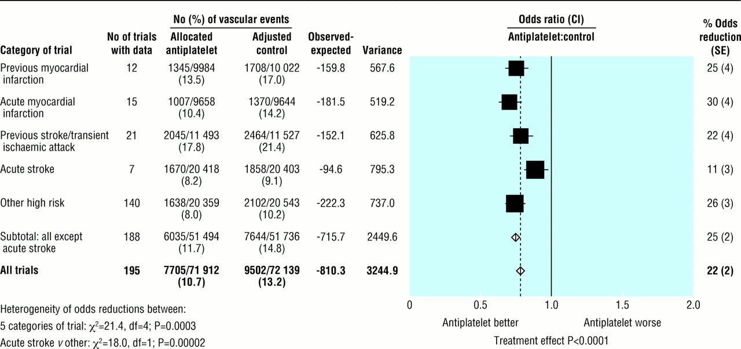
Benefit of Antiplatelet Therapy for Secondary Prevention of CV Disease
(non-fatal MI, non-fatal stroke, vascular death)
% Odds
Reduction
25%
30%
22%
11%
26%
25%
22%
(Antithrombotic Trialists’ Collaboration. BMJ 2002;324:71-86)

Slide 14
Guideline-Based Renin-Angiotensin-Aldosterone Blocker Therapy
Secondary Prevention
I
IIa
IIb
III
ACE inhibitor (or ARB if ACEI intolerant) should be prescribed in all patients with SIHD who also have hypertension, diabetes mellitus, LVEF ≤40%, or CKD, unless contraindicated.
ACE inhibitor (or ARB if ACEI intolerant) is reasonable in patients with both SIHD and other vascular disease (vascular protection).
A
I
IIa
IIb
III
B
(Fihn SD, et al. JACC 2012;60:e44-e164)

Slide 15
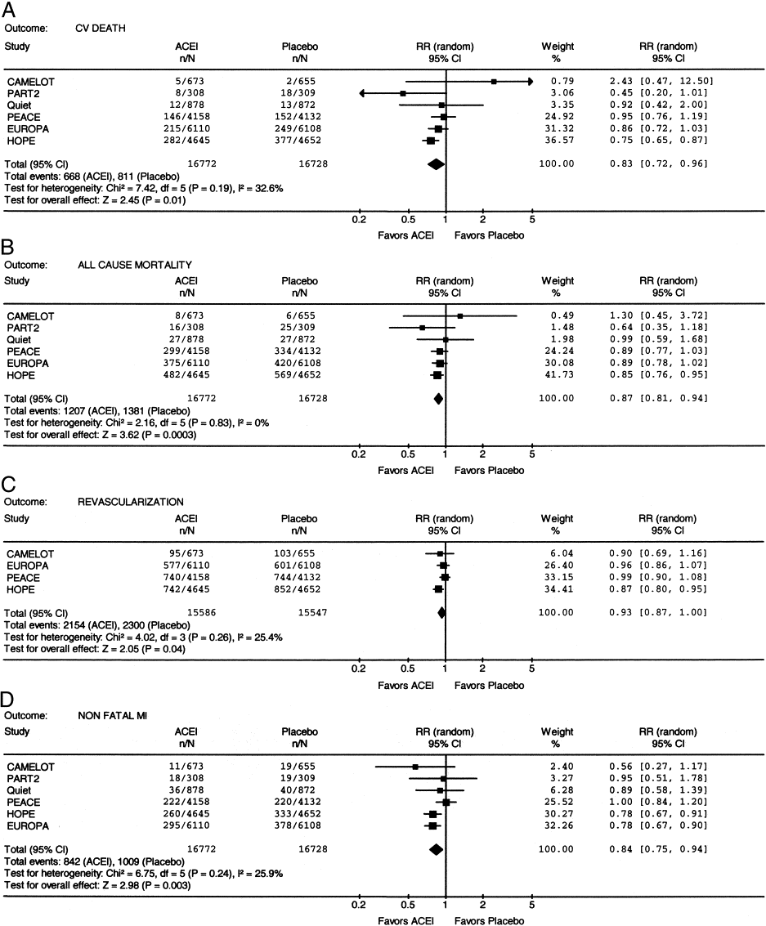
Benefit of ACEI for
Secondary Prevention of CV Disease
Meta-Analysis of RCTs of Patients with CAD and Preserved LVEF
6 Trials with 33,500 Patients
Cardiovascular Death
Non-Fatal MI
17% CV Death
16% Non-Fatal MI
(Al-Mallah, et al. JACC 2006;47:1576)

Slide 16

Treatment of Symptoms (Angina): Determinants of Myocardial O₂ Supply:Demand Balance
O₂ Demand
O₂ Supply
Heart Rate
Contractility
Ventricular Wall Tension
- Preload
- Afterload
Diastolic blood flow
Resistances
- Regulation
- Metabolic control
- Endothelial function
- Myogenic/
extravascular
compression

Slide 17
Guideline-Based Anti-Ischemic Medications for Angina
I
IIa
IIb
III
β-blockers should be prescribed as initial therapy.
Ca⁺⁺-channel blockers or long-acting nitrates should be prescribed when β-blockers are contraindicated or cause unacceptable side effects
Ca⁺⁺-channel blockers or long-acting nitrates, in combination with β-blockers, should be prescribed when initial treatment with β-blockers is unsuccessful.
B
I
IIa
IIb
III
B
I
IIa
IIb
III
B
(Fihn SD, et al. JACC 2012;60:e44-e164)

Slide 18
Guideline-Based Anti-Ischemic Medications for Angina (cont.)
I
IIa
IIb
III
B
Sublingual NTG or spray for immediate relief of angina.
Long-acting verapamil or diltiazem instead of a β-blocker as initial therapy is reasonable.
Ranolazine can be useful as a substitute for β-blockers if initial treatment with β-blockers leads to unacceptable side effects, is ineffective or is contraindicated.
Ranolazine in combination with β-blockers can be useful when initial treatment with β-blockers is not successful.
I
IIa
IIb
III
B
I
IIa
IIb
III
B
I
IIa
IIb
III
A
(Fihn SD, et al. JACC 2012;60:e44-e164)

Slide 19
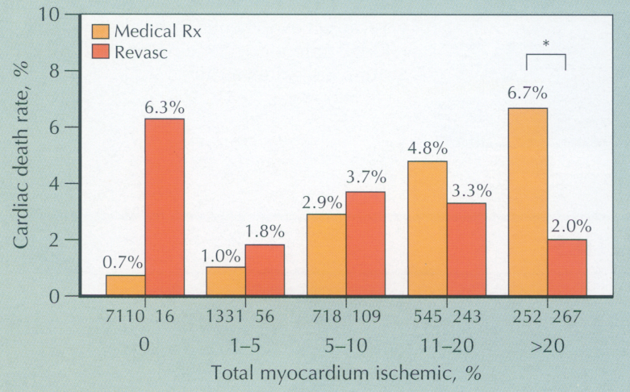
Benefit of Medical vs Revascularization Therapy Based on Amount of Ischemic Myocardium
10,627 consecutive patients, myocardial stress perfusion imaging (exercise or adenosine), with followup 1.9±0.6 years
Threshold
that favors Revasc
(Hachamovitch, et al. Circulation 2003;107:2900)

Slide 20
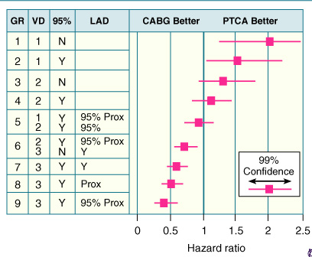
5-Year Survival Based on Revascularization by CABG vs PTCA
Least severe CAD, survival better with PTCA,
Intermediate risk, no difference
More severe CAD, survival better with CABG
(Jones, et al.
J Thorac CV Surg
1996;111:1013)

Slide 21
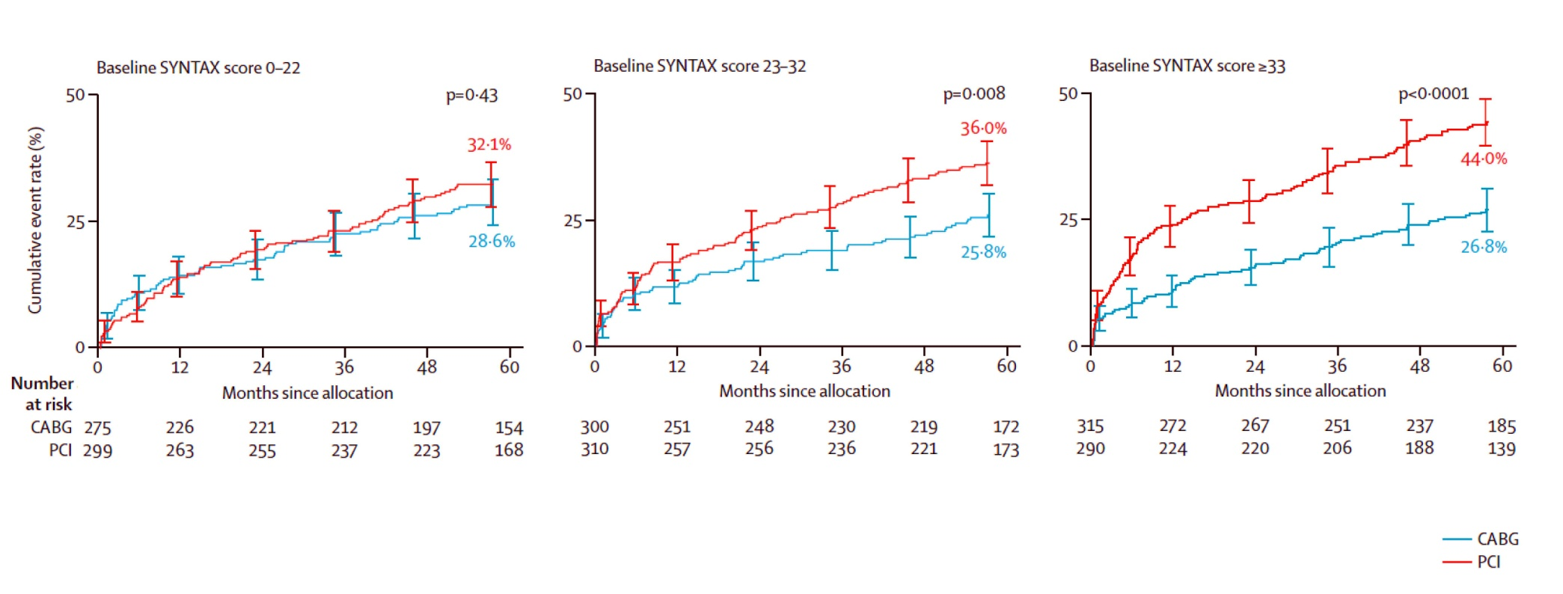
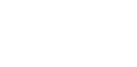
CABG vs PCI: SYNTAX
Overall Cohort
Highest-risk patients generally do better with CABG vs PCI
SYNTAX score 0-22
SYNTAX score 23-32
SYNTAX score >33
PCI
PCI
PCI
CABG
CABG
CABG
(Mohr FW et al. Lancet 2013;381:629-638)

Slide 22
Revascularization of Stable CAD 2012
Revascularization Indications in Stable Angina
FOR PROGNOSIS
SUBSET OF CAD BY ANATOMY | CLASS | LEVEL
Left main >50% | I | A
Any proximal LAD >50% | I | A
2VD or 3VD with impaired LV function | I | B
Proven large area of ischemia (>10% LV) | I | B
Single remaining vessel >50% stenosis | I | C
1VD without proximal LAD and without >10% ischemia | III | A
FOR SYMPTOMS
SUBSET OF CAD BY ANATOMY | CLASS | LEVEL
Any stenosis >50% with limiting angina or angina equivalent, unresponsive to GDMT | I | A
Dyspnea/CHF and >10% LV ischemia/viability supplied by >50% stenotic artery | IIa | B
No limiting symptoms with GDMT | III | C
(Fihn SD, et al. JACC 2012;60:e44-e164; ESC Guidelines for Revascularization 2010. EHJ. 2010;31:2501-55)

Slide 23


Stable Patient
Moderate or Severe Ischemia
Blinded Coronary CT Angio¹
no
Core lab anatomy eligible?²
Late screen failure
yes
RANDOMIZE
INVASIVE Strategy
OMT³ + Cath +
Optimal Revascularization
CONSERVATIVE Strategy
OMT³ alone
Cath reserved for OMT failures
Average 4 Years of Follow-up
Primary Endpoint: Composite of CV Death and MI
LBCT: No benefit of invasive strategy vs. optimal medical Rx
for Death/MI/UA/CHF/cardiac arrest/CVA
for pts with severe ischemia!

Slide 24
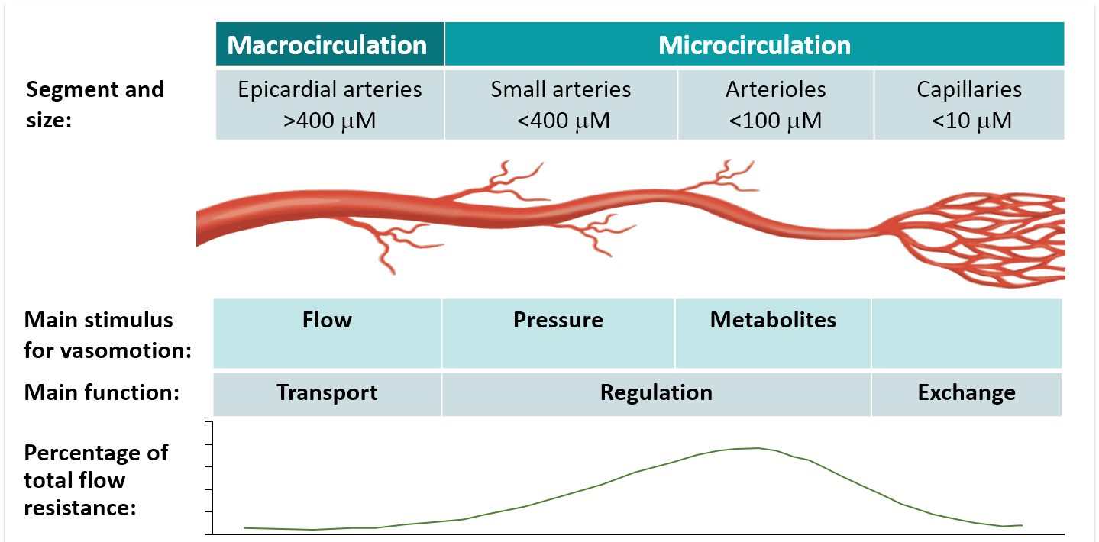
Coronary Macro- and Micro-circulation
New and Evolving Understanding of Inter-relationships of
Macrocirculation (Epicardial) and Microcirculation (Microvascular)
(De Bruyne B, et al. JACC 2016;67:1170)

Slide 25
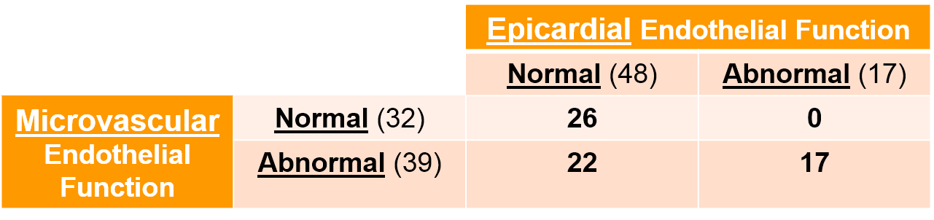
Microvascular and Epicardial Endothelial Function Results (n=65 pts w Stable CAD)
Definitions:
Microvascular endothelial dysfcn: max% increase CBF <50% by ACh
Epicardial endothelial dysfcn: decrease lumen diameter >20% by ACh
No patient with normal microvascular endothelial function had
abnormal epicardial endothelial function
Of patients with abnormal microvascular endothelial function:
56% had abnormal epicardial endothelial function and
44% had normal epicardial endothelial function
(Siasos G, et al. JACC 2018;71:2092-2102)

Slide 26
Continuum of Endothelial Dysfunction from
Microvascular to Macrovascular/Plaque Development
Among Patients with Microvascular Endothelial Dysfunction:
(n=39; defined as lack of increase in coronary blood flow to ACh)
Characteristic | Normal | Abnormal | P value
Concomitant Epicardial Endothelial Dysfcn (∆ coro diam after acetylcholine infus) | -3.02 ± 7.45 | -14.73 ±26.36 | 0.01
Blood Flow in Epicardial Artery
Low flow (Pro-atherogenic, Lowest ESS, Pa) | 0.72 ± 0.32 | 0.54 ±0.25 | 0.01
Plaque Characteristics
Plaque Area (mm²) | 2.72 ± 1.74 | 3.78 ±2.34 | <0.0001
Plaque Burden (%) | 21.33 ± 9.72 | 26.43 ±12.59 | <0.0001
Plaque Thickness (mm) | 0.28 ± 0.18 | 0.39 ±0.24 | <0.001
Worse epicardial
endothelial
dysfunction
Lower flow
(shear stress)
in epicardial
arteries
More abnormal
epicardial plaque
features:
plaque area
plaque burden
plaque thickness
(Siasos G, et al. JACC 2018;71:2092-2102)

Slide 27
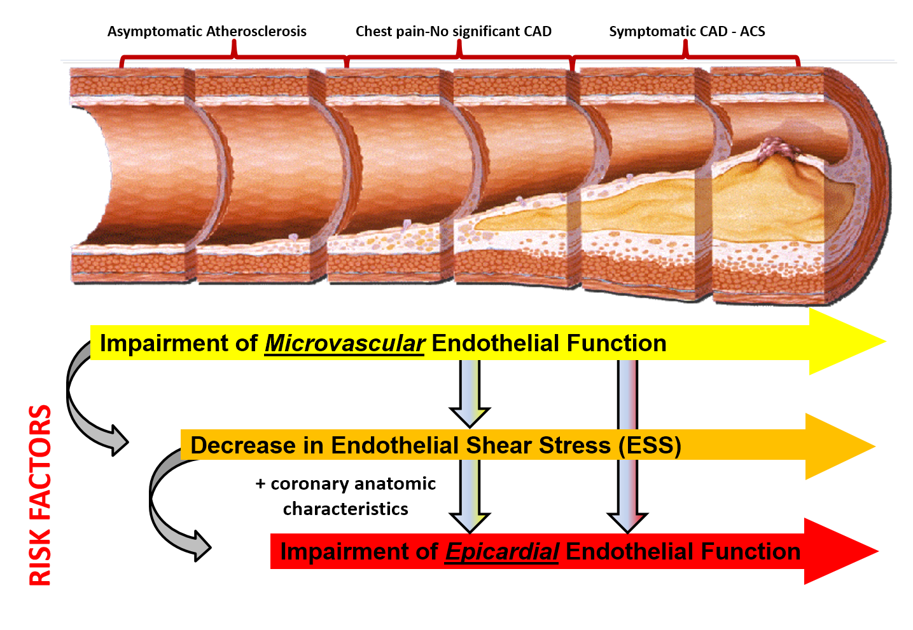
Continuous Natural History of Coronary Atherosclerosis: Opportunities for Therapeutic Intervention
CAD is an evolving process that progresses from
microvascular to epicardial endothelial dysfunction over time,
with mechanistic contributions by
Low blood flow (low shear stress) at multiple time points
A process
we need
to address!
(Siasos G, et al.
JACC 2018;
71:2092-2102)
Atherosclerosis Progression

Slide 28
Stable Ischemic Heart Disease:
State of the Art
Summary and Conclusions
Goals of management strategy includes strategies to:
  modify disease (secondary prevention: statins, BP control, Anti-plt Rx, ACEI/ARBs) and,
  improve quality of life (anti-anginal Rx)
Revascularization strategies include PCI for less extensive ischemic jeopardy, and CABG for greater extent of ischemia.
  ISCHEMIA trial LBCT indicates no benefit of cath/revasc vs. optimal medical Rx even in severe CAD!
New appreciation of continuum of phenotypic atherosclerosis process from microvascular to macrovascular manifestations
  Opportunities (and Needs) for therapeutic intervention!

Slide 30
Microvascular and Epicardial Endothelial Function Results (n=65 pts w Stable CAD)
Definitions:
Microvascular endothelial dysfcn: max% increase CBF <50% by ACh
Epicardial endothelial dysfcn: decrease lumen diameter >20% by ACh
No patient with normal microvascular endothelial function had
abnormal epicardial endothelial function
Of patients with abnormal microvascular endothelial function:
56% had abnormal epicardial endothelial function and
44% had normal epicardial endothelial function
(Siasos G, et al. JACC 2018;71:2092-2102)

Slide 31
Microvascular and Epicardial Endothelial Function Results (n=65 pts w Stable CAD)
Definitions:
Microvascular endothelial dysfcn: max% increase CBF <50% by ACh
Epicardial endothelial dysfcn: decrease lumen diameter >20% by ACh
No patient with normal microvascular endothelial function had
abnormal epicardial endothelial function
Of patients with abnormal microvascular endothelial function:
56% had abnormal epicardial endothelial function and
44% had normal epicardial endothelial function
(Siasos G, et al. JACC 2018;71:2092-2102)

Slide 32
Microvascular and Epicardial Endothelial Function Results (n=65 pts w Stable CAD)
Definitions:
Microvascular endothelial dysfcn: max% increase CBF <50% by ACh
Epicardial endothelial dysfcn: decrease lumen diameter >20% by ACh
No patient with normal microvascular endothelial function had
abnormal epicardial endothelial function
Of patients with abnormal microvascular endothelial function:
56% had abnormal epicardial endothelial function and
44% had normal epicardial endothelial function
(Siasos G, et al. JACC 2018;71:2092-2102)

