Slide 1
Autologous CD34⁺ Cells for Treatment of Refractory Angina
Thomas J. Povsic, MD, PhD
Associate Professor of Medicine
Duke Clinical Research Institute, Durham, NC

Slide 2
Disclosures
Baxter Healthcare funded the studies described
Baxter Healthcare (now Shire Plc) provided research funding to DCRI for ACT-34, RENEW, and partly funded a combined patient level analysis
Caladrius Biosciences provided research funding to DCRI for additional analyses

Slide 3
Where are we?
In the context of developing therapies for serious unmet clinical needs, the best approach is to think of clinical and statistical plausibility together.
Mechanistic plausibility
Preclinical models
Reducing risk (autologous products)
Consistency of effect
Totality of data
Clinical need

Slide 4
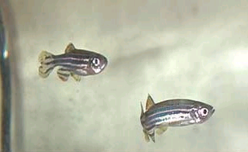
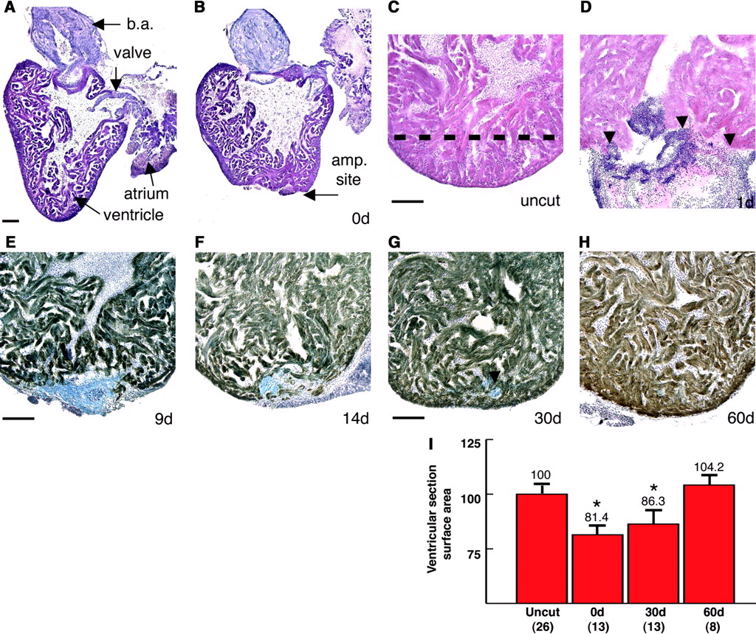
The promise…..
Zebrafish fully regenerate hearts within 2 months of 20% ventricular resection
Robust proliferation of myocytes at epicardial edge of new myocardium
? Model to illuminate factors to induce regeneration in man
-- Ross KD et al, Science, 2002
Notes:
The promise of stem cell therapy is not only attempting to prevent progression of disease but to actually regenerate myocardium, which is thought to represent an organ with minimal if any regenerative capcity in humans. We should remember that more primitive organisms, such as the zebrafish shown here, have remarkable heart reparative capacity. As shown in this work conducted at Duke, Ken Poss’ lab was able to demonstrate that zebrafish can regenerate a large portion of damaged myocardium.

Slide 5
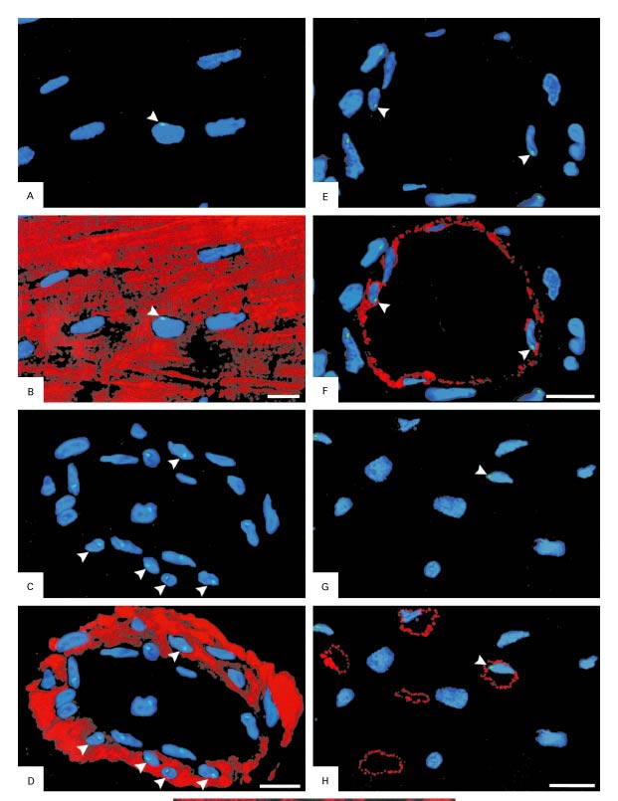
Myocardial Repair
The Y Chromosome in Transplanted Hearts:
Endothelial
Cells
Myocytes
Capillary
Endothelium
SMCs
Quaini, F. et al. N Engl J Med 2002;346:5-15

Slide 6
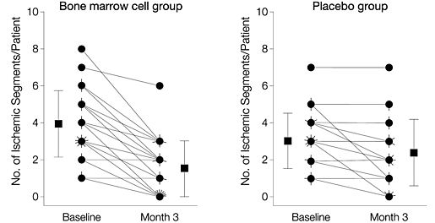
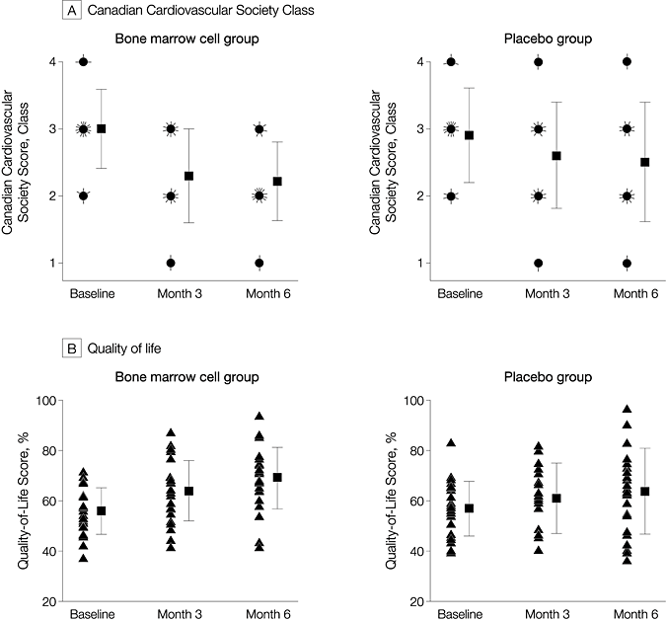
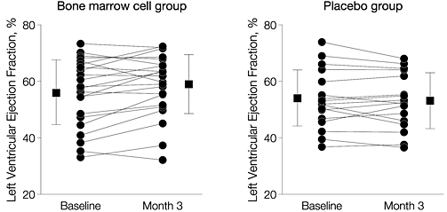
van Ramshorst, J. et al. JAMA 2009;301:1997-2004

Slide 7
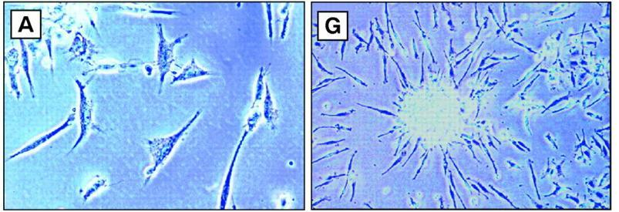
Original Description of Endothelial
Progenitor Cells (EPC) in Adults
CD34+ cells isolated
Cultured on fibronectin
Grew into colonies resembling embryonic blood islands
Asahara et al. Science 1997;275:964-7
Notes:
EPCs have come on the scene only recently. The original identification and description occurred in 1997 in a series of experiments by a group at Tufts.

Slide 8
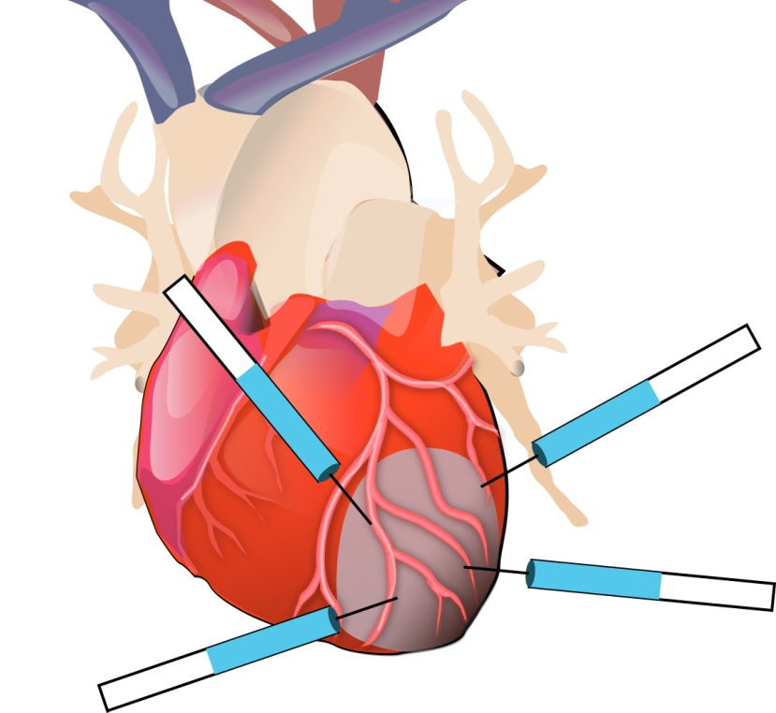
Pre-clinical Experience of Transplanted CD34+ Human Progenitor Cells in a Chronic Myocardial Ischemia Rat Model
Treatment Groups
PBS: 100 µl
Low MNC: 5×10⁵ cells/rat kg
High MNC: total MNCs containing CD34+ dose
CD34+: 5×10⁵ cells/rat kg
n=8∼11 rats in each group
PBS = Phosphate-buffered saline; MNC = mononuclear cells.
Kawamoto A, et al. Circulation. 2003;107:461-468

Slide 9
Pre-clinical Experience Results: Treatment with CD34+ Cells Increases Myocardial Capillary Density
Capillary Density
1200
P<0.001
P<0.001
P<0.001
800
P<0.01
Capillaries/mm²
P<0.01
400
0
PBS
(n=8)
Low MNC
(n=8)
High MNC
(n=11)
CD34+
(n=10)
PBS = Phosphate-buffered saline; MNC = mononuclear cells.
Kawamoto A, et al. Circulation. 2003;107:461-468

Slide 10
CD34+ Cells Are Associated with Aerobic Physical Function
 | Unadjusted |  | Adjusted*
 | Estimate | p-value | Estimate | p-value
Usual Gait Speed | 0.055 | 0.005 | 0.046 | 0.015
Rapid Gait Speed | 0.092 | 0.007 | 0.079 | 0.020
6MWD | 90.6 | 0.004 | 71.7 | 0.012
5-chair stand | -0.66 | 0.031 | -0.50 | 0.10
Balance Time | 0.188 | 0.25 | 0.124 | 0.40
Grip Strength | 0.663 | 0.33 | 0.743 | 0.26
SPPB summary score | 0.211 | 0.073 | 0.172 | 0.15
SF-36 Phys. Fxn Score | 4.38 | 0.009 | 3.07 | 0.045
*Adjusted for age, arm, BMI, 8 comorbid conditions, and IL-6 level.
CD34⁺ cells were more tightly associated than CD133⁺ or ALDH^{br} cells
Povsic et al. J. Geron. Med. Sci. 2013,16:1559-1566

Slide 11
CD34⁺ Cells Predict Future Physical Function
 | Unadjusted |  | Adjusted*
 | Estimate | p-value | Estimate | p-value
3-month
Usual Gait Speed | 0.073 | 0.002 | 0.065 | 0.003
Rapid Gait Speed | 0.101 | 0.006 | 0.086 | 0.014
6MWD | 74.4 | 0.027 | 59.6 | 0.036
12-month
Usual Gait Speed | 0.057 | 0.032 | 0.041 | 0.087
Rapid Gait Speed | 0.141 | 0.001 | 0.126 | 0.003
6MWD | 100.3 | 0.023 | 701 | 0.028
Change
Usual Gait Speed | 0.026 | 0.035 | 0.025 | 0.034
Rapid Gait Speed | 0.056 | 0.007 | 0.056 | 0.006
6MWD | 4.29 | 0.774 | 14.02 | 0.228
 | Unadjusted |  | Adjusted*
 | Estimate | p-value | Estimate | p-value
3-month
Usual Gait Speed | 0.073 | 0.002 | 0.065 | 0.003
Rapid Gait Speed | 0.101 | 0.006 | 0.086 | 0.014
6MWD | 74.4 | 0.027 | 59.6 | 0.036
12-month
Usual Gait Speed | 0.057 | 0.032 | 0.041 | 0.087
Rapid Gait Speed | 0.141 | 0.001 | 0.126 | 0.003
6MWD | 100.3 | 0.023 | 701 | 0.028
*Adjusted for age, arm, BMI, 8 comorbid conditions, and IL-6 level.

Slide 12
 | Study 11196 | Study 24779/34976 | Study 901001
N | 24 | 167 | 112
CD34⁺ treated ptns | 18 | 112 | 57
AF at baseline | - | ≧7 episodes/wk | ≧7 episodes/wk
Exercise at baseline | 1-6 minutes Bruce Protocol | 3-10 minutes mod Bruce Protocol | 3-10 minutes mod Bruce Protocol
Cell mobilization | G-CSF 5 mcg/kg/d x 5 d | G-CSF 5 mcg/kg/d x 5 d | G-CSF 5 mcg/kg/d x 4 d
Cell Harvesting | Apheresis day 5 | Apheresis day 5 | Apheresis day 5
Cell Isolation | Local | Local | Central
Cell Delivery | IM via NOGA Myostar | IM via NOGA Myostar catheter | IM via NOGA Myostar catheter
Cell Dose | 1 x 10⁴, 1 x 10⁵, and 5 x 10⁵ cells/kg | 1 x 10⁵, and 5 x 10⁵ cells/kg | 1 x 10⁵ cells/kg
Randomization | 1:1:1:1 to 3 doses vs. placebo | 1:1:1 to 2 doses and placebo | 2:1:1 to CD34+ cells vs. placebo vs. open label SOC
Efficacy control | Active (cell mobilization, apheresis, placebo injection) | Active (cell mobilization, apheresis, placebo injection) | Active (cell mobilization, apheresis, placebo injection)
Design | Double blind | Double Blind | Double blind (efficacy) with open label SOC arm
AF assessments | Baseline, 3m, 6 m | Baseline, 3m, 6m, 12 m, 24 m | Baseline, 3m, 6m, 12 m
TET Assessments | Baseline, 3 m | Baseline, 3m, 6m, 12 m | Baseline, 3m, 6m, 12 m
Clinical FU | 6 m | 12 m (24779), 24 m (34976) | 24 m
Clinical FU | Investigator reported | CEC adjudicated | CEC adjudicated

Slide 13
Phase I: The Dose Range is Feasible
Actual Auto-CD 34+ Cell Dose Delivered / kg
(n = 6 / dose group)
Auto-CD 34+ Cell Dose/kg x 10⁴
( log scale)
Control
No cells
Group 1
5 X 10⁴ cells
Group 2
1 x 10⁵ cells
Group 3
5 X 10⁵ cells
Losordo D W et al. Circulation 2007;115:3165-3172

Slide 14
Phase I: Angina Frequency
Episodes per Week
+6.5
-4.5
-11.6**
-12.6
-15.6
Months
12 month control data is not represented due to control patient cross-over after 6 months
**p=0.053 ANOVA between treatment groups
Losordo D W et al. Circulation 2007;115:3165-3172

Slide 15
Randomized, Double-Blind, Placebo Controlled Trial of Autologous CD34+ Cell Therapy for Refractory Myocardial Ischemia
Screening and Baseline Visits
Subject population
(n=167)
21-80 yrs
CCS class III or IV Angina
Attempted “best” medical therapy
Non-candidate for Surgical/Perc. revasc.
Ischemia on SPECT
3-10 min. mod. Bruce protocol with angina or anginal equivalent at baseline
Cell Mobilization (GCSF 5mcg/kg/d x 5d)
Apheresis on Day 5
Randomization
1 x 10^5 CD34+ cells/kg
(n = 55)
Placebo
(n = 56)
5 x 10^5 CD34+ cells/kg
(n = 56)
Endomyocardial Mapping and Injection with NOGA
Isolex selected CD34+ cells / Placebo Rx
Follow-up Safety and Efficacy Assessments:
1 - 7 days, and 1, 3, 6, and 12 months; ETT at 3, 6, 12 months
MRI at 6 months, SPECT at 6 & 12 months

Slide 16
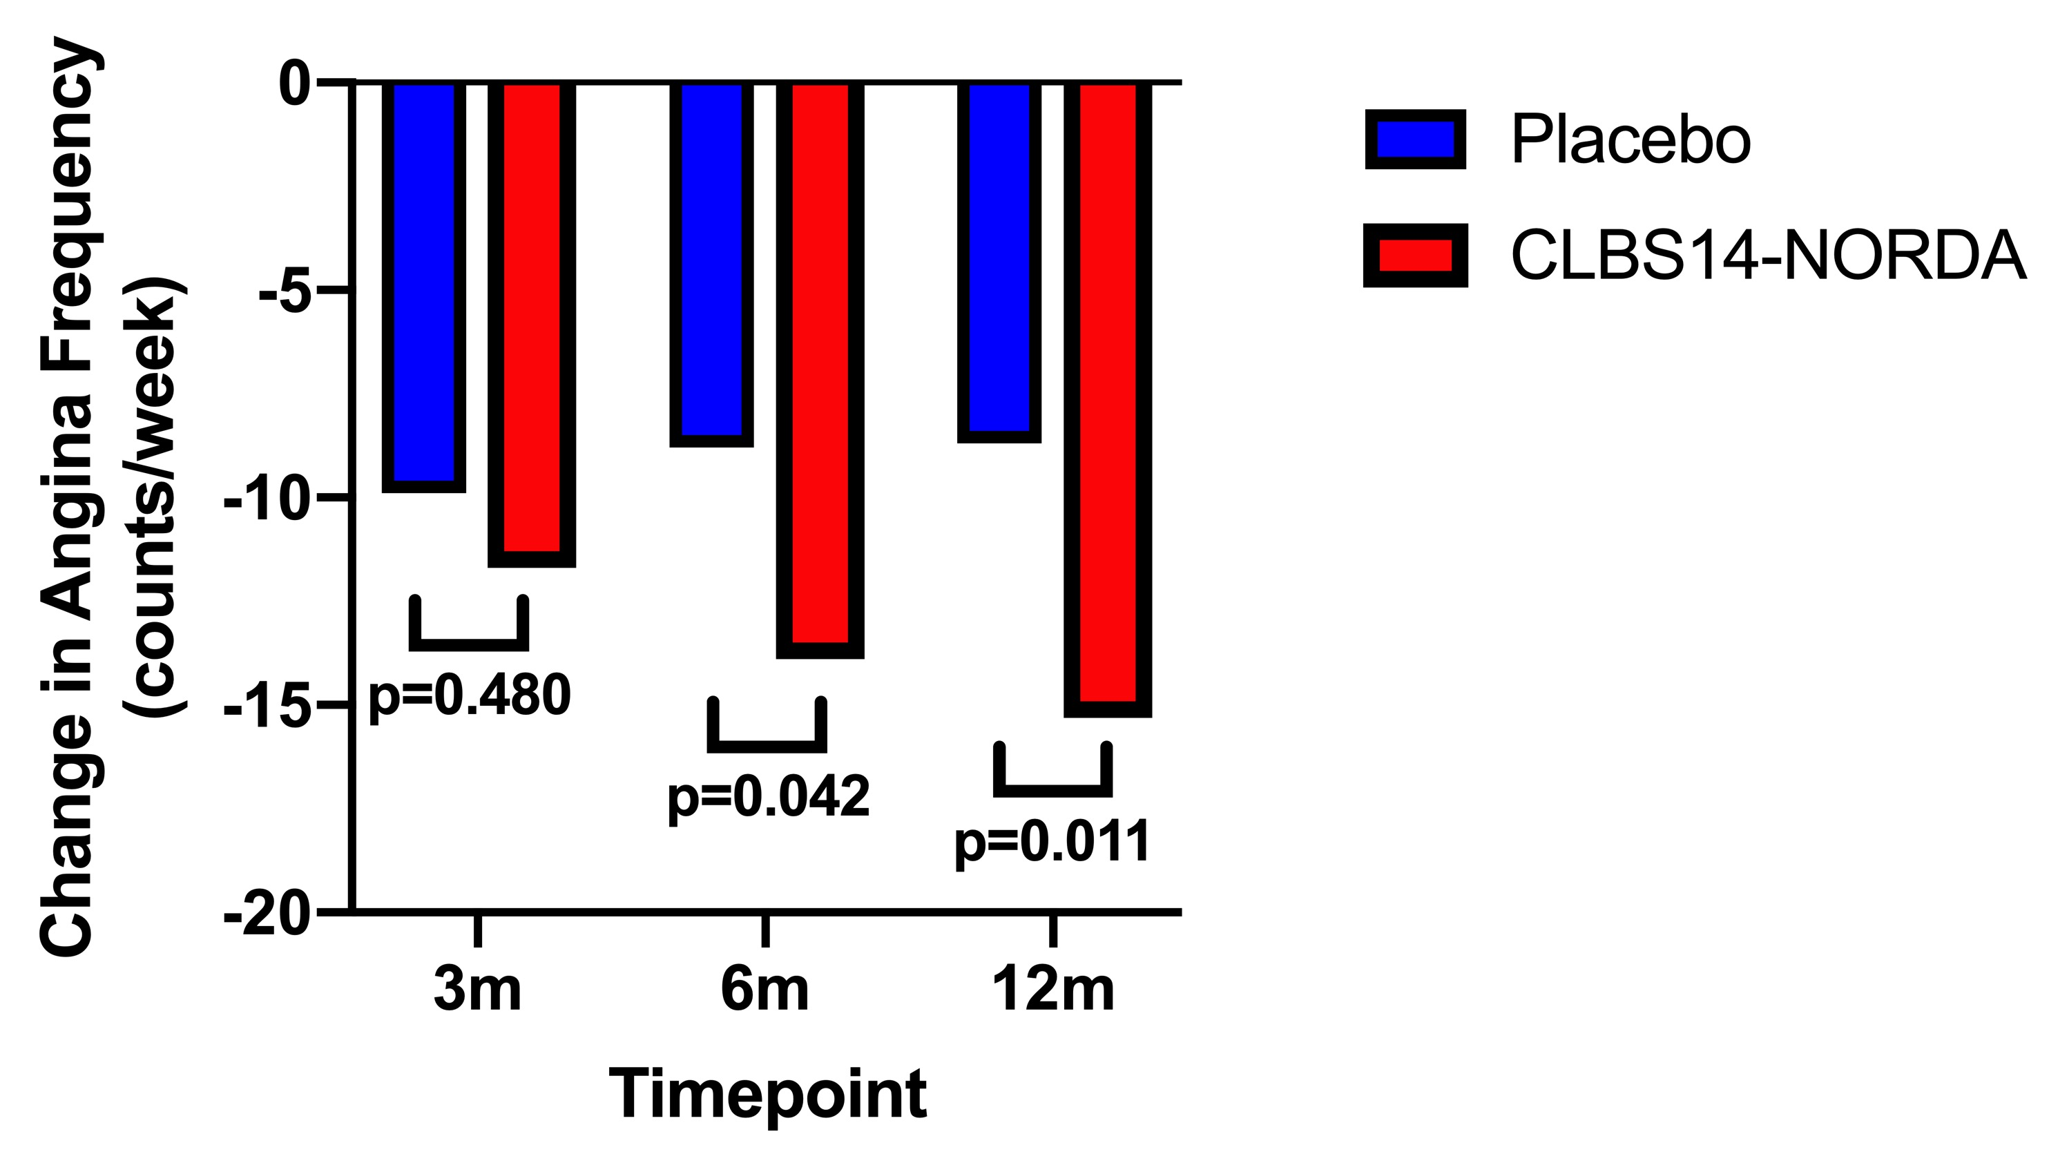
Change in Angina Counts

Slide 17
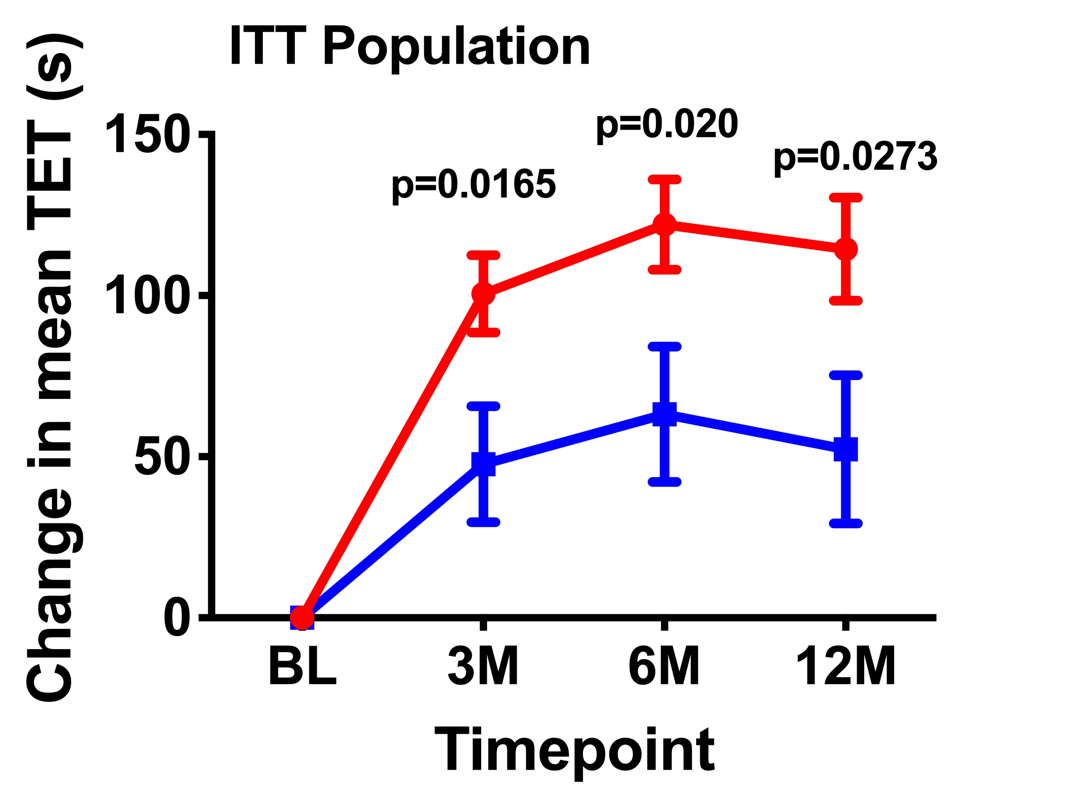
Change in Exercise Capacity

Slide 18
Major Adverse Cardiac Events (12 Months)
 | Control | 1x10⁵ CD34^{+cells}/kg | 5x10⁵ CD34^{+cells}/kg | p-value*
Death | 3 (5.4%) | 0 (%) | 0(%) | 0.107
MI | 7 (12.5%) | 3 (5.5%) | 3 (5.4%) | 0.305
Death, MI | 10 (17.9%) | 3 (5.5%) | 3 (5.4%) | 0.058
Death, MI, Urgent Revasc | 11 (19.6%) | 5 (9.1%) | 4 (7.1%) | 0.106
Death, MI, Urgent Revasc, Worse CHF, ACS | 15 (26.8%) | 7 (12.7%) | 7 (12.5%) | 0.093
Pts with MACE events from start of mobilization thru 12 mo in injected pts; *= Fisher’s Exact Test
Notes:
18
18
18
18

Slide 19
ACT-34 Mortality

Slide 20
RENEW Study Design
Screening and Baseline Visits
Inclusion Criteria:
21-80 yrs
CCS class III or IV Angina
Attempted “best”
medical therapy
Non-candidate for
Surgical/Perc. revasc.
Ischemia w/stress
3-10 min. mod. Bruce protocol with angina or anginal equivalent at baseline
ETT reproducible <20%
7 angina/wk
Exclusion Criteria:
Recent hospitalization
Other angiogenic trials
Must forgo other txt x 2 years
Pre-Qual Committee Central Review
Randomization
1 x 10⁵ CD34+ cells/kg
(n = 200)
Active Control
(n = 100)
Unblinded Standard of Care
(n = 100)
Unblinded Standard of Care
(n = 100)
Cell Mobilization (G-CSF 5 mg/kg/d x 4d)
Apheresis on Day 5
Intramyocardial Mapping and Injection with NOGA
ISOLEX selected CD34+ cells / Placebo
Efficacy Assessments during 12 month follow-up: ETT, angina frequency, and QoL (SF-36)
Safety Assessments during 24 month follow-up: AEs, SAEs, MACE
Safety Assessments during 24 month follow-up: AEs, SAEs, MACE

Slide 21
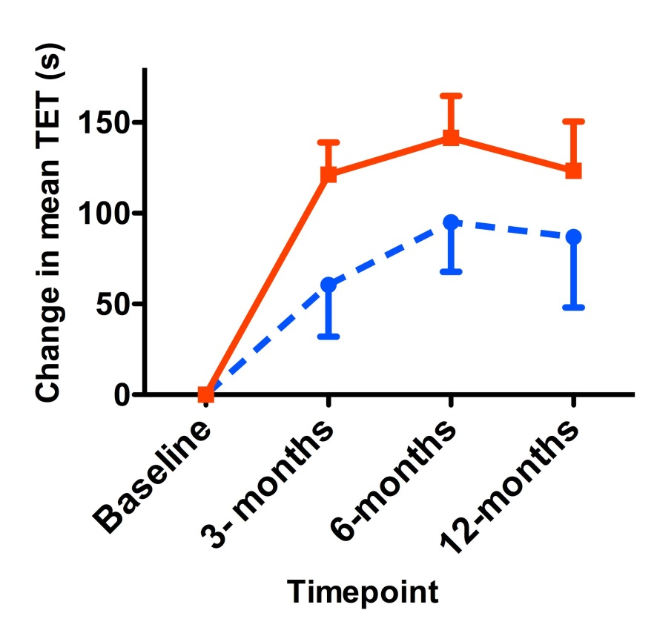
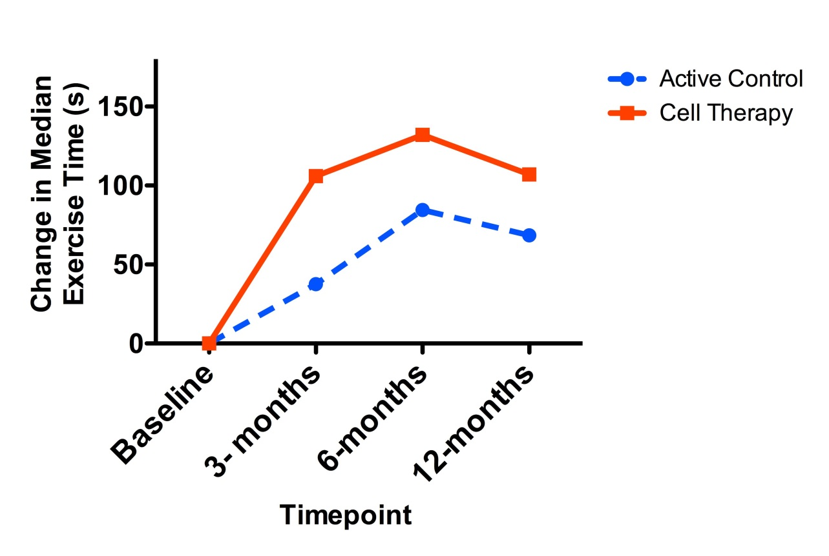
RENEW: Primary Endpoint as Treated
MEAN
MEDIAN

Slide 22
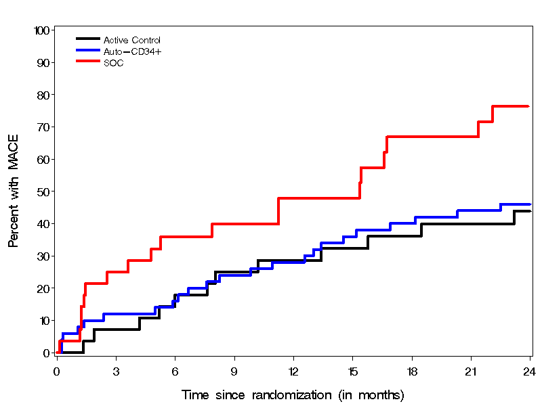
Kaplan-Meier Curves: Cumulative Risk of MACE
As Treated
Auto-CD34+ vs. SOC: HR=0.48 p=0.018
Active Control vs. SOC: HR=0.43 p=0.022

Slide 23
RENEW Results: 2-Year MACE
 | Standard of Care (n=28) | Active Control (n=28) | CD34+ Cell Txt (n=50) | Started Mobilization but Not Injected (n=6)
Patients with MACE | 19 (67.9%) | 12 (42.9%) | 23 (46.0%) | 2 (33.3%)
Death | 2 (7.1%) | 3 (10.7%) | 2 (4.0%) | 0
MI | 2 (7.1%) | 3 (10.7%) | 5 (10.0%) | 2 (33.3%)
Perforation | 0 | 0 | 2 (4.0%) | 1* (16.7%)
Stroke | - | - | - | -
CV hospitalization | 18 (64.3%) | 9 (32.1%) | 21 (42.0%) | 2 (33.3%)
Ventricular arrhythmias | 1 (3.6%) | 2 (7.1%) | 1 (2.0%) | -
MACE <2 weeks | 0 | 0 | 3 (6.0%) | 2 (33.3%)
MACE during follow-up | 19 (67.9%) | 12 (42.9%) | 21 (42.0%) | 2 (33.3%)

Slide 24
Goals: Combine patient level data from 3 trials of Auto-CD34⁺ cell therapy for refractory angina
All trials:
  Double-blind randomized design
  IM injection of CD34⁺ cells vs. placebo
  Assessed exercise capacity (ETT) and angina frequency at 3-, 6- and 12- months
  Collected MACE to 24 months

Slide 25
Baseline Characteristics
 | Placebo (n=89) | CD34⁺ (n=187) | SOC (n=28) | Total (n=304)
Age (median) | 64 (56,69) | 62 (56,68) | 63 (55,69) | 63 (56,69)
Female | 11 (12%) | 30 (16%) | 4 (4%) | 45 (15%)
Caucasian | 80 (90%) | 171 (91%) | 27 (96%) | 278 (91%)
Diabetes | 50 (56%) | 95 (51%) | 16 (57%) | 161 (53%)
Hypertension | 77 (87%) | 163 (87%) | 24 (86%) | 264 (87%)
Hyperlipidemia | 74 (83%) | 154 (82%) | 27 (96%) | 255 (84%)
CHF | 31 (35%) | 50 (27%) | 8 (29%) | 89 (29%)
PVD | 24 (27%) | 44 (24%) | 4 (14%) | 72 (24%)
h/o PCI | 78 (88%) | 162 (87%) | 26 (93%) | 266 (88%)
h/o CABG | 80 (90%) | 173 (93%) | 23 (82%) | 276 (91%)

Slide 26
Medication use
 | Placebo (n=89) | CD34⁺ (n=187) | SOC (n=28) | Total (n=304)
β-blockers | 82 (92%) | 169 (90%) | 26 (93%) | 277 (91%)
Nitrates | 70 (79%) | 138 (74%) | 24 (86%) | 232 (76%)
Ranolazine | 29 (33%) | 66 (35%) | 18 (64%) | 113 (37%)
Ca-blockers | 34 (38%) | 79 (42%) | 13 (46%) | 126 (41%)
AceI/ARB | 47 (53%) | 104 (56%) | 15 (54%) | 166 (55%)
Statins | 70 (79%) | 154 (82%) | 25 (89%) | 249 (82%)

Slide 27
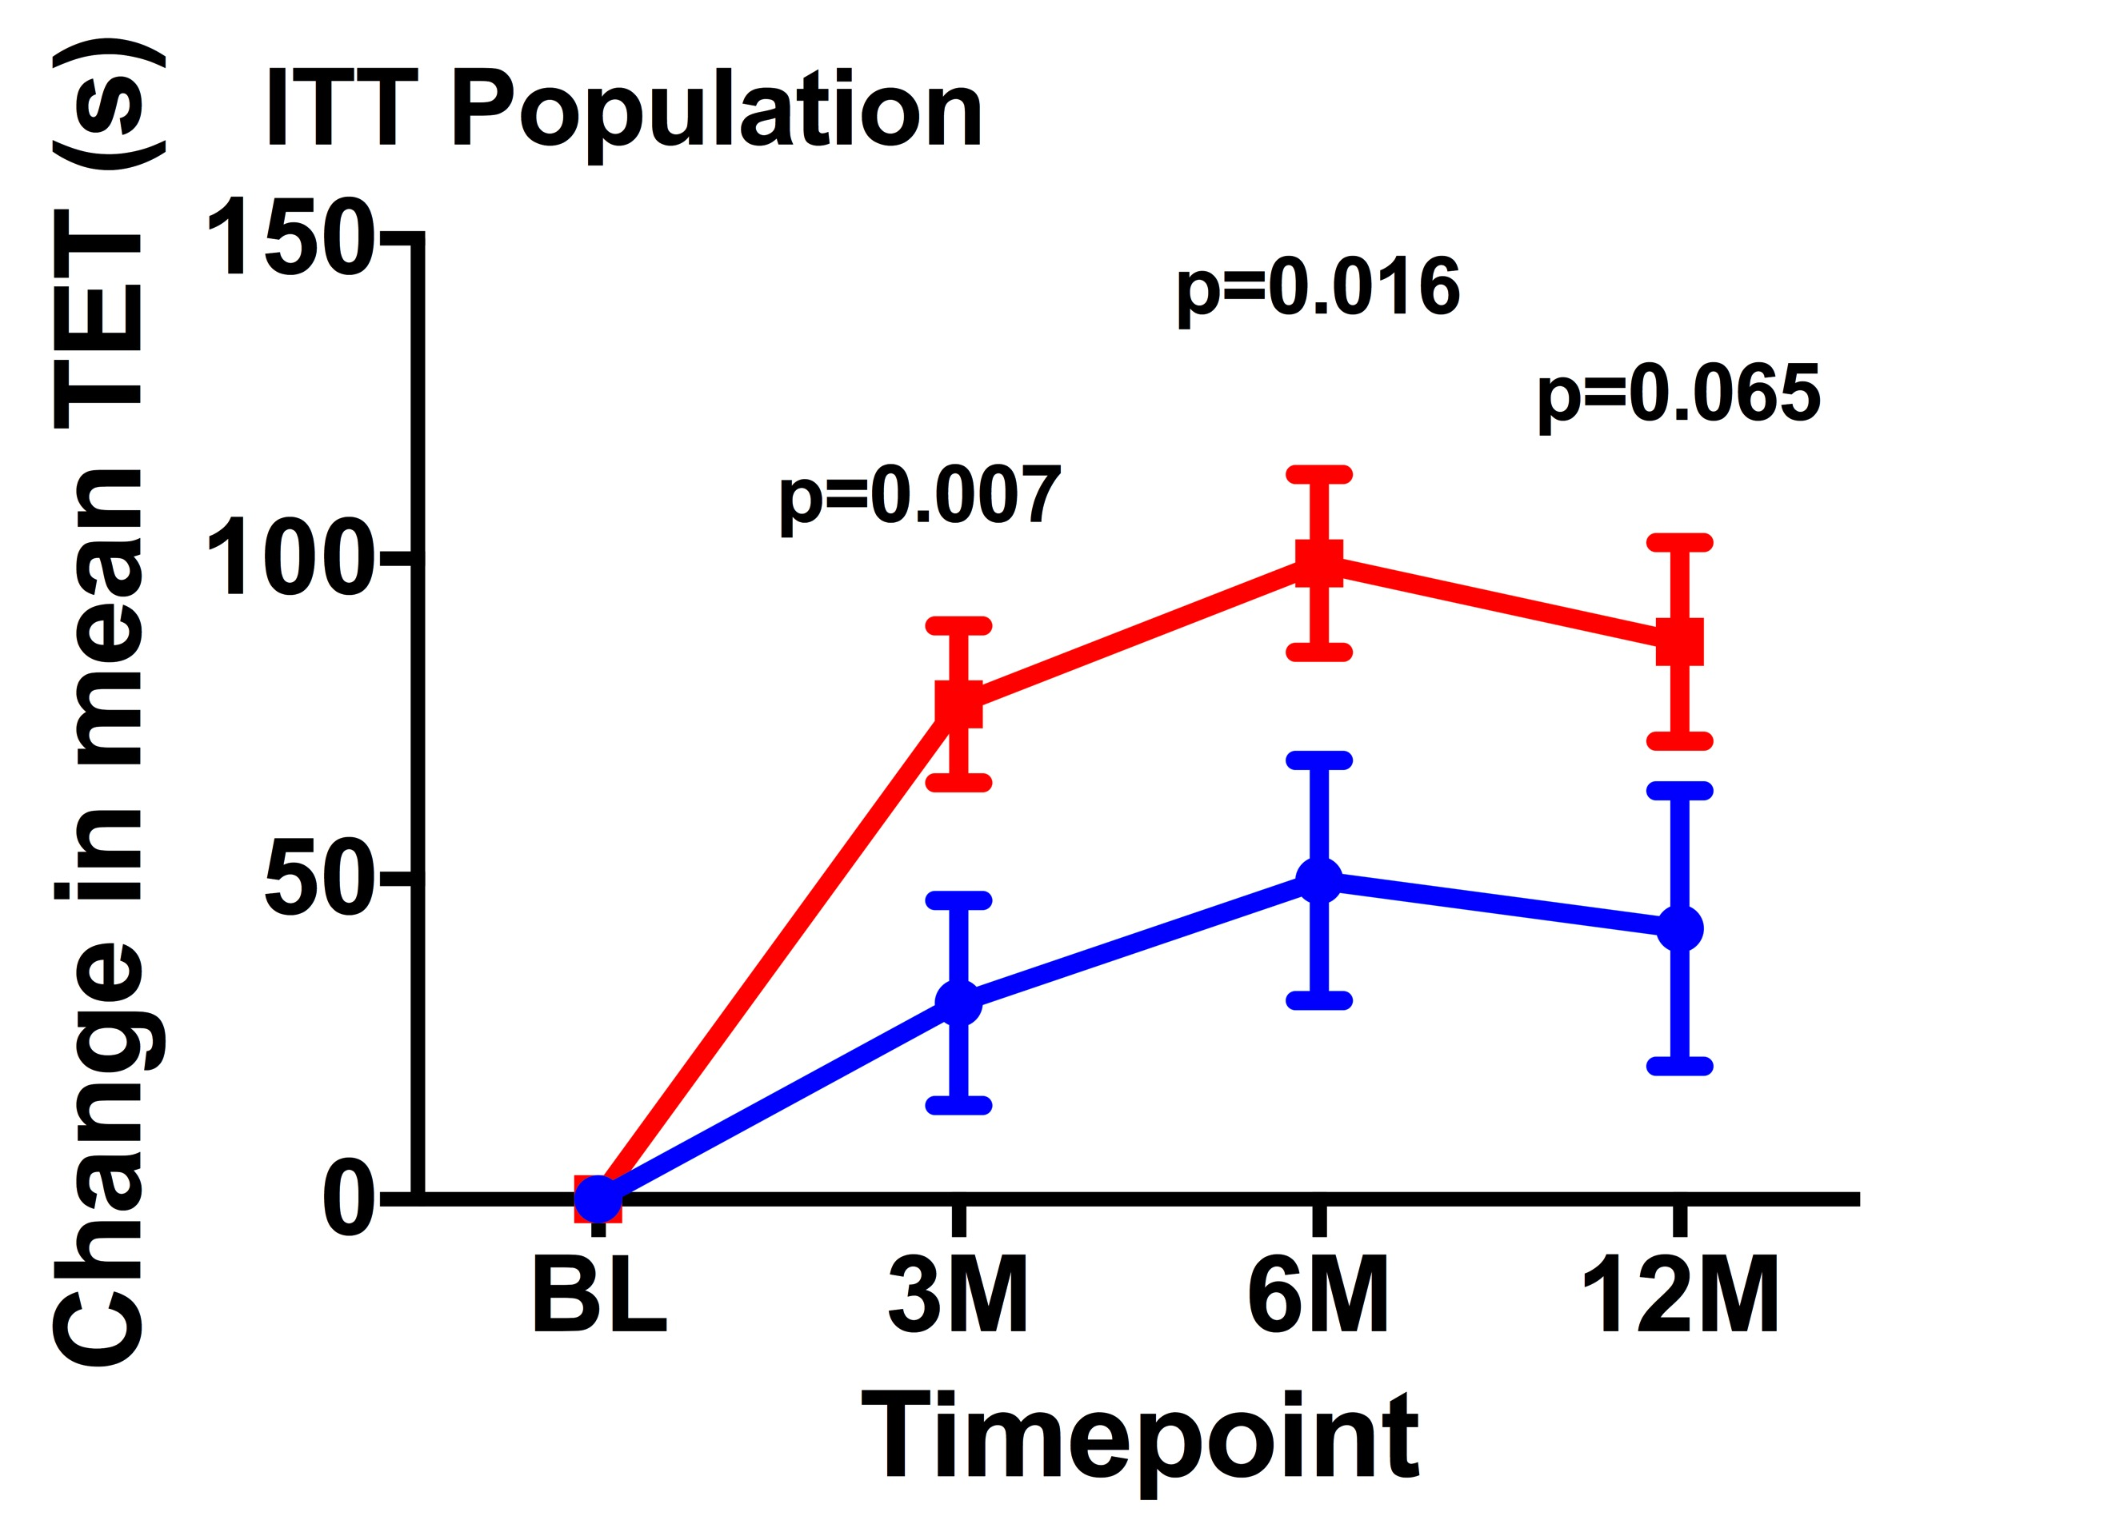
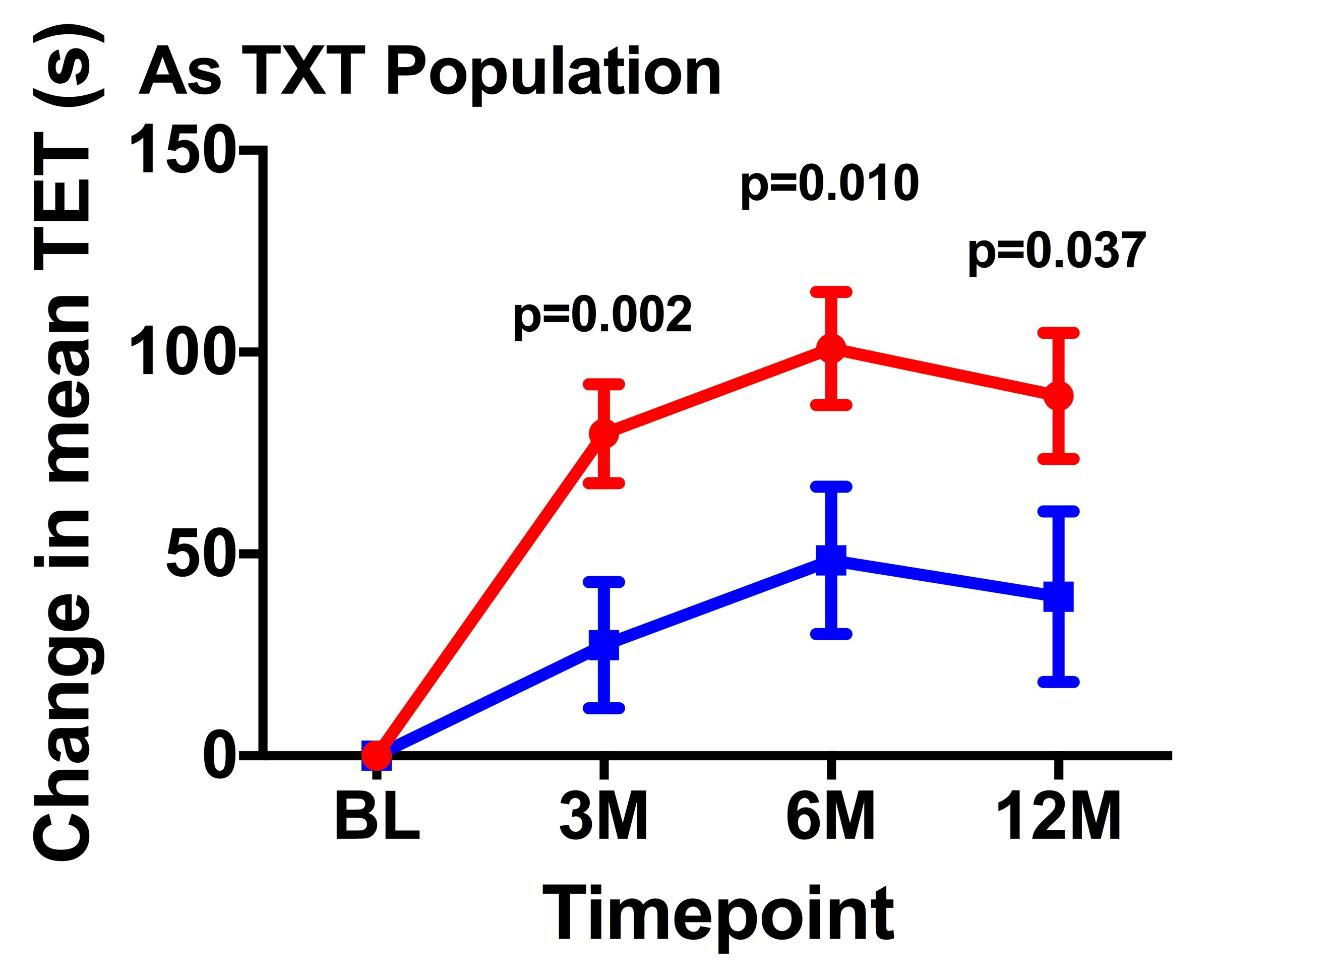
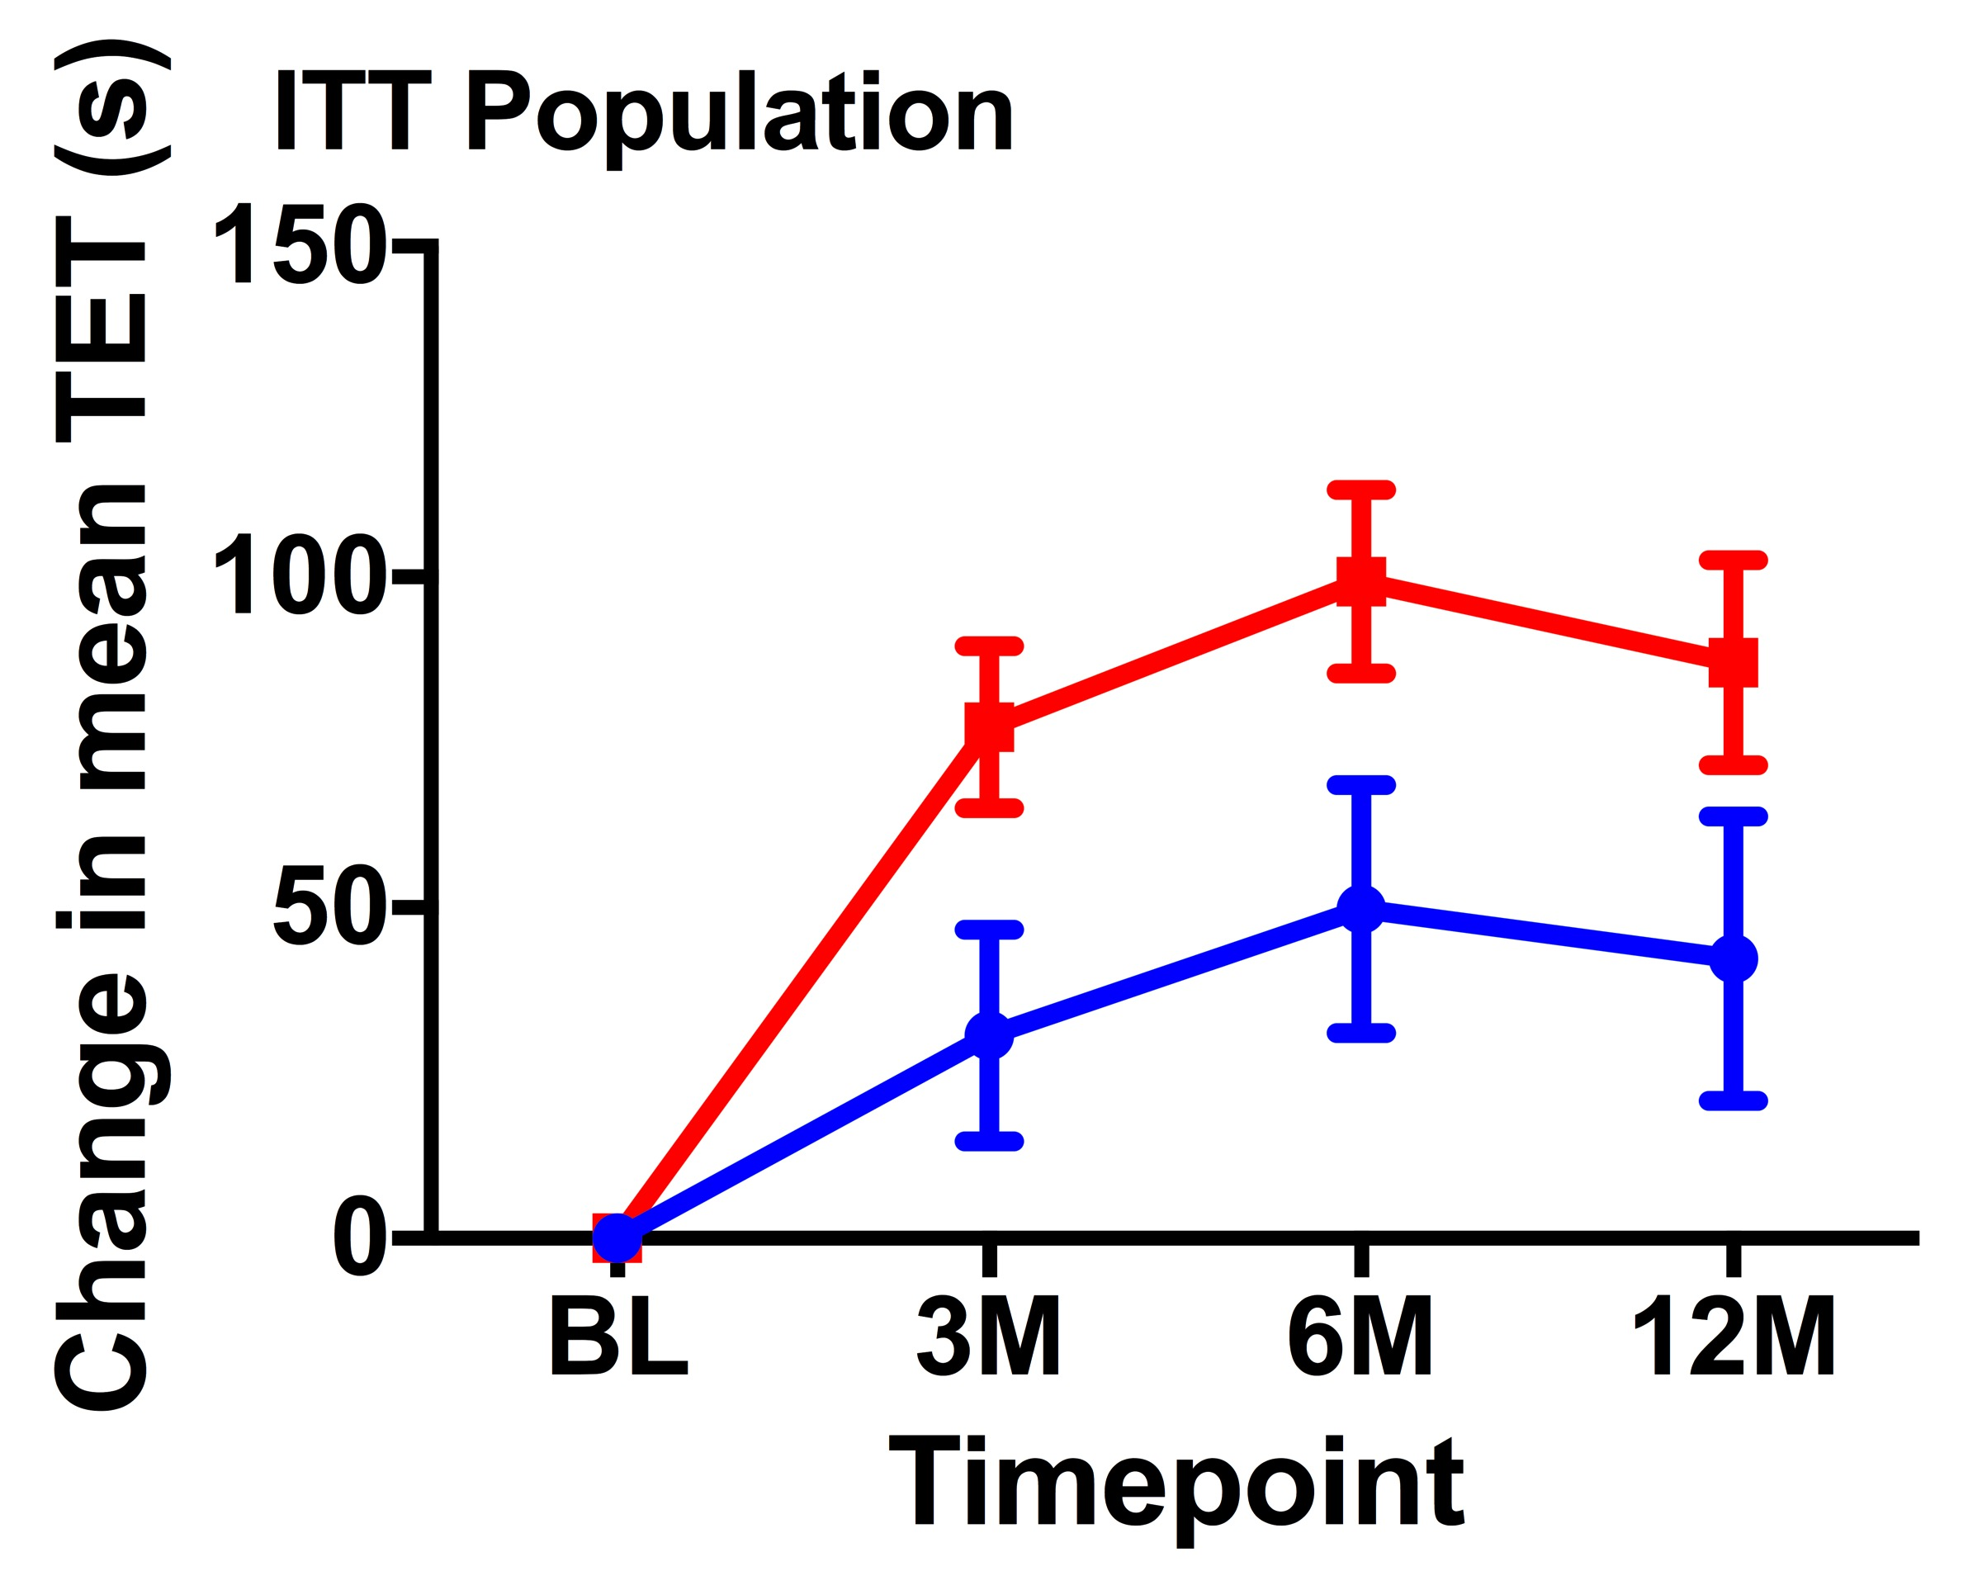
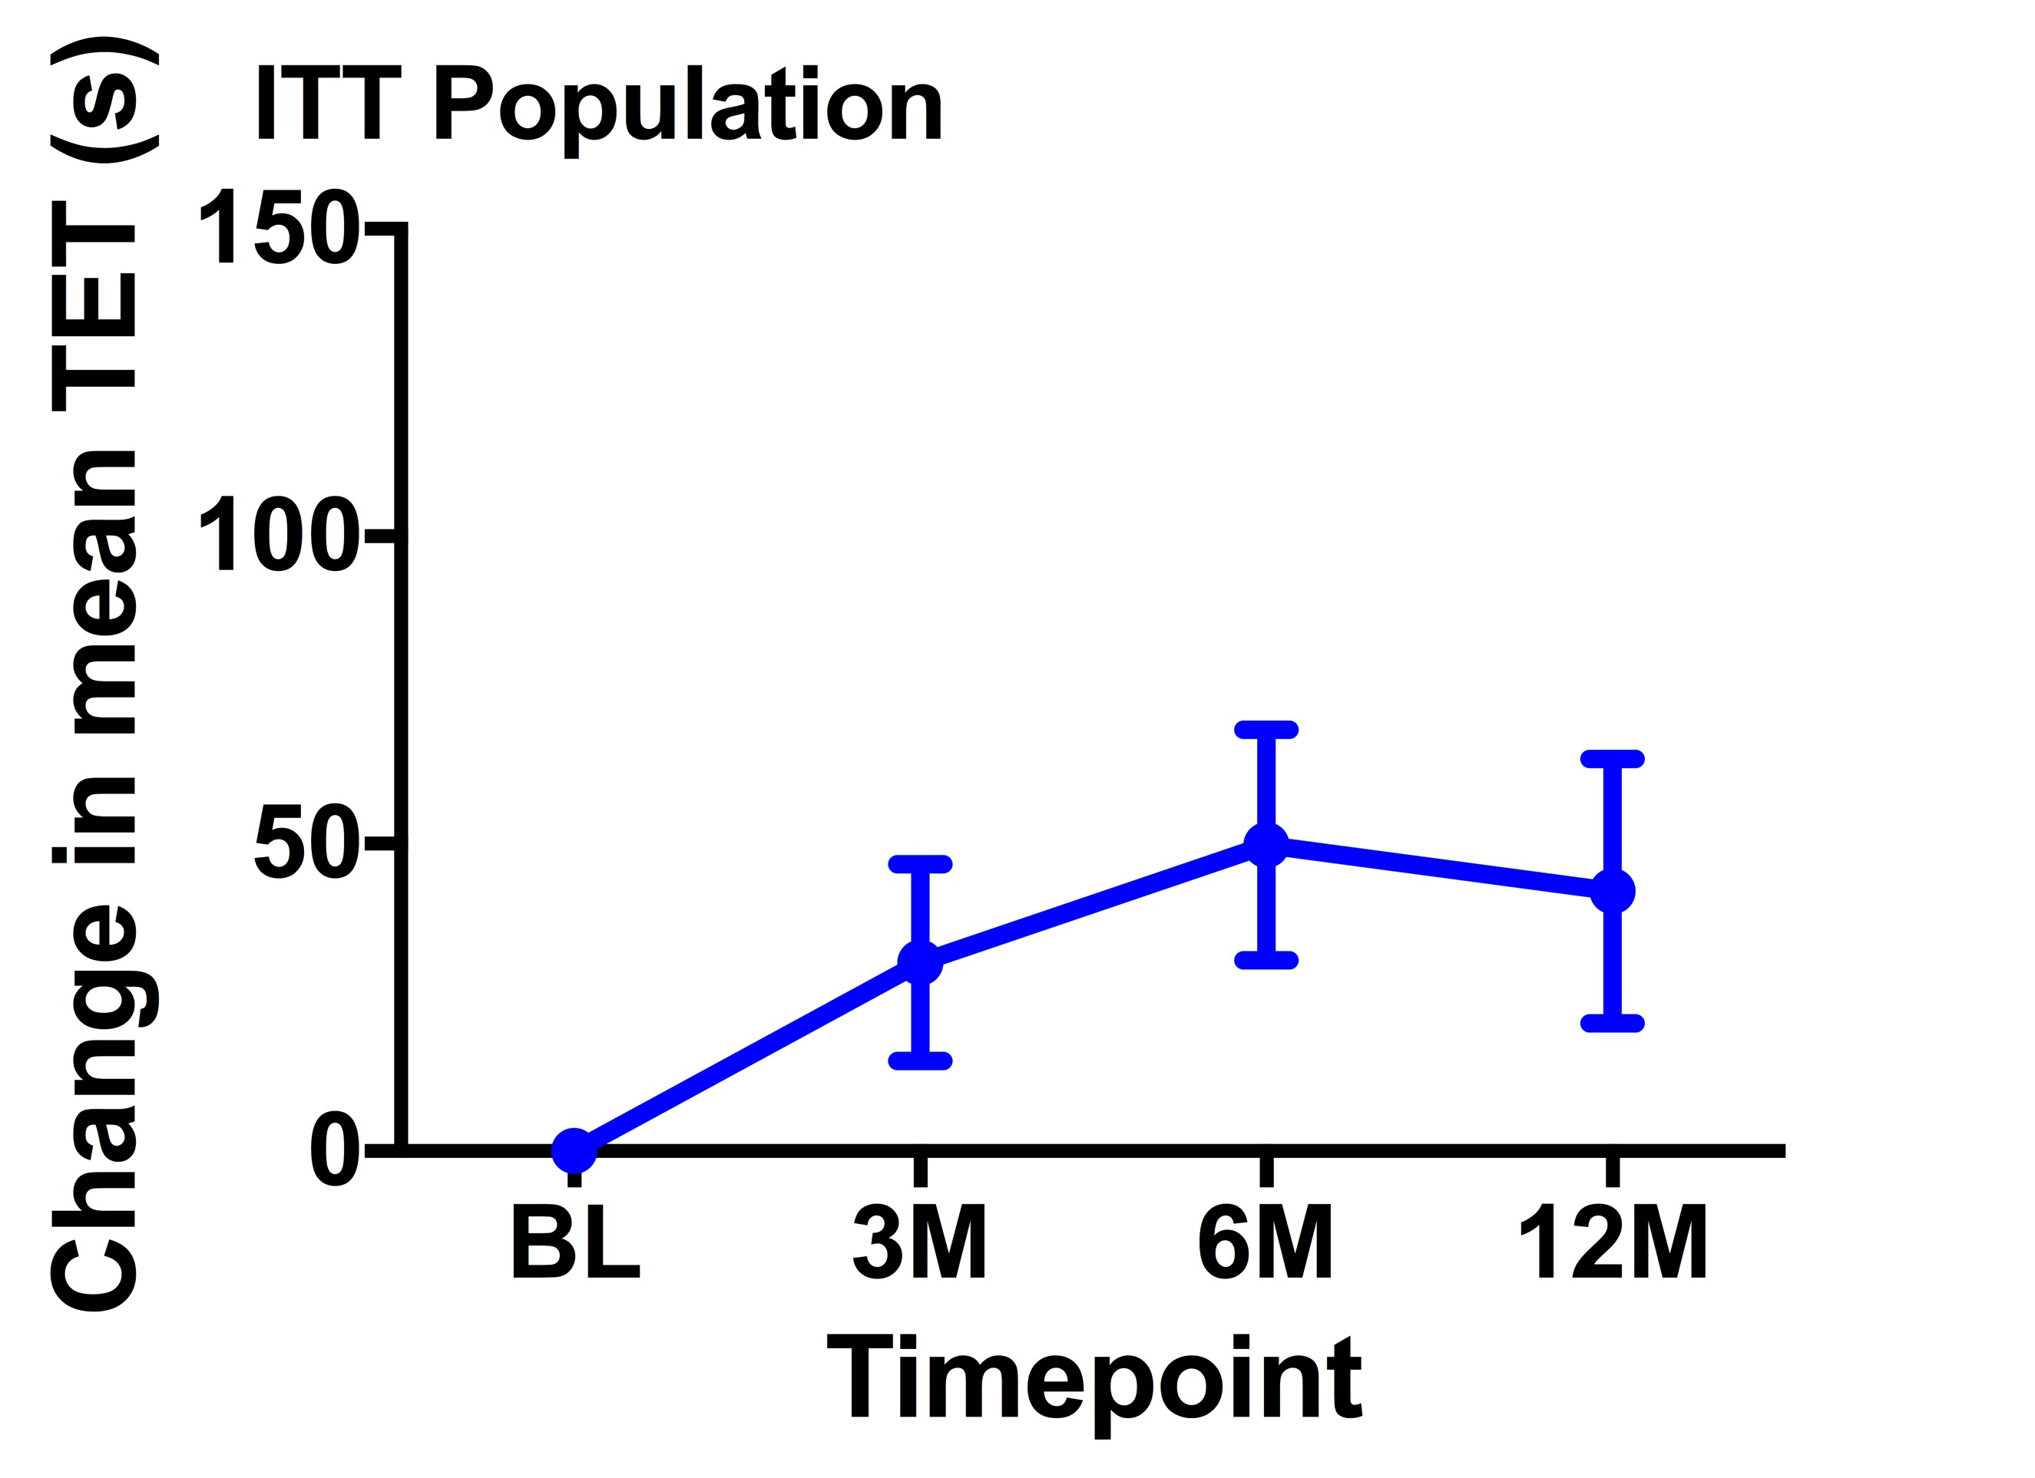
Results: Total Exercise Time
Auto-CD34⁺ Cells
Active Control

Slide 28
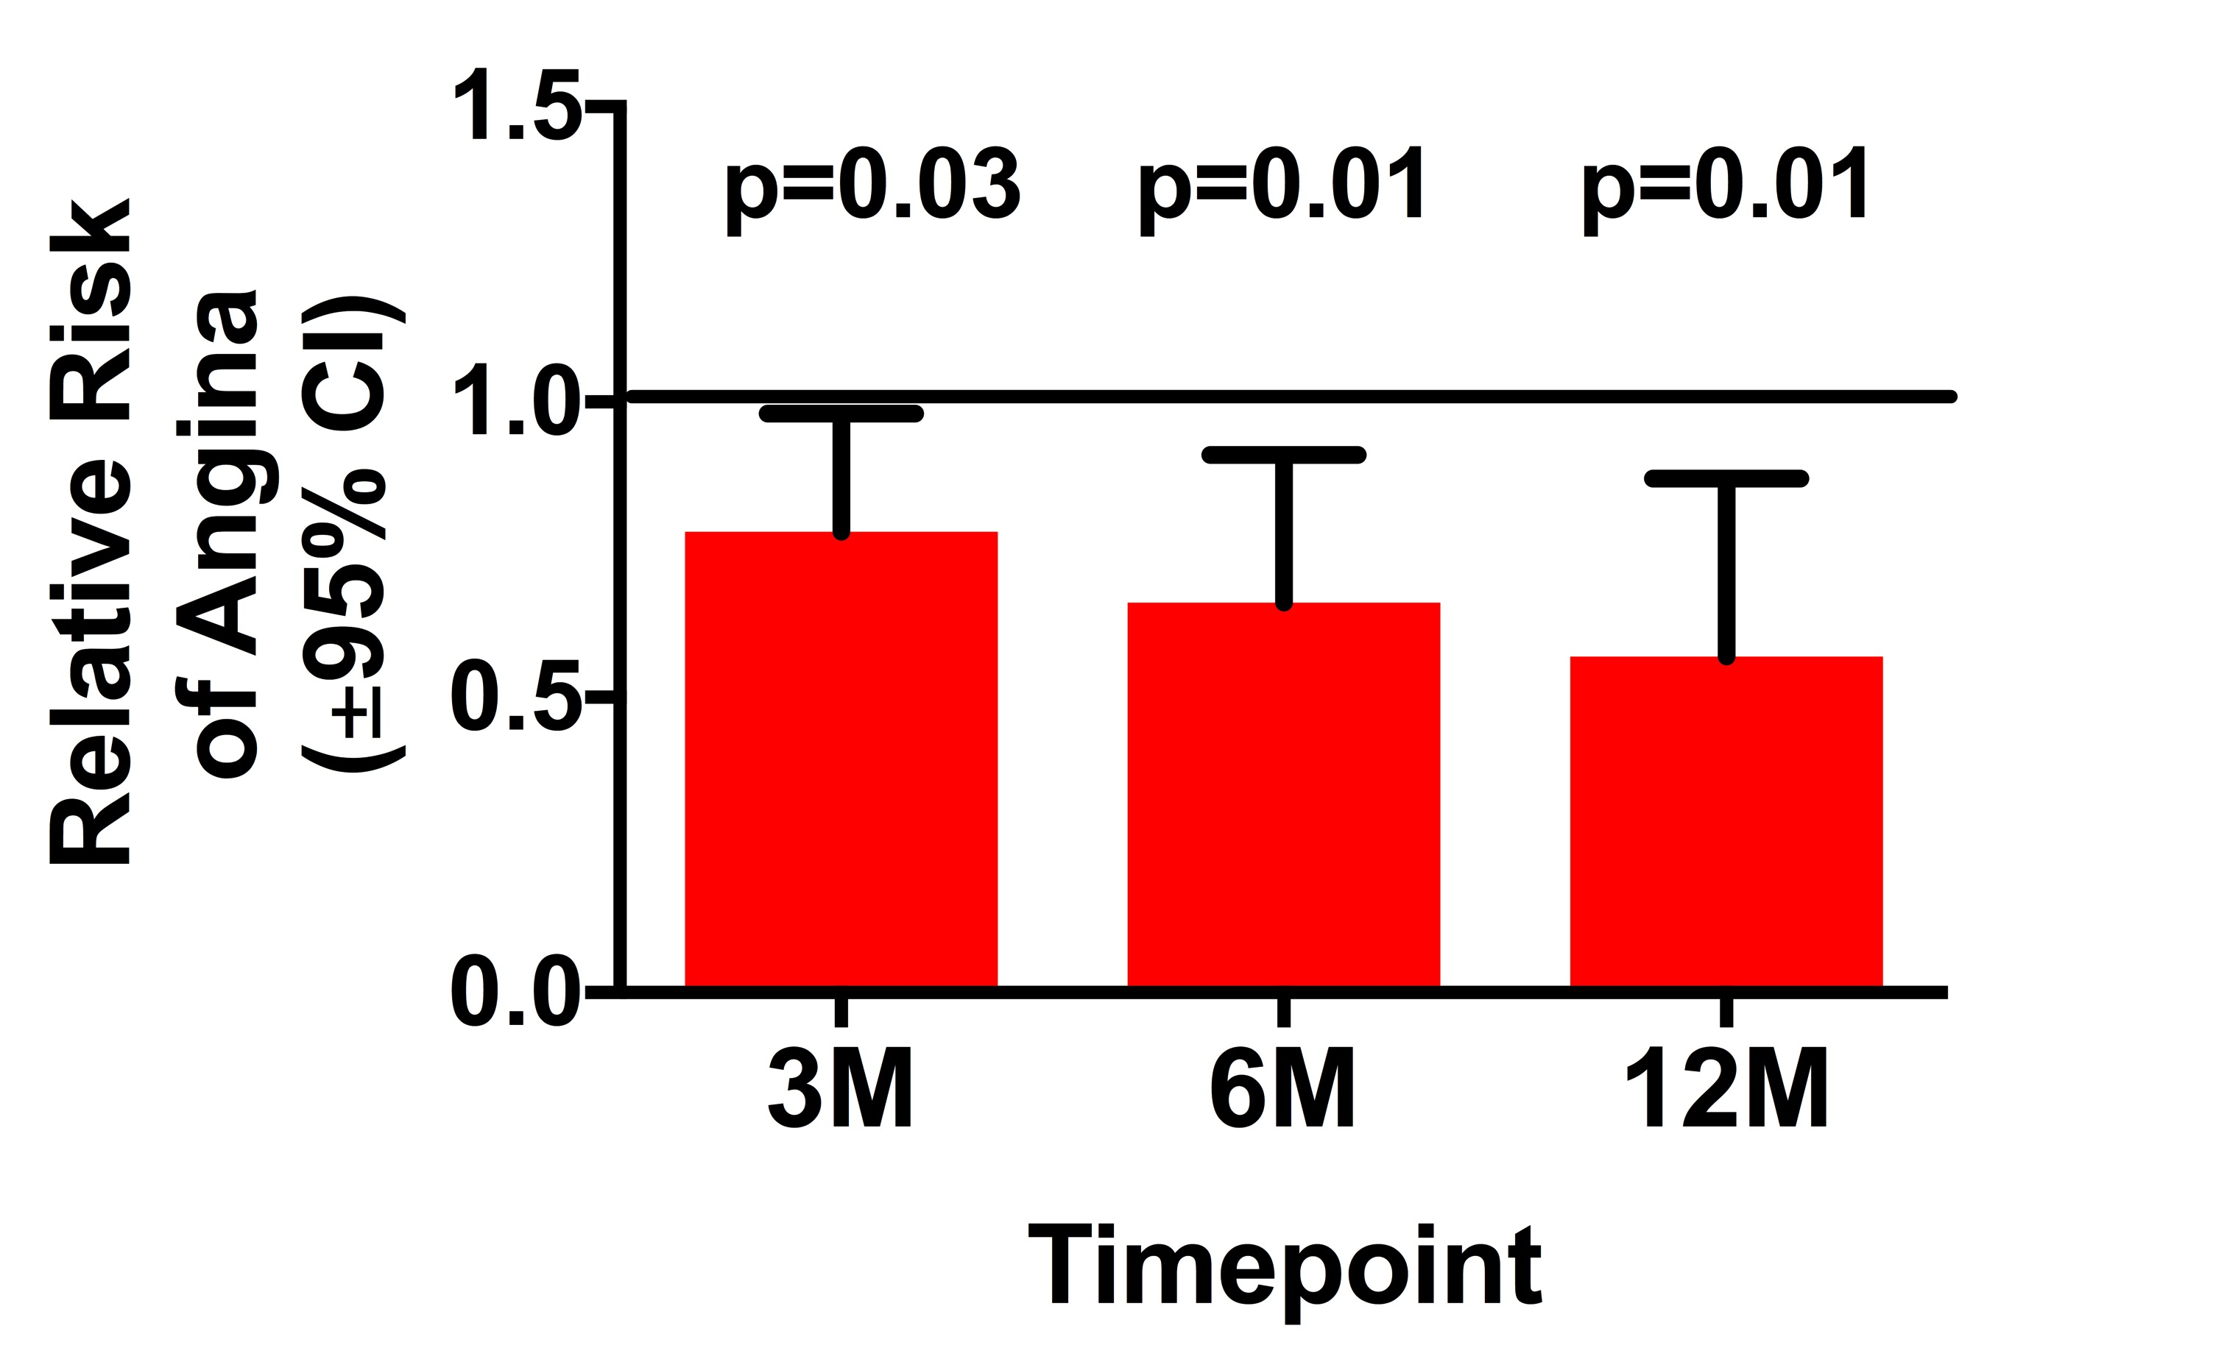

Relative Risk of Angina*
ITT Analysis
As Txt Analysis
*Prespecified Poisson Distribution

Slide 29
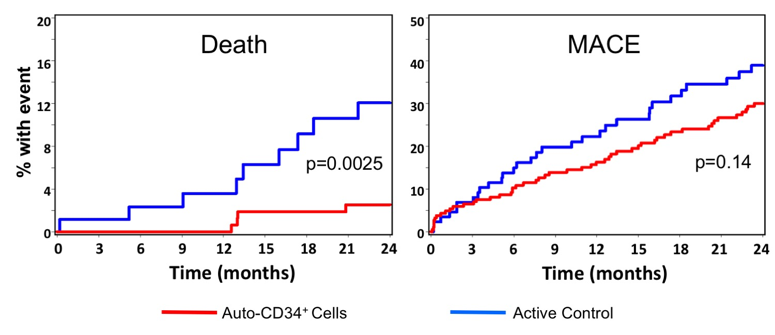
Kaplan-Meier Analysis

Slide 30
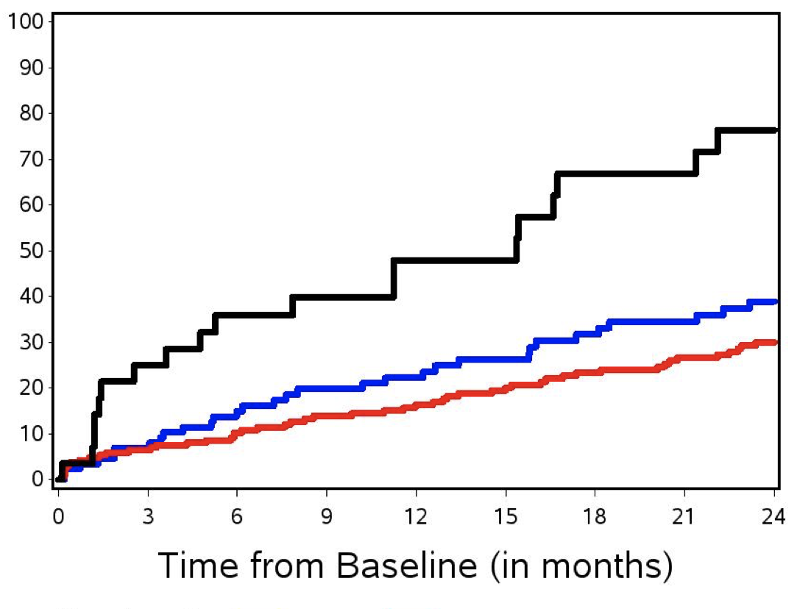
Kaplan-Meier Analysis
% with event
Auto-CD34⁺ Cells
Active Control
Open Label SOC

Slide 31
Efficacy Comparison: Change in ETT

Slide 32
Efficacy Comparison: Change in Angina Frequency

Slide 33
Conclusions
CD34⁺ cells, compared with placebo injections, result in:
  Clinically and statistically significant durable improvements in exercise capacity to at least 12 months
  Overall improvements in angina frequency
  MACE events favor cell therapy
  Statistically significant improvement in mortality with cell therapy
  SOC arm faired poorly
  Effect larger than other accepted therapies for angina

Slide 34
Where are we?
In the context of developing therapies for serious unmet clinical needs, the best approach is to think of clinical and statistical plausibility together.
Mechanistic plausibility
Preclinical models
Reducing risk (autologous products)
Consistency of effect
Totality of data
Clinical need

Slide 35
Conclusions
This type of cell therapy for refractory angina is particularly promising and may improve both functional status and mortality
It is imperative to explore methods to bring this therapy to patients with high clinical need and limited if any other options

Slide 36
