Slide 1
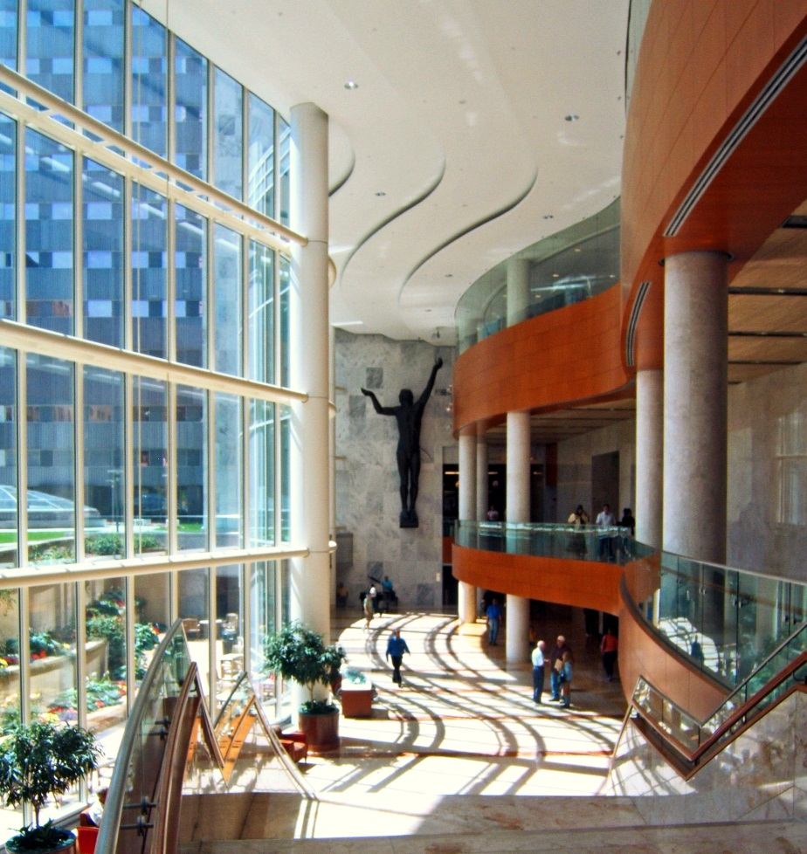
Advancing Cell Therapies for Coronary Microvascular Dysfunction: Experts Roundtable
Defining “Refractory Angina”: Epicardial and Microvascular
Amir Lerman, MD
Barbara Woodward Lips Endowed Professor
Director Cardiovascular Research Center
Department of Cardiovascular Diseases
Mayo Clinic, Rochester, MN

Slide 2
DISCLOSURE
Relevant financial relationship(s) with industry
Itamar Medical: advisory board
Volcano/Philips consultant
Off Label Usage
None

Slide 3
50-Year-Old Female With Chest Pain
Had a severe episode of CP while driving on highway 110 with her window open on her way for dental appointment.
Arrived at the ER: MI was ruled out
History of obesity and PCO syndrome
She continues to complain on recurrent episodes of chest pain

Slide 4
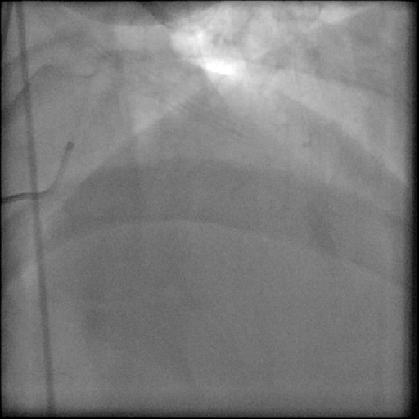
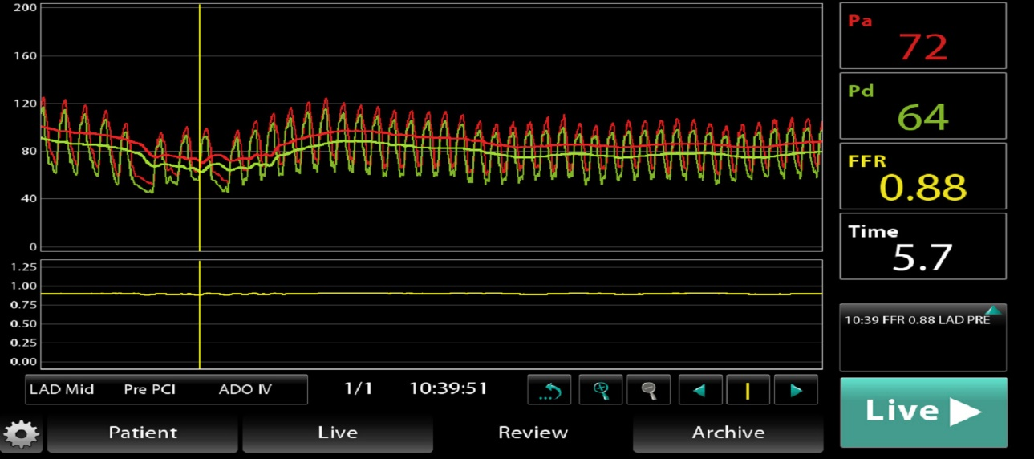
67 year old male with Chest Pain
S/P NSTEMI and stent to LAD
Continue to complain on progressive chest pain during exertion
Several ER visits with ECG changes

Slide 5
Study Population and Rates of Obstructive Coronary Artery Disease
Among 37 674 patients, 8384 patients (22.3%) had non obstructive CAD
37.6%
397,954 patients at 663 sites
1–year myocardial infarction
Obstructive CAD
(n=149,739)
Multivessel CAD 53.0%
1-vessel CAD 46.7%
2-vessel CAD 30.5%
3-vessel CAD 22.5%
Framingham Risk Category
Symptom Characteristic
1–year mortality
Low (<10%)
Intermediate
High(>20%)
Atypical symptoms
No symptoms
Angina
Obstructive CAD (%)
Obstructive CAD (%)
Results of noninvasive tests
Results of noninvasive tests
Patel et al: N Engl J Med 362:886, 2010
Maddox,JAMA. 2014;312(17):1754-1763..

Slide 6
Major Adverse Cardiovascular Event-Free Survivor Functions Women
Degree of CAD
Change over time – Women
Survivor functions for women:
Age adjusted to 60 years
Non obstructive coronary artery disease by angiography is common and is associated with cardiovascular events
Asymptomatic
MACE free survival
Time (years)
No obstructive CAD
2VD
1VD
Diffuse non-obstructive CAD
Normal coronary arteries
3VD

Slide 7
Functional Class in COURAGE – SYNTAX 3-VD and FAME
% Free of Angina at 1 Year
PCI -FFR
CABG
PCI - angio
PCI
PCI
Medical
%

Slide 8
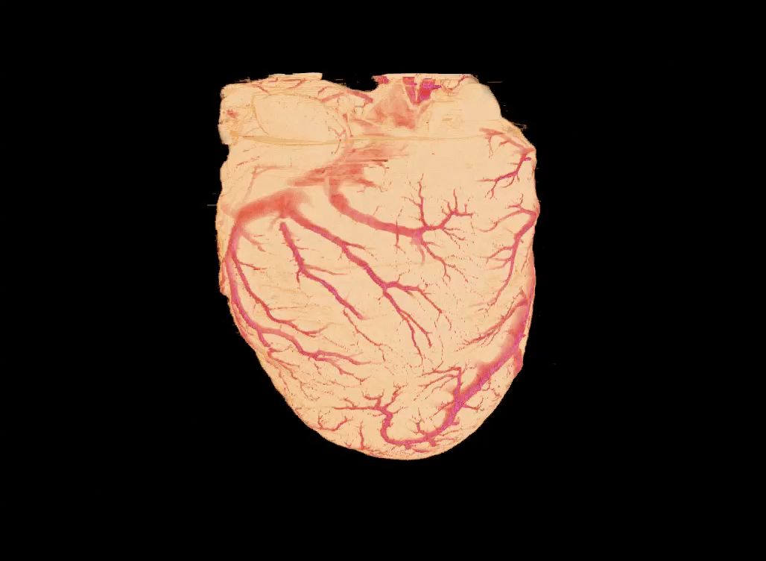
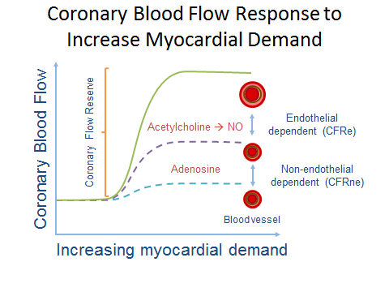
Coronary Microcirculation
High oxygen extraction 60-80% vs. 20-30% in skeletal muscle: coronary perfusion is flow dependent

Slide 9
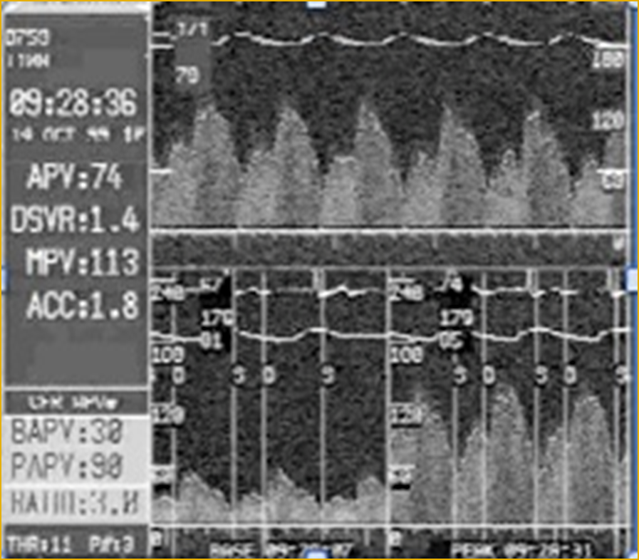
Coronary Flow Reserve
Response to Adenosine is Non-Endothelial Dependent
5
Maximum
vasodilation
4
3
Coronary flow
2
1
0
Coronary pressure
Coronary
reserve
=
Flow_{dilated}
Flow_{initial}

Slide 10
How to assess endothelial function?
Shear stress
Reactive hyperemia
Acetylcholine
Bradykinin
Ca²
(-)
L-arg
Endo-
thelium
NOS
NO
(Ca²⁺)
R
A
Smooth
muscle
sGC
GTP
Cyclic GMP
Relaxation
Coronary blood flow increase in response to exercise and mental stress is endothelium dependent and parallel the response to intracoronary acetylcholine.

Slide 11
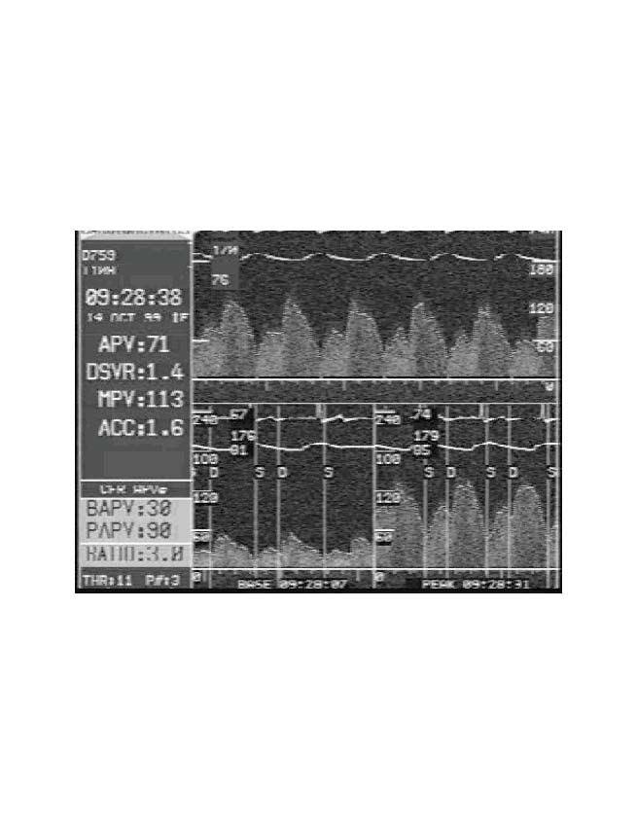
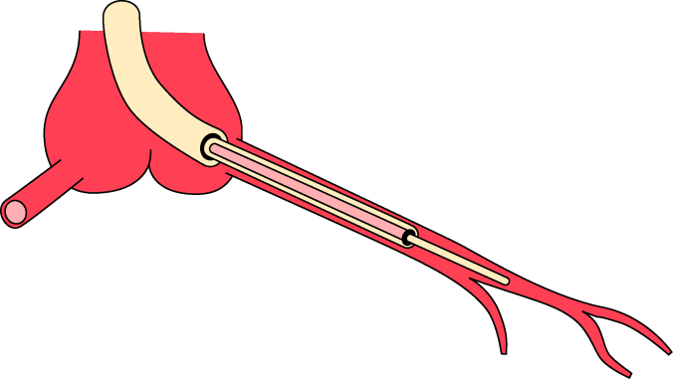
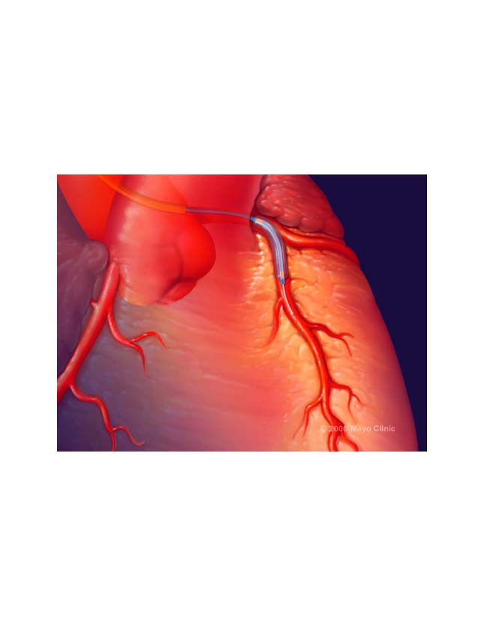
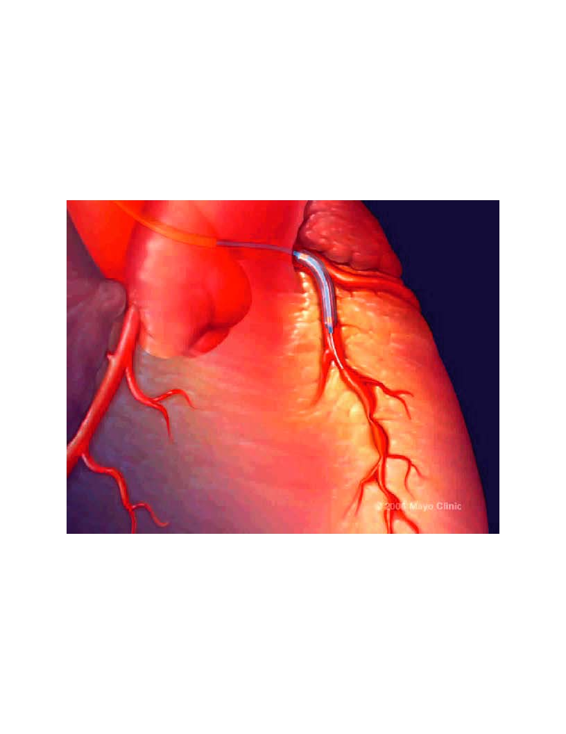
Functional Angiogram Protocol
Diagnostic
angiography
Adenosine IC
24-72 μg
CFR: Non endothelium
microcirculation
Acetylcholine (endothelium dependent
vasodilator)
Epicardial
Microcirculation

Slide 12
Mechanism/drug | Non-Endothelium | Endothelial function Epicardial | Endothelial function Microcirculation
Adenosine Microcirculation | % ∆ in CBF Doppler >2.5 | _ | _
Acetylcholine | _ | % ∆ in CAD >20% | % ∆ in CBF >50%
NTG Epicardial | % ∆ in CAD QCA | _ | _
CAD: coronary artery diameter, CBF coronary blood flow

Slide 13
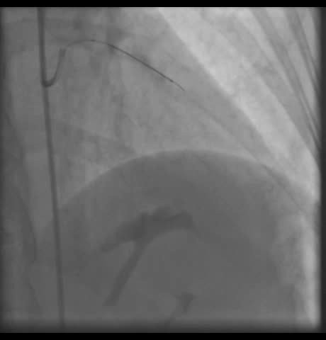
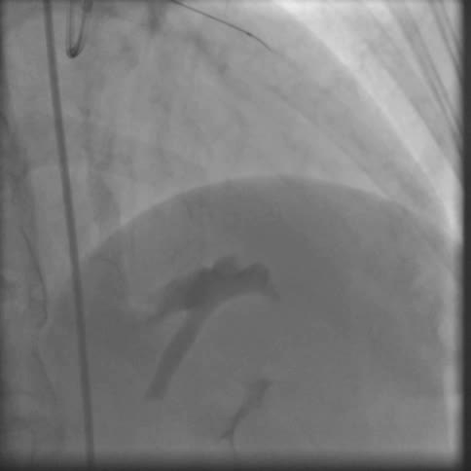
50-Year-Old Female With Chest Pain: Functional coronary angiography
Baseline
Acetylcholine 10-4M
CFR to adenosine 2.2 changes in CBF to Ach -10 %

Slide 14
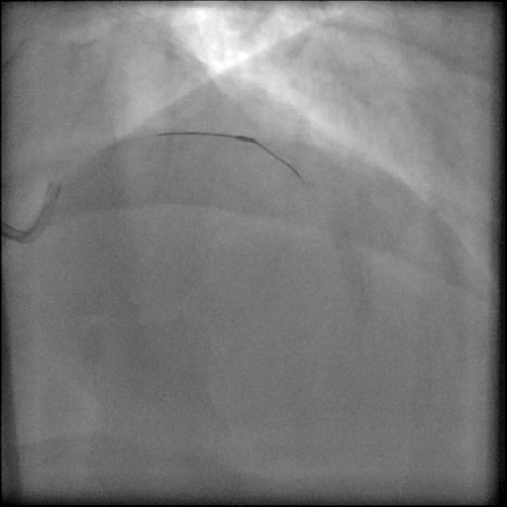
67 year old male with Chest Pain
CFR= 2.5
Response to IC acetylcholine
% change of CBF 10%

Slide 15
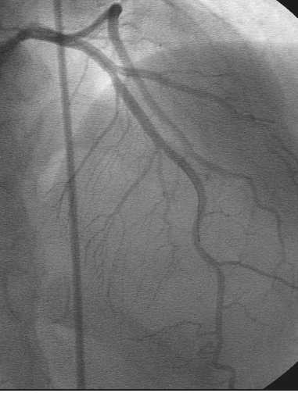
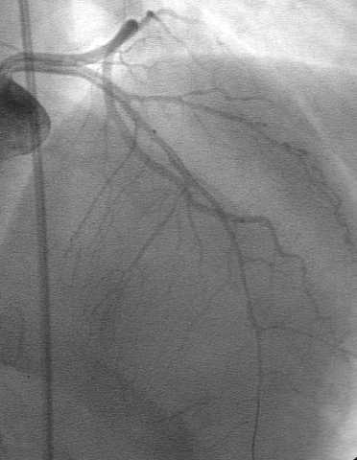
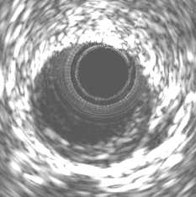
50-Year-Old Female With Chest Pain
Baseline
Acetylcholine
Nitroglycerine

Slide 16
Prevalence of Microvascular Dysfunction in Patients With Non-Obstructive CAD
1,439 patients with chest pain and non-obstructive
Microvessel endothelial-dependent and independent function was examined by evaluating changes in coronary blood flow after intracoronary administration of adenosine acetylcholine.
60.4%
Male patients (%)
The majority of the patients with chest pain and non-obstructive CAD have microvascular dysfunction
63.9%
65.7%
Patients (%)
Female patients (%)

Slide 17
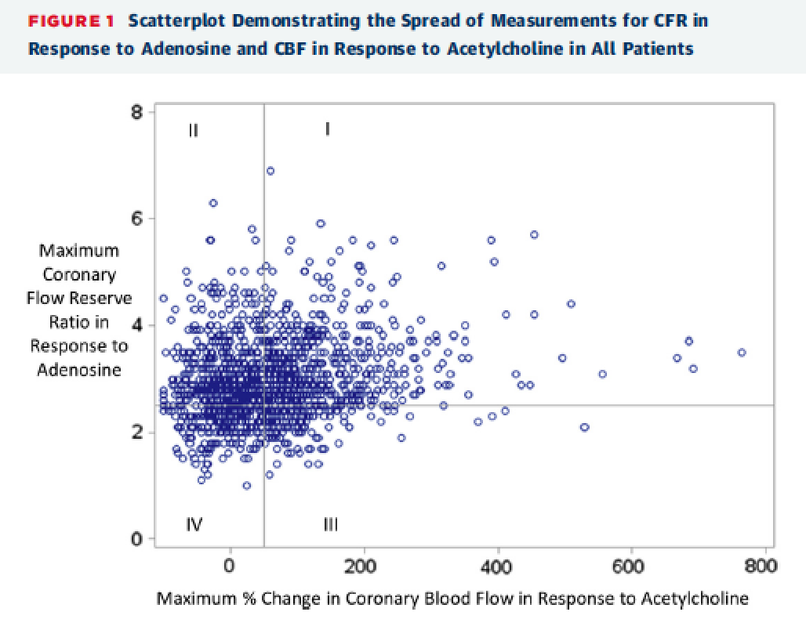
Coronary microvascular dysfunction among patients with chest pain and non-obstructive coronary artery disease
1,439 patients with measurements available for both CBF and CFR.
Two-thirds of all patients had some sort of microvascular dysfunction.
Sara & Lerman et al JACC 2015

Slide 18
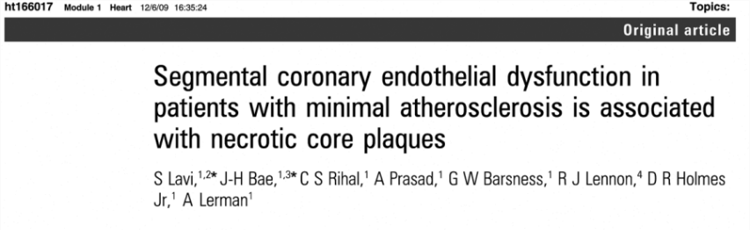
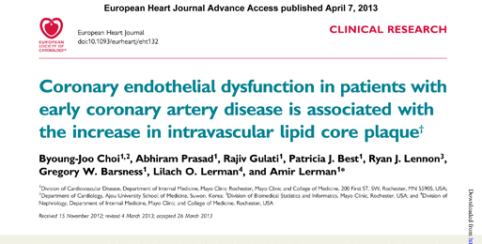
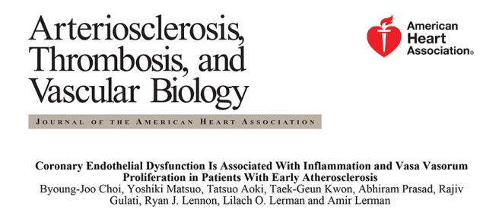
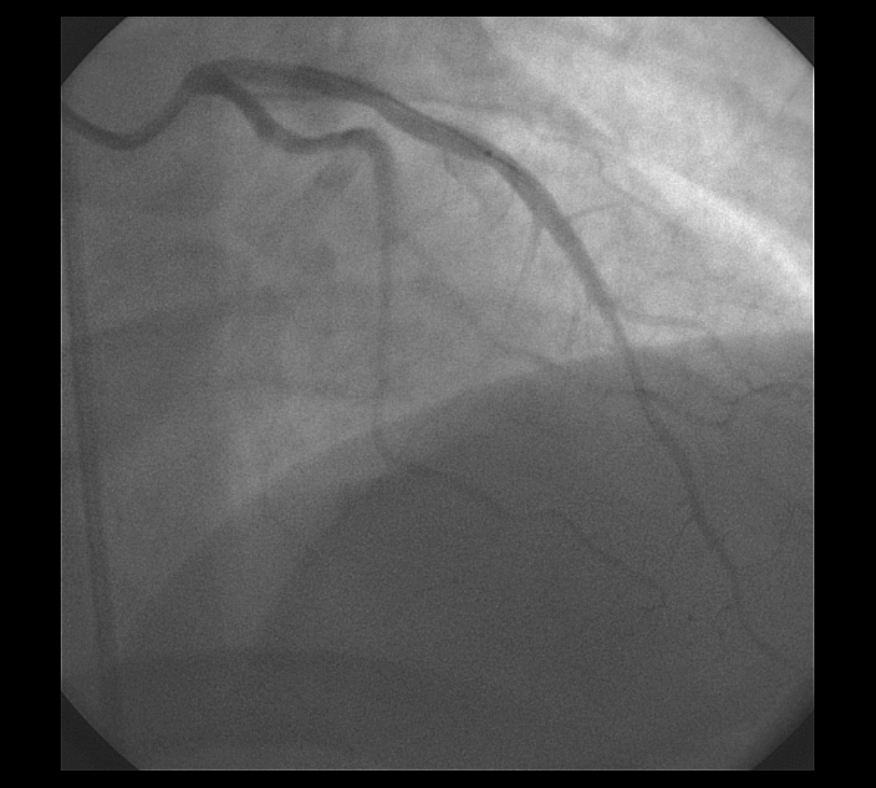
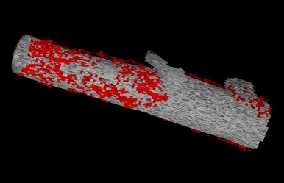
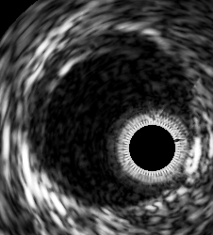
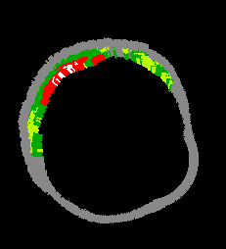
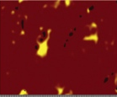
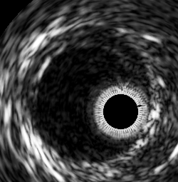
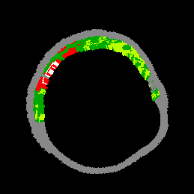
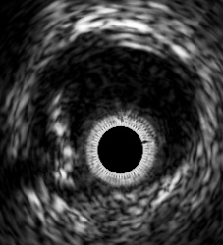
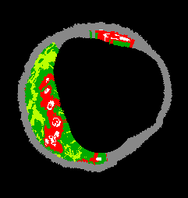
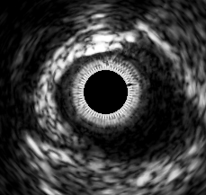
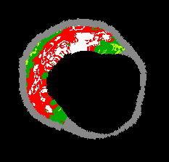
Endothelial dysfunction is associated with tissue characterization of vulnerable plaque
Baseline
6 months
Endothelial
dysfunction
Normal
endothelial
function

Slide 19
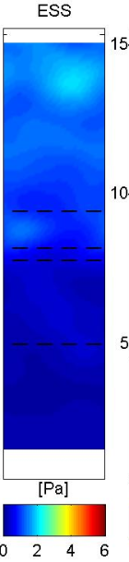
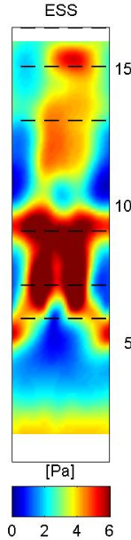
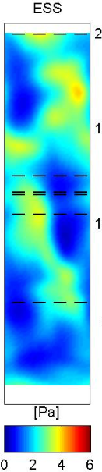
The cross talk between the micro and epicardial and
Microcirculation
LAD with Normal Epicardial
Endothelial Function and abnormal
microvascular function
LAD with Normal Epicardial
Endothelial Function
LAD with Abnormal Epicardial
Endothelial Function
65 patients with nonobstructive coronary atherosclerosis
Microvascular and epicardial coronary endothelial function was assessed by using intracoronary acetylcholine infusion
Each reconstructed artery was divided into sequential 3-mm segments and analyzed for local ESS with computational fluid dynamics
Plaque Characteristics in 1 Segment Per Artery: Analysis Based on
Both Microvascular and Epicardial Endothelial Function
Length of Coronary Artery
Length of Coronary Artery
Max Plaque Burden
Max Plaque Thickness
Min Lumen Area
80
P =
0.
40
2.0
.
P =
0
P =
0.
64
.30
15
P =
0.
06
P =
0
.
7
0
P =
0
.
7
0
P =
0.
9
60
1.5
P =
0
9
.
052
P =
0
.
78
mm
10
%
40
1.0
mm²
20
0.5
5
0
0.0
0
Norm Microv
& Norm Epicard
Abn Microv
& Norm Epicard
Abn Microv
& Abn Epicard

Slide 20
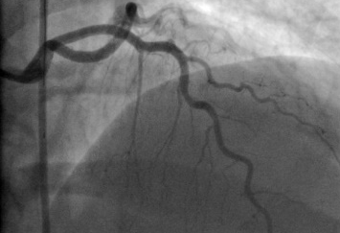
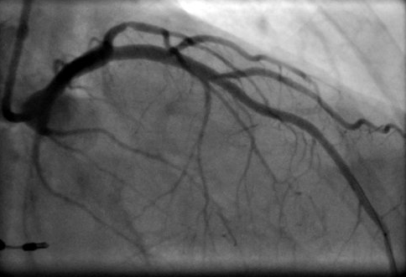
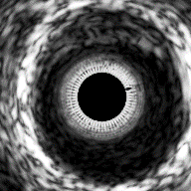
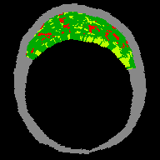
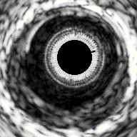
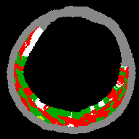
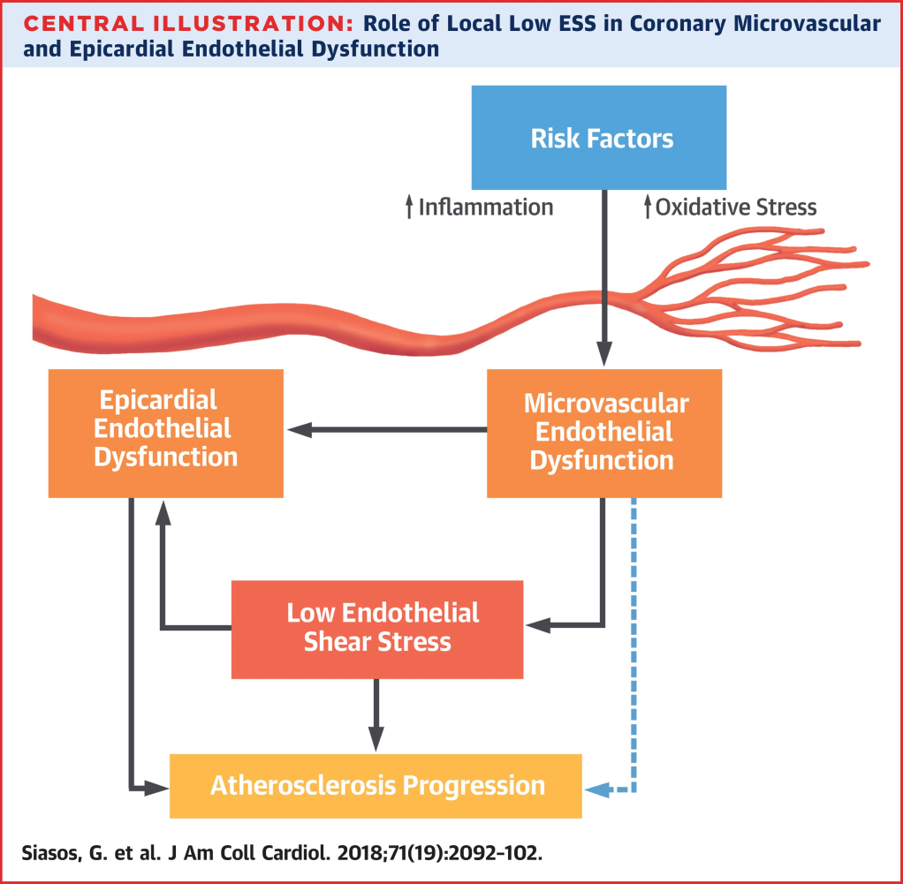
The Relationship between the microcirculation and Epicardial Disease
Normal microvascular function
Abnormal microvascular function
Association of coronary microvascular endothelial function with plaque burden and plaque volume.
<0.001
Plaque volume index (mm³/mm)
P = 0.001
60
10
Risk Factors
Plaque burden (%)
8
40
6
↑Inflammation
↑Oxidative Stress
4
20
2
0
CMED(−)
Mild
Severe
0
CMED(−)
Mild
Severe
CMED(+)
CMED(+)
Epicardial Endothelial Dysfunction
Microvascular Endothelial Dysfunction
Association of coronary microvascular endothelial function with plaque composition and vulnerability.
C
Frequency of TCFA (%)
100
80
P = 0.0012
Low Endothelial
Shear Stress
60
P = 0.0486
40
Artherosclerosis Progression
20
0
CMED(−)
Mild
Severe
CMED(+)

Slide 21
Association Between Noninvasive
Tests and Coronary Flow Reserve
Test | No. | % (+) | (95% CI) | (95% CI) | (95% CI) | (95% CI)
Exercise Echo | 100 | 40.0 | 42 (28-57) | 62 (47-75) | 52 (38-65) | 53 (36-68)
Dobutamine Echo | 21 | 38.1 | 18 (2-52) | 40 (12-74) | 31 (9-61) | 25 (3-65)
Exercise SPECT | 131 | 38.2 | 37 (26-50) | 61 (48-73) | 48 (37-60) | 50 (36-64)
Vasodilator SPECT | 63 | 50.8 | 61 (42-78) | 59 (41-76) | 61 (42-78) | 59 (41-76)
Vasodilator PET | 33 | 36.4 | 20 (4-48) | 50 (26-74) | 43 (22-66) | 25 (5-57)
All imaging | 365 | 41.6 | 41 (34-49) | 58 (50-65) | 49 (42-56) | 50 (42-58)
Exercise ECG | 233 | 15.5 | 18 (12-27) | 78 (69-85) | 51 (43-59) | 61 (43-77)
All imaging + ECG | 365 | 6.3 | 8 (4-12) | 90 (85-94) | 50 (45-56) | 61 (39-80)
Imaging Stress Tests
Endothelial function
Non-endothelial CFR
Change (%)
Ratio

Slide 22
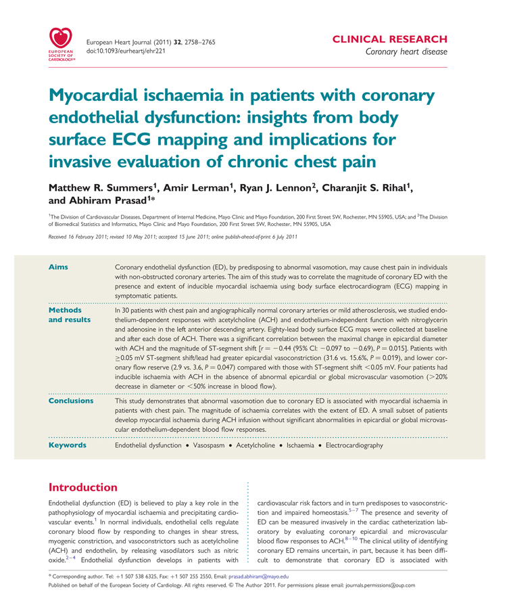
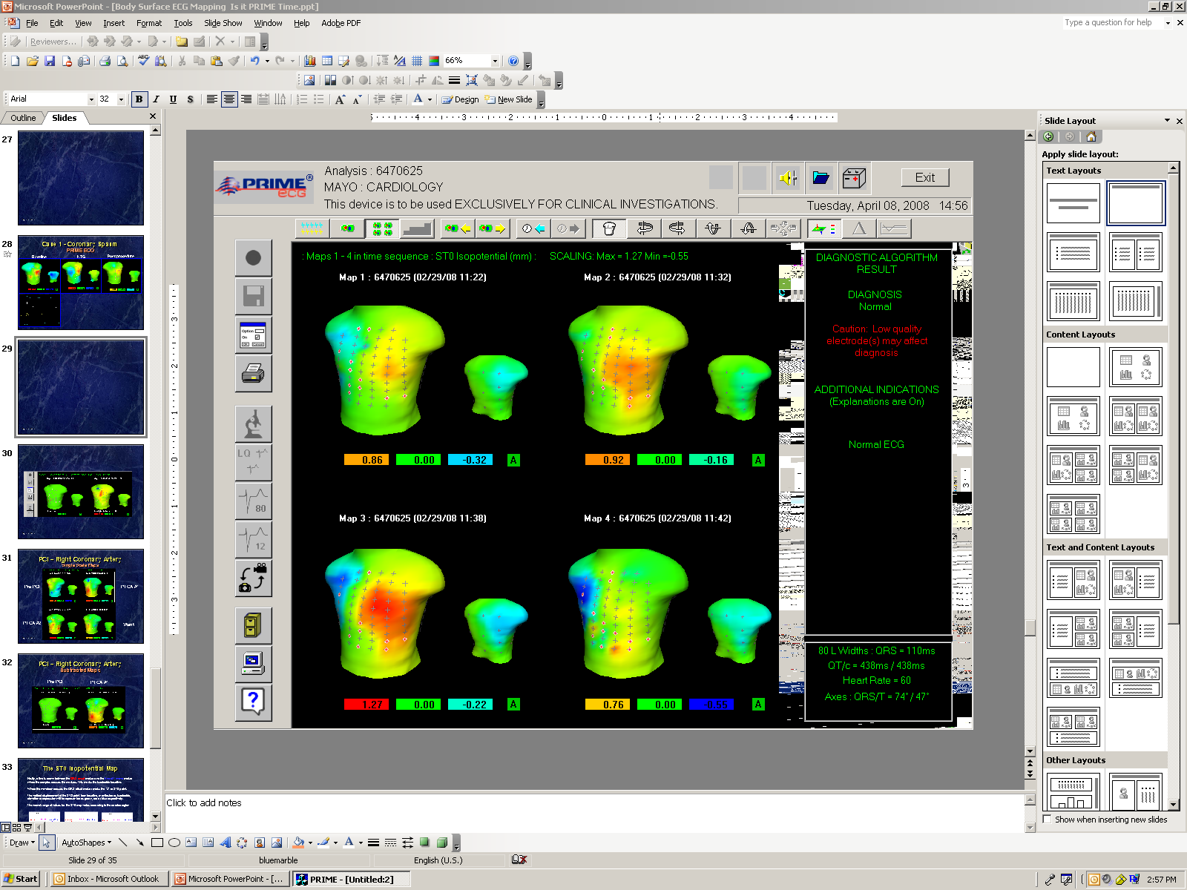
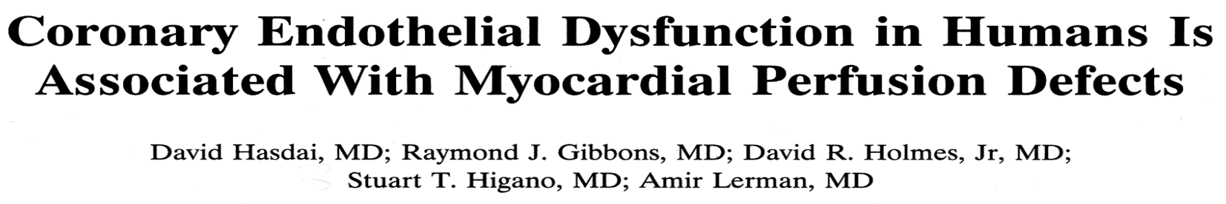
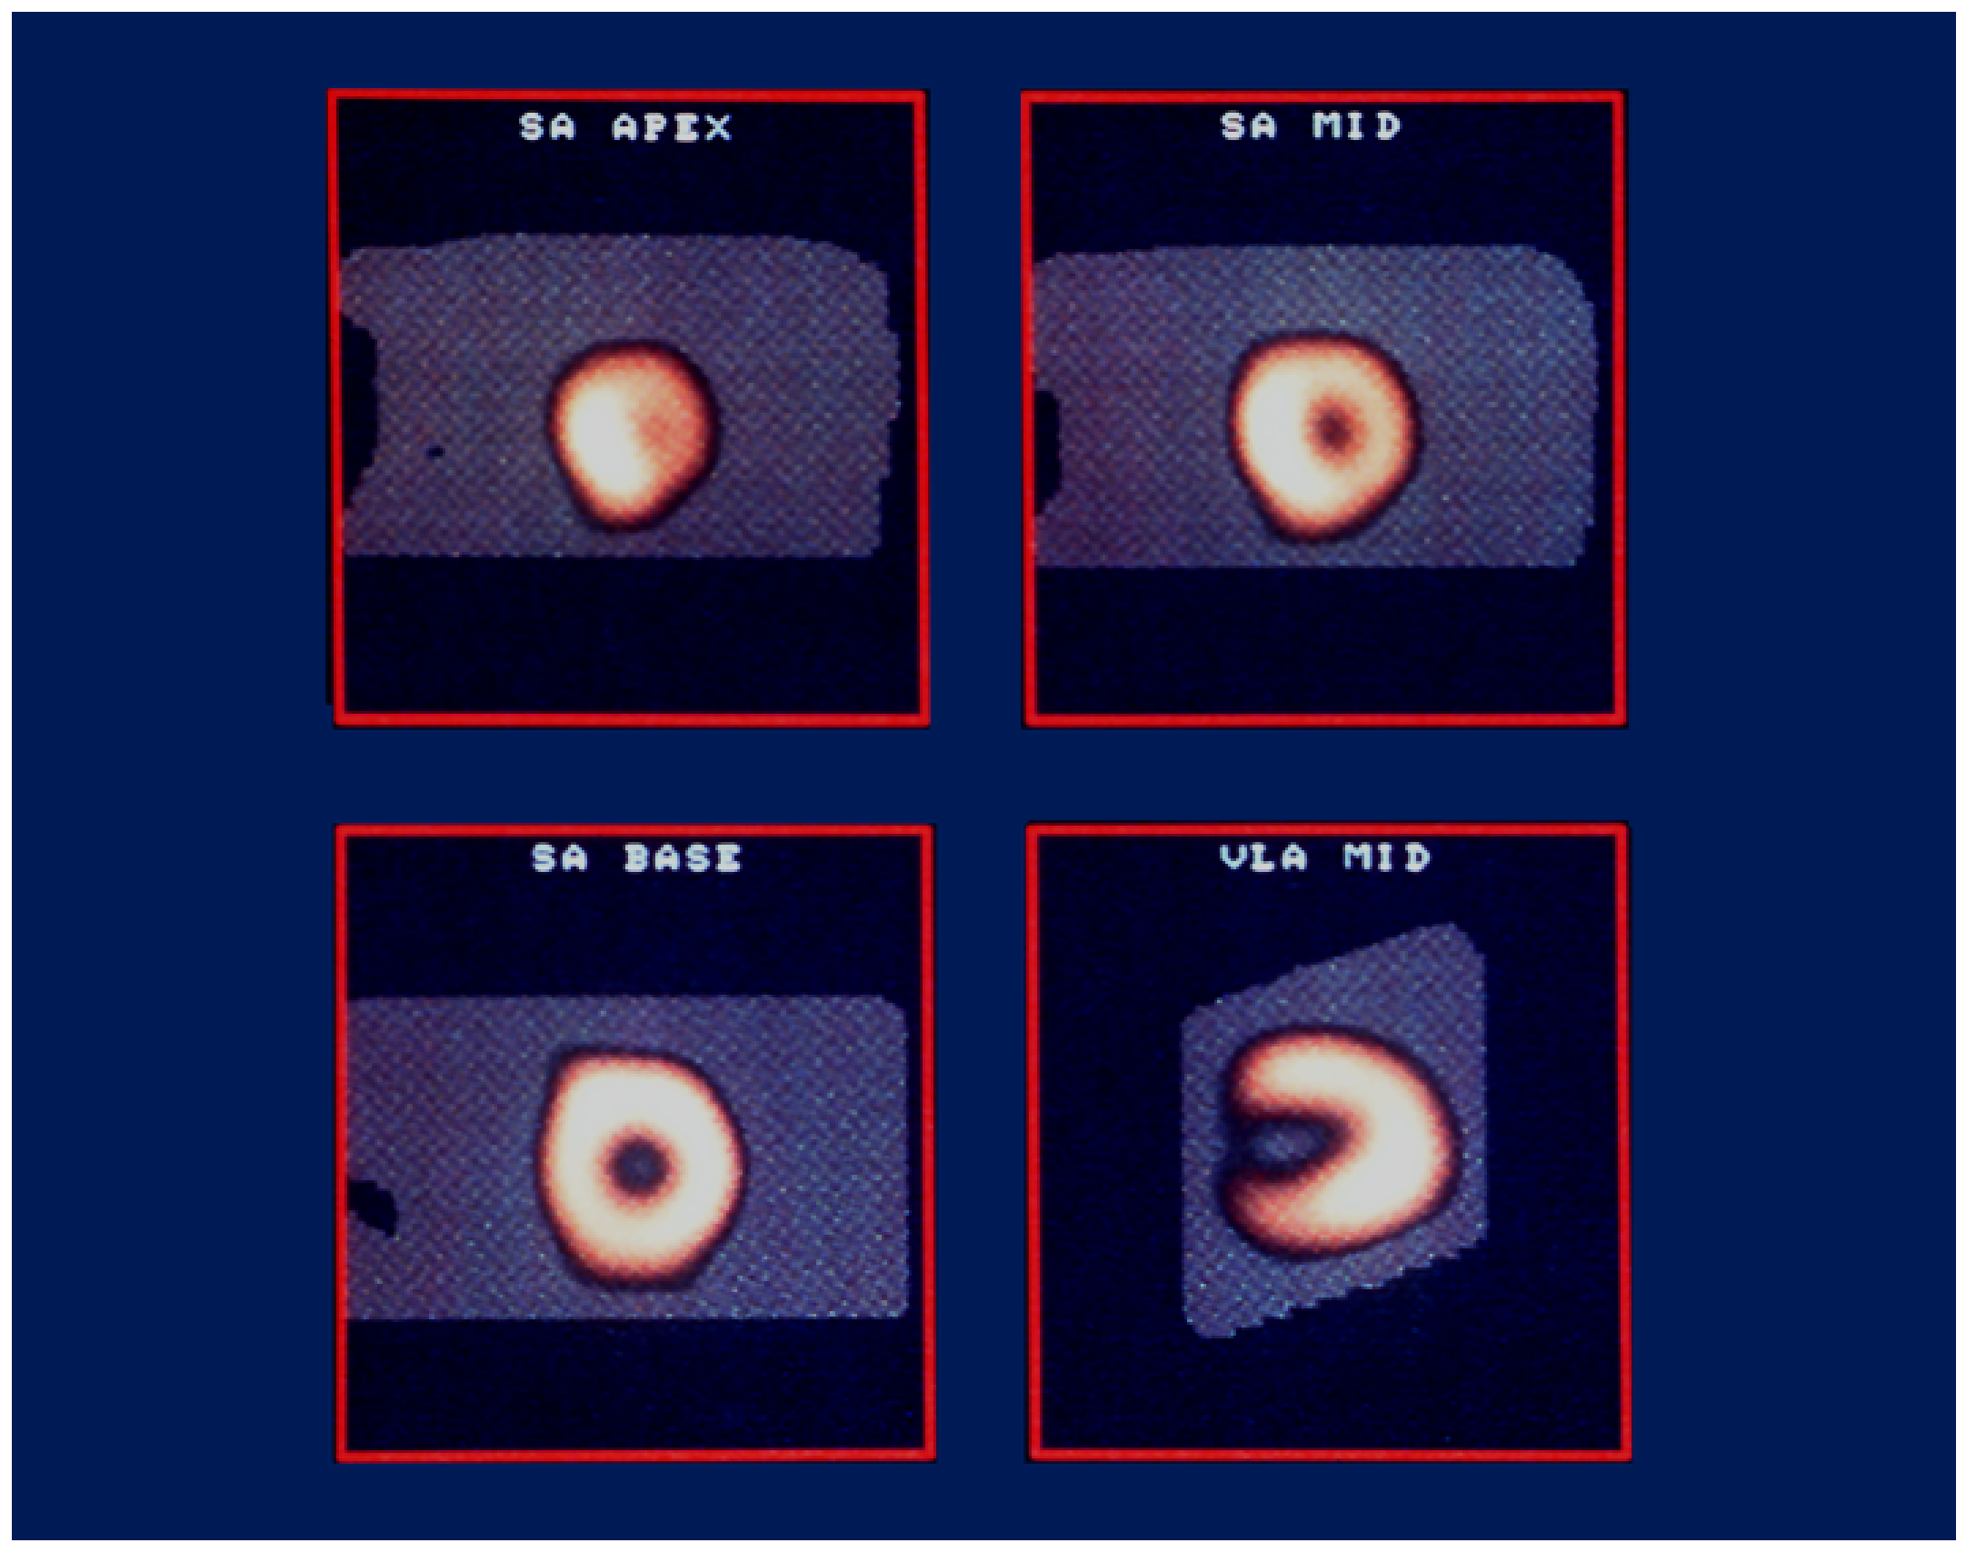
Coronary Endothelial Function: Prime ECG
Baseline
ACH 10⁻⁴M
Coronary endothelial function in response to acetylcholine
Eighty lead body surface ECG
Epicardial diameter change
Degree of ischemia (Anterior ST-shift (mV)
Notes:
Prayter

Slide 23
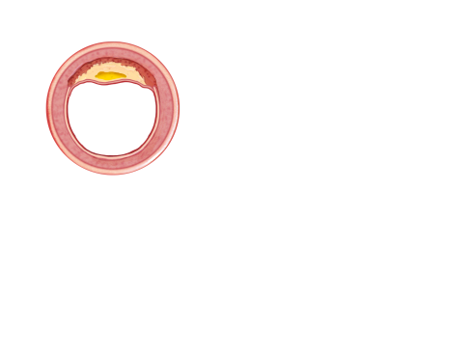
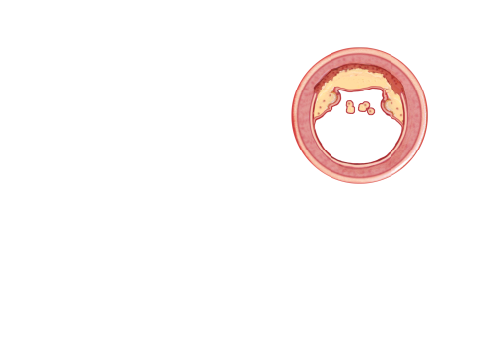
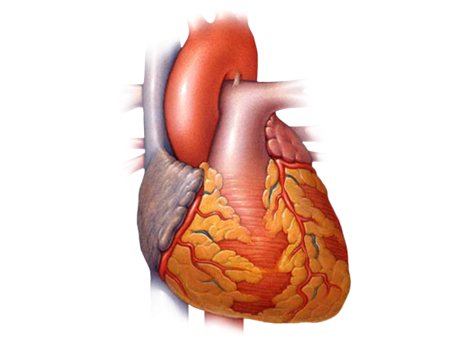

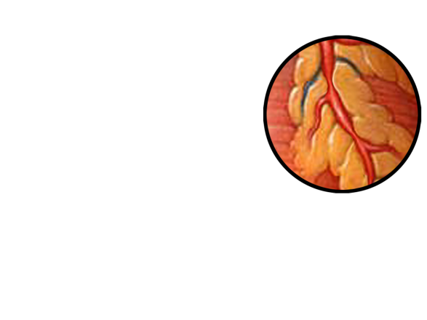

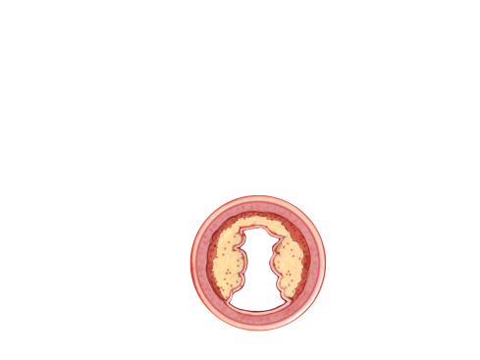

Coronary Microvascular Dysfunction
Epicardial endothelial dysfunction
Vulnerable plaque
Plaque rupture or erosion
ACS
Coronary endothelial dysfunction
Plaque progression
Shear stress
Myocardial ischemia
Microcirculatory endothelial dysfunction
Angina
Cardiomyopathy, diastolic dysfunction, apical ballooning

Slide 24

CV events were assessed after a median follow-up of 9.7 years
K–M Curve Showing Cumulative Proportion of Patients Without CV Events During F-U
Figure 2. SF-36 in patients with microvascular endothelial dysfunction
Figure 2. SF-36 in patients with microvascular endothelial dysfunction
Figure 2. SF-36 in patients with microvascular endothelial dysfunction
Normal endothelial
function
Figure 2. SF-36 in patients with microvascular endothelial dysfunction
Figure 2. SF-36 in patients with microvascular endothelial dysfunction
Figure 2. SF-36 in patients with microvascular endothelial dysfunction
Variable (events) | NRI
FRS + microvascular CEF | 0.11
FRS + epicardial CEF | 0.12
FRS + microvascular and epicardial CEF | 0.228
100
Normal %chg. CBF>50%
Coronary endothelial
dysfunction
100
Normal %chg. CBF>50%
Abnormal Diagnosis
%chg. CBF≤ 50%
Event-free survival 100%
100
Normal %chg. CBF>50%
Abnormal Diagnosis
%chg. CBF≤ 50%
80
100
Normal %chg. CBF>50%
p=0.05
Abnormal Diagnosis
%chg. CBF≤ 50%
p=0.033
80
100
Normal %chg. CBF>50%
p=0.05
Abnormal Diagnosis
%chg. CBF≤ 50%
p=0.033
80
100
p=0.042
Normal %chg. CBF>50%
SF-36 Score
p=0.05
Abnormal Diagnosis
%chg. CBF≤ 50%
p=0.033
Years after endothelial function angiogram
80
100
p=0.042
Normal %chg. CBF>50%
SF-36 Score
Abnormal Diagnosis
%chg. CBF≤ 50%
60
80
p=0.05
p=0.042
p=0.033
SF-36 Score
Abnormal Diagnosis
%chg. CBF≤ 50%
60
80
p=0.05
p=0.042
p=0.033
SF-36 Score
60
80
p=0.05
p=0.042
p=0.033
SF-36 Score
60
p=0.05
p=0.042
p=0.033
40
SF-36 Score
60
p=0.042
40
SF-36 Score
60
40
60
20
40
20
40
20
40
0
20
40
0
20
Emotional
Mental Competency
Score
Vitality
0
20
Emotional
Mental Competency
Score
Vitality
0
20
Emotional
Mental Competency
Score
Vitality
0
Mental Competency
Score
Vitality
Emotional
0
Mental Competency
Score
Vitality
Emotional
0
Mental Competency
Score
Vitality
Emotional
Mental Competency
Score
Vitality
Emotional

Slide 25


OBJECTIVES The purpose of this study was to test whether an interventional diagnostic procedure (IDP) linked to stratified medicine improves health status in patients with INOCA.
Primary Efficacy Outcome: Treatment Difference
in the 6-Month SAQ Summary Score
Stratified Medical Therapy Guided by an IDP
in Patients With Angina but No Obstructive CAD
Angina Summary Score
Angina Limitation
Angina Stability
Angina Frequency
Treatment Satisfaction
Quality of Life
-10
0
10
20
Between Group Difference in SAQ
Favors
Control
Favors
Intervention

Slide 26

Systemic Manifestation of Endothelial Dysfunction The Vulnerable Patient
Stroke/TIA’s
Sleep apnea
Dementia
Renal failure
Myocardial infarction
Sudden Death
Metabolic Syndrome
Erectile dysfunction
EPCs dysfunction/
Cancer
Claudication

Slide 27




Reactive Hyperemia: Endothelium Dependent
Brachial diameter (mm)
Pre
30
60
90
120
Time after cuff release (sec)

Slide 28


RH-PAT
Index
Sensitivity (%)
AUC 0.834 (0.747-0.921)
P<0.0001
N=94
P<0.001
1-specificity (%)
Non-IHD
n=30
Obstructive
CAD
No CAD
n=42

Slide 29


Relative Risk for
FMD and Endo PAT
Univariate
3.0
2.5
2.0
1.5
RR for CV events
1.0
0.5
0.0
Thirty-five FMD studies of 17 280 participants and 6 RH-PAT studies of 602 participants were included in the meta-analysis.
-1SD
Mean
+1SD
-0.3%
1.2%
0.31 (1.36)
-4.3%
6.4%
0.56 (1.76)
8.9%
11.6%
0.82 (2.28)
Multivariate
3.0
The magnitude of the prognostic
value in cardiovascular disease subjects was comparable between these 2 methods; a 1 SD worsening
in endothelial function was associated with double cardiovascular risk.
2.5
2.0
1.5
RR for CV events
1.0
0.5
0.0
-1SD
Mean
+1SD
Distal occlusion FMD
Proximal occlusion FMD
EndoPAT

Slide 30


Can We use Endothelial Function to Individualize Therapy?

Slide 31
Event-Free Rate According to Persistent Endothelial Dysfunction in Patients With Mild CAD
Improved endothelial function
Persistent impaired endothelial function
Event-free survival (%)
P<0.0001
Months

Slide 32


CV risk factors
Environmental
Vascular injury
EPCs
Inflammation &
oxidative stress
Abnormal repair
Endothelial dysfunction: The risk of the risk factors

Slide 33



Classification EPCs
CD34 (hematopoietic/endothelial stem cell marker)
CD133 (hematopoietic/endothelial stem cell marker)
VEGFR2/KDR (endothelial marker)
Number of EPCs
The function of the EPCs
Colony formation unit
Tube formation
KDR
CD133
CD34

Slide 34

Relation Between the Number of Endothelial Progenitor Cells and Endothelial Function
Endothelial Progenitor Cells
(Colony-Forming Units)
r=-0.59
P<0.001
Change in brachial reactivity (%)

Slide 35

Normal
Coronary endothelial
dysfunction
10 μm
P=0.02
Total CFU count
Cell count/100 μL buffy coat

Slide 36


Traditional and non-taditional CV risk factors
Normal endothelial Function
Endothelial Dysfunction
Continue current management
Ongoing CV risk and Events
Life style modification
Stress
Sleep apnea
Statins
L-arginine
Renexa
Ongoing
Vascular injury
Vasodilators
Cell therapy (EPCs)
Modify current management

Slide 37
Thank you
Lerman.amir@mayo.edu

Slide 38
Functional Class in COURAGE – SYNTAX 3-VD and FAME
% Free of Angina at 1 Year
PCI -FFR
CABG
PCI - angio
PCI
PCI
Medical
%

