Slide 2
Program Overview
Michael Gibson, MD (Co-Chair)
    &
Peter H. Stone, MD (Co-Chair)

Slide 3
Today’s Faculty
Michael Gibson, MD (Co-Chair)
Interventional Cardiologist
Professor of Medicine, Harvard Medical School
CEO and President
Baim Institute and PERFUSE Study Group
Founder, Editor-in-Chief, Wikidoc.org
Boston, MA
Peter H. Stone, MD (Co-Chair)
Professor of Medicine, Brigham and Women’s Hospital
Heart & Vascular Center
Professor of Medicine, Harvard Medical School
Boston, MA

Slide 4
Today’s Faculty
Amir Lerman, MD
Barbara Woodward Lips Professor
Associate Chair, Cardiovascular Medicine
Director, Cardiovascular Research Center, Mayo Clinic
Rochester, MN
C. Noel Bairey Merz, MD
Director, Barbara Streisand Women’s Heart Center
Professor of Medicine
Cedars-Sinai Heart Institute
Los Angeles, CA

Slide 5
Today’s Faculty
Thomas J. Povsic, MD, PhD
Interventional Cardiologist
Duke University Medical Center
Durham, NC
Andreas Zeiher, MD
Chairman of Medicine
J. W. Goethe University of Frankfurt
Frankfurt, Germany
President, German Cardiac Society

Slide 6
Meeting Announcements
In your folder:
  Agenda
  Faculty bios
  Learning objectives
  CME information
Submit questions to faculty by using question cards located on at the center of your table
No unauthorized recording devices permitted (audio, video, cell phone, camera)
Place cell phones on vibrate or silence mode

Slide 7
Online materials for this CME activity
Access slides online
Faculty slides are available here: medtelligence.net/nov16
Scroll to the “Related” section and click on “Syllabus”
Online CME credit
All attendees will receive an email with a link to the evaluation form
Once you complete the online evaluation form, you will receive a link to download your CME certificate
  Or, access your certificate within your Medtelligence/ReachMD profile

Slide 8
Stable Angina: State of the Art
Peter H. Stone, MD
Professor of Medicine, Brigham and Women’s Hospital
Heart & Vascular Center
Professor of Medicine, Harvard Medical School
Boston, MA

Slide 9
Microvascular Disease: Prevalence and Unmet Needs
C. Noel Bairey Merz, MD
Director, Barbara Streisand Women’s Heart Center
Cedars-Sinai
Los Angeles, CA

Slide 10
Faculty Disclosure
C. Noel Bairey Merz, MD
CONSULTING: Medscape*, Sanofi-Vascular*, NIH CSR and NIH ORWHAB*, iRhythm, Caladrius
HONORARIUM*: Abbott Diagnostics
GRANT SUPPORT*: NHLBI, Louis B Mayer Foundation, NIH-CTSI, CMDRP-DoD, NIH-Caladrius, California Institute for Precision Medicine (CIAPM), Sanofi-Vascular
*paid to CSMC

Slide 11
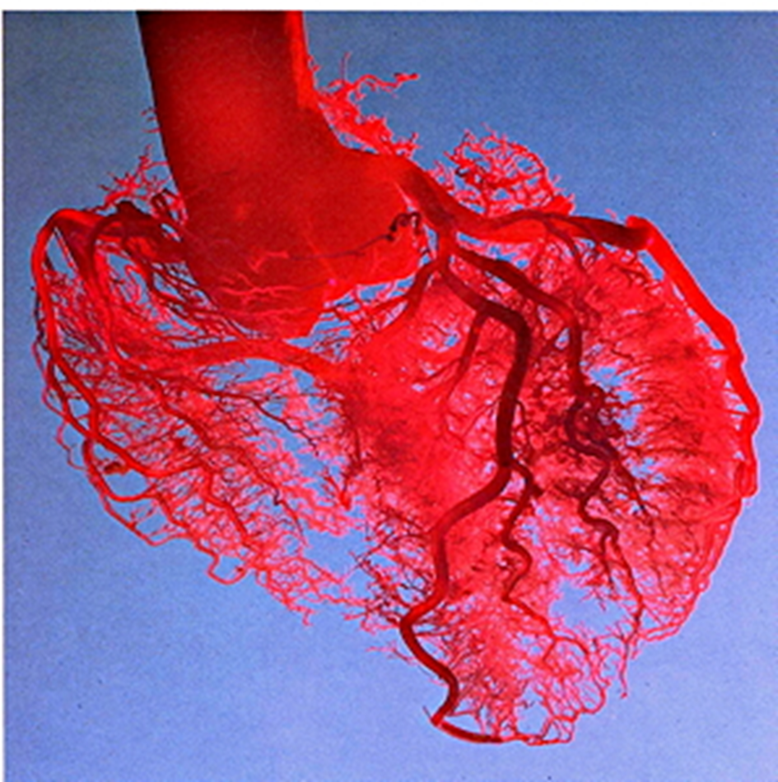
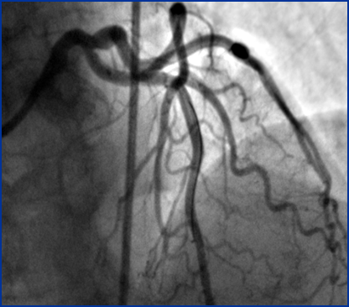
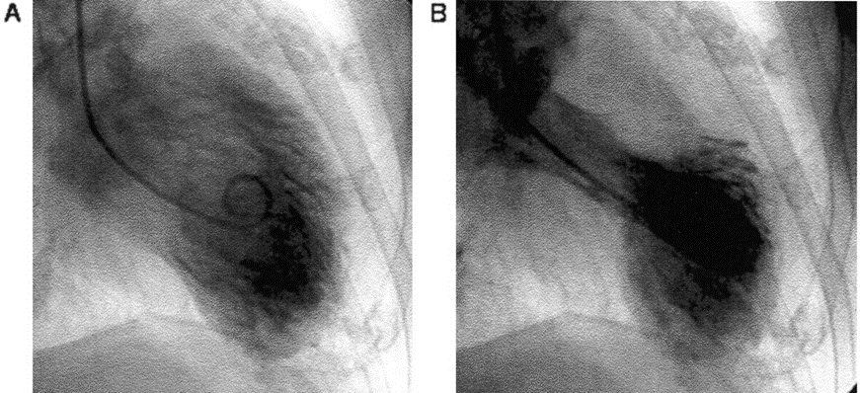
Women and Coronary Microvascular Dysfunction
INOCA/MINOCA
Ischemia with No Obstructive CAD (INOCA)
Myocardial Infarction with No Obstructive CAD (MINOCA)

Slide 12
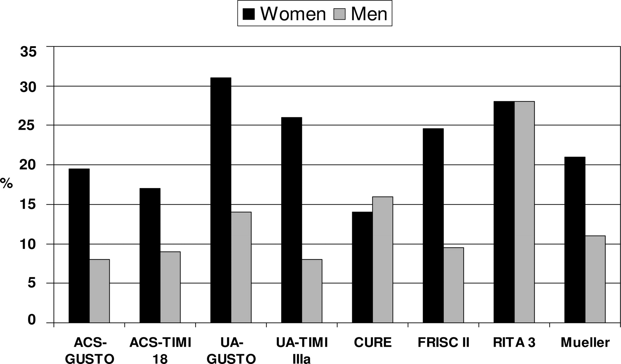
Prevalence of normal or non-obstructive coronary arteries:
common in women
Anderson RD et al. Circulation 2007;115:823-826
Notes:
Most of the trials show 20% or greater excess of normal or nonobstructive arteries in women vs men.

Slide 13
VA CART 37,674 male patients –
47% non-obstructive or normal coronary arteries
Now common in men!

Slide 14
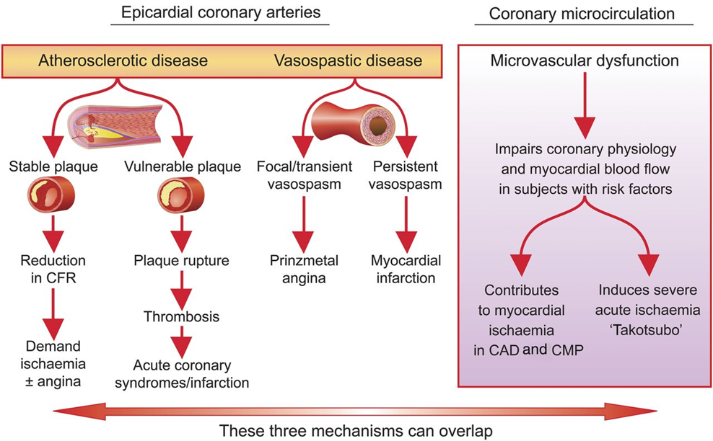
Mechanisms of Myocardial Ischemia (including INOCA)
Crea, Filippo, Paolo G. Camici, and Cathleen Noel Bairey Merz. "Coronary microvascular
dysfunction: an update." European heart journal (2013): eht513.

Slide 15
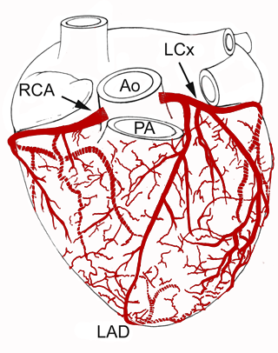
Coronary Vascular Resistance
Epicardial arteries normally contribute <10% of the coronary vascular resistance
  hemodynamic significance when >70% of the lumen is obstructed
Coronary microvasculature is responsible for >70% of the coronary resistance under physiological circumstances.
www.vhlab.umn.edu/
Gould KL et al. Am J Cardiol. 1974;33:87–94.
Camici P et al. Heart, Lung, and Circ. 2009;18:19-27

Slide 16
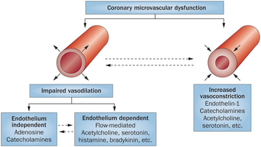
Coronary Microvascular Dysfunction
Crea, F, et al. Nature Reviews Cardiology. 2015;12:48–62.

Slide 17
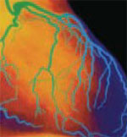
Mechanisms: Coronary Microvascular Dysfunction (CMD) is Prevalent in INOCA
Approximately 50% of patients with:
    persistent chest pain
    non-obstructive coronary artery disease
- have physiologic evidence of coronary microvascular dysfunction measured by abnormal coronary flow reserve (CFR) or coronary blood flow (CBF)
- prevalence is higher (70%) with evidence
of myocardial ischemia
Hasdai D et al. Mayo Clin Proc. 1998;73:1133-1140
Wei J et al. JACC Interventions. 2012;6(5):64

Slide 18
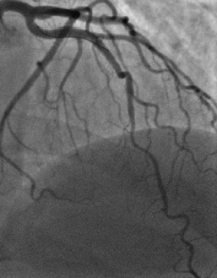
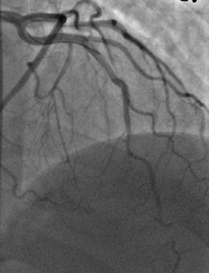
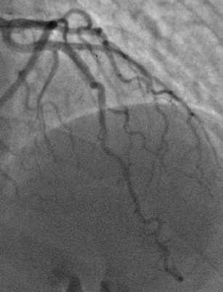
Case: Functional Coronary Angiography
Baseline
Adenosine
Nitroglycerin
mid LAD bridging and plaque on IVUS
Abnormal CFR 1.8, adenosine-induced vasoconstriction, chest pain but no ST-T changes
Resolution of vasoconstriction
Abnormal LVEDP = 18
Notes:
3/2012: Coronary Reactivity Testing:
Elevated LVEDP 18
low CFR 1.8 (normal >2.5) to low dose adenosine 18mcg
vasospasm in distal LAD, reversed by 200mcg followed by 300mcg of intracoronary nitroglycerin. No ST-T changes on EKG
mid LAD bridging and minimal plaque on IVUS

Slide 19
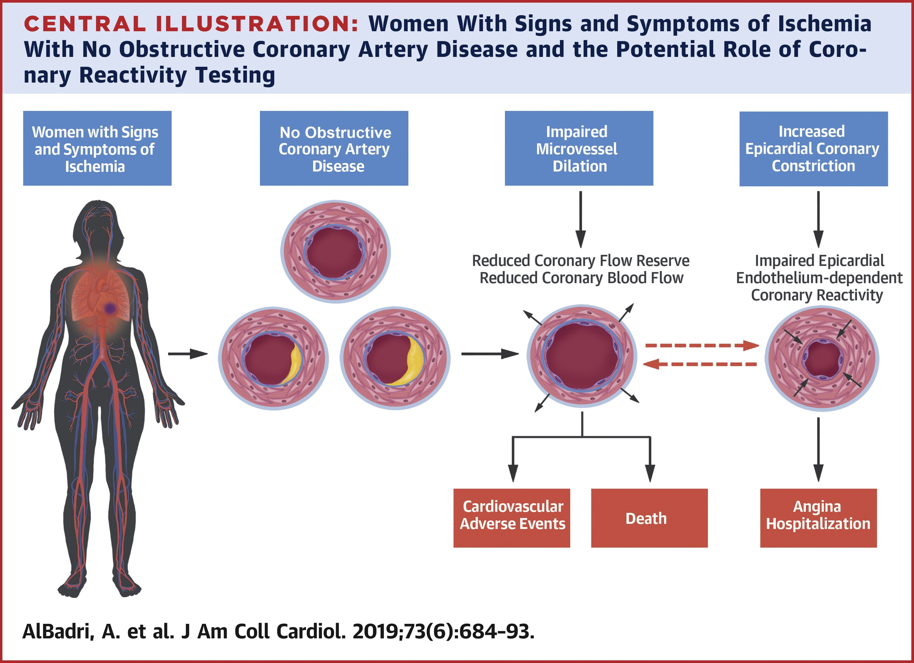

Slide 20
INOCA Treatment Knowledge Gaps
Coronary Microvascular Dysfunction is associated with elevated major cardiac event rate, persistent angina and elevated health costs
Observational and randomized intermediate outcome trials support therapeutic strategies
Existing guidelines focus on symptom management and current clinical practice is reassurance
Therapeutic clinical trials are needed

Slide 21
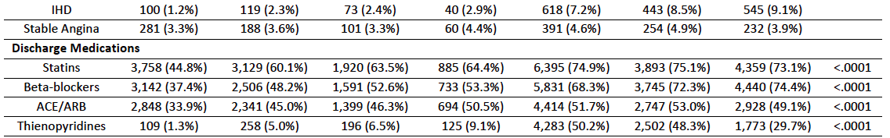
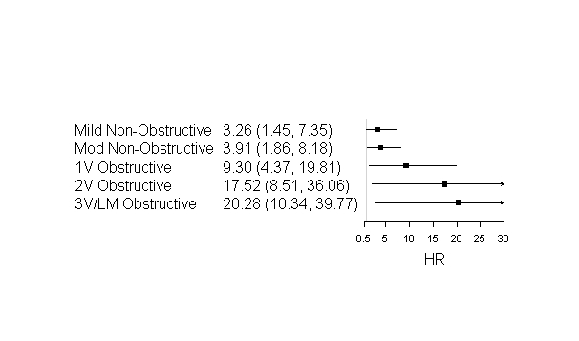
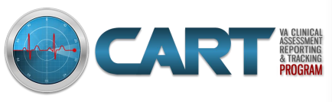
Observational Outcomes: Low use of optimal medical therapy and elevated 1-year MI rate following INOCA angiogram

Slide 22
WISE CMD Randomized Pharmacologic PROBE Trials
Trial (n) | Intervention | Results
QWISE¹ (n=78) | quinipril | ⬆ CFR; ⬇ angina
FemHRT-WISE ²(n=35) | ethinyl estradiol and norethindrone acetate | ➔ MRS; ⬇ angina
EWISE³ (n=41) | eplenerone | ➔CFR; ➔angina
SWISE⁴ (n=23) | sildenafil | ➔CFR; ➔angina
RWISE Pilot⁵ (n=20) | ranolazine | MPRI; ⬇angina
RWISE⁶ (n=128) | ranolazine | ➔MPRI; ➔angina
CFR = coronary flow reserve, MRS = magnetic resonance spectrosopy; myocardial perfusion reserve index; WISE = Women’s Ischemia Syndrome Evaluation. 1. Pauley AHJ 2011; 2. Bairey Merz AHJ 2010; 3. Bavry AHJ 2014; Denardo Clin Card 2011; 5. Mehta JACC Imaging; 6. Bairey Merz EHJ 2015
Notes:
Imaging results for 46-y-old woman who had history of diabetes mellitus, hypertension, high cholesterol, and smoking and was referred for evaluation of atypical chest pain and dyspnea. (A and B) Selected coronary angiographic views of left (A) and right (B) coronary arteries, without significant obstructive CAD. (C) Short-axis stress–rest myocardial perfusion images showing TID without significant regional perfusion abnormalities. Patient’s quantitative global CFR was 1.3.

Slide 23
DES in Stable Angina: ORBITA Trial
Change from Baseline | PCI | Sham | P Value
Exercise time (sec) | 28.4 | 11.8 | 0.200
Peak oxygen uptake (ml/min) | -2.0 | 10.9 | 0.741
SAQ Physical Limitation | 7.4 | 5.0 | 0.420
SAQ Angina Frequency | 14.0 | 9.6 | 0.260
SAQ Angina Stability | -4.2 | -5.1 | 0.851
Quality of Life | 0.03 | 0.03 | 0.994
Duke Treadmill Score | 1.22 | 0.10 | 0.104
Complete Freedom from Angina | 49.5% | 31.5% | <0.05
Compared with placebo, PCI improved stress echo by 1.07 segment units (p<0.00001),
with larger improvements in stress echo with lower levels of FFR and iFR (p_{interaction} <0.00001)
Al-Lamee R et al. Lancet 2018; 391: 31–40

Slide 24
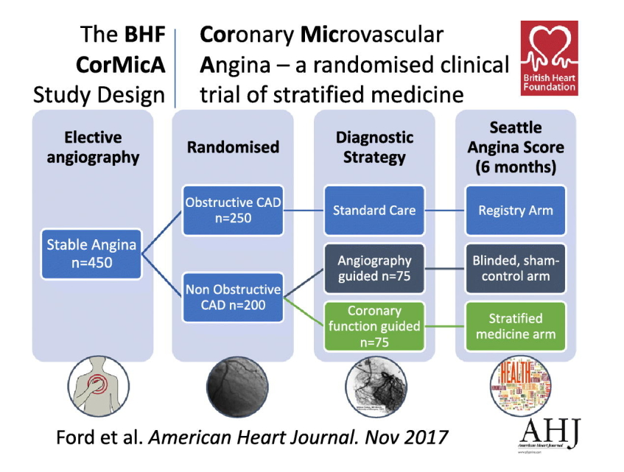
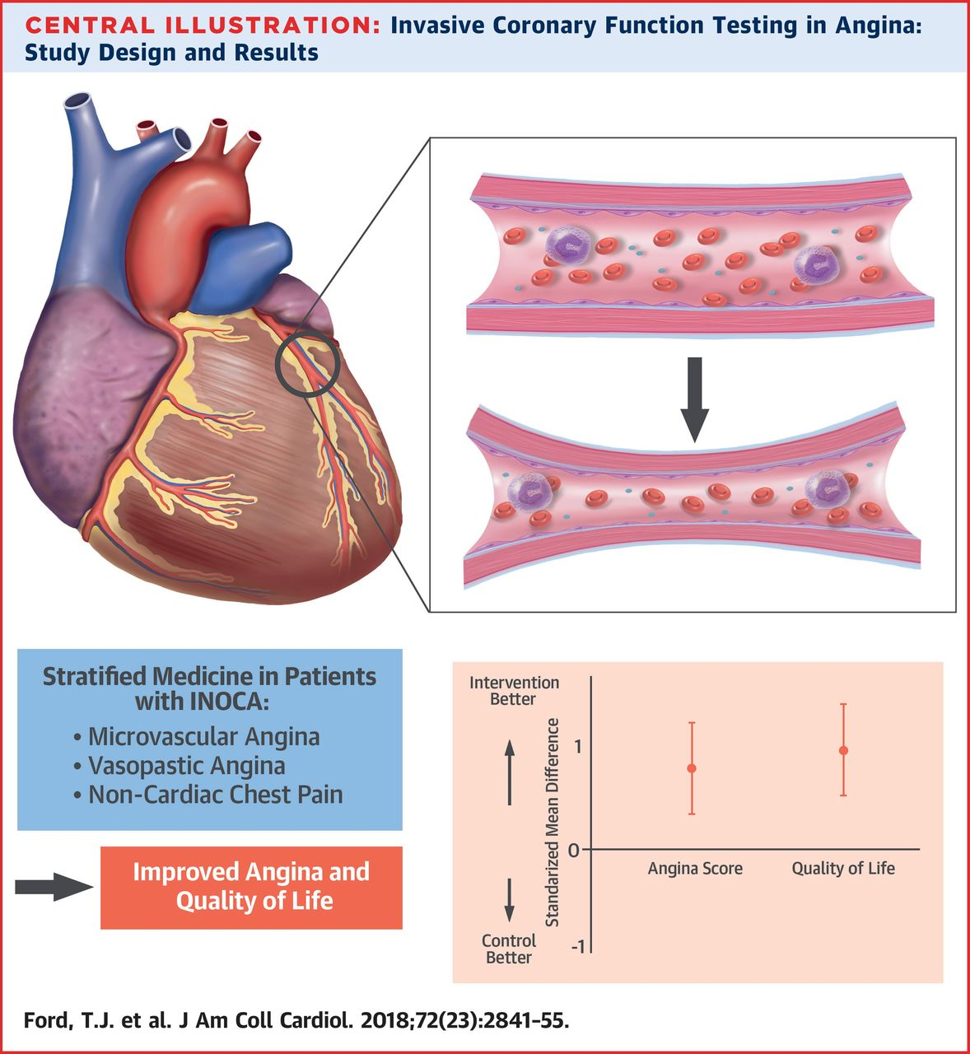
Randomized CRT Protocol Improves Angina Outcomes

Slide 25


WARRIOR: Women’s IschemiA TReatment Reduces Events In Non-ObstRuctive CAD Trial
Carl Pepine MD
Noel Bairey Merz MD
Eileen Handberg PhD
Rhonda Cooper-DeHoff PharmD
Janet Wei MD
John Spertus MD
Bernard Chaitman MD
William Weintraub MD
4,422 subjects with angina, no obstructive CAD randomized to IMT (intensive statin and ACE/ARB) vs GMT (guideline directed risk factor management) for reduction of MACE (all-cause death, non-fatal-MI, -stroke, or hospitalization for angina or HF)
Women’s Ischemia
Syndrome Evaluation
WISE

Slide 26
Coronary Microvascular Dysfunction: Prevalence and Unmet Needs
CMD is prevalent in >50% INOCA patients
ESC guidelines endorse treatment consistent with stable angina (SIHD) guidelines¹
Diagnostic testing and use of anti-anginal therapy improved angina and quality of life
Additional, novel anti-ischemic/anti-anginal therapies are needed
Large outcome trials are needed
¹Fox K et al. Eur Heart J 2006;27:1341-1381

