Slide 1
ORION-10
Inclisiran for subjects with ACSVD and elevated low-density lipoprotein cholesterol
RS Wright Rochester
D Kallend | Zurich | LA Leiter | Toronto | W Koenig | Munich
KK Ray | London | D Raal | Johannesburg | PL Wijngaard | Parsippany
JP Kastelein | Amsterdam
On behalf of the ORION-10 investigators

Slide 2
ORION-10: Background and rationale Challenges remain in ASCVD patients
ASCVD remains the leading cause of death globally¹
LDL-C lowering is the most effective intervention to change the course of ASCVD yet substantial residual risk remains despite aggressive treatment with statins and other agents.
Lifestyle modification and statin treatment are foundational for secondary prevention^{2,3}
Ezetimibe and monoclonal antibodies to PCSK9 are adjunctive strategies to reduce LDL-C and clinical events by multiple treatment guidelines⁴⁻⁶
Benjamin et al. Circulation 2019;139:e56-e528.
Grundy et al. Circulation 2019;139:e1082-e143.
Mach F et al. European Heart Journal 2019 doi:10.1093/eurheartj/ehz455
Cannon et al. N Engl J Med 2015;372:2387-97.
Sabatine et al. N Engl J Med 2017;376:1713-22.
Schwartz et al. N Engl J Med 2018;379:2097-107

Slide 3
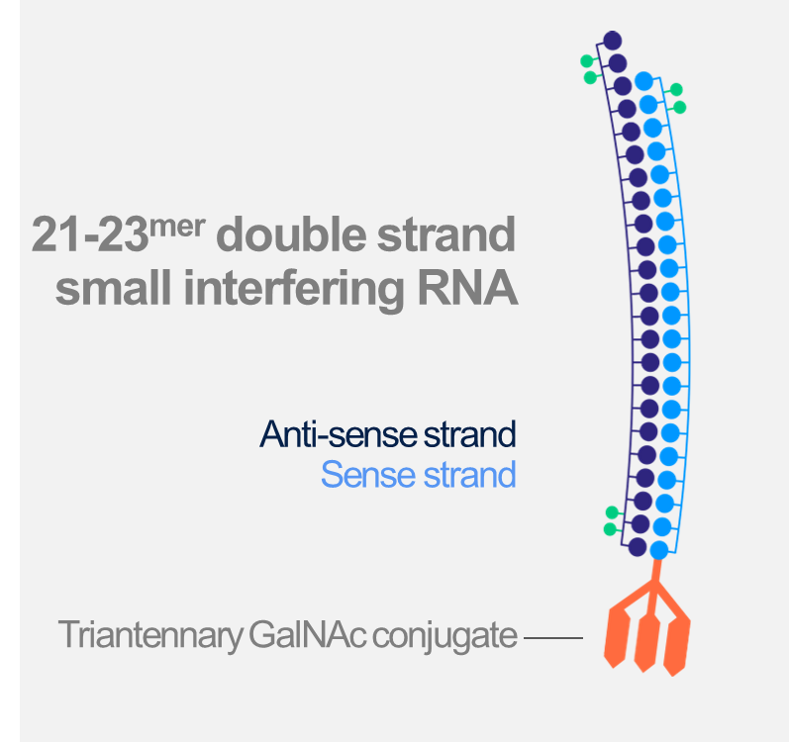
ORION-10: Background and rationale Harnessing the natural process of RNAi
Inclisiran
Small interfering double-stranded RNA¹
Harnesses the natural process of RNAi
Nucleotides modified for durability and low immunogenicity
Distributed to liver due to GalNAc conjugation
Inhibits production of PCSK9 in hepatocytes
Fitzgerald et al. N Engl J Med. 2016;376:41-51.

Slide 4
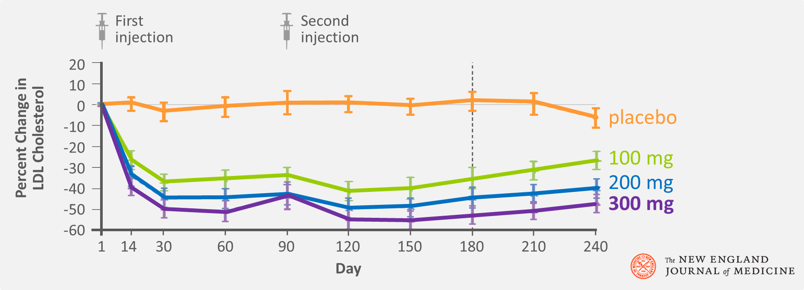
ORION-10: Background and rationale Phase I-II studies identified twice yearly dose potential
Selected data from ORION-1 dose finding study¹
Ray et al. N Engl J Med 2017; 376: 1430-40

Slide 5
ORION-10 Purpose
To assess efficacy and safety of inclisiran 300 mg compared to placebo in a high risk population of ASCVD subjects using an 18 month placebo controlled trial.

Slide 6
ORION-10: Study design 18 months treatment & observation in patients with ASCVD
Randomized 1:1 inclisiran 300 mg vs. placebo – with maximally tolerated statins
Screening
Day -14 to -1
Visit 1
Day 1
V2
Day 30
V3
Day 90
V4
Day 150
V5
Day 270
V6
Day 330
V7
Day 450
V8
Day 510
End of Study
Day 540 (V9)
90 days post last dose
Study
assessments

Slide 7
ORION-10: Entry criteria ASCVD patients not at LDL-C goal
Inclusion criteria |  | Exclusion criteria
Age ≥18 years |  | Prior or planned use of PCSK9 mAbs
ASCVD with LDL-C ≥70 mg/mL |  | MACE within 3 months of randomization
 |  | NYHA class III-IV HF ─ or LVEF 30%
Statin treatment Maximally tolerated doses, or Documented intolerance |  | Uncontrolled severe hypertension
 |  | Severe concomitant non CV disease
Ezetimibe allowed |  | Prior/planned other investigational drug
Informed consent required |  | Fasting TG >400 mg/mL (4.52mmol/L)

Slide 8
ORION-10: Objectives To confirm inclisiran efficacy and safety over 18 months
Study endpoints
1. Effectiveness |  | 2. Safety and tolerability
Primary |  | Treatment emergent adverse events
Percent LDL-C change vs. placebo |  | Laboratory parameters
At day 510
Average over days 90 – 540
Secondary |  | 3. Exploratory
LDL-C change over time |  | Cardiovascular events¹
Changes in PCSK9 and other lipids
1. MedDRA-defined cardiovascular non-adjudicated terms including cardiac death, and any signs or symptoms of cardiac arrest, non-fatal MI and/or stroke

Slide 9
ORION-10: Statistical plan Large sample enrolled to enable reliable inference
Sample size assumptions
Mean LDL-C reduction will be no less than 30 mg/dL (SD 20 mg/dL) with 5% drop outs
>90% power to detect 30% lowering of LDL-C level with one-sided α = 0.025
Primary endpoints
Family-wise type I error rate controlled using a sequential testing procedure
Sensitivity analysis for primary efficacy endpoints
Pre-specified imputation and analysis methods used to account for missing data
Safety observation of ~3000 inclisiran injections and 1125 years patient exposure

Slide 10
ORION-10: Patient disposition High proportion of patients completed the study
Abbreviated consort diagram
Medication not given 2
Other 14
Lost to follow-up 24
Withdrew consent 34
Died 11
Placebo
ITT 780
Safety 778
Completed 89%
Screened
2329
Randomized
1561
Screen failures 768
Entry criteria miss 704
Withdrew consent 46
Other 18
Inclisiran
ITT 781
Safety 781
Completed 92%
Died 12
Withdrew consent 24
Lost to follow-up 10
Other 14
Safety population comprises any subject given any study medication

Slide 11
ORION-10: Patients Representative high risk cohort balanced by randomization
Patient characteristic | Placebo |  | Inclisiran
ITT population¹ | N = 780 |  | N = 781
Age median (range) - years | 66 | (39-89) | 67 | (35-90)
Male gender | 548 | (70%) | 535 | (69%)
Diabetes | 331 | (42%) | 371 | (48%)
Heterozygous familial hypercholesterolemia | 69 | (9%) | 68 | (9%)
Lipid management treatment | 730 | (94%) | 748 | (96%)
Statins | 692 | (89%) | 701 | (90%)
Of which high intensity statins given | 546 | (79%) | 538 | (77%)
Ezetimibe use | 74 | (9%) | 80 | (10%)
Baseline LDL-C mg/dL (SD) | 105 | (37) | 105 | (40)
1. All patients who were randomized, analyzed according to randomization 2. SD is standard deviation

Slide 12
ORION-10
Efficacy results

Slide 13
Efficacy Highly significant lowering of LDL-C relative to placebo
Treatment group | N (ITT) | Percent change LDL-C
 |  | Mean at day 510
 |  | Observed | Imputed¹
Placebo | 780 | + 1 | + 1
Inclisiran | 781 | - 56 | - 51
Difference (1º endpoint) |  | - 58 | - 52
P-value |  | <0.00001
A wash-out model was used to account for missing data

Slide 14
ORION-10: Efficacy Highly significant lowering of LDL-C relative to placebo
Treatment group | N (ITT) | Percent change LDL-C
 |  | Mean at day 510 |  | Time-averaged day 90 - 540
 |  | Observed | Imputed¹ | Observed | Imputed²
Placebo | 780 | + 1 | + 1 | + 3 | + 3
Inclisiran | 781 | - 56 | - 51 | - 53 | - 51
Difference (1º endpoint) |  | - 58 | - 52 | - 56 | - 54
P-value |  | <0.00001 |  | <0.00001
A wash-out model was used to account for missing data
A pattern mixed model was used to account for missing data

Slide 15
ORION-10: Efficacy Durable and potent with consistent effect over 18 months
Percent change in LDL-C over time – observed values in ITT patients
Δ 58%
Time-averaged Δ 56%
P-value for placebo – inclisiran comparison at each time point <0.00001
All 95% confidence intervals are less than ±2% and therefore are not visible outside data points

Slide 16
ORION-10: Efficacy Potent, consistent LDL-C response to inclisiran
Individual patient responses contributing to primary endpoint -- 17 months
Placebo
Inclisiran

Slide 17
ORION-10
Safety results

Slide 18
ORION-10: Safety and tolerability Adverse event profile similar to placebo
Treatment emergent adverse event (TEAE) | Placebo |  | Inclisiran
Safety population¹ – AEs in ≥5% patients | N = 778 |  | N = 781
Patients with at least one TEAE | 582 | (75%) | 574 | (74%)
Diabetes mellitus adverse events | 108 | (14%) | 120 | (15%)
Hypertension | 42 | (5%) | 42 | (5%)
Back pain | 39 | (5%) | 39 | (5%)
Bronchitis | 30 | (4%) | 46 | (6%)
Upper respiratory tract infection | 38 | (5%) | 37 | (5%)
Dyspnea | 33 | (4%) | 39 | (5%)
Safety population includes all patients who received at least 1 dose of study medication
Other TEAEs reported with lower frequencies than 5% in any group had no clinically meaningful differences

Slide 19
ORION-10: Safety and tolerability Injection site AEs infrequent, mostly mild and transient
Injection site TEAEs | Placebo |  | Inclisiran |  | Δ
Safety population¹ | N = 778 |  | N = 781
Protocol-defined event | 7 | (0.9%) | 20 | (2.6%) | 1.7%
(Reaction, erythema, rash, pruritus, hypersensitivity)
Mild | 7 | (0.9%) | 13 | (1.7%) | 0.8%
Moderate | 0 | (0.0%) | 7 | (0.8%) | 0.8%
Severe | 0 | (0.0%) | 0 | (0.0%)
Persistent | 0 | (0.0%) | 0 | (0.0%)
Injection site pain
Vial + syringe (cycle 1+2) | 3 | (0.4%) | 18 | (2.1%) | 1.7%
Pre-filled syringe (cycle 3+4) | 1 | (0.1%) | 7 | (1.0%) | 0.9%
1. Safety population includes all patients who received at least 1 dose of study medication

Slide 20
ORION-10: Safety and tolerability No evidence of liver, kidney, muscle or platelet toxicity
Laboratory tests |  | Placebo |  | Inclisiran
Safety population^{1,2} |  | N = 778 |  | N = 781
Liver function | ALT >3x ULN | 2 | (0.3%) | 2 | (0.3%)
 | AST >3x ULN | 5 | (0.6%) | 4 | (0.5%)
 | ALP >2x ULN | 3 | (0.4%) | 5 | (0.6%)
 | Bilirubin >2x ULN³ | 3 | (0.4%) | 4 | (0.5%)
Kidney function | Creatinine >2 mg/dL | 30 | (3.9%) | 30 | (3.9%)
Muscle | CK >5x ULN | 8 | (1.0%) | 10 | (1.3%)
 | CK >10x ULN | 2 | (0.3%) | 1 | (0.1%)
Hematology | Platelet count <75x10⁹/L | 0 | (0) | 1 | (0.1%)
1. Safety population includes all patients who received at least 1 dose of study medication 2. Patients may be counted in more than one category
3. No cases met Hy’s Law

Slide 21
ORION-10: Safety and tolerability No difference in serious adverse events
Serious treatment emergent adverse events | Placebo |  | Inclisiran
Safety population^{1,2} | N = 778 |  | N = 781
Patients with at least one serious TEAE | 205 | (26.3%) | 175 | (22.4%)
All cause death | 11 | (1.4%) | 12 | (1.5%)
Cardiovascular | 5 | (0.6%) | 7 | (0.9%)
Cancer | 3 | (0.4%) | 1 | (0.1%)
New, worsening or recurrent malignancy | 26 | (3.3%) | 26 | (3.3%)
TEAEs leading to drug discontinuation | 17 | (2.2%) | 19 | (2.4%)
1. Safety population includes all patients who received at least 1 dose of study medication 2. Patients may be counted in more than one category

Slide 22
ORION-10: Exploratory endpoint Adverse cardiovascular events
Cardiovascular TEAEs | Placebo |  | Inclisiran
Safety population^{1,2} | N = 778 |  | N = 781
Pre-specified exploratory CV endpoint³ | 79 | (10.2%) | 58 | (7.4%)
Cardiovascular death | 5 | (0.6%) | 7 | (0.9%)
Fatal or non-fatal MI or stroke⁴ | 26 | (3.3%) | 32 | (4.1%)
1. Safety population includes all patients who received at least 1 dose of study medication 2. Patients may be counted in more than one category
3. MedDRA-defined CV basket of non-adjudicated terms cardiac death, and any signs or symptoms of cardiac arrest, non-fatal MI and/or stroke 4. Post hoc analysis

Slide 23
ORION-10: Summary Twice-a-year inclisiran lowered LDL-C by ≥50% safely
Efficacy
ORION-10 met all primary and secondary endpoints
Inclisiran reduced the primary LDL-C endpoint
At 17 months by 58% (observed values) and 52% (imputed)
From month 3 to 18 by 56% (observed) and 54% (imputed)
Safety and tolerability
Inclisiran safety profile was similar to placebo
No adverse changes in laboratory markers
Injection site events on inclisiran 2.6% - predominantly mild and none persistent
Numerically lower with prefilled syringe than with vial and syringe
Exploratory basket of CV events numerically less frequent on inclisiran than placebo

Slide 24
ORION-10: Conclusions and implications Inclisiran is the first and only cholesterol lowering siRNA
Inclisiran achieved durable and potent LDL-C reduction with twice yearly injection in ASCVD patients on appropriate lipid lowering therapies over 18 months of follow-up with a safety profile similar to placebo in a high risk cardiovascular population
Assuming FDA approval, twice yearly administration coincides with typical twice yearly patient visits with HCP’s
Inclisiran therefore potentially offers a novel new treatment for LDL-C
Pre-filled syringe convenient and well tolerated
Meaningful new choice for patients
HCP opportunities for influencing medication adherence in routine clinical practice
Safe, potent and durable LDL-C lowering results

Slide 25
ORION-10: Acknowledgements Contributions from 145 sites in the United States
Lead enrolling investigators
Aslam Ahmad | Northwest Houston Clinical Research |  | John Evans | East Coast Institute for Research
Ferris George | East Coast Institute for Research |  | John LeDoux | CB Flock Research
Matthew Teltser | A&R Research Group |  | David Ramstad | Hampton Roads Center for Clinical Research
Neil Fraser | Troy Internal Medicine |  | Jose Cardona | Indago Research and Health
Alan Miller | Alta Pharmaceutical Research Center |  | Andrew Waxler | Northridge Hospital Medical Center
Sara Llerena | Columbus Clinical Services |  | Mehrdad Ariani

Slide 26
Thank you

