Slide 1
Effect of BET Protein Inhibition With Apabetalone on Cardiovascular Outcomes in Patients With Acute Coronary Syndrome and Diabetes
Results of the BETonMACE Trial
American Heart Association Presentation
November 16, 2019

Slide 2
BETonMACE: Committees
Clinical Steering Committee
K. K. Ray (Chair) | S. J. Nicholls | H. Ginsberg | K. Kalantar-Zadeh
P. Toth | K. Buhr (Independent Statistician) |  |  | G. G. Schwartz
Non- Voting Members | M. Sweeney | N. C. W. Wong | J. O. Johansson
Clinical Events Committee
J McMurray (Chair) | M Petrie(Chair) | E Connolly | Ninian Lang
Pardeep Jhund | Matthew Walters
DSMB
E Lonn (Chair) | L Leiter | D Waters | P Watkins
J Currier | Ml Szarek

Slide 3
BETonMACE: Acknowledgements
Contributions from 13 countries at 195 sites:
Country | National Lead Investigator(s)
Argentina | A. Lroenzatti, M. Vico
Bulgaria | M. Milanova
Croatia | Z. Popovic, G. Melicevic
Germany | H. Ebelt
Hungary | R. G. Kiss
Israel | B. Lewis
Mexico | E. Bayram-Llamas
Poland | M. Banach
Russia | S. Tereschenko
Serbia | M. Pavlovic
Slovakia | D. Pella
Taiwan | C. E. Chiang

Slide 4
BET Protein Inhibition with Apabetalone Favorably Impacts Pathways Implicated in Cardiovascular and Kidney Disease
Cardiovascular & Renal Disease
Cardiovascular & Renal Disease
Complement System
Vascular Inflammation
Epigenetic
Regulation By
Apabetalone
Coagulation Cascade
Reverse Cholesterol Transport
Vascular Calcification
Acute Phase Response
Wasiak et al. 2017; Gilham et al. 2019;
Tsujikawa et al. 2019; Jahagirdar et al. 2014

Slide 5
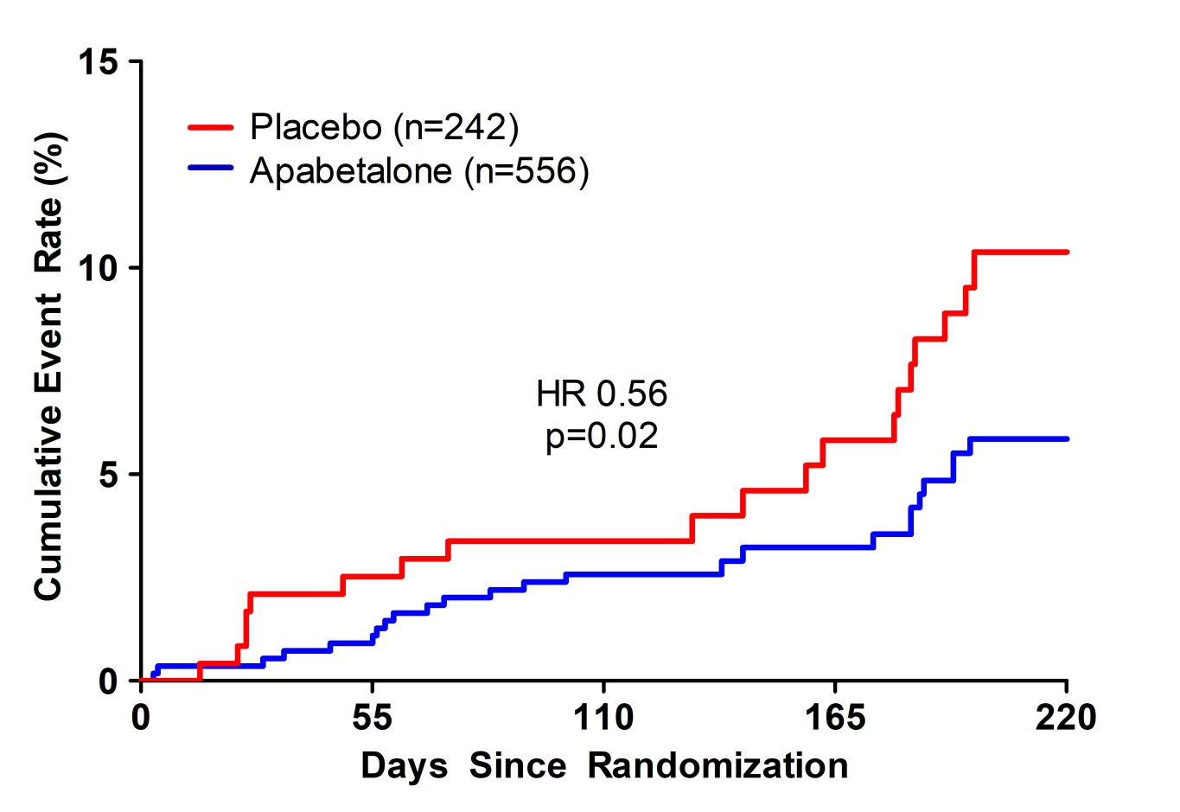
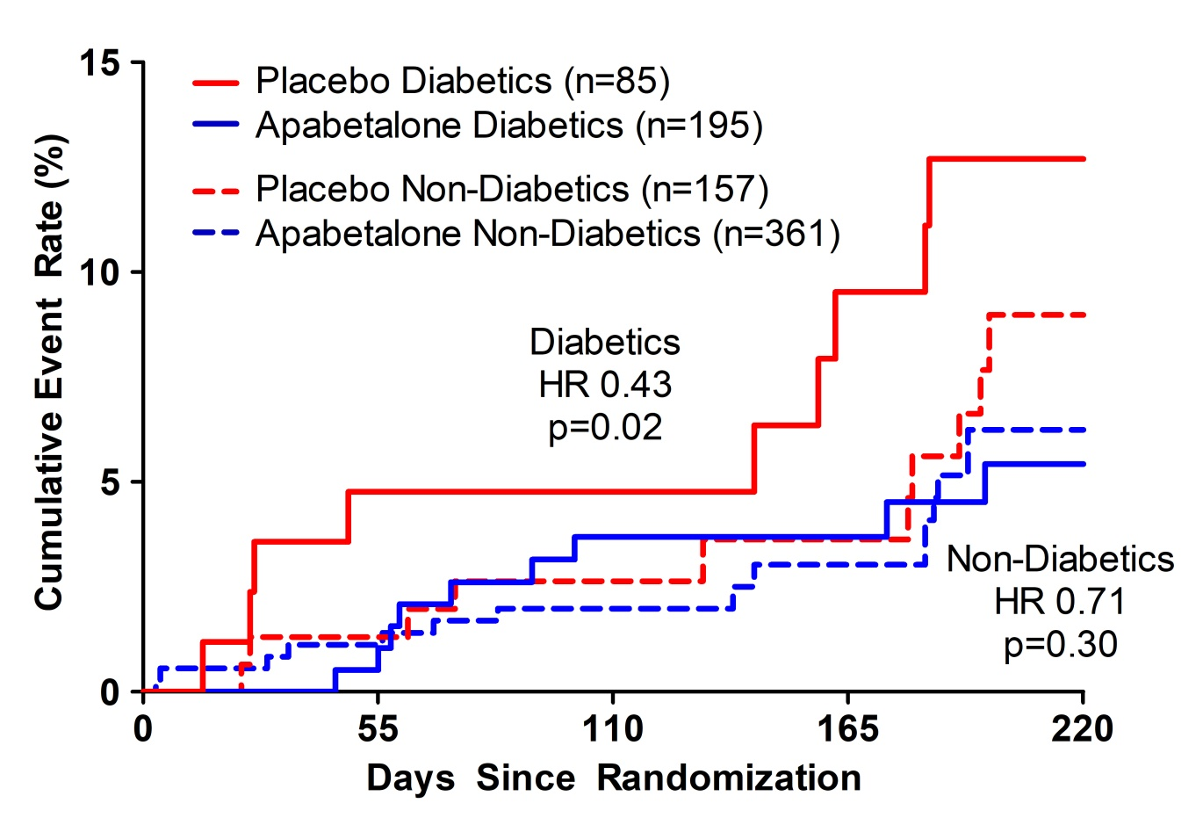
Phase 2 Trials Suggest Potential CV Benefit with Apabetalone
MACE Incidence in Total Patient Group
MACE Incidence by Presence of Diabetes
MACE (major adverse cardiovascular events) including death, myocardial infarction, coronary revascularization, and hospitalization for cardiovascular causes.
Other characteristics associated with greater effect of apabetalone in pooled Phase 2 were low HDL-C and high hsCRP
Data shown are aggregate from the following trials: ASSERT;ASSURE;SUSTAIN. Nicholls Am J Cardiovasc Drugs 2018
Notes:
“Based in part on these data, apabetalone was tested in patients with ACS, diabetes, and low HDL-C because of their high risk for recurrent events and because an inflammatory and prothrombotic state might be modified by BET inhibition.”

Slide 6
BETonMACE: Inclusion/ Exclusion Criteria
Key Inclusion Criteria
Type 2 Diabetes Mellitus
HbA1c >6.5% or history of diabetes medication use
Acute coronary syndrome 7-90 days prior to the screening visit
Unstable angina (limited to 25% of participants) or acute myocardial infarction
Low HDL cholesterol
<40 mg/dL (1.04 mmol/L) for males; <45 mg/dL (1.17 mmol/L) for females at the screening visit
Key Exclusion Criteria
Planned further coronary revascularization at time of screening visit
Previous or current diagnosis of severe heart failure (New York Heart Association Class IV)
Coronary artery bypass grafting within 90 days prior to Visit 1.
Severe renal impairment as determined by any one of the following:
eGFR <30 mL/min/1.7m² at screening visit
need for dialysis
Evidence of cirrhosis from liver imaging or biopsy, or liver transaminases (ALT or AST) >1.5x the upper limit of normal range at screening visit

Slide 7
BETonMACE: Study Endpoints
Primary Endpoint
Time to first occurrence of CV death or non-fatal MI or stroke
Pre-specified sensitivity analysis excluding deaths of undetermined cause from endpoint
Key Secondary Endpoints
Time to first 4-part MACE: primary endpoint + hospitalization for CV events*
Total (first and recurrent) non-fatal MI or stroke, and CV death
Time to first CV Death or Non-fatal MI
Time to first coronary heart disease death or non-fatal MI
Individual components of primary endpoint
All-cause death
Hospitalization for congestive heart failure (CHF)
*Unstable angina or urgent or emergency coronary revascularization at least 30 days after the index ACS

Slide 8
Statistical assumptions
A sample size of 2400 randomized subjects was predicted to yield 80% power for the primary analysis under the following assumptions:
Total number of events: 250
2-sided type 1 error rate: α=5%
10.5% event rate in the placebo arm at 18 months
30% relative risk reduction (7.47% event rate at 18 months in the apabetalone arm)

Slide 9
BETonMACE: Study Design
Screening Period
Follow-Up
Period
Treatment Period
Active Arm:
apabetalone 100 mg b.i.d +
standard of care
N=2425
1:1 Randomization
End of Treatment
Statin Run-in
40-80 mg
atorvastatin
or
20-40 mg
rosuvastatin
Placebo Arm:
matching placebo
+
standard of care
1-2 weeks
Until 250 adjudicated primary events
3-5 weeks

Slide 10
BETonMACE: Patient Disposition
Completed
n = 1,083 (89.8%)
Placebo
n = 1,206
Reason for non-completion
Adverse Event | 3
Withdrew Consent | 24
Lost to Follow-up | 13
Died | 72
Other | 15
Randomized in error: 4
Screened
n = 3,937
Randomized
n = 2,425
Screen Failures | n=1,512
HDL-C |  | 998
Bilirubin |  | 136
Triglycerides |  | 60
Withdrew Consent |  | 151
Other |  | 167
Apabetalone
n = 1,212
Completed
n = 1,088
(89.8%)
Randomized in error: 3
Reason for non-completion
Adverse Event | 2
Withdrew Consent | 31
Lost to Follow-up | 7
Died | 61
Other | 26
95.7% of randomized patients had full ascertainment of the primary outcome
through the planned observation period or else were known to be deceased
Vital status known for 99.2% of randomized patients

Slide 11
Baseline Characteristics, Prior Medical and Index ACS History
 | Apabetalone (n=1212) | Placebo (n=1206)
Median age, yrs | 62.0 | 62.0
Male sex- % | 74.8 | 74.0
Body mass index, kg/m² | 30.2 | 30.3
Hypertension - % | 89.4 | 87.8
eGFR Mean ± SD, mL/min/1.73m² | 104.9 | 101.7
Duration of diabetes – yrs | 8.4 | 8.7
Index acute coronary syndrome – %
Myocardial infarction | 73.0 | 74.0
STEMI | 38.4 | 38.6
NSTEMI | 34.1 | 35.1
Unstable angina | 26.7 | 25.0
PCI for index acute coronary syndrome | 79.8 | 79.2
Time from index ACS to randomization – days | 38 | 38

Slide 12
Baseline Characteristics: Cardiovascular and Diabetes Medications
Cardiovascular and Diabetes Medications (%) | Apabetalone (N=1212) | Placebo (N=1206)
Atorvastatin | 51.2 | 51.4
Rosuvastatin | 48.8 | 48.6
High intensity statin | 89.9 | 90.5
ACE inhibitors/ angiotensin II blockers | 92.3 | 92.0
Beta blockers | 91.0 | 90.2
Antiplatelet agents | 98.7 | 99.1
Dual antiplatelet agents | 87.2 | 88.3
Metformin | 83.3 | 82.0
Insulin | 36.7 | 38.5
Sulfonylureas | 30.0 | 28.5
DPP4 inhibitors | 14.9 | 14.8
SGLT2 inhibitors | 12.4 | 12.3
GLP1 receptor agonists | 3.4 | 3.7

Slide 13
BETonMACE: Baseline Laboratory Parameters
Baseline Laboratory Parameters | Apabetalone (n=1212) | Placebo (n=1206)
HbA1c, % | 7.4 (6.8-8.7) | 7.3 (6.4-8.6)
eGFR, ml/min/1.73m² † | 104.9 ± 39.3 | 101.7 ± 38.6
Total cholesterol, mg/dL | 134.8 ± 35.3 | 136.8 ± 38.2
LDL cholesterol, mg/dL | 69.7 ± 29.8 | 70.9 ± 32.4
HDL cholesterol, mg/dL | 33.3 ± 5.1 | 33.3 ± 5.1
Triglycerides, mg/dl | 144.4 (110.7-194.9) | 149.7 (116.0-201.9)
Alkaline phosphatase, U/L | 83.3 ± 38.2 | 81.9 ± 34.8
Alanine aminotransferase, units/L | 25.3 ± 14.3 | 25.4 ± 14.7
Total bilirubin, µmol/L | 9.8 ± 4.2 | 9.9 ± 4.2
High sensitivity C-reactive protein § | 2.9 (1.3-5.9) | 2.7 (1.1-6.1)
† Estimated glomerular filtration rate (eGFR) was calculated using the Cockcroft Gault method,
based on age and weight at baseline.
§ High-sensitivity C-Reactive Protein was assessed in only a subset of patients. Triglycerides expressed as median and IQR

Slide 14
BETonMACE: Efficacy Results

Slide 15
Change in Biochemical Parameters (from baseline at 100 weeks)
Biochemical parameters | Apabetalone (n=1212) | Placebo (n=1206) | P value Change from baseline
HDL cholesterol, mg/dL | +16.2% | +10.4% | 0.001
LDL cholesterol, mg/dL | +11.5% | +14.9% | 0.35
eGFR, ml/min/1.73m² | -0.4 | +2.1 | 0.03
Hemoglobin A1c, % | +0.05 | +0.15 | 0.32
Serum glucose, mg/dL | +4.4% | +7.8% | 0.74
Alkaline phosphatase, U/L | -4.8 | +2.2 | 0.003
hCRP § | -17.1% | -16.7% | 0.72
Changes are % changes where indicated (%) otherwise absolute changes if not specified
§-at 52 weeks, only at centers in Hungary and Argentina

Slide 16
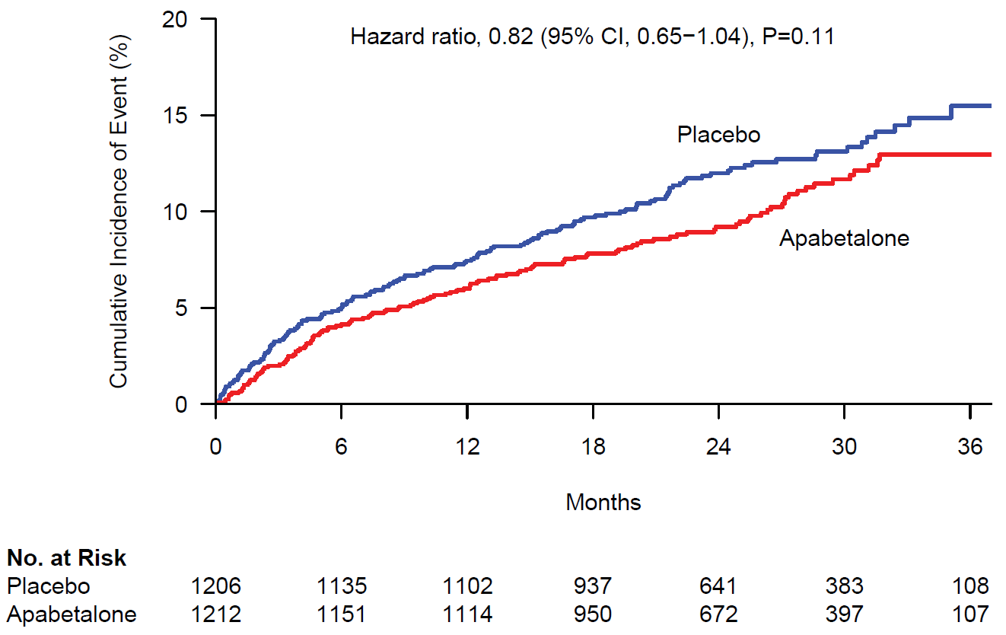
Primary Efficacy End Point: CV Death, Non-Fatal MI and Stroke (N=274)
Median follow-up
26 months
Primary Endpoint:
Placebo 12.4%
Apabetalone 10.3%

Slide 17
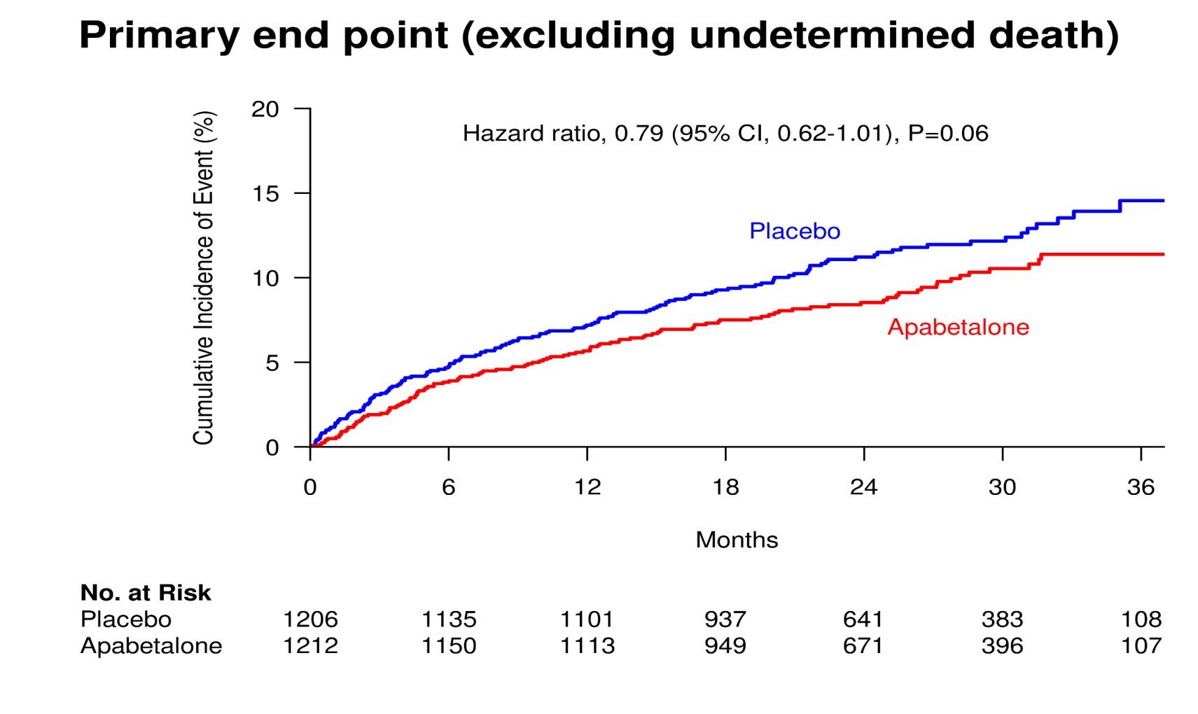
Prespecified Primary End Point Sensitivity Analysis: Excluding Deaths of Undetermined Cause
CV Death (excluding death of undetermined cause), non-fatal MI, or stroke

Slide 18
End Points
Primary End Point | Apabetalone | Placebo | Hazard Ratio (95% CI)
 | no. of events (%)
First occurrence of primary end point | 125 (10.3%) | 149 (12.4%) |  | 0.82 [0.65, 1.04] p=0.11
First occurrence of primary end point, excluding undetermined death | 113 (9.3%) | 140 (11.6%) |  | 0.79 [0.62, 1.01]
Key Secondary End Points
First occurrence of primary end point or hospitalization for unstable angina or urgent or emergency revascularization procedure | 144 (11.9%) | 166 (13.8%) |  | 0.85 [0.68, 1.06]
First and recurrent primary end point events | 171 | 203 |  | 0.79 [0.60, 1.06]
Cardiovascular death or non-fatal myocardial infarction | 112 (9.2%) | 139 (11.5%) |  | 0.79 [0.61, 1.01]
Coronary heart disease death or non-fatal myocardial infarction | 110 (9.1%) | 136 (11.3%) |  | 0.79 [0.61, 1.02]
Non-fatal myocardial infarction | 77 (6.4%) | 94 (7.8%) |  | 0.80 [0.59, 1.08]
Cardiovascular death | 45 (3.7%) | 55 (4.6%) |  | 0.81 [0.54, 1.19]
Stroke | 17 (1.4%) | 17 (1.4%) |  | 1.01 [0.52, 1.98]
All cause mortality | 61 (5.0%) | 69 (5.7%) |  | 0.88 [0.62, 1.24]
First hospitalization for congestive heart failure | 29 (2.4%) | 48 (4.0%) |  | 0.59 [0.38, 0.94]
Apabetalone Better
Placebo Better

Slide 19
Primary End Point in Pre-specified Subgroups
Subgroup | Apabetalone | Placebo | Hazard Ratio (95% CI) |  | P Value
 | no. of events/patients (%)
Sex
Female | 23/305 (7.5%) | 32/313 (10.2%) |  | 0.79 [0.46, 1.36] | 0.70
Male | 102/907 (11.2%) | 117/893 (13.1%) |  | 0.84 [0.64, 1.10]
Statin
Rosuvastatin | 62/591 (10.5%) | 71/586 (12.1%) |  | 0.86 [0.62, 1.22] | 0.67
Atorvastatin | 63/621 (10.1%) | 78/620 (12.6%) |  | 0.78 [0.56, 1.09]
LDL cholesterol
< Median | 48/595 (8.1%) | 78/597 (13.1%) |  | 0.60 [0.42, 0.86] | 0.024
≥ Median | 77/618 (12.5%) | 71/606 (11.7%) |  | 1.06 [0.77, 1.46]
Hemoglobin A1c
< Median | 51/563 (9.1%) | 60/595 (10.1%) |  | 0.88 [0.60, 1.28] | 0.79
≥ Median | 73/639 (11.4%) | 85/599 (14.2%) |  | 0.82 [0.60, 1.12]
Estimated glomerular filtration rate
< 60 | 13/124 (10.4%) | 35/164 (21.3%) |  | 0.50 [0.26,0.96] | 0.032
≥ 60 | 112/1084 (10.3%) | 114/1041 (11.0%) |  | 0.94 [0.73, 1.22]
Apabetalone Better
Placebo Better

Slide 20
Safety Overview
Variable | Apabetalone (n=1212) | Placebo (n=1207)
Adverse events - n (%)
Patients with at least one adverse event | 830 (68.5) | 820 (67.9)
Adverse event leading to discontinuation | 114 (9.4) | 69 (5.7)
Serious adverse events – n (%)
Patients with at least one SAE | 354 (29.2) | 339 (28.1)
Death | 61 (5.0) | 72 (6.0)
Cardiovascular deaths | 34 (2.8) | 42 (3.5)
Liver Function
ALT >3x ULN | 78 (6.4) | 18 (1.5)
ALT >5x ULN | 40 (3.3) | 9 (0.7)
Bilirubin >2x ULN | 7 (0.6) | 9 (0.7)
Hy’s law | 0 | 0
Discontinuation due to LFT elevation – n (%) | 35 (2.9) | 11 (0.9)

Slide 21
BETonMACE Summary
Apabetalone did not have a significant effect on incidence of the primary endpoint (CV death, non-fatal MI or stroke)
Observed event rate in placebo group (9.7%) was somewhat lower than anticipated (10.5%) at 18 months
Study was powered on a 30% reduction in risk of primary endpoint, and was underpowered to detect a smaller difference in events
Apabetalone was generally well tolerated with an overall incidence of adverse events similar to that in the placebo group. However, discontinuation of treatment due to elevated liver function tests was more frequent with apabetalone.

Slide 22
BETonMACE Conclusions
First cardiovascular outcomes trial assessing the potential of epigenetic modification with BET protein inhibition shows promise
Favorable trends were observed for the primary endpoint and key components except stroke with a nominal difference in heart failure hospitalization
Further studies of this approach are warranted

