Slide 1
Dean J. Kereiakes, Timothy D Henry, Anthony DeMaria, Marilyn Carlson, Linda H Martin, Jeff Midkiff, Mason Dixon, Barry S. Coller
First Human use of a Novel Subcutaneous Platelet GPIIb/IIIa Inhibitor (RUC-4) Designed for STEMI Point of Care Treatment
The Christ Hospital Heart & Vascular Center,
The Carl & Edyth Lindner Center for Research and Education, Cincinnati, Ohio

Slide 2
Disclosures
The Christ Hospital/ Lindner Research Center
has received research grants to perform this trial

Slide 3
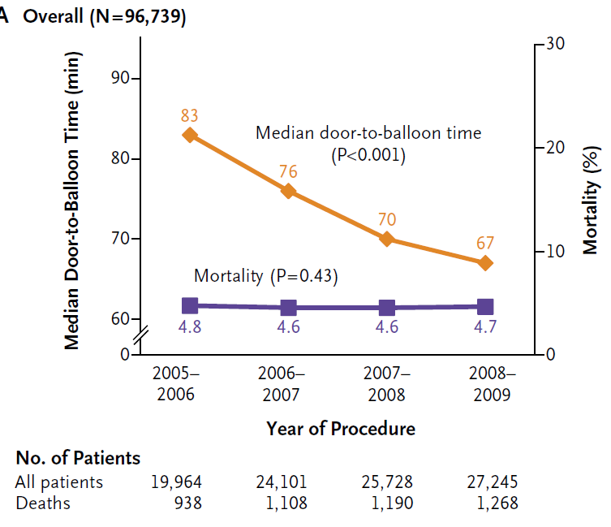
Door to Balloon Times* and Mortality Following PPCI
Menees et al. NEJM 2013;369:901-9
*2017 average <60 min (new focus on total ischemic time)

Slide 4
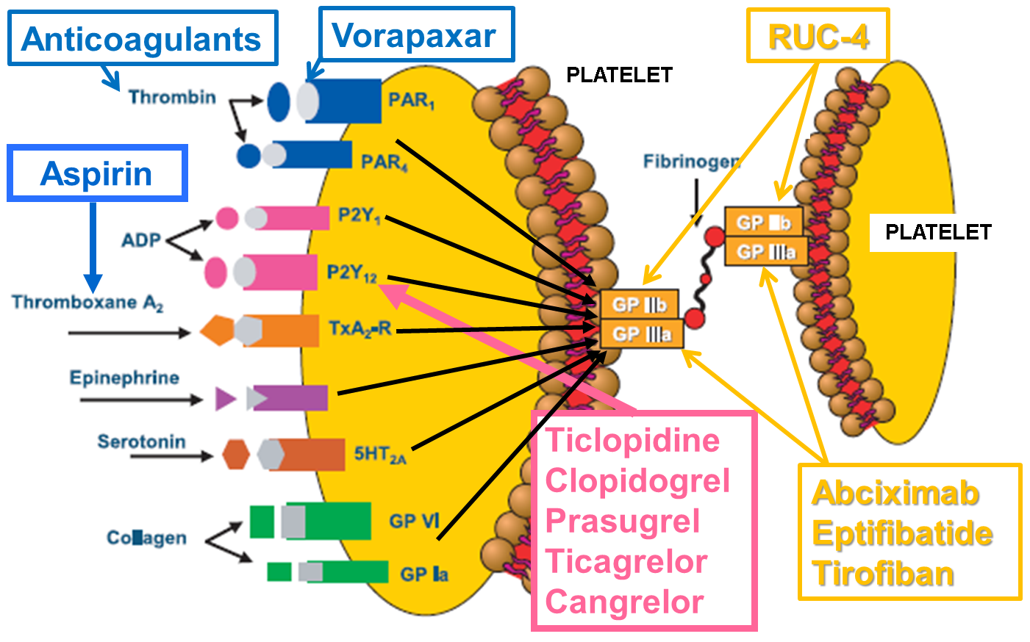
Platelet Receptors and Antiplatelet Agents
(Adapted from Chintala M., J Pharmacol Sci. 108:433, 2008)
TRAP

Slide 5
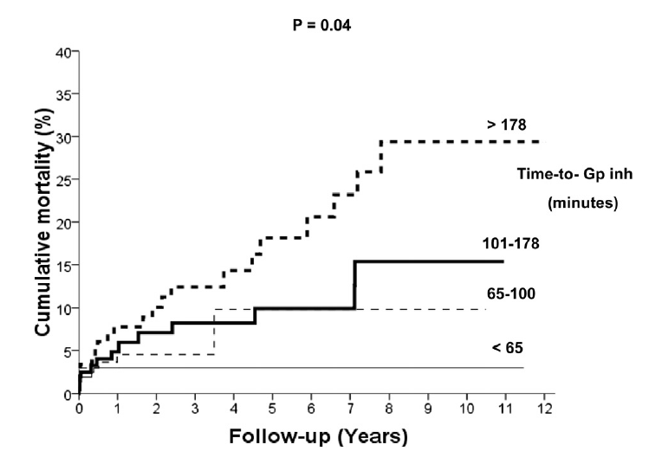
Mortality as a Function of Time-to-GPIIb/IIIa Antagonist Treatment in STEMI
Unadjusted p=0.007
Adjusted p=0.04
N=814
De Luca et al., Am J Cardiol, 2015;115:711

Slide 6
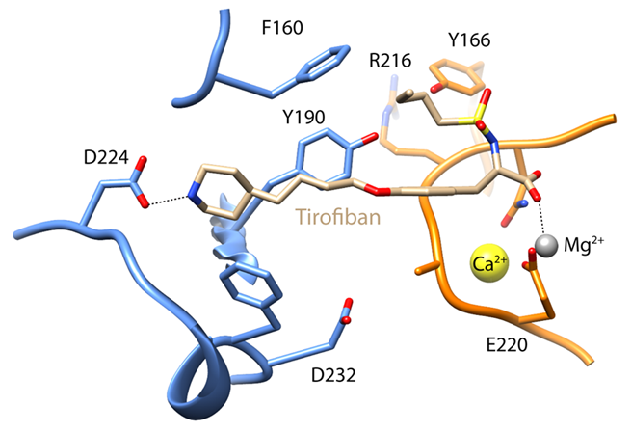
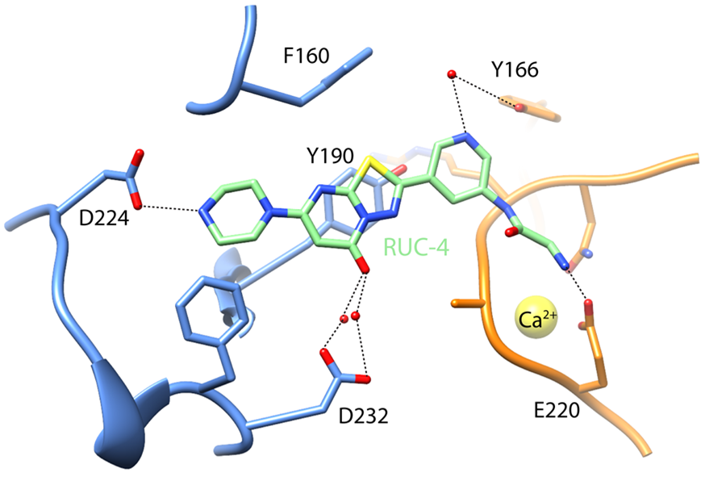
RUC-4: A Unique GPIIb/IIIa (αIIbβ3) Antagonist Designed for Point of Care Therapy of STEMI
Tirofiban
Small molecule designed to:
  Potently inhibit fibrinogen binding and platelet aggregation
  Lock the receptor in its inactive conformation with potential benefits of less thrombocytopenia and greater efficacy (displaces rather than binds Mg²⁺)
Active when administered subcutaneously to facilitate point-of-care use
High solubility so total dose can be administered in less than 1 ml by autoinjector.
RUC-4

Slide 7
Study Objectives
Primary Objective:
· Assess safety and tolerability of RUC-4 administered subcutaneously (SC) in healthy volunteers and subjects on aspirin with stable coronary artery disease (CAD) at escalating doses until a weight-adjusted (mg/kg) biologically effective dose (BED)* or maximum tolerated dose (MTD) is identified.
Secondary Objectives:
· Assess the pharmacokinetics (PK) and pharmacodynamics (PD) of escalating doses of RUC-4 administered SC in healthy volunteers and subjects on aspirin with stable CAD until a weight adjusted (mg/kg) BED or MTD is reached.
* Dose of RUC-4 leading to ≥80% inhibition of ADP-induced platelet aggregation within 15 minutes of SC administration with return toward baseline values ≤ 4 hours

Slide 8
RUC-4 Phase 1 Dose Escalation Study Design
Healthy Volunteers
Dose (mg/kg):
0.05 □ □ □ □ □ □ □
0.075 □ □ □ □ □ □ □
Patients with Stable Coronary Artery Disease on Aspirin
Dose (mg/kg):
0.04 □ □
0.05 □ □ □ □ □ □ □
0.075 □ □ □ □ □ □ □
Open Label Sentinel Group
Randomized 4 RUC-4-1 Placebo
Weight 52-72 kg □ □ □ □ □ □ □
Weight 100-120 kg □ □ □ □ □ □ □
Stable CAD Patients on Aspirin Dose Extension: 0.075 mg/kg

Slide 9
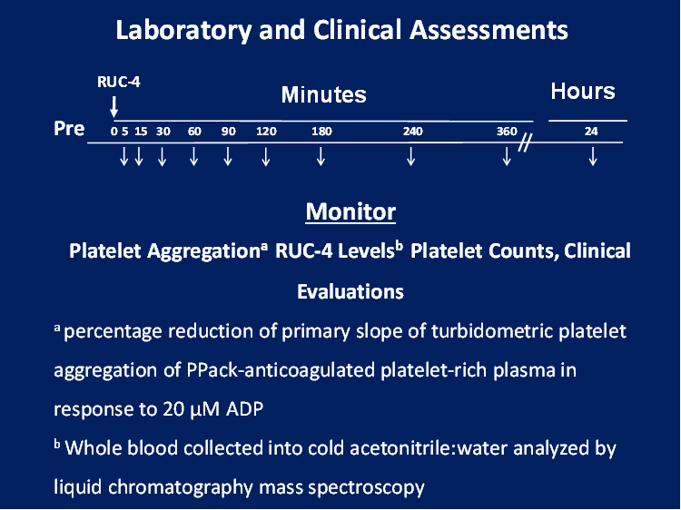

Testing Assessments
Laboratory and Clinical Assessments
RUC-4
Minutes Hours
Pre 0 5 15 30 60 90 120 180 240 360 24
//
Monitor
Platelet Aggregationª RUC-4 Levels^{b} Platelet Counts, Clinical Evaluations
ªpercentage reduction of primary slope of turbidometric platelet aggregation of Ppack-anticoagulated platelet-rich plasma in response to 20µM ADP
^{b}Whole blood collected into cold acetonitrile:water analyzed by liquid chromatography mass spectroscopy

Slide 10
Demographics and Baseline Characteristics
Healthy Volunteers (n=14)
Stable CAD Patients on Aspirin (n=30)
Parameter
Median Age, years (min, max)
Male/Female, n (%)
Weight, kg (SD)
Mean BMI, kg/m² (SD)
Type 2 diabetes mellitus, n (%)
45.1 (18,70)
9 (64.3) / 5 (35.7)
84.3 (14.5)
29.0 (4.9)
0 (0)
64.9 (47,75)
21 (70.0) / 9 (30.0)
90.0 (19.6)
29.5 (4.8)
2 (6.7)

Slide 11
Correlation Between IPA and RUC-4 Concentration

Slide 12
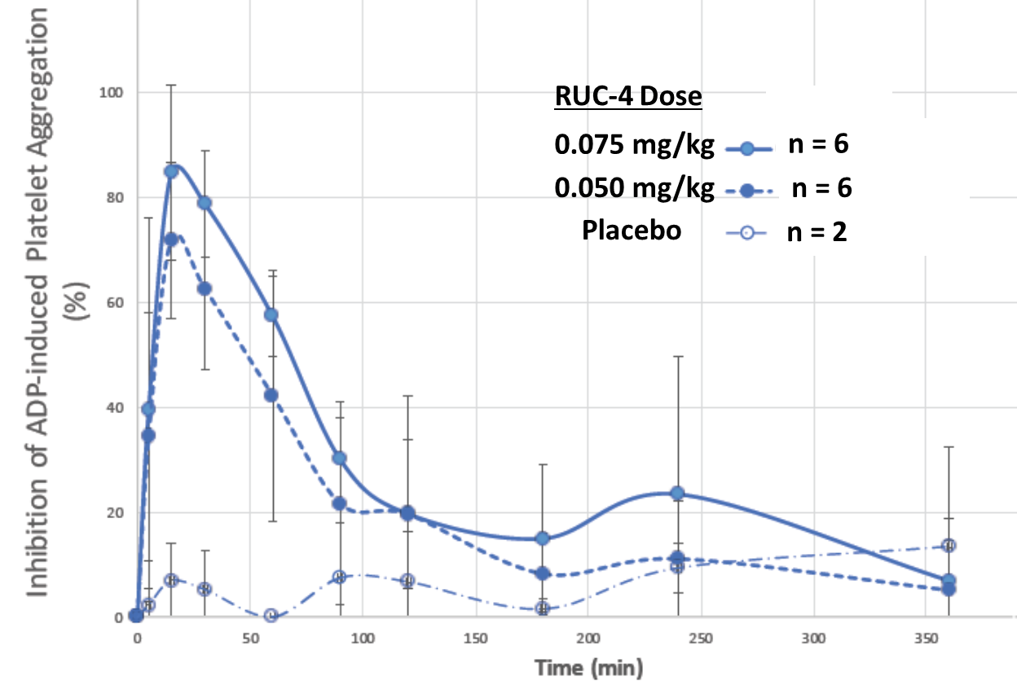
Inhibition of ADP-Induced Platelet Aggregation Over Time After SC RUC-4 in Healthy Volunteers

Slide 13
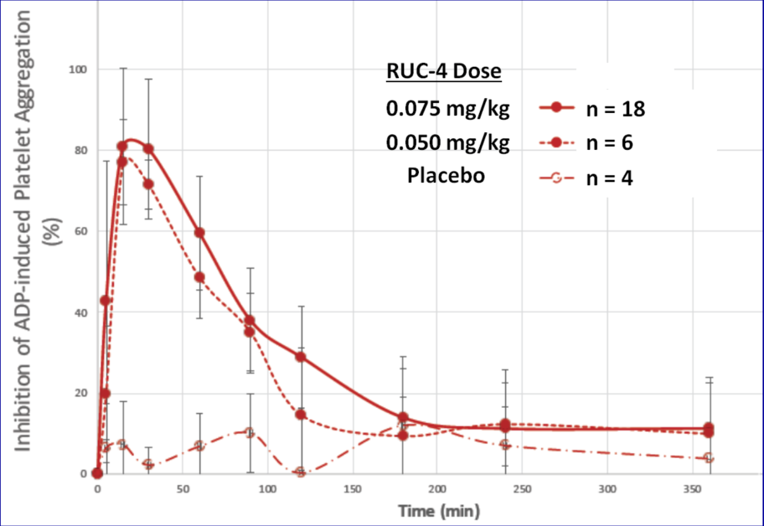
Inhibition of ADP-Induced Platelet Aggregation Over Time After SC RUC-4 in Patients with Stable Coronary Artery Disease on Aspirin
*
* Median IPA 88%

Slide 14
Effect of Gender, Weight, BMI, Aspirin on Clearance*
Only weight significantly influenced the pharmacokinetic model
Weight (Kg)
BMI
Sex
Population
Male Female
Male Female
No Aspirin Aspirin
* Clearance = AUC/ Total Dose

Slide 15
Safety:RUC-4 was Well-tolerated by Healthy Volunteers and Patients with Stable CAD on Aspirin
No drug-related changes in laboratory values, platelet counts, ECGs
No serious adverse events (SAEs)
The majority of AEs were mild, none led to study discontinuation
Bleeding events were uncommon, mild (modified BARC type 1) and limited to the injection site (n=3)
Injection site reactions, including bruising, were mild
Daily aspirin (81 mg or 325 mg) use did not increase bleeding

Slide 16
Conclusions
RUC-4 provides rapid (<15 minutes), high grade (>80%) platelet inhibition that resolves within 2 hours
RUC-4 PK/PD are not significantly affected by aspirin
RUC-4 appears safe and well tolerated with no significant bleeding, adverse events, or injection site reactions: hemoglobin levels and platelet counts remained stable
The results of this Phase 1 trial help identify RUC-4 dose(s) for a planned Phase 2 study in STEMI

Slide 17
Backups

Slide 18
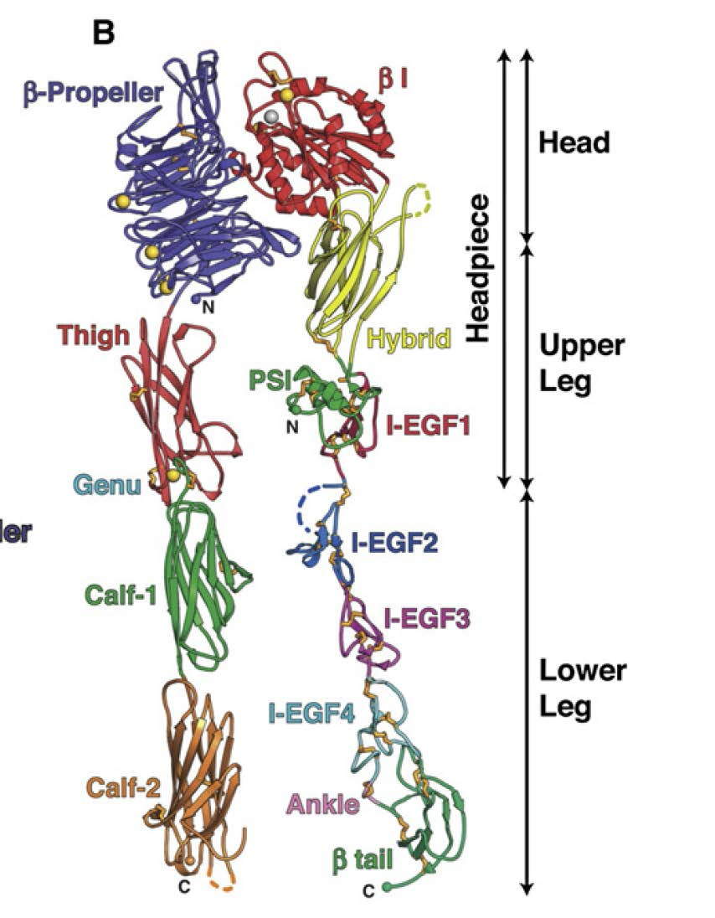
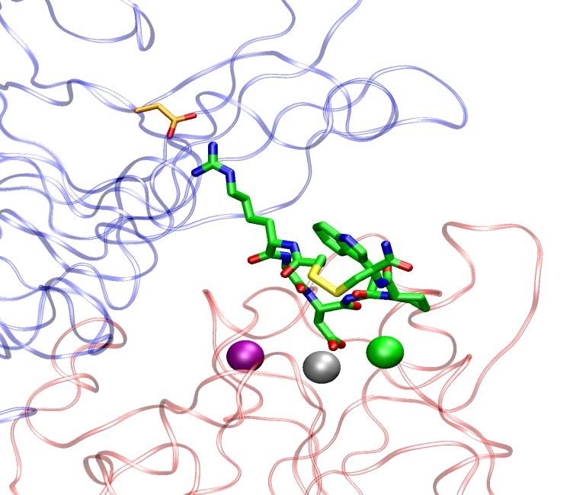
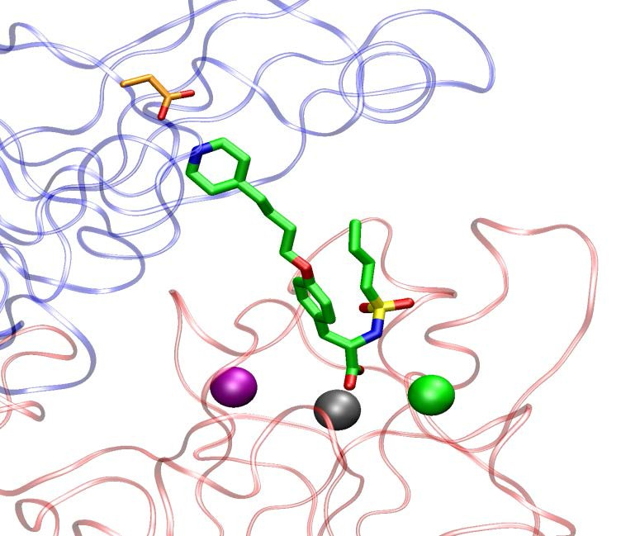
αIIbβ3 Ligand Binding Region
Eptifibatide
αIIb
MIDAS
β3
αIIb
β3
Tirofiban
αIIb
MIDAS
β3
Xiao, 2004 and Zhu, 2008 *Mg metal ion-dependent adhesion site (MIDAS)

Slide 19
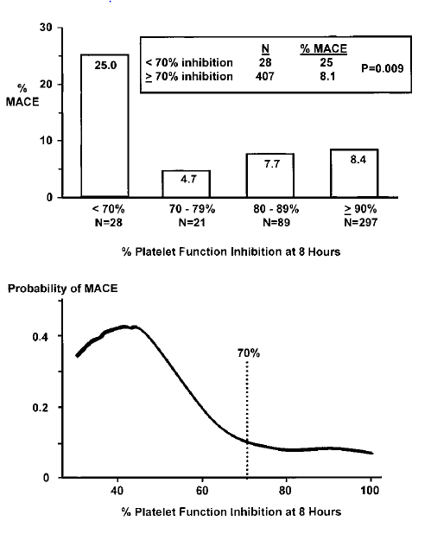
Point of Care Platelet Inhibition and Adverse Cardiac Events After PCI: GOLD Multicenter Study
Steinhubl, Kereiakes et al. Circ 2001;103:2572-2578

Slide 20
TITAN-TIMI 34 Primary Endpoint: Pre-PCI TIMI Frame Count
Primary Analysis: Modified Intent-to-Treat
p < 0.05
p < 0.05
84.3 + 30.7
(n=137)
ER
Eptifibatide
77.5 + 32.2
(n=168)
Cath Lab
Eptifibatide
CTFC
ER
Eptifibatide
Cath Lab
Eptifibatide
Frame Count
p=0.046 adjusting for infarct location
Slide by C. Michael Gibson, M.S., M.D.
Gibson CM et al. Am Heart J. 2006;152(4):668-75
Notes:
5
5
5
Dr. Eugene Braunwald was the study chairman and Ms. Carolyn McCabe the project director. Drs. Skene and Wilcox coordinated the Eastern hemisphere and the data coordinating center.

Slide 21
TITAN-TIMI 34: Increased Duration of Pre-Treatment Improves Pre-PCI TIMI Frame Count
85.6
p = 0.003 for linear trend
F
A
S
T
E
R
F
L
O
W
76.6
Mean TIMI Frame Count
68.6
n=165
n=111
n=17
In cath lab to
15 min prior
15 min to 60
min. prior
> 60 min.
prior
Duration of Therapy Before First Injection
Earlier Treatment
Slide by C. Michael Gibson, M.S., M.D.
Gibson CM et al. Am Heart J. 2006;152(4):668-75

Slide 22
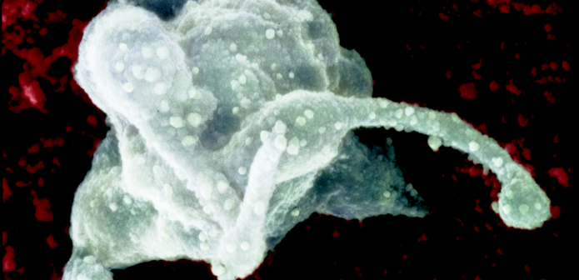

In STEMI Complete Reperfusion (TFG 3, TMPG 3, ST Res ≥ 70%) is Associated with a Greater Percent of Receptors Occupied by Integrilin
52.0%
% Pts With Complete Reperfusion
p=0.006
15.4%
13/25
4/22
> 80% Receptors Blocked by Integrilin
< 80% Receptors Blocked by Integrilin
Slide by C. Michael Gibson, M.S., M.D.
Gibson CM et al, Circulation 2004

Slide 23
TITAN-TIMI 34: Secondary Angiographic Endpoint TIMI Myocardial Perfusion Grade Improved with Pre-PCI Eptifibatide
24.3%
p = 0.026
Pre - PCI TMPG 3 (%)
14.2%
(41/169)
(20/141)
ER
Eptifibatide
Cath Lab
Eptifibatide
Slide by C. Michael Gibson, M.S., M.D.
Gibson CM et al. Am Heart J. 2006;152(4):668-75
Notes:
5
5
5
Dr. Eugene Braunwald was the study chairman and Ms. Carolyn McCabe the project director. Drs. Skene and Wilcox coordinated the Eastern hemisphere and the data coordinating center.

Slide 24
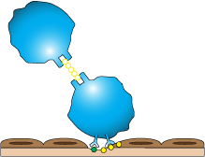


Platelet-Mediated Thrombosis Targets
Clopidogrel, Ticlopidine,
Prasugrel
Ticagrelor
Cangrelor
Selatogrel
Abciximab, Eptifibatide, Tirofiban,
RUC- 4
ADP (P2Y12) Receptor
(Α₂β₃ Integrin) Platelet Collagen Receptor (GPIa)
TXA₂ Receptor
Platelet vWF Receptor (GP1b)
GP IIb/IIIa Receptor
ADP
TXA₂
Intact endothelium
Collagen
vWF
Aspirin
Endothelial Damage
No currently approved
antiplatelet agents specifically target Adhesion
Aspirin + Thienopyridines block platelet Activation Thienopyridines block Amplification
GP IIb/IIIa inhibitors inhibit the
“final common pathway”
Aggregation
GP=glycoprotein. vWF=von Willibrand factor. ADP=adenosine diphosphate. TX=thromboxane.
Slide by C. Michael Gibson, M.S., M.D.
Meadows et al. Circulation Res. 2007;100:1261-1275.

Slide 25
RUC-4 Whole Concentrations & Inhibition of Platelet Aggregation Were Similar at 15, 30, and 60 Minutes Across Body Weights
15 Minutes
30 Minutes
60 Minutes
Induced by20 µM ADP

Slide 26
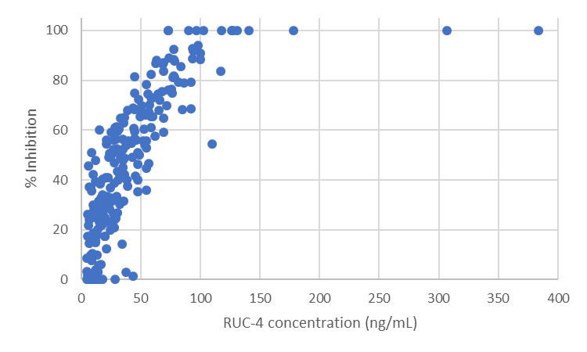
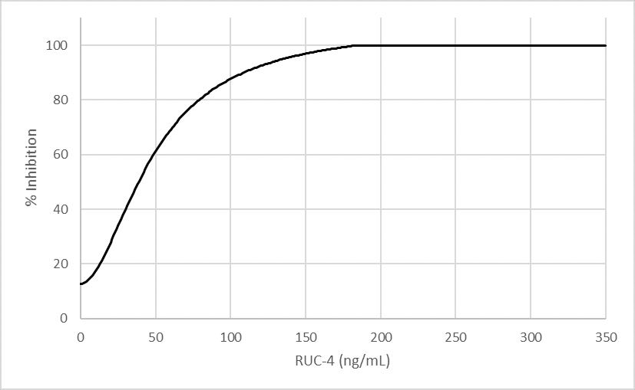
Correlation Between IPA and RUC-4 Concentration

