Slide 1


Scientific Sessions 2019
Randomized Clinical Trial Comparing a Rivaroxaban-based Strategy With an Antiplatelet-based Strategy for the Prevention of Subclinical Leaflet Thrombosis in Transcatheter Aortic Valves
Ole De Backer, MD, PhD – Rigshospitalet, Copenhagen, Denmark

Slide 2
Background
Subclinical hypoattenuated leaflet thickening (HALT) and reduced leaflet motion (RLM) of bioprosthetic aortic valves have been demonstrated by four-dimensional computed tomography (4DCT).
In a substudy of the large randomized GALILEO trial, we investigated whether anticoagulation can reduce these phenomena after transcatheter aortic valve replacement (TAVR).
ScientificSessions.org
#AHA19

Slide 3
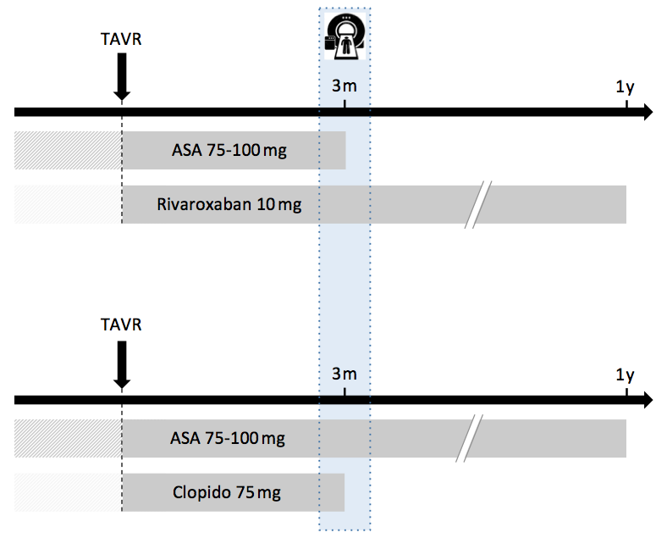
Study design
Rivaroxaban group
Study population:
Patients with
successful TAVR
1-7 days
R
1:1
Antiplatelet group
4DCT-scan at 3 months
ScientificSessions.org
#AHA19

Slide 4
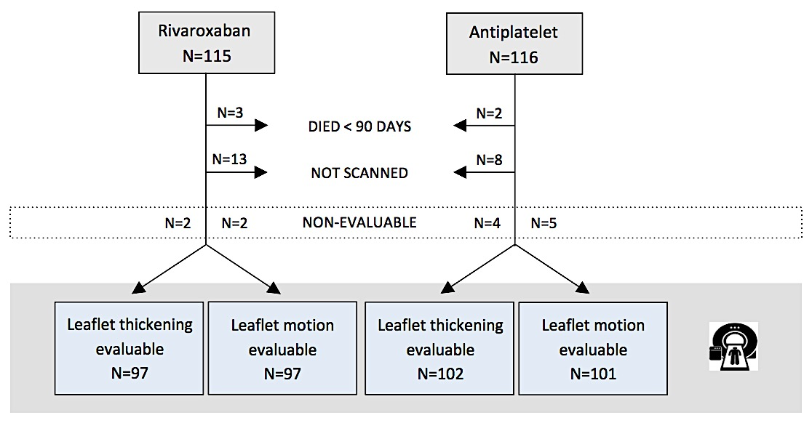
Study population (ITT) – evaluable CT-scans
ScientificSessions.org
#AHA19

Slide 5
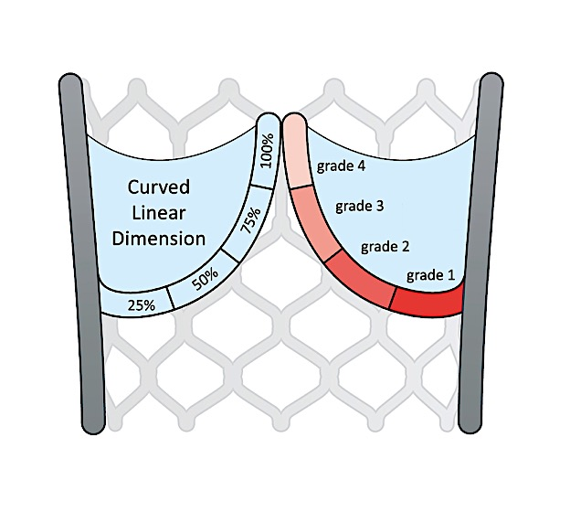
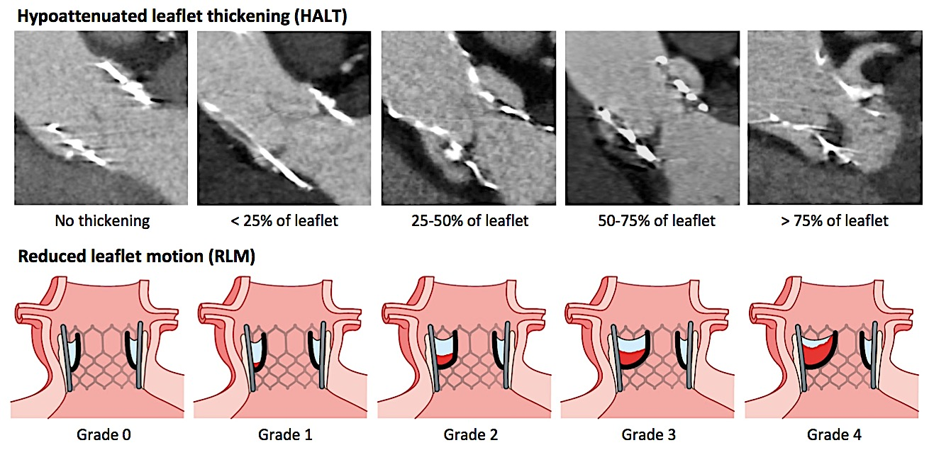
Study Methodology – 4DCT analysis
Reduced leaflet motion (RLM) was defined as:
  Grade 0: normal/unrestricted
  Grade 1: minimally restricted (<25%)
  Grade 2: mildly restricted (25-50%)
  Grade 3: moderately restricted (50-75%)
  Grade 4: largely immobile (>75%)
Grade 1 Grade 2
Grade 3 Grade 4
Hypoattenuated leaflet thickening (HALT) was defined as visually identifiable increased leaflet thickness on contrast-enhanced multi-planar reformats, carefully aligned with the long and short axis of the valve prosthesis.
Blanke P, et al. JACC Cardiovasc Imaging. 2019;12:1-24.
ScientificSessions.org
#AHA19

Slide 6
Study Endpoints
Primary endpoint
The proportion of patients with at least one prosthetic valve leaflet with reduced leaflet motion (RLM) ≥ grade 3
Secondary endpoints
The proportion of patients with at least one thickened leaflet (HALT)
The proportion of valve leaflets with HALT or RLM ≥ grade 3
Transprosthetic mean pressure gradient (TTE)
Safety and efficacy outcomes identical to main GALILEO trial
ScientificSessions.org
#AHA19

Slide 7
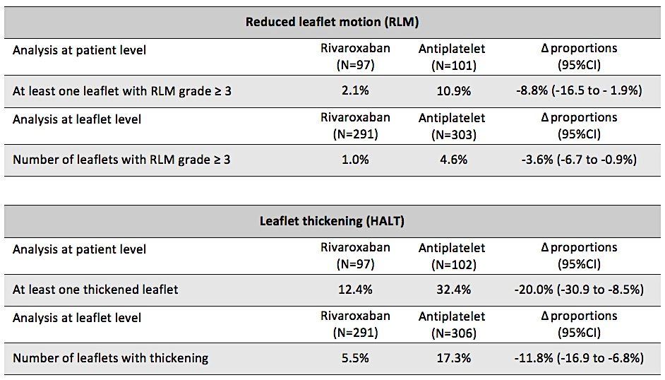
4DCT outcomes
Primary endpoint
ScientificSessions.org
#AHA19

Slide 8
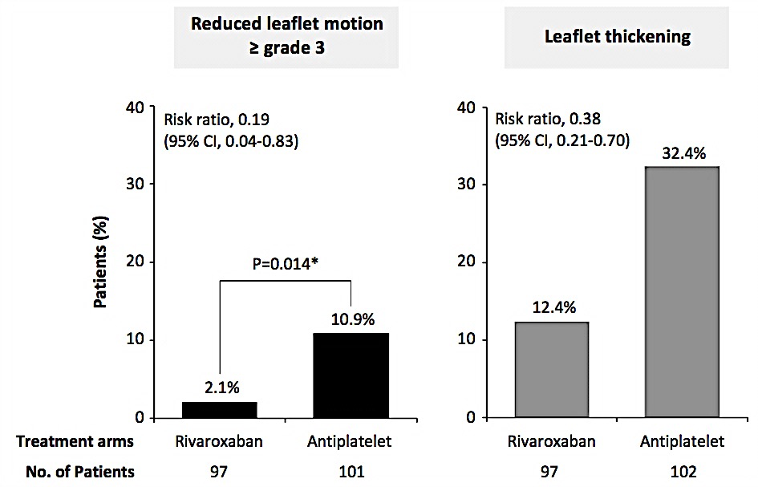
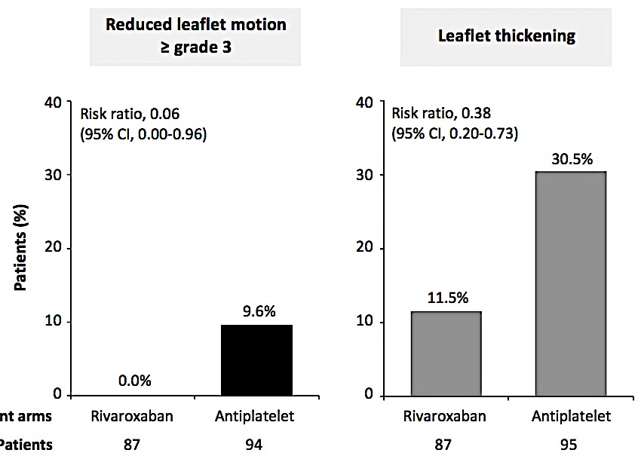
4DCT outcomes
Intention-to-treat (ITT)
Per-protocol (PP)
Reduced leaflet motion
≥ grade 3
Leaflet thickening
Reduced leaflet motion
≥ grade 3
Leaflet thickening
ScientificSessions.org
#AHA19

Slide 9
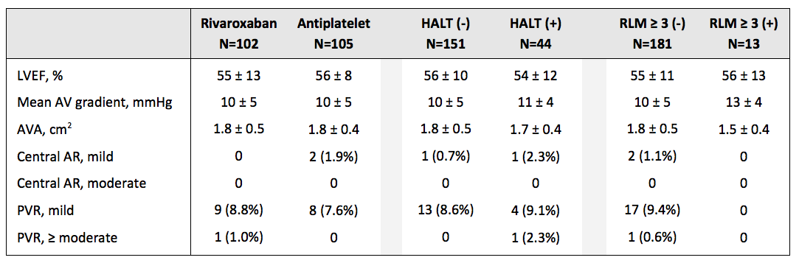
Echocardiographic outcomes
ScientificSessions.org
#AHA19

Slide 10
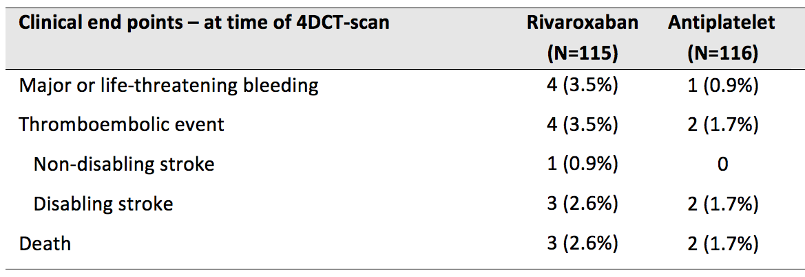
Clinical outcomes
Too few clinical events to permit any assessment of the impact of
RLM and HALT on clinical outcomes
Clinical outcomes in the main GALILEO trial should be considered
ScientificSessions.org
#AHA19

Slide 11
Conclusions
The overall proportions of patients with reduced leaflet motion (grade 3 or more) and leaflet thickening were 6.6% and 22.6%, respectively.
Both findings were less frequent with the rivaroxaban-based strategy than the antiplatelet-based strategy.
Echocardiography was not useful in identifying patients with these valvular abnormalities.
The rivaroxaban-based strategy was associated with a higher risk of death or thromboembolic complications and a higher risk of bleeding in the main GALILEO trial.
ScientificSessions.org
#AHA19

Slide 12

Thank you!
ScientificSessions.org
#AHA19

