Slide 1
Onyx ONE – A Randomized Trial of a Durable-Polymer Drug-Eluting Stent vs. a Polymer-Free Drug-Coated Stent in Patients at High Risk of Bleeding Treated With 1-Month DAPT
Stephan Windecker
Azeem Latib, Elvin Kedhi, Ajay Kirtane, David Kandzari, Roxana Mehran, Matthew Price, Sandeep Brar, Lisa Bousquette, Alexandre Abizaid, Daniel Simon, Stephen Worthley, Azfar Zaman and Gregg W. Stone
on behalf of the Onyx ONE Investigators

Slide 2
Disclosure Statement of Financial Interest
I, Stephan Windecker, declare the following:
Research grants to the institution from Abbott, Amgen, Bayer, BMS, Boston Scientific, Biotronik, CLS Behring, Edwards Lifesciences, Medtronic, Polares and Sinomed

Slide 3
Background
Up to 40% of patients undergoing PCI have high bleeding risk (HBR) characteristics
Guidelines recommend 3-6 months of DAPT for HBR patients undergoing PCI with consideration for DAPT duration as short as 1 month in selected patients
LEADERS FREE established superiority of polymer-free biolimus-A9 coated stents (BioFreedom) over otherwise identical BMS in terms of both safety and effectiveness in HBR patients treated with 1-month DAPT
Current generation polymer-based DES have not been compared to polymer-free drug-coated stents (DCS) in HBR patients treated with 1-month DAPT
Kedhi E, et al. Am Heart J. 2019;214:134-141

Slide 4
Objective
To compare the safety and efficacy of a durable polymer-based zotarolimus-eluting stent (Resolute Onyx) with a polymer-free biolimus A9-drug coated stent (BioFreedom) among HBR patients undergoing PCI with planned 1-month DAPT

Slide 5
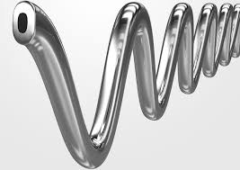
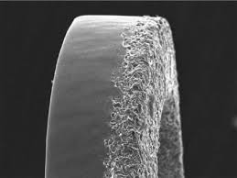
Study Devices
 | Resolute Onyx™ DES | BioFreedom™ DCS
Metallic stent material | CoCr with platinum iridium core | 316L Stainless steel
Antiproliferative drug | Zotarolimus | Biolimus A9™
Stent surface characteristic | BioLinx™, biocompatible durable polymer | Polymer-free, selectively micro-structured abluminal surface
Strut thickness (μm) | 81 – 91 μm | 112 μm
Available stent diameters | 2.0 – 5.0 mm | 2.25 – 4.0 mm

Slide 6
Onyx ONE Global Study Design
Prospective, Multicenter, Single-blind Randomized Trial
High Bleeding Risk patients undergoing PCI
(no lesion, vessel limitations)
Resolute Onyx™ ZES
with 1 Month DAPT
(N=1000)
1:1 randomization
84 global sites
Enrollment Nov 2017 – Sep 2018
BioFreedom™ DCS
with 1 Month DAPT
(N=1000)
Clinical Follow-up
1mo
2mo
6mo
1yr
2yr
Primary safety endpoint: Cardiac death, MI or stent thrombosis (def/prob) at 1 year
2° Efficacy endpoint (powered): Target Lesion Failure (TLF; cardiac death, TV-MI or cd-TLR) at 1 year
Other secondary endpoints: Lesion, device and procedure success rates, BARC bleeding, individual components of primary endpoints

Slide 7
HBR Inclusion Criteria (One or More)
Elderly age ≥75 years | Thrombocytopenia (<100,000/mm³)
OAC planned after PCI | Cancer diagnosed or treated within 3 yrs
Renal failure (CrCl <40 ml/min) | Stroke within 1 year or any prior ICH
Planned surgery <1 year | Severe chronic liver disease
Anemia (Hgb <11 g/dl) | Long-term NSAID or steroid use
Hospitalization for bleeding within 1 year | Expected DAPT non-compliance

Slide 8
Antithrombotic Therapy
PCI
After PCI, 1-month DAPT was prescribed, including:
Daily dose of aspirin (75-100 mg) AND
P2Y₁₂ inhibitor (clopidogrel preferred, others allowed)
Patients receiving OAC could receive single or dual antiplatelet therapy during this 1st month after PCI
After 1-month DAPT, single antiplatelet therapy was prescribed (at physician discretion):
Either aspirin OR
P2Y₁₂ inhibitor
ASA
P2Y₁₂
1M
ASA / P2Y₁₂

Slide 9
Sample Size Estimation (Powered for Non-inferiority)
 | Primary Safety Endpoint | Secondary Efficacy Endpoint
Definition | Cardiac death, MI or ST | TLF (cardiac death, TV-MI or cd-TLR)
Expected event rate | 9.4%¹ for both arms | 11% for both arms
Non-inferiority margin | 4.1% | 4.4%
One-sided type I error (α) | 0.05
Power | >90%
Lost to follow-up | 10%
Total sample size: 2000 patients

Slide 10
Trial Organization
Principal Investigators | S. Windecker (Lead PI) A. Latib, E. Kedhi (Co-PIs)
Executive Committee | G. Stone (Program Chair) A. Abizaid, D. Kandzari, E. Kedhi, A. Kirtane, A. Latib, R. Mehran, M. Price, D. Simon, S. Windecker, S. Worthley, A. Zaman
DSMB | JP. Carrozza (Chair) Cardiovascular Research Foundation, New York NY, USA
CEC | S. Marx (Chair) Cardiovascular Research Foundation, New York NY, USA
Angiographic Core Lab | Cardiovascular Research Foundation, New York NY, USA
Statistics | Medtronic (Analysis) and Baim Institute for Clinical Research, Boston MA, USA (Independent Validation)
Data Management & Monitoring | Medtronic, Santa Rosa CA, USA
Sponsor | Medtronic, Santa Rosa CA, USA

Slide 11
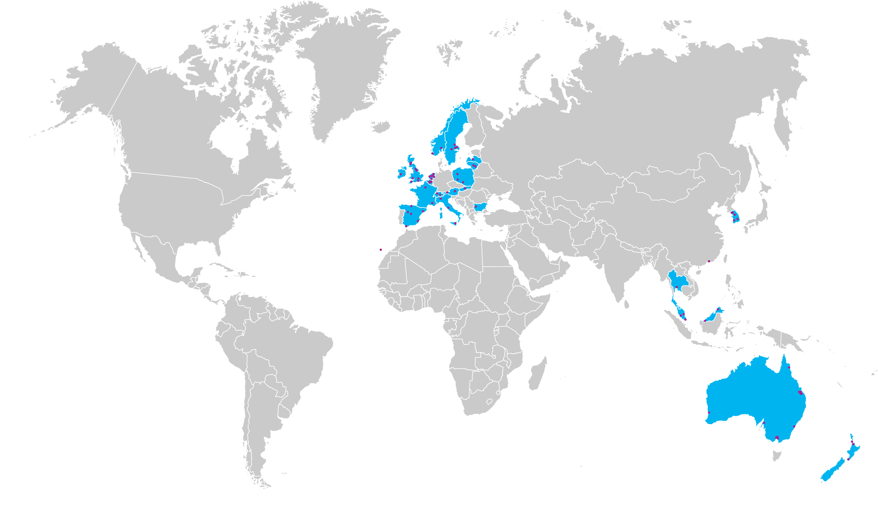
84 Participating Centers
Republic of Korea: HS Kim, SH Hur, YS Jang, IH Chae, MH Jeong, JH Yoon, HC Gwon, KY Chang, SJ Park
Spain: E Pinar, R Moreno, F Bosa Ojeda, B Vaquerizo, J de la Torre Hernández , Á Cequier, V Mainar, I Cruz
Slovakia: M Hudec
Malaysia: AKA Ghapar, TK Ong, HB Liew, AA Nuruddin
Australia: C Tie, A Conradie, A Walton, C Hammett, P Garrahy, C Raffel, G Starmer, A Sinhal, S Shetty, R Bhindi, R Whitbourn
Italy: F Fabbiocchi, A Latib/M Montorfano, G Sardella, C Tamburino
Netherlands: E Kedhi, A Van 't Hof, R Troquay, MJ Suttorp, S Somi, P van der Harst
Bulgaria: I Petrov
United Kingdom: D Muir, K Oldroyd, A Ludman, R Anderson, N Uren, A Zaman, S Kalra, B. Anantharam
New Zealand: S Pasupati, S Harding, M Webster
Ireland: D Mylotte
Belgium: A Aminian, P Lancellotti, W Desmet
Sweden: E Diderholm, R Kastberg, N Witt, O Fröbert, L Henareh
Poland: A Włodarczak, M Lesiak, W Wojakowski
Hong Kong: FCC Tam, MKY Lee
France: B Chevalier, M Silvestri
Latvia: A Ērglis, A Kalniņš
Switzerland: T Moccetti, S Windecker
Austria: G Toth, G Friedrich
Singapore: PJL Ong, KH Chan
Lithuania: A Baranauskas, R Unikas
Thailand: D Tresukosol
Norway: A Opdahl, AI Larsen

Slide 12
Top Enrolling Sites
Site Principal Investigator | Hospital | Location | Patients Randomized
Martin Hudec | Stredoslovensky Ustav Srdcovych a Cievnych Chorob | Banska Bystrica, Slovakia | 209
Kahar Abdul Ghapar | Hospital Serdang | Kajang Selangor, Malaysia | 153
Ivo Petrov | Acibadem City Clinic | Sofia, Bulgaria | 109
Darren Mylotte | University Hospital Galway | Galway, Ireland | 63
Eduardo Pinar | Hospital Clínico Universitario Virgen de la Arrixaca | El Palmar, Spain | 57
Raul Moreno | Hospital Universitario La Paz | Madrid, Spain | 54
Franco Fabbiocchi | Centro Cardiologico Monzino | Milan, Italy | 53
Sanjeevan Pasupati | Waikato Hospital | Hamilton, New Zealand | 52
Hyo Soo Kim | Seoul National University Hospital | Seoul, Korea | 50
Adel Aminian | C.H.U. de Charleroi | Charleroi, Belgium | 43
Elvin Kedhi | Isala Ziekenhuis | Zwolle, Netherlands | 42
Charles Tie | St Andrew's Hospital | Adelaide, Australia | 42
Adrian Włodarczak | Miedziowe Centrum Zdrowia | Lubin, Poland | 42

Slide 13
Patient Flowchart
Randomized
N=1996
Resolute Onyx ZES
N=1003
ITT Population
BioFreedom DCS
N=993
ITT Population
979 Implanted ZES only
2 Cross-over to implanted DCS only
7 Implanted non-study stent
15 No procedure or stent implanted
932 Implanted DCS only
40 Cross-over to implanted ZES only
7 Implanted DCS, ZES and/or non-study stent
14 No procedure or stent implanted
12 withdrawal
3 visit not done
19 withdrawal
5 visit not done
1-Year Follow-up Analysis
n=988 (98.5%)
1-Year Follow-up Analysis
n=969 (97.6%)

Slide 14
Baseline Characteristics
% or mean ± SD | Resolute Onyx (N=1003) | BioFreedom (N=993)
Age (yrs) | 74.0 ± 9.5 | 74.1 ± 9.8
Female | 32.5 | 34.2
Diabetes | 38.7 | 38.5
Hypertension | 79.4 | 81.3
Hyperlipidemia | 64.1 | 62.3
Previous MI | 26.3 | 25.1
Previous revascularization | 31.3 | 29.8
Atrial fibrillation | 32.7 | 31.8
Silent ischemia | 9.1 | 11.0
Chronic coronary syndrome | 38.1 | 38.6
Acute coronary syndrome | 52.8 | 50.4
STEMI | 6.2 | 5.1
Non-STEMI | 27.1 | 27.0
Unstable angina | 19.5 | 18.3

Slide 15
HBR Inclusion Criteria (Mean 1.6 Criteria / Pt)
Patients meeting criteria (%)

Slide 16
Lesion Characteristics
% or mean ± SD | Resolute Onyx (N=1003) | BioFreedom (N=993) | P-value
Radial access | 75.0 | 75.1 | 0.96
Staged procedure (performed) | 2.6 | 4.7 | 0.01
Lesion location
LAD | 55.2 | 59.0 | 0.09
LCX | 25.9 | 26.1 | 0.92
RCA | 34.5 | 31.6 | 0.18
Left main | 1.3 | 1.9 | 0.29
Bypass graft | 2.4 | 2.0 | 0.65
Bifurcation | 15.2 | 16.8 | 0.26
Moderate/severe calcification | 46.4 | 48.5 | 0.30
B2/C lesion class | 79.7 | 79.9 | 0.96
Number of treated lesions per patient | 1.3 ± 0.6 | 1.3 ± 0.6 | 0.85
Number of stents per patient | 1.7 ± 1.0 | 1.7 ± 1.0 | 0.73
Total stent length per patient (mm) | 37.9 ± 25.2 | 37.3 ± 25.0 | 0.61

Slide 17
Procedural Characteristics
% or mean ± SD | Resolute Onyx (N=1003) | BioFreedom (N=993) | P-value
Cross-over to other study stent | 0.2 (2) | 4.0 (40) | <0.001
Pre-procedural QCA
Lesion length (mm) | 21.2 ± 12.5 | 20.8 ± 12.7 | 0.48
RVD (mm) | 2.84 ± 0.46 | 2.83 ± 0.44 | 0.74
MLD (mm) | 0.89 ± 0.41 | 0.90 ± 0.41 | 0.42
% Diameter stenosis | 68.6 ± 13.4 | 68.2 ± 13.2 | 0.44
Post-procedural QCA
% Diameter stenosis (in-stent) | 9.9 ± 8.7 | 11.2 ± 9.4 | <0.001
% Diameter stenosis (in-segment) | 20.2 ± 9.8 | 21.2 ± 10.3 | 0.02
Acute gain (mm, in-stent) | 1.72 ± 0.49 | 1.67 ± 0.48 | 0.004
Acute gain (mm, in-segment) | 1.43 ± 0.50 | 1.39 ± 0.50 | 0.045
Lesion success¹ | 93.8 | 94.2 | 0.67
Device success² | 92.8 | 89.7 | 0.007
Procedure success³ | 83.3 | 86.2 | 0.09
¹ The attainment of <30% residual stenosis by QCA (or <20% by visual assessment) and TIMI flow 3 after the procedure, using any percutaneous method.
² The attainment of <30% residual stenosis by QCA (or <20% by visual assessment) and TIMI flow 3 after the procedure, using the assigned device only.
³ The attainment of <30% residual stenosis by QCA (or <20% by visual assessment) and TIMI flow 3 after the procedure, using any percutaneous method without the occurrence of MACE during the hospital stay.

Slide 18
Antithrombotic Therapy Transition After PCI
SAPT
92% at 2 Mo
Aspirin 55.9%
P2Y₁₂ 44.1%
SAPT
88.0% at 1 Yr
Aspirin 56.8%
P2Y₁₂ 43.2%

Slide 19
Primary Safety Endpoint: Cardiac Death, MI, ST
Resolute Onyx (N=1003) 17.1%
BioFreedom (N=993) 16.9%
Difference: 0.2% Upper 1-sided 95% CI: 3.0%
P-value _{non-inferiority} 0.011
Non-inferiority margin = 4.1%
-2% | -1% | 0 | 1% | 2% | 3% | 4% | 5%
Non-Inferiority Endpoint Met

Slide 20
Primary Safety Endpoint: Cardiac Death, MI, or ST
30%
Resolute Onyx ZES
Cardiac Death, MI, or ST (%)
BioFreedom DCS
HR 1.02, 95% CI [0.83, 1.27]
P-value 0.84
20%
17.3%
17.3%
10%
0%
0
1
2
4
6
8
10
12
Months after PCI
Number at risk
ZES | 1003 | 955 |  |  |  |  | 844 |  |  |  |  | 790
DCS | 993 | 949 |  |  |  |  | 833 |  |  |  |  | 782

Slide 21
Primary Safety Endpoint and Components
Cardiac death, MI or ST
Myocardial Infarction
30%
30%
Resolute Onyx ZES
Cumulative Incidence (%)
P = 0.84
Cumulative Incidence (%)
P = 0.50
BioFreedom DCS
20%
17.3%
20%
17.3%
15.0%
13.5%
10%
10%
0%
0%
0
1
2
4
6
8
10
12
0
1
2
4
6
8
10
12
Months after PCI
Months after PCI
30%
Cardiac Death
5%
Stent Thrombosis
Cumulative Incidence (%)
Cumulative Incidence (%)
P = 0.40
4%
P = 0.21
20%
3%
2%
2.2%
10%
1.5%
4.6%
1%
3.9%
0%
0%
0
1
2
4
6
8
10
12
0
1
2
4
6
8
10
12
Months after PCI
Months after PCI

Slide 22
Myocardial Infarction
Stent Thrombosis
Resolute Onyx ZES (n=988)
Early ST (0 – 30 days)
BioFreedom DCS (n=969)
Late ST (> 30 days – 1 year)
P = 0.26
P = 0.02
ZES
1.3%
0.6
1-Year Event Rates (%)
P = 0.22
DCS
1.3
2.1%
Definite / Probable ST

Slide 23
One-Month Landmark Analyses (Time of DAPT Discontinuation)
Cardiac death, MI or ST
Myocardial Infarction
20%
20%
Resolute Onyx ZES
Cumulative Incidence (%)
P = 0.38
HR 1.13 [0.86, 1.49]
P = 0.28
HR 0.84 [0.61, 1.16]
Cumulative Incidence (%)
P = 0.36
P = 0.01
BioFreedom DCS
10%
10.7%
10%
9.9%
9.5%
8.8%
8.7%
7.5%
6.8%
4.3%
0%
0%
0
1
2
4
6
8
10
12
0
1
2
4
6
8
10
12
Months after PCI
Months after PCI
20%
Cardiac Death
5%
Stent Thrombosis
Cumulative Incidence (%)
Cumulative Incidence (%)
4%
P = 0.81
P = 0.25
P = 0.11
P = 0.99
3%
10%
2%
1.2%
3.5%
1%
1.3%
0.9%
1.1%
2.7%
0.6%
0.9%
0%
0%
0
1
2
4
6
8
10
12
0
1
2
4
6
8
10
12
Months after PCI
Months after PCI

Slide 24
Powered Secondary Effectiveness Endpoint: TLF
30%
Resolute Onyx ZES
BioFreedom DCS
HR 1.02, 95% CI [0.83, 1.26]
P-value 0.84
Target Lesion Failure (%)
20%
18.0%
17.9%
10%
0%
0
1
2
4
6
8
10
12
Months after PCI
Number at risk
ZES | 1003 | 956 |  |  |  |  | 845 |  |  |  |  | 787
DCS | 993 | 949 |  |  |  |  | 835 |  |  |  |  | 779

Slide 25
Powered Secondary Effectiveness Endpoint: TLF at 1 Year
Resolute Onyx ZES (n=988)
BioFreedom DCS (n=969)
P = 0.95
P_{NI} = 0.007
P = 0.43
P = 0.43
P = 0.17
1-Year Event Rates (%)

Slide 26
One-Month Landmark Analyses (Time of DAPT Discontinuation)
TLF
TV-MI
20%
20%
Resolute Onyx ZES
Cumulative Incidence (%)
P = 0.51
HR 1.10 [0.83, 1.45]
P = 0.38
HR 0.87 [0.63, 1.19]
Cumulative Incidence (%)
P = 0.44
P = 0.02
BioFreedom DCS
10%
10.5%
10%
9.7%
9.6%
9.2%
8.7%
8.2%
5.9%
3.7%
0%
0%
0
1
2
4
6
8
10
12
0
1
2
4
6
8
10
12
Months after PCI
Months after PCI
20%
Cardiac Death
20%
cd-TLR
Cumulative Incidence (%)
Cumulative Incidence (%)
P = 0.81
P = 0.25
P = 0.08
P = 0.40
10%
10%
1.2%
3.5%
0.8%
3.7%
1.1%
2.7%
0.2%
3.1%
0%
0%
0
1
2
4
6
8
10
12
0
1
2
4
6
8
10
12
Months after PCI
Months after PCI

Slide 27
BARC Bleeding Rates at 1 Year
Resolute Onyx ZES (n=988)
BioFreedom DCS (n=969)
P = 0.43
P = 0.40
P = 0.67
1-Year Bleeding Rates (%)

Slide 28
Limitations
Single-blinded trial
More frequent crossover in pts allocated to BioFreedom
Patients and outcome assessors were blinded to allocation
Trial not powered for low frequency 2° endpoints (TLR, ST)
Powered for non-inferiority of 1° safety and 2° effectiveness EP
Periprocedural MI prior to DAPT interruption at 30 days significantly contributed to 1° EP and powered 2° EP
Results were consistent in 30-day landmark analyses
Lack of control arm of 3- or 6-month DAPT

Slide 29
Summary
ONYX ONE is a contemporary trial:
First trial comparing DES versus DCS
Investigating 1-month DAPT
Very complex HBR patient and lesion population
Among HBR patients treated with 1-month DAPT after PCI, Resolute Onyx was as safe and effective as BioFreedom
Resolute Onyx had improved angiographic outcomes and greater device success post-PCI

Slide 30
Conclusion
These data demonstrate that Resolute Onyx is safe and effective in complex high bleeding risk patients who receive 1-month DAPT

